Slide 1
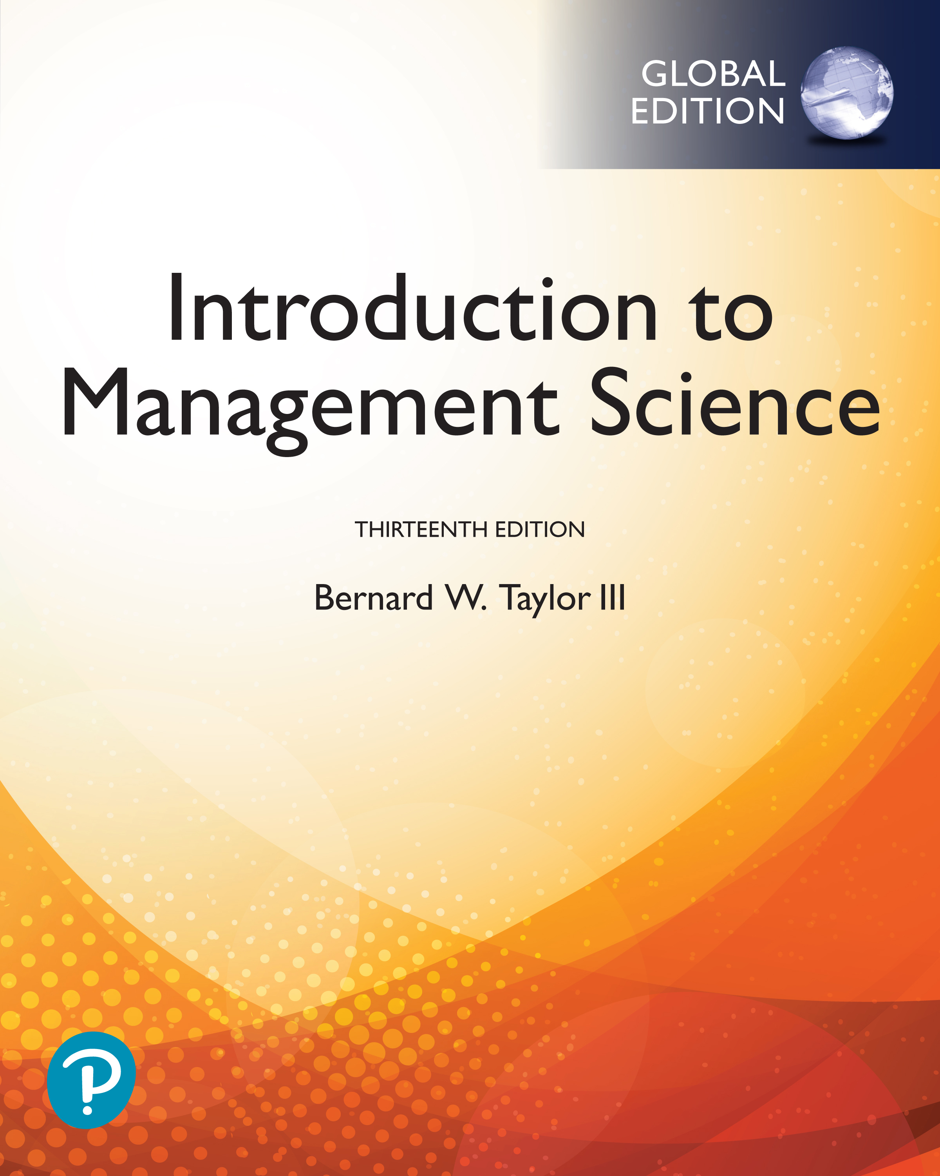
Introduction to Management Science
Thirteenth Edition, Global Edition
Chapter 2
Linear Programming: Model Formulation and Graphical Solution
Copyright © 2019 Pearson Education, Ltd. All Rights Reserved
Notes:
If this PowerPoint presentation contains mathematical equations, you may need to check that your computer has the following installed:
1) MathType Plugin
2) Math Player (free versions available)
3) NVDA Reader (free versions available)

Slide 2
Learning Objectives
2.1 Model Formulation
2.2 A Maximization Model Example
2.3 Graphical Solutions of Linear Programming Models
2.4 A Minimization Model Example
2.5 Irregular Types of Linear Programming Problems
2.6 Characteristics of Linear Programming Problems

Slide 3
Linear Programming: An Overview
Objectives of business decisions frequently involve maximizing profit or minimizing costs.
Linear programming uses linear algebraic relationships to represent a firm’s decisions, given a business objective, and resource constraints.
Steps in application:
Identify problem as solvable by linear programming.
Formulate a mathematical model of the unstructured problem.
Solve the model.

Slide 4
Learning Objective 2.1
Model Formulation

Slide 5
Model Components
Decision variables - mathematical symbols representing levels of activity by the firm.
Objective function - a linear mathematical relationship describing an objective of the firm, in terms of decision variables - this function is to be maximized or minimized.
Constraints - requirements or restrictions placed on the firm by the operating environment, stated in linear relationships of the decision variables.
Parameters - numerical coefficients and constants used in the objective function and constraints.

Slide 6
Summary of Model Formulation Steps
Step 1: Define the decision variables
How many bowls and mugs to produce?
Step 2: Define the objective function
Maximize profit
Step 3: Define the constraints
The resources (clay and labor) available

Slide 7
Learning Objective 2.2
A Maximization Model Example

Slide 8
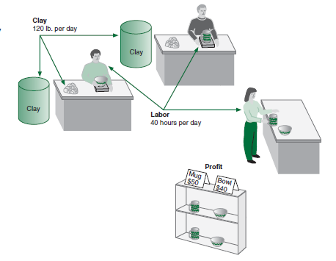
L P Model Formulation 1 (1 of 3)
Resource Requirements
product | Labor (Hr./Unit) | Clay (Lb./Unit) | Profit ($/Unit)
Bowl | 1 | 4 | 40
Mug | 2 | 3 | 50
Figure 2.1 Beaver Creek Pottery Company
Product mix problem - Beaver Creek Pottery Company
How many bowls and mugs should be produced to maximize profits given labor and materials constraints?
Product resource requirements and unit profit:

Slide 9
L P Model Formulation 1 (2 of 3)
Resource Availability:
40 hrs of labor per day
120 lbs of clay
Decision Variables:
x₁ = number of bowls to produce per day
x₂ = number of mugs to produce per day
Objective Function:
Maximize Z = $40x₁ + $50x₂
Where Z = profit per day
Resource Constraints:
hours of labor
pounds of clay
Non-Negativity Constraints:

Slide 10
L P Model Formulation 1 (3 of 3)
Complete Linear Programming Model:
Maximize
subject to:

Slide 11
Feasible Solutions
A feasible solution does not violate any of the constraints:
Example:
Labor constraint check:
Clay constraint check:

Slide 12
Infeasible Solutions
An infeasible solution violates at least one of the constraints:
Example:
Labor constraint check:

Slide 13
Learning Objective 2.3
Graphical Solutions of Linear Programming Models

Slide 14
Graphical Solution of L P Models
Graphical solution is limited to linear programming models containing only two decision variables (can be used with three variables but only with great difficulty).
Graphical methods provide a picture of how a solution for a linear programming problem is obtained.

Slide 15
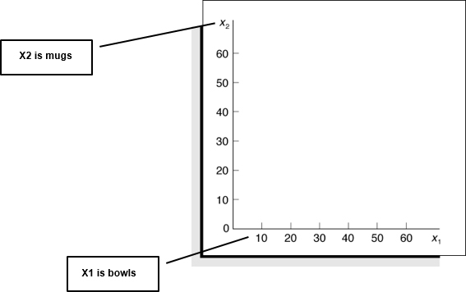
Coordinate Axes
Maximize
subject to:
Figure 2.2 Coordinates for graphical analysis

Slide 16
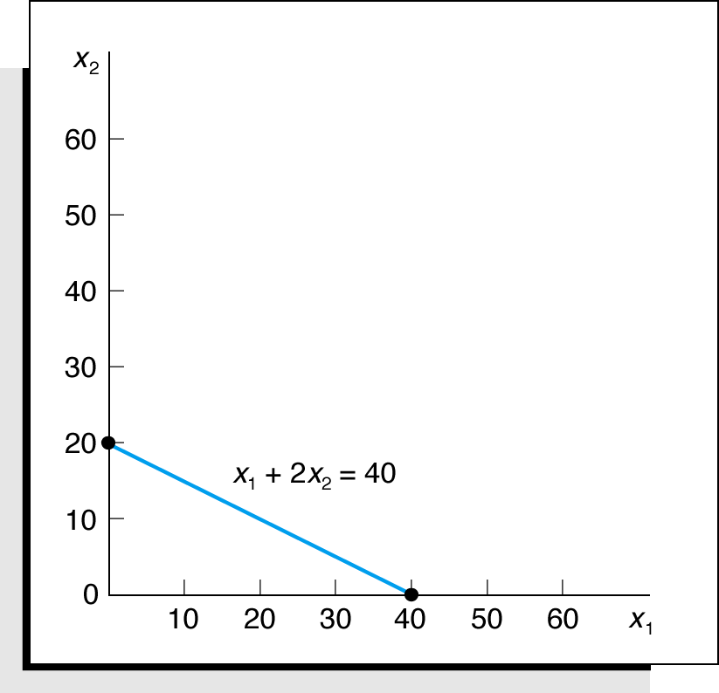
Labor Constraint
Figure 2.3 Graph of labor constraint

Slide 17
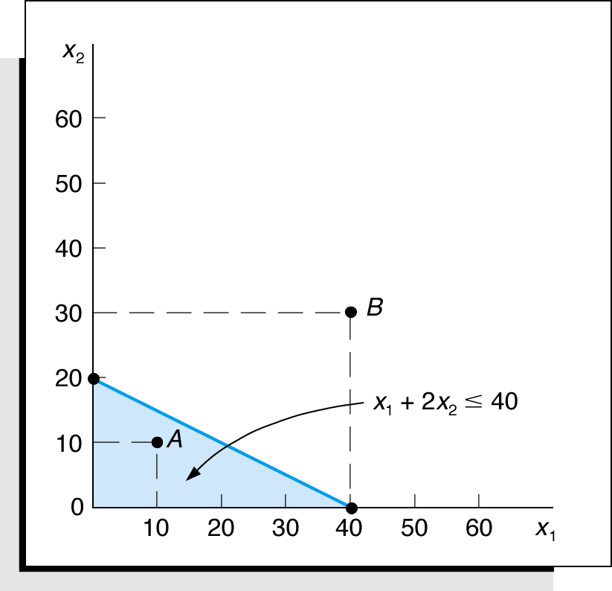
Labor Constraint Area
Figure 2.4 Labor constraint area

Slide 18
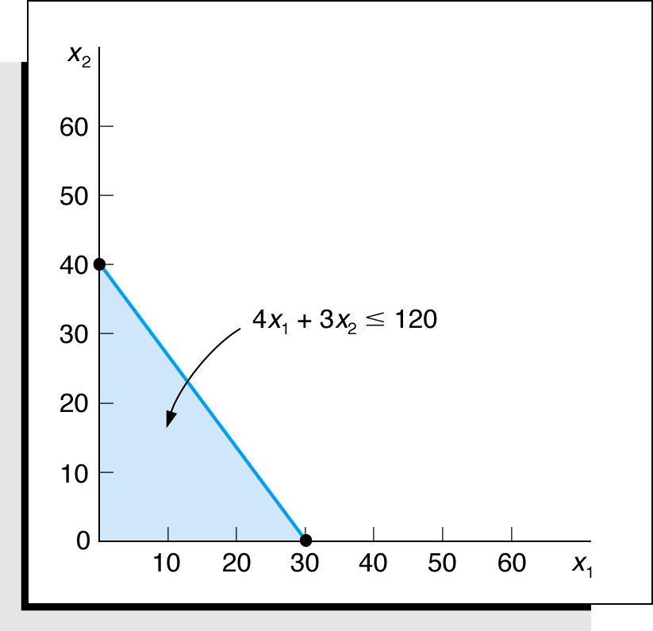
Clay Constraint Area
Figure 2.5 The constraint area for clay

Slide 19
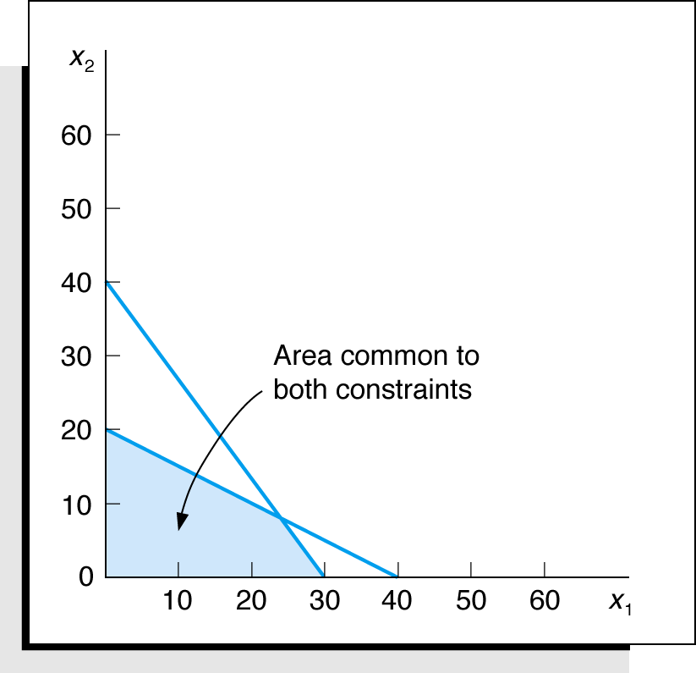
Both Constraints
Figure 2.6 Graph of both model constraints

Slide 20
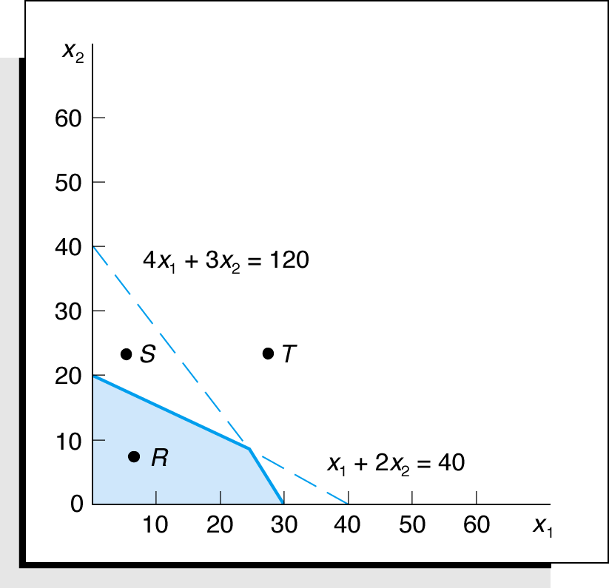
Feasible Solution Area
Figure 2.7 The feasible solution area constraints

Slide 21
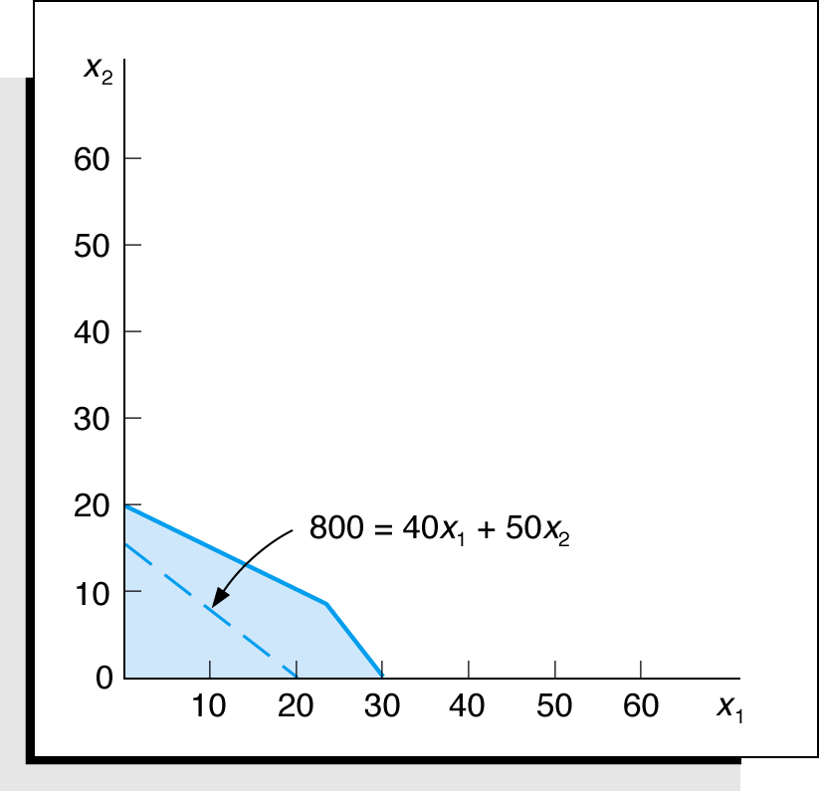
Objective Function Solution Z= $800
Figure 2.8 Objective function line for Z = $800

Slide 22
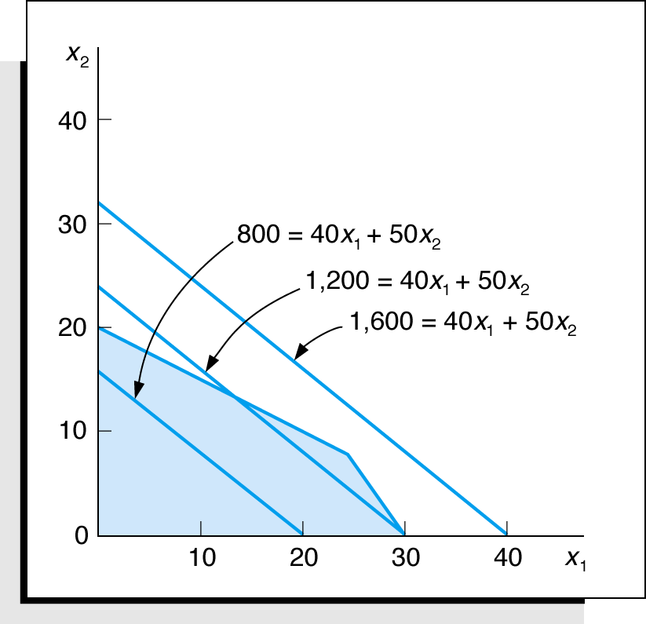
Alternative Objective Function Solution Lines
Figure 2.9 Alternative objective function lines for profits, Z, of $800, $1,200, and $1,600

Slide 23
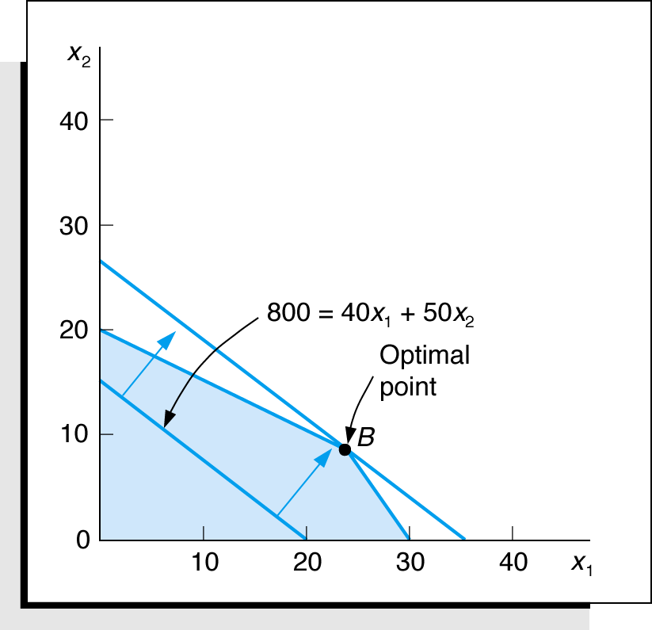
Optimal Solution
The optimal solution point is the last point the objective function touches as it leaves the feasible solution area.
Figure 2.10 Identification of optimal solution point

Slide 24
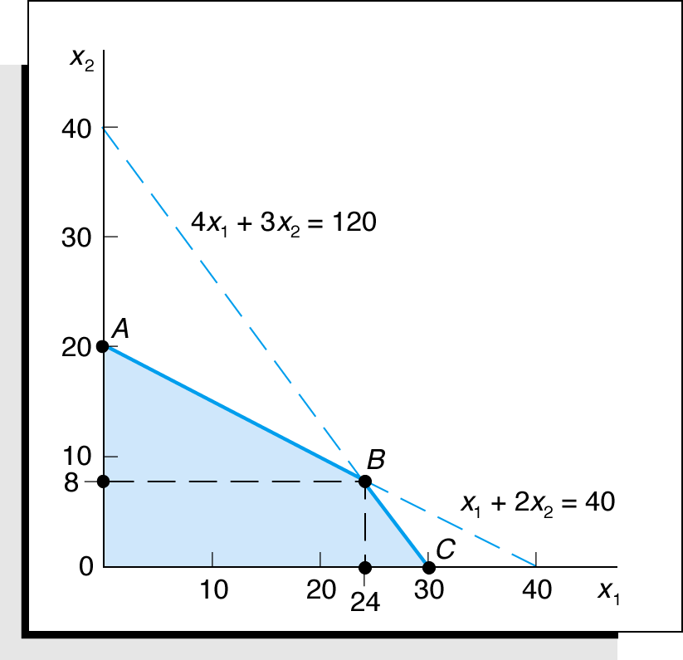
Optimal Solution Coordinates
Figure 2.11 Optimal solution coordinates

Slide 25
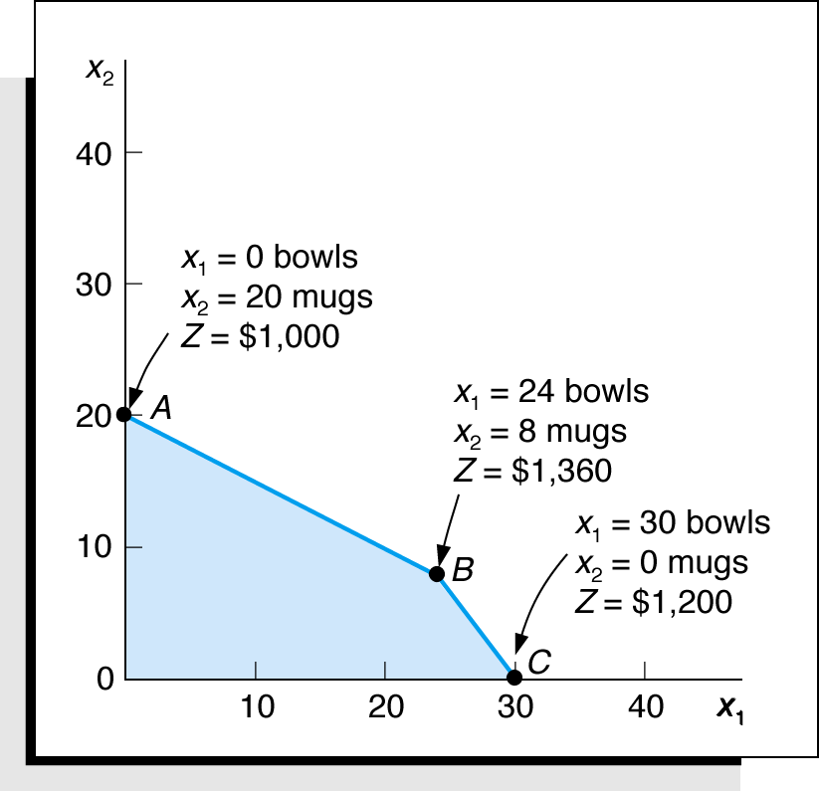
Extreme (Corner) Point Solutions
Figure 2.12 Solutions at all corner points

Slide 26
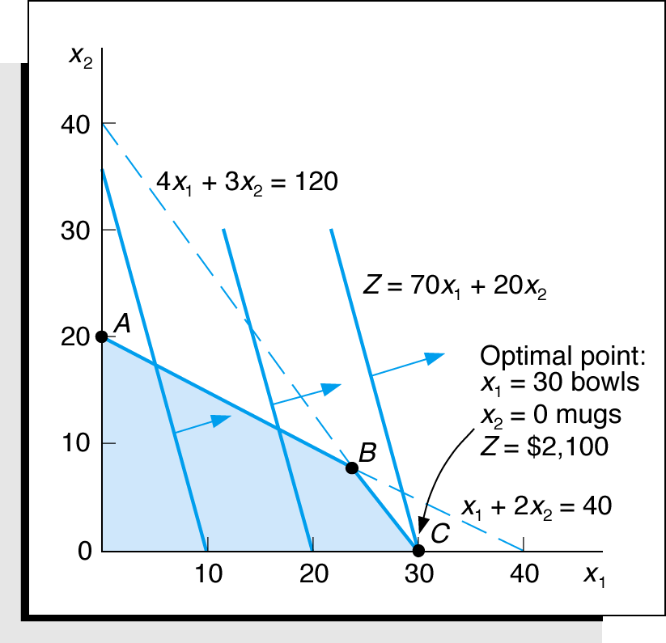
Optimal Solution for New Objective Function
Maximize
subject to:
Figure 2.13 Optimal solution with

Slide 27
Slack Variables
Standard form requires that all constraints be in the form of equations (equalities).
A slack variable is added to a
constraint (weak inequality) to convert it to an equation (=).
A slack variable typically represents an unused resource.
A slack variable contributes nothing to the objective function value.

Slide 28
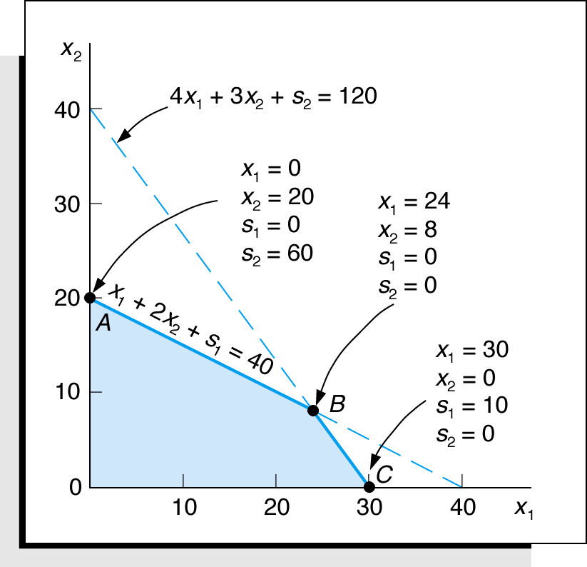
Linear Programming Model: Standard Form
Max
subject to:
Where:
x₁ = number of bowls
x₂ = number of mugs
s₁, s₂ are slack variables
Figure 2.14 Solutions at points A, B, and C with slack

Slide 29
Learning Objective 2.4
A Minimization Model Example

Slide 30
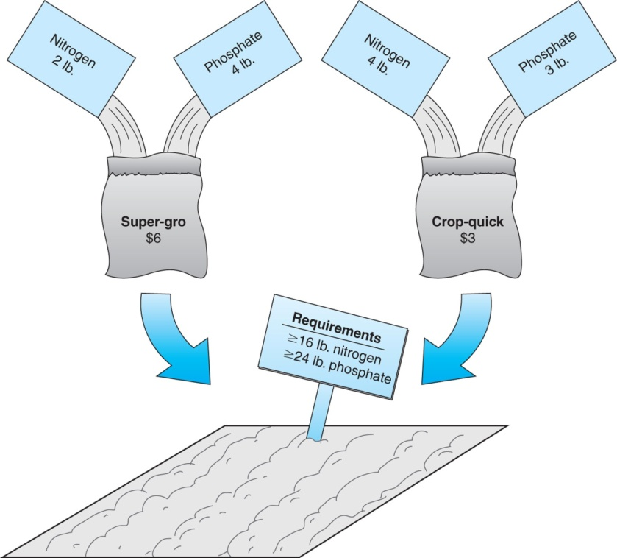
L P Model Formulation 2 (1 of 2)
Two brands of fertilizer available – Super-gro, Crop-quick.
Field requires at least 16 pounds of nitrogen and 24 pounds of phosphate.
Super-gro costs $6 per bag, Crop-quick $3 per bag.
Problem: How much of each brand to purchase to minimize total cost of fertilizer given following data ?
Figure 2.15 Fertilizing farmer’s field
Chemical Contribution
Brand | Nitrogen (lb./bag) | Phosphate (lb./bag)
Super-gro X1 | 2 | 4
Crop-quick X2 | 4 | 3

Slide 31
L P Model Formulation 2 (2 of 2)
Decision Variables:
x₁ = bags of Super-gro to purchase
x₂ = bags of Crop-quick to purchase
The Objective Function:
Minimize Z = $6x₁ + 3x₂
Where: $6x₁ = cost of bags of Super-Gro
$3x₂ = cost of bags of Crop-Quick
Model Constraints:

Slide 32
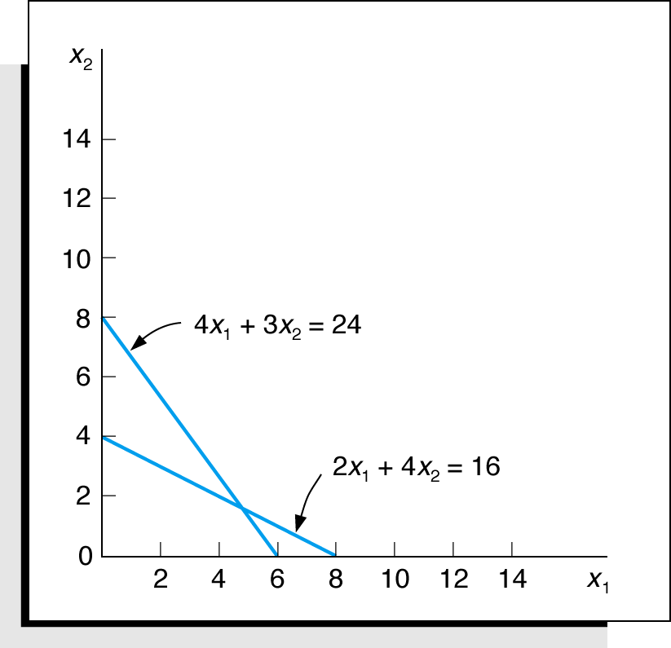
Constraint Graph
Minimize
subject to:
Figure 2.16 Constraint lines for fertilizer model

Slide 33
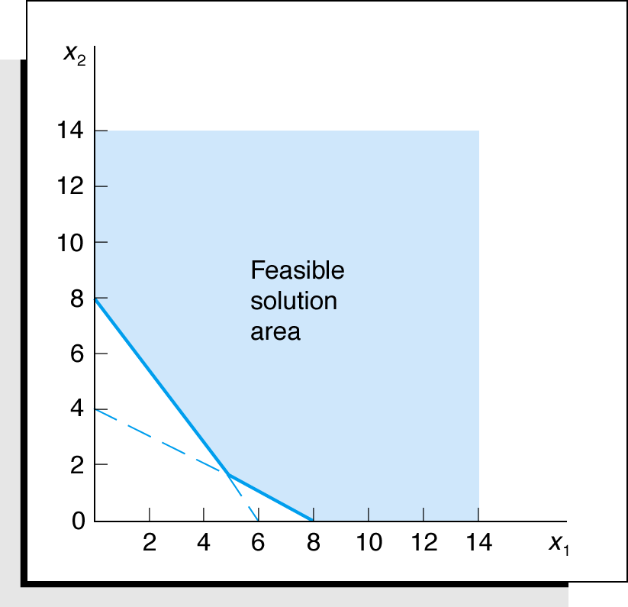
Feasible Region
Figure 2.17 Feasible solution area

Slide 34
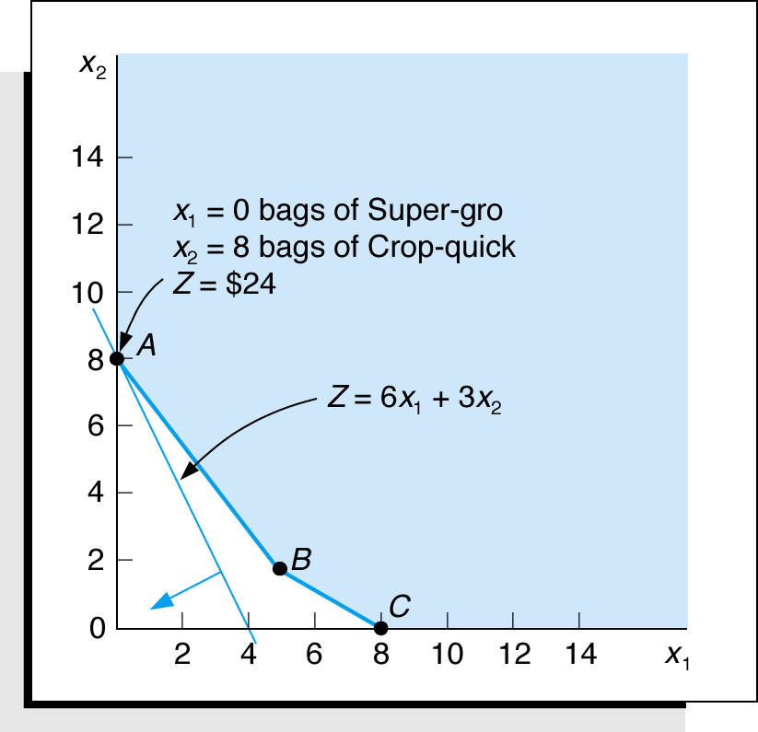
Optimal Solution Point
The optimal solution of a minimization problem is at the extreme point closest to the origin.
Figure 2.18 The optimal solution point

Slide 35
Surplus Variables
constraint to convert it to an equation (=).
A surplus variable represents an excess above a constraint requirement level.
A surplus variable contributes nothing to the calculated value of the objective function.
Subtracting surplus variables in the farmer problem constraints:
A surplus variable is subtracted from a

Slide 36
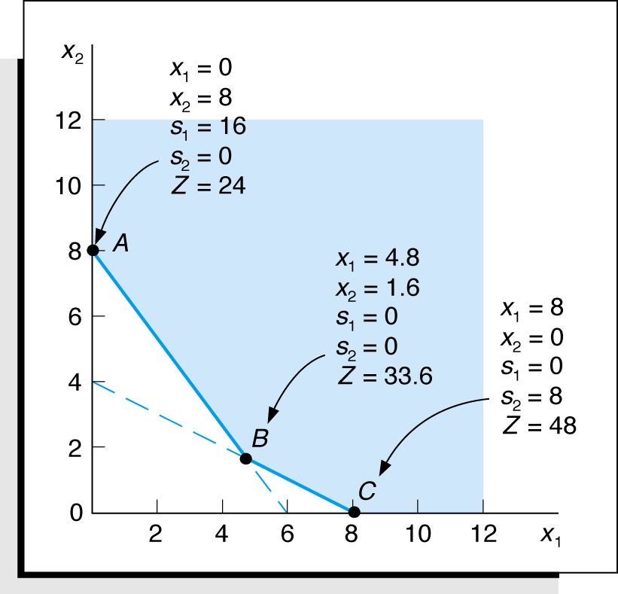
Graphical Solutions
Minimize
subject to:
Figure 2.19 Graph of the fertilizer example

Slide 37
Learning Objective 2.5
Irregular Types of Linear Programming Problems

Slide 38
Irregular Types of Linear Programming Problems
For some linear programming models, the general rules do not apply.
Special types of problems include those with:
Multiple optimal solutions
Infeasible solutions
Unbounded solutions

Slide 39
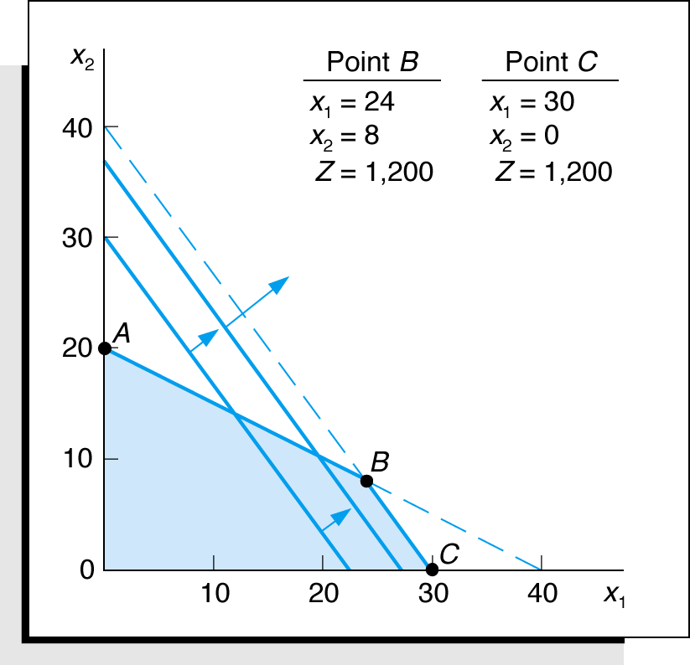
Multiple Optimal Solutions Beaver Creek Pottery
The objective function is parallel to a constraint line.
Maximize
subject to:
Where:
x₁ = number of bowls
x₂ = number of mugs
Figure 2.20 Graph of the Beaver Creek Pottery example with multiple optimal solutions

Slide 40
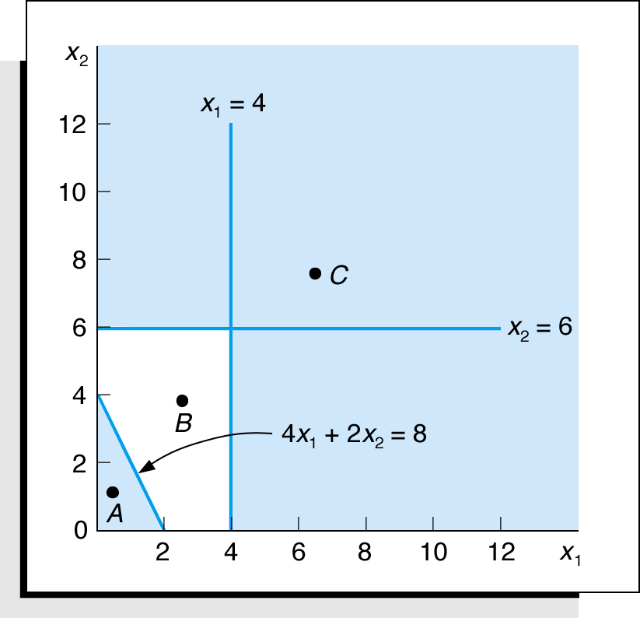
An Infeasible Problem
Every possible solution violates at least one constraint:
Maximize
subject to:
Figure 2.21 Graph of an infeasible problem

Slide 41
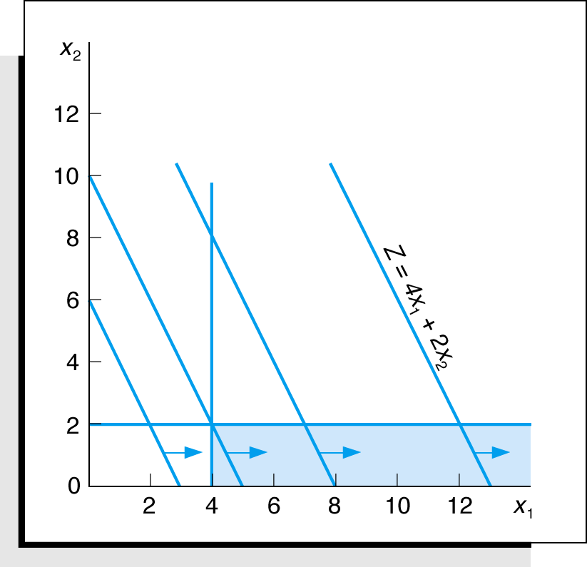
An Unbounded Problem
Value of the objective
function increases indefinitely:
Maximize
subject to:
Figure 2.22 Graph of an unbounded problem

Slide 42
Learning Objective 2.6
Characteristics of Linear Programming Problems

Slide 43
Characteristics of Linear Programming Problems
A decision among alternative courses of action is required.
The decision is represented in the model by decision variables.
The problem encompasses a goal, expressed as an objective function, that the decision maker wants to achieve.
Restrictions (represented by constraints) exist that limit the extent of achievement of the objective.
The objective and constraints must be definable by linear mathematical functional relationships.

Slide 44
Properties of Linear Programming Models
Proportionality - The rate of change (slope) of the objective function and constraint equations is constant.
Additivity - Terms in the objective function and constraint equations must be additive.
Divisibility - Decision variables can take on any fractional value and are therefore continuous as opposed to integer in nature.
Certainty - Values of all the model parameters are assumed to be known with certainty (non-probabilistic).

Slide 45
Problem Statement: Example Problem N o. 1
Hot dog mixture in 1000-pound batches.
Two ingredients, chicken ($3/lb) and beef ($5/lb).
Recipe requirements:
at least 500 pounds of “chicken”
at least 200 pounds of “beef”
Ratio of chicken to beef must be at least 2 to 1.
Determine optimal mixture of ingredients that will minimize costs.

Slide 46
Solution: Example Problem N o. 1 (1 of 2)
Step 1:
Identify decision variables.
x₁ = lb of chicken in mixture
x₂ = lb of beef in mixture
Step 2:
Formulate the objective function.
Minimize Z = $3x₁ + $5x₂
where Z = cost per 1,000-lb batch
$3x₁ = cost of chicken
$5x₂ = cost of beef

Slide 47
Solution: Example Problem N o. 1 (2 of 2)
Step 3: Establish Model Constraints
The Model: Minimize

Slide 48
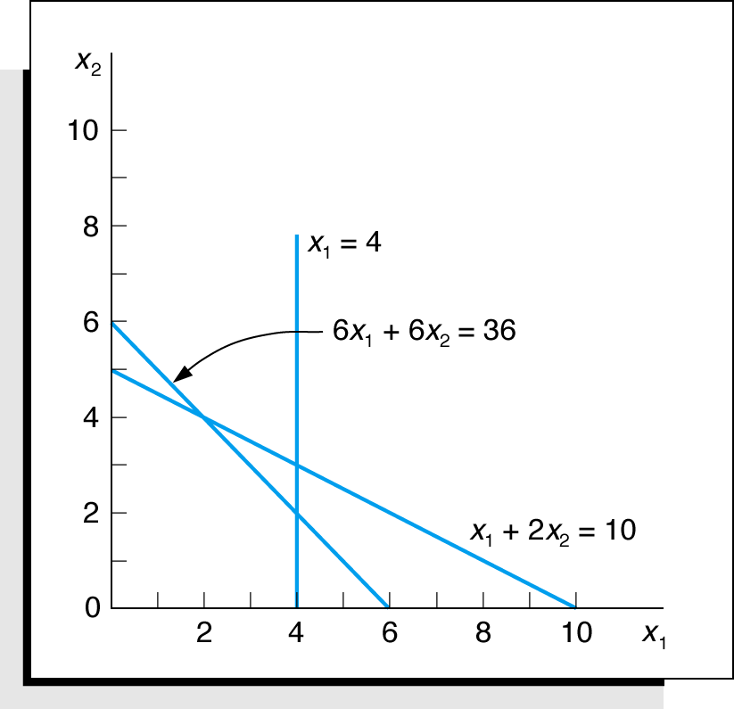
Example Problem N o. 2 (1 of 3)
Solve the following model graphically:
Maximize
subject to:
Step 1: Plot the constraints as equations
Figure 2.23 Constraint equations

Slide 49
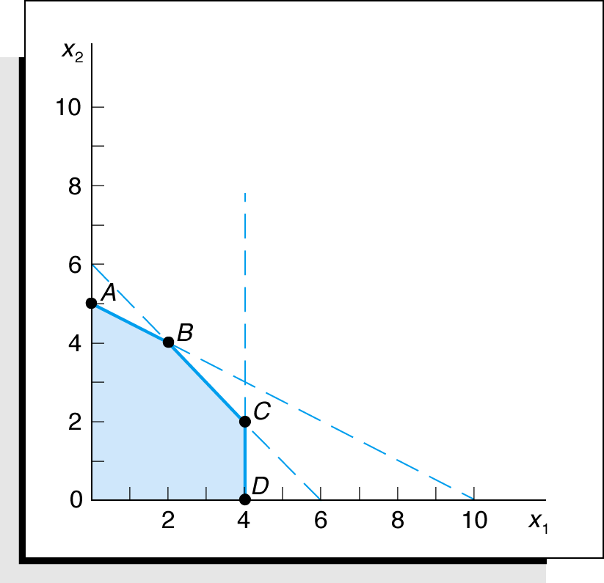
Example Problem N o. 2 (2 of 3)
Step 2: Determine the feasible solution space
Figure 2.24 Feasible solution space and extreme points

Slide 50
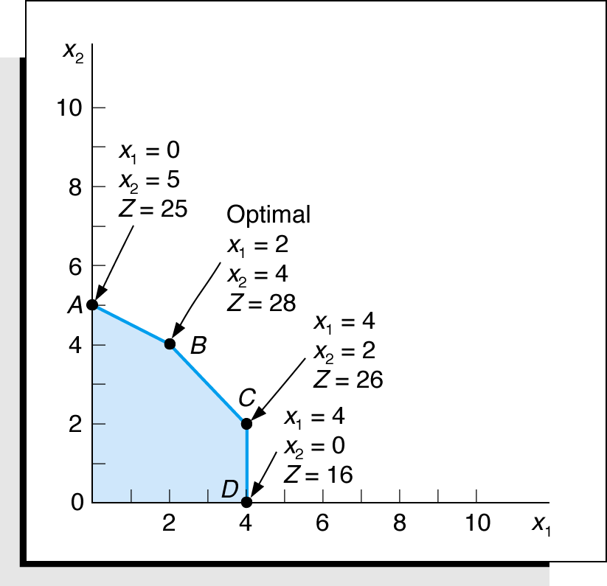
Example Problem N o. 2 (3 of 3)
Step 3 and 4: Determine the solution points and optimal solution
Figure 2.25 Optimal solution point

