Slide 1
Introduction to Management Science
Thirteenth Edition, Global Edition
Chapter 5
Integer Programming
Copyright © 2019 Pearson Education, Ltd. All Rights Reserved
Notes:
If this PowerPoint presentation contains mathematical equations, you may need to check that your computer has the following installed:
1) MathType Plugin
2) Math Player (free versions available)
3) NVDA Reader (free versions available)

Slide 2
Learning Objectives
5.1 Integer Programming (I P) Models
5.2 Integer Programming Graphical Solution
5.3 Computer Solution of Integer Programming Problems With Excel and Q M for Windows
5.4 0-1 Integer Programming Modeling Examples

Slide 3
Learning Objective 5.1
Integer Programming (I P) Models

Slide 4
Types of Models
Total Integer Model: | All decision variables required to have integer solution values.
0-1 Integer Model: | All decision variables required to have integer values of zero or one.
Mixed Integer Model: | Some of the decision variables (but not all) required to have integer values.

Slide 5
A Total Integer Model (1 of 2)
Machine shop obtaining new presses and lathes.
Marginal profitability: each press $100/day; each lathe $150/day.
Resource constraints: $40,000 budget, 200 sq. ft. floor space.
Machine purchase prices and space requirements:
Machine | Required Floor Space left parenthesis feet squared right parenthesis | Purchase Price
Press | 15 | $8,000
Lathe | 30 | 4,000

Slide 6
A Total Integer Model (2 of 2)
Integer Programming Model:
subject to:

Slide 7
A 0 - 1 Integer Model (1 of 2)
Recreation facilities selection to maximize daily usage by residents.
Resource constraints: $120,000 budget; 12 acres of land.
Selection constraint: either swimming pool or tennis center (not both).
Recreation Facility | Expected Usage (people/day) | Cost ($) | Land Requirements (acres)
Swimming pool | 300 | 35,000 | 4
Tennis center | 90 | 10,000 | 2
Athletic field | 400 | 25,000 | 7
Gymnasium | 150 | 90,000 | 3

Slide 8
A 0 - 1 Integer Model (2 of 2)
Integer Programming Model:
subject to:

Slide 9
A Mixed Integer Model (1 of 2)
$250,000 available for investments providing greatest return after one year.
Data:
Condominium cost $50,000/unit; $9,000 profit if sold after one year.
Land cost $12,000/ acre; $1,500 profit if sold after one year.
Municipal bond cost $8,000/bond; $1,000 profit if sold after one year.
Only 4 condominiums, 15 acres of land, and 20 municipal bonds available.

Slide 10
A Mixed Integer Model (2 of 2)
subject to:

Slide 11
Learning Objective 5.2
Integer Programming Graphical Solution

Slide 12
Integer Programming Graphical Solution
Rounding non-integer solution values up to the nearest integer value can result in an infeasible solution.
A feasible solution is ensured by rounding down non-integer solution values but may result in a less than optimal (sub-optimal) solution.

Slide 13
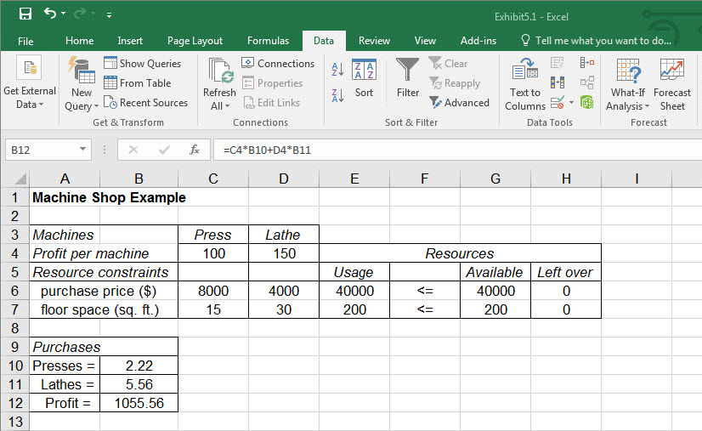
Machine Shop Model Solved as a Linear Programming Model
Exhibit 5.1

Slide 14
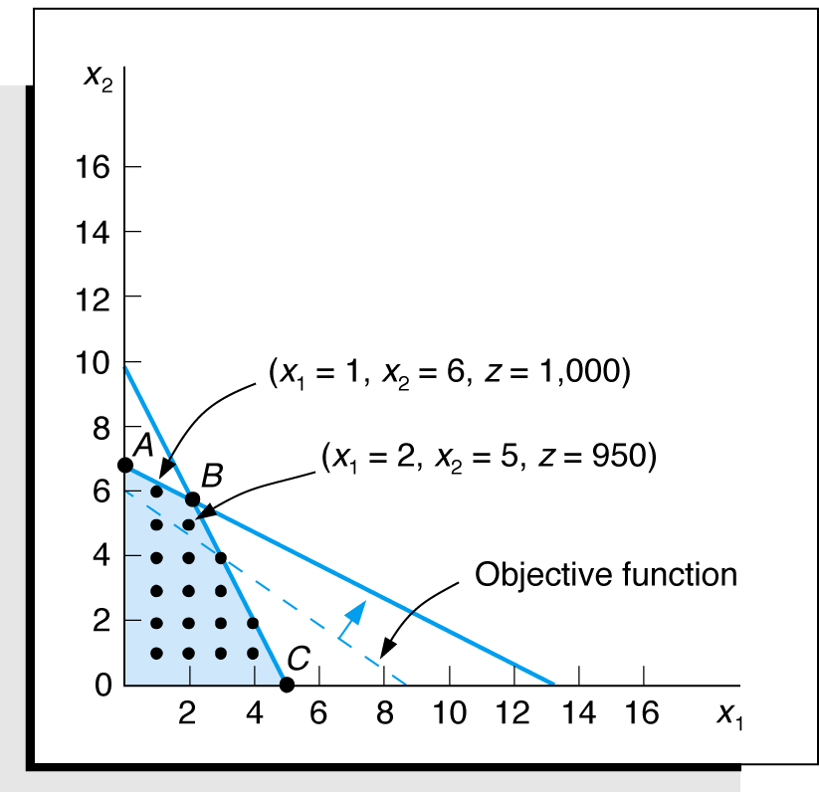
Integer Programming Example: Graphical Solution of Machine Shop Model
subject to:
Optimal Solution:
Figure 5.1 Feasible solution space with integer solution points

Slide 15
Branch and Bound Method
Traditional approach to solving integer programming problems.
Feasible solutions can be partitioned into smaller subsets
Smaller subsets evaluated until best solution is found.
Method is a tedious and complex mathematical process.
Excel and Q M for Windows used in this book.
See companion web site Module C – “Integer Programming: the Branch and Bound Method” for a detailed description of this method.

Slide 16
Learning Objective 5.3
Computer Solution of Integer Programming Problems With Excel and Q M for Windows

Slide 17
0 – 1 Model with Excel (1 of 5)
Recreational Facilities Example:
subject to:

Slide 18
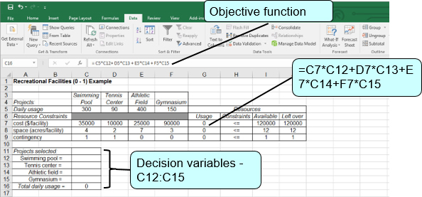
0 – 1 Model with Excel (2 of 5)
Exhibit 5.2

Slide 19
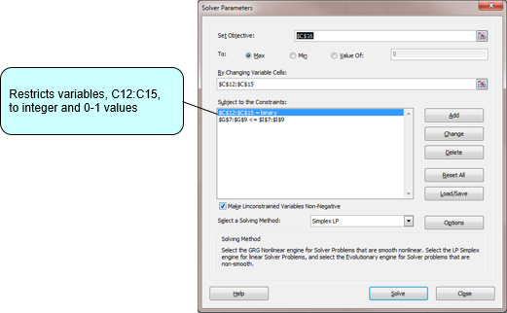
0 – 1 Model with Excel (3 of 5)
Exhibit 5.3

Slide 20
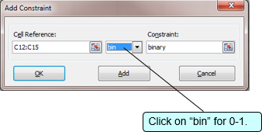
0 – 1 Model with Excel (4 of 5)
Exhibit 5.4

Slide 21
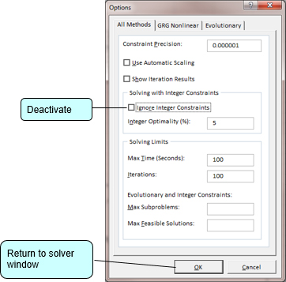
0 – 1 Model with Excel (5 of 5)
Exhibit 5.5

Slide 22
0 – 1 Model with Q M for Windows (1 of 4)
Recreational Facilities Example:
subject to:

Slide 23
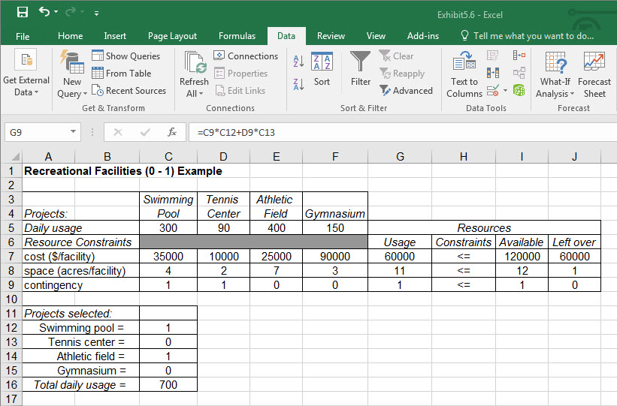
0 – 1 Model with Q M for Windows (2 of 4)
Exhibit 5.6

Slide 24
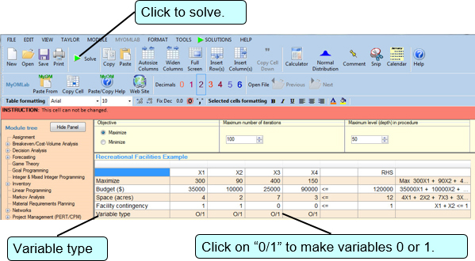
0 – 1 Model with Q M for Windows (3 of 4)
Exhibit 5.7

Slide 25
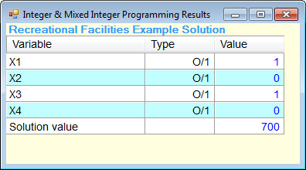
0 – 1 Model with Q M for Windows (4 of 4)
Exhibit 5.8
Solution:
X₁=1 swimming pool
X₂=0 tennis center
X₃=1 athletic field
X₄=0 gymnasium
Z=700 people per day usage

Slide 26
Total Integer Model with Excel (1 of 5)
Integer Programming Model of Machine Shop:
subject to:

Slide 27
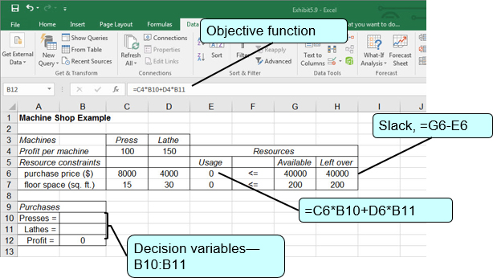
Total Integer Model with Excel (2 of 5)
Exhibit 5.9

Slide 28
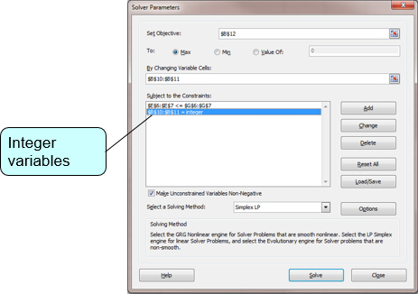
Total Integer Model with Excel (3 of 5)
Exhibit 5.10

Slide 29
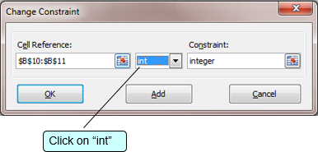
Total Integer Model with Excel (4 of 5)
Exhibit 5.11

Slide 30
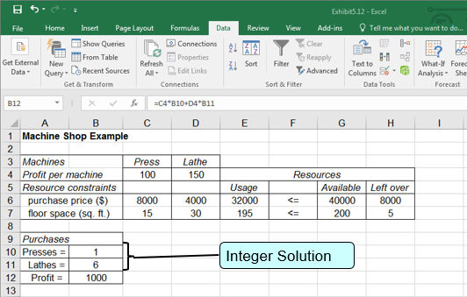
Total Integer Model with Excel (5 of 5)
Exhibit 5.12

Slide 31
Mixed Integer Model with Excel
Integer Programming Model for Investments Problem:
subject to:

Slide 32
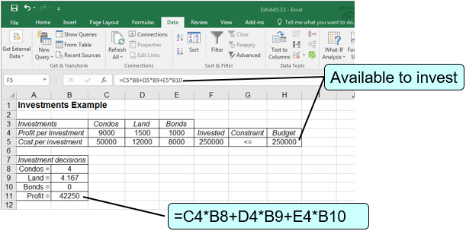
Total Integer Model with Excel
Exhibit 5.13

Slide 33
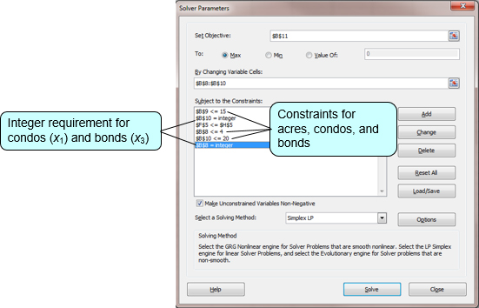
Solution of Total Integer Model with Excel
Exhibit 5.14

Slide 34
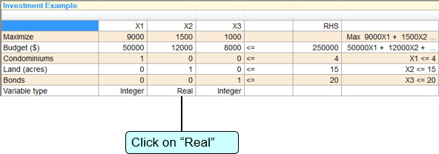
Mixed Integer Model with Q M for Windows (1 of 2)
Exhibit 5.15

Slide 35
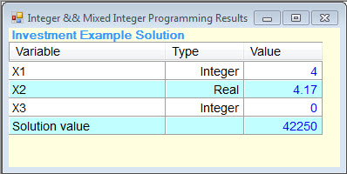
Mixed Integer Model with Q M for Windows (2 of 2)
Exhibit 5.16

Slide 36
Learning Objective 5.4
0 – 1 Integer Programming Modeling Examples

Slide 37
Capital Budgeting Example (1 of 6)
University bookstore expansion project.
Not enough space available for both a computer department and a clothing department.

Slide 38
Capital Budgeting Example (2 of 6)
Project | N P V Return ($1,000s) | 1 Project Costs/Year ($1,000s) | 2 Project Costs/Year ($1,000s) | 3 Project Costs/Year ($1,000s)
1. Web site | $120 | $55 | $40 | $25
2. Warehouse | 85 | 45 | 35 | 20
3. Clothing department | 105 | 60 | 25 | —
4. Computer department | 140 | 50 | 35 | 30
5. A T M s | 70 | 30 | 30 | —
Available funds per year | Blank | $150 | $110 | $60

Slide 39
Capital Budgeting Example (3 of 6)
x₁ = selection of web site project
x₂ = selection of warehouse project
x₃ = selection clothing department project
x₄ = selection of computer department project
x₅ = selection of A T M project
x_{i} = 1 if project “i” is selected, 0 if project “i” is not selected

Slide 40
Capital Budgeting Example (4 of 6)
subject to:

Slide 41
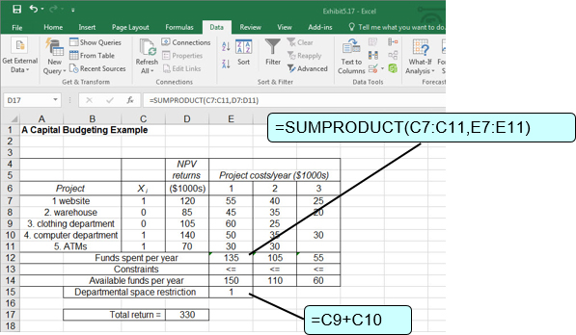
Capital Budgeting Example (5 of 6)
Exhibit 5.17

Slide 42
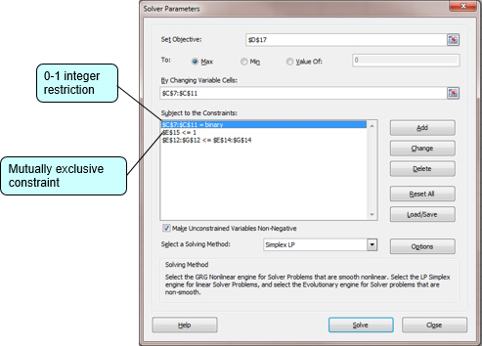
Capital Budgeting Example (6 of 6)
Exhibit 5.18

Slide 43
Fixed Charge and Facility Example (1 of 6)
Which of six farms should be purchased that will meet current production capacity at minimum total cost, including annual fixed costs and shipping costs?
Plant | Available Capacity (thousands of tons)
A | 12
B | 10
C | 14

Slide 44
Fixed Charge and Facility Example (2 of 6)
Farm | Fixed Annual Costs ($1,000s) | Projected Annual Harvest (thousands of tons)
1 | $405 | 11.2
2 | 390 | 10.5
3 | 450 | 12.8
4 | 368 | 9.3
5 | 520 | 10.8
6 | 465 | 9.6
Farm | A Plant (shipping costs, $/ton) | B Plant (shipping costs, $/ton) | C Plant (shipping costs, $/ton)
1 | 18 | 15 | 12
2 | 13 | 10 | 17
3 | 16 | 14 | 18
4 | 19 | 15 | 16
5 | 17 | 19 | 12
6 | 14 | 16 | 12

Slide 45
Fixed Charge and Facility Example (3 of 6)
y_{i} = 0 if farm i is not selected, and 1 if farm i is selected; i = 1,2,3,4,5,6
x_{ij} = potatoes (1000 tons) shipped from farm i to plant j; j = A,B,C.
subject to:

Slide 46
Fixed Charge and Facility Example (4 of 6)

Slide 47
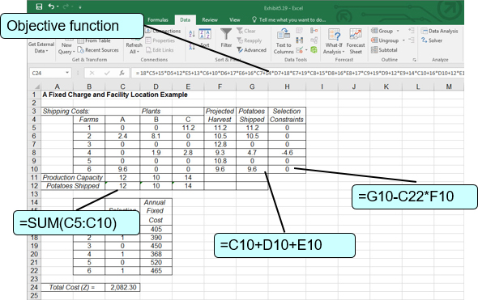
Fixed Charge and Facility Example (5 of 6)
Exhibit 5.19

Slide 48
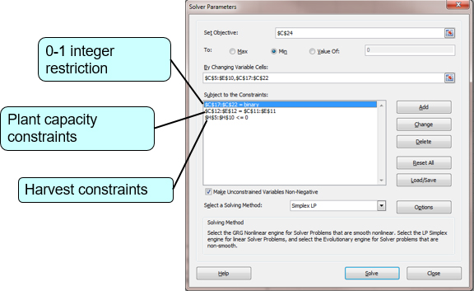
Fixed Charge and Facility Example (6 of 6)
Exhibit 5.20

Slide 49
Set Covering Example (1 of 5)
A P S wants to construct the minimum set of new hubs in these twelve cities such that there is a hub within 300 miles of every city:

Slide 50
Set Covering Example (2 of 5)
Cities | Cities within 300 miles
1. Atlanta | Atlanta, Charlotte, Nashville
2. Boston | Boston, New York
3. Charlotte | Atlanta, Charlotte, Richmond
4. Cincinnati | Cincinnati, Detroit, Indianapolis, Nashville, Pittsburgh
5. Detroit | Cincinnati, Detroit, Indianapolis, Milwaukee, Pittsburgh
6. Indianapolis | Cincinnati, Detroit, Indianapolis, Milwaukee, Nashville, St. Louis
7. Milwaukee | Detroit, Indianapolis, Milwaukee
8. Nashville | Atlanta, Cincinnati, Indianapolis, Nashville, St. Louis
9. New York | Boston, New York, Richmond
10. Pittsburgh | Cincinnati, Detroit, Pittsburgh, Richmond
11. Richmond | Charlotte, New York, Pittsburgh, Richmond
12. St. Louis | Indianapolis, Nashville, St. Louis

Slide 51
Set Covering Example (3 of 5)
x_{i} = city i, i = 1 to 12; x_{i} = 0 if city is not selected as a hub and x_{i} = 1 if it is.

Slide 52
Set Covering Example (4 of 5)
subject to:

Slide 53
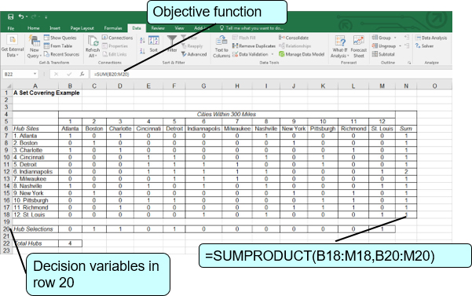
Set Covering Example in Excel
Exhibit 5.21

Slide 54
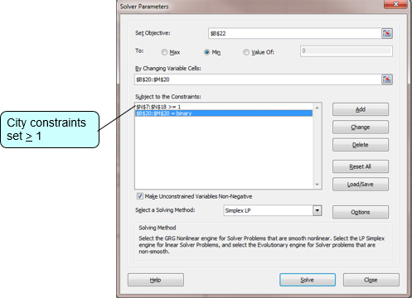
Set Covering Example (5 of 5)
Exhibit 5.22

Slide 55
Total Integer Programming Modeling Example: Problem Statement
Textbook company developing two new regions.
Planning to transfer some of its 10 salespeople into new regions.
Average annual expenses for sales person:
Region 1 - $10,000/salesperson
Region 2 - $7,500/salesperson
Total annual expense budget is $72,000.
Sales generated each year:
Region 1 - $85,000/salesperson
Region 2 - $60,000/salesperson
How many salespeople should be transferred into each region in order to maximize increased sales?

Slide 56
Total Integer Programming Modeling Example: Model Formulation
Step 1:
Formulate the Integer Programming Model
subject to:
Step 2:
Solve the Model using Q M for Windows

Slide 57
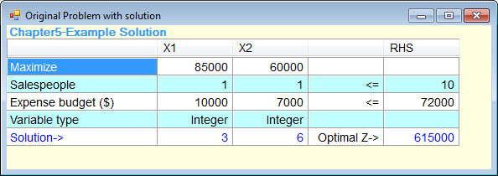
Total Integer Programming Modeling Example: Solution with Q M for Windows

