Slide 1
Introduction to Management Science
Thirteenth Edition, Global Edition
Chapter 8
Project Management
Copyright © 2019 Pearson Education, Ltd. All Rights Reserved
Notes:
If this PowerPoint presentation contains mathematical equations, you may need to check that your computer has the following installed:
1) MathType Plugin
2) Math Player (free versions available)
3) NVDA Reader (free versions available)

Slide 2
Learning Objectives
8.1 The Elements of Project Management
8.2 C P M/P E R T
8.3 Probabilistic Activity Times
8.4 Microsoft Project
8.5 Project Crashing and Time-Cost Trade-Off
8.6 Formulating the C P M/P E R T Network as a Linear Programming Model

Slide 3
Overview
Network representation is useful for project analysis.
Networks show how project activities are organized and are used to determine time duration of projects.
Network techniques used are:
C P M (Critical Path Method)
P E R T (Project Evaluation and Review Technique)
Developed independently during late 1950s.

Slide 4
Learning Objective 8.1
The Elements of Project Management

Slide 5
Elements of Project Management
Management is generally perceived as concerned with planning, organizing, and control of an ongoing process or activity.
Project management is concerned with control of an important activity for a relatively short period of time after which management effort ends.
Primary elements of project management to be discussed:
Project Planning
Project Return
Project Team
Project Control

Slide 6
Project Planning
Objectives
Project scope
Contract requirements
Schedules
Resources
Personnel
Control
Risk and problem analysis

Slide 7
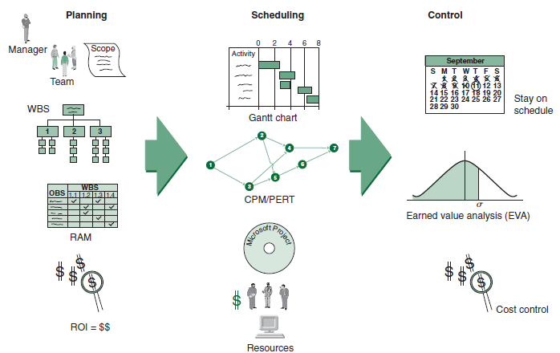
Figure 8.1 The Project Management Process

Slide 8
Project Return
Return on investment (R O I) is a measure used to evaluate projects calculated by dividing the dollar gain minus the dollar cost by the dollar cost.
R O I can be used to rank projects
Not all project benefits can be measured in dollars

Slide 9
The Project Team
Project team typically consists of a group of individuals from various areas in an organization and often includes outside consultants.
Members of engineering staff often assigned to project work.
Project team may include workers.
Most important member of project team is the project manager.
Project manager is often under great pressure because of uncertainty inherent in project activities and possibility of failure. Potential rewards, however, can be substantial.
Project manager must be able to coordinate various skills of team members into a single focused effort.

Slide 10
Scope Statement
Document providing common understanding of project.
Justification describing the factors giving rise to need for project.
Expected results and what constitutes success.
List of necessary documents and planning reports.
Statement of work (S O W) - a planning document for individuals, team members, groups, departments, subcontractors and suppliers, describing what are required for successful completion on time.

Slide 11
Work Breakdown Structure (W B S) (1 of 2)
W B S breaks down project into major components (modules).
Modules are further broken down into activities and, finally, into individual tasks.
Identifies activities, tasks, resource requirements and relationships between modules and activities.
Helps avoid duplication of effort.
Basis for project development, management , schedule, resources and modifications.

Slide 12
Work Breakdown Structure (W B S) (2 of 2)
Approaches for W B S development:
Top down process
Brainstorm entire project

Slide 13
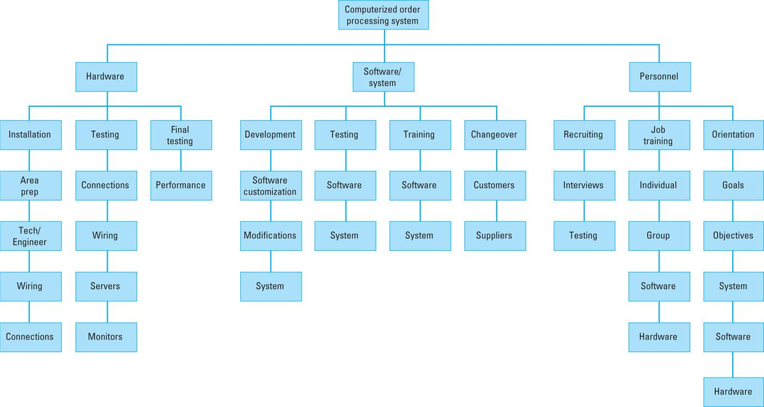
Work Breakdown Structure
Figure 8.2 W B S for computer order-processing system project

Slide 14
Responsibility Assignment Matrix
R A M shows who is responsible for doing the necessary work in the project
Project manager assigns work elements to organizational units, departments, groups, individuals or subcontractors.
Uses an organizational breakdown structure (O B S).
O B S is a table or a chart showing which organizational units are responsible for work items.
O B S leads to the responsibility assignment matrix (R A M)

Slide 15
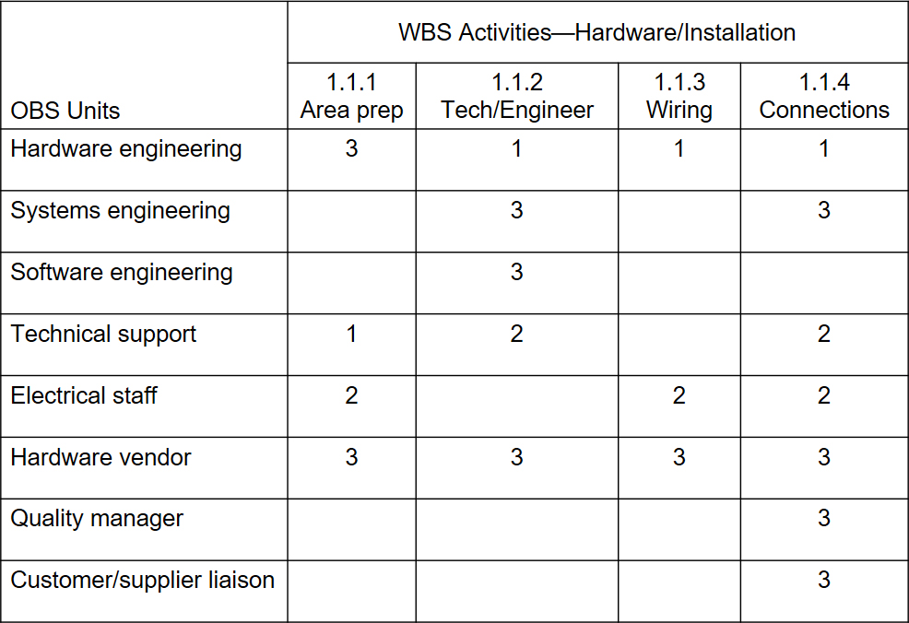
Figure 8.3 A Responsibility Assignment Matrix
Level of responsibility: 1 = Overall responsibility 2 = Performance responsibility 3 = Support

Slide 16
Project Scheduling (1 of 2)
Project schedule evolves from planning documents, with focus on timely completion.
Critical element in project management – source of most conflicts and problems.
Schedule development steps:
Define activities,
Sequence activities,
Estimate activity times,
Develop schedule.

Slide 17
Project Scheduling (2 of 2)
Gantt chart and C P M/P E R T techniques can be useful.
Computer software packages available, example Microsoft Project.

Slide 18
Gantt Chart
Popular, traditional technique, also known as a bar chart -developed by Henry Gantt (1914).
Direct precursor of C P M/P E R T for monitoring work progress.
A visual display of project schedule showing activity start and finish times and where extra time is available.
Suitable for projects with few activities and precedence relationships.
Drawback: precedence relationships are not always discernible which limits chart’s use for smaller projects

Slide 19
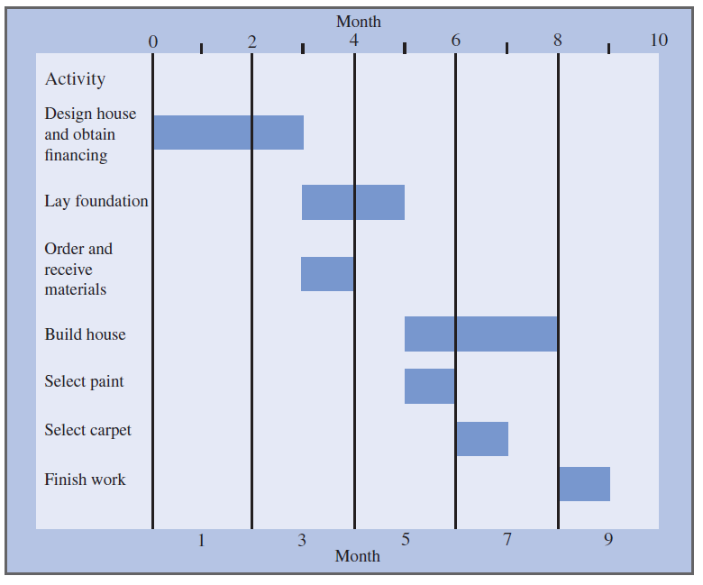
Figure 8.4 Gantt Chart

Slide 20
Project Control
Process of ensuring progress toward successful completion.
Monitoring project to minimize deviations from project plan and schedule.
Corrective actions necessary if deviations occur.
Key elements of project control
Time management
Cost management
Performance management
Earned value analysis (E V A)

Slide 21
Learning Objective 8.2
C P M/P E R T

Slide 22
The Project Network (1 of 2)
Activity-on-Arc (A O A) Network
A branch reflects an activity of a project.
A node represents the beginning and end of activities, referred to as events.
Branches in the network indicate precedence relationships.
When an activity is completed at a node, it has been realized.

Slide 23
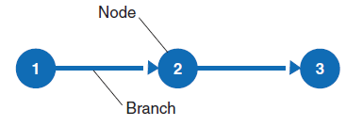
The Project Network (2 of 2)
Figure 8.5 Nodes and branches

Slide 24
The Project Network: House Building Project Data
Number | Activity | Predecessor | Duration
1 | Design house and obtain financing | -- | 3 months
2 | Lay foundation | 1 | 2 months
3 | Order and receive materials | 1 | 1 month
4 | Build house | 2,3 | 3 months
5 | Select paint | 2,3 | 1 month
6 | Select carper | 5 | 1 month
7 | Finish work | 4,6 | 1 month

Slide 25
The Project Network: Concurrent Activities (1 of 2)
Activities can occur at the same time (concurrently).
Network aids in planning and scheduling.
Time duration of activities shown on branches.

Slide 26
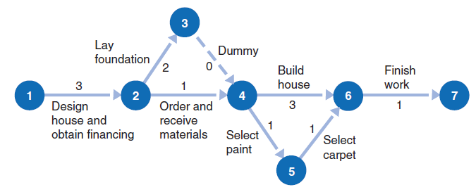
The Project Network: Concurrent Activities (2 of 2)
Figure 8.6 Concurrent activities for house-building project

Slide 27
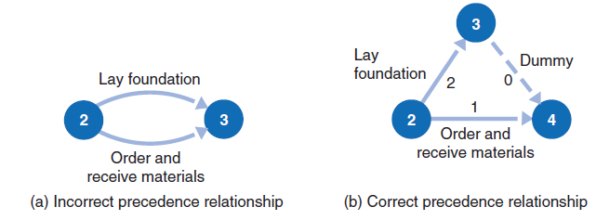
The Project Network: Dummy Activities
A dummy activity shows a precedence relationship but reflects no passage of time.
Two or more activities cannot share the same start and end nodes.
Figure 8.7 A dummy activity

Slide 28
The Project Network: A O N Network for House Building Project (1 of 2)
Activity-on-Node (A O N) Network
A node represents an activity, with its label and time shown on the node
The branches show the precedence relationships
Convention used in Microsoft Project software

Slide 29
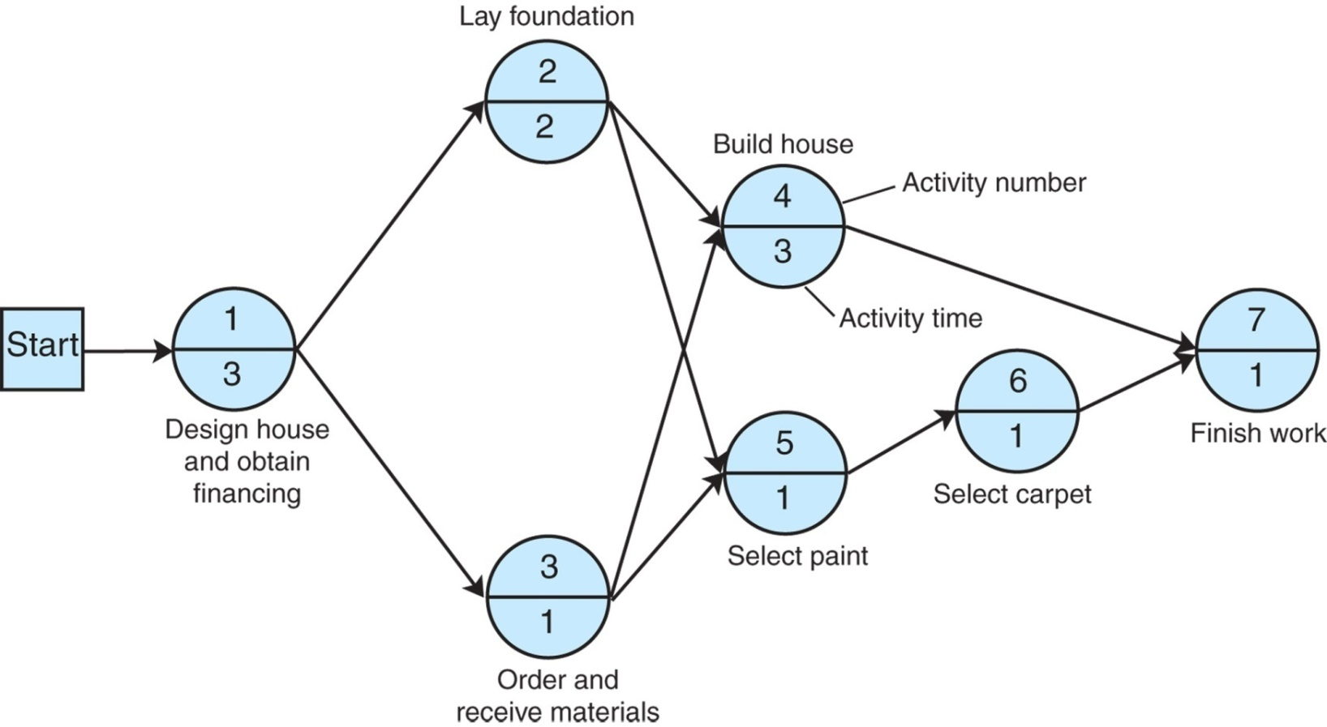
The Project Network: A O N Network for House Building Project (2 of 2)
Figure 8.8 A O N network

Slide 30
The Project Network: Paths Through a Network
Table 8.1 Paths through the house-building network
Path | Events
A | 1→2→4→7
B | 1→2→5→6→7
C | 1→3→4→7
D | 1→3→5→6→7

Slide 31
The Project Network: The Critical Path
The critical path is the longest path through the network; the minimum time the network can be completed. From Figure 8.8:
Path A: 1 → 2 → 4 → 7 | 3 + 2 + 3 + 1 = 9 months
Path B: 1 → 2 → 5 → 6 → 7 | 3 + 2 + 1 + 1 + 1= 8 months
Path C: 1 → 3 → 4 → 7 | 3 + 1 + 3 + 1 = 8 months
Path D: 1 → 3 → 5 → 6 → 7 | 3 + 1 + 1 + 1 + 1 = 7 months

Slide 32
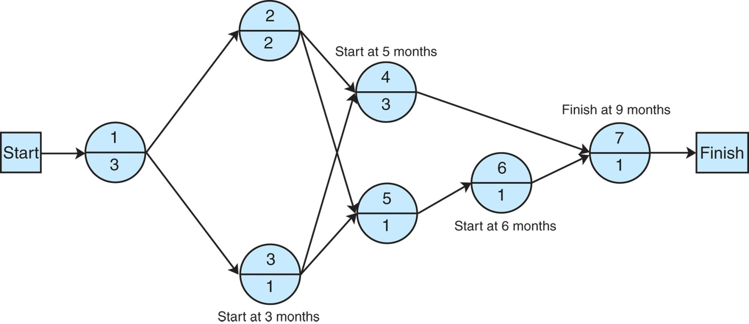
The Project Network: Activity Start Times
Figure 8.9 Activity start time

Slide 33
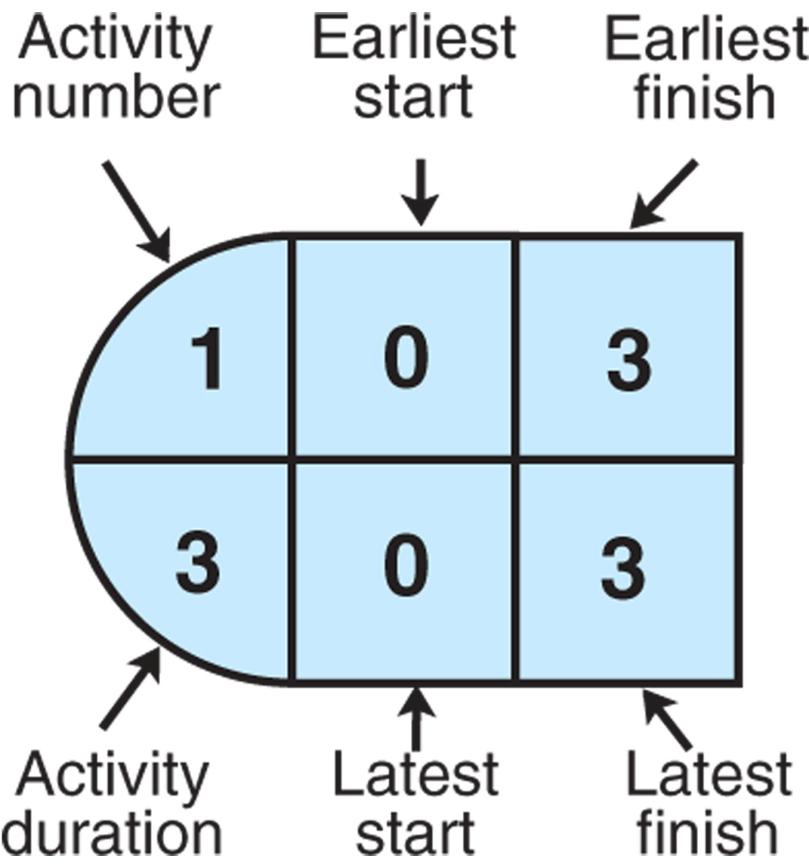
The Project Network: Activity Scheduling in Activity-on-Node Configuration
Figure 8.10 Activity-on-node configuration

Slide 34
The Project Network: Activity Scheduling: Earliest Times (1 of 2)
E S is the earliest time an activity can start:
E F is the earliest start time plus the activity time:

Slide 35
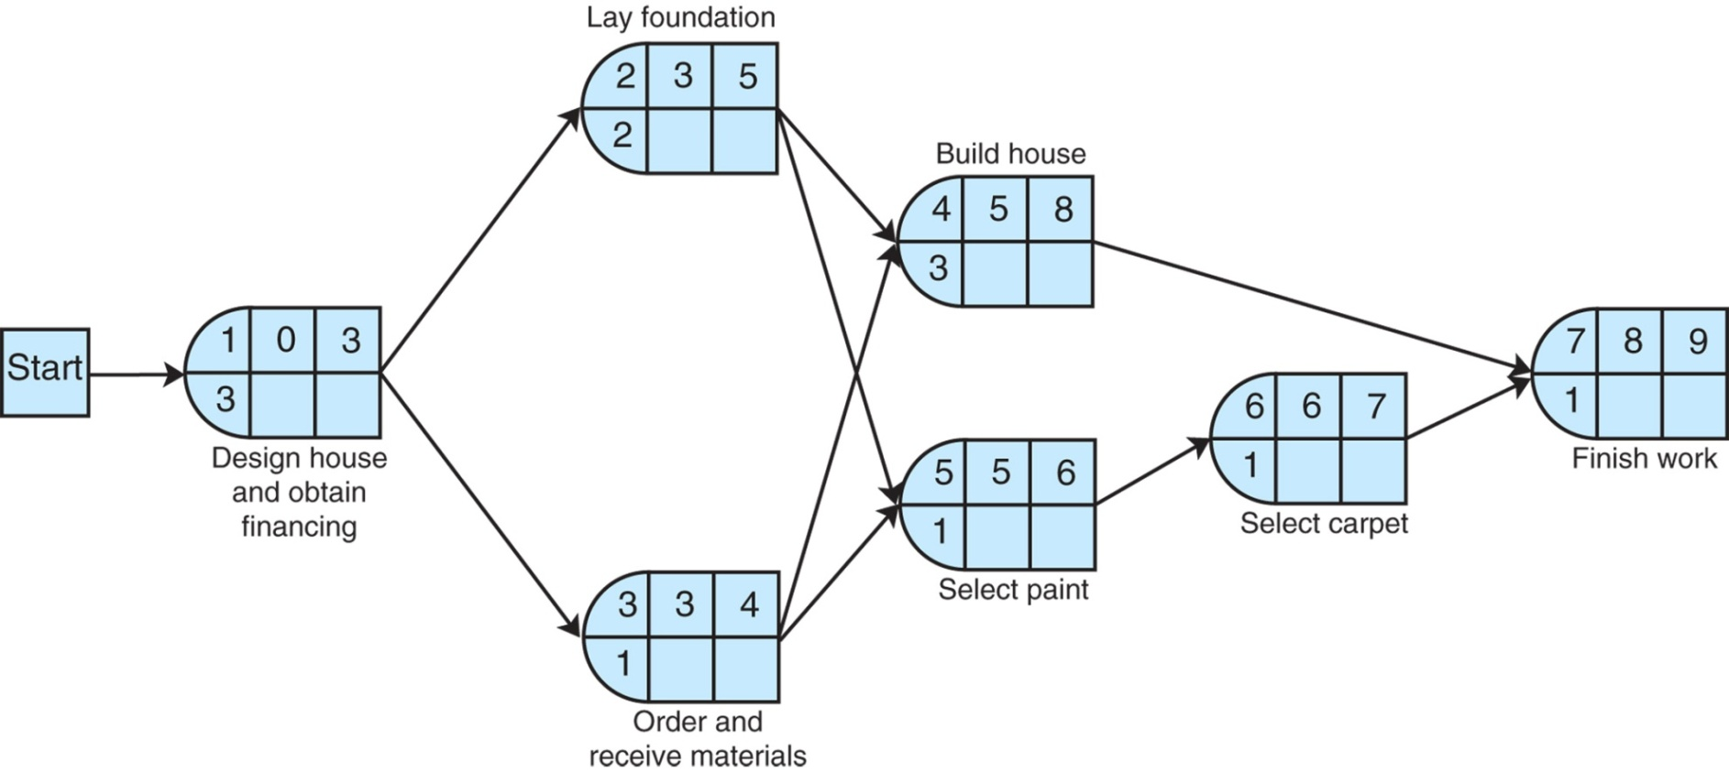
The Project Network: Activity Scheduling: Earliest Times (2 of 2)
Figure 8.11 Earliest activity start and finish times

Slide 36
The Project Network: Activity Scheduling: Latest Times (1 of 2)
L S is the latest time an activity can start without delaying critical path time:
L F is the latest finish time:

Slide 37
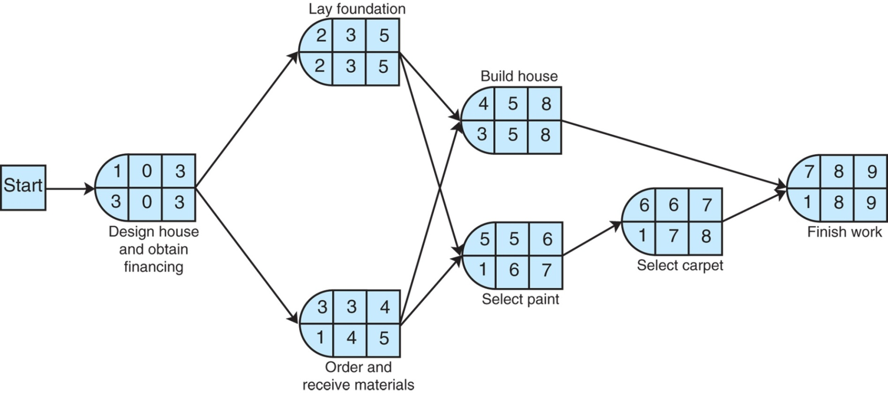
The Project Network: Activity Scheduling: Latest Times (2 of 2)
Figure 8.12 Latest activity start and finish times

Slide 38
The Project Network: Activity Slack Time (1 of 3)
Slack is the amount of time an activity can be delayed without delaying the project: S = L S − E S = L F − E F
Slack Time exists for those activities not on the critical path for which the earliest and latest start times are not equal.
Shared Slack is slack available for a sequence of activities.

Slide 39
The Project Network: Activity Slack Time (2 of 3)
Table 8.2 Activity Slack
Activity | L S | E S | L F | E F | Slack, S
*1 | 0 | 0 | 3 | 3 | 0
*2 | 3 | 3 | 5 | 5 | 0
3 | 4 | 3 | 5 | 4 | 1
*4 | 5 | 5 | 8 | 8 | 0
5 | 6 | 5 | 7 | 6 | 1
6 | 7 | 6 | 8 | 7 | 1
*7 | 8 | 8 | 9 | 9 | 0
*Critical path

Slide 40
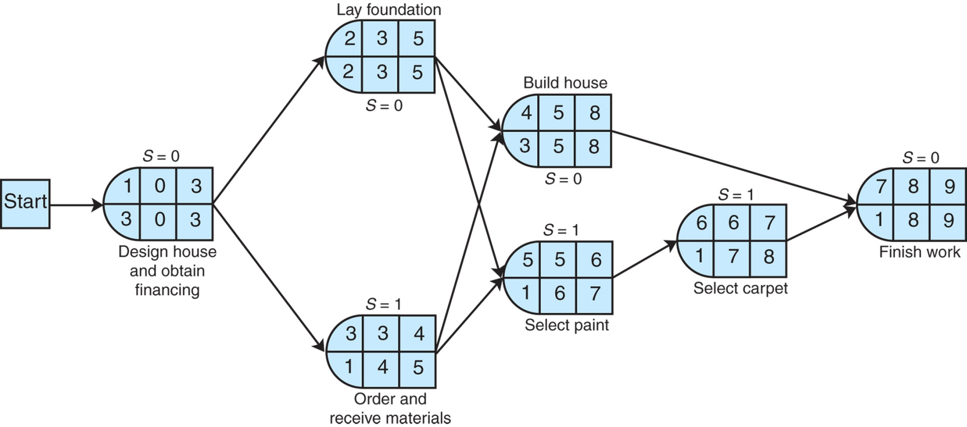
The Project Network: Activity Slack Time (3 of 3)
Figure 8.13 Activity slack

Slide 41
Learning Objective 8.3
Probabilistic Activity Times

Slide 42
Probabilistic Activity Times (1 of 2)
Activity time estimates usually cannot be made with certainty.
P E R T used for probabilistic activity times.
In P E R T, three time estimates are used: most likely time (m), the optimistic time (a), and the pessimistic time (b).
These provide an estimate of the mean and variance of a beta distribution:

Slide 43
Probabilistic Activity Times (2 of 2)

Slide 44
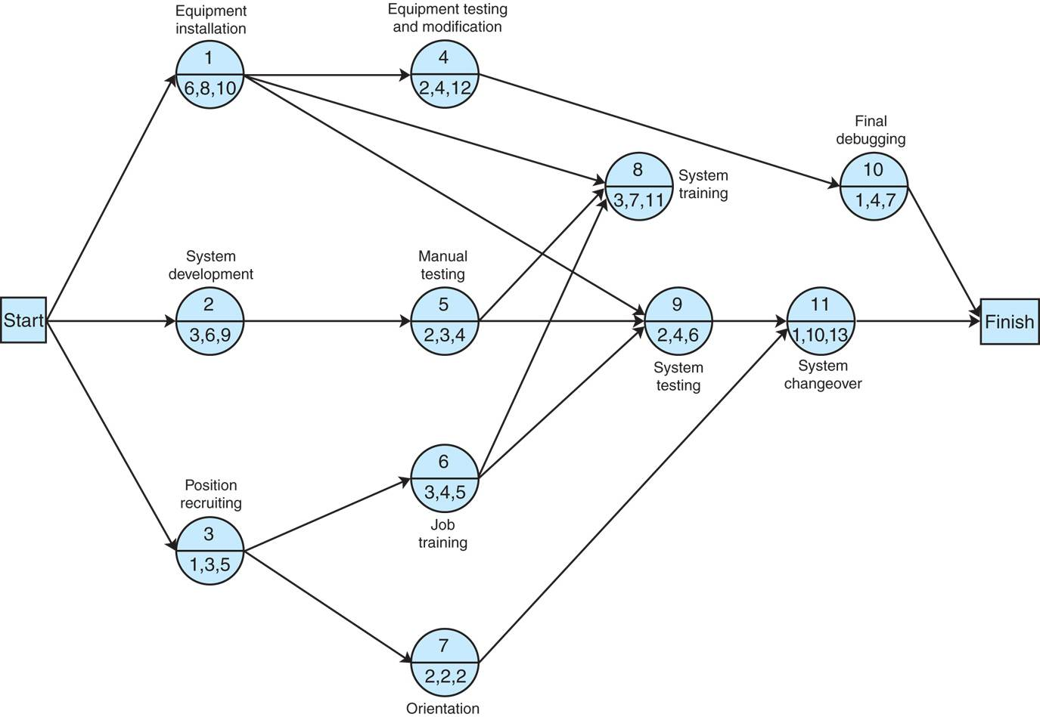
Example (1 of 4)
Figure 8.14 Network for order processing system installation

Slide 45
Example (2 of 4)
Table 8.3 Activity time estimates for Figure 8.14
Activity | Time Estimates (weeks) a | Time Estimates (weeks) m | Time Estimates (weeks) b | Time t | Mean Variance v
1 | 6 | 8 | 10 | 8 | 4 ninth
2 | 3 | 6 | 9 | 6 | 1
3 | 1 | 3 | 5 | 3 | 4 ninth
4 | 2 | 4 | 12 | 5 | 25 ninths
5 | 2 | 3 | 4 | 3 | 1 ninth

Slide 46
Example (3 of 4)
Activity | Time Estimates (weeks) a | Time Estimates (weeks) m | Time Estimates (weeks) b | Time t | Mean Variance v
6 | 3 | 4 | 5 | 4 | 1 ninth
7 | 2 | 2 | 2 | 2 | 0
8 | 3 | 7 | 11 | 7 | 16 ninths
9 | 2 | 4 | 6 | 4 | 4 ninths
10 | 1 | 4 | 7 | 4 | 1
11 | 1 | 10 | 13 | 9 | 4

Slide 47
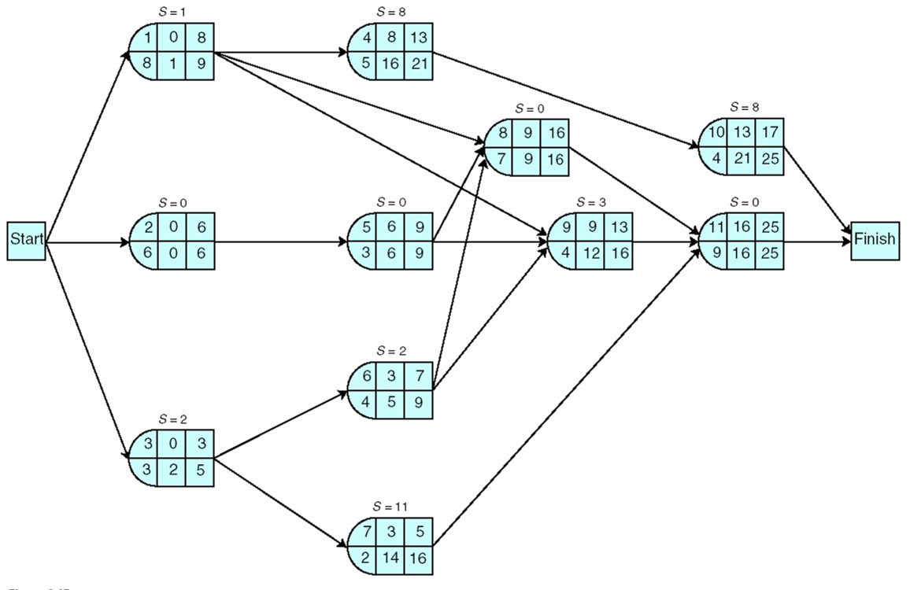
Example (4 of 4)
Figure 8.15 Earliest and latest activity times

Slide 48
Expected Project Time and Variance (1 of 2)
Expected project time is the sum of the expected times of the critical path activities.
Project variance is the sum of the critical path activities’ variances
The expected project time is assumed to be normally distributed (based on central limit theorem).
In example, expected project time (t_{p}) and variance (v_{p}) interpreted as the mean (μ) and variance
of a normal distribution:

Slide 49
Expected Project Time and Variance (2 of 2)
Critical Path Activity | Variance
2 | 1
5 | 1 ninth
8 | 16 ninths
11 | 4
Blank | 62 ninths

Slide 50
Probability Analysis of a Project Network (1 of 2)
Using the normal distribution, probabilities are determined by computing the number of standard deviations (Z) a value is from the mean.
The Z value is used to find the corresponding probability in Table A.1, Appendix A.

Slide 51
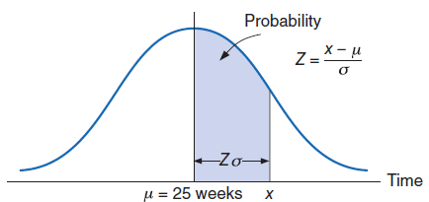
Probability Analysis of a Project Network (2 of 2)
Figure 8.16 Normal distribution of network duration

Slide 52
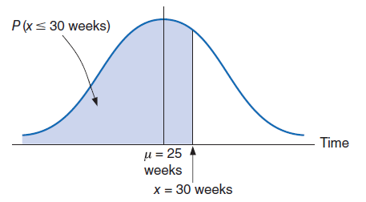
Probability Analysis of a Project Network Example 1 (1 of 2)
Figure 8.17 Probability that the network will be completed in 30 weeks or less

Slide 53
Probability Analysis of a Project Network Example 1 (2 of 2)
What is the probability that the new order processing system will be ready by 30 weeks?
Z value of 1.90 corresponds to probability of .4713 in Table A.1, Appendix A. The probability of completing project in 30 weeks or less:
(.5000 + .4713) = .9713.

Slide 54
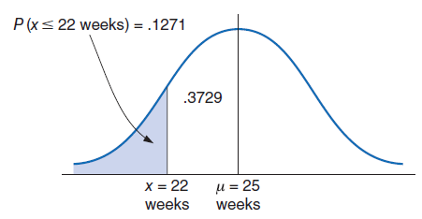
Probability Analysis of a Project Network Example 2 (1 of 2)
Figure 8.18 Probability the network will be completed in 22 weeks or less

Slide 55
Probability Analysis of a Project Network Example 2 (2 of 2)
A customer will trade elsewhere if the new ordering system is not working within 22 weeks. What is the probability that she will be retained?
Z value of 1.14 (ignore negative) corresponds to probability of .3729 in Table A.1, Appendix A.
Probability that customer will be retained is .1271 (.5000−.3729)

Slide 56
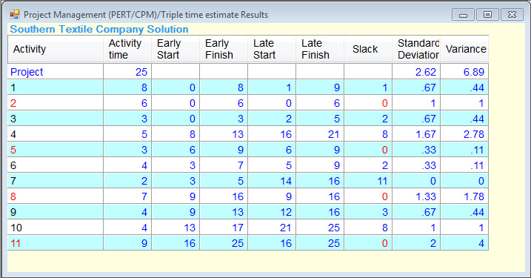
C P M/P E R T Analysis with Q M for Windows & Excel Q M (1 of 2)
Exhibit 8.1: Q M for Windows solution output for system installation

Slide 57
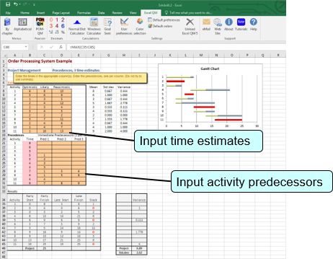
C P M/P E R T Analysis with Q M for Windows & Excel Q M (2 of 2)
Exhibit 8.2: Excel Q M solution

Slide 58
Learning Objective 8.4
Microsoft Project

Slide 59
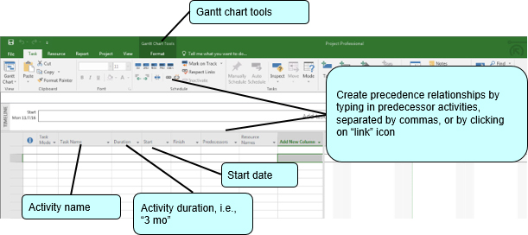
Analysis with Microsoft Project (1 of 6)
Microsoft Project handles only A O N networks.
Exhibit 8.3

Slide 60
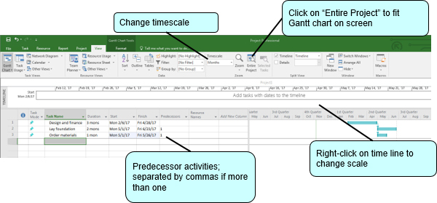
Analysis with Microsoft Project (2 of 6)
Exhibit 8.4

Slide 61
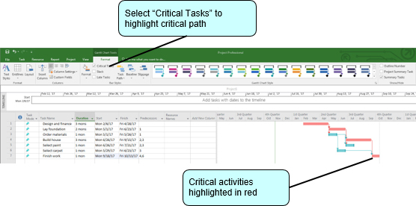
Analysis with Microsoft Project (3 of 6)
Exhibit 8.5

Slide 62
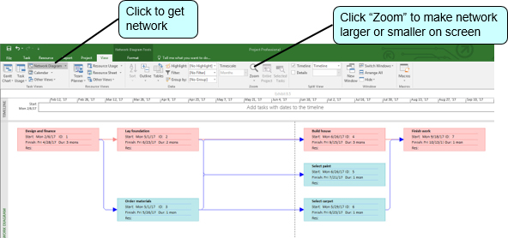
Analysis with Microsoft Project (4 of 6)
Exhibit 8.6

Slide 63
Analysis with Microsoft Project (5 of 6)
Exhibit 8.7

Slide 64
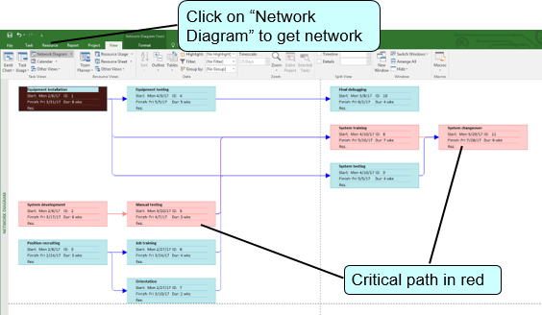
Analysis with Microsoft Project (6 of 6)
Exhibit 8.8

Slide 65
Learning Objective 8.5
Project Crashing and Time-Cost Trade-Off

Slide 66
Project Crashing and Time-Cost Trade-Off Overview
Project duration can be reduced by assigning more resources to project activities.
However, doing this increases project cost.
Decision is based on analysis of trade-off between time and cost.
Project crashing is a method for shortening project duration by reducing one or more critical activities to a time less than normal activity time.

Slide 67
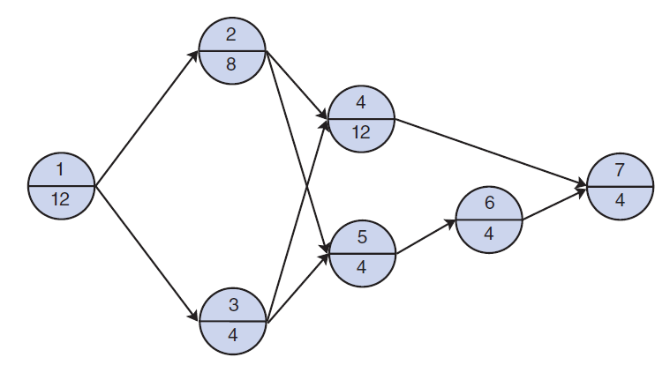
Example Problem 1 (1 of 6)
Figure 8.19 The project network for building a house

Slide 68
Example Problem 1 (2 of 6)
Crash cost & crash time have a linear relationship

Slide 69
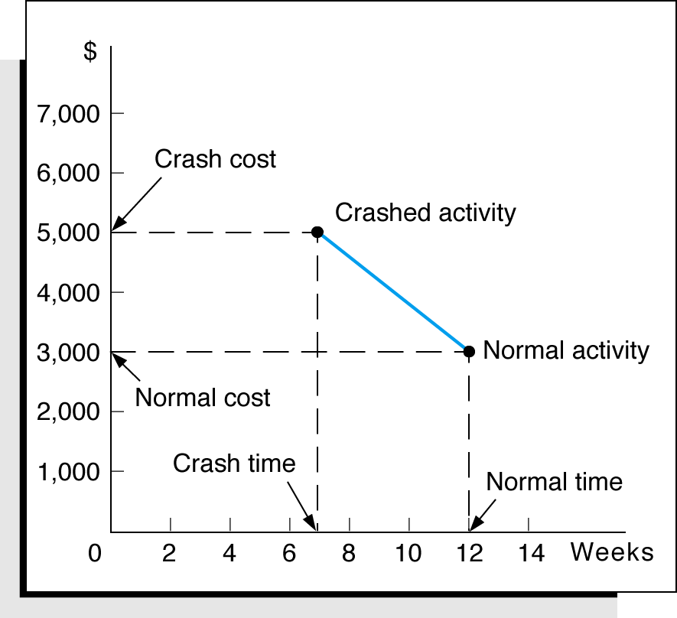
Example Problem 1 (3 of 6)
Figure 8.20 Time-cost relationship for crashing activity 1

Slide 70
Example Problem 1 (4 of 6)
Table 8.4 Normal activity and crash data for the Figure 8.19 network
Activity | Normal Time (weeks) | Crash Time (weeks) | Normal Cost | Crash Cost | Total Allowable Crash Time (weeks) | Crash Cost per Week
1 | 12 | 7 | $ 3,000 | $ 5,000 | 5 | $ 400
2 | 8 | 5 | 2,000 | 3,500 | 3 | 500
3 | 4 | 3 | 4,000 | 7,000 | 1 | 3,000
4 | 12 | 9 | 50,000 | 71,000 | 3 | 7,000
5 | 4 | 1 | 500 | 1,100 | 3 | 200
6 | 4 | 1 | 500 | 1,100 | 3 | 200
7 | 4 | 3 | 15,000 | 22,000 | 1 | 7,000
Blank | Blank | Blank | $75,000 | $110,700 | Blank | Blank

Slide 71
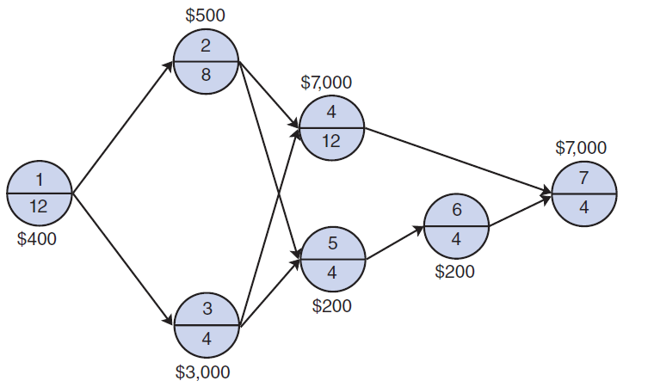
Example Problem 1 (5 of 6)
Figure 8.21 Network with normal activity times and weekly crashing costs

Slide 72
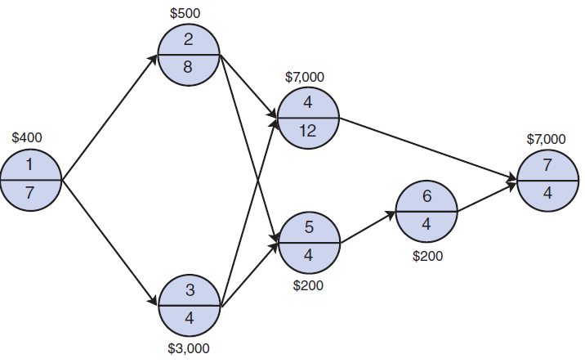
Example Problem 1 (6 of 6)
As activities are crashed, the critical path may change and several paths may become critical.
Figure 8.22 Revised network with activity 1 crashed

Slide 73
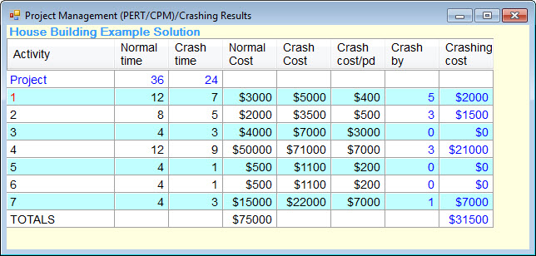
Q M for Windows
Exhibit 8.9

Slide 74
General Relationship of Time and Cost (1 of 2)
Project crashing costs and indirect costs have an inverse relationship.
Crashing costs are highest when the project is shortened.
Indirect costs increase as the project duration increases.
The optimal project time is at the minimum point on the total cost curve.

Slide 75
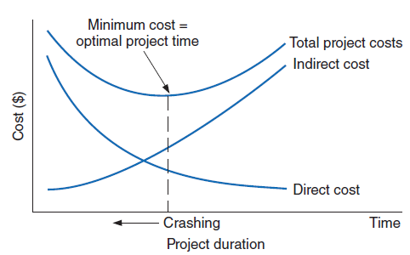
General Relationship of Time and Cost (2 of 2)
Figure 8.23 The time-cost trade-off

Slide 76
Learning Objective 8.6
Formulating the C P M/P E R T Network as a Linear Programming Model

Slide 77
Formulating as a Linear Programming Model
The objective is to minimize the project duration (critical path time).
General linear programming model with A O A convention

Slide 78
Example Problem Formulation and Data (1 of 2)
Figure 8.24 C P M/P E R T network with earliest event times

Slide 79
Example Problem Formulation and Data (2 of 2)
subject to:

Slide 80
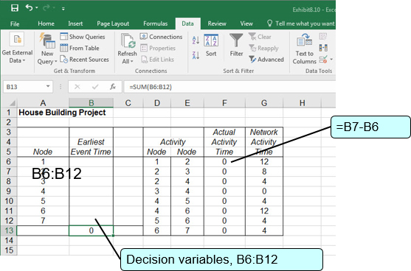
Example Problem Solution with Excel (1 of 4)
Exhibit 8.10

Slide 81
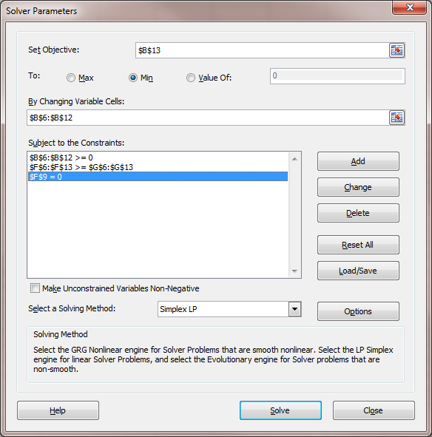
Example Problem Solution with Excel (2 of 4)
Exhibit 8.11

Slide 82
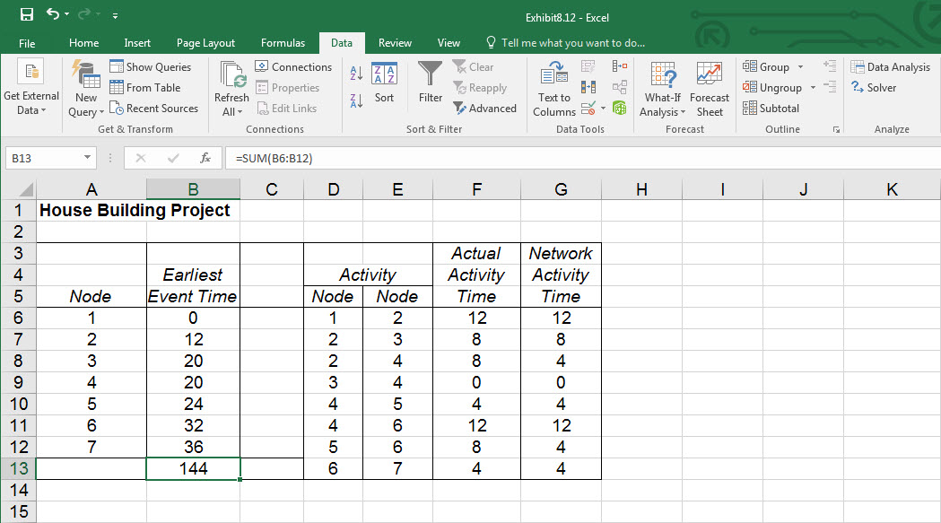
Example Problem Solution with Excel (3 of 4)
Exhibit 8.12

Slide 83
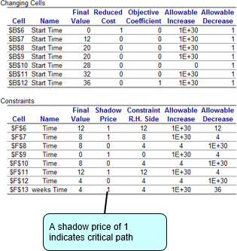
Example Problem Solution with Excel (4 of 4)
Exhibit 8.13 Sensitivity report for house-building project

Slide 84
Project Crashing with Linear Programming Example Problem – Model Formulation (1 of 2)
subject to:

Slide 85
Project Crashing with Linear Programming Example Problem – Model Formulation (2 of 2)
x_{i} = earliest event time of node i
x_{j} = earliest event time of node j
y_{ij} = amount of time by which activity i → j is crashed
The objective is to minimize the cost of crashing

Slide 86
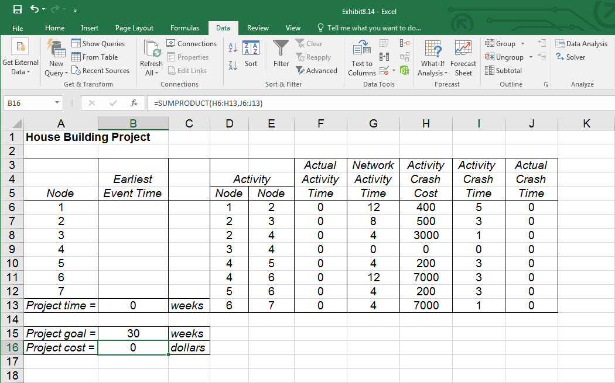
Project Crashing with Linear Programming Excel Solution (1 of 3)
Exhibit 8.14

Slide 87
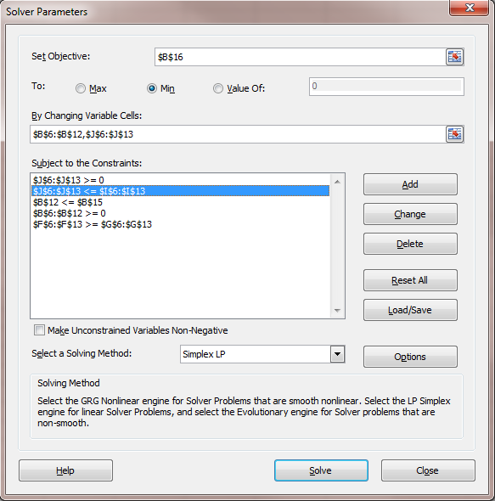
Project Crashing with Linear Programming Excel Solution (2 of 3)
Exhibit 8.15

Slide 88
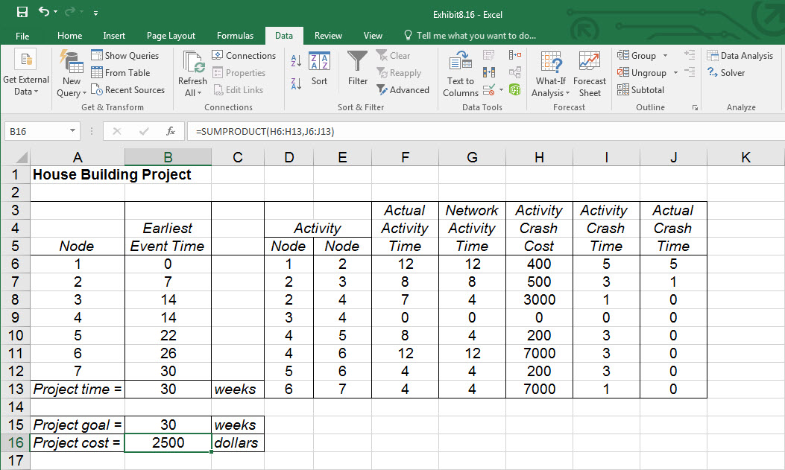
Project Crashing with Linear Programming Excel Solution (3 of 3)
Exhibit 8.16

Slide 89
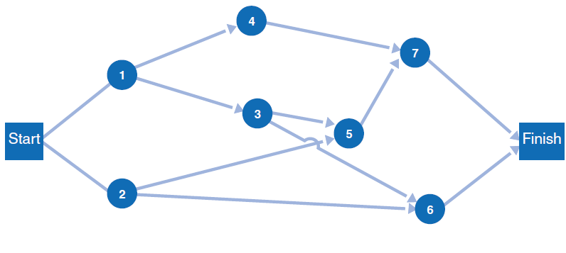
Example Problem 2 (1 of 6)
Given this A O N network and the data on the following slide, determine the expected project completion time and variance, and the probability that the project will be completed in 28 days or less.

Slide 90
Example Problem 2 (2 of 6)
Activity | Time Estimates (weeks) a | Time Estimates (weeks) m | Time Estimates (weeks) b
1 | 5 | 8 | 17
2 | 7 | 10 | 13
3 | 3 | 5 | 7
4 | 1 | 3 | 5
5 | 4 | 6 | 8
6 | 3 | 3 | 3
7 | 3 | 4 | 5

Slide 91
Example Problem 2 (3 of 6)
Step 1: Compute the expected activity times and variances.
Activity | t | v
1 | 9 | 4
2 | 10 | 1
3 | 5 | 4 ninth
4 | 3 | 4 ninth
5 | 6 | 4 ninth
6 | 3 | 0
7 | 4 | 1 ninth

Slide 92
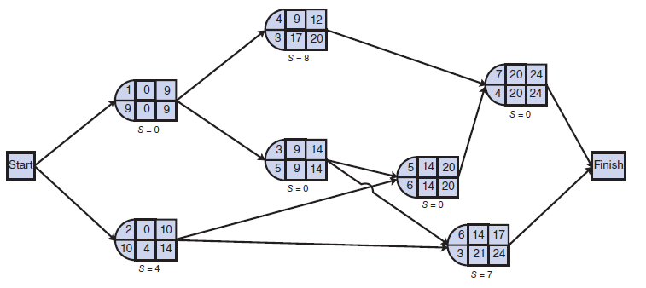
Example Problem 2 (4 of 6)
Step 2: Determine the earliest and latest activity times & slacks

Slide 93
Example Problem 2 (5 of 6)
Step 3: Identify the critical path and compute expected completion time and variance.
Critical path (activities with no slack): 1 → 3 → 5 → 7
Expected project completion time: t_{p} = 9+5+6+4 = 24 days
Variance:

Slide 94
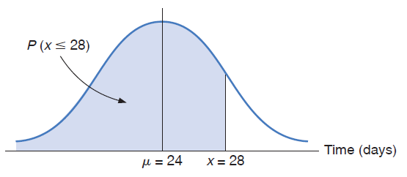
Example Problem 2 (6 of 6)
Step 4: Determine the Probability That the Project Will be Completed in 28 days or less
Corresponding probability from Table A.1, Appendix A, is .4633 and

