Slide 1
Kinetics analysis of β-fructofuranosidase enzyme
2-The effects of enzyme concentration on the rate of an enzyme catalyzed reaction.

Slide 2
Systematic names and numbers
β-Fructofuranosidase (EC 3.2.1.26)
Reactions catalysed:
It hydrolyses sucrose to yield glucose and fructose

Slide 3
The activity of the enzyme can be detected by using a reagent that can detect reducing sugars (glucose and fructose).
One reagent commonly used to measure invertase activity in industrial procedures is dinitrosalicylate (DNS).
Reducing sugars are produced by the action of invertase on sucrose; these reducing sugars reduce DNS to aminonitrosalicylate (ANS).
The reduction of DNS to ANS results in an observable color change from a [yellow/orange] and Absorbance is determined at 540 nm.

Slide 4
DNS is added to the mixture after the completion of the reaction, the mixture is converted to a colored form which absorbs lights at 540 nm.
the velocity of the reaction (μ moles of reducing sugar/minute) can be easily calculated.

Slide 5
Effect of enzyme concetrationOn The Rate Of An Enzymatic Reaction

Slide 6
Objective
To establish the relationship between enzyme concentration and the rate of an enzyme catalyzed reaction

Slide 7
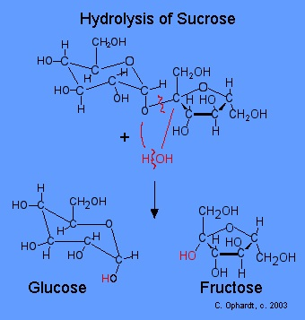
Principle
Within acidic environment using acetate buffer (PH= 4.7) β-fructofuranosidase enzyme cleavage its substrate (Sucrose) non reducing sugar to mixture of reducing sugar glucose and fructose, using 3,5,dinitrocylislic acid .

Slide 8
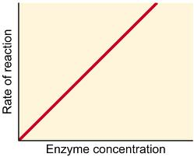
The rate of reaction is directly proportional to increasing enzyme concentration
a series of 10 -minutes assays, will performed in which a different enzyme concentration is added each time the reaction is initiated.
Provided that substrate remains in excess, the rate of an enzyme catalyzed reaction is directly proportional to increasing enzyme concentration. The results should indicate the range of enzyme concentrations that yield a linear response

Slide 9
Material
Solutions :-
0.05M Sodium Acetate buffer , pH 4.7 .
0.18 M Sucrose ,
Reducing sugar (0.005M glucose + 0.005M fructose)
Beta Fructofuranosidase (Invertase ) enzyme extract from yeast.
DNS (dinitrosalicylicacid )Reagent .
Sodium Bicarbonate .

Slide 10
Method:
1- Prepare 8 tubes in the following manner table ( 1 ) :
Tube | Acetate buffer (ml) | 0.18M Sucrose (ml)
Blank | 1.0 | 2.0
A | 1.0 | 2.0
B | 1.0 | 2.0
C | 1.0 | 2.0
D | 1.0 | 2.0
E | 1.0 | 2.0
F | 1.0 | 2.0
2- Mix each tube then add 0.05ml of diluted enzyme according to the following table (2) , EXCEPT FOR THE BLANK ADD 0.05ml OF DISTILLED WATER INSTEAD , mix and start the stop clock immediately , incubate each tube for 10 min , then stop the reaction by adding 2.0ml of the DNS reagent to each tube.
Note : Mix each tube frequently during the incubation time .

Slide 11
Method:
2- Mix each tube then add 0.05ml of diluted enzyme according to the following table (2) , EXCEPT FOR THE BLANK ADD 0.05ml OF DISTILLED WATER INSTEAD , mix and start the stop clock immediately , incubate each tube for 10 min , then stop the reaction by adding 2.0ml of the DNS reagent to each tube.
Note : Mix each tube frequently during the incubation time .
Tube | Enzyme Solution | Enzyme concentration x 10-3
Blank | --- | 0
A | E1 | 8.0X
B | E2 | 10.0X
C | E3 | 15.0X
D | E4 | 20X
E | E5 | 30X
F | E6 | 60X
Table (2).

Slide 12
Method:
Tube | Start (min) By adding 0.05ml E | Stop By adding 2 ml DNS (min)
Blank | 0.0 | 10
A | 1.0 | 11.0
B | 2.0 | 12.0
C | 3.0 | 13.0
D | 4.0 | 14.0
F | 5.0 | 15.0
G | 6.0 | 16.0
Table(3).

Slide 13
Method:
3- Mix properly , cover each tube by aluminum foil and place in a boiling water bath for 5min to allow the color to develop .
4- Then remove from water bath cool under tap water , add 20ml of distilled water to each tube , mix properly then measure the absorbance at 540nm .
5- Record the absorbance of each test tube in the following table ( 4),
6- Convert the Absorbance reading obtained to micromoles of sucrose hydrolyzed making use of the standard reducing sugars calibration curve , then divide by 10 to obtain the number of micromoles of sucrose hydrolyzed /min (v_{i} ).
7 – Draw a graph between the (v_{i} ) the micromoles of sucrose hydrolyzed /min and enzyme concentration .

Slide 14
Result
Plot velocity against enzyme concentration (units/ml). Describe the shape of this curve and discuss the reasons for its shape.
Tube | Absorbance 540nm | µmoles of sucrose hydrolyzed | µmoles /min ( v_{i} )
A
B
C
D
E
F
Table (4)

Slide 15
Discussion
Comment on the curve shape and conclude the relationship between enzyme concentration and the rate of an enzyme catalyzed reaction.

Slide 16
Thank You

