Slide 1
Kinetics analysis of β-fructofuranosidase enzyme
2-The effects of PH value on the rate of a reaction catalyzed by ß- fructofuranosidase.

Slide 2
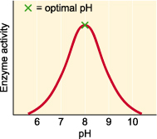
Enzymes are affected by changes in pH. The most favorable pH value - the point where the enzyme is most active is known as the optimum pH.
Extremely high or low pH values generally result in complete loss of activity for most enzymes. pH is also a factor in the stability of enzymes. As with activity, for each enzyme there is also a region of pH optimal stability.

Slide 3
Optimum pH:is the pH at which the rate of reaction is maximum.
At higher or lower pH, the rate of an enzymatic reaction decrease.
For most enzymes, the optimum pH lies in the range from pH 5 to pH 9
The bell shape of pH activity curve is resulted from the following factors:
Enzyme denaturation at extremely high or low pH
Effects on the charged state of the substrate or enzyme.

Slide 4
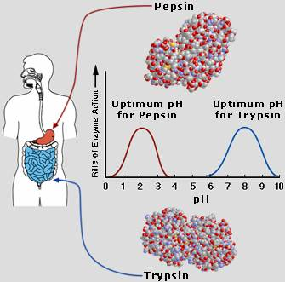
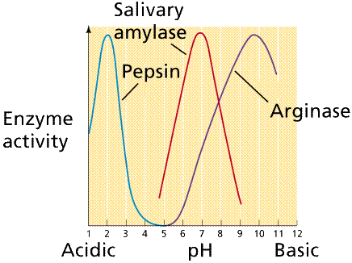
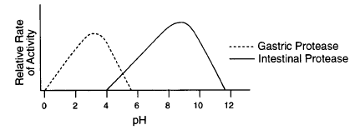
Different Enzymes with Different optimum PH

Slide 5
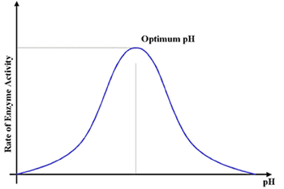
For the majority of enzymes, the relationship between the rate of an enzymatic reaction and pH takes form of a bell-shape.

Slide 6
Objective
a)To establish the relationship between pH and the rate of an enzyme catalyzed reaction.
b) To determine the optimum pH for β-Fructofuranosidase enzyme.

Slide 7
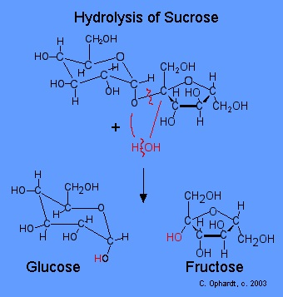
Principle
Within acidic environment using acetate buffer (PH= 4.7) β-fructofuranosidase enzyme cleavage its substrate (Sucrose) non reducing sugar to mixture of reducing sugar glucose and fructose, using 3,5,dinitrocylislic acid .

Slide 8
Material
Solutions :-
0.05M Sodium Acetate buffer , pH 4.7 .
0.18 M Sucrose ,
Reducing sugar (0.005M glucose + 0.005M fructose)
Beta Fructofuranosidase (Invertase ) enzyme extract from yeast.
DNS (dinitrosalicylicacid )Reagent .
Sodium Bicarbonate .

Slide 9
Method:
1- Prepare 6 tubes of different by following the table provided. ( 1 ) :
Tube | Buffer 1.0 (ml) | Sucrose (ml)
A | pH 3.0 | 2.0
Blank A | pH 3.0 | 2.0
B | pH 4.7 | 2.0
Blank B | pH 4.7 | 2.0
C | pH 7.0 | 2.0
Blank C | pH 7.0 | 2.0
D | pH 8.0 | 2.0
Blank D | pH 8.0 | 2.0
E | pH 12.0 | 2.0
Blank E | pH12.0 | 2.0
Table (1).

Slide 10
2- Mix each tube properly then incubate all tubes at 40˚C for 5min .
3- Start the reaction by adding 0.05ml of diluted enzyme to all test tubes tubes except for the blanks add 0.05ml of distilled water instead , mix and start the stop clock immediately , incubate each tube for 10min , then stop the reaction by adding 2.0ml of the DNS reagent to each tube and mix well .(follow table 2 for adding enzyme and DNS to tubes ) .
Note : Mix each tube frequently during the incubation time .

Slide 11
Method:
Tube | Start Time (min) | Stop by adding 2.0ml DNS . (min)
Blank A | 0 | 10
Blank B | 1.0 | 11
Blank C | 2.0 | 12
Blank D | 3.0 | 13
Blank E | 4.0 | 14
A | 5.0 | 15
B | 6.0 | 16
C | 7.0 | 17
D | 8.0 | 18
E | 9.0 | 19
Table(2)

Slide 12
Method:
4- Mix properly , cover each tube by aluminum foil and place in a boiling water bath for 5min to allow the color to develop .
5- Remove from water bath cool under tap water , add 20ml of distilled water to each tube , mix properly then measure the absorbance at 540nm .
6- Record the absorbance of each test tube in the following table ( 3 ),
7- Convert the Absorbance reading obtained to micromoles of sucrose hydrolyzed making use of the standard reducing sugars calibration curve , determine the initial velocity v_{i} for each tube and record all in table 3 .
8- Obtain the relationship between the initial velocity v_{i} and pH , by drawing a graph between the initial velocity v_{i} and pH . Determine the optimum pH for your enzymatic reaction reaction.

Slide 13
Result
Plot velocity against PH value. Describe the shape of this curve and discuss the reasons for its shape.
Tube | Absorbance 540nm | µmoles of sucrose hydrolyzed | µmoles of sucrose hydrolyzed/min(vi)
A
B
C
D
E
Table (3)

Slide 14
Discussion
Comment on the curve shape and conclude the relationship between PH value and the rate of an enzyme catalyzed reaction.

Slide 15
Thank You

