Slide 1
Medical Terminology
Dr. Malak Qattan

Slide 2
Course Policies
Attendance is MANDATORY.
You must bring your notebook and take lecture notes.
Studying by medical dictionary will make this subject easier.
You are responsible for all notes given in class. These notes are in addition to anything in the textbook.

Slide 3
Course Objectives
Apply basic principles of medical word building.
Correctly pronounce medical terms.
Define common medical terms.
Relate common medical terms to human anatomy and physiology; common disease states, and diagnostic tests.
Identify the medical terminology in medical record reports.

Slide 4
Course outlines
1. Basic Elements of a Medical Word
2. Gastrointestinal System
3. Respiratory System
4. Cardiovascular System
5. Musculoskeletal System
6. Urinary System
7. Female and male Reproductive System

Slide 5
Page 7
Define Medical Terminology?
Medical terminology is a special vocabulary used by health care professionals for effective and accurate communication. Because it is based mainly on Greek and Latin words, medical terminology is consistent and uniform throughout the world.

Slide 6
Page 7
Medical terminology word Parts or words elements
Words are formed from roots, prefixes, and suffixes.
1) Word Root:
The fundamental unit of each medical word. This establishes the basic meaning of the word and is the part to which modifying prefixes and suffixes are added.
2) A suffix:
Is a short word part or series of parts added at the end of a root to modify its meaning., such as -itis.
3) A prefix:
Is a short word part added before a root to modify its meaning., such as pre.
4) Combining Forms:
When a suffix beginning with a consonant is added to a root, a vowel (usually an o) is inserted between the root and the suffix to aid in pronunciation.
A combining vowel may be added between a root and a suffix.

Slide 7
Page 8
An Example
-Thus, when the suffix –logy, meaning “study of,” is added to the root neur, meaning “nerve or nervous system,”
a combining vowel is added:
neur + o + logy = neurology (study of the nervous system)
Note: A combining vowel usually is not used if the ending begins with a vowel.
The root neur is combined with the suffix -itis, meaning “inflammation of,” in this way:
neur + itis = neuritis (inflammation of a nerve)
There are some exceptions to this rule, particularly when pronunciation or meaning is affected.

Slide 8
Page 9
combining vowel
A combining vowel is an important connector between the root to aid in pronunciation and it is comes to link the root to the suffix or to the other root.
A combining vowel is usually the letter (O) , which has no meaning of its own
It is not used if the ending ( suffix) begins with a vowel as in neuritis .
Combining Form
Is the combination of word root with the combining vowel ( o ) .
Example :
Cardi / o is a combining form consists of cardio with h means heart , and the combining vowel ( o ) .

Slide 9
Page 11
Suffixes
A suffix is a word ending that modifies a root. A suffix may indicate that the word is a noun or an adjective and often determines how the definition of the word will begin.
For example, using the root myel/o, meaning “bone marrow,”
-the adjective ending -oid forms the word myeloid, which means
“like or pertaining to bone marrow.”
-The ending -oma produces myeloma, which is a tumor of the bone marrow.
-Adding another root, gen, which represents genesis or origin and the adjective ending -ous forms the word myelogenous, meaning “originating in bone marrow.”

Slide 10
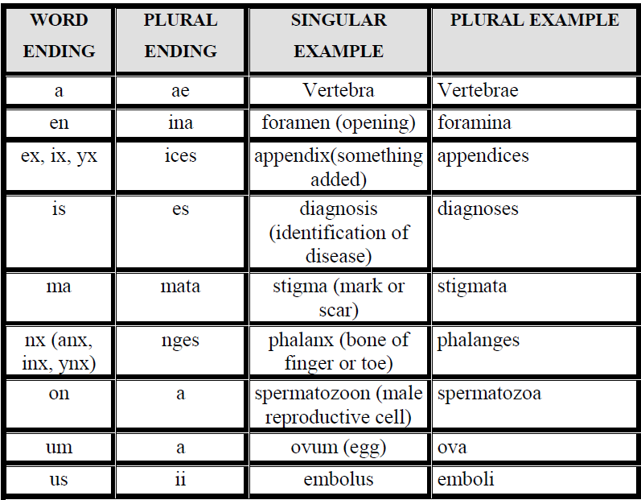
Page 14
Plural Endings:

