Slide 1
Chapter 7 The Lympathtic System
Abdullah A. Alrumayh
BSc EMS, MSc Cardiovascular, Lecturer
Department of Basic Sciences, PSCEMS
http://fac.ksu.edu.sa/aalrumayh

Slide 2
Learning Objectives
Describe the functions of the lymphatic system.
Describe the system of lymph vessels and explain how lymph is returned to the blood.
State how lymph is formed.
State the location and function of lymph nodes, the thymus, and the spleen.
Explain the role of the thymus in immunity.

Slide 3
Learning Objectives
Define immunity.
Explain the differences between humoral response and cellular immune response.
Compare and contrast the development and function of B cells and T cells.
Describe the differences between active and passive immunity.

Slide 4
Learning Objectives
List the five types of immunoglobulins and explain which type is important in the activation of B cells.
Differentiate between primary and secondary immune responses.
Explain how vaccines work.
Define infectious disease.

Slide 5
Learning Objectives
Name some important infectious diseases found in prehospital care.
Explain how microorganisms are named and classified.
Describe the distribution of and the benefits of normal flora.
List different methods by which infectious diseases are spread.

Slide 6
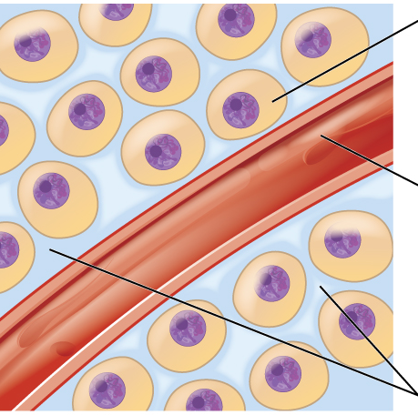
Introduction
Transports fluids through a network of vessels
Primary function is production, maintenance, and distribution of lymphocytes > immune function
Also transports excess fluid out of interstitial spaces > CVS function

Slide 7
Introduction
Lacteals
Special lymphatic capillaries
Located in the small intestine’s lining
Absorb digested fats and carry them to the venous circulation
Biochemicals and cells of the lymphatic system attack foreign particles in the body.

Slide 8
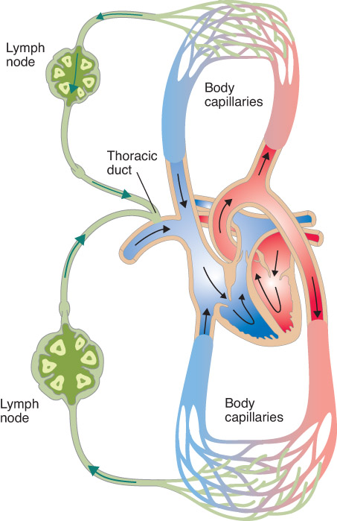
Introduction

Slide 9
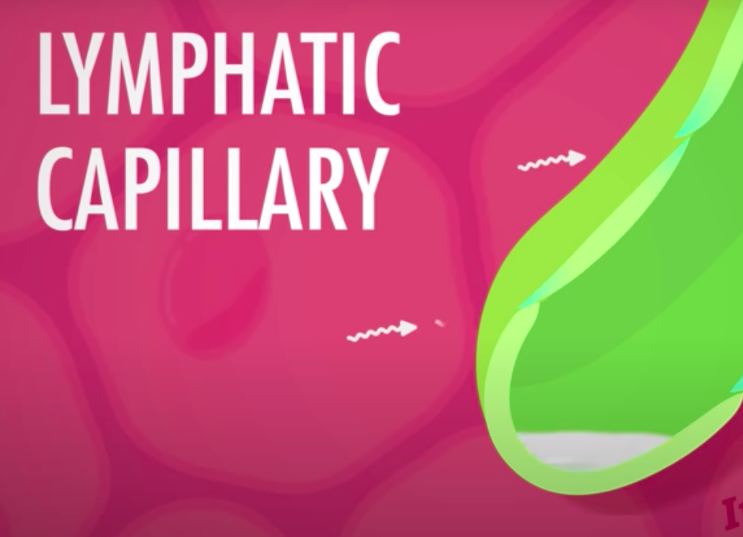
Lymphatic Vessels
Only carry fluid away from the tissues
Lymphatic pathways
Tiny tubes formed by lymphatic capillaries
Microscopic lymphatic capillaries extend into interstitial spaces in complex networks.
Lymph
The fluid inside these capillaries

Slide 10
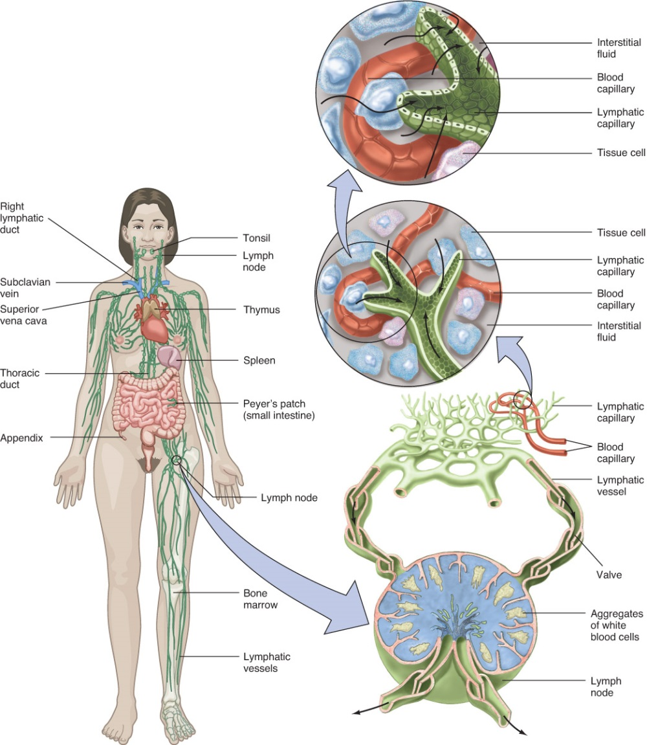
Lymphatic Vessels
Have valves to prevent backflow of lymph
Lymph nodes
Lymphatic trunks drain into one of two collecting ducts:
Thoracic duct
Right lymphatic duct
Lymph then moves into the venous system, becoming part of the plasma.

Slide 11
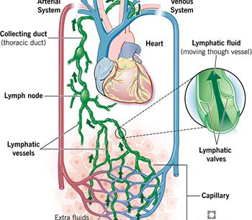
Tissue Fluid & Lymph Formation
Lymph
Thin, plasma-like fluid formed from interstitial or extracellular fluid
Basically the same as tissue fluid
Referred to as lymph once it enters a lymphatic capillary
Lymph also carries foreign particles (including bacteria and viruses) to the lymph nodes.

Slide 12
Movement of Lymph
Influenced by muscular activity > SMC
Lymph is under low hydrostatic pressure.
Continuous movement of lymph stabilizes fluid volume in the body’s interstitial spaces. > Otherwise swelling

Slide 13
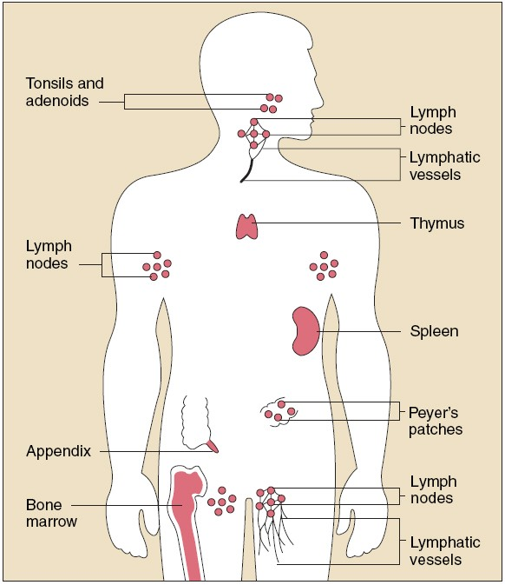
Lymph Nodes
Found along the lymphatic pathways
Bean-shaped, 2.5 cm long
Contain many lymphocytes and macrophages
Fight invading microorganisms
Hilum
Indented region where blood vessels and nerves are attached
Capsule
Protective membrane that surrounds each lymph node

Slide 14
Lymph Nodes
Lymph nodules – functional units
Denser arrangements of lymphoid tissue
Found in digestive, respiratory, and urinary systems
Major collections of lymph nodes:
Axillary nodes
Cervical nodes
Inguinal nodes (Groin)

Slide 15
Mucosa-associated lymphoid tissues (MALTs)
Found in the mucous membrane outside the lymphotic vessels
Tonsils is one of the largest collection of these tissue.
Peyer’s patches too, which is located in the distal portion of the small intestine.
Appendix destroy any remaining bacteria before it breach the intistinal wall.

Slide 16
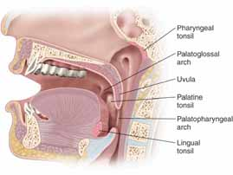
Tonsils
Protect the body from bacteria introduced through the nose and mouth
Comprised of three sets of lymphatic organs
Palatine tonsils
Pharyngeal tonsils
Lingual tonsils

Slide 17
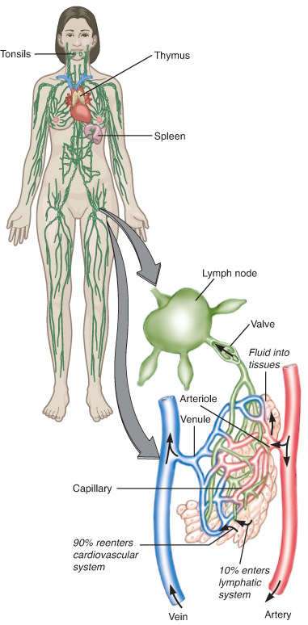
Lymph Organs: Lymph Nodes
Two functions:
Filter
Monitor
Lymphocytes
Macrophages

Slide 18
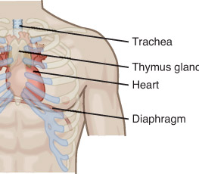
The Thymus
Produces lymphocytes
Plays a major role in immunity
Divided into lobules
Lymphocytes
Thymocytes
T lymphocytes

Slide 19
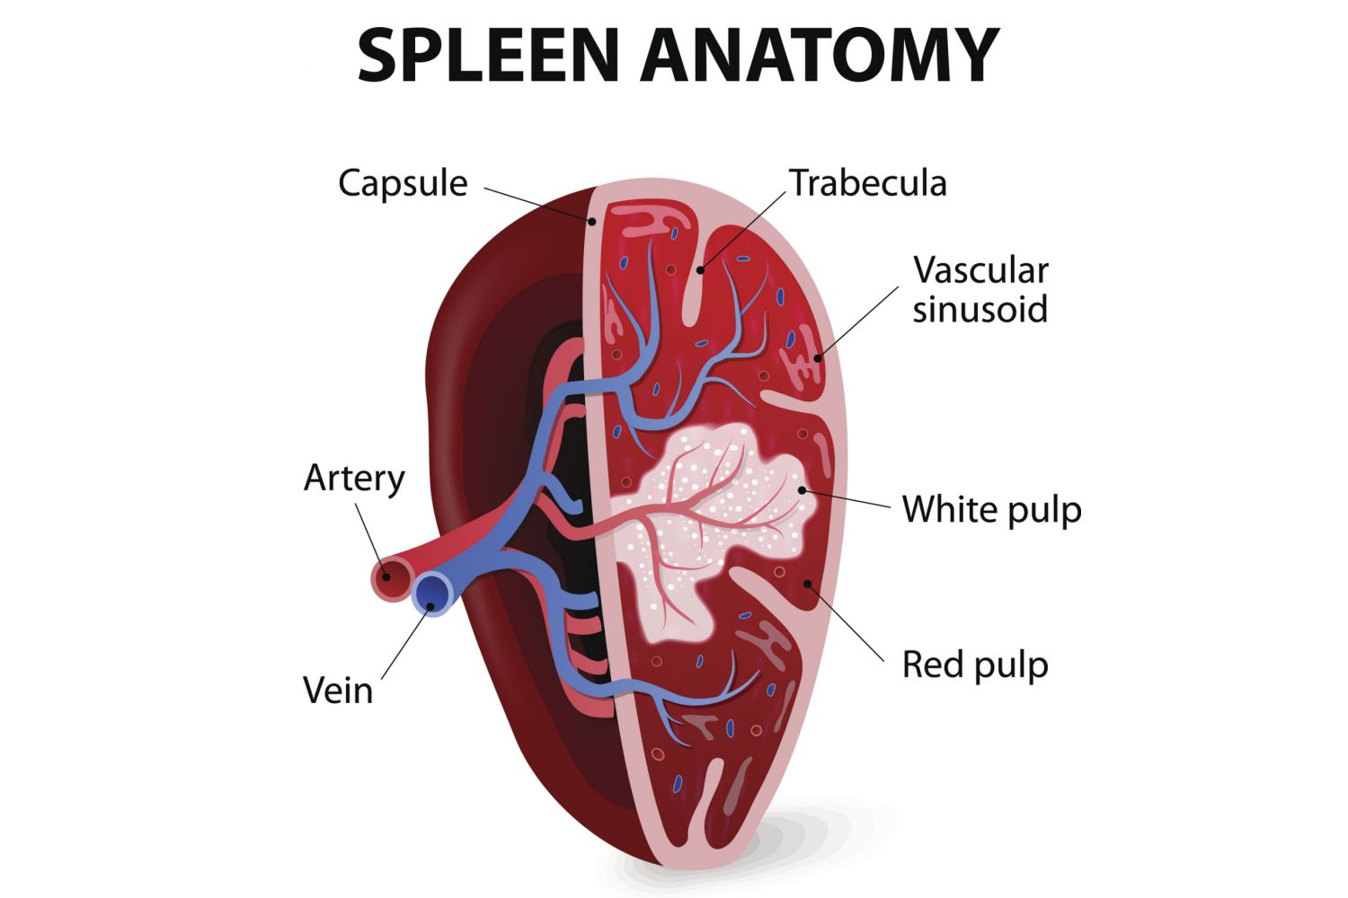
The Spleen
Consists of two types of lymph tissue: red pulp and white pulp
White pulp (lymphatic tissue)
Red pulp (venous sinuses)
Virtually all blood in the body is filtered through splenic tissue.

Slide 20
Immune System
Responsible for providing immunity
Immunity
Ability to resist damage from foreign substances or harmful chemicals
Integrally related to the lymphatic system
Infection may be caused by:
Virus
Bacterium
Fungus
Protozoan

Slide 21
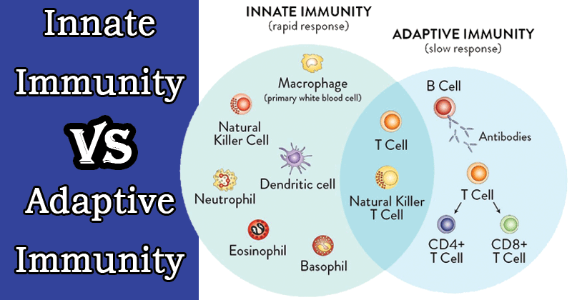
Immune System
Two general categories:
Innate (nonspecific)
Defends against many types of pathogens
Present at birth
Adaptive (specific)
Target specific pathogens

Slide 22
Innate Immunity
Prevent or limit microorganisms and other environmental hazards from approaching, entering, or spreading
Mechanical barriers – skin, mucous, hair
Chemical barriers – provided by enzymes

Slide 23
Innate Immunity
Inflammation
Inflammatory response - Results in the influx of cells and other chemicals that fight the foreign challenge
Chemicals that promote inflammation include:
Histamine
Kinins
Complement
Prostaglandins
Leukotrienes

Slide 24
Innate Immunity
Immunologic surveillance
NK cells monitor, recognize, and destroy abnormal cells.
Phagocytosis
Injured tissues attract neutrophils and monocytes, which engulf and digest particles.
Monocytes influence development of macrophages.
Species resistance
Humans may be resistant to diseases that affect other species (and vice versa).

Slide 25
Immunity (Specific Defenses)
Third line of defense
Resistance to specific pathogens or their toxins and metabolic byproducts
Body is able to recognize, respond to, and remember a particular substance.
Antigens (or allergens)
Substances that are foreign to the body

Slide 26
Immunity (Specific Defenses)
T lymphocytes (T cells)
Specialized from lymphocyte precursors released by red bone marrow before birth
Later make up between 70% and 80% of circulated blood lymphocytes
Others exist in lymphatic organs
Others remain in the red bone marrow

Slide 27
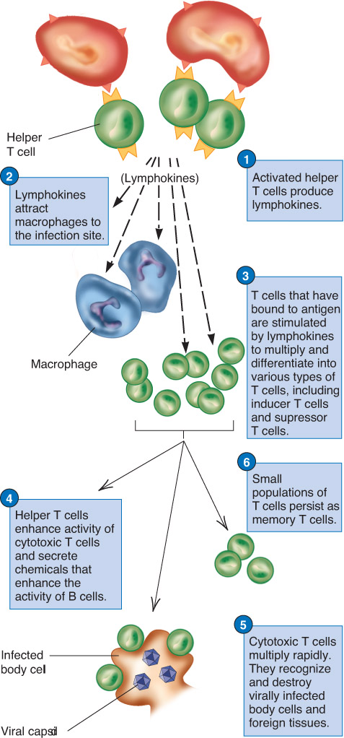
Immunity (Specific Defenses)
Cell-mediated immunity
T lymphocytes (T cells)
Create lymphokines
Interleukin-1 and -2 stimulate synthesis of cytokines

Slide 28
Immunity (Specific Defenses)
Before a lymphocyte can respond to an antigen, it must be activated.
Occurs through the presence of processed antigen fragments attached to the surface of an antigen-presenting cell.
Macrophages
B Cells
Other types of cells

Slide 29
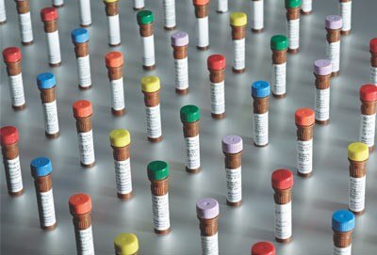
Immunity (Specific Defenses)
Antibody-mediated immunity
Antibodies are produced by B lymphocytes (B cells)
Classes of antibodies:
IgG
Very effective against bacteria, viruses, and toxins.
IgA
In exocrine gland secretions, breast milk, tears, nasal fluid, gastric juice, etc.
IgM
First antibody to be produced in response to inflection
IgD
Important in the activation of B cells
IgE
Involved in allergic reactions

Slide 30
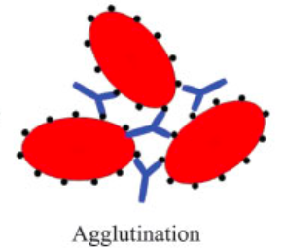
Immunity (Specific Defenses)
Antibodies
Attack antigens directly
Combine with antigens
Agglutination
Precipitation
Phagocytosis

Slide 31
Immunity (Specific Defenses)
Primary immune response
Constituted by activation of B cells or T cells
Secondary immune response
Some B cells remain as memory cells.

Slide 32
Immunity (Specific Defenses)
Adaptive (acquired) Immunity
Caused by natural events or administration
May be active or passive
Passive – patient receives antibodies produced by another person
Active – occurs as a result of exposure to a pathogen
Vaccine
Tissue rejection reaction
A transplanted body part is attacked by the receiving patient’s immune system.
Autoimmunity
The immune system fails to distinguish self from nonself.

Slide 33
Infectious Disease
Transmitted from one person to another via a specific microscopic organism
Most frequent infectious diseases seen in prehospital care are serious infections such as pneumonia and hepatitis.
E.g. Hepatitis and TB (FYI)

Slide 34
Disease Transmission
Common modes of disease transmission
Airborne transmission
Body substance
Injection
Needle
Foreign body (e.g., a splinter or needle)
Bites and stings
Oral transmission

Slide 35
Disease-causing Microscopic Agents
Known infectious agents include:
Bacteria – TB and plaque
Viruses – Covid and HIV
Fungi (mushrooms)
Protozoans – Malaria
Nematodes (worm)

Slide 36
Normal Flora
Bacteria that colonize certain body sites to maintain homeostasis
Escherichia coli (E coli)
Located in the GI tract
Certain types may cause serious diseases
Essential in the metabolism of waste products
Colonize the oral and nasal cavities

Slide 37
Ref.
Lymphatic System
https://www.youtube.com/watch?v=I7orwMgTQ5I
https://www.kinderkrebsinfo.de/diseases/lymphomas/the_lymphatic_system/index_eng.html
Immune System
https://www.youtube.com/watch?v=GIJK3dwCWCw
https://www.youtube.com/watch?v=2DFN4IBZ3rI
https://www.youtube.com/watch?v=rd2cf5hValM

