Slide 1
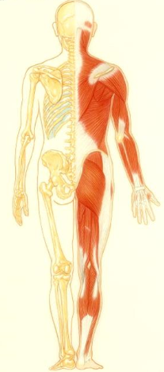
Musculoskeletal System
Dr. Malak Qattan

Slide 2
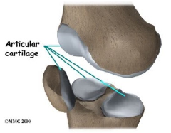
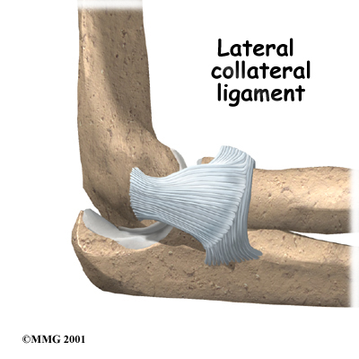
Musculoskeletal System
The Musculoskeletal System consists of :
Bones
Joints
Ligaments
Cartilage
Muscles

Slide 3
Musculoskeletal System
MUSCULOSKELETAL = two words musculo + sketetal
musculo- = means muscles
-sketetal = means skeleton (Bones) 206 bones
Muscles
Skeleton

Slide 4
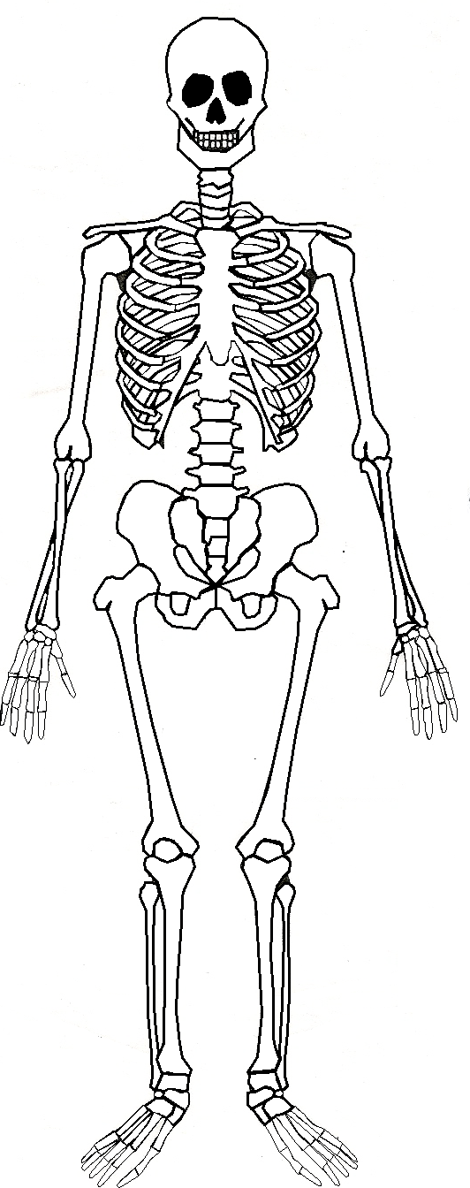
Skeleton Function
Support
Supports the body
Provides framework for the body
Gives shape to the body
Protection
Protects vital organs
Protects soft tissues
Movement
Provides locomotion (walking, movement) by
attachment of muscles, tendons, and ligaments
Hematopoiesis
Produces red blood cells
Produces white blood cells
Produces platelets
Storage
Provides calcium
Provides phosphorus
SKELETON

Slide 5
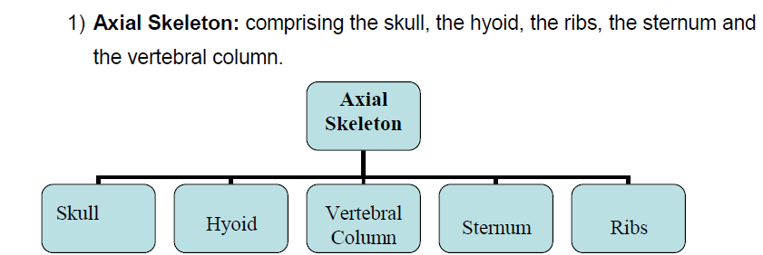
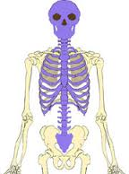
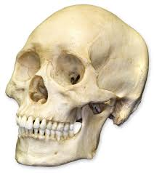
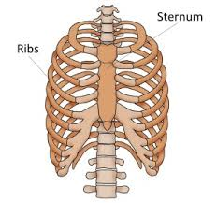
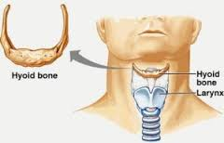
The skeletal system divided into:

Slide 6
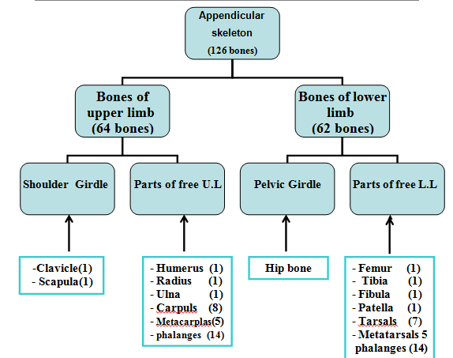
2) Appendicular Skeleton: Consists of bones of the limb girdles and limbs.

Slide 7
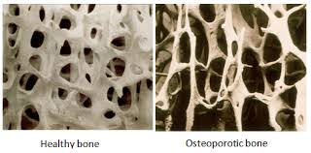
1. Osteoporosis
Diseases and Disorders of the bones
Metabolic disorder of bones
Less bone mineral (calcium) than normal
Over 10 million in US affected
Post-menopausal females most commonly
Bones are brittle, porous, easily broken
More prone to pathological fracture

Slide 8
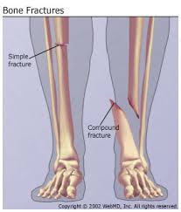
2. Fractures
Diseases and Disorders of the bones
is a break in the continuity of the bone.
Caused by high force stress
Closed/simple
Open/compound

