Slide 1
Chapter 8 The Nervous System
Abdullah A. Alrumayh
BSc EMS, MSc Cardiovascular, Lecturer
Department of Basic Sciences, PSCEMS
http://fac.ksu.edu.sa/aalrumayh

Slide 2
Learning Objectives
Name the anatomic and functional divisions of the nervous system.
Name the parts of a neuron and the function of each.
Describe the types of neurons, nerves, and nerve tracts.
Explain the importance of Schwann cells in the peripheral nervous system and neuroglia in the central nervous system.
Describe the electrical nerve impulse and impulse transmission at the synapse.

Slide 3
Learning Objectives
Name the meninges and point out their locations on a diagram.
State the functions of cerebrospinal fluid.
Name the cranial nerves.
Distinguish between the sympathetic and parasympathetic divisions of the autonomic nervous system.
State the functions of the parts of the brain and locate each part on a diagram.
Explain the importance of stretch reflexes, flexor reflexes, and a reflex arc.

Slide 4
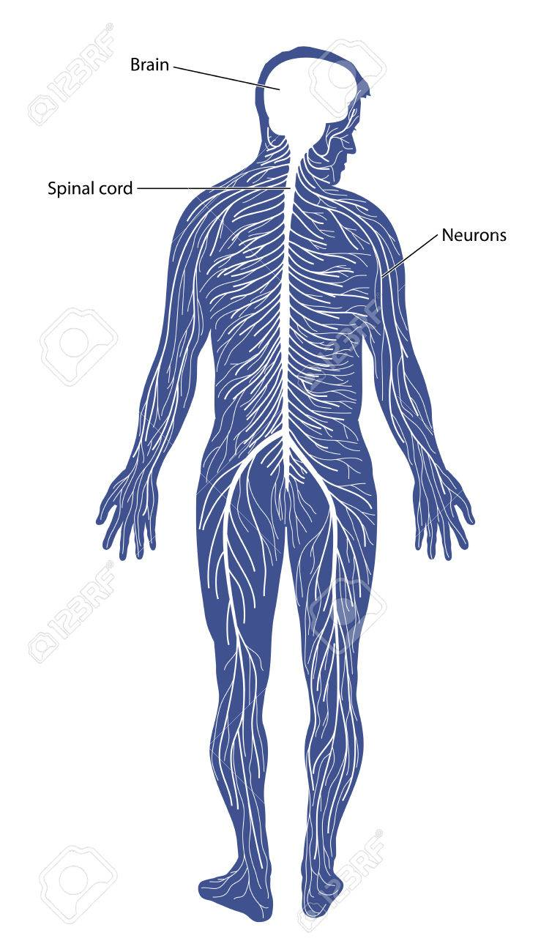
Introduction
The nervous system is a complex array of structures that help the body function.
Two major structures:
The brain – Command Center
The spinal cord - Pathway for messages
Is responsible for fundamental functions and higher level activity

Slide 5
Introduction
The nervous system is divided into two main portions:
The central nervous system (CNS)
The peripheral nervous system
Somatic nervous system
Regulates systems over which there is voluntary control
Autonomic nervous system (ANS)
Controls body functions that occur without voluntary control

Slide 6
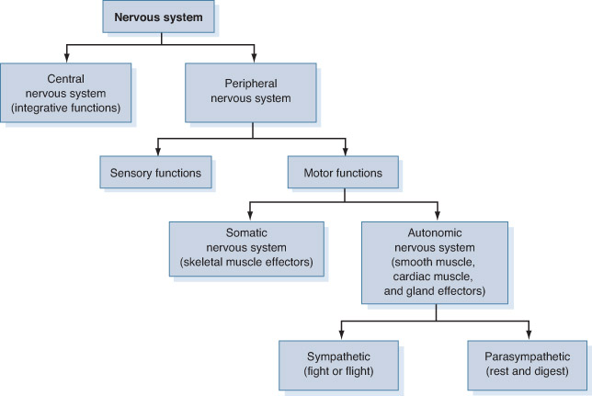

Slide 7
The Nervous System
Nerve
Formed by groups of nerve fibers
Nerve fiber
Groups of neurons that are bundled together
Neural tissue contains two basic types of cells:
Neurons
Axons
Dendrites
Neuroglia

Slide 8
Neuroglia
Supporting cells that have four basic functions:
Provide a supporting skeleton for neural tissue
Isolate and protect the cell membranes of neurons
Regulate the composition of interstitial fluid
Defend neural tissue from pathogens and aid in the repair of injury

Slide 9
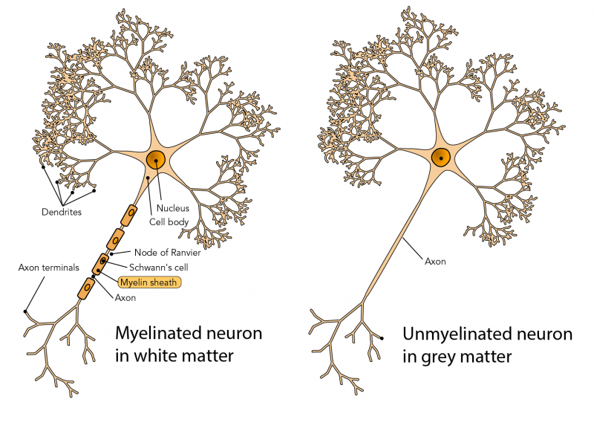
Myelin Sheath
Axons may or may not be surrounded by a membrane sheath.
Unmyelinated axons
Action potential electrical signals propagate along the entire axon membrane.
Myelinated nerves
Membrane is formed by Schwann cells
Nodes of Ranvier
Regions between the Schwann cells
Action potential
Jumps between the Nodes of Ranvier

Slide 10
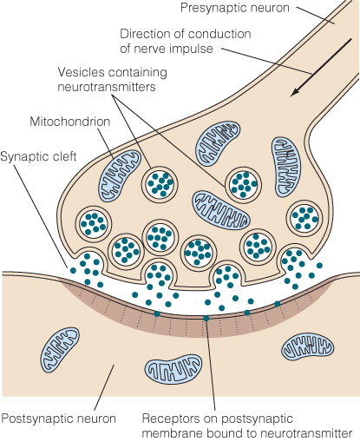
Transmission of Electrical Impulses
Synapse
Gap between nerve cells that consists of a terminal bouton or other type of axon terminal, the synaptic cleft, and the membrane of the postsynaptic cell.
Presynaptic terminal
End of a neuron where neurotransmitters are released from synaptic vesicles into the synaptic cleft.
Synaptic cleft
The space between neurons
Postsynaptic terminal
Beginning of a neighboring neuron, opposite the presynaptic terminal, and across the synaptic cleft

Slide 11
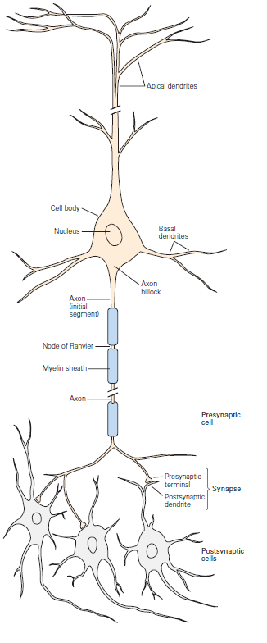
Electrical impulses travel down
Neurons
Trigger the release of neurotransmitters
Synaptic Cleft
Stimulate an electrical reaction

Slide 12
Transmission of Electrical Impulses
Neurotransmitters
Chemicals released from neurons that stimulate electrical reactions in adjacent neurons
Synaptic vesicles
Vesicles that contain neurotransmitters

Slide 13
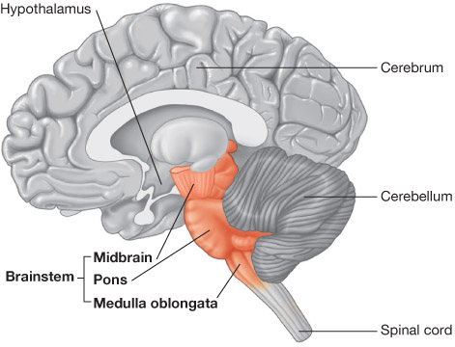
Brain
Located within the cranial cavity
Major regions:
Cerebrum
Diencephalon
Cerebellum
Brainstem

Slide 14
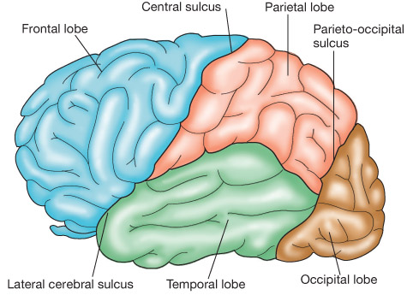
The Cerebrum
Largest portion of the brain
Controls the higher thought processes
Divided into right and left hemispheres, or halves, by a longitudinal fissure

Slide 15
The Cerebrum
Longitudinal fissure
Crevasse that separates the right and left hemispheres of the cerebrum
Gyri
Numerous folds that greatly increase the surface area of the cortex
Sulci
Grooves located between the gyri

Slide 16
The Cerebrum
Lobes
Subdivisions located within each hemisphere
Frontal lobe
Important in voluntary motor action, as well as personality traits
Parietal lobe
Site for reception and evaluation of some sensory information
Separated from the frontal lobe by the central sulcus
Occipital lobe
Responsible for the processing of visual information
Temporal lobe
Plays an important role in hearing and memory
Separated from the rest of the cerebrum by a lateral fissure

Slide 17
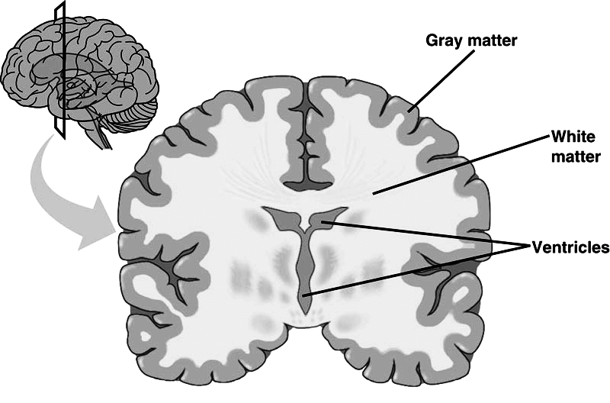
The Cerebrum
Cerebral cortex
Thin layer of gray matter comprising the outer portion of the cerebrum
Contains about 75% of all the neuron cell bodies of the nervous system
Covers the white matter that comprises most of the cerebrum

Slide 18
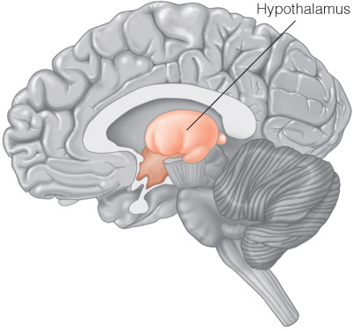
The Diencephalon
The part of the brain between the brain stem and the cerebrum
Includes:
Thalamus - Processes most sensory input and influences mood and general body movements
Subthalamus - Involved in controlling motor functions
Epithalamus - Involved in control of emotions, circadian rhythms, and connecting the limbic system with the rest of the brain
Hypothalamus - Most inferior portion of the diencephalon
involved in different daily activities like eating or drinking, in the control of the body's temperature and energy maintenance, and in the process of memorizing and in stress control.
Notes:
Hypothalamus: involved in different daily activities like eating or drinking, in the control of the body's temperature and energy maintenance, and in the process of memorizing and in stress control.

Slide 19
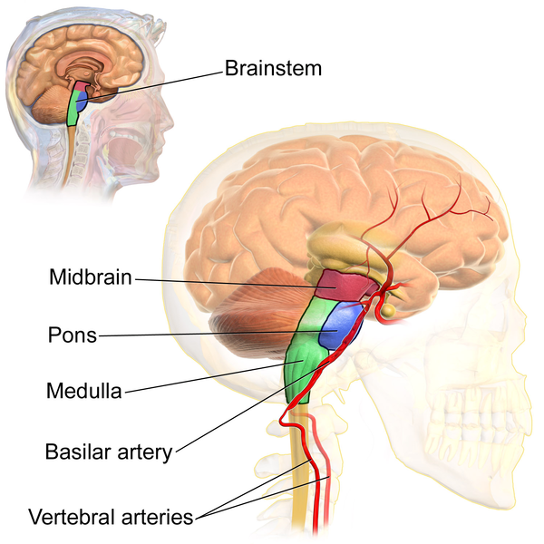
The Brainstem
Consists of:
Midbrain
Lies immediately below the diencephalon
Smallest region of the brain stem
Basal ganglia - linked to the thalamus in the base of the brain and involved in coordination of movement.

Slide 20
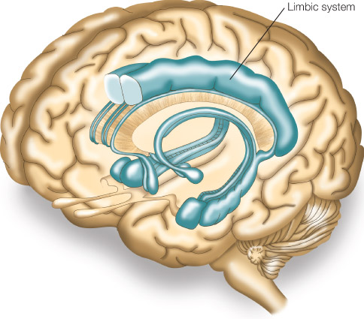
The Brainstem
Limbic system – parts of the cerebrum and diencephalon
Includes structures that influence:
Emotions
Motivation
Mood
Sensations of pain and pleasure

Slide 21
The Brainstem
Pons
Lies below the midbrain and above the medulla
Contains numerous important nerve fibers and the medullary respiratory center
Medulla
The inferior portion of the midbrain that is continuous inferiorly with the spinal cord
Serves as a conduction pathway for both ascending and descending nerve tracts
The pons and medullary respiratory center are responsible for all respiratory movements.

Slide 22
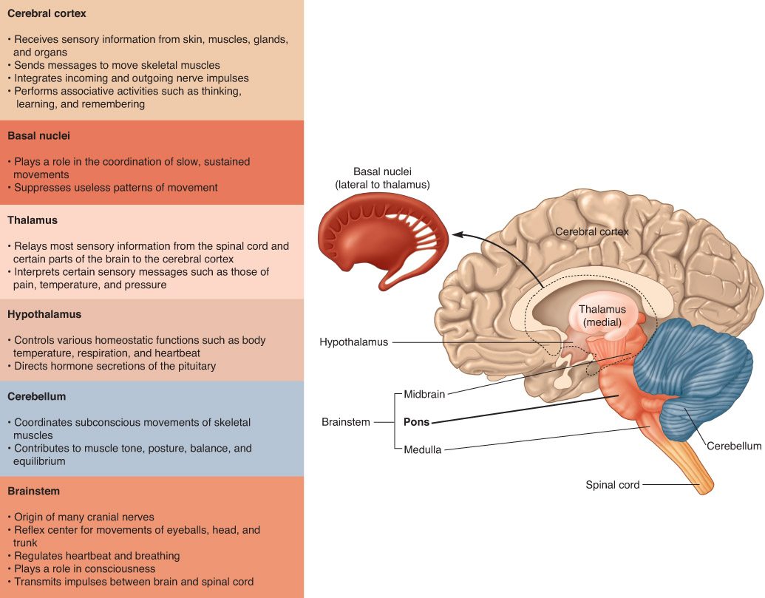
The Brainstem

Slide 23
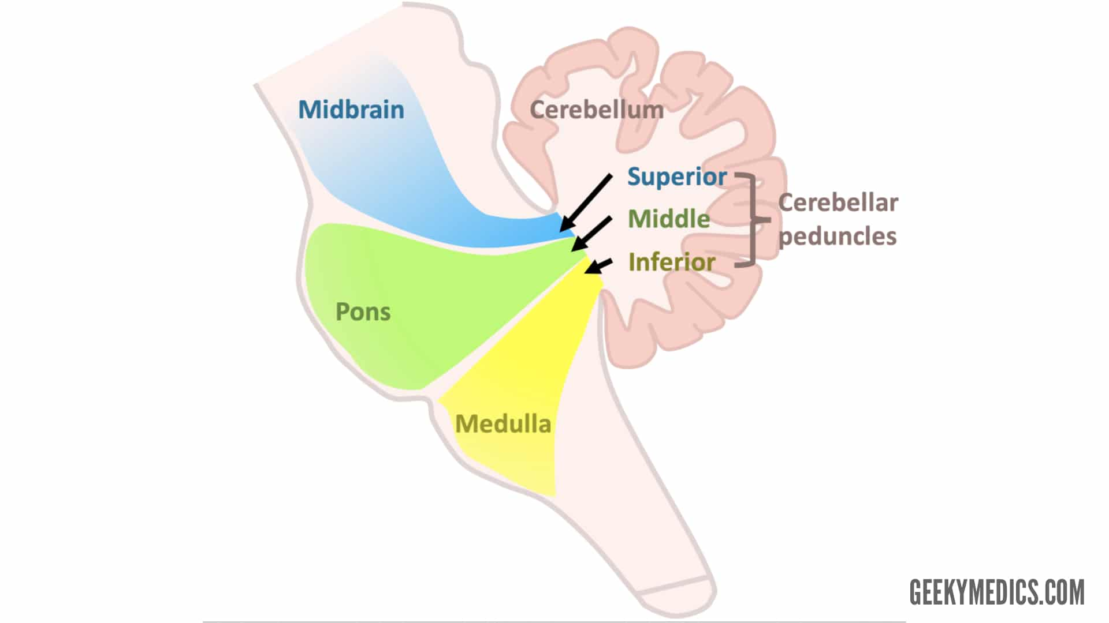
The Cerebellum
Communicates with the other regions of the CNS through the cerebellar peduncles
Cerebellar peduncles
A set of three bands of nerve fibers
Essential in coordinating muscle movements of the body
Necessary for proper balance and movement

Slide 24
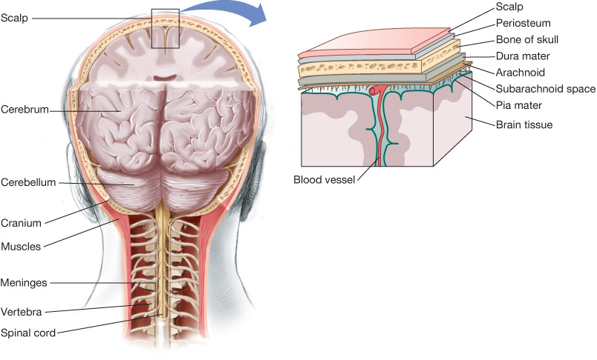
The Meninges
A set of three tough membranes that enclose the entire CNS

Slide 25
The Meninges
Dura mater
Outer and toughest membrane that carrying blood from the brain toward the heart
Arachnoid
Second layer with many blood vessels that make it appear like a spider web
helps protect the brain and spinal cord from sudden impact.
Pia mater
Inner layer resting directly on the brain
protect the CNS by containing the cerebrospinal fluid
Cerebrospinal fluid (CSF)
Fluid in which the meninges float; it is manufactured in the ventricles of the brain and flows in the subarachnoid space. protection, nourishment, and waste removal
Subarachnoid space
Located between the pia mater and the arachnoid mater

Slide 26
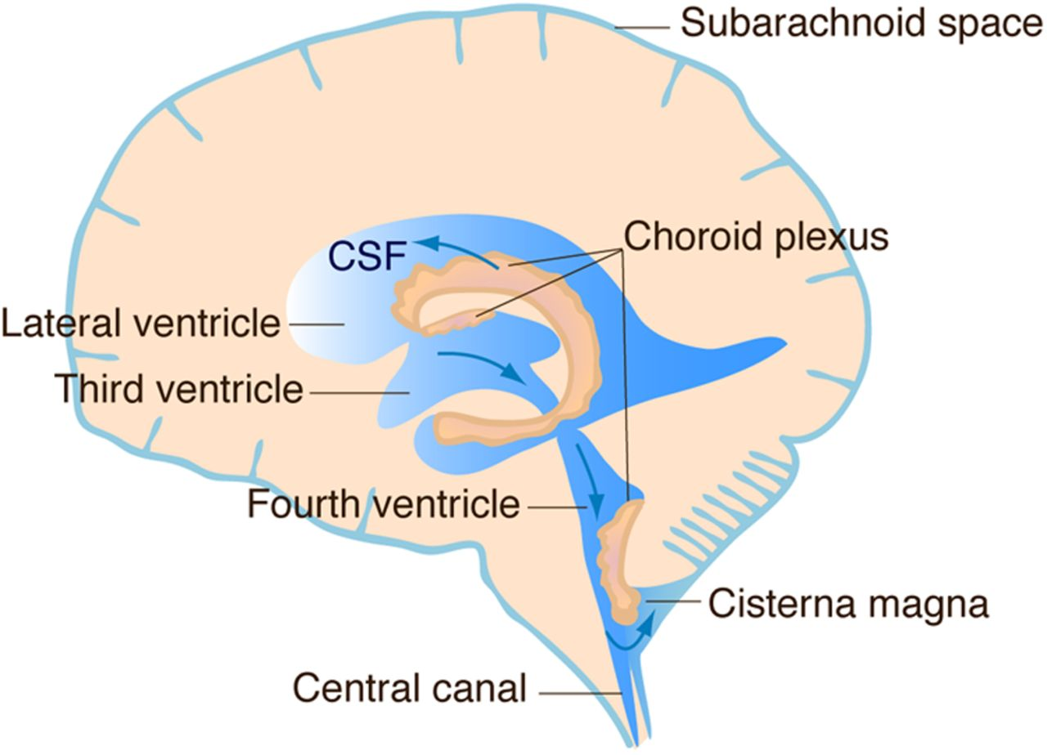
The Meninges
Choroid plexus
Specialized cells within hollow areas in the ventricles of the brain that produce CSF
Ventricles
Specialized hollow areas in the brain
The ventricles of the brain are a communicating network of cavities filled with cerebrospinal fluid (CSF) and located within the brain parenchyma
Meninges and CSF form a fluid-filled sac that cushions and protects the brain and spinal cord.

Slide 27
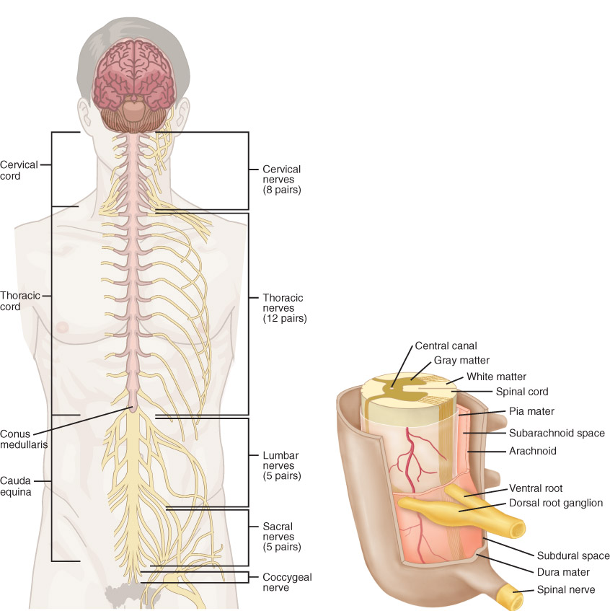
Spinal Cord
Located at the base of the brain
Composed of bundles of nerve fibers
Primary function of the spinal cord is to transmit messages between the brain and the body.
Spinal nerves arise from each of its 31 segments.

Slide 28
Spinal Cord
Cervical enlargement
Supplies nerves to the upper limbs
Lumbar enlargement
Supplies nerves to the lower limbs

Slide 29
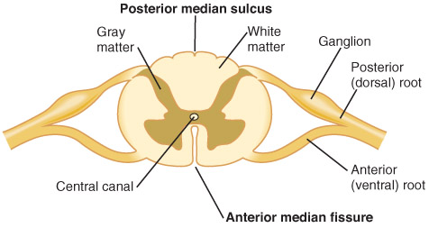
Spinal Cord
Divided into right and left halves by a deep anterior median fissure and a shallow posterior median fissure

Slide 30
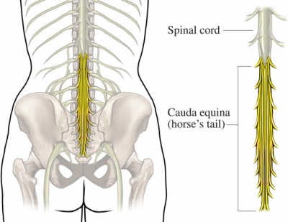
Spinal Cord
Extends to the level of the second lumbar vertebra, where it gives rise to the cauda equina
Cauda equina
Numerous individual nerve roots that extend from the spinal cord at the level of the second lumbar vertebra
Vertebral canal
Bony canal formed by vertebrae that houses and protects the spinal cord

Slide 31
Spinal Cord
Tracts
Pathways within the spinal cord that contain nerve fibers
Ascending tracts
Carry sensory information for the periphery back to the brain
Descending tracts
Carry motor impulses from the brain to the fibers of the peripheral nervous system

Slide 32
Peripheral Nervous System
Consists of 31 pairs of nerves
Ganglia
Collections of nerve cell bodies located outside the CNS
Spinal nerves
Arise from numerous rootlets along the dorsal and ventral surfaces of the spinal cord

Slide 33
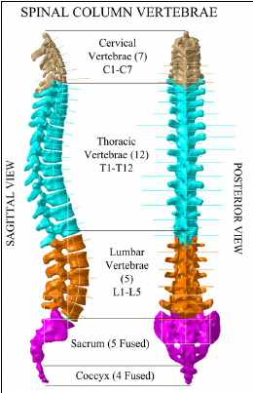
Peripheral Nervous System
Eight pairs of spinal nerves in the cervical region
Twelve in the thoracic region
Five in the lumbar region
Five in the sacral region
One in the coccygeal region
Numbered based on the vertebral level at which it exits the spinal canal (C1, T12)

Slide 34
Nerves of the Peripheral Nervous System
Made up of two types of nerves: sensory and motor nerves
Sensory nerves (afferent nerves)
Dermatome
Motor nerves (efferent nerves)
Neuromuscular junction

Slide 35
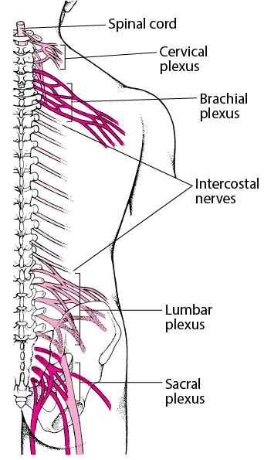
Plexus
An organized intermingling formed by several nerves
The plexuses are:
Cervical
Brachial
Lumbar
Sacral
Give rise to the peripheral nerves, which branch and eventually supply motor function and sensation to many areas of the body

Slide 36
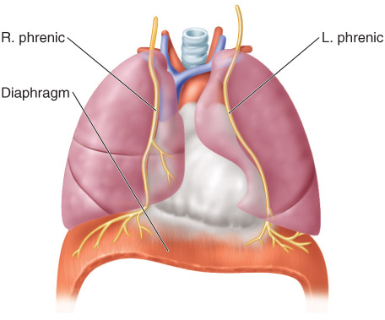
The Cervical Plexus
Innervates the neck and posterior portion of the head
Consists of spinal nerves C1 to C4
Conduct motor impulses to the diaphragm

Slide 37
The Brachial Plexus
Consists of spinal nerves C5 to T1
Major nerves emanating from the brachial plexus are:
Axillary
Radial
Median
Musculocutaneous
Ulnar

Slide 38
Axillary, Radial and Median Nerves
Axillary nerve
Supplies the deltoid and teres minor muscles, enabling arm abduction and lateral rotation
Innervates a small patch of skin on the lateral border of the proximal arm
Radial nerve
Supplies the muscles that extend the elbow, supinate the forearm, and extend the wrist, fingers, and thumb muscles
Median nerve
Supplies the pronator muscles of the forearm, as well as those that flex the wrist, the fingers, and the thumb

Slide 39
Musculocutaneous and ulnar Nerves
Musculocutaneous nerve
Innervates muscles that flex the shoulder and elbow
Provides sensation to the lateral surface of the forearm
Ulnar nerve
Innervates muscles that flex the wrist and fingers and abduct and adduct the fingers and thumb
Provides sensation to the medial one third of the hand, the little finger, and the medial one half of the ring finger

Slide 40
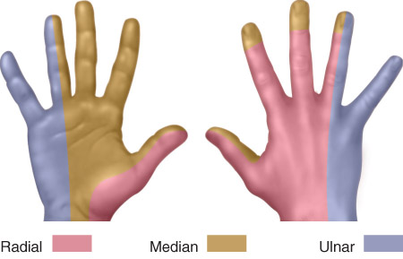
Sensory Distribution

Slide 41
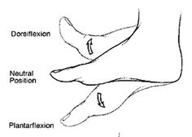
The Lumbosacral Plexus
Lumbar plexus – spinal nerves L1 to L4
Sacral plexus – spinal nerves L4 to S4
Four major nerves exit the lumbosacral plexus and supply the lower extremity:
Obturator – Adduction and sensation (upper part) of thigh
Femoral – Flex hip and extend the knee
Tibial – flex knee and toes, planter flex ankle + sensation to the foot
Common peroneal – sensation of knee skin of toes

Slide 42
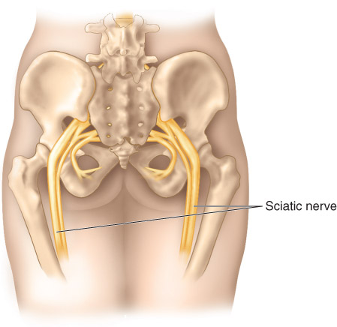
Sciatic Nerve
Sciatic nerve
Combination of the common peroneal and tibial nerves
Largest peripheral nerve in the body

Slide 43
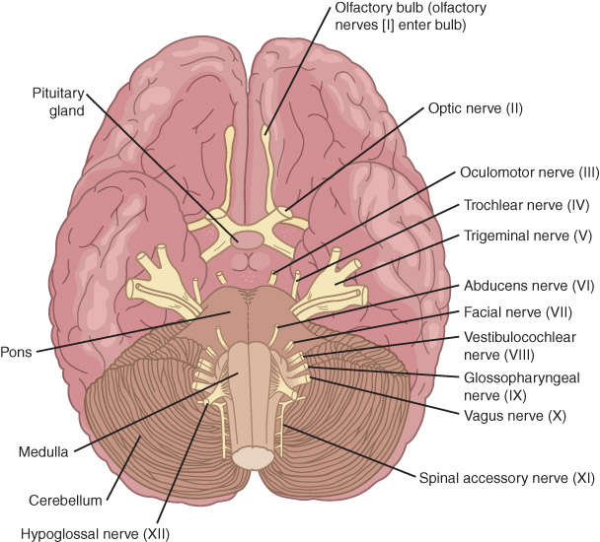
The Cranial Nerves
There are 12 pairs of cranial nerves
Arise from the base of the brain
All but two pairs, the olfactory nerves and the optic nerves, exit from the brainstem.

Slide 44
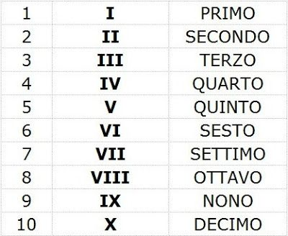
The Cranial Nerves
Cranial nerves carrying only sensory fibers:
I, II, and VIII
Cranial nerves carrying only motor fibers:
III, IV, VI, XI, and XII
Mixed nerves, carrying a combination of sensory fibers and motor fibers:
V, VII, IX, and X

Slide 45
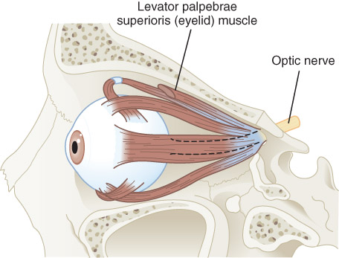
The Cranial Nerves
I – Olfactory – smell
II – Optic – vision
III – Oculomotor – movement of eye

Slide 46
The Cranial Nerves
IV – Trochlear - motor supply to the muscle of the eye
V – Trigeminal - sensation in the face and motor functions such as biting and chewing; it is the most complex of the cranial nerves
VI – Abducens - motor functions of the eye
VII – Facial - motor control of all of the muscles of facial expression

Slide 47
The Cranial Nerves
VIII – Vestibulocochlear - special sensation of hearing, and its vestibular portions are involved in balance, spatial sensation, and posture
IX – Glossopharyngeal - swallowing and the gag reflex
X – Vagus - regulation of internal organ functions (e.g. heart rate)
XI – Accessory - controls the movement of certain neck muscles
XII – Hypoglossal - tongue musculature

Slide 48
Autonomic Nervous System
Somatomotor division
Autonomic nervous system
Responsible for the "fight-or-flight" response
Sympathetic pathway
Responsible for the body's response to shock and stress
Adrenal glands
Parasympathetic nervous system
Relaxes the body

Slide 49
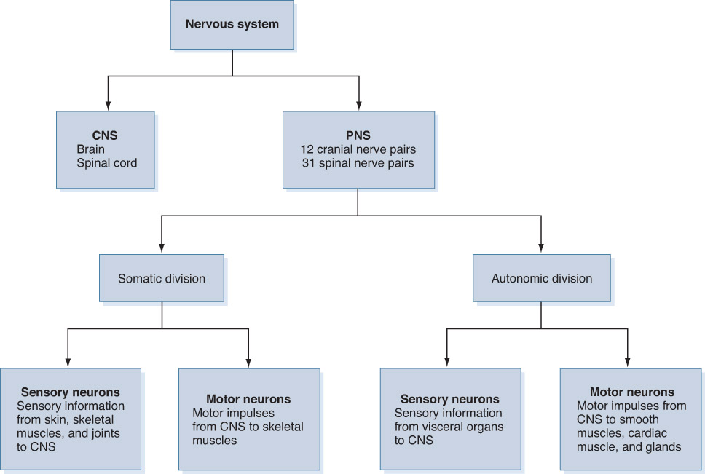
Autonomic Nervous System

Slide 50
Neurotransmitters and Receptors
Sympathetic and parasympathetic divisions secrete one of two neurotransmitters
Acetylcholine
Norepinephrine

Slide 51
Neurotransmitters and Receptors
Cholinergic fiber
Neuron that secretes acetylcholine
Adrenergic fiber
Neuron that secretes norepinephrine
Cholinergic fiber
Neuron that secretes acetylcholine
Adrenergic fiber
Neuron that secretes norepinephrine
Both sympathetic and parasympathetic nerves release acetylcholine molecules from preganglionic fibers into the synaptic cleft

Slide 52
Neurotransmitters and Receptors
Acetylcholine diffuses across to nicotinic receptors in the postganglionic neuron.
Impulse travels down the postganglionic neuron to reach the synapse at the target tissue with the neuroeffector cell.

Slide 53
Neurotransmitters and Receptors
Adrenergic fiber
Neuron that secretes norepinephrine
Adrenergic receptors
Classified into two structural and functional categories
Alpha receptors
Beta receptors

Slide 54
Neurotransmitters and Receptors
Norepinephrine binds to both alpha and beta receptors, but has somewhat greater affinity for alpha receptors.
Alpha and beta receptors are subdivided
Alpha-1 – e.g. SMC contraction
Alpha-2 – e.g. negative impact to reduce BP
Beta-1 – e.g. Increase HR
Beta-2 – e.g. Bronchodilator

Slide 55
Conclusion
https://www.youtube.com/watch?v=6O-0CVAgaEM

Slide 56
Ref.
https://www.youtube.com/watch?v=qPix_X-9t7E
https://www.youtube.com/watch?v=OZG8M_ldA1M
https://www.youtube.com/watch?v=VitFvNvRIIY
https://www.youtube.com/watch?v=q8NtmDrb_qo
https://www.youtube.com/watch?v=QY9NTVh-Awo

