Slide 1
GE404 Engineering Management
Topic1. INTRODUCTION

Slide 2
GE404 Course Topics Covered
Introduction
Introduction for project management objectives.
Project Participants and Project Life Cycle.
Contractual and organizational approaches
Projects Planning
Processes, and Bar (Gantt) Chart
Network Model
Scheduling using activity-on-node, precedence methods and time Scaled.
Resource leveling and allocation.
Project time-cost trade-off.
Financial Management: Cashflow Forecasting
Project time and cost control
Analysis of Scheduling Delay

Slide 3
GE404 Course Learning Objectives
Students completing this course successfully will be able to:
Using bar chart technique to formulate a complete plan for a project.
Apply activity-on-node network, and precedence diagram to schedule a project.
Level and allocate project resources.
Shorten project duration.
Monitor an engineering project for purpose of time and cost control.
Use computer software for preparing project schedules
Understand principles of project organization and contractual relationships including definition of professional responsibilities of project participants.

Slide 4
GE404 Textbook(s) and/or Other Required Material
Project Management with CPM, PERT, and Precedence Diagramming, 3rd Edition, by Moder J., Phillips, C., and Davis, E.
Construction Planning and Scheduling (4th Edition) by Jimmie W. Hinze, February 28, 2011
Course lectures are also found on the following website:
http://fac.ksu.edu.sa/slee & LMS (Blackboard)

Slide 5
GE404 Grade Distribution
Mid-term Exams 48%
Assignments and Quizzes 8 %
MS Project 4 %
Final Examination 40 %

Slide 6
What is a Project?
“A Project is :
a temporary endeavor undertaken to create a unique product or service or result. (PMI)
a one-shot, time-limited, goal-directed, major undertaking requiring the commitment of varied skills and resources. (PMI)
A Combination of human and non-human resources pooled together to achieve a specific purpose and deliverables.

Slide 7
Project Characteristics
Temporary (start, end, project team)
Unique (Product, Service or Result)
Completed (objectives, acceptance& Satisfaction)
Progressive Elaboration
Project variables and parameters (nature, size, budget, resources, complexity)
Project Categories (small, medium, large)
Source (PMI,2004)

Slide 8
Project Examples
Construction projects of various types as:
Building projects (Residential as non residential), and Construction projects (dams, tunnels, and bridges, power plants and refineries)
Engineering Projects:
Product Development, Manufacturing, \construction, Design Engineering, Industrial Engineering, technology, production, or any other field that employs personnel who perform an engineering function.
Research and development projects such as the Stealth fighter plan.
Software Development projects such as the university registration computer program.

Slide 9
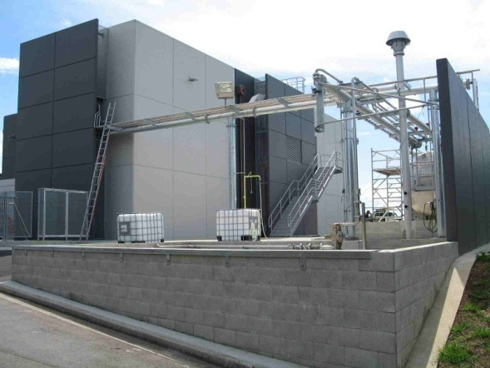
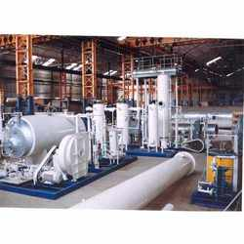
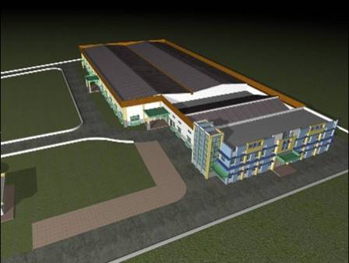
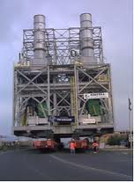
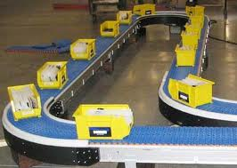
Examples of Projects

Slide 10
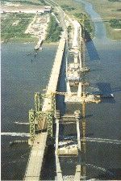
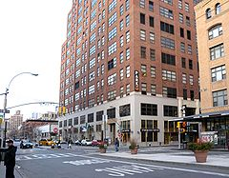
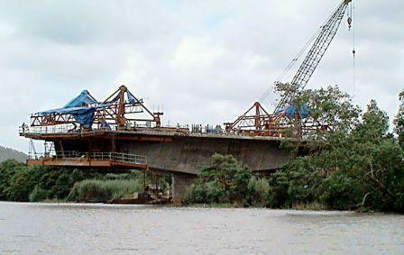
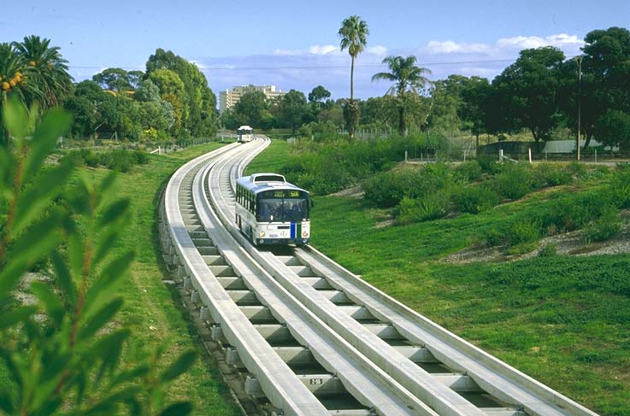
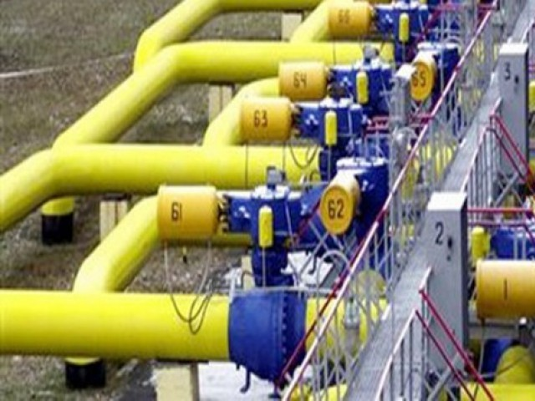
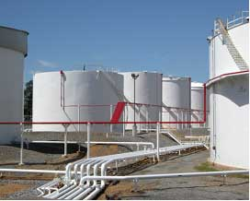
Examples of Projects

Slide 11
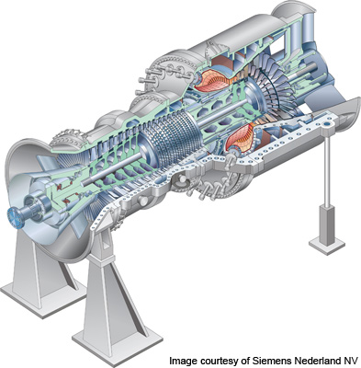
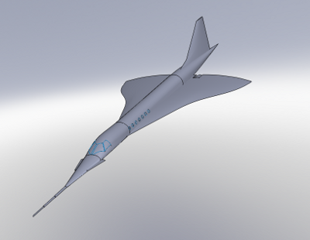
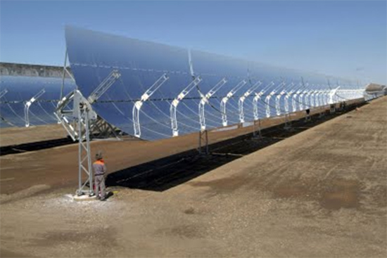
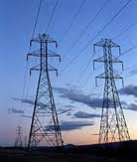
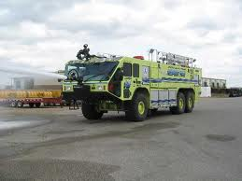
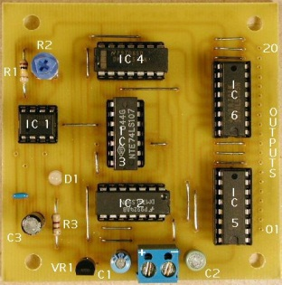
Examples of Projects

Slide 12
What is Management?
Management is a process concerned with the attainment of objectives.
Levels of Management
Top
Middle
Low
Project Management
Figure below shows the involvement % of the different levels of management for:
(Planning vs. controlling)
(conceptual vs. technical)
Planning
Control
Conceptual
Technical
Top
Management
Middle
Management
Low
Management

Slide 13
Management Functions
Planning
What are we aiming for and why?
Organizing
What’s involved and why?
Motivation
What motivates people to do their best work?
Directing
Who decides what and when?
Control
Who judges results and by what standards?

Slide 14
Planning
What are we aiming for and why?
Develop project objectives, goals, and strategies.
Develop project work breakdown structure.
Develop precedence diagrams to establish logical relationship of project activities and milestones.
Develop time-based schedule for the project based on the time precedence diagram.
Plan for the resource support of the project.

Slide 15
Organizing
What is involved and why?
Establish organizational structure for the team.
Identify and assign project roles to members of the project team.
Define project management policies, procedures, and techniques.
Prepare project management charter and other delegation instruments.
Establish standards for authority, responsibility and accountability of the project team.

Slide 16
Motivation
What motivates people to do their best work?
Determine project team member needs.
Assess factors that motivate people to do their best work.
Provide appropriate counseling and mentoring as required.
Establish rewards program for project team members.
Conduct initial study of impact of motivation on productivity.

Slide 17
Directing
Who decides what and when?
Establish “limits” of authority for decision making for the allocation of project resources.
Develop leadership style.
Enhance interpersonal skills.
Prepare plan for increasing participative management techniques in managing the project team.
Develop consensus decision making techniques for the project team.

Slide 18
Control
Who judges results and by what standards?
Establish cost, schedule, and technique performance standards for project.
Prepare plans for means to evaluate project progress.
Establish a project management information system for the project.
Prepare project review strategy.
Evaluate project progress.

Slide 19
What is Project Management?
Project Management is defined as the application of knowledge, skills, tools, and techniques (as optimization) to project activities to meet project requirements (scheduling and resourcing). (PMI, 2004)
Project Management involves planning, organizing, staffing, directing, and controlling to achieve an objective with constraints on
Time
Cost
Performance of the end product

Slide 20
Project Management main Function Activities
Planning
Objectives
Resources
Work break-down schedule
Organization
Scheduling
Project activities
Start & end times
Network
Controlling
Monitor, compare, revise, action

Slide 21
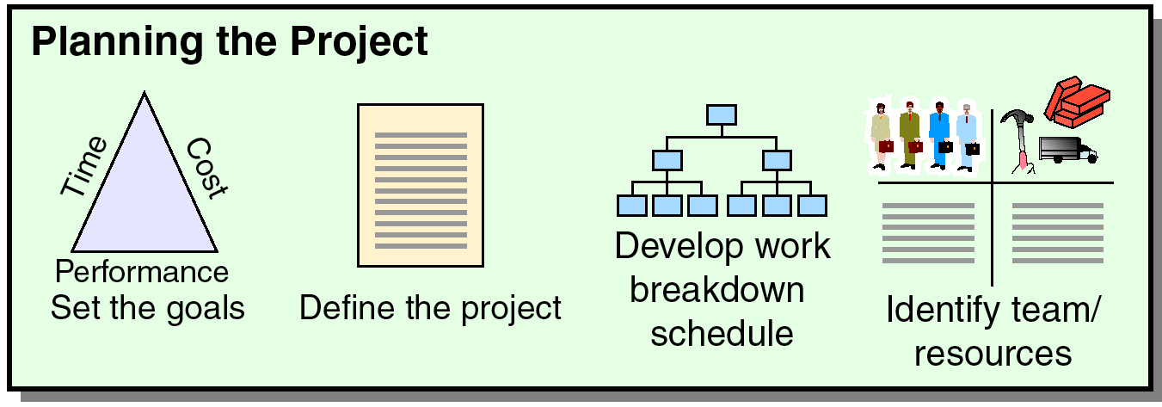
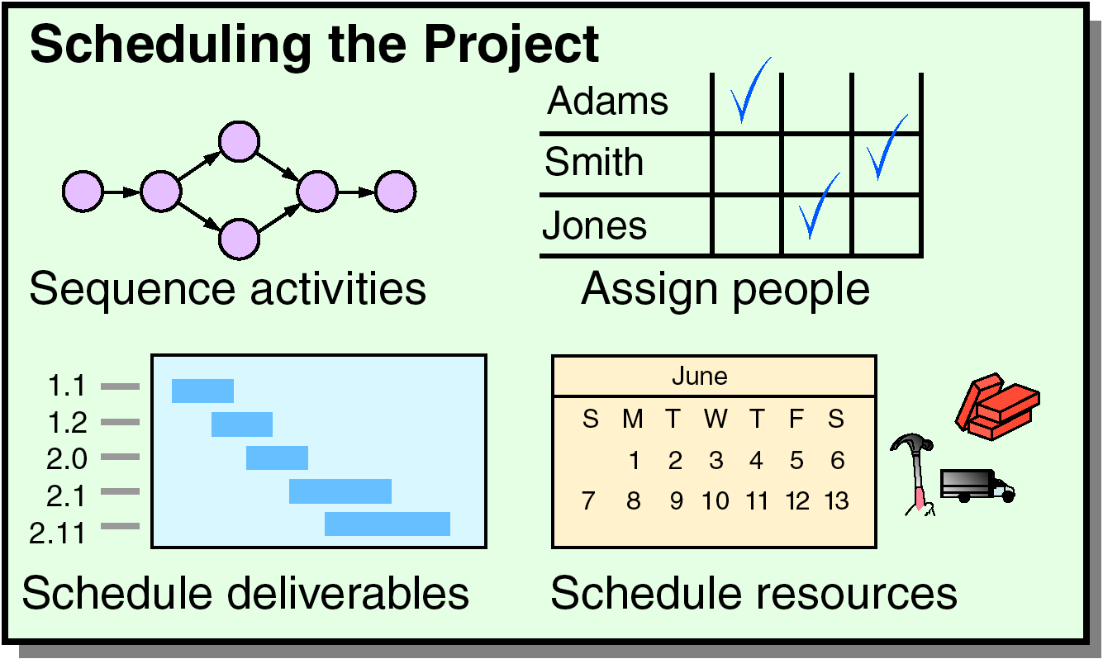
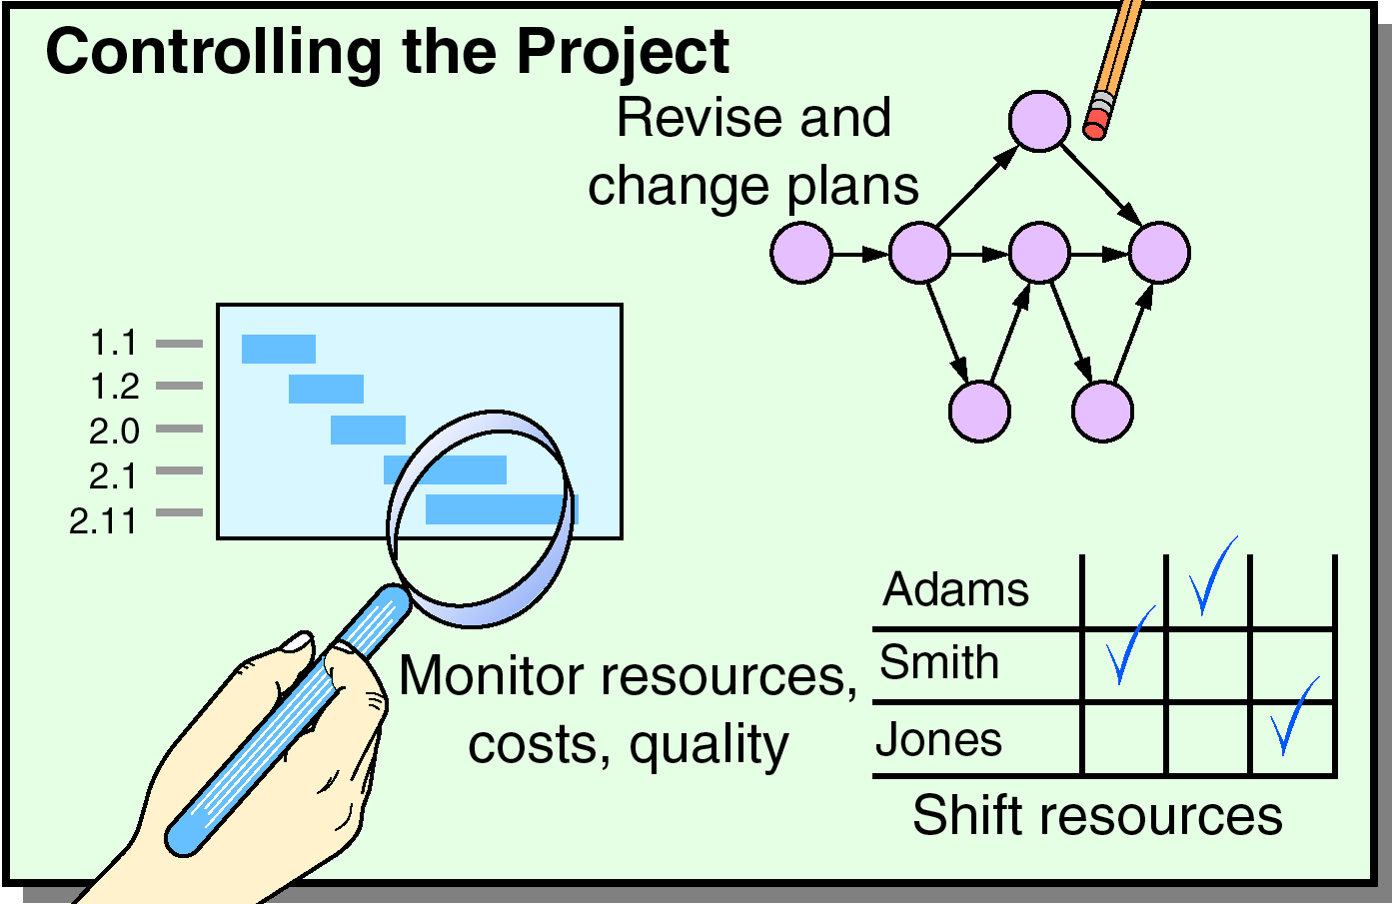
Project Management main Function Activities
Time/cost estimates
Budgets
Engineering diagrams
Cash flow charts
Material availability details
Budgets
Delayed activities report
Slack activities report
CPM/PERT
Gantt charts
Milestone charts
Cash flow schedules
Before Start of project During
project Timeline project
Figure 3.1 (from Heizer/Render –Operation Management

Slide 22
Project Stakeholders
Project sponsor
Project Owner
Project manager
Customer/user
Functional managers
Performing organization
Project team members
Project management team
Internal and external contractors, suppliers and vendors
Government agencies and media

Slide 23
Project Common Resources
The main resources are (3M)
Manpower (People)
Money
Materials And Machines.

Slide 24
Project Objective Key Factors
The objective Key factors affecting and varying the project are:
Scope
Cost
Time, and
Quality (affected by balancing the above three factors)
Scope
Good Will
Quality
Safety
Cost
Time

Slide 25
Assessing Project Success
Within Schedule
Within Budget
Meeting Spec requirements
With minimal or agreed upon scope changes
Without disturbing workflow of organization
Acceptance by customer and or user
Customer Satisfaction
Without negatively affecting corporate culture

