Slide 1
Toxic Gases
Pulmonary irritants, simple asphyxiants, toxic products of combustion, lacrimating agents, and chemical asphyxiants constitute a diverse group of toxic gases capable of causing a variety of local and pulmonary reactions.
The sources of these compounds are as varied, encompassing both naturally occurring and synthetic chemicals developed over the last 50 years.
In addition, exposure to the gases are encountered accidentally, at home or in the workplace with industrial products, as environmental hazards, or intentionally, as commercial sprays for individual protection, for law enforcement, or as potential bioterrorist weapons.

Slide 2
Chemical asphyxiants
Chemical asphyxiants produce toxicity through induction of cellular hypoxia or anoxia.
Among the chemical asphyxiants, carbon monoxide, cyanide and hydrogen sulfide are the most frequently encountered chemical asphyxiants
These agents alter the oxygen-carrying capacity of hemoglobin (such as with carbon monoxide) or inhibit cellular metabolic enzymes (cyanide, hydrogen sulfide), ultimately interfering with normal physiologic respiration.

Slide 3
Carbon monoxide (CO)
Carbon monoxide (CO) is a colorless, odorless, tasteless, non irritating gas-hence, its designation as a silent killer.
CO produces toxicity through induction of cellular hypoxia or anoxia (>3500 death/year).
Sources: Natural: ocean (microorganisms), forest fires.
Pollution: fossil fuel combustion.
Other: cigarette smoke, fires.
Methylene chloride, a solvent contained in paint stripping products, is a unique source of CO exposure. Production of CO occurs endogenously through hepatic metabolism of inhaled methylene chloride.
High concentrations: heavy traffic, underground garages and tunnels, fires.

Slide 4
Factors affecting toxicity:
Decrease barometric pressure (high altitude).
High alveolar ventilation (exercise, excitement).
High metabolic rate (e.g., children).
Preexisting diseases (heart & pulmonary diseases).
What are the major pathophysiological mechanisms involved in CO poisoning?
CO exerts its pathologic effects through a number of different mechanisms. In susceptible tissues, these may include a combination of impaired O2 delivery, O2 utilization, and possibly, oxidant stress injury.

Slide 5
Mechanisms of toxicity
Less oxygen in the blood (lower conc. of O2 in air).
Reduction in oxygen carrying capacity (affinity of CO for hemoglobin is 250x more than that of O2) and the formation of carboxyhemoglobin (COHb).
Reduction in the dissociation of oxygen from hemoglobin (less O2 available for cellular uptake and utilization). A leftward shift of the oxyhemoglobin dissociation curve.
Muscle cells: binding of CO to myoglobin.
Mitochondria: binding of CO to cytochromes (blockage of electron transport chain).
Results: Cellular hypoxia

Slide 6
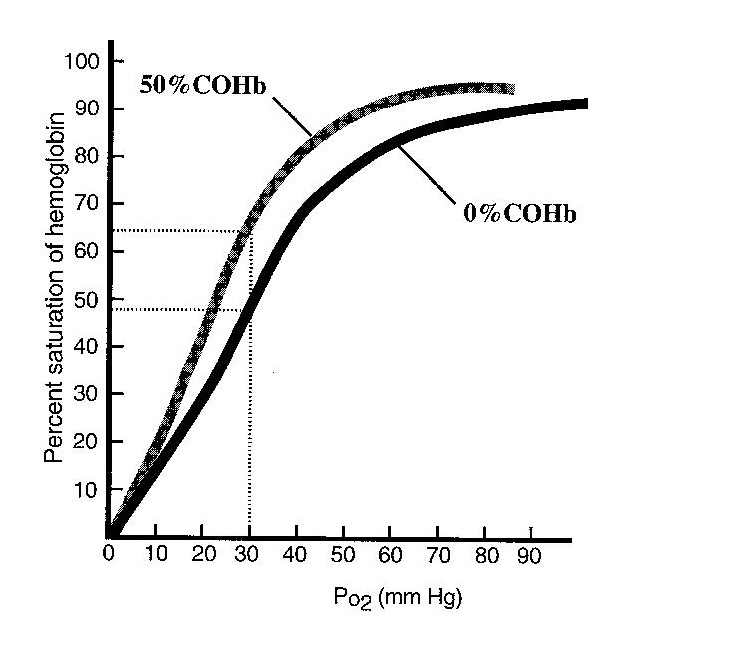
Oxygen-hemoglobin and carboxyhemoglobin dissociation curves

Slide 7
CO toxicity
Clinical presentation of CO poisoning depends on the time of exposure and the concentration of CO in the air.
Acute toxicity
Headache, dizziness, nausea, vomiting (0.01%)
Severe headache (0.01-0.05%)
Atrial fibrillation
Sinus tachycardia
Convulsions, coma, and death (0.1-0.5%)
Infants are highly susceptible (fetal hemoglobin has greater affinity for CO).
Delayed effects (survivors): neuropsychiatric impairments (impaired judgment, abstract thinking, lack of concentration).

Slide 9
Clinical diagnosis
Cyanotic appearance due to CO-myoglobin (living patients).
Cherry-red discoloration of the face and extremities at autopsy due to CO Hb (dead patient).
Treatment
Oxygen (100% normbaric: 1 atm of pressure)
O2 in hyperbaric chambers: 3 atm of pressure (if available).
Chronic toxicity (firemen, smokers)
Cardiovascular diseases (atherosclerosis).
Fetal toxicity (birth defects, mental retardation).
Behavioral effects (impaired judgment).
Neuropsychiatric impairments.

Slide 10
Cyanide
Cyanide is a rapidly acting agent. Its ranked among the most potent poisons known.
Hydrogen cyanide gas is used as fumigants (used to destroy the pets in situations were other liquid or sprayed pesticide applications are ineffective).
Cyanide sources
Cyanide arises from the combustion of many compounds including silk, nylon, solid plastics, and polyurethane.
Cyanide is found in many plants, especially in seeds of apple, pear, and apricot.
Cyanides even arises from the metabolism of some pharmaceuticals (e.g., nitroprusside).

Slide 11
Mechanism of toxicity
High affinity for Fe3+ in cytochrome oxidase.
Blocks oxygen utilization in mitochondria.
Inhibits cellular respiration (inhibit electron transport chain and decrease ATP production lead to cell death).
The decrease in aerobic respiration forces the cell to revert to anaerobic metabolism, which generates excess lactic acid, triggering metabolic acidosis.
Toxicokinetics
Acute lethal toxicity results within 1 h from an oral dose of 100 to 200 mg, while inhalation of 150 to 200 ppm of HCN gas is fatal.
The workplace limit is 4.7 ppm.

Slide 12
Signs and symptoms of acute toxicity
Initially symptoms of neurological toxicity appear, including headache, nausea, vomiting, weakness, and dizziness.
The chemical stimulates chemoreceptors in the carotid artery, triggering reflex hyperpnea (increased respiration), tachypnea (gasping for air), and pulmonary edema.
Hypotension with reflex tachycardia, followed by bradycardia.
Convulsions due to brain anoxia.
Respiratory arrest and death.
Characteristic odor: Bitter almond breath

Slide 13
The design of cyanide antidote
The endogenous pathway for the disposal of cyanide:
In this pathway the enzyme rhodanase reacts with thiosulfate and cyanide and produces thiocyanate and sulfite.
The cyanide antidote was prepared with three ingredients:
(1) Amyl nitrite (2) sodium nitrite (3) sodium thiosulfate.
It works to produce the reactions shown as follows:

Slide 14
Treatment
Amyl nitrite can be administered by inhalation and so it starts working quickly. This is followed by intravenous injection of sodium nitrite, which causes a much greater conversion of Hb to metHb (Hb oxidized form).
Nitrites
Nitrites induces the formation of methemoglobin.
Cyanide preferentially binds to methemoglobin over cytochrome oxidase enzyme forming cyanomethemoglobin. This frees the enzyme from inhibition and allows oxidative phosphorylation to resume.
Thiosulfate (sulfur donor)
Through the reaction catalyzed by rhodanases, thiosulfate binds with cyanide (from the cyanomethemoglobin complex) to form a relatively nontoxic complex, thiocyanate, which is eliminated by renal excretion.

Slide 15
Hydrogen Sulfides
Hydrogen sulfides (H2S) is a colorless and highly toxic gas and its characteristic rotten egg odor is well known.
It is produced from the decomposition of sulphur-containing organic materials found in sewage, gas wells, liquid manure, volcanoes, and sulphur hot springs.
Industrial processes in petroleum refiners, synthetic rubber, leather making, and roof asphalt also generate large amounts of hydrogen sulfide as by-products.
Because it is heavier than air, there have been a number of fatalities in which workers died when descending ladders into sewers where they suddenly encountered lethal build-ups of H2S.

Slide 16
Mechanism of toxicity
Hydrogen sulfides is highly lipid soluble and is rapidly absorbed after inhalation, affecting brain stem respiratory centers and resulting in abrupt onset of unconsciousness. For this reason, it is known as a “knockdown gas”
Hydrogen sulfide has two major toxic actions:
The first is a depressant effect on the CNS. As result of this effect is paralysis of the respiratory center and death.
The second is inhibition of cytochrome oxidase in a manner very similar to the effect of cyanide. H2S is actually a more potent inhibitor of cytochrome oxidase than is cyanide.

Slide 17
What are toxic levels of H2S
H2S LEVEL CHARACTERISTIC

Slide 18
How do H2S-toxic patients present?
At low levels, irritant effects predominate. Symptoms include keratoconjunctivitis (gas eyes) and upper airway irritation and coughing.
At higher levels systemic effects such as nausea, vomiting, confusion, headache, dizziness and coma are seen.
At very high levels, respiratory arrest leading to cardiovascular collapse and death can occur in minutes.

Slide 19
How should patients with H2S toxicity be managed?
Rescuers should wear a self contained breathing apparatus before entering a contaminated areas.
Patients should moved into fresh air immediately.
Oxygen and supportive care should be given.
Because the mechanism of toxicity of H2S and cyanide is similar, the cyanide antidote kit is effective. The nitrites within the kit convert hemoglobin to methemoglobin which becomes an agent for binding H2S before it can bind cytochrome oxidase and cause death.
Sulfmethemoglobin is formed by the reaction between methemoglobin and H2S and this substance is excreted into the urine as such or as nontoxic metabolites.

