Slide 1
Tumors

Slide 2
It’s a disturbance in growth:
Can be : 1- Acquired 2- Congenital
Neoplasia: it’s a new growth, purposeless and progressive.
May be: Benign or Malignant.

Slide 3
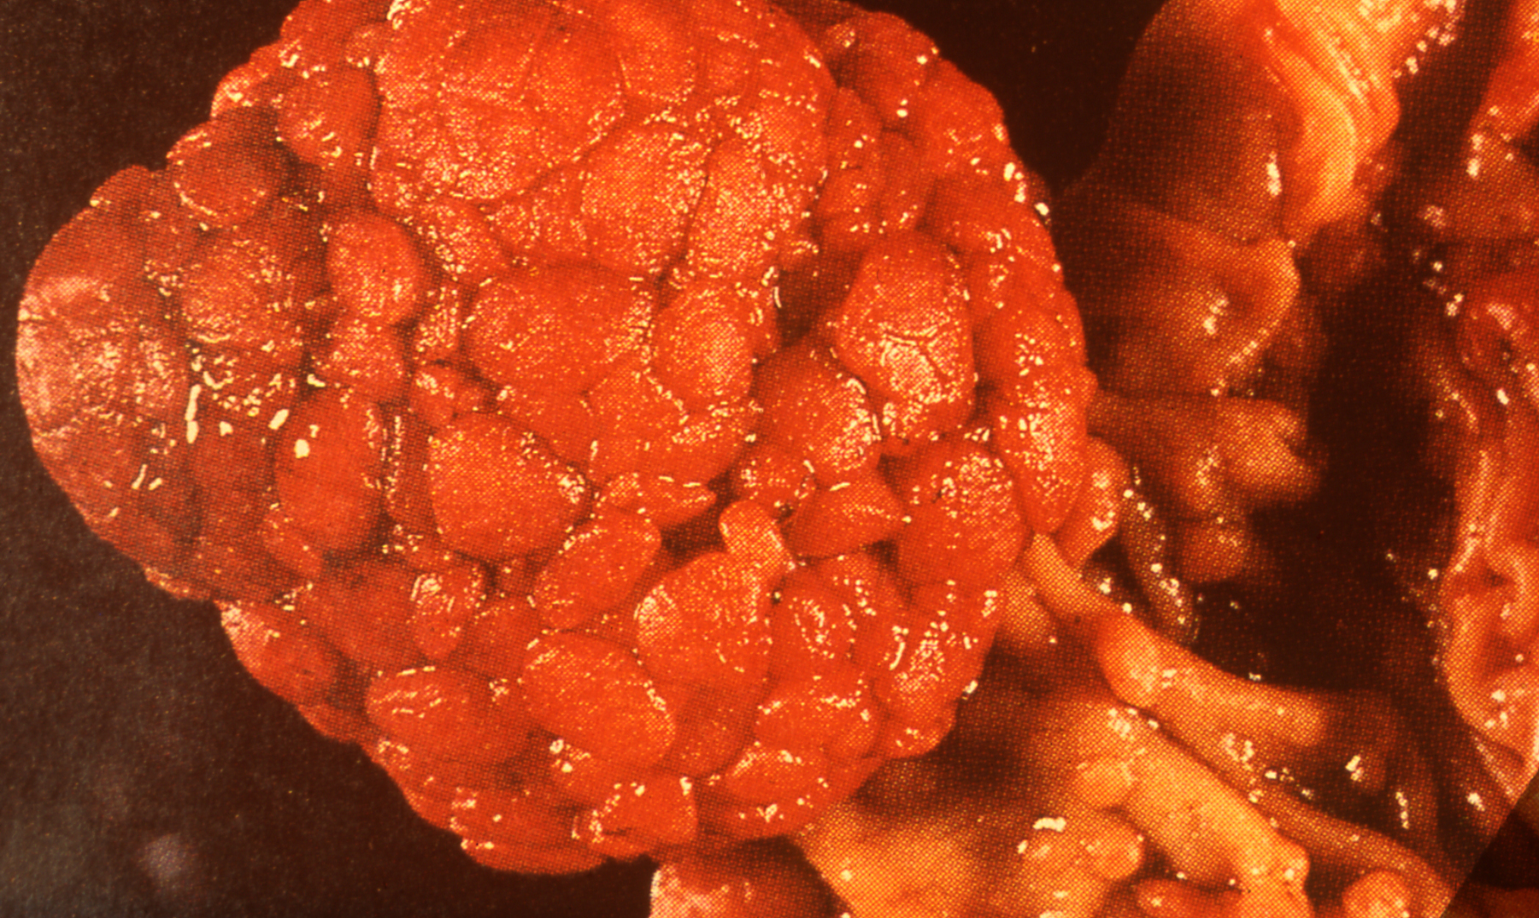
1- Adenoma in colon (Gross):

Slide 4
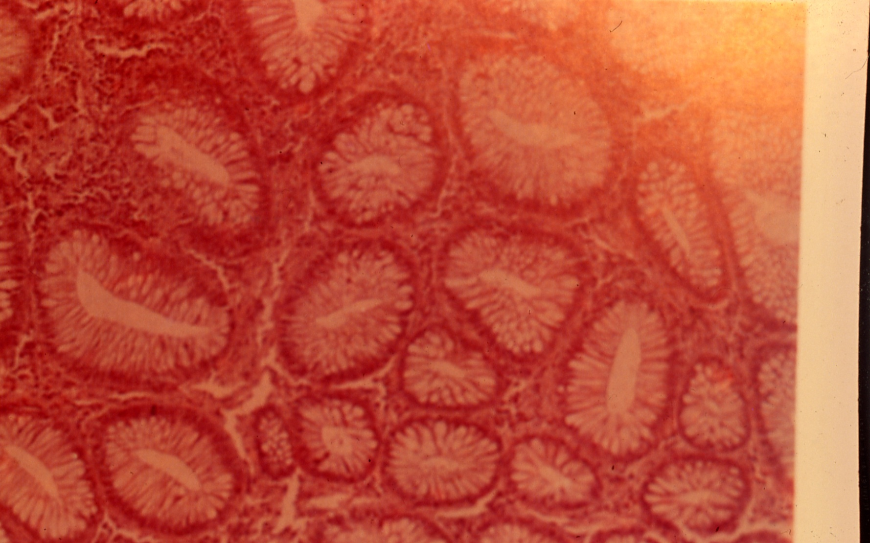
2- Adenoma in intestine (Micro):

Slide 5
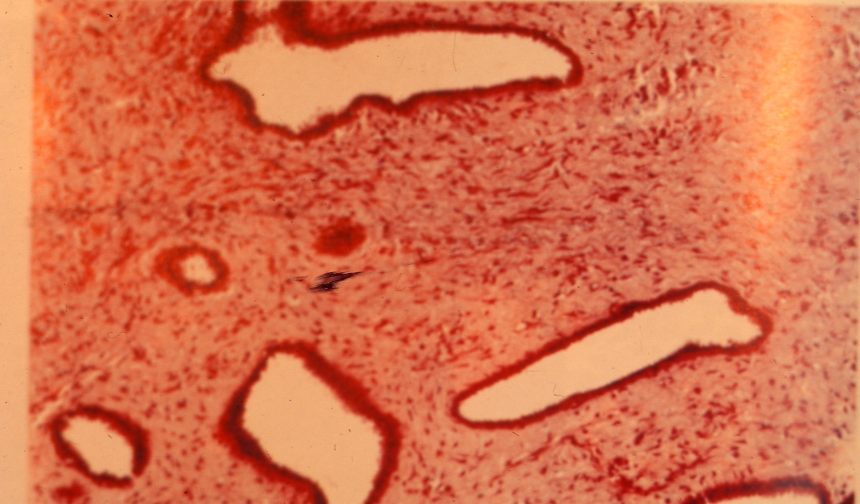
3- pericanalicular fibro adenoma in breast:

Slide 6
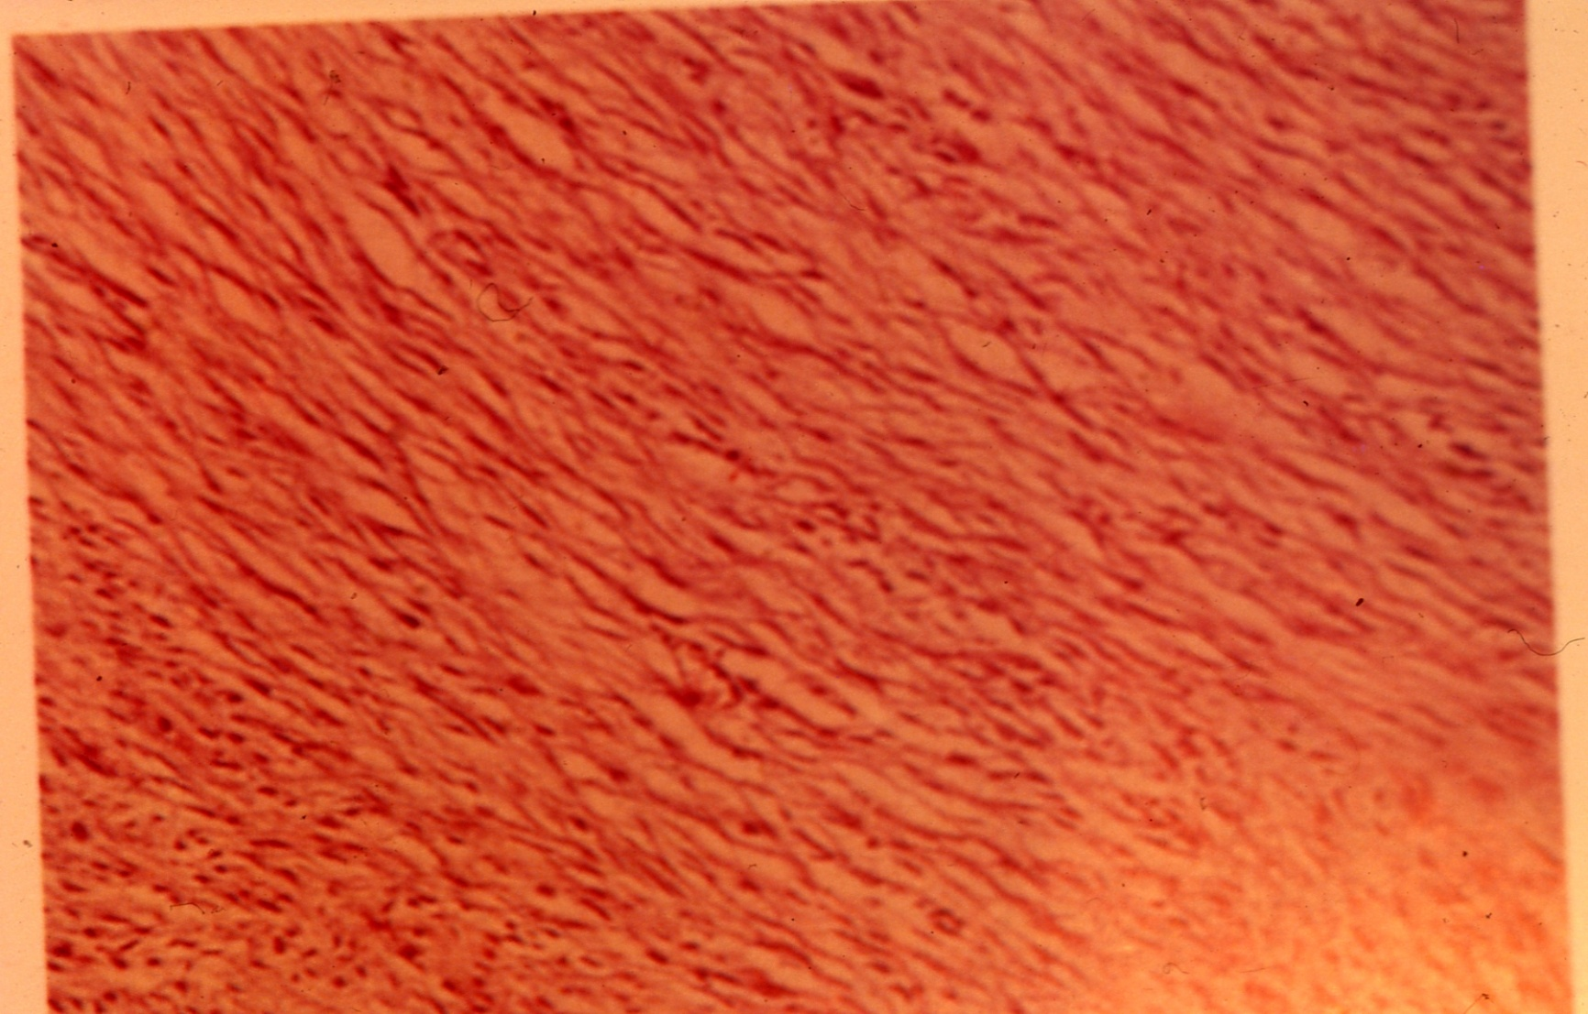
4- Fibroma:

Slide 7
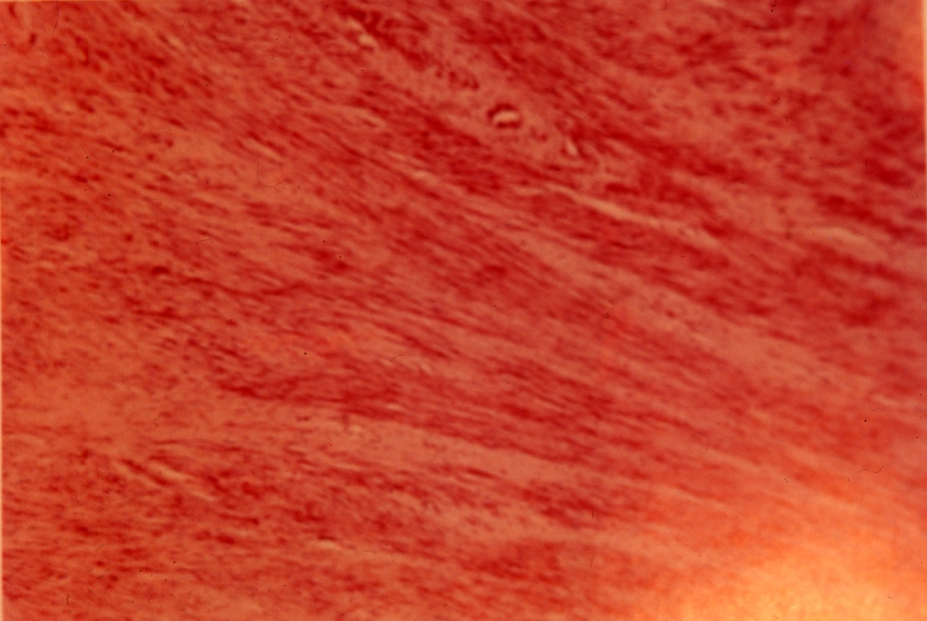
5- Fibromyoma:

Slide 8
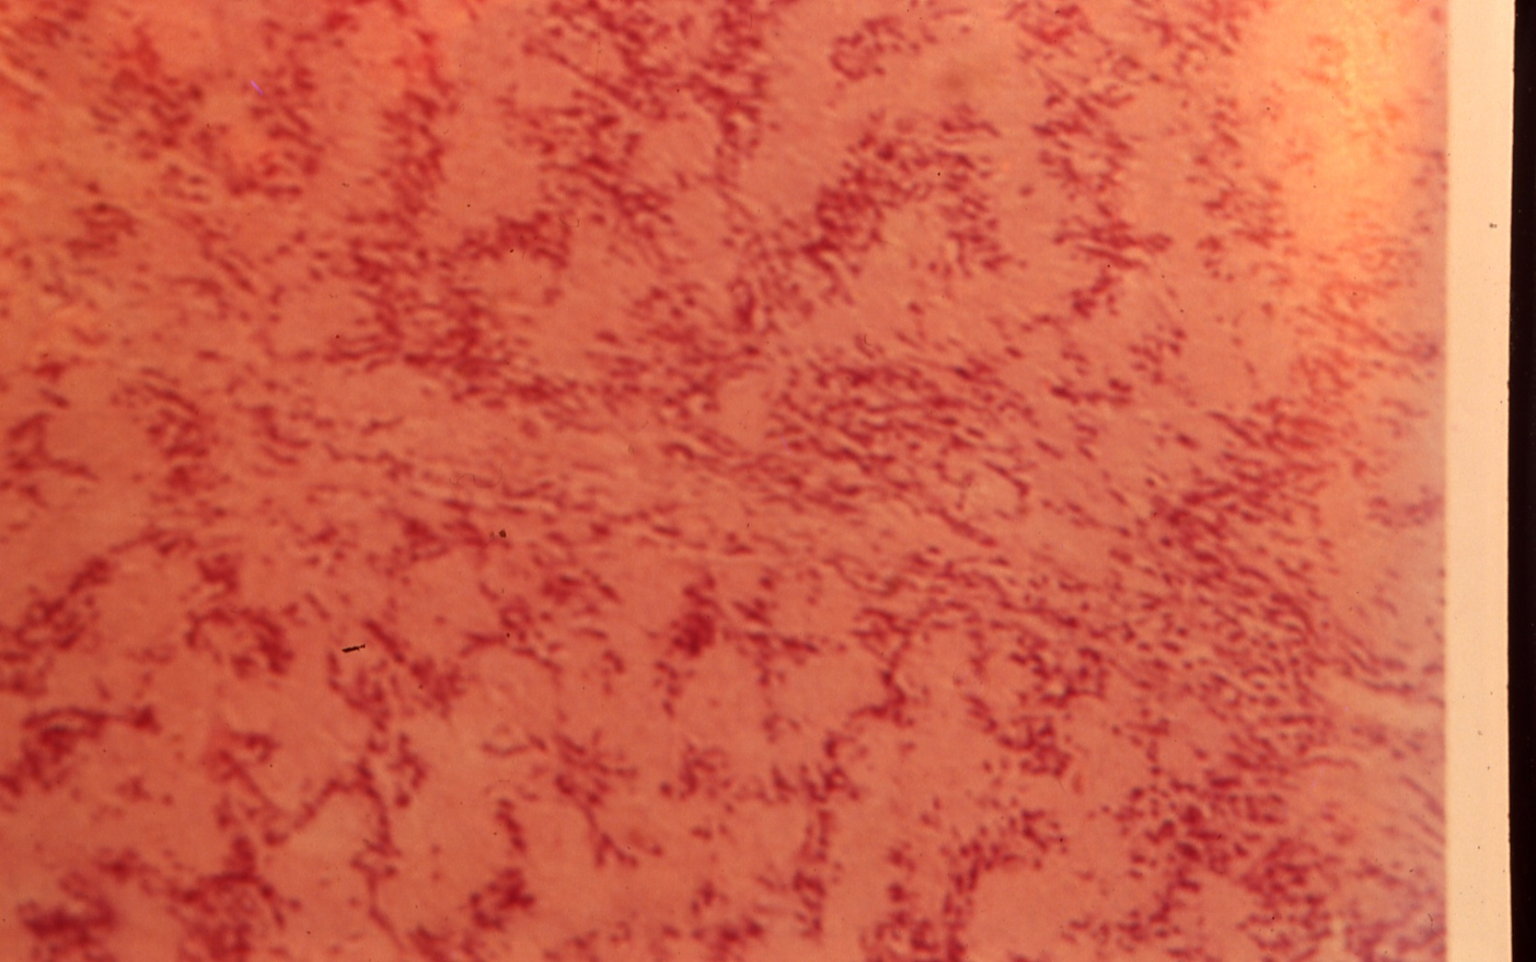
6- Shwanoma, neurolemmoma:

Slide 9
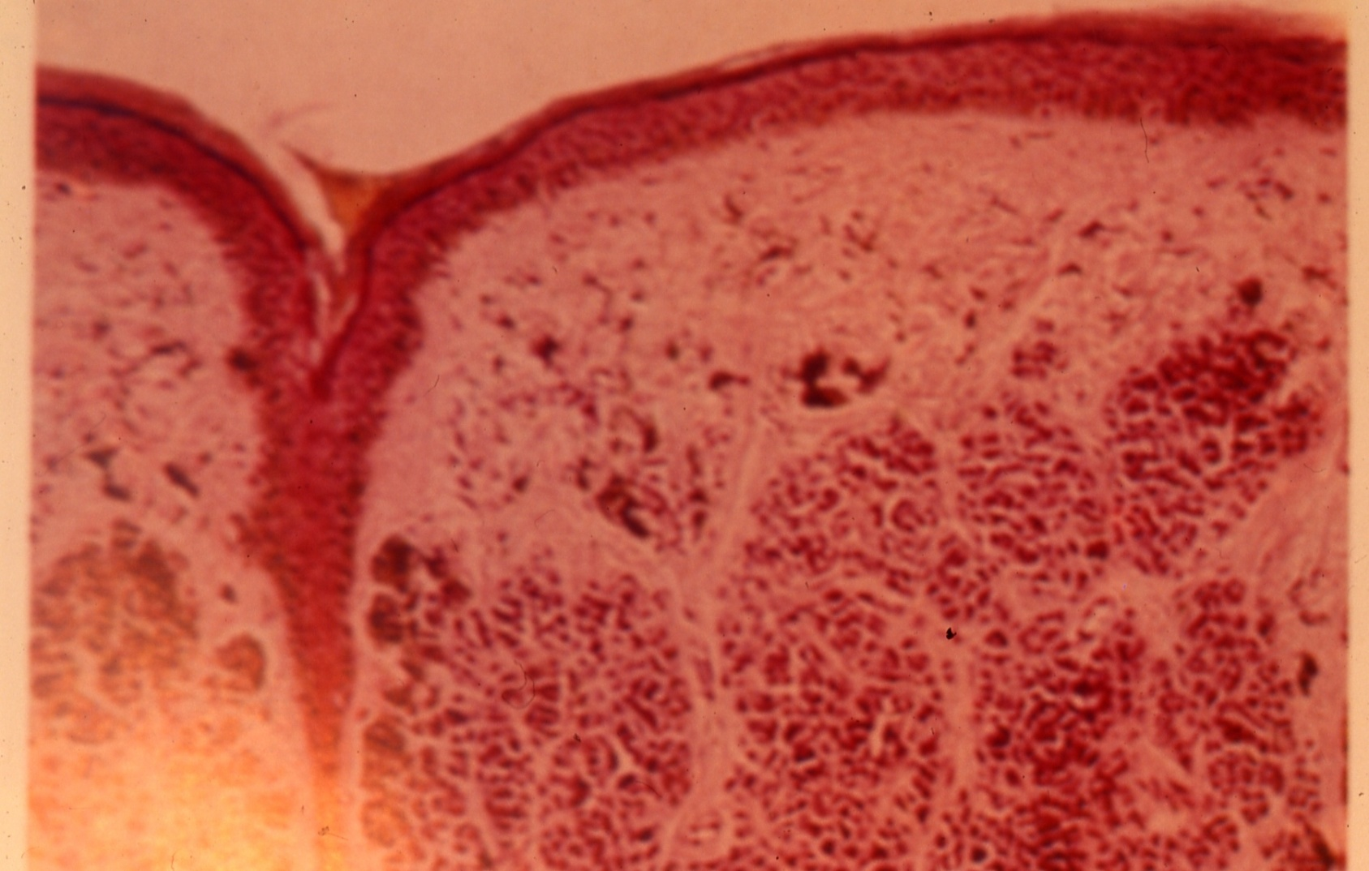
7- Benign melanoma in skin:

