Slide 1
College of Computer and Information Sciences
Department of Computer Science
CSC 220: Computer Organization
Unit 12
CPU Design & Programming

Slide 2
Unit 12: CPU Design & Programming
Overview
Simple Computer Architecture
Instruction Set Architecture (ISA)
Storage Resources
Instruction Formats
Instruction Specifications
Single-Cycle Hardwired Control Unit
Assembly and machine languages
Chapter-8
M. Morris Mano, Charles R. Kime and Tom Martin, Logic and Computer Design Fundamentals, Global (5th) Edition, Pearson Education Limited, 2016. ISBN: 9781292096124

Slide 3
An overview of CPU design
We can divide the design of our CPU into three parts:
The datapath does all of the actual data processing (Unit-11).
An instruction set is the programmer’s interface to CPU.
A control unit uses the programmer’s instructions to tell the datapath what to do.

Slide 4
Simple Computer Architecture
A computer is controlled by a series of instructions. Instructions are binary words that are used to determine both the datapath processing and the control behavior.
A program is a collection of instructions that are used to accomplish some task(s).
A program counter (PC) is used to keep track of the address of the next instruction in memory. The PC has counting logic, as well as parallel load and other logic to permit changes in the instruction sequence.

Slide 5
Simple Computer Architecture
Changes in the instruction sequence can be either conditional or unconditional.
Instructions are executed by activating the necessary microoperations to perform the specified task.
Note that the computer uses programmable control, but we will use a hardwired control unit to actually implement the programmable control.

Slide 6
Instruction Set Architecture (ISA)
The instruction set architecture (ISA): a comprehensive description of the instructions a computer can execute.
The ISA has three major components
Storage Resources
Instruction Formats
Instruction Specification

Slide 7
Storage Resources
resources available for storing information
Register file
Program counter (PC)
Instruction memory (program memory)
Data memory
Program counter
(PC)
Instruction
memory
2
15
x
16
Register file
8
x
16
Data
memory
2
15
x
16
FIGURE 8-13 Storage Resource Diagram for a Simple Computer

Slide 8
Instruction Formats
Instructions are divided into bit groupings called fields. Each field will contain a specific part of the instruction.
Operation code (opcode)
The opcode field determines what the actual operation will be.
An n-bit opcode can specify up to 2^{n} different operations.
Operand(s)
Registers
Addresses of Operands
Constant data
Operands may be specified implicitly as well.

Slide 9
Instruction Formats -1
Register: The source(s) and destination of an instruction can all be registers.
The source registers are read and the new information is written to the destination register.
All registers are explicitly identified (usually).

Slide 10
Instruction Formats - 2
Immediate operands: data constants are contained within the instruction.
Note that only three bits of data can be specified here, so
It must be extended to the register length by zero-fill or sign-extension.
Clever encodings enable wider immediates
RR format, RI format, B format

Slide 11
Instruction Formats - 3
Jump and Branch: Changes in program flow are caused by jump or branch instructions, affecting only the PC.
Can load the PC from source SA.
Can add the sign-extended 6-bit offset (AD) to the PC.
Can be either unconditional, or conditional based on some flag value (i.e. Z, N, C, V).

Slide 12
Instruction Specifications
The instruction specifications describe in detail each instruction the system can execute.
A mnemonic is written by the programmer to represent the opcode in text.
assembler generates the actual binary instruction.
Not every instruction sets every flag
Refer to Table 8-8

Slide 13
ISA: Instruction Specifications
The specifications provide:
The name of the instruction
The instruction's opcode
A shorthand name for the opcode called a mnemonic
A specification for the instruction format
A register transfer description of the instruction, and
A listing of the status bits that are meaningful during an instruction's execution (not used in the architectures defined in this chapter)

Slide 14
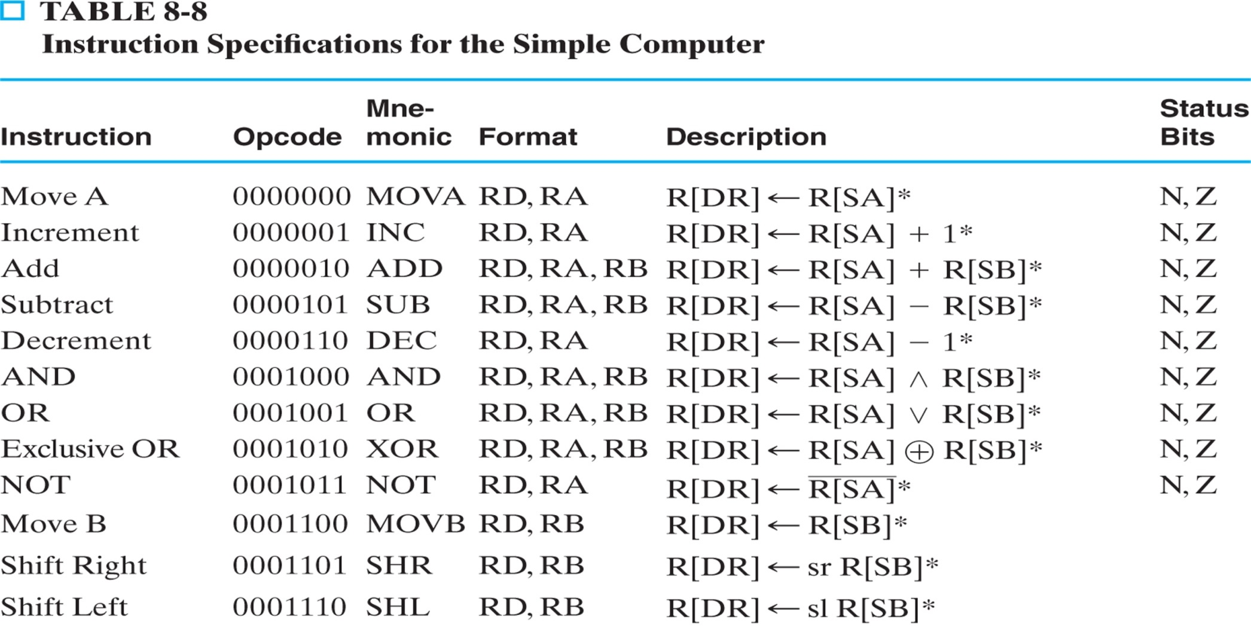
ISA: Instruction Specifications
Here we have arithmetic, logic and shift instruction sets correspond to micro-operations discussed in Unit 8-11. The opcode (7 bit) and FS (4 bit) have one-to-one correspondence – first three bits of an opcode are 000.
RTL instruction (in description) is written in a slightly different way. For example, R[DR] <- R[SA] is a RTL instruction where DR and SA are destination and source register addresses respectively.

Slide 15
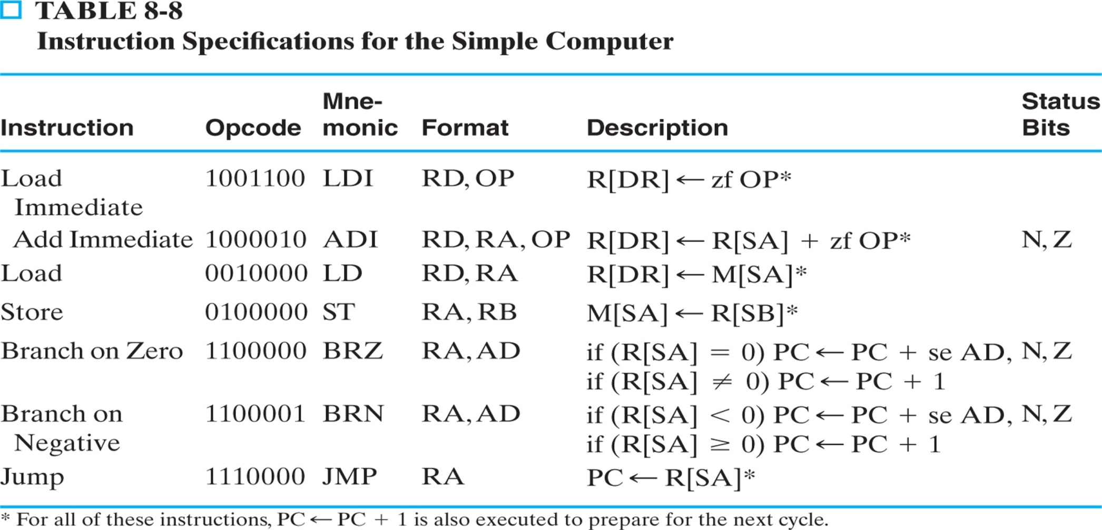
ISA: Instruction Specifications (continued)
These are additional instructions having no corresponding micro-operations – for them first three bits have non-zero values.
For instruction LDI, RTL is R[DR] <- zf OP where zf means zero filled and OP is a 3 bit constant (that is used for the simple computer).
In description of BRZ and BRN, se mean sign extended. This is done to make it 16 bit because the RAM has 2¹⁶ ×16 configuration (refer to slide 8, figure 8-13).

Slide 16
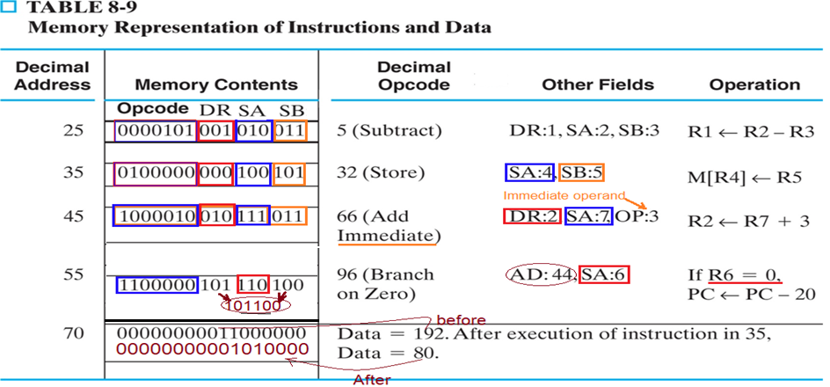
ISA: Memory Representation
Table 8-9 shows Instructions and data, in binary, are placed in memory. Here, we assume that we have a program (in machine language) in the RAM and we show instructions at locations 25, 35, 45, and 55 (as examples).
Corresponding assembly codes for four instructions are as follows.
25: SUB R1, R2, R3
35: ST (R4), R5 [suppose R4=70, R5=80]
45: ADI R2, R7, 3
55: BRZ R6, AD [suppose AD(left)=101, AD(right)=100, se AD = 1111111111101100 = -20]

Slide 17
Block diagram of a processor
The control unit connects programs with the datapath.
In real computers, the datapath actions are determined by the program that’s loaded and running
It converts program instructions into control words for the datapath, including signals WR, DA, AA, BA, MB, FS, MW, MD.
It executes program instructions in the correct sequence.
It generates the “constant” input for the datapath.
The datapath also sends information back to the control unit. For instance, the ALU status bits V, C, N, Z can be inspected by branch instructions to alter a program’s control flow.
Program
Control signals
Control
Unit
Datapath
Status signals

Slide 18
Single-Cycle Hardwired Control
In single-cycle hardwired control, the PC is updated on each clock cycle. Each instruction is completed in a single cycle.
The PC is used to select a word from the instruction memory, which is driven to the instruction decoder.
The instruction decoder then provides the control word to the datapath to activate the desired functionality, and determines how the PC is updated.

Slide 19
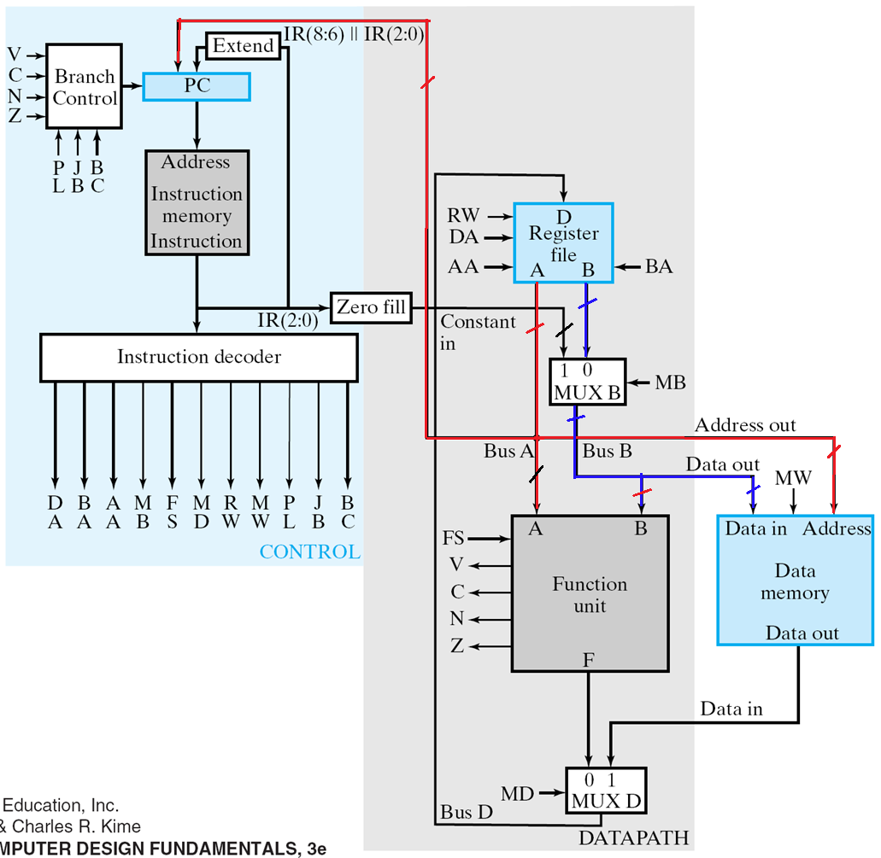
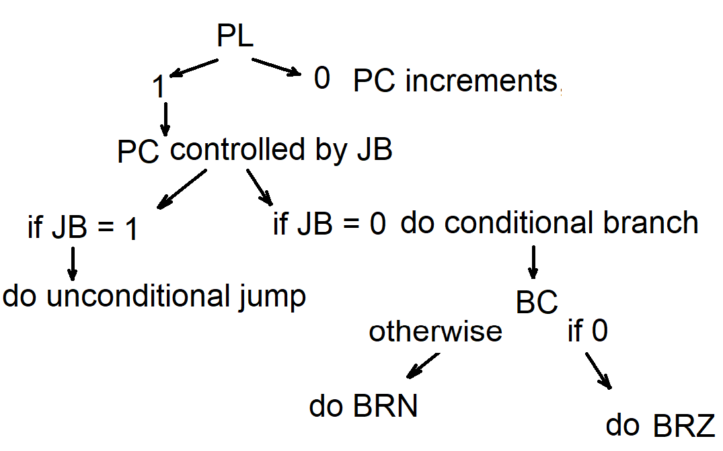
Control Unit
The concatenated offset field is sign-extended for PC-relative addressing.
The instruction decoder maps the instruction word to a control word.
The constant field is zero-filled and made available to the datapath
PL – if 0, the PC increments, otherwise the update is controlled by JB
JB – if 0, do conditional branch, otherwise do unconditional jump
BC – if 0, do BRZ, otherwise do BRN
IR

Slide 20
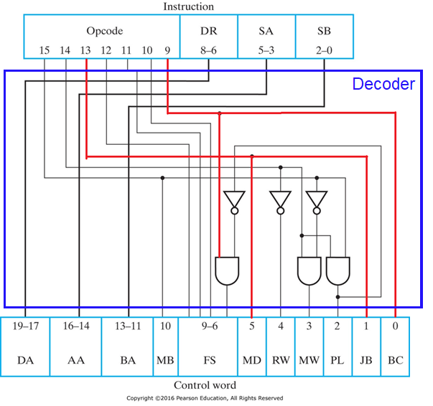
Instruction Decoder
Source A
destination
Source B

Slide 21
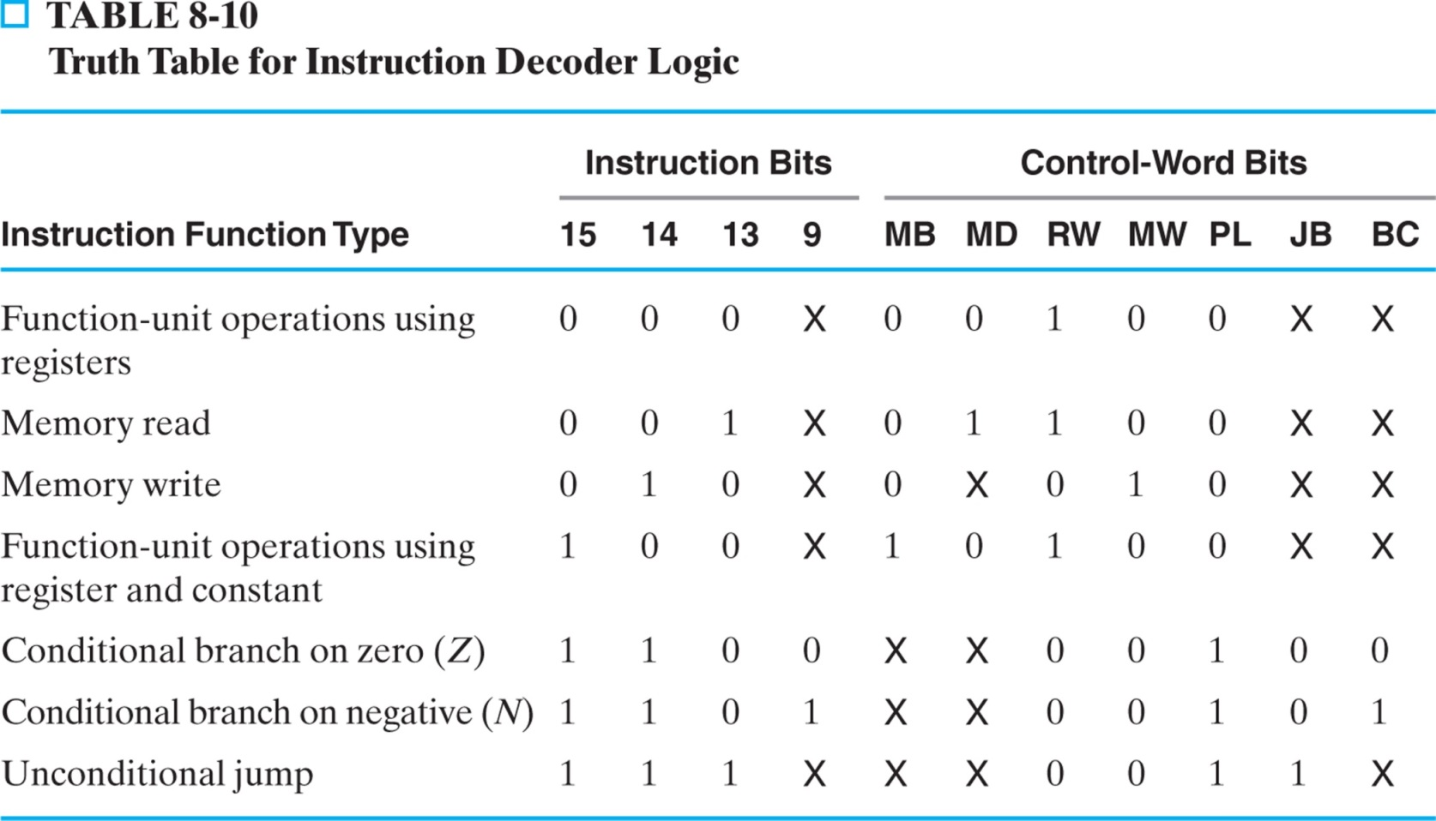
Instruction Decoder
Control-word fields DA, AA, and BA are equal to the instruction fields DR, SA, and SB, respectively
Control field BC for selection of the branch condition status bits is taken directly from the last bit of Opcode.
The remaining control-word fields: MB, MD, RW, and MW
There are two added bits for the control of the PC: PL and JB

Slide 22
Sample Programs
Example Program: Assume address 248 in data memory containing 2, and location 249 contains 83. Evaluation of arithmetic expression 83 - (2 + 3) and place the result in location 250.
LDI R3, 248 Load address 248 in R3
LD R1, (R3) Load R1 with contents of location 248 in memory (R1 becomes = 2)
ADI R1, R1, 3 Add 3 to R1 (R1 becomes =5)
INC R3, R3 Increment the contents of R3 (R3 becomes = 249)
LD R2, (R3) Load R2 with contents of location 249 in memory (R2 becomes = 83)
SUB R2, R2, R1 Subtract contents of R1 from contents of R2 (R2 becomes = 78)
INC R3, R3 Increment the contents of R3 (R3 = 250)
ST (R3), R2 Store R2 in memory location 250 (M[250] = 78)

Slide 23
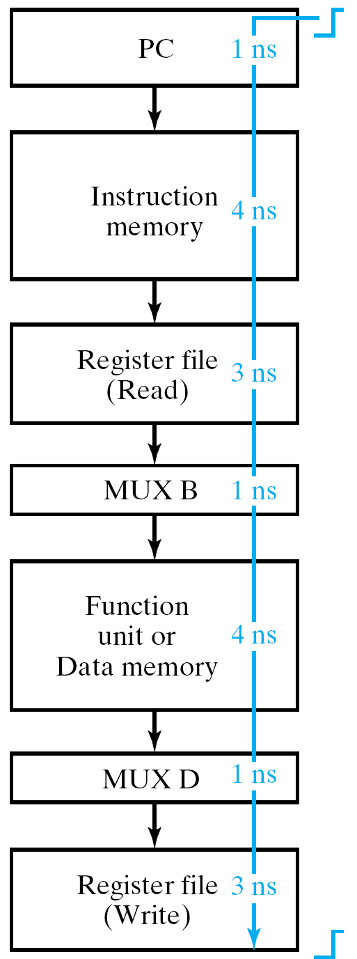
Single-Cycle Computer Issues
Complex operations
Only combinational logic can be used in data transformation – no sequential logic
E.g. no multiplier
Unified memory
If program and data are in one memory, how can you simultaneously access the same memory for an instruction and a data operand?
Worst-case delay

Slide 24
Programming and CPUs
Programs written in a high-level language like C++ must be compiled to produce an executable program.
The result is a CPU-specific machine language program. This can be loaded into memory and executed by the processor.
CSC 220 focuses on stuff below the dotted blue line, but machine language serves as the interface between hardware and software.
High-level program
Compiler
Executable file
Software
Hardware
Control Unit
Machine language instructions are sequences of bits in a specific order.
To make things simpler, people typically use assembly language. Example assemblers for Intel x86 processor: NASM, YASM, MASM
Control words
Datapath

