Slide 1

Unit 8
Registers and RTL
College of Computer and Information Sciences
Department of Computer Science
CSC 220: Computer Organization

Slide 2
Unit 8: Registers and RTL
Overview
  Registers
    Parallel in Parallel out Registers
    Shift Registers
  Bus Construction
  Register Transfer Language
    Micro operations
Chapter-6
M. Morris Mano, Charles R. Kime and Tom Martin, Logic and Computer Design Fundamentals, Global (5th) Edition, Pearson Education Limited, 2016. ISBN: 9781292096124

Slide 4
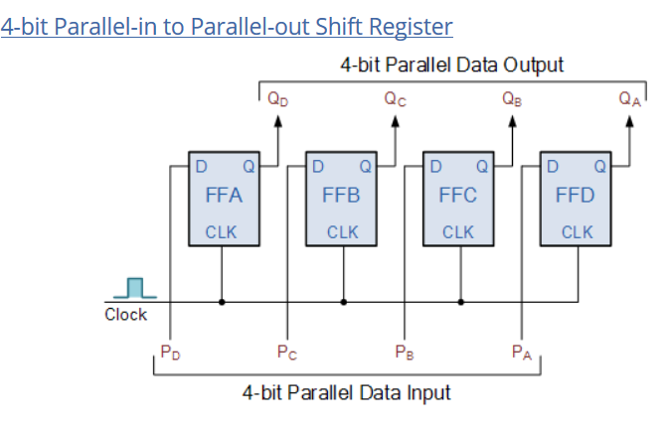

Slide 7
MUX 2 - 1
MUX 2 - 1

Slide 8
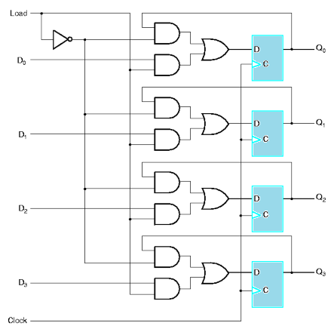

Slide 9
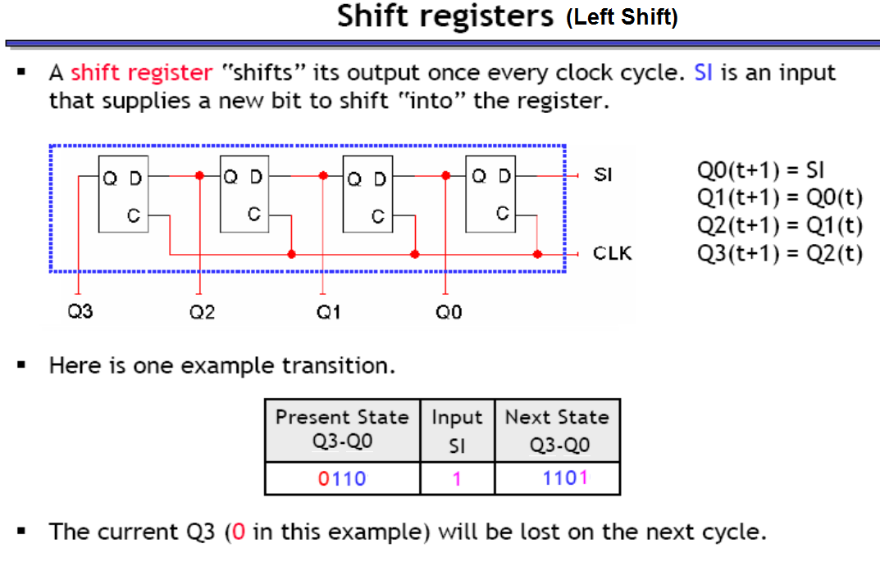

Slide 10
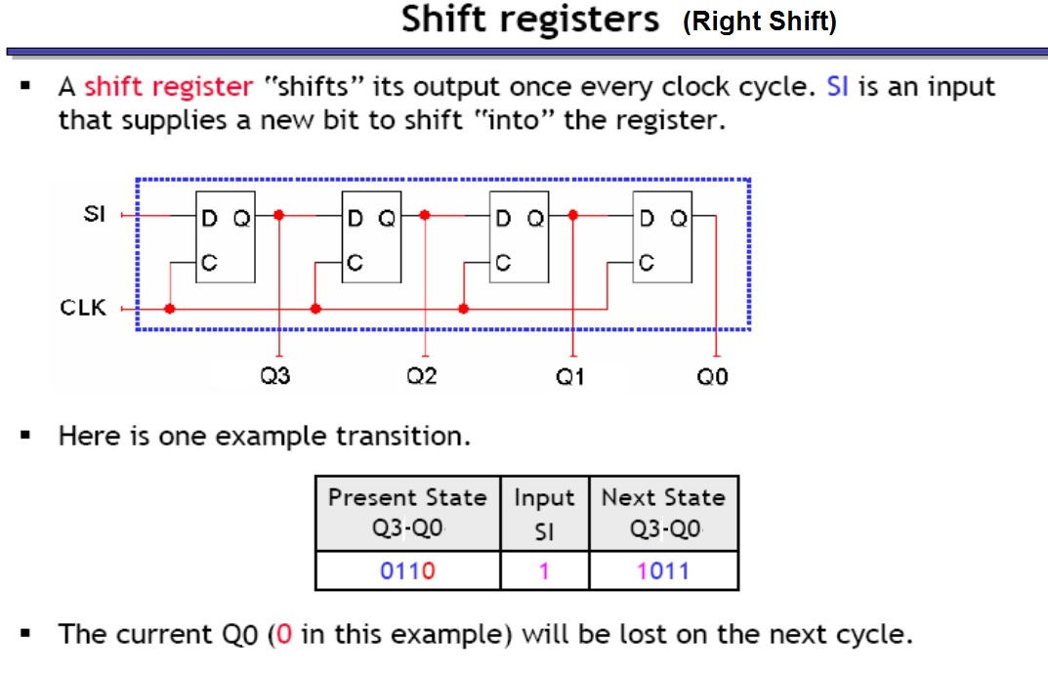

Slide 11
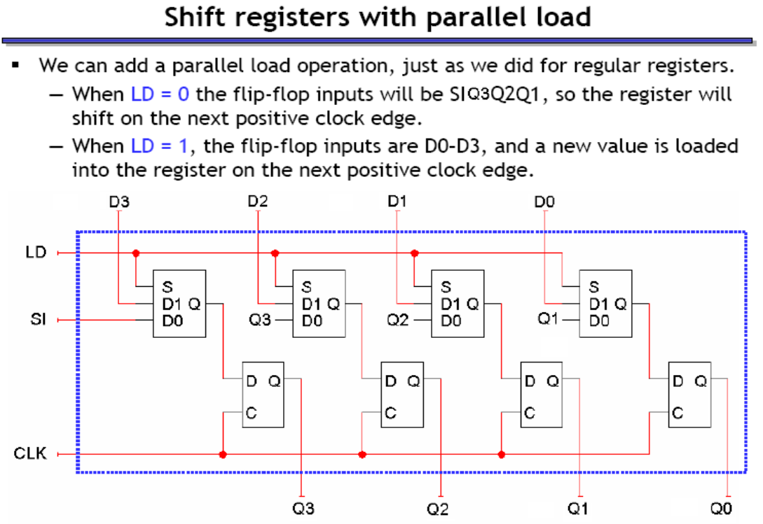
Serial
Parallel
MUX 2 - 1
MUX 2 - 1

Slide 12
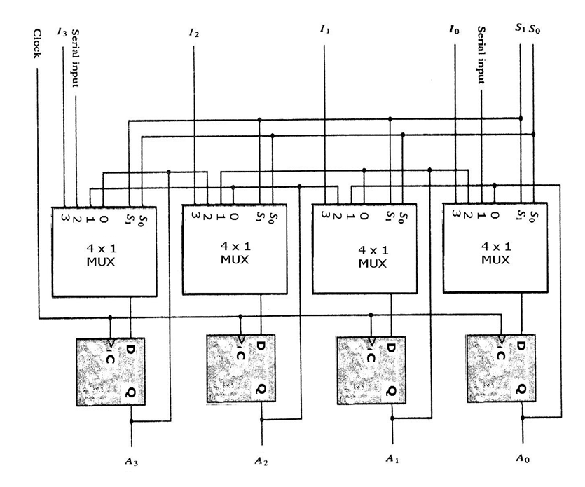
A Bidirectional Shift Register with parallel load
Operation |  | S0 | S1
No change |  | 0 | 0
Shift left |  | 1 | 0
Shift right |  | 0 | 1
Parallel load |  | 1 | 1

Slide 13
Other types of shift registers
Logical shifts – Standard shifts like we just saw. In the absence of a SI input, 0 occupies the vacant position.
  Left: 0110 -> 1100
  Right: 0110 -> 0011
Circular shifts (also called ring counters or rotates) – The shifted out bit wraps around to the vacant position.
  Left: 1001 -> 0011
  Right: 1001 -> 1100
Switch-tail ring counter (aka Johnson counter) – Similar to the ring counter, but the serial input is the complement of the serial output.
  Left: 1001 -> 0010
  Right: 1001 -> 0100
Arithmetical shifts – Left shifting is the same as a logical shift. Right shifting however maintains the MSB.
  Left: 0110 -> 1100
  Right: 0110 -> 0011; 1011 -> 1101

Slide 14
Example
Consider a 4-bit register with the following inputs
  parallel data inputs ABCD = 0011
  left serial input LSI = 1 (This is the serial input for a left shift.)
  right serial input RSI = 0 (This is the serial input for a right shift.)
  The three control inputs S₂, S₁, S₀ operate as shown in the table to the right.
  Let the initial register content be Q_{A}Q_{B}Q_{C}Q_{D} = 0101
S2 | S1 | S0 | Operation
0 | 0 | 0 | left shift
0 | 0 | 1 | circular left shift
0 | 1 | 0 | right shift
0 | 1 | 1 | circular right shift
1 | 0 | 0 | no change
1 | 0 | 1 | parallel load
1 | 1 | 0 | complement each bit
1 | 1 | 1 | set to 1111

Slide 15
Example
S2 | S1 | S0 | Operation
0 | 0 | 0 | left shift
0 | 0 | 1 | circular left shift
0 | 1 | 0 | right shift
0 | 1 | 1 | circular right shift
1 | 0 | 0 | no change
1 | 0 | 1 | parallel load
1 | 1 | 0 | complement each bit
1 | 1 | 1 | set to 1111
Other Information
Parallel Load |  |  | ABCD = 0011
LS1 |  |  | 1
RSI |  |  | 0
S2 | S1 | S0 | Q_{A} | Q_{B} | Q_{C} | Q_{D}
 |  |  | 0 | 1 | 0 | 1
0 | 0 | 0
0 | 0 | 1
0 | 1 | 0
1 | 0 | 0
0 | 1 | 1
1 | 0 | 1
1 | 1 | 1
0 | 0 | 0
1 | 1 | 0

Slide 16
Example
S2 | S1 | S0 | Operation
0 | 0 | 0 | left shift
0 | 0 | 1 | circular left shift
0 | 1 | 0 | right shift
0 | 1 | 1 | circular right shift
1 | 0 | 0 | no change
1 | 0 | 1 | parallel load
1 | 1 | 0 | complement each bit
1 | 1 | 1 | set to 1111
Other Information
Parallel Load |  |  | ABCD = 0011
LS1 |  |  | 1
RSI |  |  | 0
S2 | S1 | S0 | Q_{A} | Q_{B} | Q_{C} | Q_{D}
 |  |  | 0 | 1 | 0 | 1
0 | 0 | 0
0 | 0 | 1
0 | 1 | 0
1 | 0 | 0
0 | 1 | 1
1 | 0 | 1
1 | 1 | 1
0 | 0 | 0
1 | 1 | 0

Slide 17
Example
S2 | S1 | S0 | Operation
0 | 0 | 0 | left shift
0 | 0 | 1 | circular left shift
0 | 1 | 0 | right shift
0 | 1 | 1 | circular right shift
1 | 0 | 0 | no change
1 | 0 | 1 | parallel load
1 | 1 | 0 | complement each bit
1 | 1 | 1 | set to 1111
Other Information
Parallel Load |  |  | ABCD = 0011
LS1 |  |  | 1
RSI |  |  | 0
S2 | S1 | S0 | Q_{A} | Q_{B} | Q_{C} | Q_{D}
 |  |  | 0 | 1 | 0 | 1
0 | 0 | 0 | 1 | 0 | 1 | 1
0 | 0 | 1
0 | 1 | 0
1 | 0 | 0
0 | 1 | 1
1 | 0 | 1
1 | 1 | 1
0 | 0 | 0
1 | 1 | 0

Slide 18
Example
S2 | S1 | S0 | Operation
0 | 0 | 0 | left shift
0 | 0 | 1 | circular left shift
0 | 1 | 0 | right shift
0 | 1 | 1 | circular right shift
1 | 0 | 0 | no change
1 | 0 | 1 | parallel load
1 | 1 | 0 | complement each bit
1 | 1 | 1 | set to 1111
Other Information
Parallel Load |  |  | ABCD = 0011
LS1 |  |  | 1
RSI |  |  | 0
S2 | S1 | S0 | Q_{A} | Q_{B} | Q_{C} | Q_{D}
 |  |  | 0 | 1 | 0 | 1
0 | 0 | 0 | 1 | 0 | 1 | 1
0 | 0 | 1 | 0 | 1 | 1 | 1
0 | 1 | 0
1 | 0 | 0
0 | 1 | 1
1 | 0 | 1
1 | 1 | 1
0 | 0 | 0
1 | 1 | 0

Slide 19
Example
S2 | S1 | S0 | Operation
0 | 0 | 0 | left shift
0 | 0 | 1 | circular left shift
0 | 1 | 0 | right shift
0 | 1 | 1 | circular right shift
1 | 0 | 0 | no change
1 | 0 | 1 | parallel load
1 | 1 | 0 | complement each bit
1 | 1 | 1 | set to 1111
Other Information
Parallel Load |  |  | ABCD = 0011
LS1 |  |  | 1
RSI |  |  | 0
S2 | S1 | S0 | Q_{A} | Q_{B} | Q_{C} | Q_{D}
 |  |  | 0 | 1 | 0 | 1
0 | 0 | 0 | 1 | 0 | 1 | 1
0 | 0 | 1 | 0 | 1 | 1 | 1
0 | 1 | 0 | 0 | 0 | 1 | 1
1 | 0 | 0
0 | 1 | 1
1 | 0 | 1
1 | 1 | 1
0 | 0 | 0
1 | 1 | 0

Slide 20
Example
S2 | S1 | S0 | Operation
0 | 0 | 0 | left shift
0 | 0 | 1 | circular left shift
0 | 1 | 0 | right shift
0 | 1 | 1 | circular right shift
1 | 0 | 0 | no change
1 | 0 | 1 | parallel load
1 | 1 | 0 | complement each bit
1 | 1 | 1 | set to 1111
Other Information
Parallel Load |  |  | ABCD = 0011
LS1 |  |  | 1
RSI |  |  | 0
S2 | S1 | S0 | Q_{A} | Q_{B} | Q_{C} | Q_{D}
 |  |  | 0 | 1 | 0 | 1
0 | 0 | 0 | 1 | 0 | 1 | 1
0 | 0 | 1 | 0 | 1 | 1 | 1
0 | 1 | 0 | 0 | 0 | 1 | 1
1 | 0 | 0 | 0 | 0 | 1 | 1
0 | 1 | 1
1 | 0 | 1
1 | 1 | 1
0 | 0 | 0
1 | 1 | 0

Slide 21
Example
S2 | S1 | S0 | Operation
0 | 0 | 0 | left shift
0 | 0 | 1 | circular left shift
0 | 1 | 0 | right shift
0 | 1 | 1 | circular right shift
1 | 0 | 0 | no change
1 | 0 | 1 | parallel load
1 | 1 | 0 | complement each bit
1 | 1 | 1 | set to 1111
Other Information
Parallel Load |  |  | ABCD = 0011
LS1 |  |  | 1
RSI |  |  | 0
S2 | S1 | S0 | Q_{A} | Q_{B} | Q_{C} | Q_{D}
 |  |  | 0 | 1 | 0 | 1
0 | 0 | 0 | 1 | 0 | 1 | 1
0 | 0 | 1 | 0 | 1 | 1 | 1
0 | 1 | 0 | 0 | 0 | 1 | 1
1 | 0 | 0 | 0 | 0 | 1 | 1
0 | 1 | 1 | 1 | 0 | 0 | 1
1 | 0 | 1
1 | 1 | 1
0 | 0 | 0
1 | 1 | 0

Slide 22
Example
S2 | S1 | S0 | Operation
0 | 0 | 0 | left shift
0 | 0 | 1 | circular left shift
0 | 1 | 0 | right shift
0 | 1 | 1 | circular right shift
1 | 0 | 0 | no change
1 | 0 | 1 | parallel load
1 | 1 | 0 | complement each bit
1 | 1 | 1 | set to 1111
Other Information
Parallel Load |  |  | ABCD = 0011
LS1 |  |  | 1
RSI |  |  | 0
S2 | S1 | S0 | Q_{A} | Q_{B} | Q_{C} | Q_{D}
 |  |  | 0 | 1 | 0 | 1
0 | 0 | 0 | 1 | 0 | 1 | 1
0 | 0 | 1 | 0 | 1 | 1 | 1
0 | 1 | 0 | 0 | 0 | 1 | 1
1 | 0 | 0 | 0 | 0 | 1 | 1
0 | 1 | 1 | 1 | 0 | 0 | 1
1 | 0 | 1 | 0 | 0 | 1 | 1
1 | 1 | 1
0 | 0 | 0
1 | 1 | 0

Slide 23
Example
S2 | S1 | S0 | Operation
0 | 0 | 0 | left shift
0 | 0 | 1 | circular left shift
0 | 1 | 0 | right shift
0 | 1 | 1 | circular right shift
1 | 0 | 0 | no change
1 | 0 | 1 | parallel load
1 | 1 | 0 | complement each bit
1 | 1 | 1 | set to 1111
Other Information
Parallel Load |  |  | ABCD = 0011
LS1 |  |  | 1
RSI |  |  | 0
S2 | S1 | S0 | Q_{A} | Q_{B} | Q_{C} | Q_{D}
 |  |  | 0 | 1 | 0 | 1
0 | 0 | 0 | 1 | 0 | 1 | 1
0 | 0 | 1 | 0 | 1 | 1 | 1
0 | 1 | 0 | 0 | 0 | 1 | 1
1 | 0 | 0 | 0 | 0 | 1 | 1
0 | 1 | 1 | 1 | 0 | 0 | 1
1 | 0 | 1 | 0 | 0 | 1 | 1
1 | 1 | 1 | 1 | 1 | 1 | 1
0 | 0 | 0
1 | 1 | 0

Slide 24
Example
S2 | S1 | S0 | Operation
0 | 0 | 0 | left shift
0 | 0 | 1 | circular left shift
0 | 1 | 0 | right shift
0 | 1 | 1 | circular right shift
1 | 0 | 0 | no change
1 | 0 | 1 | parallel load
1 | 1 | 0 | complement each bit
1 | 1 | 1 | set to 1111
Other Information
Parallel Load |  |  | ABCD = 0011
LS1 |  |  | 1
RSI |  |  | 0
S2 | S1 | S0 | Q_{A} | Q_{B} | Q_{C} | Q_{D}
 |  |  | 0 | 1 | 0 | 1
0 | 0 | 0 | 1 | 0 | 1 | 1
0 | 0 | 1 | 0 | 1 | 1 | 1
0 | 1 | 0 | 0 | 0 | 1 | 1
1 | 0 | 0 | 0 | 0 | 1 | 1
0 | 1 | 1 | 1 | 0 | 0 | 1
1 | 0 | 1 | 0 | 0 | 1 | 1
1 | 1 | 1 | 1 | 1 | 1 | 1
0 | 0 | 0 | 1 | 1 | 1 | 1
1 | 1 | 0

Slide 25
Example
S2 | S1 | S0 | Operation
0 | 0 | 0 | left shift
0 | 0 | 1 | circular left shift
0 | 1 | 0 | right shift
0 | 1 | 1 | circular right shift
1 | 0 | 0 | no change
1 | 0 | 1 | parallel load
1 | 1 | 0 | complement each bit
1 | 1 | 1 | set to 1111
Other Information
Parallel Load |  |  | ABCD = 0011
LS1 |  |  | 1
RSI |  |  | 0
S2 | S1 | S0 | Q_{A} | Q_{B} | Q_{C} | Q_{D}
 |  |  | 0 | 1 | 0 | 1
0 | 0 | 0 | 1 | 0 | 1 | 1
0 | 0 | 1 | 0 | 1 | 1 | 1
0 | 1 | 0 | 0 | 0 | 1 | 1
1 | 0 | 0 | 0 | 0 | 1 | 1
0 | 1 | 1 | 1 | 0 | 0 | 1
1 | 0 | 1 | 0 | 0 | 1 | 1
1 | 1 | 1 | 1 | 1 | 1 | 1
0 | 0 | 0 | 1 | 1 | 1 | 1
1 | 1 | 0 | 0 | 0 | 0 | 0

Slide 26
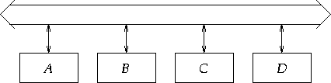
Bus Construction
  A bus consists of a set of parallel data lines
  To transfer data using a bus:
    connect the output of the source register to the bus;
    connect the input of the target register to the bus;
    when the clock pulse arrives, the transfer occurs

Slide 27
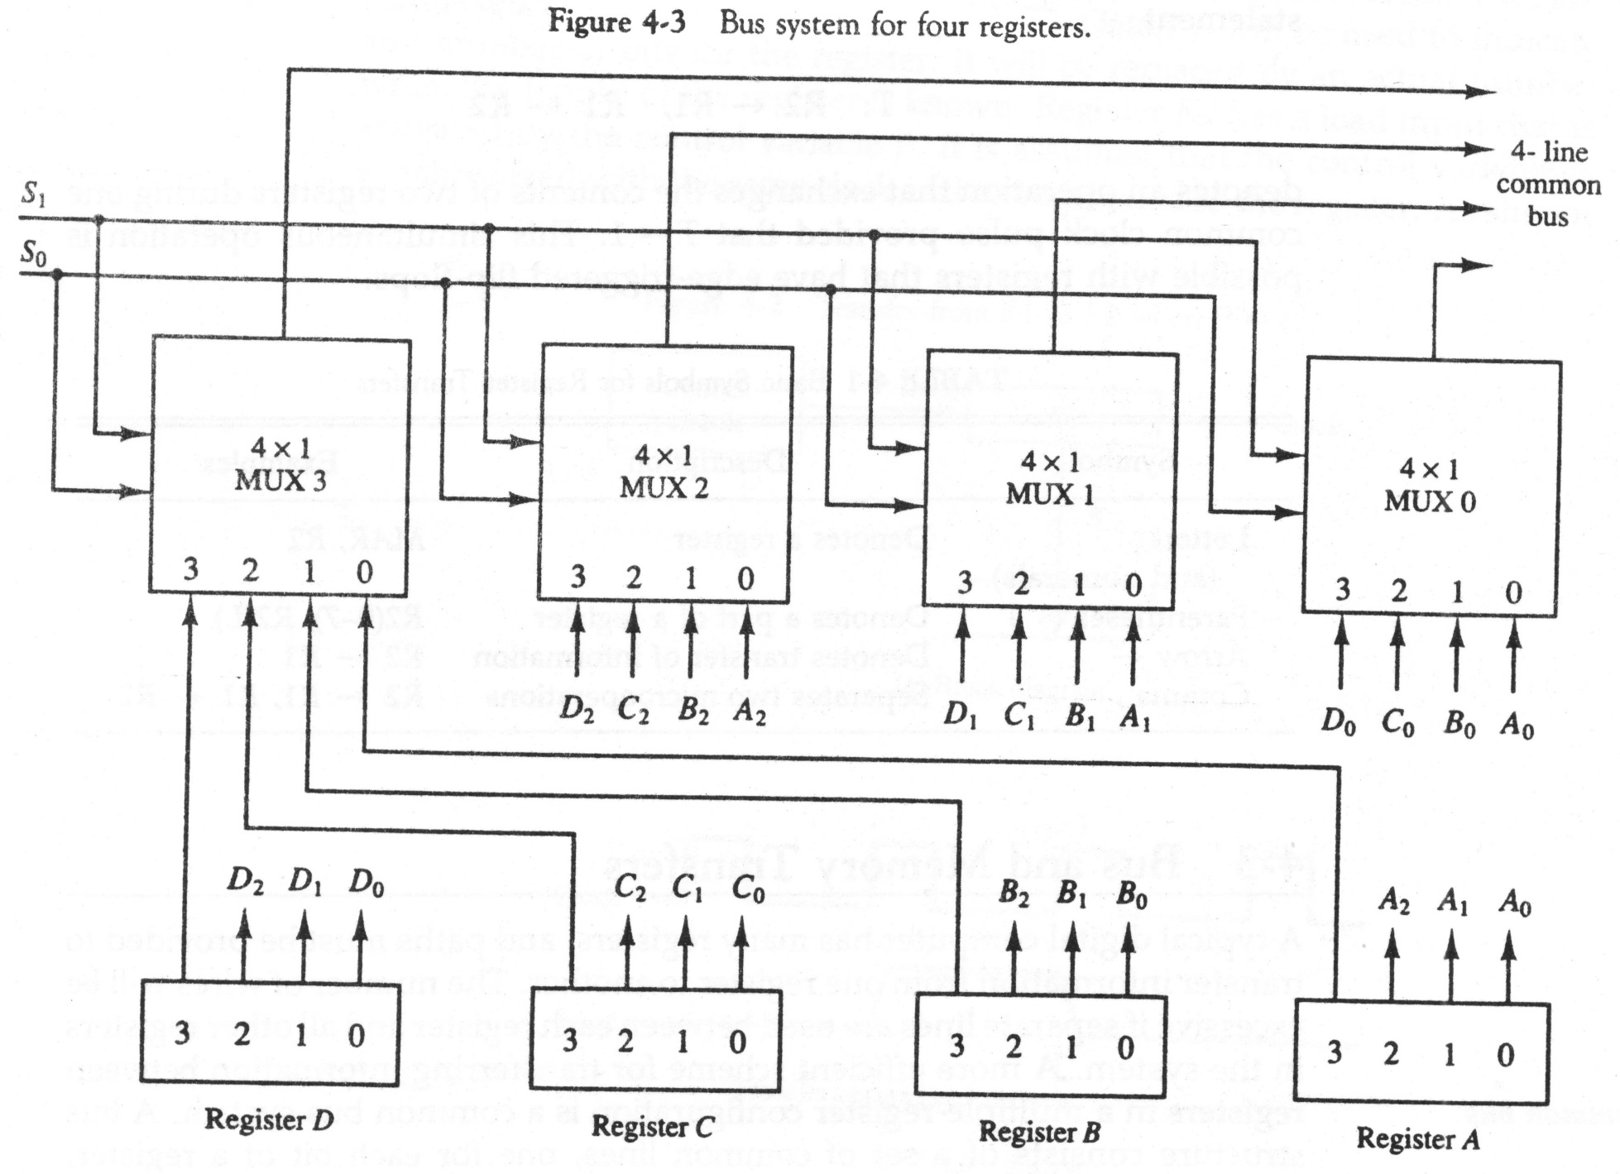
Bus and Memory transfers

Slide 28
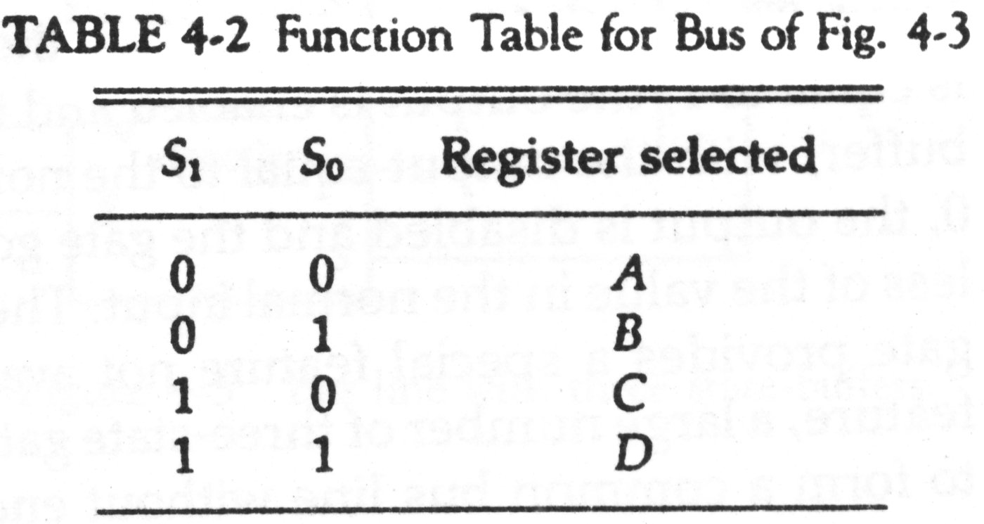



Step 1: The content of register C is placed on the bus
Step 2: The content of the bus is loaded into register A by activating its load control input.

Slide 29
Question
A digital computer has a common bus system for 16 registers of
32 bit each. The bus is constructed with multiplexers.
  How many selection inputs are there is each multiplexer?
  What size of multiplexers is needed?
  How many multiplexers are there in the bus?

Slide 30
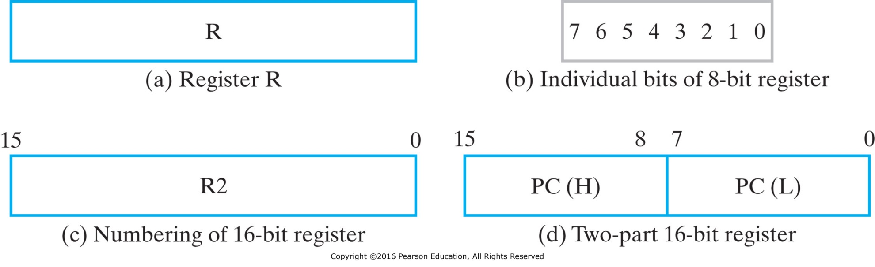
Register Transfer Language
  Micro operations (micro-ops) are operations on data stored in registers
  Register transfer language (RTL) is a concise and precise means of describing those operations
RTL expressions are made up of elements which describe the registers being manipulated, and the micro-ops being performed on them
Registers are denoted by uppercase letters (sometimes followed by numbers) that indicate the function of the register
  e.g. R0, R1, AR, PC, MAR, et al.
  The individual bits can be denoted using parenthesis and bit numbers or labels
    e.g. R0(0), R0(7:0), PC(L), PC(H)

Slide 31
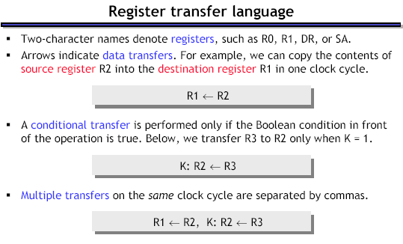
Note: The contents of the source register do not change as a result of the transfer— only the contents of the destination register change.

Slide 32
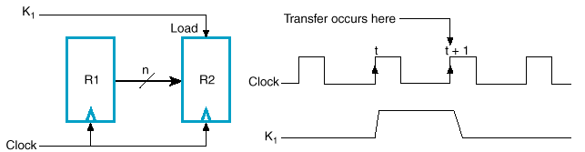
A statement that specifies a register transfer implies that datapath circuits are available from the outputs of the source register to the inputs of the destination register and that the destination register has a parallel load capability.
Every statement written in register-transfer notation presupposes a hardware construct for implementing the transfer.
All RTL statements occur in response to a clock tick. Normally we want a given transfer to occur not for every clock pulse, but only for specific values of the control signals.
  RTL conditional statements:
    e.g. If (K1 = 1) Then (R2 ← R1)
  Control function notation (Colon, :)
    e.g. K1: R2 ← R1
A comma is used to separate two or more register transfers that are executed at the same time.
  e.g. Go: R2 ← R1, R4 ← R3

Slide 33
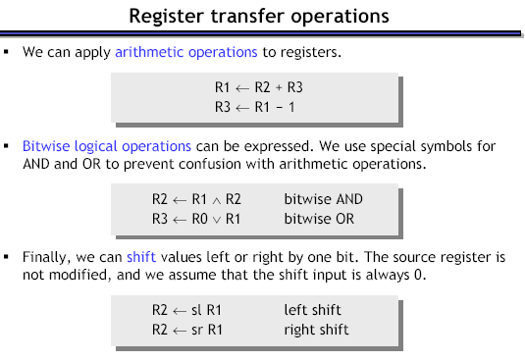

Slide 34
Bitwise operations
Most computers also support logical operations like AND, OR and NOT, but extended to multi-bit words instead of just single bits.
To apply a logical operation to two words X and Y, apply the operation on each pair of bits X_{i} and Y_{i}:
Single operand logical operation: “complementing” all the bits in a number.
1 0 1 1
AND 1 1 1 0
1 0 1 0
1 0 1 1
OR 1 1 1 0
1 1 1 1
1 0 1 1
XOR 1 1 1 0
0 1 0 1
NOT 1 0 1 1
0 1 0 0

Slide 35
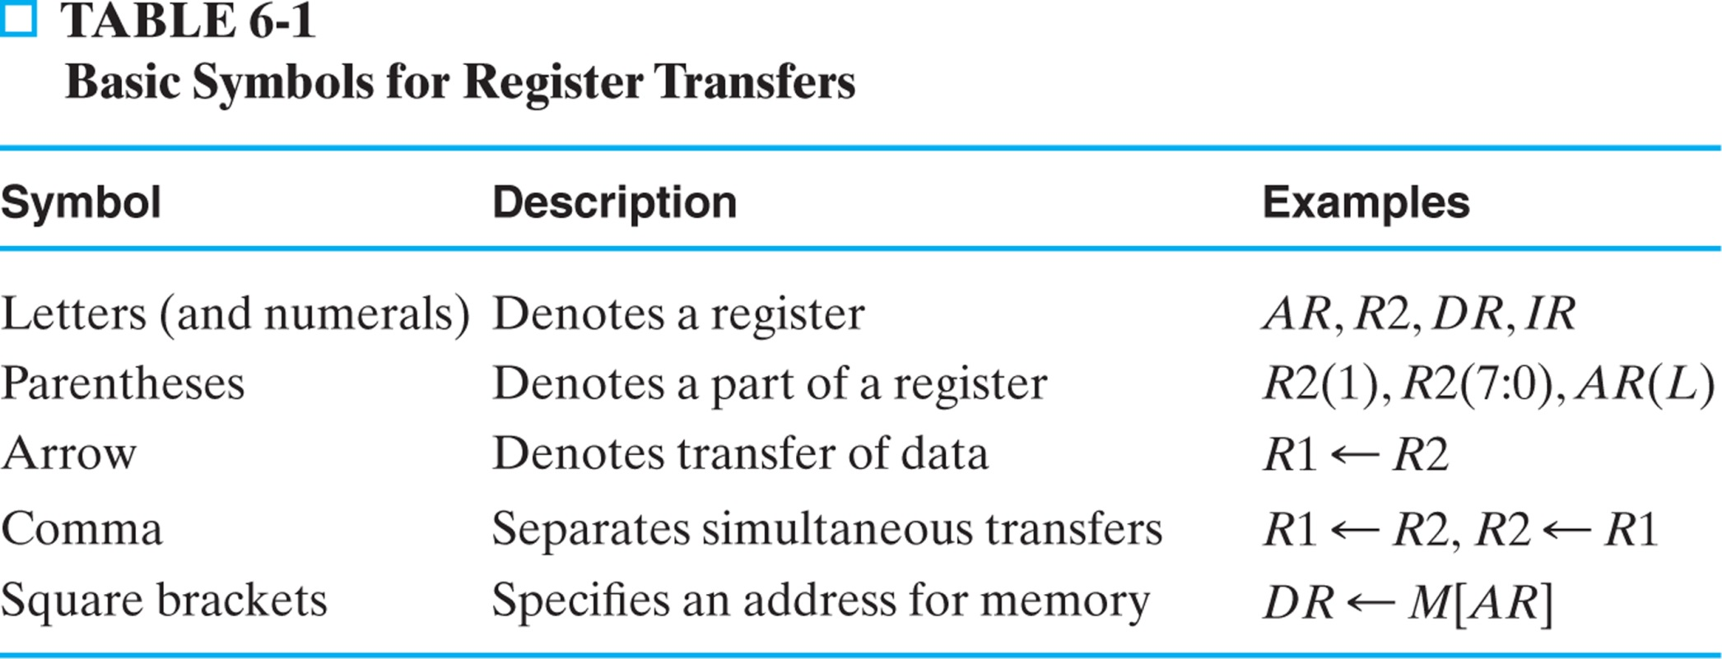
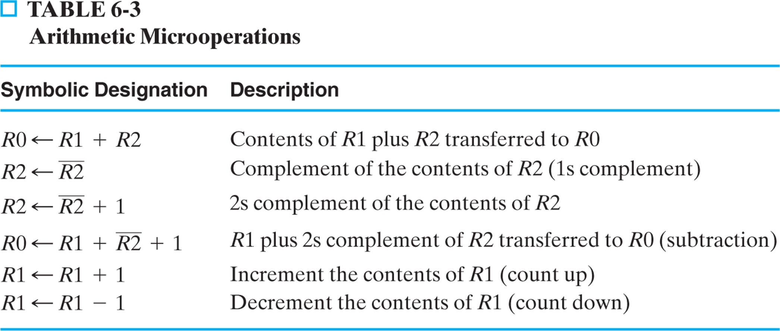

Slide 36
