Slide 1
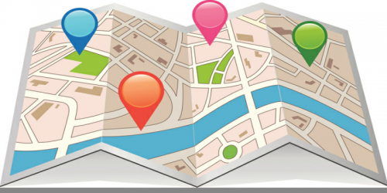
Unit 2: DIGITAL GEOGRAPHIC DATA AND MAPS: Part 1
Geo 382: Geographical Information Systems
Geology and Geophysics Department
King Saud University

Slide 2
introduction
Unlike the real world, our digital environments are composed of cartographic objects that represent the individual components of the earth.
These objects differ in size, shape, color, pattern, scale of measurement, and importance.
They can be measured directly by instruments on the ground, sensed by satellites hundreds of miles above the surface, collected by census takers, or extracted literature and existing maps.

Slide 3
Basic geographic concepts
Basic geographic concepts are:
Location
Region
Density, Pattern
Spatial Interaction
Size and Scale

Slide 4
Basic geographic concepts (location)
Location can be described in two ways: absolute and relative and answers the question of “Where is it?”
Absolute describes the position of a feature or event in space, using some form of geographic coordinates.
Relative uses descriptive text to describe the position of the feature or event in relationship to another object or event.
Understanding the location of features or events is the building blocks to geographic study, including using GIS for mapping and analysis.

Slide 5
Basic geographic concepts (location)
Absolute location describes the location of a place based on a fixed point on earth.
The most common way is to identify the location using coordinates such as latitude and longitude.
For example the absolute location of kingdom tower is 24.711374°N and 46.674429°E.
Relative location refers to the position of a place or entity based on its location with respect to other locations.
For example, Faisaliyah Tower is located 2.5 kilometers south of the kingdom tower.

Slide 6
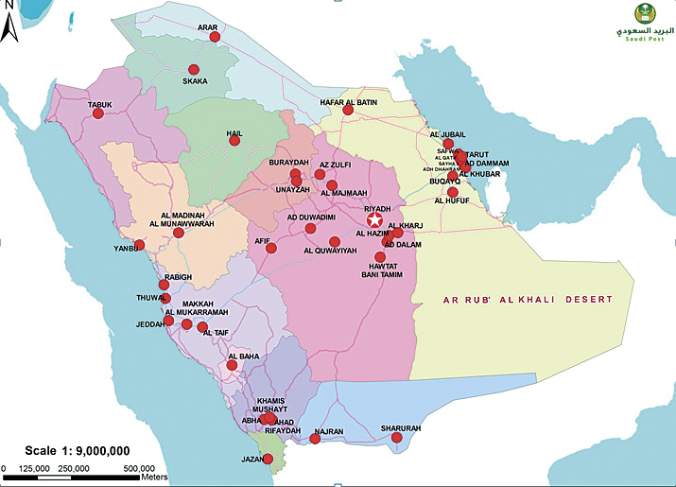
Basic geographic concepts (regions)
Regions are groupings of geographic information.
A region is a geographic area defined by one or more distinctive characteristics.
Regions can be based on physical features (such as a watershed), political boundaries (a county, country, or continent), culture or religion, or other categorized geographies.

Slide 7
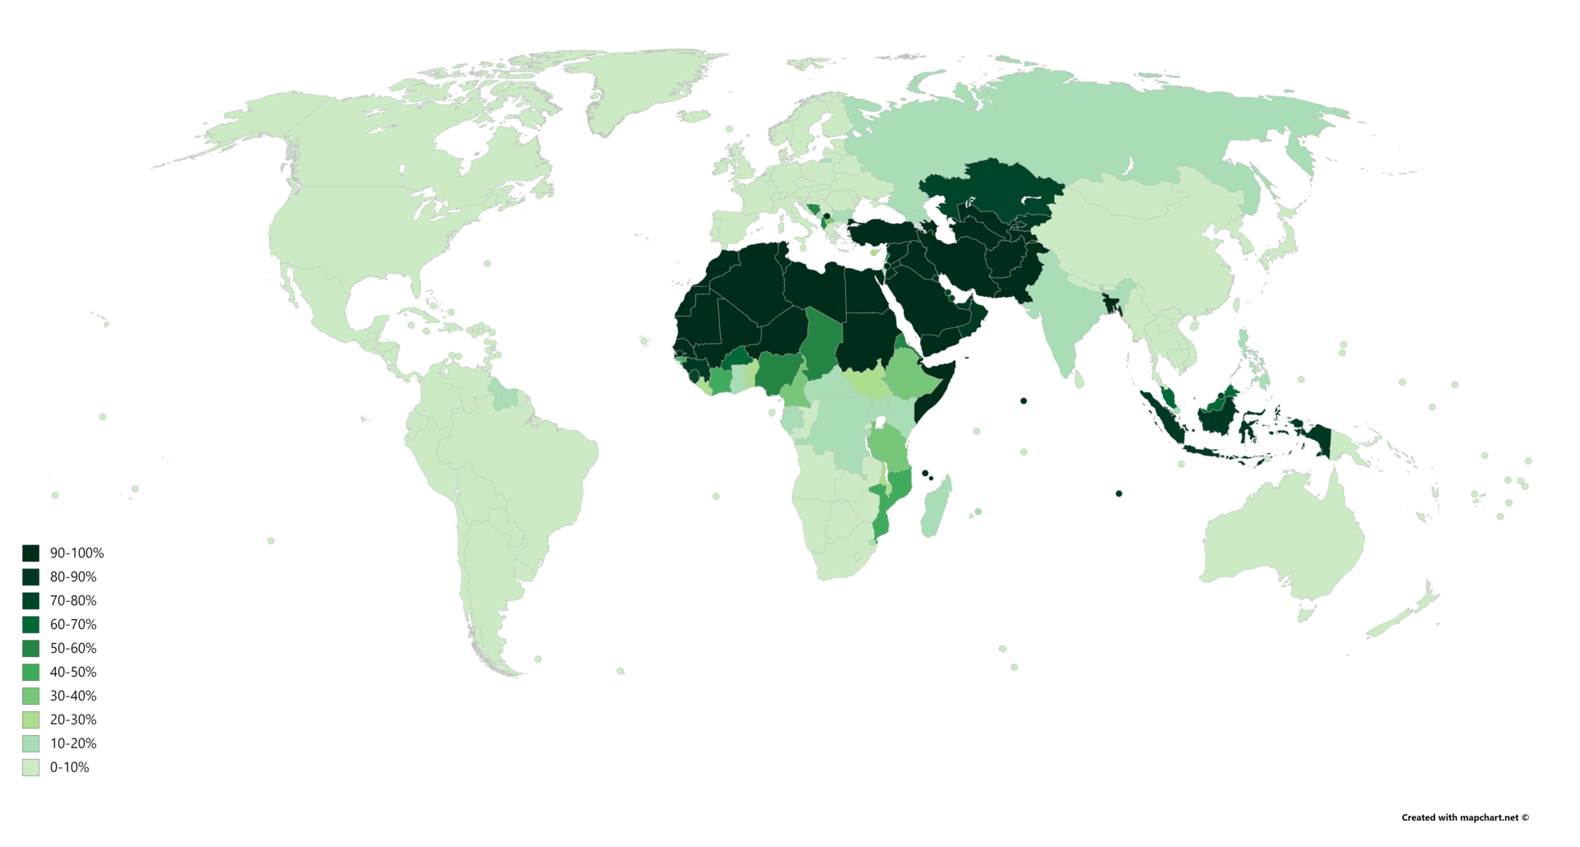
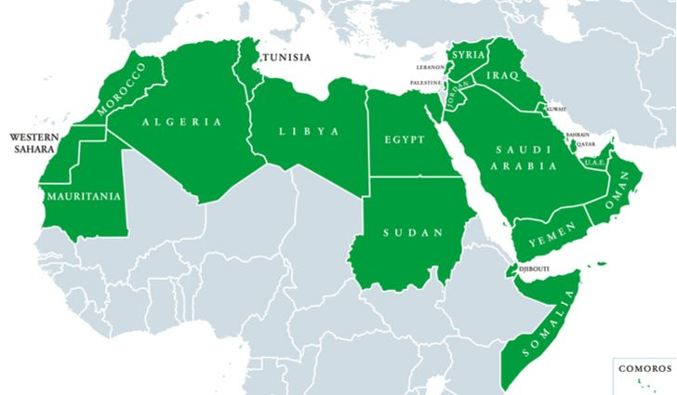
Basic geographic concepts (regions)
ISLAMIC COUNTRIES
ARAB COUNTRIES

Slide 8
Basic geographic concepts (density, pattern)
Understanding spatial pattern is an important aspect of geographic inquiry.
A spatial pattern is the placement, or arrangement of objects on Earth. It also includes the space in between those objects.
Patterns may be recognized because of their arrangement; maybe in a line or by a clustering of points.
Questions spatial patterns ask
Is there an area that is more dense with objects than others?
Is there an area that has fewer or no objects than others?
Are there clusters of objects?
Is there a randomness or uniformity to the location of the objects?
Does there seem to be a relationship between individual objects (is one object located where is its because of another)

Slide 9
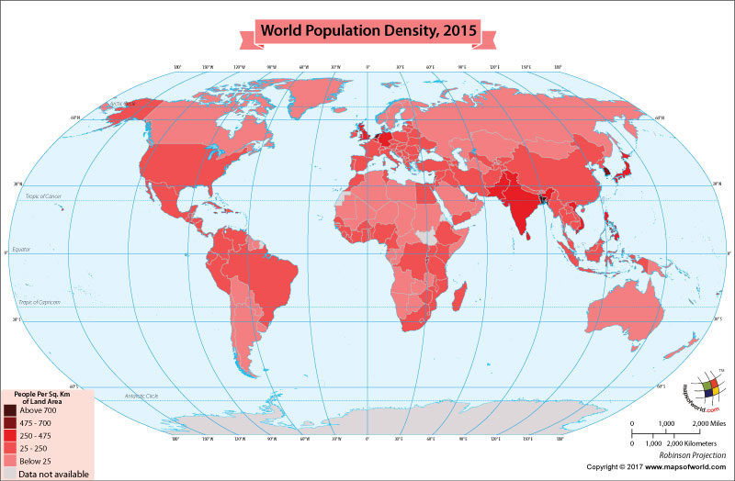
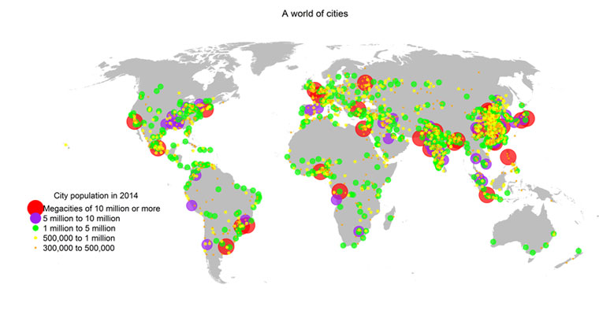
Basic geographic concepts (density, pattern)
Types of Patterns
Point pattern is spatial pattern that is composed of closely arranged, somewhat organized, points.
Line pattern can be analyzed in a similar manner as point patterns, by measuring line density, directional bias and directional alignment.
Area Pattern is spatial pattern based on density and space of areas.

Slide 10
Basic geographic concepts (Spatial Interaction)
Spatial interaction is the cause and effect of an event in one region or area that affects another area and takes a look at the connectivity and relationships of features.
A workplace such as a factory or office tower is an example of a place with a demand for labor, while a residential neighborhood provides a source of workers.
A sawmill requires logs, while a forest provides them.

Slide 11
Basic geographic concepts (size and scale)
Geographic features are visualized using a map which is a representation of reality.
The size and scale affects the degree of generalization of the features being mapped.
The smaller the scale, the less detail is shown.
In other words, a small scale shows a larger geographic area (e.g. a map of the world or of a continent) but shows more generalized features and less detail (e.g. only major highways and major rivers).
A large scale map shows a smaller geographic area (e.g. a map of a city or a neighborhood) but shows a greater amount of detail (e.g. the entire street network and all branches of a river).

Slide 12
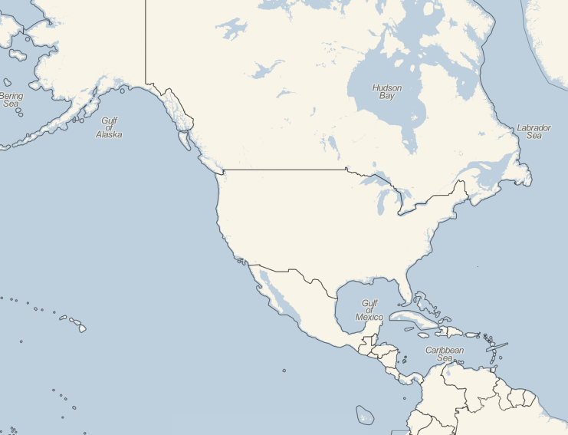
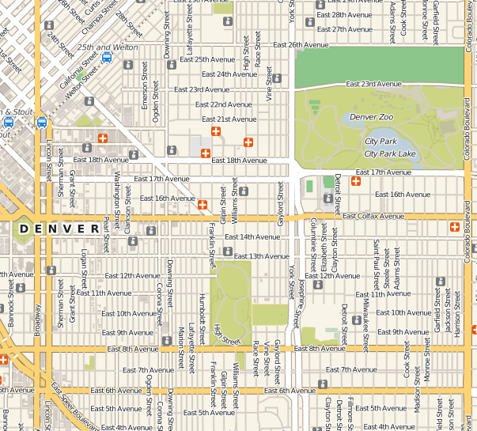
Basic geographic concepts (size and scale)
Small scale map (1:400,000)
Large scale map (1:1,500)

Slide 13
Spatial awareness
The focus on one underlying principle, the examination of spatial patterns separates geography from all other fields of study.
We will begin exercising our geographic skills by examining the types of objects and features we encounter.
Spatial objects in the real world can be thought of as occurring as four easily identifiable types: points, lines, areas, and surfaces

Slide 14
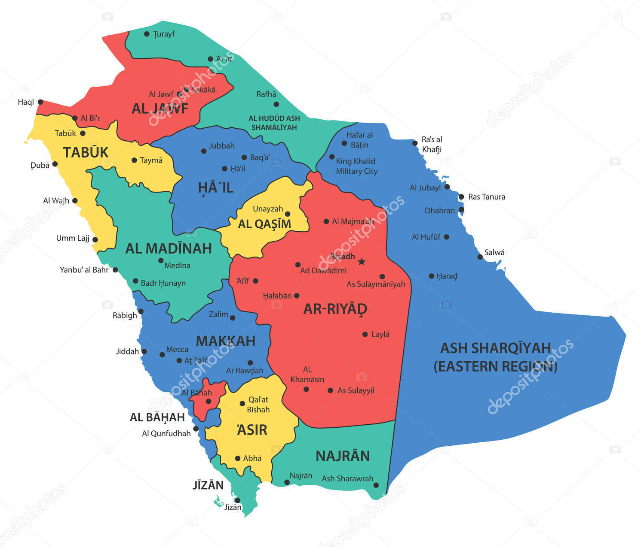
Spatial objects: points
Inside the GIS software, real-world objects are represented explicitly by three of these object types: Points, lines, and areas can be represented by their respective symbols
Point features are spatial phenomena, each of which occurs at a single location: example: trees, houses, road intersections.
Each feature is said to be discrete in that it can occupy only a given point in space at any time.
These objects have no spatial dimension (no length or width) although each can be referenced by its locational coordinates.
Points are said to have ‘‘0’’ dimensionality.

Slide 15
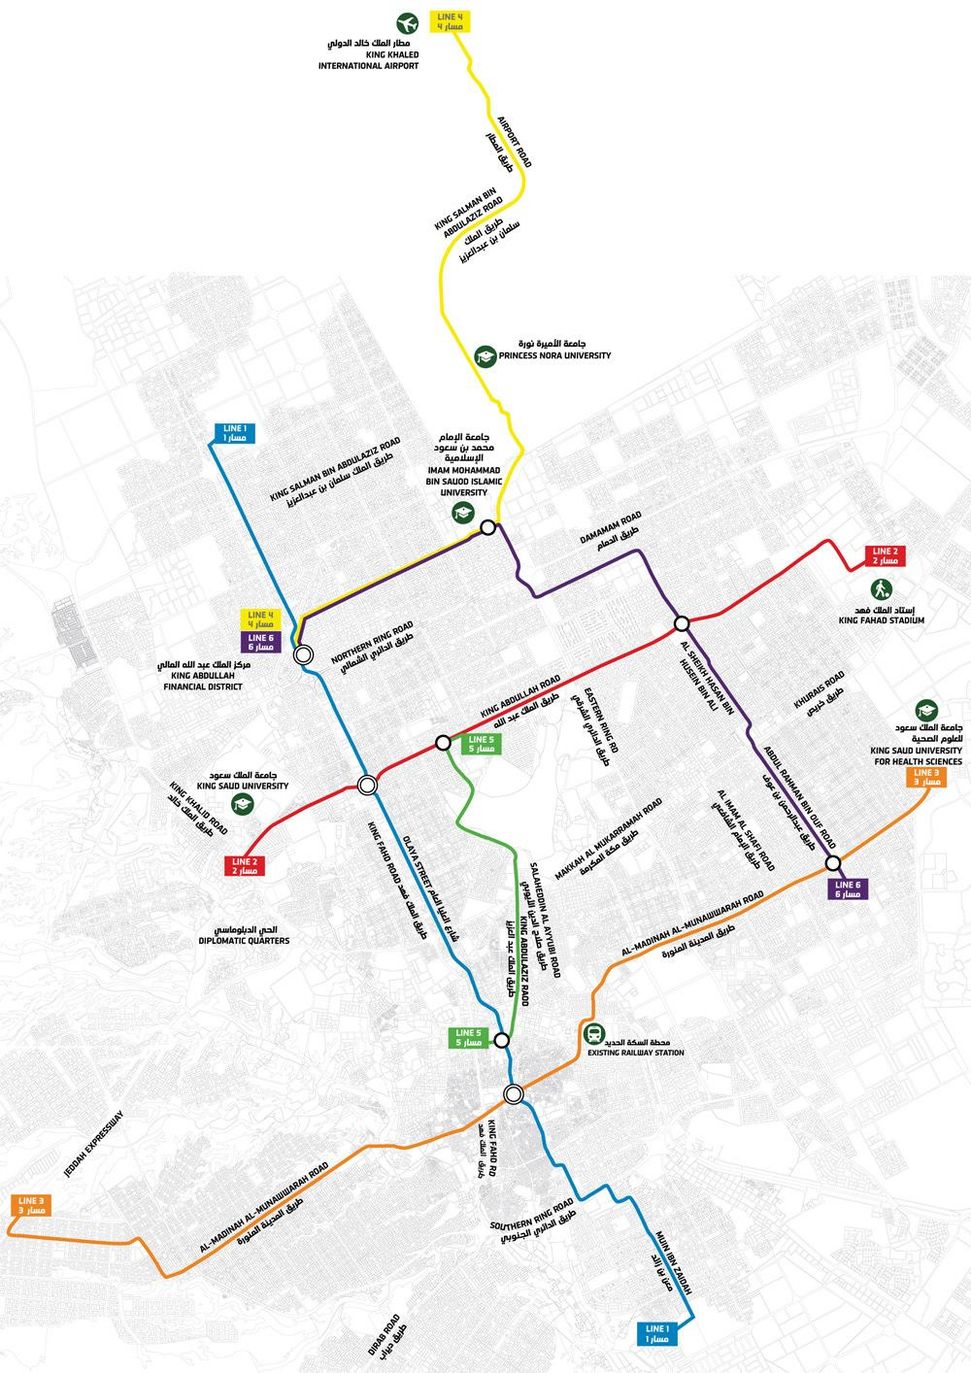
Spatial objects: line
Linear objects are perceived as occupying a single dimension in coordinate space. Examples of these ‘‘one-dimensional’’ objects include roads, rivers, political boundaries.
Linear objects, unlike point objects, have a measurable length. In addition, they require at least two coordinate pairs to describe their spatial location.
The more complex the line, the more points we need to describe them. If we take a stream as an example of a linear object, the description of its many twists and turns may require many points.

Slide 16
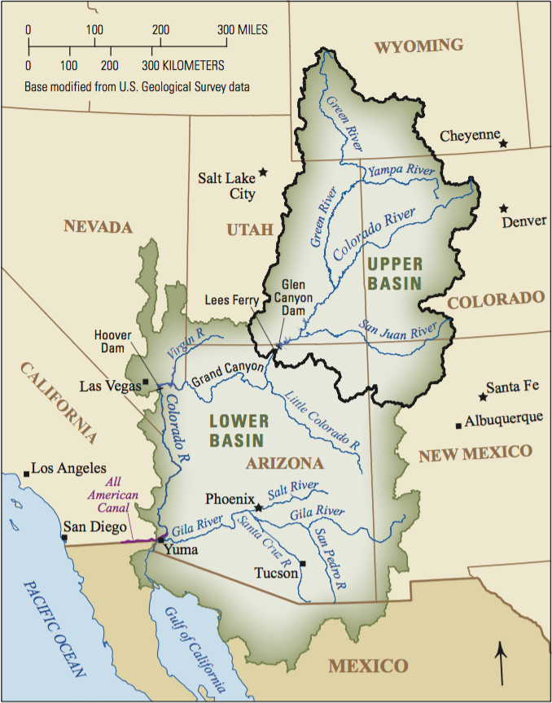
Spatial objects: area
Objects observed closely enough to be clearly seen to occupy both length and width are called areas.
Examples of ‘‘two-dimensional’’ objects include ball fields, the areal extent of a city, and even an area as large as a continent.
In GIS we conceive of areas as closed graphic forms composed of lines that begin and end at the same location.
With areas we can now add the area occupied as a measurable feature not available for points or lines.

Slide 17
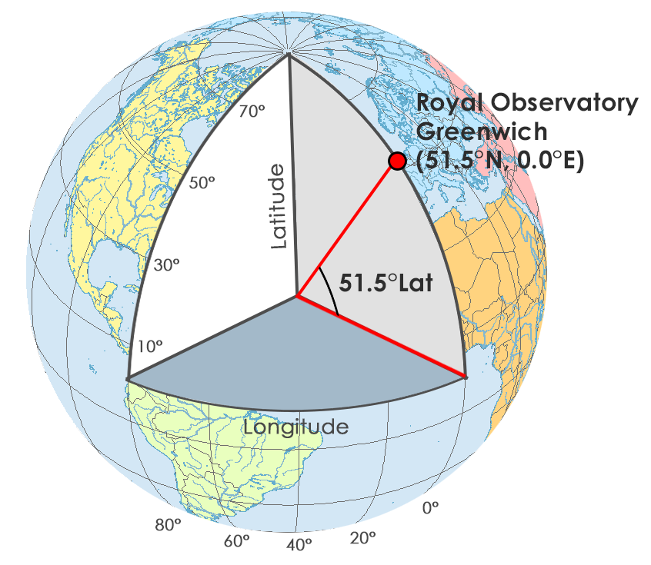
Spatial location and reference
Until now we have indicated that we can locate objects in space.
But to locate objects means that we need a mechanism to communicate the coordinates of each object.
One type of location, absolute location, gives us a definitive, measurable, fixed point in space.
But first we must have a reference system, and this reference system must have a fixed relationship to the earth we measure.
The earth is a roughly spherical object. Around that spherical shape we can use simple geometry to create a spherical grid system that corresponds to the rules of geometry.
Locations on the earth’s surface are measured in angular units from the center of the earth relative to two planes: the plane defined by the equator and the plane defined by the prime meridian.

Slide 18
Spatial location and reference
A latitude measures the angle from the equatorial plane to the location on the earth’s surface.
The latitude is specified by degrees, starting from 0° and ending up with 90° to both sides of the equator, making latitude Northern and Southern.
The equator is the line with 0° latitude.
A longitude measures the angle between the prime meridian plane and the north-south plane that intersects the location of interest.
The longitude is defined as an angle pointing west or east from the Greenwich Meridian, which is taken as the Prime Meridian.
The longitude can be defined maximum as 180° east from the Prime Meridian and 180° west from the Prime Meridian.
Both latitude and longitude are measured in degrees, which are in turn divided into minutes and seconds.

Slide 19
Spatial location and reference
LATITUDE
LONGITUDE

Slide 20
MAP SCALE
Scale is the amount of map reduction. It can be defined as the ratio of distance on the map to the same distance on the earth.
A map legend might indicate that 1 inch on the map is equal to 5,280 feet on the ground. Such a scale, expressed as ‘‘1 inch equals 5,280 inches,’’ is called a verbal scale and is easily understood by most map users.
Another common method is the representative fraction (RF) method, in which both the map distance and the ground distance are in the same units as a fraction. This eliminates the need to include units of measure. An example would be 1:24,000.
A graphic scale is another method of expressing scale; here, distances appear graphically on the map. GIS map manipulations are likely to entail many changes in output scale.
A graphic scale device can be placed on the map during input and, as the map scale changes on output, so will the scale bar itself.

Slide 21
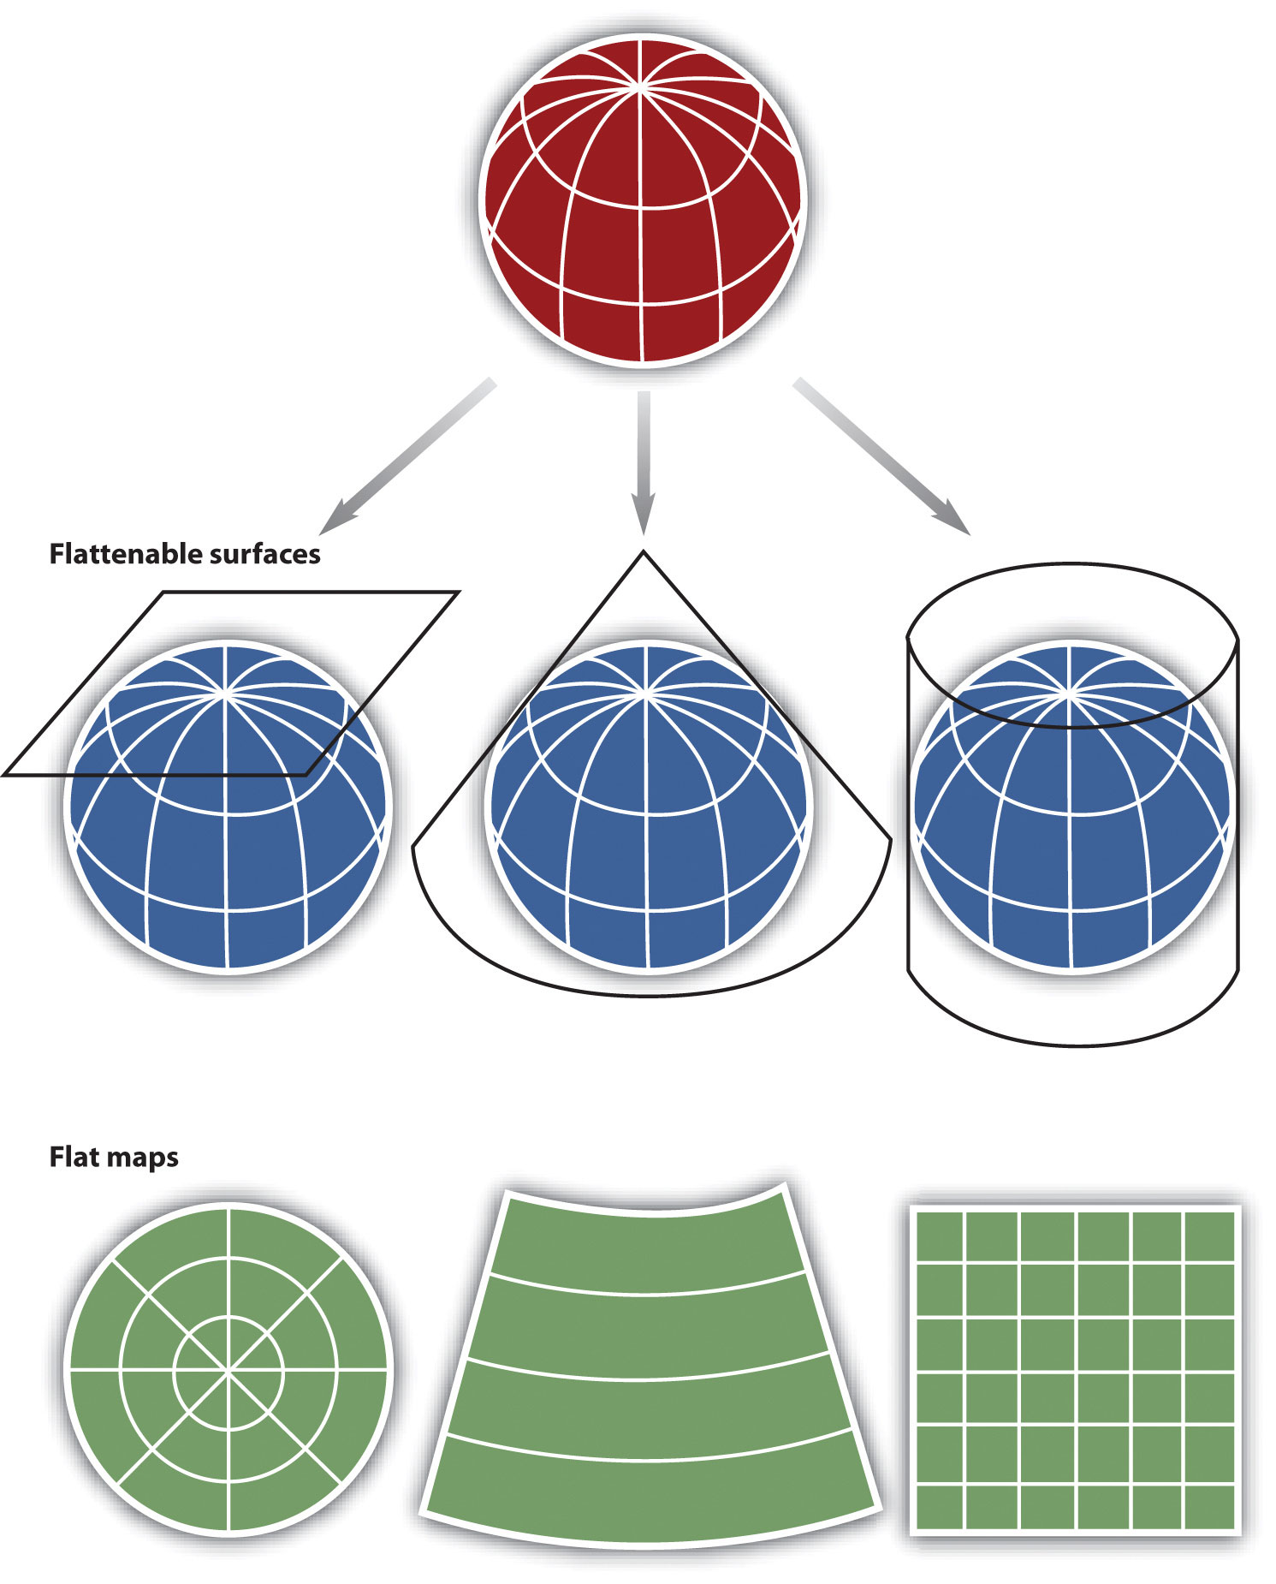
Map projections
When viewed up close the earth appears to be relatively flat except for the terrain.
We all know that earth is more or less spherical.
Maps are reductions of reality, designed to represent not only earth’s features, but its shape and spatial configurations as well.
Cartographers have developed a set of techniques called map projections to relatively accurately represent the spherical earth in two-dimensional media.

Slide 22
Map Projections
Different ways of map projecting could be produced by surrounding the globe in a cylindrical fashion, as a cone, or even as a flat piece of paper.
Each of these methods produces a projection family.
Thus, there is a family of azimuthal projections a family of cylindrical projections, and a family of conical projections

Slide 23
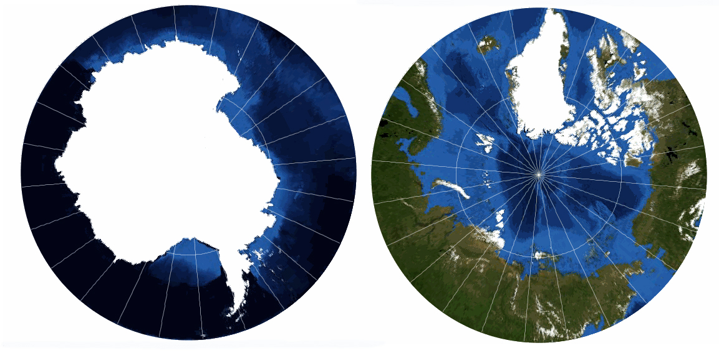
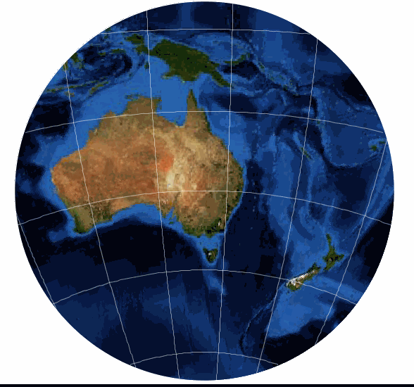
Common map projections
Azimuthal Projection – Stereographic
This is the oldest known projection and is probably one of the most widely used Azimuthal projections.
It is most commonly used over Polar areas, but can be used for small scale maps of continents such as Australia.
The great attraction of the projection is that the Earth appears as if viewed form space or a globe.
This is a conformal projection in that shapes are well preserved over the map, although extreme distortions do occur towards the edge of the map.
Directions are true from the center of the map (the touch point of our imaginary ‘piece of paper’), but the map is not equal-area.

Slide 24
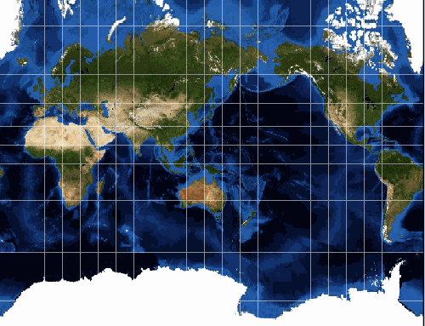
Common map projections
Cylindrical Projection – Mercator
One of the most famous map projections is the Mercator, created by a Flemish cartographer and geographer, Geradus Mercator in 1569.
The Mercator Projection always has the Equator as its Standard Parallel.
Its construction is such that the lines of longitude and latitude are at right angles to each other – this means that a world map is always a rectangle.
The lines of longitude are evenly spaced apart. But the distance between the lines of latitude increase away from the Equator. This relationship is what allows the direction between any two points on the map to be constant true direction.

Slide 25
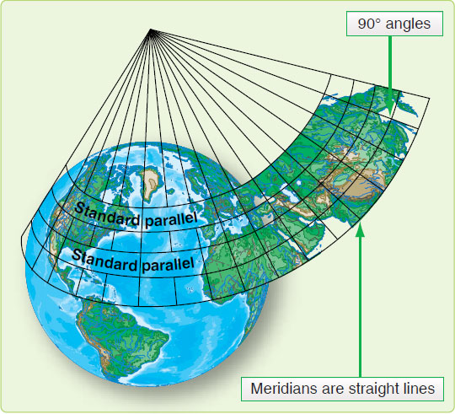
Common map projections
Conic Projection – Lambert Conformal Conic
The Lambert Conformal Conic projection has become a standard projection for mapping large areas (small scale) in the mid-latitudes – such as USA, Europe and Australia.
For world maps the shapes are extremely distorted away from Standard Parallels.
This is why it is very popular for regional maps in mid-latitude areas (approximately 20° to 60° North and South).

Slide 26
A Special Case – Universal Transverse Mercator System (UTM)
The Universal Transverse Mercator system is not really universal, but it does cover nearly the entire Earth surface.
Only polar areas: latitudes higher than 84° North and 80° South are excluded. (Polar coordinate systems are used to specify positions beyond these latitudes.)
The UTM system divides the remainder of the Earth's surface into 60 zones, each spanning 6° of longitude.
These are numbered west to east from 1 to 60, starting at 180° West longitude (roughly coincident with the International Date Line).
Each zone in turn is divided into rows or sections of 8 degrees of latitude each, with the exception of the northernmost section, which is 12 degrees, allowing all the land of the northern hemisphere to be covered with the system.

Slide 27
UTM GRID

Slide 28
Map Symbols
Since a map is a reduced representation of the real world, map symbols are used to represent real objects. Without symbols, we wouldn't have maps.
Both shapes and colors can be used for symbols on maps. A small circle may mean a point of interest, with a brown circle meaning recreation, red circle meaning services, and green circle meaning rest stop. Colors may cover larger areas of a map, such as green representing forested land and blue representing waterways.
To ensure that a person can correctly read a map, a Map Legend is a key to all the symbols used on a map. It is like a dictionary so you can understand the meaning of what the map represents.

Slide 29
