Slide 1
Unit 3

Slide 2
Different mode and types of inheritance

Slide 3
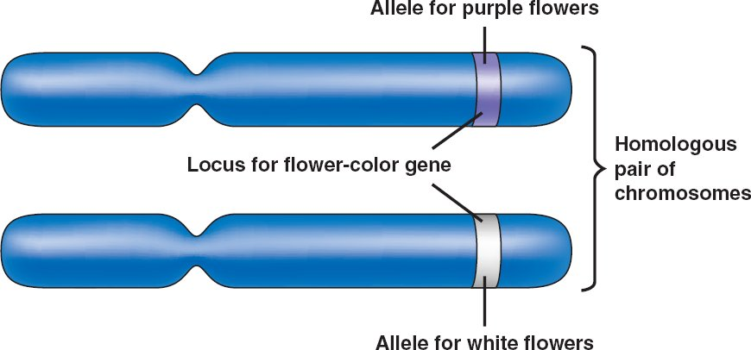
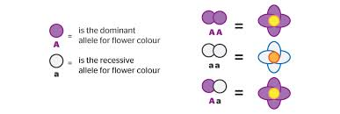
Definition
Allelle
is an alternative form of a gene (one member of a pair) that is located at a specific position on a specific chromosome.
These DNA coding determine distinct traits that can be passed on from parents to offspring.
The process by which alleles are transmitted was discovered by Gregor Mendel and formulated in what is known as Mendel’s law of segregation.
Example:
The gene for seed shape in pea plants exists in two forms, one form or allele for round seed shape (R) and the other for wrinkled seed shape (r).

Slide 4
Inheritance
Genetic trait or characteristic that is passed on from a parent to the next generation of offspring
Dominant genes are most often expressed as observable characteristics.
Recessive genes are most often masked by the dominant genes, unless the offspring inherits one of the same recessive gene from each parent.

Slide 5
Homozygous means that the two alleles an individual possesses for one gene are the same i.e. AA or aa
Heterozygous means that the two alleles an individual possesses for one gene are different i.e. Aa

Slide 6
Mode and types of inheritance
Single Gene Inheritance
Autosomal dominant
Autosomal recessive
X-linked
Multifactorial Inheritance
Mitochondrial Inheritance

Slide 7
Single gene inheritance
Autosomal dominant
Autosomal recessive
Sex linked

Slide 8
Single gene inheritance
Genetic conditions caused by a mutation in a single gene follow predictable patterns of inheritance within families.
Types
Autosomal dominant
Autosomal recessive
X-linked

Slide 9
Autosomal recessive conditions
With an autosomal recessive condition, a gene alteration needs to be present in both copies of a particular gene to cause sufficient impairment to cell function to cause disease. The alterations are located on an autosome.
A person with an autosomal recessive condition must have inherited one gene alteration from each parent.
In autosomal recessive inheritance, people with one copy of the gene alteration do not have the condition. They are said to be carriers for the autosomal recessive condition.

Slide 10
types
Y- Linked (holandric inheritance)
X- linked recessive
X- linked dominant
X- linked codominant

Slide 11
SeX- linked inheritance
X-linked disorders are those in which the defective gene lies on the X sex chromosome.
If we inherit two copies of the X chromosome, we're female; an X and a Y, and we're male.
We inherit the sex chromosomes along with the other 44 (22 pairs) of non-sex chromosomes from our parents.

Slide 12
This is the reason why a male who carries an abnormal gene on his single X chromosome will express clinical signs of disease
whereas a woman who has an abnormal gene on only one of her X chromosomes will be a carrier.

Slide 13
males
X-linked disorders are most common in males as there is no second X chromosome carrying the normal copy to compensate.
In males therefore a recessive gene can cause a genetic disorder.

Slide 14
females
Females are less likely to be affected as they have the non-affected X chromosome as well.
Females rarely show signs of X-linked recessive conditions as they usually have a second unaltered copy of the gene on their other X chromosome to compensate for an altered gene.
A female who has a gene alteration on one of her X chromosomes is said to be a carrier for the X-linked recessive condition.

Slide 15
X-linked dominant
The inheritance pattern describing a dominant trait or condition caused by a mutation in a gene on the X chromosome.
The condition is expressed in heterozygous females as well as males, who have only one X chromosome.
Affected males tend to have more significant disease than affected females.
Disorders inherited in this manner are relatively rare.

Slide 16
Multifactorial inheritance

Slide 19
CHARACTERISTICS OF MULTIFACTORIAL INHERITANCE
Polygenic threshold characters tend to run in families because affected individuals have relatives who share their genes with them.
Parents who have several affected children will have more high risk alleles than parents with only one affected child.
Thus recurrence risk increases with increasing number of previously affected children.

Slide 20
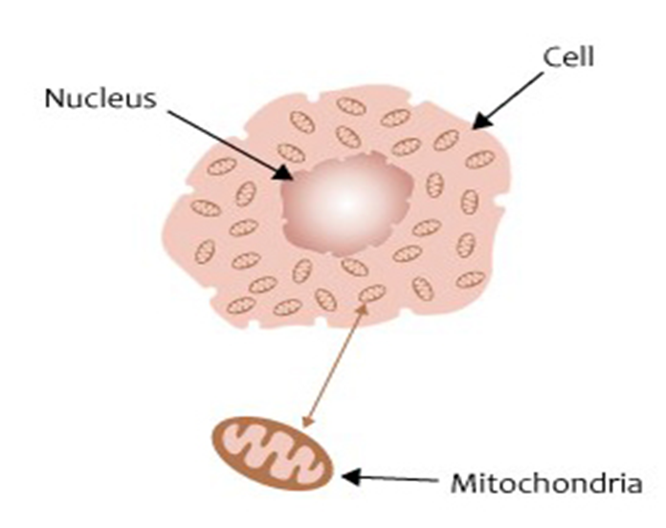
Mitochondrial inheritance
The transmission of the mitochondrial genome from mother to child.
WHY? Since egg cells, but not sperm cells, keep their mitochondria during
fertilization, mitochondrial DNA is always inherited from the female parent.
Causes: mutations in the non-nuclear DNA of mitochondria.
Both males and females are equally affected
An affected male does not pass on his mitochondria to his children, so all his children will be unaffected. This is called mitochondrial (sometimes matrilineal) inheritance.
Neuromuscular Features.

Slide 21
KEY POINTS to remember
The pattern of inheritance associated with alterations in the mtDNA involves both males and females, but always with the condition passed on through the female line (maternal inheritance).
Since many mitochondria are passed into the egg from the cells in the ovary, all the offspring of an affected woman would be expected to inherit the condition.
An affected male does not pass his mitochondria on to his children, so his children will be unaffected.

Slide 22
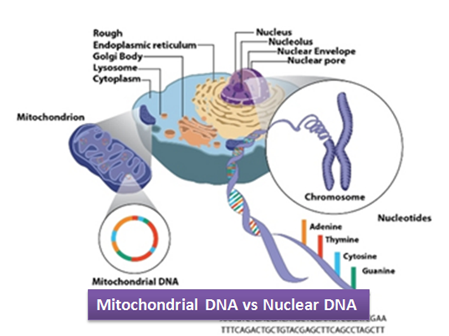
Did you know?
As a mitochondrial condition is caused by incorrectly functioning mitochondria, it may be due to:
- an alteration in the nuclear DNA (e genome)
- an alteration in the mitochondrial DNA

Slide 23
summary
Single Gene Inheritance
Changes or mutations occur in DNA sequence of a single gene
Multifactorial Inheritance
A combination of environmental factors and multiple gene
Mitochondrial Inheritance
Mutations in the non-nuclear DNA mitochondria

Slide 24
Thank you

