Slide 1
Groundwater Quality
UNIT 5

Slide 2
Groundwater quality: Introduction
Quality of groundwater is as important as its quantity.
All groundwater contains salts that are derived from the location and past movement of the water.
The quality of the required groundwater supply depends on its purpose therefore needs for drinking water, industrial water and irrigation water vary widely.

Slide 3
Groundwater quality: Introduction
To establish the quality criteria it is necessary to measure the chemical, physical, biological and radiological constituents of groundwater.
Standard methods of reporting and presenting groundwater quality parameters help in comparing the comparison of water quality from different sources.

Slide 4
Measures of water quality
The chemical characteristics of groundwater are determined by the chemical and biological reaction in the zones through which the water moves.
In specifying the quality characteristics of groundwater, chemical, physical and biological analyses are normally required.

Slide 5
Measures of water quality
Natural inorganic constituents commonly dissolved in water that are most likely to affect water use include:
Bicarbonate
Carbonate
Chloride
Sulphate
Fluoride
Iron
Magneisum
Calcium
Sodium and
Manganese

Slide 6
Measures of water quality
In addition there are other minor constituents which are present and are reported in elemental form.
Water quality analysis also includes measurement of pH and specific electrical conductance.
Properties of groundwater evaluated in physical analysis include temperature, color, turbidity odor and taste.
Bacteriological analysis includes tests to detect the presence of coliform bacteria which indicates the sanitary quality of water for human consumption.

Slide 7
Major Cations
The cations which are present in greater concentration (almost always greater than 1mg/L) are called the major cations.
They include
Calcium (Ca²⁺)
Magnesium (Mg²⁺)
Sodium (Na⁺)
Potassium (K⁺)

Slide 8
Major Anions
The anions which are present in higher concentrations (normally higher than 1mg/L) are called major anions.
The include
Bicarbonate (HCO3)⁻
Sulfate (SO4)²⁻
Chloride (Cl⁻)

Slide 9
Minor ions
Cations and anions present in the concentration range of 0.01-1.0mg/L are know as minor ions.
They include
Iron
Manganese
Nitrate
Ammonium
Hydrogen Sulfide
Fluoride
Boron

Slide 10
Trace ions
Virtually all the elements from the periodic table which have not been included as major air minor ions can be included in the category of trace ions.
Their concentration range in groundwater is normally less than 0.01mg/L.
Where the ions in question are toxic to humans (e.g. Cadmium, Mercury) and/or to wildlife (e.g. Aluminum, Zinc, Copper) their importance in practical terms far outweigh the contribution to TDS of the water.

Slide 11
Hardness
Hardness of groundwater results from the presence of Calcium and Magnesium in groundwater.
The total hardness H_{T} can be given by the formula H_{T} = 2.5Ca +4.1Mg
where Ca and Mg concentrations are in mg/l.
Water Class | Hardness (mg/l) as CaCO₃
Soft | 0-75
Moderately Hard | 75-150
Hard | 150-300
Very Hard | Over 300

Slide 12
Total Dissolve Solids (TDS)
The TDS content of the water is the most common measure of the content of overall dissolved mineral matter in water.
It is also the best measure of the salinity of water.
TDS can be calculated by summing the concentrations of the individual dissolved components of the water.
Based on the TDS of water, it is possible to classify the water as follows.
Type of Water | TDS value (mg/L)
Fresh | Less than 1000
Brackish | 1000-10,000
Saline | 10,000-100,000
Hyper Saline | Greater than 100,000

Slide 13
pH
pH is the most common measure of the acidity/alkalinity balance in a solution.
Values of acidity fall within the range of 0-14 (no units).
Water having a pH of 7 is said to be neutral.
If the pH is less than 7, the water is said to be acidic.
If the pH is more than 7 the water is said to be alkaline

Slide 14
Chemical Analyses: TDS by Electrical Conductance
A rapid determination of total dissolved solids can be made by measuring the electrical conductance of a groundwater sample.
Conductance of a given groundwater sample increases with the increase in salt concentration.
Specific conductance is measured in microsiemens/cm.

Slide 15
Chemical Analyses
Once a sample of groundwater has been analysed in the laboratory, methods for reporting water analyses must be considered.
From an understanding of expressions and units for describing water quality, standards can be established so that the analyses can be interpreted in terms of the ultimate purpose of water supply.

Slide 16
Chemical Analyses: Concentration by weight
Concentration of the common ions found in groundwater are reported by weight per volume units of milligrams per litre (mg/l).
The total dissolved solids(TDS) is also reported in this manner.
Parts per million (ppm) can also be used at times instead of mg/l.

Slide 17
Chemical Analyses: Chemical Equivalence
Positively charged cations and negative anions combine and dissociate in definite weight ratios.
By expressing ion concentration in equivalent weights, these ratios are readily determined because one equivalent weight of a cation will exactly combine with one equivalent weight of an anion.
When the concentrations in mg/l is divided by the combining weight of the cation or anion the equivalent weight expressed in milliequivalets per liter (meq/l) results.
In application, therefore it may be expected that of the total dissolved solids in groundwater sample, the sum of cation and the sum of anion when expressed in meq/l should be equal.
If the chemical analyses of the various ionic constituents indicates a difference from this balance, it may be concluded that either there are other undetermined constituents present or there is error in the analyses.

Slide 18
Cation-Anion Balance
Once the chemical analysis is complete, the final test of quality is provided by the principle of electroneutrality which states that water is electrically neutral and does not carry any positive or negative charge.
Therefore the some of the positively charged (cations) dissolved ions in water must be equal to the sum of the negatively (anions) charged dissolved ions in water.
This can be checked by the cation-anion balance (CAB) of the water which is defined as
CAB % = (sum of cations) - (sum of anions)
--------------------------------------------x100
(sum of cations) + (sum of anions)
The concentration of the ions are expressed in meq/L
If the value of CAB is less than 5%, the analysis is said to be sufficiently accurate for all uses.

Slide 19
Graphic representation of groundwater quality: Pie Charts
The simplest way of representing groundwater quality are the pie-charts.
The diameter of the pie chart can be scaled according to the concentration of the TDS

Slide 20
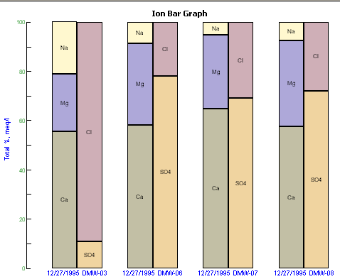
Graphic representation of groundwater quality: Bar Graphs
Vertical bar graphs are widely used for showing the chemical quality of groundwater.
The anlysis is shown as a vertical bar having height proportional to the total concentration of cation or anion, expressed in milliequivalets per liter.
The concentrations are divided horizontally to show the concentration of major ions or groups of closely related ions identified by different shading patterns.

Slide 21
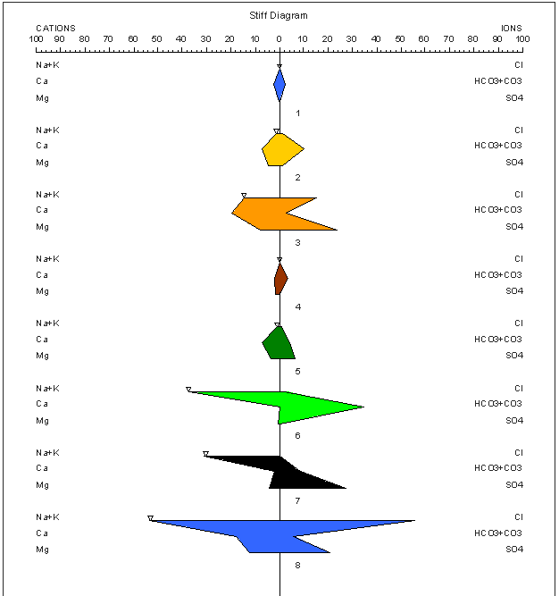
Graphic representation of groundwater quality: Stiff Diagarm
Pattern diagrams were first suggested by Stiff for representing chemical analyses.
Concentrations of cations are plotted to the left of a vertical zero axis and the anions to the right. All values are in meq/l.
The resulting point when connected form an irregular polygonal pattern.
Water of similar quality define a distinctive shape.

Slide 22
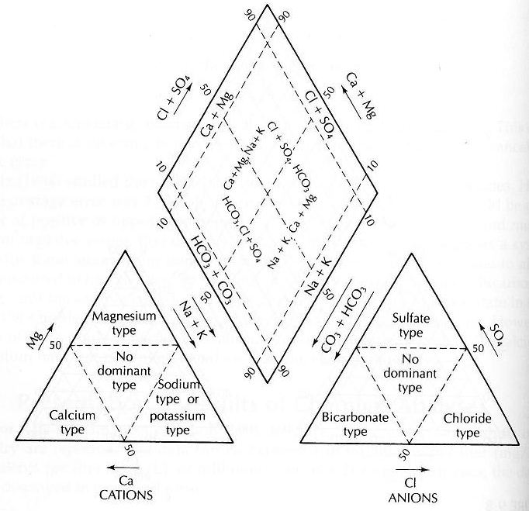
Graphic representation of groundwater quality: Piper Plot
The most commonly used diagram to interpret the results of water quality is the Piper Plot.
To plot an analysis on a Piper Plot, the cations and anions are first plotted separately in the traingles at the bottom left and right and the lines are drawn upward from the plotting position within both the triangles until the meet within the upper diamond.

