Slide 1
Unit 5: GIS Output and design
Geo 382: Geographical Information Systems
Geology and Geophysics Department
King Saud University

Slide 2
introduction
Output is the final product of any analysis. If our output is unintelligible or inadequately communicates the final results of analysis, we have failed in our mission.
After all, our purpose is not just to analyze geographical data but also to provide a tool for decision makers.
This requires us to effectively and succinctly communicate the results of our analysis.

Slide 3
Gis Data output and visulaization
Visualizing large amounts of information interactively is one of the most attractive and useful capabilities of GIS.
High-powered computers can alter any element of the display "on the fly," changing not only the look of the graphic image but also its interpretation.
This ability to create multiple perspectives -- both literally and figuratively -- enhances a viewer's perceptive abilities to understand the phenomenon being studied like never before.

Slide 4
Advantages of Gis output
Visualizing data using current computing technology and interactive GIS has many advantages over doing so using traditional paper maps. The following is a partial list, one that grows with each new version of software and each new advance in hardware.
GIS is fully interactive. Adding new fields of data, taking them off, changing the color scheme or form of the map, adding text, moving symbols, and a host of other capabilities give a user tremendous flexibility and power.
GIS displays are zoomable and pannable. Moving around in the display offers a user new perspectives, greater (or less) detail, and new insight.
Users can take advantage of computationally intensive functions such as "draping" a perspective view over a surface (like a digital elevation model) or creating the impression of three dimensions on a 2D display (the computer screen) using complex rendering and shading algorithms.

Slide 5
Map Output Overview
Design maps for appropriate medium
Print vs. electronic
Plan a layout
Link layouts to map purpose
Choose appropriate export options

Slide 6
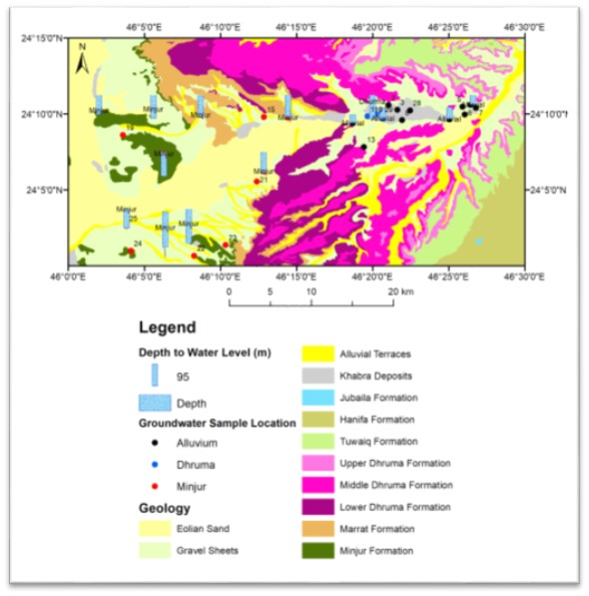
Map Output Overview
Do I know what my map’s story is?
Am I using the right map projection?
Am I using data at the right level of generalization?
Is my symbology clear?
Do my symbols match my data?
Have I used the right text symbols?
Do I need to add anything else to my map?

Slide 7
Map Layout Elements
Main map
Map title and subtitle
-what, where, and when
Legend
Data sources
Graphic scale
North arrow
Rectangular boundary (neatline)
Inset (overview) maps

Slide 8
Fonts
Simple and legible
Formal or informal
Number of fonts
Special characters
-degree symbols, degrees minutes seconds,
ESRI symbols
Placement
Halos
shadows to contrast background

Slide 9
Exporting Maps
Raster
BMP, .TIF, .JPG
Size/Resolution
Color options
Vector
Enhanced Metafile (.emf), Encapsulated
PostScript (.eps), Adobe Illustrator (.ai)

