Slide 1
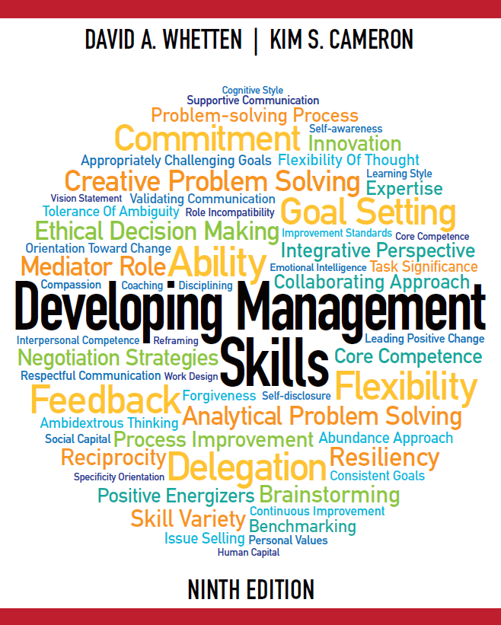

Slide 2
Developing Management Skills
Chapter 4:
Building Relationships by Communicating Supportively
Copyright © 2016 Pearson Education, Inc.
4-1

Slide 3
Learning Objectives
Build supportive relationships even when delivering negative feedback
Avoid defensiveness and disconfirmation in interpersonal communication
Improve ability to apply principles of supportive communication
Improve relationships by using personal management interviews
Copyright © 2016 Pearson Education, Inc.
4-2

Slide 4
Positive Relationships
Result in better physical and emotional well-being
Help people perform better at work and concentrate more on the task at hand.
Copyright © 2016 Pearson Education, Inc.
4-3

Slide 5
Frequent Organizational Problems
Reliance on technology
Dominance of e-mail
Less face-to-face communication
Copyright © 2016 Pearson Education, Inc.
4-4

Slide 6
Problems with Electronic Communication
Too much information, low quality
No content to information, lacks meaning
Interpretation of information depends on relationships with sender
Copyright © 2016 Pearson Education, Inc.
4-5

Slide 7
Focus on Accuracy
The ability to transmit clear and precise messages.
Copyright © 2016 Pearson Education, Inc.
4-6

Slide 8
Inconsistent Pronunciations
‘We polish Polish Furniture.’
‘He could lead if he would get the lead out.’
‘A farm can produce produce.’
‘The dump was so full it had to refuse refuse.’
‘The present is a good time to present a present.’
‘The dove dove into the bushes.’
Copyright © 2016 Pearson Education, Inc.
4-7

Slide 9
Relationships Between Unskillful Communication and Interpersonal Relationships
Copyright © 2016 Pearson Education, Inc.
4-8

Slide 10
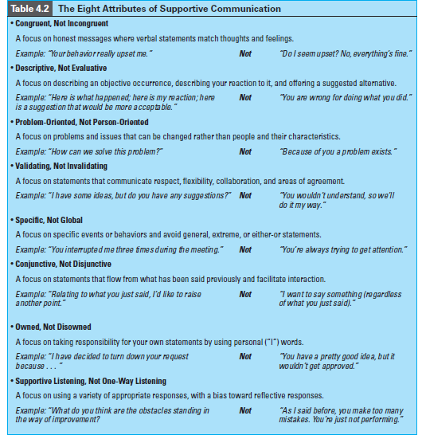

Slide 11
Coaching and Counseling
Coaching focuses on abilities:
giving advice, direction or information to improve performance
Counseling focuses on attitudes:
helping someone understand and resolve a problem him/herself by displaying understanding
Copyright © 2016 Pearson Education, Inc.
4-9

Slide 12
When to Coach or Counsel
Coach
Lack of ability
Insufficient information
Incompetence
Subordinate must understand the problem
Counsel
Personality clashes
Defensiveness
Other factors tied to emotions
“I can help you recognize that a problem exists”
Copyright © 2016 Pearson Education, Inc.
4-10

Slide 13
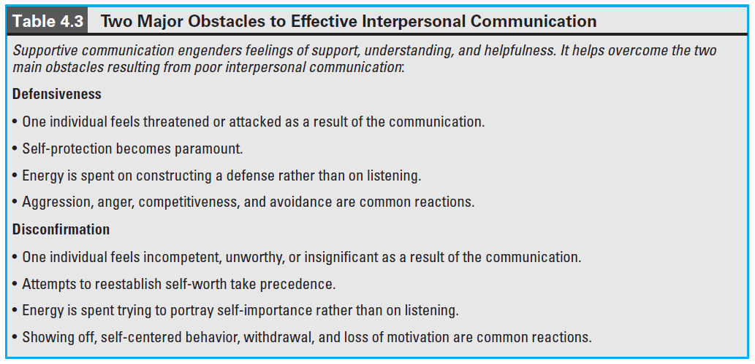
Obstacles to Supportive Communication
Copyright © 2016 Pearson Education, Inc.
4-11

Slide 14
Attributes of Supportive Communication
Congruent
Descriptive
Problem-Oriented
Validating
Specific
Conjunctive
Owned
Supportive Listening
Copyright © 2016 Pearson Education, Inc.
4-12

Slide 15
Supportive Communication
Helps the sender communicate accurately and honestly without jeopardizing interpersonal relationships
Based on congruence: a match between what an individual is thinking and feeling
Copyright © 2016 Pearson Education, Inc.
4-13

Slide 16
Supportive Communication
Is descriptive and reduces the tendency to evaluate and cause defensiveness.
Describes objectively the event, behavior, or circumstance
Focus on the behavior and your reaction
Focus on solutions
Copyright © 2016 Pearson Education, Inc.
4-14

Slide 17
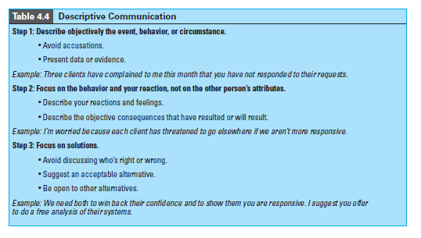
Supportive Communication

Slide 18
Supportive Communication
Is problem-oriented and does not focus on personal traits which cannot be changed.
Copyright © 2016 Pearson Education, Inc.
4-15

Slide 19
Supportive Communication
Validates and helps others feel recognized, understood, accepted, and valued.
Egalitarian
Flexible
Two-way
Based on agreement
Copyright © 2016 Pearson Education, Inc.
4-16

Slide 20
Invalidating Communication
Conveys
Superiority
Rigidity
Indifference
Imperviousness
Copyright © 2016 Pearson Education, Inc.
4-17

Slide 21
Supportive Communication
Is specific and identifies something that can be understood and acted upon.
Copyright © 2016 Pearson Education, Inc.
4-18

Slide 22
Global Communication
Focuses on extremes and absolutes which deny any alternatives. “My way or the highway!”
Copyright © 2016 Pearson Education, Inc.
4-19

Slide 23
Supportive Communication
Is conjunctive and joined to a previous message.
Copyright © 2016 Pearson Education, Inc.
4-20

Slide 24
Disjunctive Communication
Occurs when there is,
Lack of opportunity for others to speak
Extended pauses
Topic control
Copyright © 2016 Pearson Education, Inc.
4-21

Slide 25
Interaction Management
Creates conjunction by:
Taking turns speaking
Management of timing
Topic Control
Copyright © 2016 Pearson Education, Inc.
4-22

Slide 26
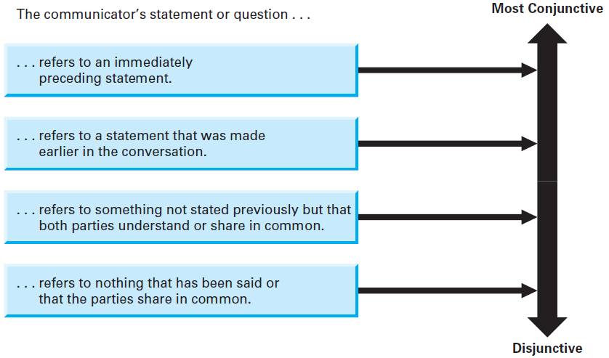
Continuum of Conjunctive Statements
Insert figure 4.2
Copyright © 2016 Pearson Education, Inc.
4-23

Slide 27
Supportive Communication
Is owned and acknowledges the source of the idea. Ownership conveys responsibility.
Copyright © 2016 Pearson Education, Inc.
4-24

Slide 28
Disowned Communication
Results in the listener never being sure of whose point of view the message represents.
Copyright © 2016 Pearson Education, Inc.
4-25

Slide 29
Supportive Communication
Requires active listening and responding effectively to someone else’s statements.
In skills important for managers, effective listening was ranked highest.
Individuals usually understand about a fourth of what is communicated.
Copyright © 2016 Pearson Education, Inc.
4-26

Slide 30
Responding to Others
Four Types of Responses
1. Advising 2. Deflecting
3. Probing 4. Reflecting
Copyright © 2016 Pearson Education, Inc.
4-27

Slide 31
Advising
Provides direction, evaluation, personal opinion, or instruction
Creates listener control over the topic
Can produce dependence
Copyright © 2016 Pearson Education, Inc.
4-28

Slide 32
Deflecting
Switches the focus from communicator’s problem to one selected by the listener
Appropriate if reassurance is needed
Imply that the communicator’s issues are not important
Copyright © 2016 Pearson Education, Inc.
4-29

Slide 33
Probing
Asks questions about what the communicator said
Used to gather information
Can appear that the communicator must justify what is happening
Copyright © 2016 Pearson Education, Inc.
4-30

Slide 34
Four Types of Probes
Elaboration
Clarification
Repetition
Reflection
Copyright © 2016 Pearson Education, Inc.
4-31

Slide 35
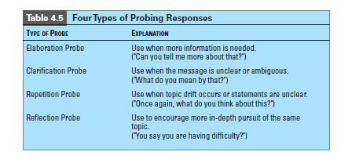
Four Types of Probes

Slide 36
Reflecting
Mirror back to the communicator the message that was heard
Involves paraphrasing and clarifying
Could appear that the listener isn’t listening
Copyright © 2016 Pearson Education, Inc.
4-32

Slide 37
Personal Management Interview
A regularly scheduled, one-on-one meeting between management and subordinates
Copyright © 2016 Pearson Education, Inc.
4-33

Slide 38
Personal Management Interview
Step 1: A role-negotiation session which sets expectations’ of employees and managers.
Step 2: A set of on-going one on one meetings to foster development and improvement.
Copyright © 2016 Pearson Education, Inc.
4-34

Slide 39
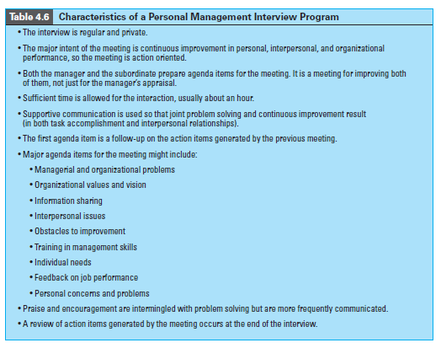

Slide 40
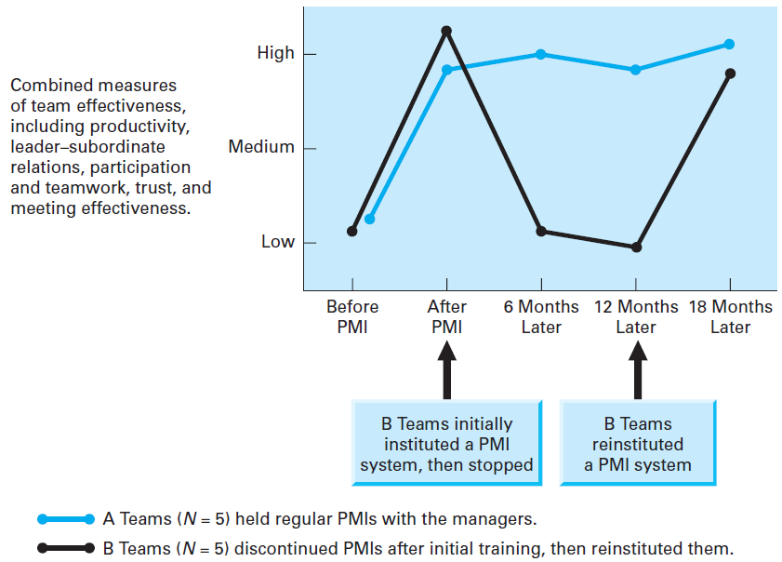
Effects of Personal Management Interview
Copyright © 2016 Pearson Education, Inc.
4-35

Slide 41
Culture and Communication
Language pattern and structures are dramatically different across cultures
There are, however, universal principles that apply to interpersonal problems
Copyright © 2016 Pearson Education, Inc.
4-36

Slide 42
Behavioral Guidelines
Differentiate between coaching situations and counseling situations
Communicate congruently. Match feelings and thoughts.
In communicating congruently, avoid creating defensiveness or disconfirmation
Use descriptive, not evaluative, statements
Use problem-oriented, not person-oriented statements
Copyright © 2016 Pearson Education, Inc.
4-37

Slide 43
Behavioral Guidelines
Use validating statements that acknowledge the other person’s importance and uniqueness
Use specific rather than global statements
Use conjunctive statements that flow smoothly from what was said previously
Own your statements, and encourage others to do likewise
Demonstrate supportive listening
Implement a personal management interview (PMI) program
Copyright © 2016 Pearson Education, Inc.
4-38

Slide 44
Copyright Information
Copyright © 2016 Pearson Education, Inc.
4-39

