Slide 1
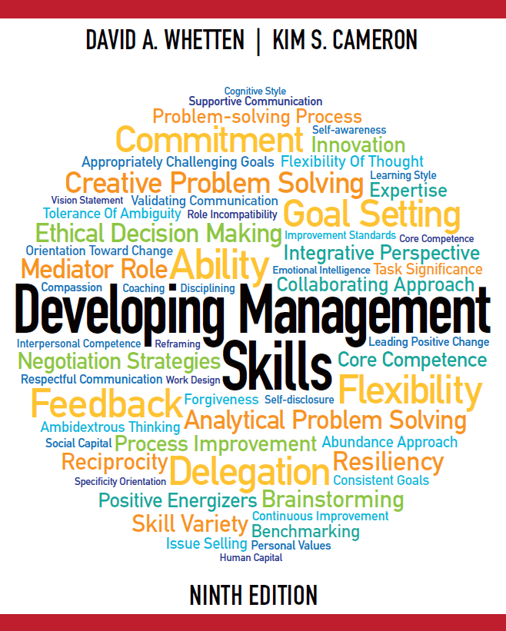

Slide 2
Developing Management Skills
Chapter 5:
Gaining Power and Influence
Copyright © 2016 Pearson Education, Inc.
5-1

Slide 3
Learning Objectives
Enhance personal and positional power
Use influence appropriately to accomplish exceptional work
Neutralize inappropriate influence attempts
Copyright © 2016 Pearson Education, Inc.
5-2

Slide 4
What is Power?
Power is the capacity to influence behavior
Effective use of power and politics is a critical managerial skill
A manager’s power comes from helping others accomplish their tasks
This usually requires political clout
Copyright © 2016 Pearson Education, Inc.
5-3

Slide 5
Odes to Power
Power tends to corrupt, and absolute power corrupts absolutely. – Lord Acton
Power has only one duty – to secure the social welfare of the People. – Benjamin Disraeli
Political power grows out of the barrel of a gun.
– Mao Tse-Tung
Copyright © 2016 Pearson Education, Inc.
5-4

Slide 6
Odes to Power
I hope our wisdom will grow with our power, and teach us, that the less we use our power the greater it will be. – Thomas Jefferson
Power? It’s like a Dead Sea fruit. When you achieve it, there is nothing there. – Harold MacMillan
Power is given only to those who dare to lower themselves and pick it up. – Fyodor Dostoyevsky
Power is the great aphrodisiac.
– Henry Kissinger
Copyright © 2016 Pearson Education, Inc.
5-5

Slide 7
A Four-Letter Word Now?
“Power has such a bad name that many good people persuade themselves they want nothing to do with it. . . . To say a leader is preoccupied with power is like saying that a tennis player is preoccupied with making shots her opponent cannot return”
- J.W. Gardner
Copyright © 2016 Pearson Education, Inc.
5-6

Slide 8
A Positive View of Power
Power can lead to great good
It is the means through which managers accomplish work
It is the lack of power that can lead to unhappiness
Copyright © 2016 Pearson Education, Inc.
5-7

Slide 9
Copyright © 2016 Pearson Education, Inc.
5-8

Slide 10
Copyright © 2016 Pearson Education, Inc.
5-9

Slide 11
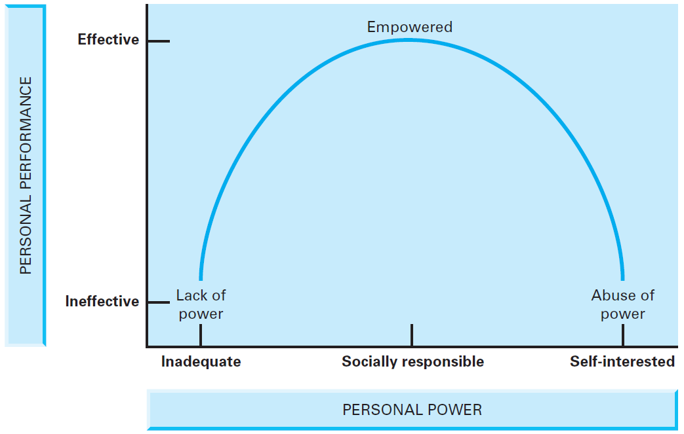
Personal Power: Stepping Stone or Stumbling Block
Insert figure 5.1
Copyright © 2016 Pearson Education, Inc.
5-10

Slide 12
Sources of Personal Power
Expertise
Personal Attraction
Effort
Legitimacy
Copyright © 2016 Pearson Education, Inc.
5-11

Slide 13
Expertise
Work related knowledge; comes from education, self-directed learning, and on-the-job experience
Copyright © 2016 Pearson Education, Inc.
5-12

Slide 14
Personal Attraction
Based on charisma, agreeable behavior and physical characteristics
Copyright © 2016 Pearson Education, Inc.
5-13

Slide 15
Characteristics of Likable People
We like people when we have a reason to believe they will:
Support an open, honest, and loyal relationship
Foster intimacy by being emotionally accessible
Provide unconditional, positive regard and acceptance
Endure some sacrifices if the relationship should demand them
Provide social reinforcement in the form of sympathy or empathy
Engage in the social exchanges necessary to sustain a relationship
Copyright © 2016 Pearson Education, Inc.
5-14

Slide 16
Effort
A desirable quality in employees
Can be related to expertise
Is viewed as a sign of commitment and dedication
Copyright © 2016 Pearson Education, Inc.
5-15

Slide 17
Legitimacy
Taking action congruent with the prevailing value system; focuses on the “hows” and “whys” of doing business the right way
Copyright © 2016 Pearson Education, Inc.
5-16

Slide 18
Sources of Position Power
Centrality
Flexibility
Visibility
Relevance
Copyright © 2016 Pearson Education, Inc.
5-17

Slide 19
Centrality
Access to information in a communication network
The most effective networks are those that have structural holes – circumstances where two people in your network are not connected to each other
Copyright © 2016 Pearson Education, Inc.
5-18

Slide 20
Flexibility
Freedom to exercise judgment; flexibility is determined by the life cycle of the position, the reward structure, and proactive personality
Proactive personality – a tendency to effect change in one’s environment
Copyright © 2016 Pearson Education, Inc.
5-19

Slide 21
Visibility
Interacting with influential people in the organization such as senior officials, decision makers, and informal leaders
Copyright © 2016 Pearson Education, Inc.
5-20

Slide 22
Relevance
Working on the central objectives and issues in an organization
Relevance is impacted by the employee’s department and the activities they perform
Copyright © 2016 Pearson Education, Inc.
5-21

Slide 23
Transforming Power into Influence
Power is a necessary precondition of influence
Influential people have power, but not all powerful people have influence
Copyright © 2016 Pearson Education, Inc.
5-22

Slide 24
The Three R’s Model
Retribution: Force others to do what you say (coercion & intimidation)
Reciprocity: Help other want to do what you say (bargaining & ingratiation)
Reason: Show others that it makes sense to do what you say (facts & appeal to values)
Copyright © 2016 Pearson Education, Inc.
5-23

Slide 25
INFLUENCE STRATEGIES: THE THREE Rs

Slide 26
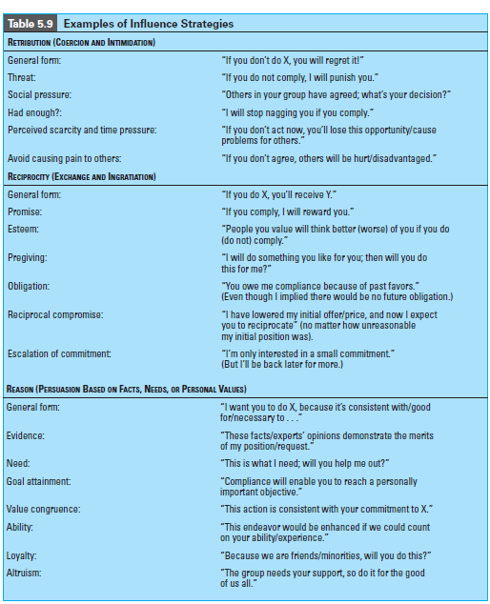

Slide 27
When to Use Retribution
Unequal power (in influencer’s favor)
Commitment and quality not important
Tight time constraints
Serious violations
Specific, unambiguous requests
Resistance to request is likely
Copyright © 2016 Pearson Education, Inc.
5-24

Slide 28
When to Use Reciprocity
Parties are mutually dependent
Each party has valued resources
Adequate time for negotiating
Established exchange norms exist
Commitment to goals not critical
Needs are specific and short-term
Copyright © 2016 Pearson Education, Inc.
5-25

Slide 29
When to Use Reason
Adequate time for extensive discussion
Common goals
Parties share mutual respect
Parties share ongoing relationship
Copyright © 2016 Pearson Education, Inc.
5-26

Slide 30
Exercising Upward Influence or Managing the “boss”
Issue Selling: convincing your boss that a particular issue is so important it requires his or her attention.
Copyright © 2016 Pearson Education, Inc.
5-27

Slide 31
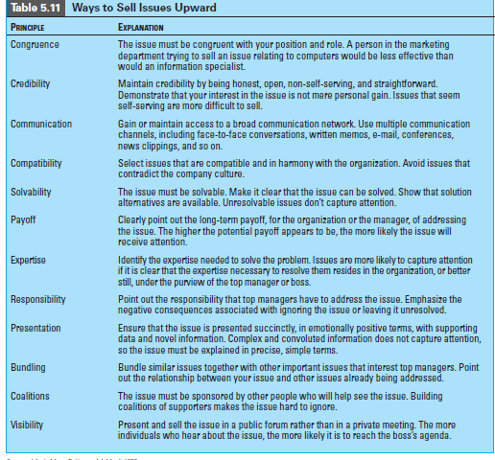

Slide 32
ACTING ASSERTIVELY: NEUTRALIZING INFLUENCE ATTEMPTS
Notes:
The importance of avoiding relationships in which individuals in power positions attempt to foster dependency in others has been the subject of research on the “toxic effects of tyranny in organizations” (Bies & Tripp, 1998). A summary of the characteristics of abusive bosses, from this study, is shown in Table 5.12. Given
the tendency for most leaders to occasionally take advantage of their position of power, we include this as a tool for identifying situations in which excess has become the norm. As you examine the following strategies for neutralizing inappropriate influence attempts, you might find it useful to use these characteristics of abusive relationships as a frame of reference. in others has been the subject of research on the

Slide 33
Neutralizing Retribution Strategies
Use countervailing power to shift dependence to interdependence
Confront the exploiting individual directly
Actively resist
Copyright © 2016 Pearson Education, Inc.
5-28

Slide 34
Neutralizing Reciprocity Strategies
Examine the intent of any gift or favor-giving activity
Confront individuals who are using manipulative bargaining tactics
Refuse to bargain with individuals who use high-pressure tactics
Copyright © 2016 Pearson Education, Inc.
5-29

Slide 35
Neutralizing Reason Strategies
Explain the adverse effects of compliance on performance
Defend your personal rights
Firmly refuse to comply with the request
Copyright © 2016 Pearson Education, Inc.
5-30

Slide 36
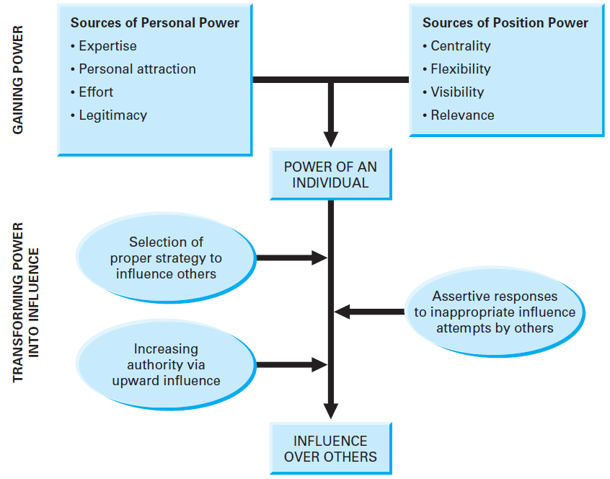
Model of Influence and Power
Insert Figure 5-2
Copyright © 2016 Pearson Education, Inc.
5-31

Slide 37
“Far better to conceive of power as consisting in part of the knowledge of when not to use all the power you have … Whoever knows how to restrain and effectively release power finds … that power flows back to him”
A. Bartlett Giamatti
Copyright © 2016 Pearson Education, Inc.
5-32

Slide 38
Behavioral Guidelines
Enhance personal power by improving your expertise, personal attraction, effort and legitimacy
Increase position power by improving your centrality, flexibility, visibility, and relevance
Copyright © 2016 Pearson Education, Inc.
5-33

Slide 39
Behavioral Guidelines
Use reason, reciprocity, and retribution strategies appropriately and, when necessary, neutralize their use upon you
Learn to sell issues to your superiors
Copyright © 2016 Pearson Education, Inc.
5-34

Slide 40
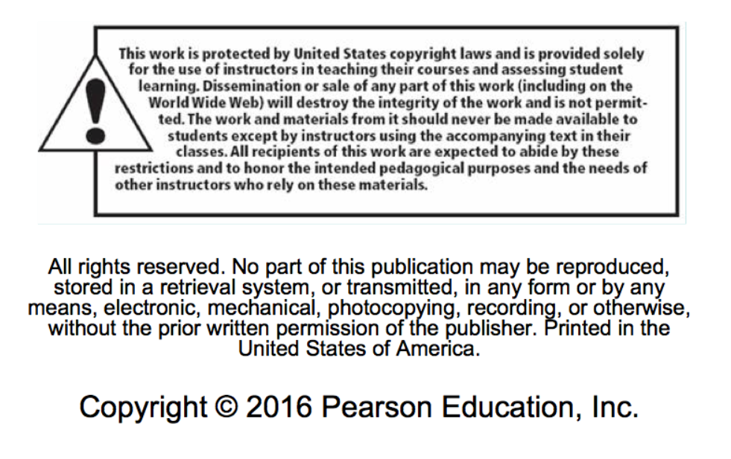
Copyright Information
Copyright © 2016 Pearson Education, Inc.
5-35

