Slide 1
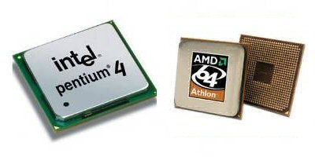
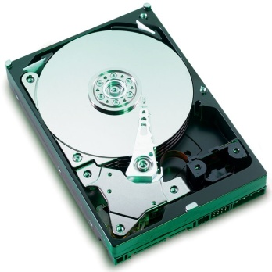
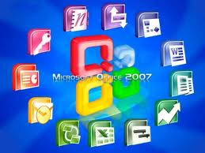
Computer performance

Slide 2
What about your computer?

Slide 3
Managing the system
If you are having problems with your computer’s hardware , you can access the Device Manager .
Any software that is currently running can be viewed and managed using the Task Manager

Slide 4
Mouse techniques
Select - deselect
Click
Right Click
Double click
Drag
On the desk top to show the short cut menu
Start or open the file
To move icons or files

Slide 5
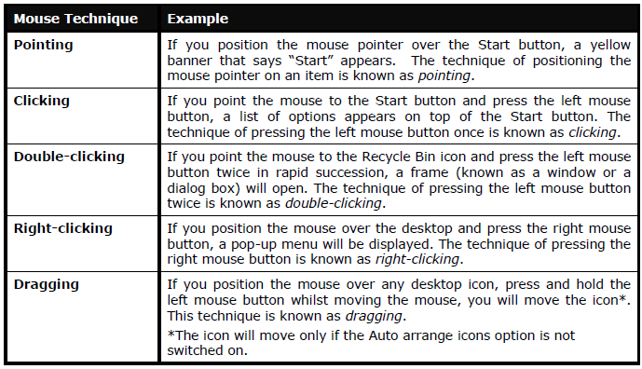

Slide 6
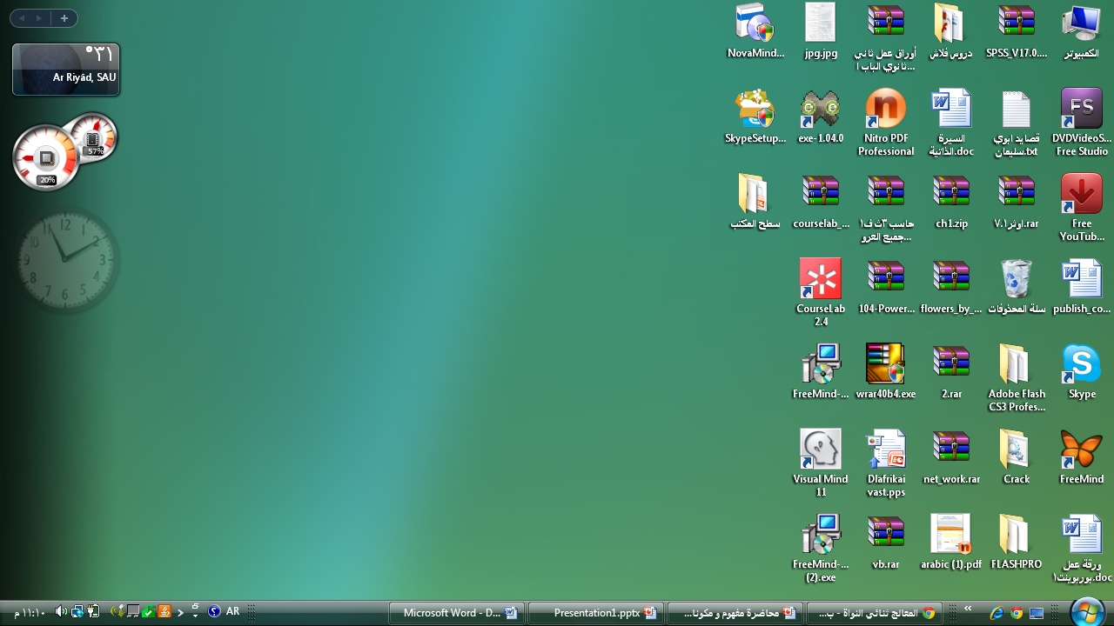
Desktop

Slide 7
Taskbar
Multi-tasking – active program
Quick launch
Notification Area
Lock the Task bar
Start menu

Slide 8
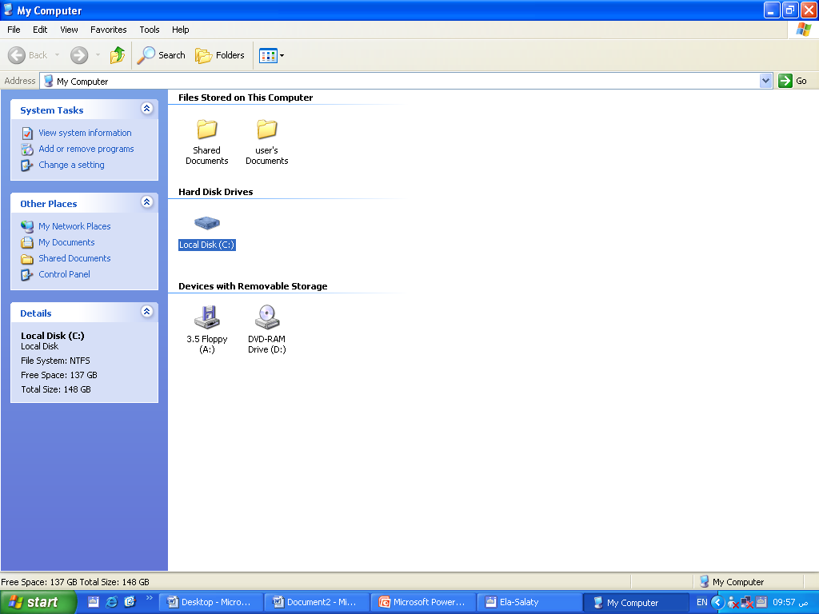
Opening Windows
Window control Buttons
Title Bar
menu Bar
Tool bar
Icons
Navigation Pane
Details Pane

Slide 9
My computer window (Different views- properties)
My Document : view->Explorer Bar,path ,details view
Folders and Files (creat – copy –cut-rename-delete-empty the recycle bin )
Files Types:Docx- pptx-xlsx- exe-jpg –mp3-zip

Slide 10
Selecting multiple Files , all files
Search
Printers : set a default –properties- printer Jobs
Print screen
Create Desk top icon(Shortcut)
Control panel :date &time-personalization

