Slide 1
Chapter 11
Questionnaire Design

Slide 2
LEARNING OUTCOMES
Know the key decisions in questionnaire design
Choose between open-ended and fixed-alternative questions
Avoid common mistakes in writing questionnaire items
Minimize problems with order bias
Understand principles of survey flow
Use the latest survey technology to reduce respondent error
Appreciate the importance of pretesting survey instruments

Slide 3
Introduction
The questionnaire is the primary tool for building responses to research questions
Questionnaire design is one of the most critical stages in the survey research process
Ask a bad question and you get bad results

Slide 4
Basic Considerations in Questionnaire Design
These decisions must be made
What should be asked?
How should questions be phrased?
In what sequence should the questions be arranged?
What questionnaire layout will best serve the research objectives?
How can the questionnaire encourage complete responses?
How should the questionnaire be pretested and then revised?

Slide 5
What Should Be Asked?
The specific questions to be asked will be a function of the previous decisions
The later stages of the research process will have an important impact on the questionnaire wording
When designing the questionnaire, the researcher must also be thinking about the types of statistical analyses that will be conducted

Slide 6
Questionnaire Relevancy
A questionnaire is relevant to the extent that all information collected addresses a research question that will help the decision maker address the current marketing problem
The researcher should be specific about data needs and have a rationale for each item
Irrelevant questions make the survey needlessly long
When planning the questionnaire design, researchers must think about possible omissions

Slide 7
Questionnaire Accuracy
Accuracy means that the information is reliable and valid
One should use simple, understandable, unbiased, unambiguous, and nonirritating words
However, no step-by-step procedure can be generalized
Respondents tend to be most cooperative when the subject of the research is interesting

Slide 8
Questionnaire Accuracy (cont’d.)
If questions are not lengthy, difficult to answer, or ego threatening, there is a high probability of obtaining unbiased answers
Question wording and sequence substantially influence accuracy

Slide 9
Question Phrasing: Open- or Closed-Ended Statements?
Open-ended response versus fixed-alternative questions
Open-ended response questions pose some problem or topic and ask respondents to answer in their own words
Fixed-alternative questions (a.k.a., closed questions) give respondents specific limited-alternative responses and ask them to choose the one closest to their own viewpoint

Slide 10
Using Open-Ended Response Questions
Most beneficial when the researcher is conducting exploratory research
By gaining free and uninhibited responses, the researcher may find some unanticipated reaction toward the project
May also be useful at the beginning of an interview as they allow the respondent to warm up to the questioning process

Slide 11
Using Open-Ended Response Questions (cont’d.)
The cost of open-ended response questions is substantially higher
Interviewer bias may influence the answer
Articulate individuals tend to give longer answers and such respondents often are better educated and from higher income groups
May not be representative of the entire population and provide a disproportionate share of these responses

Slide 12
Fixed-Alternative Questions
Require less interviewer skill, take less time, and are easier for the respondent to answer
Answers to closed questions are classified into standardized groupings
If a researcher is unaware of the potential responses to a question, fixed-alternative questions cannot be used
If the researcher assumes the responses and is wrong, he or she will have no way of knowing the extent to which the assumption was incorrect

Slide 13
Fixed-Alternative Questions (cont’d.)
Unanticipated alternatives emerge when respondents believe that closed answers do not adequately reflect their feelings
May check off obvious alternatives if they do not see the choice they would prefer
May tempt them to check an answer that is more prestigious or socially acceptable than the true answer
Most questionnaires mix open-ended and closed questions, providing a change of pace that can eliminate respondent boredom and fatigue

Slide 14
Types of Fixed-Alternative Questions
Simple-dichotomy (dichotomous-alternative) questions present two alternatives
Multiple-choice questions allow a choice from multiple alternatives
The frequency-determination question asks for an answer about the general frequency of occurrence
The checklist question allows respondents to provide multiple answers to a single question

Slide 15
Types of Fixed-Alternative Questions: Guidelines
There should be no overlap among categories in the checklist—each alternative should be mutually exclusive
The researcher should strive to ensure that there are sufficient response choices to include almost all possible answers
Including a category lower than the answers you expect often helps to negate the potential bias caused by respondents avoiding an extreme category

Slide 16
Phrasing Questions for Self-Administered, Telephone, and Personal Interview Surveys
The means of data collection—telephone interview, personal interview, self-administered questionnaire—will influence the question format and question phrasing
Questions for mail, Internet, and telephone surveys must be less complex than those used in personal interviews
Questionnaires for telephone and personal interviews should be written in a conversational style

Slide 17
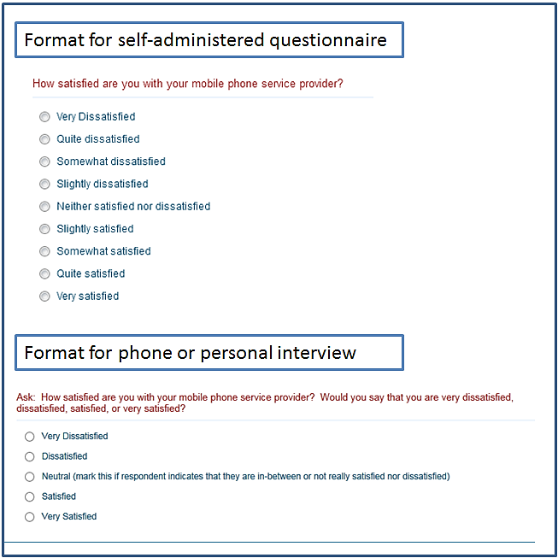
EXHIBIT 11.1 Best Question Formats Vary by the Interview Medium

Slide 18
Avoiding Mistakes
Simpler is better
Avoid leading and loaded questions
Avoid ambiguity: be as specific as possible
Avoid double-barreled items
Avoid making assumptions
Avoid taxing respondents’ memory

Slide 19
Simpler Is Better
Words used in questionnaires should be readily understandable to all respondents
The technical jargon of top executives should be avoided (e.g., “brand image,” “positioning,” etc.)

Slide 20
Avoid Leading and Loaded Questions
Leading questions suggest or imply certain answers
Such questions may result in a “bandwagon effect”, which threatens the study’s validity
Partial mention of alternatives is a variation of this phenomenon
Loaded questions suggest a socially desirable answer or are emotionally charged
Certain answers to questions are more socially desirable than others

Slide 21
Avoid Leading and Loaded Questions (cont’d.)
Asking respondents “how often” leads them to portray their ideal behavior rather than average
An introductory counterbiasing statement or preamble to a question that reassures respondents that their “embarrassing” behavior is not abnormal may help
A question statement may be leading because it is phrased to reflect either the negative or positive aspects of an issue
Split-ballot technique can be used to control for this bias

Slide 22
Avoid Ambiguity: Be As Specific As Possible
Items on questionnaires are often ambiguous because they are too general
Indefinite words such as frequently, often, ready, etc., have many different meanings

Slide 23
Avoid Double-Barreled Items
A question covering several items at once is referred to as a double-barreled question and should always be avoided
The results may be exceedingly difficult to interpret

Slide 24
Avoid Making Assumptions
The researcher should not place the respondent in a bind by including an implicit assumption in the question
Another frequent mistake is assuming that the respondent had previously thought about an issue
Research that induces people to express attitudes on subjects that they do not ordinarily think about is meaningless

Slide 25
Avoid Taxing Respondents’ Memory
Questions that give no clue as to the brand of interest are referred to as unaided recall questions
Aided-recall questions provide a clue to jog the respondent’s memory
Additional consequences of respondents’ forgetting the exact details of their behavior
Telescoping
Squishing

Slide 26
Order Bias
Question sequence
The order of questions may serve several functions
Order bias can result from an alternative answer’s position in a set of answers or from the sequencing of questions

Slide 27
Order Bias (cont’d.)
Tends to distort survey results
Asking specific questions before asking about broader issues is a common cause
Funnel technique—asking general questions before specific questions in order to obtain unbiased responses
Allows researchers to understand the respondent’s frame of reference before asking more specific questions

Slide 28
Survey Flow
Refers to the ordering of questions
Often, certain sections of a questionnaire are irrelevant to a particular respondent
Asking a question that does not apply to the respondent or that the respondent is not qualified to answer may be irritating or cause a biased response or even a survey breakoff
A breakoff means the respondent stops answering
A filter question can serve as a branching mechanism

Slide 29
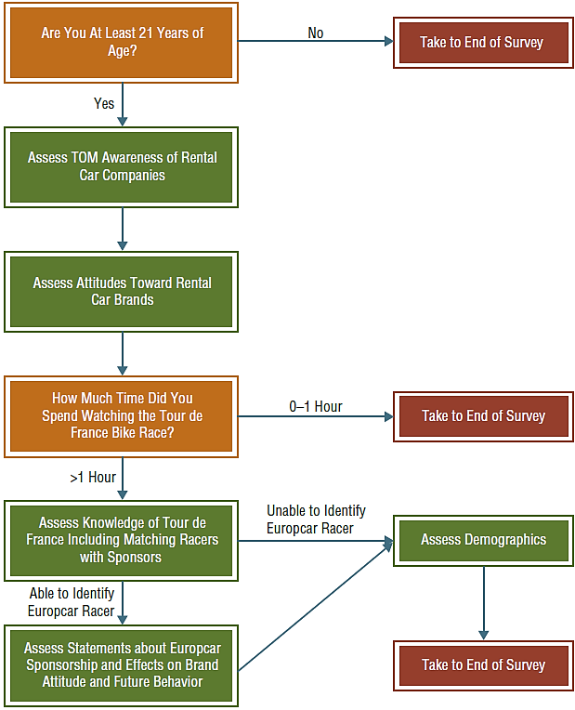
EXHIBIT 11.3 Survey Flow for Tour de France Sponsorship

Slide 30
Survey Technology
Survey software programs like Qualtrics allow several special features that facilitate design
Several key advantages
Response quality
Timing
Speeders are respondents who take relatively little time to move through a survey—so little that the veracity of their responses is questionable
Randomized assignment

Slide 31
Survey Technology: Key Advantages (cont’d.)
Physical features
Tracking interest – a heat map question is a graphical question that tracks the parts of an image or advertisement that most capture a respondent’s attention
Status bar – provides a visual indicator of questionnaire length
Prompting
Piping – allows responses to a previous question to be inserted into later questions

Slide 32
Pretesting and Revising Questionnaires
Usually, the questionnaire is tried out on a group that is similar to the sample
Pretesting allows the researcher to determine if the respondents have any difficulty understanding the questionnaire
This process can save the potential disaster of administering an invalid questionnaire to several hundred individuals
A preliminary tabulation of the pretest results often illustrates issues

Slide 33
Pretesting and Revising Questionnaires (cont’d.)
Pretests are typically conducted to answer questions about the questionnaire such as:
Can the questionnaire format be followed by the interviewer?
Does the questionnaire flow naturally and conversationally?
Are the questions clear and easy to understand?
Can respondents answer the questions easily?
Which alternative forms of questions work best?
What overall and item response rates can be expected?

Slide 34
Designing Questionnaires for Global Markets
International marketing researchers must take cultural factors into account
The most common problem involves translation into another language
Back translation is the process of translating the questionnaire from one language to another and then having it translated back again by a second, independent translator
The back translator is often a person whose native tongue is the language that will be used on the questionnaire

