Slide 1
Chapter 16
Communicating Research Results

Slide 2
LEARNING OUTCOMES
Create an outline for a research project using the basic parts of a final report
Explain how to use tables for presenting numerical information
Summarize how to select and use the types of research charts
Know how to give an effective oral presentation
Discuss the importance of Internet reporting and research follow-up

Slide 3
The Project and the Report
A research report is an formal presentation and/or a written statement that communicates research results and draws appropriate conclusions following from a research project

Slide 4
The Project and the Report (cont’d.)
The report provides the “answers” and documents procedures to the interested audience
For an applied market research project, the report presents the results accomplishing the proposal’s deliverables including specific managerial recommendations
Deliverables should be a logical conclusion of the report contents

Slide 5
The Research Report
A basic marketing researcher writes a similar report that often takes the form of a white paper or scholarly research paper targeted for publication in a research journal
Examples: the Journal of Marketing, the Journal of the Academy of Marketing Science, or the Journal of Business Research
A written research report often coincides with a formal presentation delivered in person and/or via the Internet

Slide 6
Report Format
Major elements
Title page
Letter of transmittal
Letter of authorization
Table of contents (and lists of figures and tables)
Executive summary
Objectives
Results
Conclusions
Recommendations

Slide 7
Report Format: Body and Objectives
Body
Introduction
Objectives
Methodology
Results
Limitations
Conclusions and recommendations

Slide 8
Report Format: Appendix
Contains
Data collection forms
Detailed calculations
General tables
Bibliography
Other support material

Slide 9
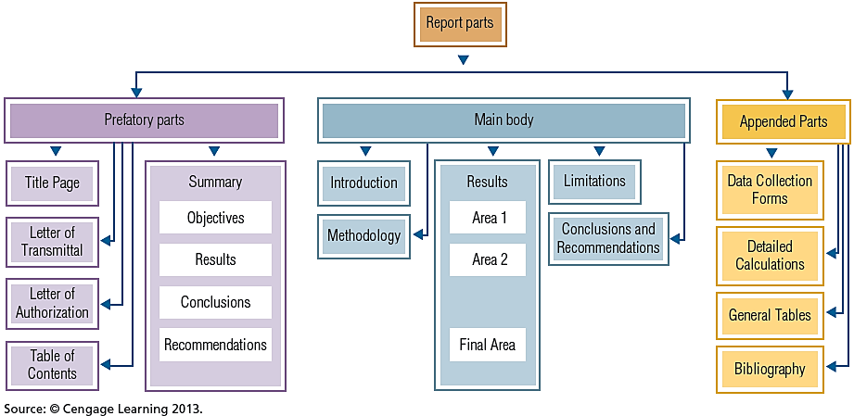
EXHIBIT 16.1 Report Format

Slide 10
Tailoring the Format to the Project
The format may need adjustment:
To obtain the proper level of formality and
To decrease the complexity of the report
A formal type of report is usually bound in a permanent cover and may be hundreds of pages
How does the researcher decide on the appropriate level of formality?
The general rule is to include all the parts needed for effective communication in the particular circumstances
This depends on how far up in management the report is expected to go and how routine the matter is

Slide 11
The Parts of the Report
The title page should state the title of the report, for whom the report was prepared, by whom it was prepared, and the date of release or presentation
The title should give a brief but complete indication of the purpose of the research project
Not more than 12 words
Include addresses, titles of the preparer and recipient
On confidential reports, list the people to whom the report should be circulated
For the most formal reports, the title page is preceded by a title fly page, which contains only the report’s title

Slide 12
Letter of Transmittal
Included in relatively formal to very formal reports
A transmittal letter’s opening paragraph releases the report and briefly identifies the factors of authorization
The letter comments generally on findings and matters of interest regarding the research
The closing section expresses the writer’s personal interest in the project just completed and in doing additional, related work
Overall, the letter explains how the report represents a key deliverable and invites further discussion on the matter

Slide 13
Letter of Authorization
A letter to the researcher that approves the project, details who has responsibility for it, and describes the resources available to support it
Not written by the researcher
In many situations, simply referring to the authorization in the letter of transmittal is sufficient and need not be included in the report
In cases where the reader may be unfamiliar with the authorization, the report should include an exact copy of the original letter

Slide 14
The Table of Contents
Essential to any report more than a few pages long
Should list the divisions and subdivisions (only the first-level subdivisions) of the report with page references
If the report includes many figures or tables, a list of these should immediately follow the table of contents

Slide 15
The Executive Summary
Briefly explains why the research project was conducted, what aspects of the problem were considered, what the outcome was, and what should be done
A vital part of the report
Studies have indicated that nearly all managers read a report’s summary; only a minority read the rest of the report
Should be written only after the rest of the report has been completed

Slide 16
The Executive Summary (cont’d.)
Should be one page long or, at most, two pages
Should be written to be self-sufficient—it is often detached from the report and circulated by itself
The summary contains four elements
The objectives of the report, including the most important background information and the specific purposes of the project
The methodology and the major results
The conclusions
Recommendations, or suggestions for action, based on the conclusions

Slide 17
The Body
Begins with an introduction section
Explains why the project was done and what it aimed to discover
Includes the basic authorization and submittal data
Includes enough background to explain why the project was worth doing
The last part explains exactly what the project tried to discover, discussing the statement of the problem and research questions as they were stated in the research proposal

Slide 18
The Research Methodology Section of the Body
Research design
Was the study exploratory, descriptive, or causal? Did the data come from primary or secondary sources? Were results collected by survey, observation, or experiment?
Sample design
What was the target population? What is the sampling frame? What sample units are selected? How were they selected? How large was the sample? What was the response rate?

Slide 19
The Research Methodology Section of the Body (cont’d.)
Data collection and fieldwork
How many and what types of fieldworkers were used? What training and supervision did they receive? Was the work verified?
Analysis
This section should outline the general statistical methods used in the study, but the information presented here should not overlap with what is presented in the results section

Slide 20
The Results Section of the Body
Should make up the bulk of the report and present those findings of the project that bear on the objectives
Design to be convincing but not to oversell the project
Use summary tables and charts (but save comprehensive or detailed ones for the appendix)

Slide 21
The Conclusions and Recommendations Section of the Body
The last part of the body
Conclusions are opinions based on the results
Recommendations are suggestions for action

Slide 22
Appendix
Presents the “too …” material
Includes any material that is too technical or too detailed to go in the body
Examples: data collection forms, detailed calculations, discussions of highly technical questions, detailed or comprehensive tables of results, and a bibliography (if appropriate)
Much appendix material is posted on internal Web pages

Slide 23
Basic Marketing Research Report
The outline above applies especially to applied market research projects
Basic research reports (e.g., published in an academic business journal) have a slightly different outline since some components become irrelevant

Slide 24
Basic Marketing Research Report: Outline
Abstract
Introduction
Background
Literature review
Hypotheses
Research Methods
Results
Appendices
Discussion
Implications
Limitations
Future research
Conclusions
References

Slide 25
Using Tables Effectively
Used properly, graphic aids can clarify complex points or emphasize a message
Used improperly or sloppily, they can be distracting or misleading
Work best when they are an integral part of the text, and they should always be interpreted in the text
Several types of graphic aids may be useful in research reports: tables, charts, maps, and diagrams

Slide 26
Creating Tables
Most useful for presenting numerical information, especially when several pieces of information have been gathered about each item discussed
Include the following for each table:
Table number
Title
Subheads and bannerheads
Notes
Source notes

Slide 27
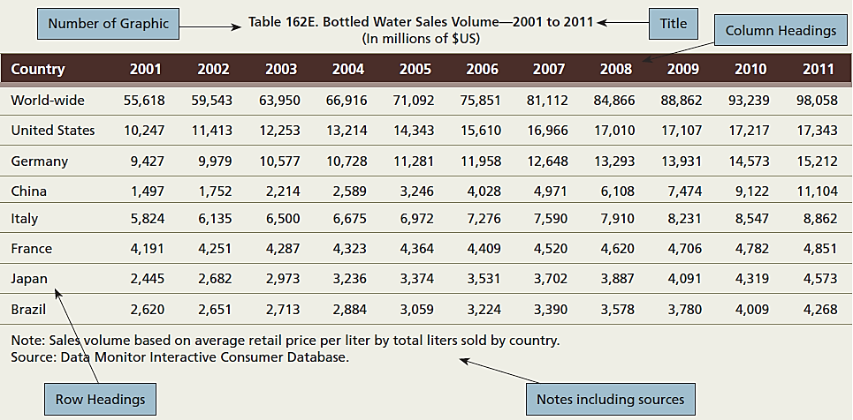
EXHIBIT 16.2 Basic Data Table Illustration

Slide 28
Using Charts Effectively
Each chart should include:
Figure number
Title
Explanatory legends
Source and footnotes
Charts are subject to distortion, whether unintentional or deliberate
A particularly severe kind of distortion comes from treating unequal intervals as if they were equal

Slide 29
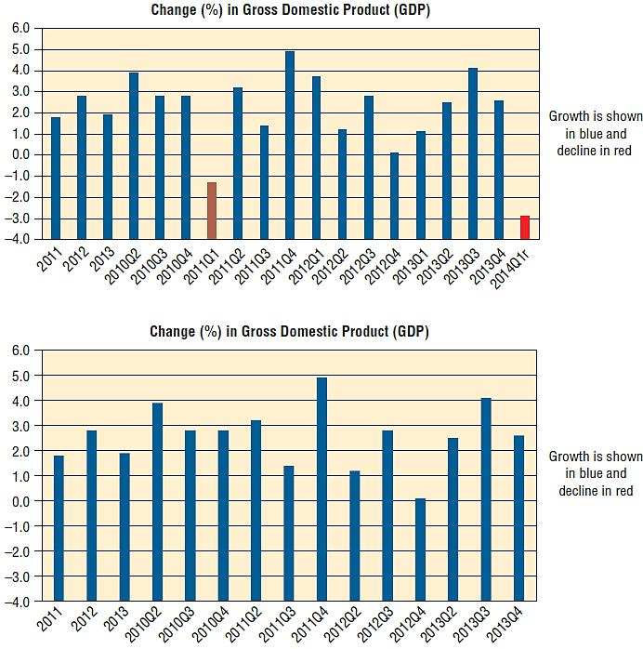
EXHIBIT 16.3 Two Differing Depictions of the Same Data

Slide 30
EXHIBIT 16.4 Axes Values Can Influence Interpretation

Slide 31
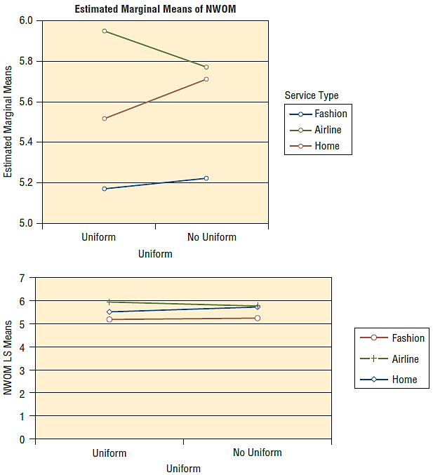
EXHIBIT 16.5 A Small-Scale Range for the Y-Axis Can Mislead the User

Slide 32
Pie Charts
One of the most useful types of charts
Shows the composition of some total quantity at a particular time
Each angle, or “slice,” is proportional to its percentage of the whole and should be labeled with its description and percentage
The writer should not try to include too many slices—about six slices is a typical maximum

Slide 33
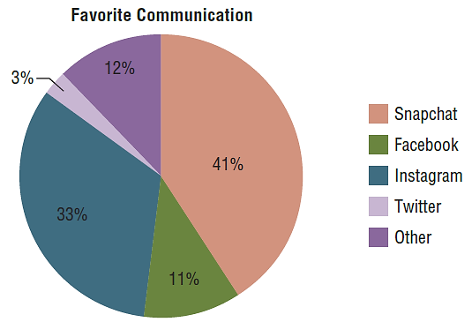
EXHIBIT 16.6 A Pie Chart Depicting a Sample of Tenth Graders’ Choice to a Question Asking Their Favorite Means of Communication

Slide 34
Line Graphs
Useful to show the relationship of one variable to another
The dependent variable is generally shown on the vertical axis and the independent variable on the horizontal axis
The most common independent variable for such charts is time, but it is not the only one

Slide 35
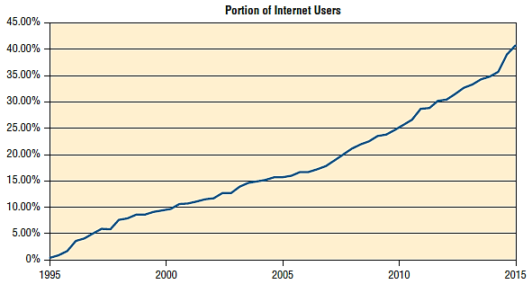
EXHIBIT 16.7 A Line Graph Depicting Percentage of Internet Users Worldwide by Year

Slide 36
Bar Charts
Show changes in the value of a dependent variable at discrete intervals of the independent variable
Multiple-bar chart – shows how multiple variables are related to the primary variables
Each bar or segment of the bar needs to be clearly identified with a different color or pattern
The writer should not use too many divisions or dependent variables
Too much detail obscures the essential advantage of charts, which is to make relationships easy to grasp

Slide 37
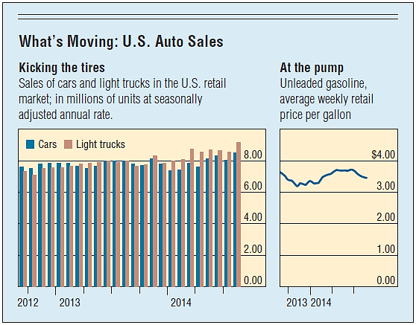
EXHIBIT 16.8 Graphic Combining a Multiple-Bar Chart and a Line Chart to Depict Trends in Car Versus Truck Sales in the United States

Slide 38
Oral Presentation
The purpose of an oral presentation is to highlight the most important findings of a research project and provide clients or line managers with an opportunity to ask questions
One simple rule—be as straightforward as possible
Prepare: the key to effective presentation
Begin at the end, meaning what a researcher wants the client to know when it has been completed
Select the three or four most important findings for emphasis and rely on the written report for full summary

Slide 39
Oral Presentation (cont’d.)
Organize around a standard format: “Tell them what you are going to tell them, tell them, and tell them what you just told them”
Tips
Introduce yourself while displaying the title of the presentation
Open up your arms to embrace your audience
Drop your arms to your sides when not using them
Avoid quick and jerky gestures which make you appear nervous

Slide 40
Reports on the Internet and Follow-Up
One easy way to share data is to have executive summaries and reports on a company intranet
A company can use information technology on the Internet to:
Design questionnaires
Administer surveys
Analyze data
Share the results in a presentation-ready format

Slide 41
Reports on the Internet and Follow-Up (cont’d.)
Real-time data capture allows for beginning-to-end reporting
A number of companies offer fully Web-based research management systems
Self-contained presentations
Make sure the title page indicates who did the research and for whom it was done
Keep in mind that viewers may use all sorts of media devices to view the presentation
Limit the number of words on a slide

Slide 42
Self-Contained Presentations (cont’d.)
Annotate any potentially complex material
Use self-advancing slides but always include an easy way for the user to move forward, stop, or repeat the presentation
Include links to any technical appendices that support the work.
On the last slide, provide clear and unambiguous contact information for easy follow-up

Slide 43
Follow-Up Reports
The research follow-up is a recontacting of decision makers and/or clients after they have had a chance to read over the report
Purpose is to determine whether the researchers need to provide additional information or clarify issues of concern to management
Can help marketing researchers ensure the satisfaction of their customers, marketing managers

