Slide 1
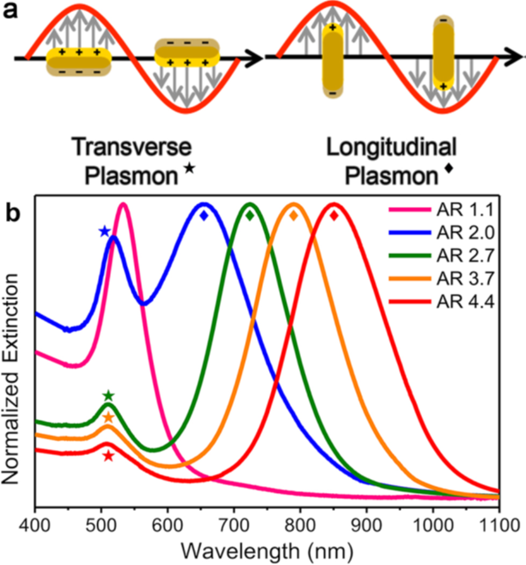
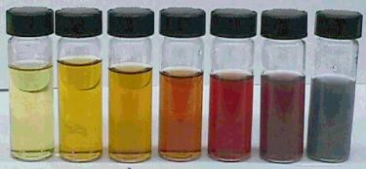
Aspect Ratio (AR) = L / W
L
W
AuNR with different aspect ratio and absorption

Slide 2
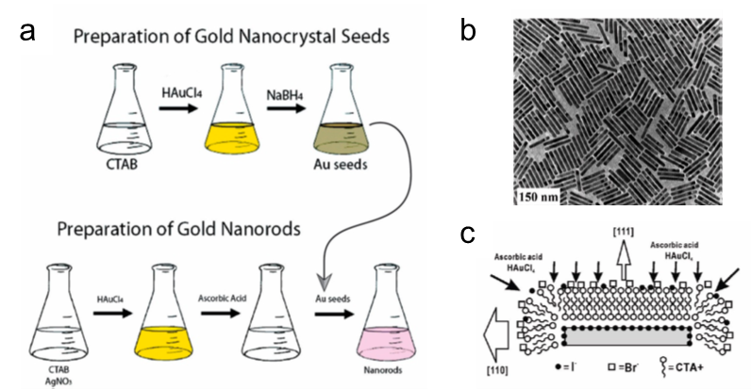

Slide 3
Photolysis of Fibrin Clot

Slide 4
Energy-dispersive X-ray (EDX)

Slide 5
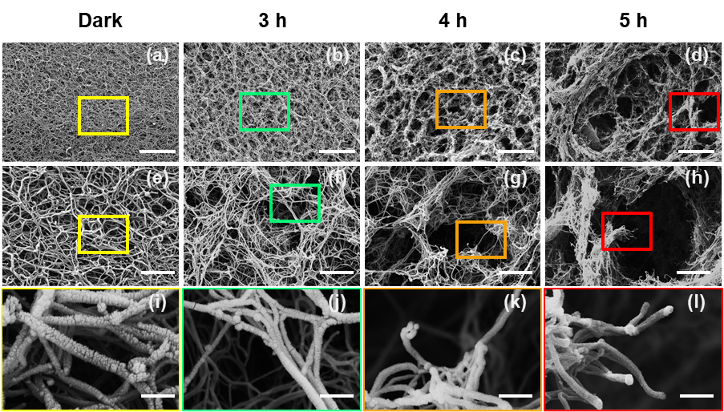
SEM images of Fibrin Degradation

Slide 6
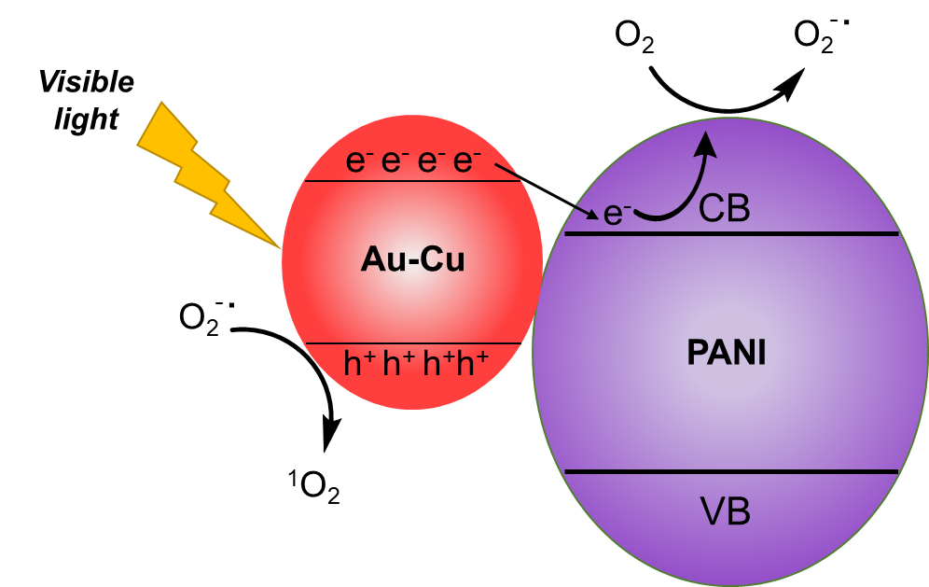
¹O₂ Generation Mechanism
AuNR-Cu@PANI + hv AuNR-Cu@PANI (e⁻ (CB) + h⁺ (VB))
O₂ + e⁻ O₂^{−˙}
O₂^{−˙} + h⁺ ¹O₂
Visible light absorption because of the SPR of Au
promoting reactivity of photoinduced charge carriers
Preventing e⁻ / h⁺ recombination
Riyadh Alshammari, Chinna Rajesh, and Jeffrey M. Zaleski.. ACS Applied Bio Materials, Submitted

Slide 7
