Slide 1
CHEM 230: Principles of Physical Chemistry

Slide 2
CHEM 230: Principles of Physical Chemistry
Molecular kinetic theory of gases, first law of thermodynamics, thermo chemistry, second and third laws of thermodynamics, free energies, adsorption and heterogeneous catalysis.

Slide 3
Content of the Course:
Molecular kinetic theory of gases
Fundamental concepts, the zeroth law, heat, internal energy, and work
First law of thermodynamics
Thermochemistry
Entropy and the second and third laws of thermodynamics
Free Energy and chemical equilibria
Adsorption and heterogeneous catalysis

Slide 4
Course Evaluation:
Midterm exams: 2 x 30 points 60 points
Final Exam: 1 x 40 points 40 points
Total 100 points

Slide 5
Chapter 1
Molecular kinetic theory of gases

Slide 6
Characteristics of Gases
Unlike liquids and solids, gases
expand to fill their containers;
are highly compressible;
have extremely low densities.

Slide 7
Pressure
Pressure is the amount of force applied to an area.
F
A
P =
Atmospheric pressure is the weight of air per unit of area.

Slide 8
Units of Pressure
Pascals (SI units)
1 Pa = 1 N/m²
$$p=\frac{F}{A}=\frac{N}{m^{2}}=\frac{kg.\left(\frac{m}{s^{2}}\right)}{m^{2}}=kg.m^{−1}.s^{−2}=\frac{kg}{m.s^{2}}=1Pa$$
$$F=m.a$$
$$1 N=1kg.\left(\frac{m}{s^{2}}\right)$$

Slide 9
Units of Pressure
mm Hg or torr
These units are literally the difference in the heights measured in mm (h) of two connected columns of mercury.
Atmosphere
1.00 atm = 760 torr
A mercury barometer

Slide 10
Bar
1 bar = 10⁵ Pa = 100 kPa
Do you Know another units ?

Slide 11
Standard Pressure
Normal atmospheric pressure at sea level is referred to as standard pressure.
It is equal to
1.00 atm
760 torr (760 mm Hg)
101.325 kPa

Slide 12
Boyle’s Law
The volume of a fixed quantity of gas at constant temperature is inversely proportional to the pressure.

Slide 13
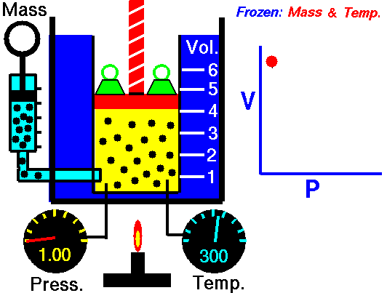
Boyle’s Law
The volume of a fixed quantity of gas at constant temperature is inversely proportional to the pressure.

Slide 14
As P and V are inversely proportional
A plot of V versus P results in a curve.
V α (1/P)
Since
V = k (1/P)
This means a plot of V versus 1/P will be a straight line.
PV = k

Slide 15
Charles’s Law
The volume of a fixed amount of gas at constant pressure is directly proportional to its absolute temperature.
V α T
V = kT
V
T
i.e.,
= k
A plot of V versus T will be a straight line.

Slide 16
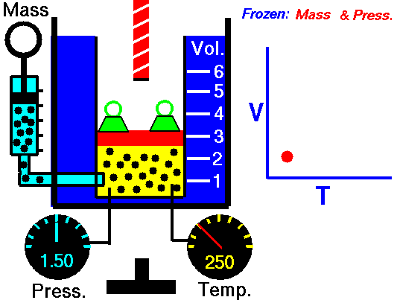
Charles’s Law
The volume of a fixed amount of gas at constant pressure is directly proportional to its absolute temperature.

Slide 17
Another form of Charles’s law shows that at constant amount of gas and volume, the pressure of a gas is proportional to temperature
P α T
P = kT
P/T=k
$$\frac{P_{1}}{T_{1}}=\frac{P_{2}}{T_{2}}$$

Slide 18
Avogadro’s Law
The volume of a gas at constant temperature and pressure is directly proportional to the number of moles of the gas.
Mathematically, this means
V = kn

Slide 19
Ideal-Gas Equation
So far we’ve seen that
V ∝ 1/P (Boyle’s law)
V ∝ T (Charles’s law)
V ∝ n (Avogadro’s law)
Combining these, we get
nT
P
V ∝

Slide 20
Ideal-Gas Equation
The relationship
nT
P
V ∝
nT
P
then becomes
V = R
or
PV = nRT

Slide 21
Ideal-Gas Equation
The constant of proportionality is known as R, the gas constant.

Slide 22
At Standard Conditions for Temperature and Pressure (STP) for any gas
T = 0 C˚ = 273 K
P = 1 atm
R = 0.082 atm.L.mol⁻¹.K⁻¹
PV = nRT
$$V= \frac{nRT}{P}= \frac{1×0.0821×273}{1}=22.4 L$$
or
P = 101325 Pa so R = 8.314 Pa.m³. mol⁻¹.K⁻¹
$V= \frac{nRT}{P}= \frac{1×8.314×273}{101325}=0.0224 m^{3}$= 22.4 dm³ or L

Slide 23
Relating the Ideal-Gas Equation and the Gas Laws
PV = nRT
When the quantity of gas and the temperature are held constant, n & T have fixed values.
PV = nRT = constant
P₁V ₁= P₂V₂

Slide 24
A metal cylinder holds 50 L of O₂ gas at 18.5 atm and 21ºC, what volume will the gas occupy if the temperature is maintained at 21 ºC while the pressure is reduced to 1.00 atm?
18.5 atm x 50 L = 1.00 atm x V₂
V₂ = 925 L
P₁V ₁= P₂V₂

Slide 25
Relating the Ideal-Gas Equation and the Gas Laws
PV = nRT
When the quantity of gas and the volume are held constant, n & V have fixed values.
P
T
nR
V
=
= constant
P₁
T₁
P₂
T₂
=

Slide 26
The gas pressure in an aerosol can is 1.5 atm at 25 ºC. Assuming that the gas inside obeys the ideal-gas equation, what would the pressure be if the can were heated to 450 ºC?
P₂ = 3.6 atm
P₁
T₁
P₂
T₂
=
1.5 atm
298 K
P₂
723 K
=

Slide 27
Relating the Ideal-Gas Equation and the Gas Laws
PV = nRT
When the quantity of gas is held constant, n has fixed values.
= nR = constant
PV
T
P₁V₁
T₁
P₂V₂
T₂
=

Slide 28
An inflated balloon has a volume of 6.0 L at sea level (1.0 atm) and is allowed to ascend in altitude until the pressure is 0.45 atm. During ascent the temperature of the gas falls from 22 ºC to -21 ºC. Calculate the volume of the balloon at its final altitude.
V₂ = 11 L
P₁V₁
T₁
P₂V₂
T₂
=
1.0 atm x 6.0 L
295 K
0.45 atm x V₂
252 K
=

Slide 29
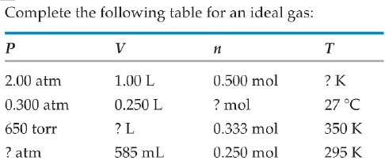
48.7 K
3.05 x 10⁻³ mol
11.2 L
10.3 atm

Slide 30
A scuba diver’s tank contains 0.29 kg of O₂ compressed into a volume of 2.3 L. (a) Calculate the gas pressure inside the tank at 9 ºC. (b) What volume would this oxygen occupy at 26 ºC and 0.95 atm?
PV = nRT
P x 2.3 L = ( 290 g/32 gmol⁻¹) x 0.082 x 282 K
P = 91 atm
V₂ = 233 L
P₁V₁
T₁
P₂V₂
T₂
=

Slide 31
What is the molar mass of a gas if 0.250 g of the gas occupy 215 mL at 0.813 atm and 30.0°C?
$n=\frac{PV}{RT}=\frac{(0.813 atm)(0.215 L)}{(0.0821 L atm {mol}^{−1} K^{−1})(303 K)}=0.00703 mol$
Molar mass $=\frac{g}{mol}=\frac{0.250 g}{0.00703 mol}=35.6 g {mol}^{−1}$

Slide 32
How many L of O₂ are need to react 28.0 g NH₃ at 24°C and 0.950 atm?
4 NH₃(g) + 5 O₂(g) 4 NO(g) + 6 H₂O(g)
Find mole of O₂
28.0 g NH₃ x 1 mol NH₃ x 5 mol O₂
17.0 g NH₃ 4 mol NH₃
= 2.06 mol O₂
V = nRT = (2.06 mol)(0.0821)(297K) = 52.9 L
P 0.950 atm

Slide 33
Densities of Gases
PV = nRT
moles × molecular mass = mass
n
V
P
RT
n × Μ = m
=
m
VM
P
RT
m
V
PM
RT
=
=

Slide 34
Densities of Gases
Density = mass ÷ volume
So,
m
V
d =
m
V
PM
RT
d =
=

Slide 35
What is the density of carbon tetrachloride (CCl₄) vapor at 714 torr and 125 ºC?
PM
RT
d =
714 torr x 154 g mol ⁻¹
62.36 L torr mol ⁻¹K⁻¹ x 398 K
d =
d = 4.43 g L⁻¹

Slide 36
Which gas is most dense at 1.00 atm and 298 K? CO₂, N₂O, or Cl₂.
PM
RT
d =
1 x 44
0.082 x 298
d =
= 1.8 g L⁻¹
CO₂
d = 1.8 g L⁻¹
N₂O
d = 2.91 g L⁻¹
Cl

Slide 37
Molecular Mass
We can manipulate the density equation to enable us to find the molecular mass of a gas:
PΜ
RT
d =
Becomes
dRT
P
Μ =

Slide 38
Calculate the density of NO₂ gas at 0.970 atm and 35 ºC. (b) Calculate the molar mass of a gas if 2.50 g occupies 0.875 L at 685 torr and 35 ºC.
PM
RT
d =
0.97 x 46
0.082 x 308
d =
d = 1.77 g L⁻¹

Slide 39
dRT
P
Μ =
d =
mass
volume
2.5 g
0.875 L
d = = 2.86 g L⁻¹
2.86 x 62.36 x 308
685
Μ =
Μ = 80.2 g mol⁻¹

Slide 40
Dalton’s Law of Partial Pressures
The total pressure of a mixture of gases equals the sum of the pressures that each would exert if it were present alone.
In other words,
P_{total} = P₁ + P₂ + P₃ + …

Slide 41
Partial Pressures
P_{total} = P₁ + P₂ + P₃ + …
P₁ = n₁ ( ); P₂ = n₂ ( ); and so on
P_{t} = (n₁+n₂+n₃+..) = n_{t}( )
RT
V
RT
V
(1)
RT
V
RT
V
(2)
Dividing equation (1) by equation (2)
P₁
P_{t}
n₁ RT/V
n_{t} RT/V
n₁
n_{t}
=
=
n₁
n_{t}
P₁ = P_{t}
P₁ = X₁ P_{t}

Slide 42
A 5.00 L scuba tank contains 1.05 mole of O₂ and 0.418 mole He at 25°C. What is the partial pressure of each gas, and what is the total pressure in the tank?
P = nRT P_{T} = P_{O2} + P_{He}
V
P_{T} = 1.47 mol x 0.0821 L-atm x 298 K
5.00 L (K mol)
= 7.19 atm

Slide 43
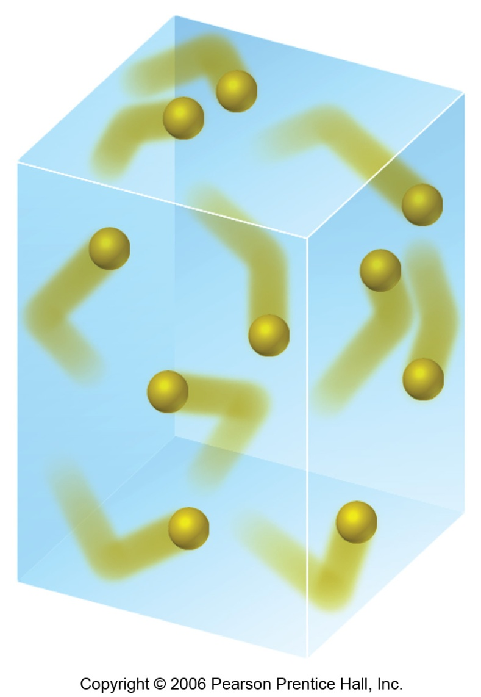
Kinetic-Molecular Theory
This is a model that aids in our understanding of what happens to gas particles as environmental conditions change.

Slide 44
Main Tenets of Kinetic-Molecular Theory
Gases consist of large numbers of molecules that are in continuous, random motion.
The combined volume of all the molecules of the gas is negligible relative to the total volume in which the gas is contained.

Slide 45
Main Tenets of Kinetic-Molecular Theory
Attractive and repulsive forces between gas molecules are negligible.
Energy can be transferred between molecules during collisions, but the average kinetic energy of the molecules does not change with time, as long as the temperature of the gas remains constant.

Slide 46
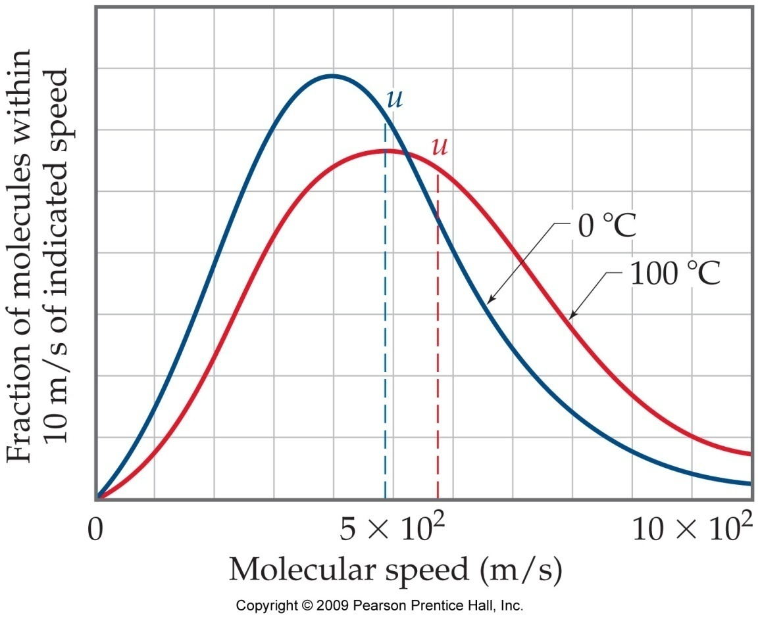
Main Tenets of Kinetic-Molecular Theory
The average kinetic energy (u) of the molecules is proportional to the absolute temperature.

Slide 47
See Part 1 Section 1
The Fundamental Equation of The Kinetic Theory
$$PV=\frac{1}{3}mN\overline{u^{2}}$$
$\overline{u^{2}}$ called mean square speed of one molecule
N number of molecules of ideal gas
m mass of the gas molecule

Slide 48
See Part 1 Section 2
On the other hand, the average of kinetic energy $\overline{ke}$ of one molecule related to speed of it as shown:
$$\overline{ke}=\frac{1}{2}m\overline{u^{2}}=\frac{3}{2}kT$$
Where $k=\frac{R}{N_{A}}$ called Boltzmann’s constant and has the value 1.38×10⁻²³ J.K⁻¹
For all molecules: $\overline{ke}×N=\frac{1}{2}mN\overline{u^{2}}$
Or:
$${\left(ke\right)}_{N}=\frac{1}{2}mN\overline{u^{2}}$$

Slide 49
For one mole:
$$KE=\overline{ke}N_{A}=\frac{1}{2}mN_{A}\overline{u^{2}}$$
Also for one mole:
$$KE=\frac{3}{2}RT$$
$$KE_{total}=\frac{3}{2}nRT$$

Slide 50
Example:
A tank used for filling helium balloons has a volume of 0.3 m³ and contains 2.00 mol of helium behaves like an ideal gas.
1- What is the total translational kinetic energy of the gas atoms?
If n= 2.00 mol and T = 293 K, use the equation:
$$KE_{total}=\frac{3}{2}nRT= \frac{3}{2}\left(2.00 mol\right)\left(8.314J {mol}^{−1}K^{−1}\right)\left(293 K\right)=7.30 ×{10}^{3} J$$

Slide 51
2- what is the average kinetic energy per atom?
$$\frac{1}{2}m\overline{v^{2}}=\frac{3}{2}kT=\frac{3}{2}\left(1.38×{10}^{−23}JK^{−1}\right)\left(293 K\right)=6.07×{10}^{−21}J$$

Slide 52
Gas molecule speeds
See Part 1 Section 3
The average speed: $\overline{u}$ or $\left\langle u\right\rangle$
$$\overline{u}=\sqrt{\frac{8RT}{πM}}$$
The most probable speed u_{P} :
$$u_{P}=\sqrt{\frac{2RT}{M}}$$
The root mean square (rms) speed u_{rms}:
$$u_{rms}=\sqrt{\frac{3RT}{M}}$$

Slide 53
Maxwell distribution of speeds

Slide 54
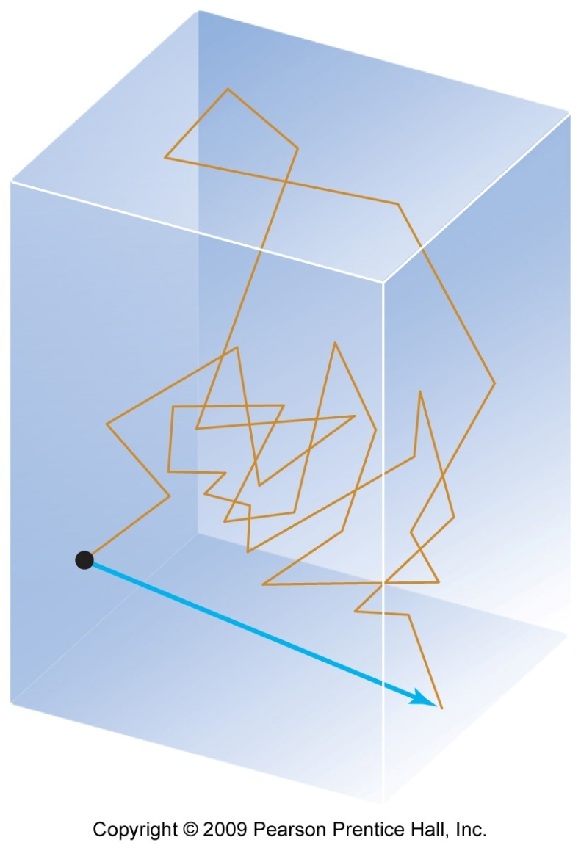
The Diffusion
Diffusion is the spread of one substance throughout a space or throughout a second substance.

Slide 55
The Diffusion
From the equation (b): $mN_{A}\overline{u^{2}}=3RT$
$m{×N}_{A}=M$ the molar mass (kg / mol)
$M\overline{u^{2}}=3RT$
$\overline{u^{2}}=\frac{3RT}{M}$
$\sqrt{\overline{u^{2}}}=\sqrt{\frac{3RT}{M}}$

Slide 56
$$u_{rms}=\sqrt{\overline{u^{2}}}$$
This molecular speed called root-mean-square speed u_{rms}of the molecules, which is the square root of the mean of the squares of the speeds of the molecules.

Slide 57
Note!!
$$u_{rms}=\sqrt{\frac{3RT}{M}}$$
The R must be:
8.314 J.mol⁻¹.K⁻¹or m³.Pa. mol⁻¹.K⁻¹
The M must be in kg/mol units

Slide 58
Because: J.mol⁻¹.K⁻¹ = kg.m².s⁻². mol⁻¹.K⁻¹
From Einstein equation: E=m.c², the units are:
J = kg.m².s⁻²
Also Pa = kg.m⁻¹.s⁻²
so
R = m³.(kg.m⁻¹.s⁻²).mol⁻¹.K⁻¹ = kg.m². s⁻².mol⁻¹.K⁻¹
$u=\sqrt{\frac{3RT}{M}} =\sqrt{\frac{kg.m^{2}. s^{−2}. {mol}^{−1}.K^{−1} ×K}{kg.{mol}^{−1}}}=\sqrt{m^{2}. s^{−2}}= m^{ }. s^{−1}$

Slide 59
Calculate the rms speed, u, of an N₂ molecule at
25 °C.

Slide 60
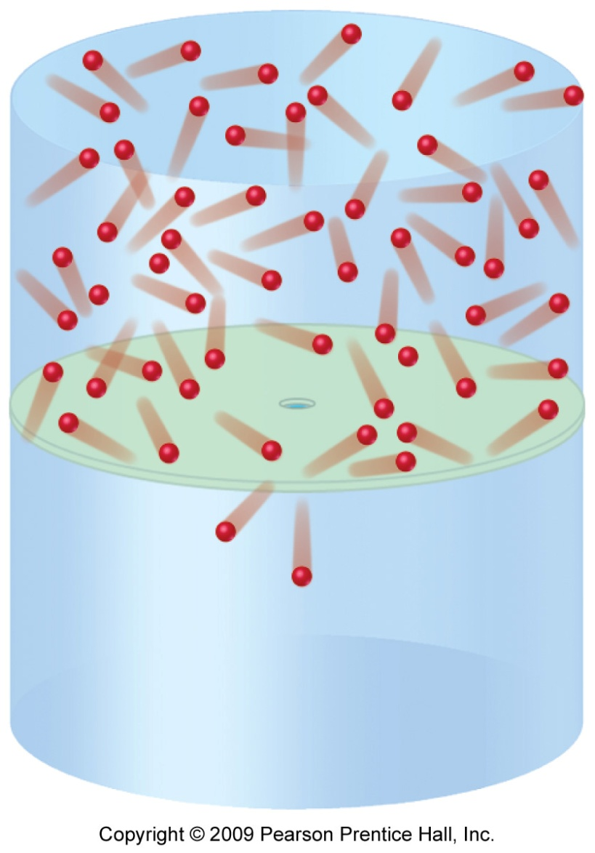
Effusion
Effusion is the escape of gas molecules through a tiny hole into an evacuated space.

Slide 61
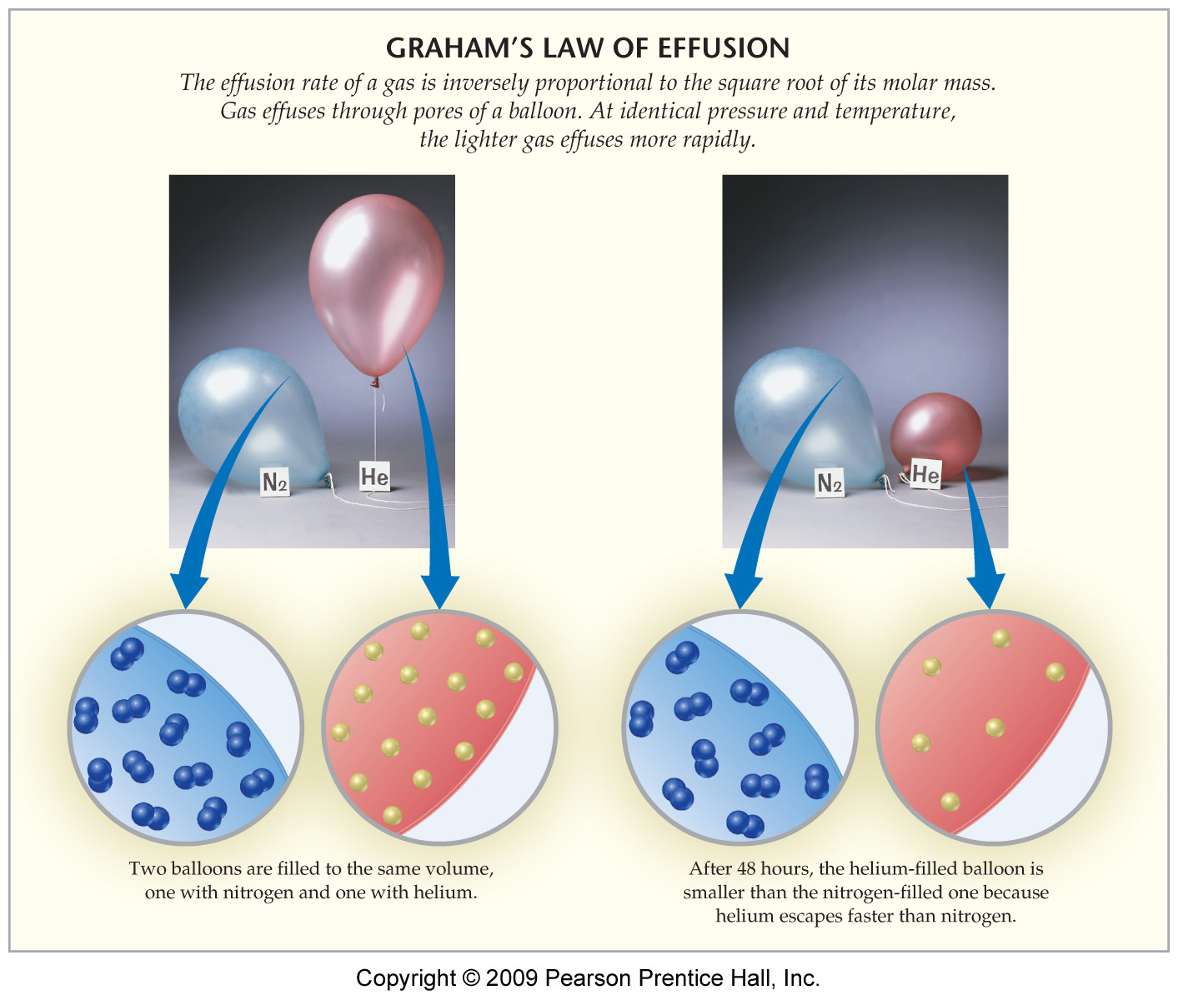
Effusion
The difference in the rates of effusion for helium and nitrogen, for example, explains a helium balloon would deflate faster.

Slide 62
Graham's Law
From root-mean-sqaure speed u_{rms} equation:
$$u_{rms}=\sqrt{\frac{3RT}{M}}$$
$$\frac{r_{1}}{r_{2}}=\frac{u_{rms1}}{u_{rms2}}=\sqrt{\frac{\left(\frac{3RT}{M_{1}}\right)}{\left(\frac{3RT}{M_{2}}\right)}}=\sqrt{\frac{M_{2}}{M_{1}}}$$
$$\frac{r_{1}}{r_{2}}=\sqrt{\frac{M_{2}}{M_{1}}}$$
Where r₁ & r₂ are rates of effusion of the two substances.

Slide 63
In the same volume:
$$\frac{r_{A}}{r_{B}}=\sqrt{\frac{d_{B}}{d_{A}}}$$

Slide 64
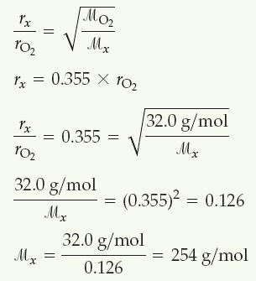
Graham's Law
An unknown gas composed of homonuclear diatomic molecules effuses at a rate that is only 0.355 times that of O₂ at the same temperature. Calculate the molar mass of the unknown, and identify it.

Slide 65
See Part 1 Section 4
The collision frequency and the mean free path
The collision number (frequency) that happened by one A molecule per one second Z_{A} is:
$Z_{A}=\sqrt{2}\overline{u_{A}}πd_{A}^{2}n_{A}=\frac{\sqrt{2}\overline{u_{A}}πd_{A}^{2}P}{kT}$ collision s⁻¹
$\overline{u_{A}}$ average speed of A molecules in unit (m.s⁻¹)
$d_{A}$ the diameter of A molecule, also call the diameter of collision in unit (m)
n_{A} number of A molecules
V the volume in unit (m³)

Slide 66
If A molecule collide with another molecule, it will take a specific distance before collide with another molecule. This distance called mean free path λ
$$λ=\frac{{\overline{u}}_{A}}{Z_{A}}=\frac{{\overline{u}}_{A}}{πd_{A}^{2}\overline{u_{rel}}n_{A}}=\frac{{\overline{u}}_{A}}{\sqrt{2}πd_{A}^{2}{\overline{u}}_{A}n_{A}}=\frac{1}{\sqrt{2}πd_{A}^{2}n_{A}}$$
$$λ=\frac{1}{\sqrt{2}πd_{A}^{2}n_{A}}=\frac{RT}{\sqrt{2}πd_{A}^{2}N_{A}P_{A}}=\frac{kT}{\sqrt{2}πd_{A}^{2}P_{A}}$$
This equation prove that reducing the pressure in a system will decrease the number of collision and increase length of the mean free path

Slide 67
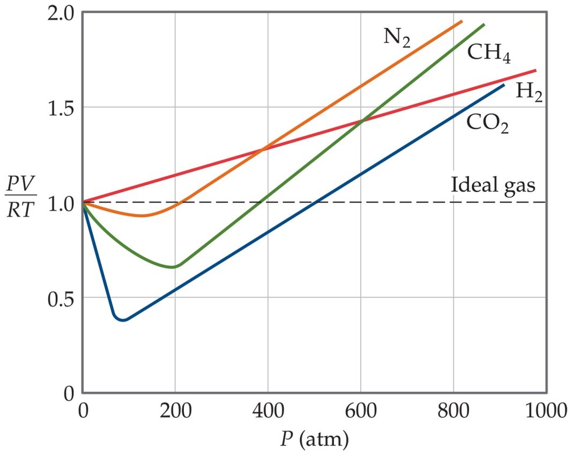
Real Gases
In the real world, the behavior of gases only conforms to the ideal-gas equation at relatively high temperature and low pressure.

Slide 68
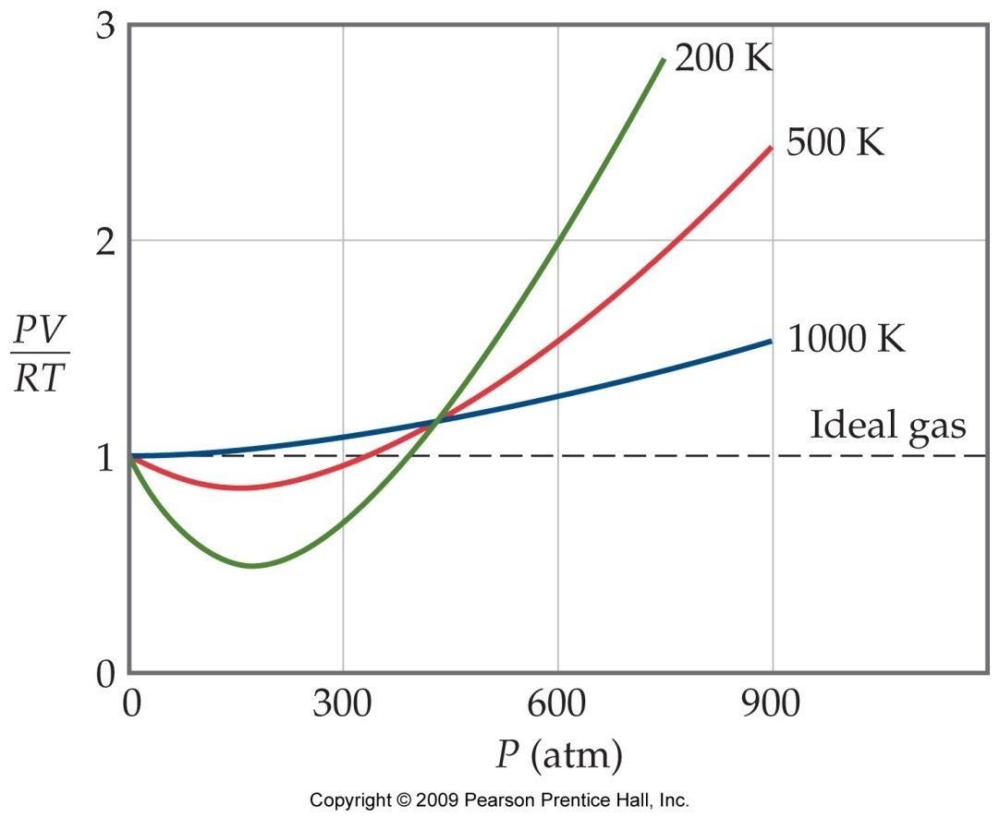
Real Gases
Even the same gas will show wildly different behavior under high pressure at different temperatures.

Slide 69
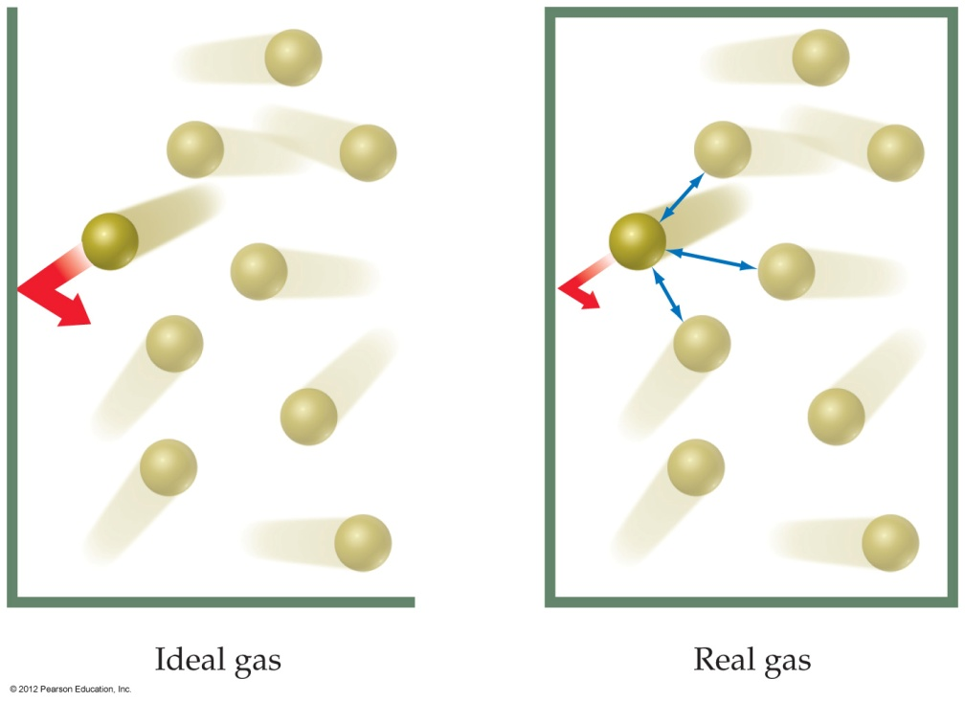
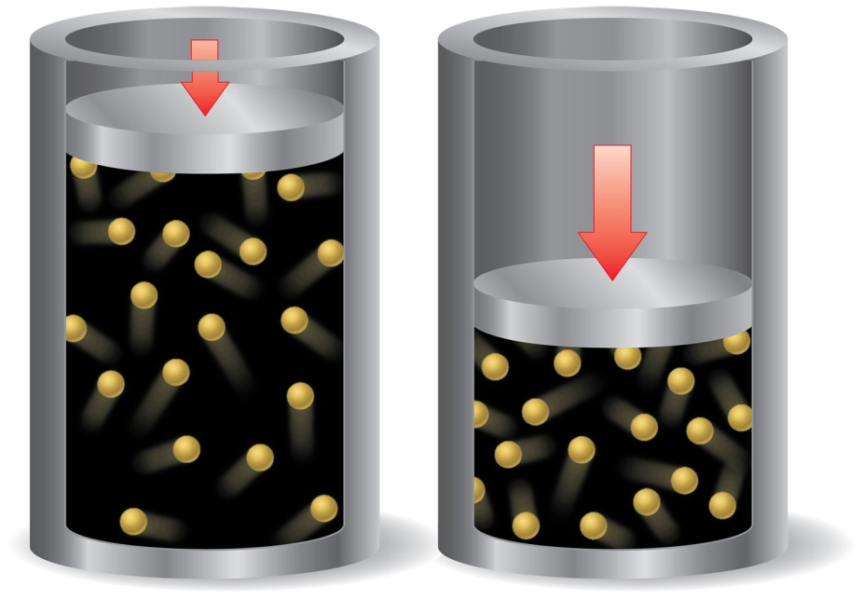
Deviations from Ideal Behavior
The assumptions made in the kinetic-molecular model (negligible volume of gas molecules themselves, no attractive forces between gas molecules, etc.) break down at high pressure and/or low temperature.

Slide 70
Corrections for Non-ideal Behavior
The ideal-gas equation can be adjusted to take these deviations from ideal behavior into account.
The corrected ideal-gas equation is known as the van der Waals equation.

Slide 71
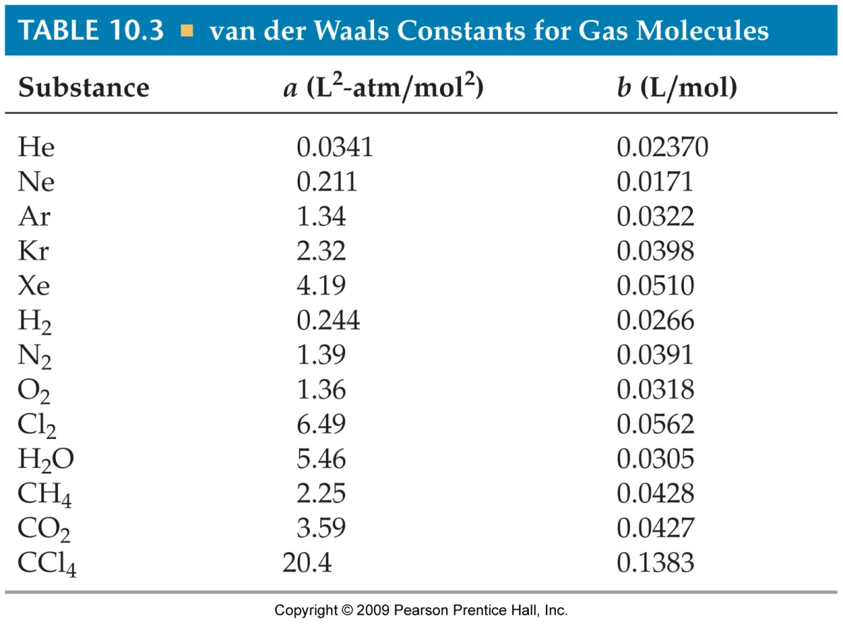
The van der Waals Equation
n²a
V²
(P +
) (V − nb) = nRT

Slide 72
$$P_{ideal}=P_{real}+\frac{{an}^{2}}{V^{2}}$$
Observed
pressure
Correction
term
$$V_{ideal}=V_{real}−nb$$
Observed
volume
Correction
term

Slide 73
$$\left(P+\frac{{an}^{2}}{V^{2}}\right)\left(V−nb\right)=nRT$$
Corrected volume
Corrected pressure
The constant “a” is a measure of how strongly the gas molecules attract one another.
The constant “b” is a measure of the finite volume occupied by the molecules.

Slide 74
The term $\frac{{an}^{2}}{V^{2}}$ accounts for the attractive forces.
The equation adjusts the pressure upward by adding $\frac{{an}^{2}}{V^{2}}$ because attractive forces between molecules tend to reduce the pressure.
The term nb accounts for the small but finite volume occupied by the gas molecules.
The equation adjusts the volume downward by subtracting nb to give the volume that would be available to the molecules in the ideal case.
WATCH THE UNITS OF “a” and “b” constants!

Slide 75
If 1.000 mol of an ideal gas were confined to 22.41 L at 0.0 °C, it would exert a pressure of 1.000 atm. Use the van der Waals equation and the constants in Table 10.3 to estimate the pressure exerted by 1.000 mol of Cl₂(g) in 22.41 L at 0.0 °C.

