Slide 1
Chapter 5
Entropy (s)
And
The Second and Third Laws of Thermodynamics

Slide 2
The Second Law of Thermodynamics
The second law of thermodynamics can be stated in several ways:
Kelvin state:
No cyclic process is possible in which heat is taken from a hot source and converted completely into work.
Which means that there is no ways to convert all the energy of the system into work without losing energy.

Slide 3
Hot source
Hot source
T_{h}
Heat q_{h}
Heat q_{h}
Engine
Engine
work
work
Heat q_{c}
Cold sink
T_{c}
Impossible
Possible

Slide 4
Clausius statement:
Heat does not pass from a body at law temperature to one at high temperature without an accompanying change elsewhere (or without work)
Hot source
Hot source
Hot source
T_{h}
Heat q_{h}
Heat q_{h}
Engine
work
Heat q_{h}
Heat q_{c}
Cold sink
Cold sink
Cold sink
T_{c}
Possible
Impossible
Possible

Slide 5
Second law of thermodynamics is the law of heat power and law of increased entropy, order to disorder, randomness.
This law states that whenever energy is transferred from one form to another form, entropy increase and energy decreases.
Another statement that the entropy of entire universe, as an isolated system, will always increase over time.
The second law also states that the changes in the entropy in the universe can never be negative.

Slide 6
Spontaneous processes are those which increase the entropy of the universe and proceed without any outside intervention.
hot
cold
Spontaneous
Not spontaneous
Spontaneous
Not spontaneous
Spontaneous means not needing to be driven by doing work. Also means the tendency for a change to occur.
Some spontaneous processes are fast. And some are very slaw.

Slide 7
4Fe (s) + 3O₂ (g) → 2Fe₂O₃ (s) slow spontaneous
2Fe₂O₃ (s) → 4Fe (s) + 3O₂ (g) nonspontaneous
Some processes are spontaneous at one temperature and may be nonspontaneous at other temperatures.
H₂O (s) → H₂O (l) spontaneous at T>0 ℃ but nonspontaneous when T<0 ℃
H₂O (l) → H₂O (g) spontaneous at T>100 ℃ but nonspontaneous when T<100 ℃

Slide 8

Entropy “S”
Entropy (S) is a term coined by Rudolph Clausius in the 19th century.
Entropy of the system relay on the consideration of heat-work cycles and the efficiency of heat engines.
Entropy is a measure of the quality of the energy: low entropy means high quality
Entropy can be thought of as a measure of the randomness of a system.
Entropy is a state function: ∆S = S₂ – S₁

Slide 9
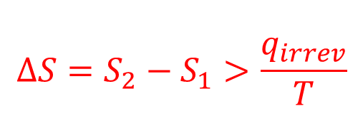
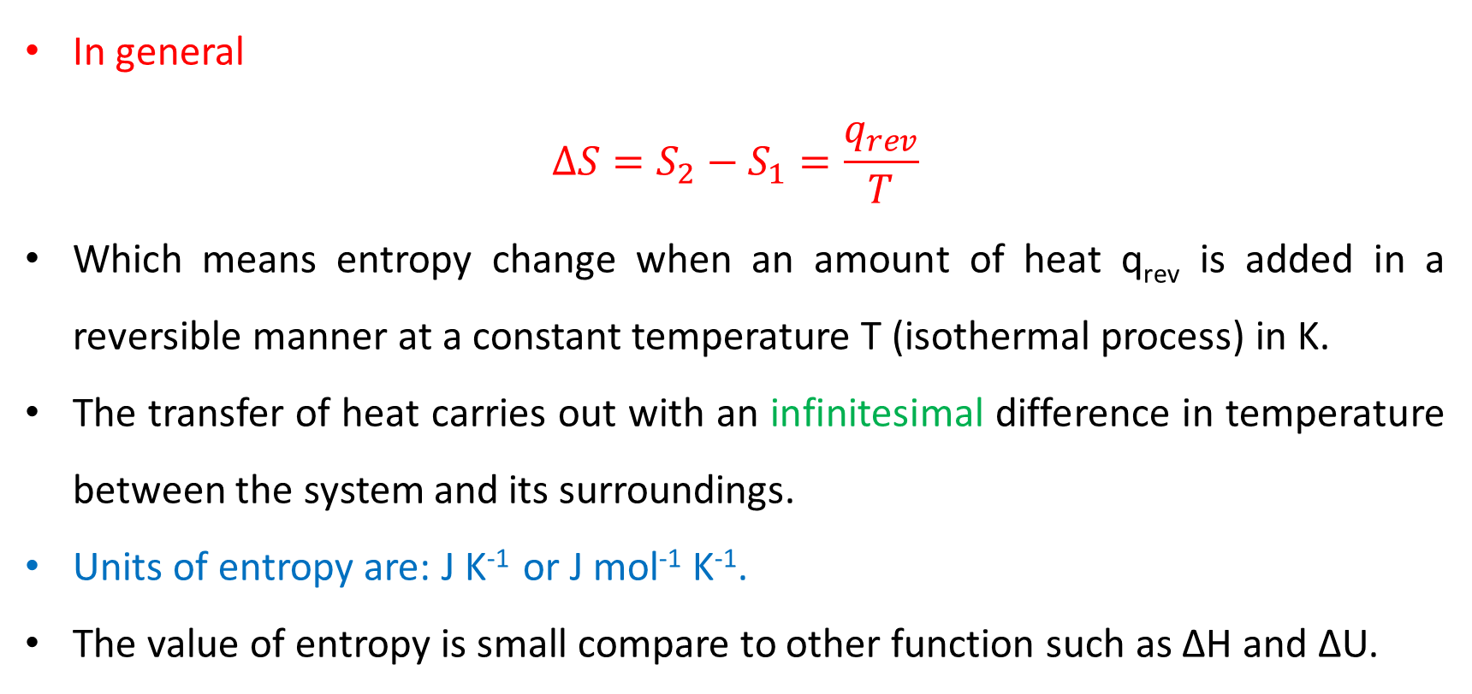
In general
$$∆S=S_{2}−S_{1}=\frac{q_{rev}}{T}$$
Which means entropy change when an amount of heat q_{rev} is added in a reversible manner at a constant temperature T (isothermal process) in K.
The transfer of heat carries out with an infinitesimal difference in temperature between the system and its surroundings.
Units of entropy are: J K⁻¹ or J mol⁻¹ K⁻¹.
The value of entropy is small compare to other function such as ∆H and ∆U.
$$∆S=S_{2}−S_{1}>\frac{q_{irrev}}{T}$$

Slide 10
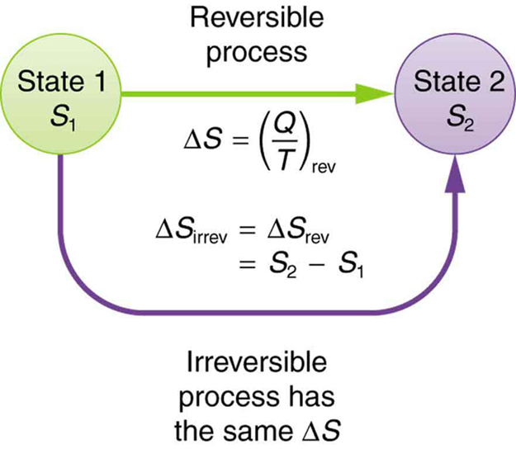
Although the relation: S = (Q/T) applies to reversible processes, it can be used to find the entropy change for an irreversible process occurring in a closed system, just replace that process with any reversible process that connects the same initial and final states – entropy is state function - and calculate the entropy change for this reversible process.

Slide 11
Entropy change: reversible process (ideal)
The entropy of universe does not change for reversible proses
∆S_{univ} = ∆S_{sys} + ∆S_{sur} = 0
(q_{reversible})_{surroundings} = -(q_{reversible})_{system}
∆S_{sys} = - ∆S_{sur}
Entropy change: irreversible process (real, spontaneous)
∆S_{univ} = ∆S_{sys} + ∆S_{sur} > 0
Will be explained later!

Slide 12
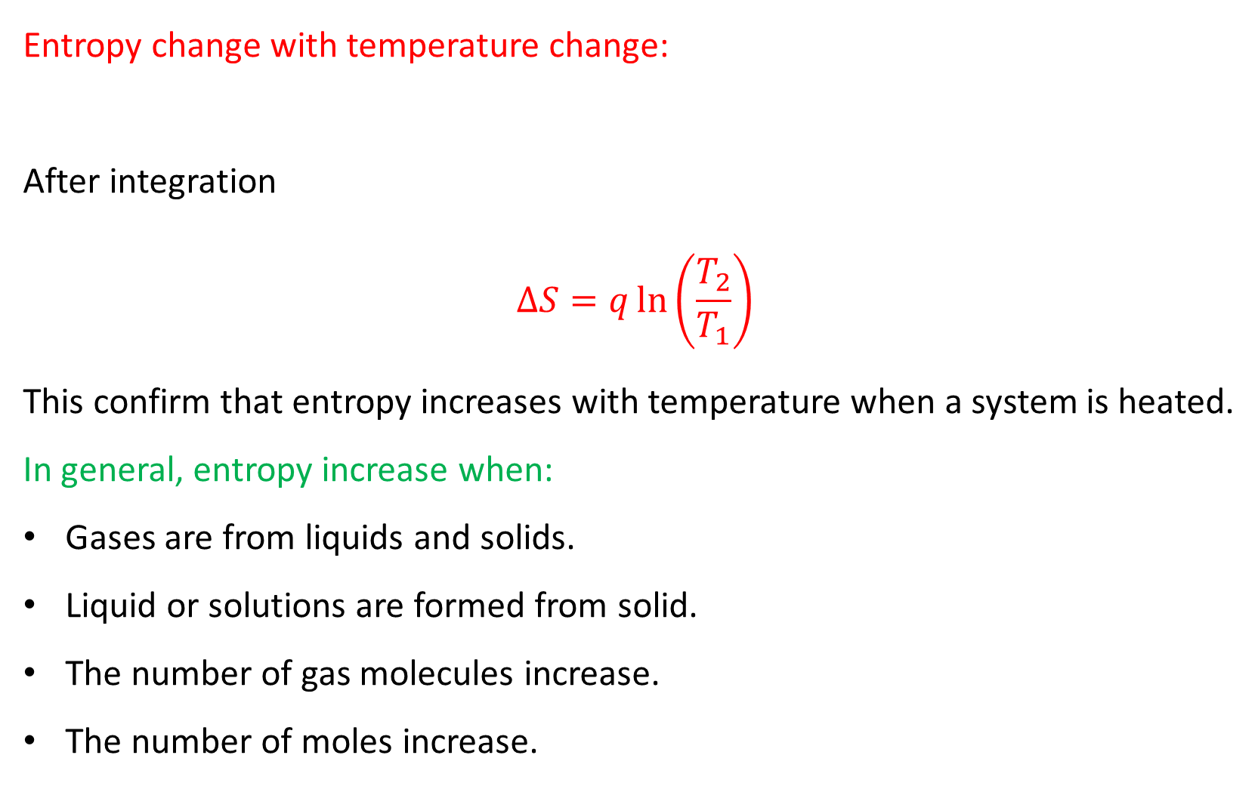
Entropy change with temperature change:
After integration
$$∆S=q\ln\left(\frac{T_{2}}{T_{1}}\right)$$
This confirm that entropy increases with temperature when a system is heated.
In general, entropy increase when:
Gases are from liquids and solids.
Liquid or solutions are formed from solid.
The number of gas molecules increase.
The number of moles increase.

Slide 13
The Entropy is described as a measure of randomness or disorder of the system. The fundamental definition of entropy is given by the Boltzmann equation:
S = k_{B} ln Ω
Where Ω is the number of ways of arranging the molecules of the system and k_{B} is Boltzmann constant.
This equation will used later in the residual enteropy, and it forms the basis of the powerful methods of statistical thermodynamics.

Slide 14
Sign of Entropy
If disorderness is increasing: positive
If disorderness is decreasing: negative
For example:
I₂ (s) → I₂ (aq) order → disorder ∆S = positive
2H₂ (g) + O₂ (g) → 2H₂O (l) disorder → order ∆S = negative
H₂ (g) → 2H (g) molecule → atoms ∆S = positive
CaCO₃ (s) → CaO (s) + CO₂ (g) order → disorder ∆S = positive

Slide 15
Example
1- which of the following reactions would you expect to have the greatest increase in entropy?
H₂O (g) → H₂O (l)
C(s) + O₂ (g) → CO₂ (g)
Ca (s) + H₂ (g) → CaH₂ (s)
N₂ (g) + 2H₂ (g) → 2NH₃ (g)
2KClO (s) → 2KCl (s) + 3O₂ (g)

Slide 16
Entropy in First Law
The zeroth law the temperature
The first law the internal energy
The second law the entropy
First law: ∆U = q + w and w = -P∆V
Second law: ∆S = q/T so q = T∆S
Therefore: ∆U = T∆S - P∆V at constant pressure

Slide 17
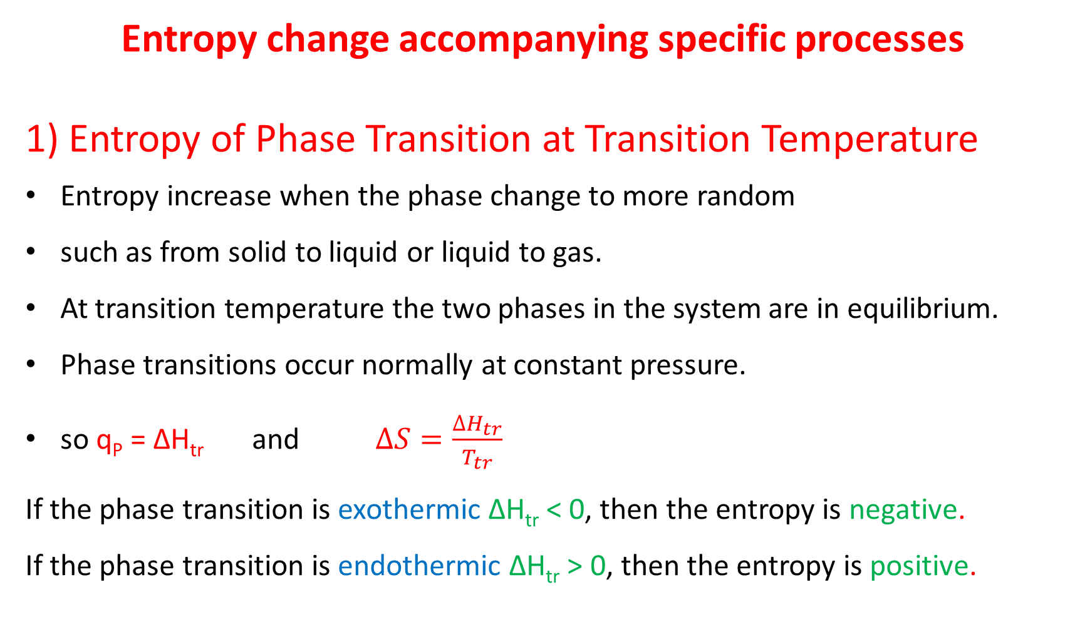
Entropy change accompanying specific processes
1) Entropy of Phase Transition at Transition Temperature
Entropy increase when the phase change to more random
such as from solid to liquid or liquid to gas.
At transition temperature the two phases in the system are in equilibrium.
Phase transitions occur normally at constant pressure.
so q_{P} = ∆H_{tr} and $∆S=\frac{{∆H}_{tr}}{T_{tr}}$
If the phase transition is exothermic ∆H_{tr} < 0, then the entropy is negative.
If the phase transition is endothermic ∆H_{tr} > 0, then the entropy is positive.

Slide 18
Some experimental entropies of phase transition at 1 atm, ∆Sº (in J K⁻¹ mol⁻¹)
notice: ∆H_{tr} = T_{tr}∆S
 | ∆Sº Fusion at T_{f} | ∆Sº Vaporization at T_{b}
Ar | 14.17 (at 83.8 K) | 74.53 (at 87.3 K)
Br₂ | 39.76 (at 265.9 K) | 88.61 (at 332.4 K)
C₆H₆ | 38.00 (at 278.6 K) | 87.19 (at 353.2 K)
CH₃COOH | 40.40 (at 289.8 K) | 61.90 (at 391.4 K)
CH₃OH | 18.03 (at 175.2 K) | 104.60 (at 337.2 K)
Cl₂ | 37.22 (at 172.1 K) | 85.38 (at 239.0 K)
H₂ | 8.38 (at 14.0 K) | 44.96 (at 20.38 K)
H₂O | 22.00 (at 273.2 K) | 109.00 (at 373.2 K)
H₂S | 12.67 (at 187.6 K) | 87.75 (at 212.9 K)
He | 4.80 (at 1.8 K and 30 bar) | 19.9 (at 4.22 K)
N₂ | 11.39 (at 63.2 K) | 75.22 (at 77.4 K)
NH₃ | 28.93 (at 195.4 K) | 97.41 (at 239.73 K)
O₂ | 8.17 (at 54.4 K) | 75.63 (at 90.2 K)

Slide 19
Examples
2- The molar heats of fusion and vaporization of benzene are 10.6 kJ/mol and 30.8 kJ/mol, respectively. Calculate the entropy changes for the solid-liquid and liquid-vapor transitions for benzene. At 1 atm pressure, benzene melts at 5.5 ℃ and boils at 80.1 ℃.
3- Calculate the entropy changes involved in the conversion of 5 mole of ice at 0 ℃ to liquid at 1 atm; the enthalpy of fusion per mole of ice is 6008 J/mol.

Slide 20
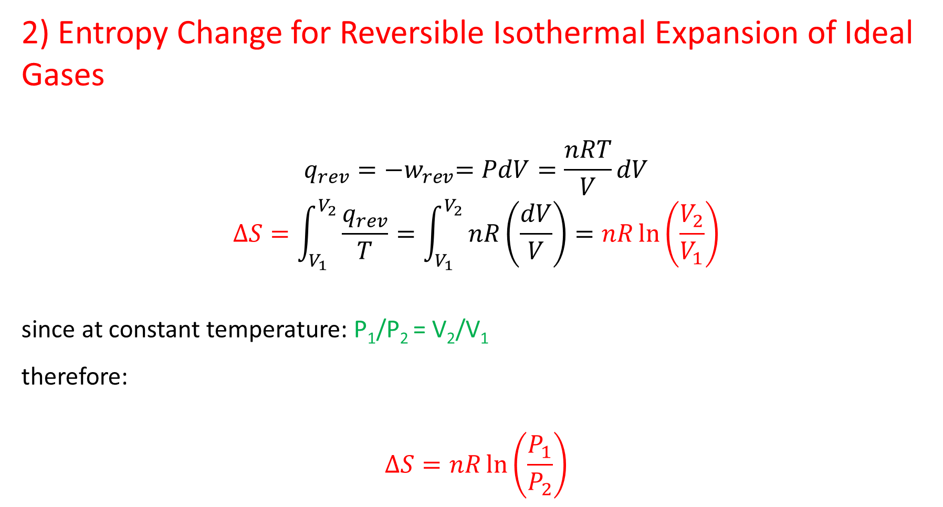
2) Entropy Change for Reversible Isothermal Expansion of Ideal Gases
$$q_{rev}={−w}_{rev}=PdV=\frac{nRT}{V}dV$$
$$∆S=\int_{V_{1}}^{V_{2}}{\frac{q_{rev}}{T}}=\int_{V_{1}}^{V_{2}}{nR\left(\frac{dV}{V}\right)}=nR\ln\left(\frac{V_{2}}{V_{1}}\right)$$
since at constant temperature: P₁/P₂ = V₂/V₁
therefore:
$$∆S=nR\ln\left(\frac{P_{1}}{P_{2}}\right)$$

Slide 21
Example
4- Calculate the entropy change when 1 mole of an ideal gas expands reversibly from an initial volume of 1 dm³ to final volume of 10 dm³ at a constant temperature of 298 K

Slide 22
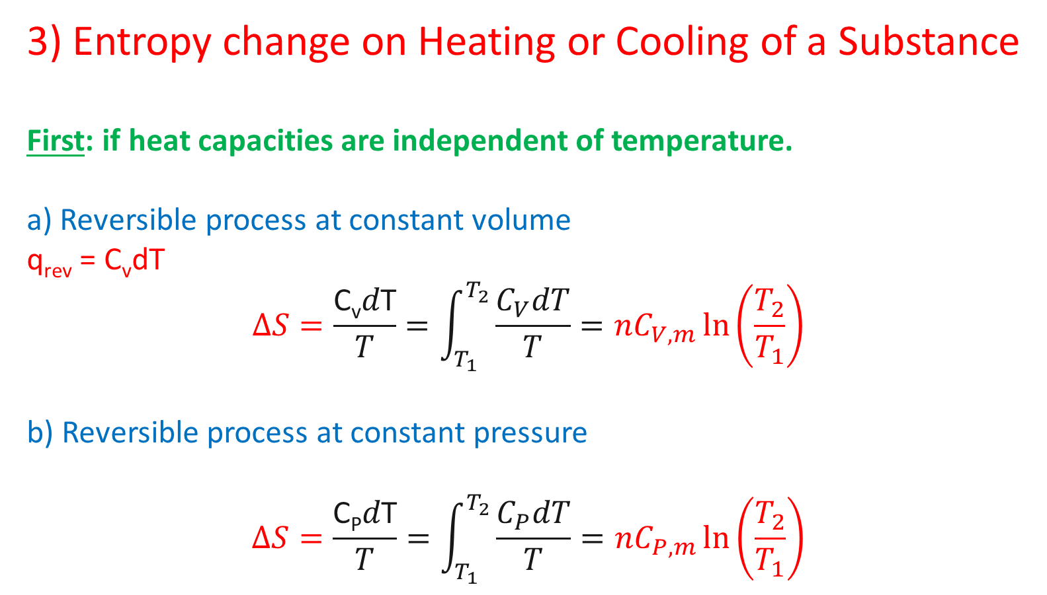
3) Entropy change on Heating or Cooling of a Substance
First: if heat capacities are independent of temperature.
a) Reversible process at constant volume
q_{rev} = C_{v}dT
$$∆S=\frac{\text{C}\text{v}d\text{T}}{T}=\int_{T_{1}}^{T_{2}}{\frac{C_{V}dT}{T}}=nC_{V, m}\ln\left(\frac{T_{2}}{T_{1}}\right)$$
b) Reversible process at constant pressure
$$∆S=\frac{\text{C}\text{P}d\text{T}}{T}=\int_{T_{1}}^{T_{2}}{\frac{C_{P}dT}{T}}=nC_{P, m}\ln\left(\frac{T_{2}}{T_{1}}\right)$$

Slide 23
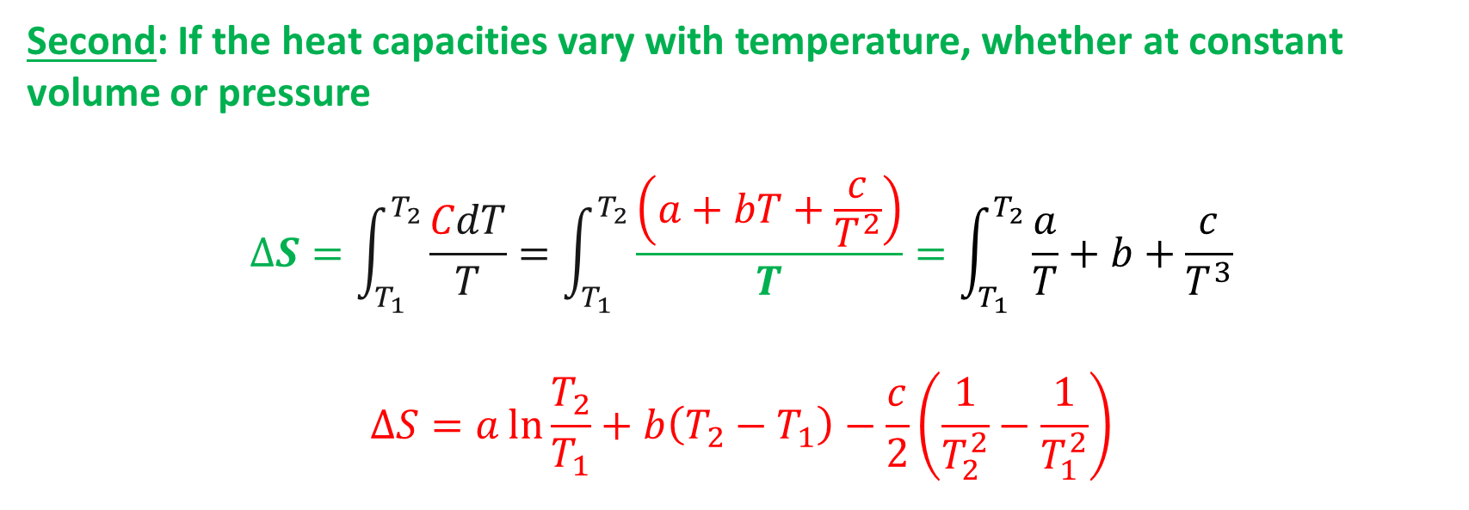
Second: If the heat capacities vary with temperature, whether at constant volume or pressure
$$∆S=\int_{T_{1}}^{T_{2}}{\frac{CdT}{T}}=\int_{T_{1}}^{T_{2}}{\frac{\left(a+bT+\frac{c}{T^{2}}\right)}{T}}=\int_{T_{1}}^{T_{2}}{\frac{a}{T}+b+\frac{c}{T^{3}}}$$
$$∆S=a\ln{\frac{T_{2}}{T_{1}}}+b\left(T_{2}−T_{1}\right)−\frac{c}{2}\left(\frac{1}{T_{2}^{2}}−\frac{1}{T_{1}^{2}}\right)$$

Slide 24
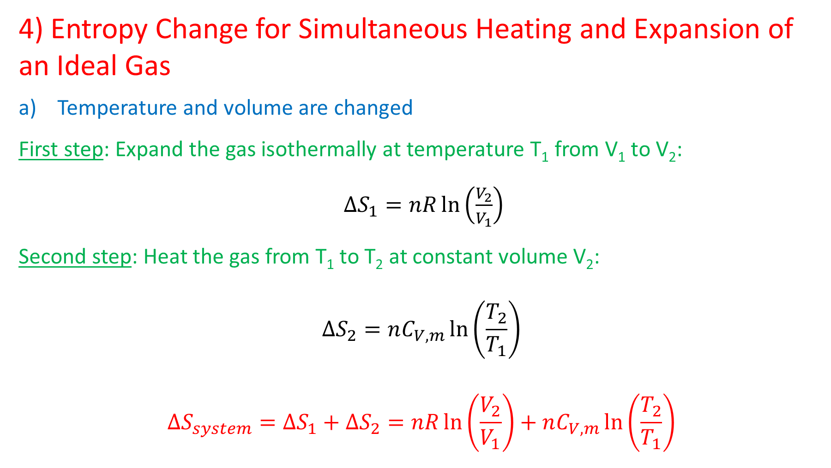
4) Entropy Change for Simultaneous Heating and Expansion of an Ideal Gas
Temperature and volume are changed
First step: Expand the gas isothermally at temperature T₁ from V₁ to V₂:
$∆S_{1}=nR\ln\left(\frac{V_{2}}{V_{1}}\right)$
Second step: Heat the gas from T₁ to T₂ at constant volume V₂:
$$∆S_{2}=nC_{V, m}\ln\left(\frac{T_{2}}{T_{1}}\right)$$
$$∆S_{system}=∆S_{1}+∆S_{2}=nR\ln\left(\frac{V_{2}}{V_{1}}\right)+nC_{V, m}\ln\left(\frac{T_{2}}{T_{1}}\right)$$

Slide 25
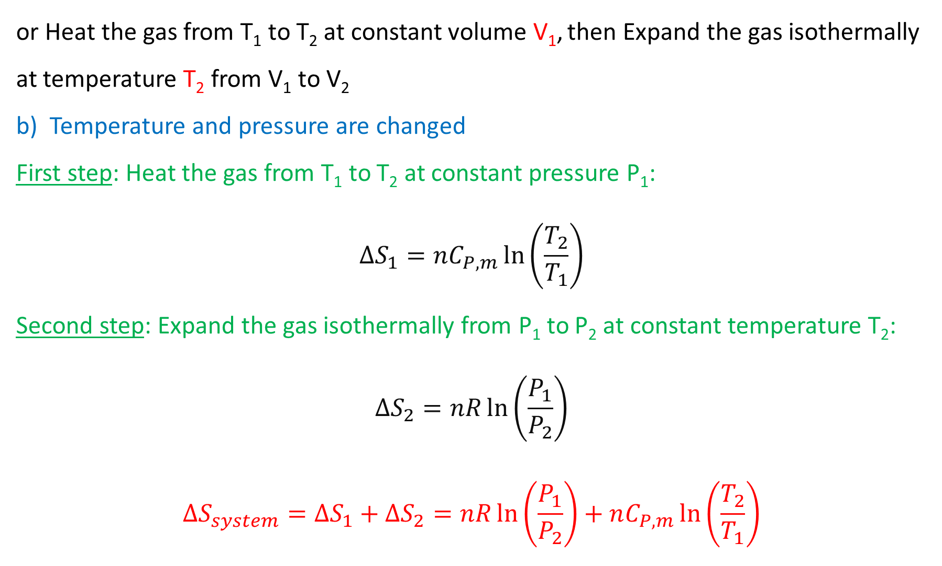
or Heat the gas from T₁ to T₂ at constant volume V₁, then Expand the gas isothermally at temperature T₂ from V₁ to V₂
b) Temperature and pressure are changed
First step: Heat the gas from T₁ to T₂ at constant pressure P₁:
$$∆S_{1}=nC_{P, m}\ln\left(\frac{T_{2}}{T_{1}}\right)$$
Second step: Expand the gas isothermally from P₁ to P₂ at constant temperature T₂:
$$∆S_{2}=nR\ln\left(\frac{P_{1}}{P_{2}}\right)$$
$$∆S_{system}=∆S_{1}+∆S_{2}=nR\ln\left(\frac{P_{1}}{P_{2}}\right)+nC_{P, m}\ln\left(\frac{T_{2}}{T_{1}}\right)$$

Slide 26
Example
5- A 5.0-mol sample of an ideal gas (C_{V} = 3/2 R) is initially at 10 atm pressure and 300 K. What is the entropy change if the gas heated to 500 K (a) at constant volume, (b) at constant pressure.
6- A 250-g sample of water at 80 ℃ is mixed with 250 g of water at 10 ℃. Find the entropy changes for (a) the hot water, (b) the cool water and (c) the system. (C_{P} of water is 75.31 J K⁻¹ mol⁻¹)

Slide 27
7- For a certain ideal gas C_{P} = 2.5 R ( J K⁻¹ mol⁻¹) . calculate the change in entropy suffered by 3 moles of the gas on being cooled from 600 to 300 K at constant volume.
8- Calculate ∆S when 1 mole of water H₂O is heated from 263 to 283 K at 1 atm where C_{P} (ice) = 2.09 + 0.126T ( J K⁻¹ mol⁻¹) , ∆H_{f} = 6.01 kJ mol⁻¹ and C_{P} (water) = 75.31 J K⁻¹ mol⁻¹.

Slide 28
Solved Example
9- Calculate the entropy change when argon at 25 ℃ and 1.00 atm in a container of volume 500 cm³ and is compressed to 50.0 cm³ and is simultaneously cooled to -25 ℃? (C_{P,m} of argon is 20.786 J K⁻¹ mol⁻¹)

Slide 29
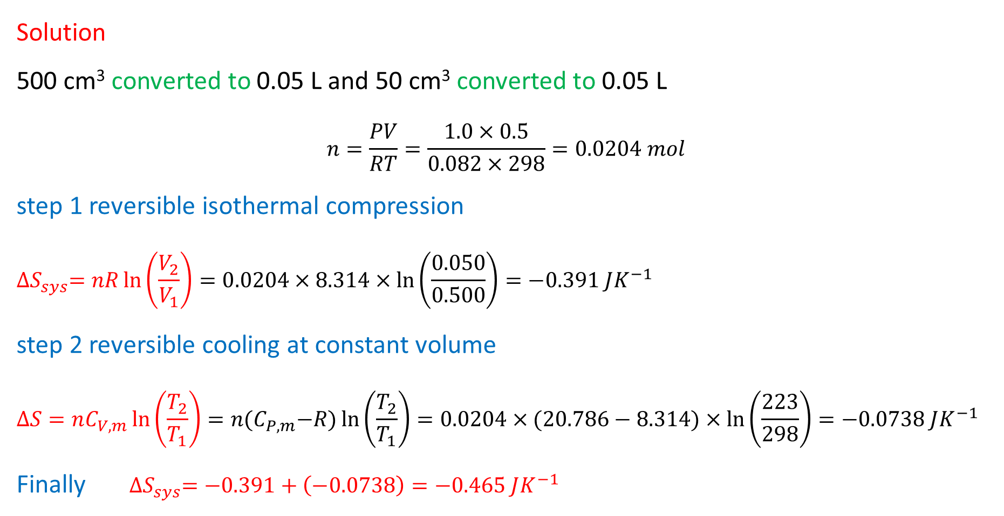
Solution
500 cm³ converted to 0.05 L and 50 cm³ converted to 0.05 L
$$n=\frac{PV}{RT}=\frac{1.0×0.5}{0.082×298}=0.0204 mol$$
step 1 reversible isothermal compression
$${∆S}_{sys}=nR\ln\left(\frac{V_{2}}{V_{1}}\right)=0.0204×8.314×\ln\left(\frac{0.050}{0.500}\right)=−0.391 JK^{−1}$$
step 2 reversible cooling at constant volume
$$∆S=nC_{V, m}\ln\left(\frac{T_{2}}{T_{1}}\right)=n{(C}_{P, m}−R)\ln\left(\frac{T_{2}}{T_{1}}\right)=0.0204×(20.786−8.314)×\ln\left(\frac{223}{298}\right)=−0.0738 JK^{−1}$$
Finally ${∆S}_{sys}=−0.391+\left(−0.0738\right)=−0.465 JK^{−1}$

Slide 30
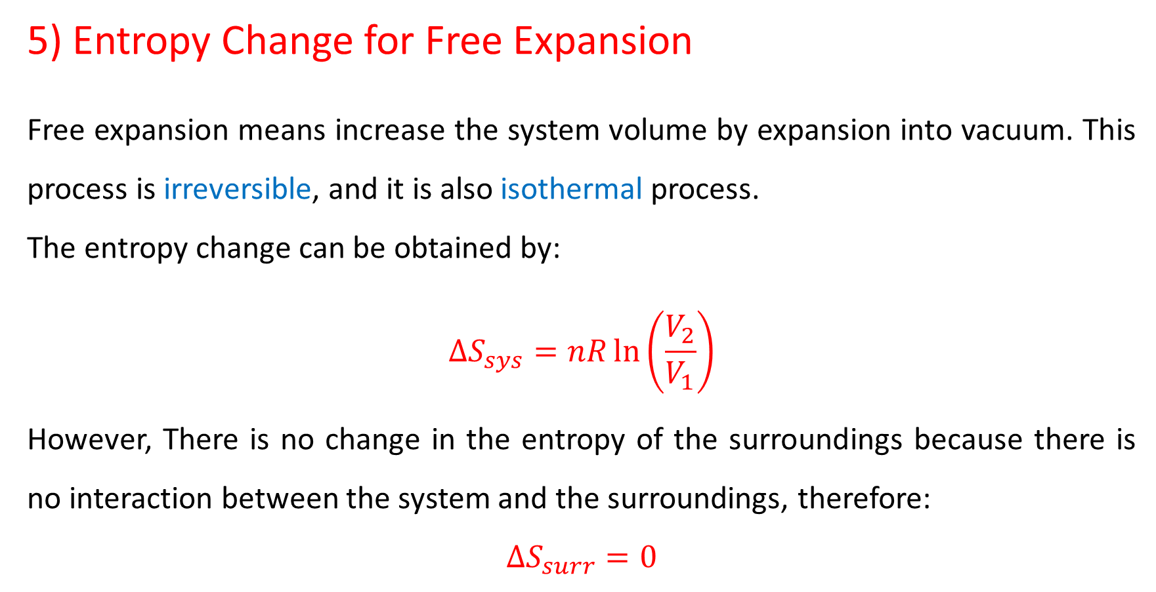
5) Entropy Change for Free Expansion
Free expansion means increase the system volume by expansion into vacuum. This process is irreversible, and it is also isothermal process.
The entropy change can be obtained by:
$$∆S_{sys}=nR\ln\left(\frac{V_{2}}{V_{1}}\right)$$
However, There is no change in the entropy of the surroundings because there is no interaction between the system and the surroundings, therefore:
$$∆S_{surr}=0$$

Slide 31
Applications of Second law of Thermodynamics
Heat engines, Carnot’s principle, the Carnot's engine, Carnot’s cycle, heat pump, refrigerator and air conditioner
1- Heat engines
A heat engine is any device that uses heat to perform work. It has three essential features:
1- Heat is supplied to the engine at a relatively high input temperature from a place called the hot source (reservoir).

Slide 32
2- Part of the input heat is used to perform work by the working substance of the engine, which is the material within the engine that does the work.
(e.g. the gasoline-air mixture in an automobile engine).
3- The remainder of the input heat is rejected to a place called cold sink (reservoir) which has a temperature lower than input temperature.
note: q_{h} , q_{c} and w when appeared in an equation they do not have negative values assigned to them.
A system taken in closed cycle ∆U = 0, therefore, net heat absorbed = work done
Hot source
T_{h}
Heat q_{h}
Engine
work
Heat q_{c}
Cold sink
T_{c}
q_{h} = w + q_{c}

Slide 33


Efficiencies are often quoted as percentages obtained by multiplying the ratio w/q_{h} by a factor of 100.
$$e=\frac{work done}{input heat}=\frac{w}{q_{h}}$$
and q_{h} = w + q_{c} therefore w = q_{h} – q_{c}
Also
$$q_{h}=\frac{w}{e}$$
$$e=\frac{q_{h}−q_{c}}{q_{h}}=1−\frac{q_{c}}{q_{h}}$$

Slide 34
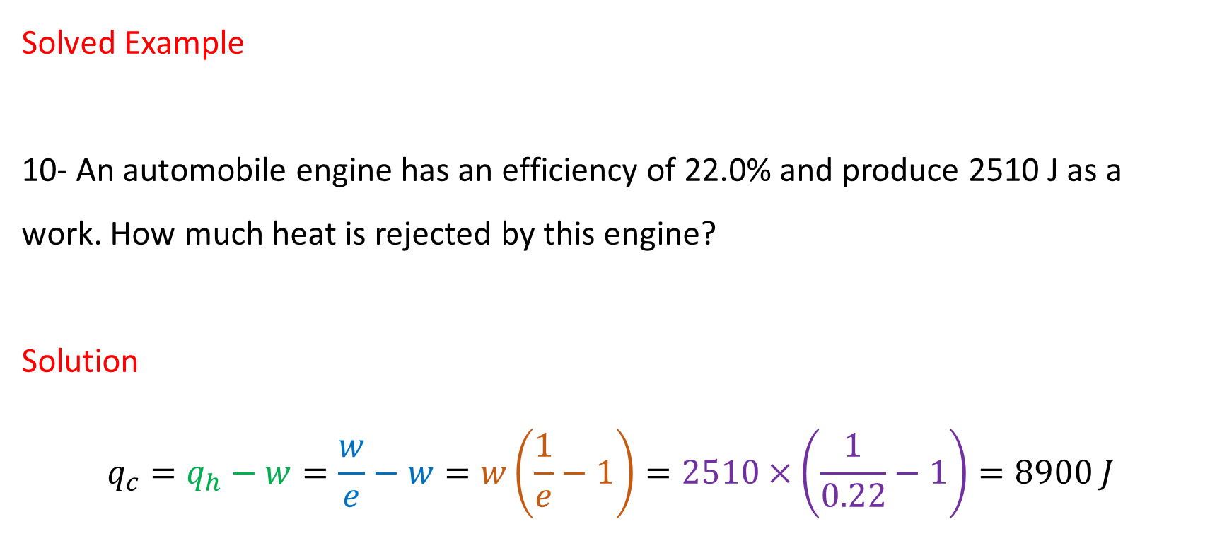
Solved Example
10- An automobile engine has an efficiency of 22.0% and produce 2510 J as a work. How much heat is rejected by this engine?
Solution
$$q_{c}=q_{h}−w=\frac{w}{e}−w=w\left(\frac{1}{e}−1\right)=2510×\left(\frac{1}{0.22}−1\right)=8900 J$$

Slide 35
2- Carnot’s principle and the Carnot's engine
A reversible process is one in which both the system and its environment can be returned to exactly the states they were in before the process occurred.
CARNOT’S PRINCIPLE: AN ALTERNATIVE STATEMENT OF THE SECOND LAW OF THERMODYNAMICS
No irreversible engine operating between two reservoirs (hot source and cold sink) at constant temperatures can have a greater efficiency than a reversible engine operating between the same temperatures. Furthermore, all reversible engines operating between the same temperatures have the same efficiency.

Slide 36
A Carnot engine is a reversible engine in which all input heat q_{h} originates from a hot reservoir (hot source) at a single temperature T_{h}, and all rejected heat q_{c} goes into a cold reservoir (cold sink) at a single temperature T_{c}. The work done by the engine is w.
Hot source
T_{h}
Heat q_{h}
Engine
work
Heat q_{c}
Cold sink
T_{c}
q_{h} = w + q_{c}

Slide 37
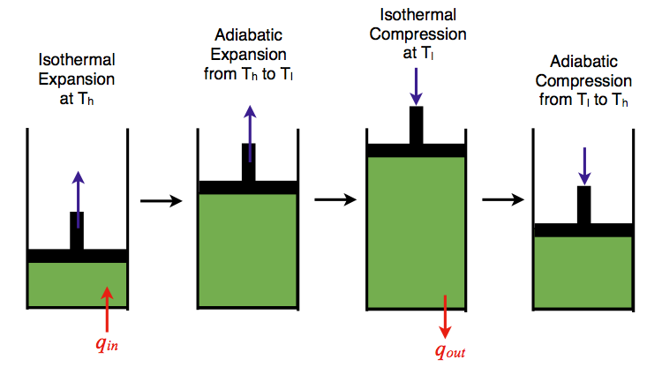
3- The Carnot’s Cycle
The Carnot cycle has the greatest efficiency possible of an engine based on the assumption of the absence of incidental wasteful processes such as friction, and no conduction of heat between different parts of the engine at different temperature.
Isothermal
Compression
at T_{c}
Adiabatic
Expansion
from T_{h} to T_{c}
Adiabatic
Compression
from T_{c} to T_{h}
The Carnot cycle consists of four processes:
q_{h}
q_{c}

Slide 38
The Carnot cycle consists of four processes:
I- A reversible isothermal gas expansion process. In this process, the ideal gas in the system absorbs q_{h} amount heat from a heat source at high temperature T_{h}, expands and does work on surrounding.
II- A reversible adiabatic gas expansion process. In this process, the system is thermally insulated. The gas continues to expand and do work on surroundings, which causes the system to cool to a lower temperature, T_{c} .
III- A reversible isothermal gas compression process. In this process, surroundings do work to the gas at T_{c}, and causes a loss of heat, q_{c} .
IV- A reversible adiabatic gas compression process. In this process, the system is thermally insulated. Surroundings continue to do work to the gas, which causes the temperature to rise back to T_{h}.

Slide 39
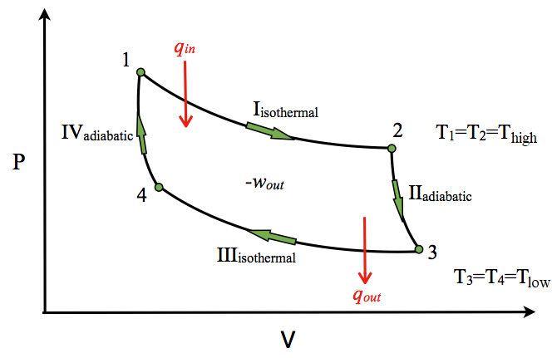
The P-V diagram of the Carnot cycle
q_{h}
T₁ = T₂ = T_{hot}
T₃ = T₄ = T_{cold}
q_{c}
In isothermal process I and III, ΔU=0 because ΔT=0. In adiabatic process II and IV, q=0

Slide 40
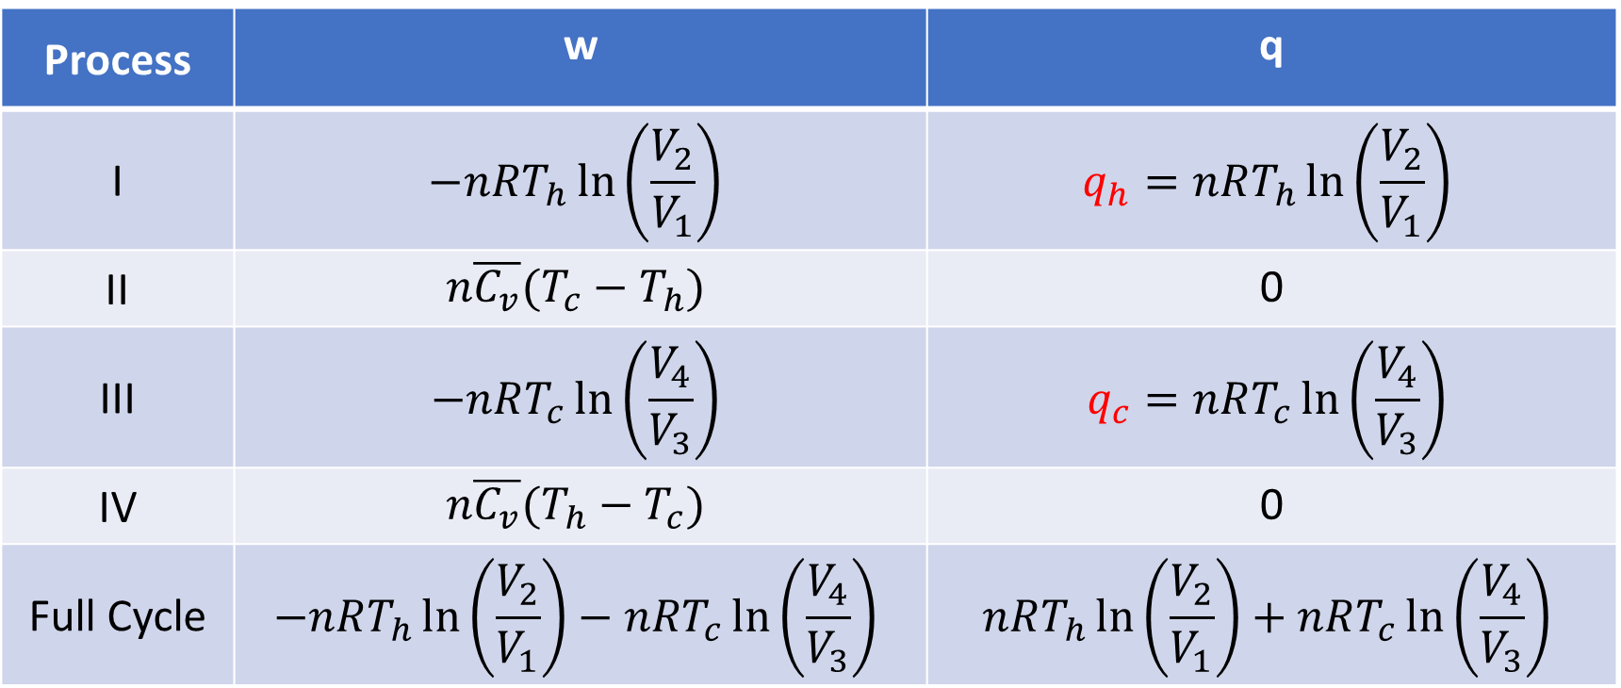
The P-V diagram of the Carnot cycle
Table summarize work and heat in the P-V diagram of each process in the Carnot cycle
Process | w | q
I | $$−nRT_{h}\ln\left(\frac{V_{2}}{V_{1}}\right)$$ | $$q_{h}=nRT_{h}\ln\left(\frac{V_{2}}{V_{1}}\right)$$
II | $$n\overline{C_{v}}(T_{c}−T_{h})$$ | 0
III | $$−nRT_{c}\ln\left(\frac{V_{4}}{V_{3}}\right)$$ | $$q_{c}=nRT_{c}\ln\left(\frac{V_{4}}{V_{3}}\right)$$
IV | $$n\overline{C_{v}}(T_{h}−T_{c})$$ | 0
Full Cycle | $$−nRT_{h}\ln\left(\frac{V_{2}}{V_{1}}\right)−nRT_{c}\ln\left(\frac{V_{4}}{V_{3}}\right)$$ | $$nRT_{h}\ln\left(\frac{V_{2}}{V_{1}}\right)+nRT_{c}\ln\left(\frac{V_{4}}{V_{3}}\right)$$

Slide 41
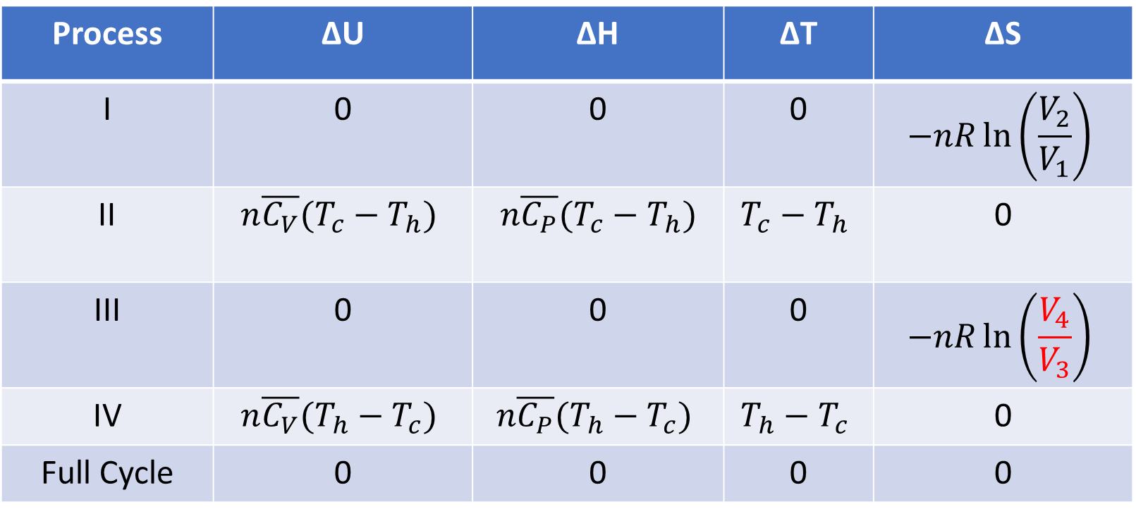
The P-V diagram of the Carnot cycle
Table summarize ∆U, ∆H, ∆T and ∆S in the P-V diagram of each process in the Carnot cycle.
Process | ∆U | ∆H | ∆T | ∆S
I | 0 | 0 | 0 | $$−nR\ln\left(\frac{V_{2}}{V_{1}}\right)$$
II | $$n\overline{C_{V}}(T_{c}−T_{h})$$ | $$n\overline{C_{P}}(T_{c}−T_{h})$$ | $$T_{c}−T_{h}$$ | 0
III | 0 | 0 | 0 | $$−nR\ln\left(\frac{V_{4}}{V_{3}}\right)$$
IV | $$n\overline{C_{V}}(T_{h}−T_{c})$$ | $$n\overline{C_{P}}(T_{h}−T_{c})$$ | $$T_{h}−T_{c}$$ | 0
Full Cycle | 0 | 0 | 0 | 0

Slide 42
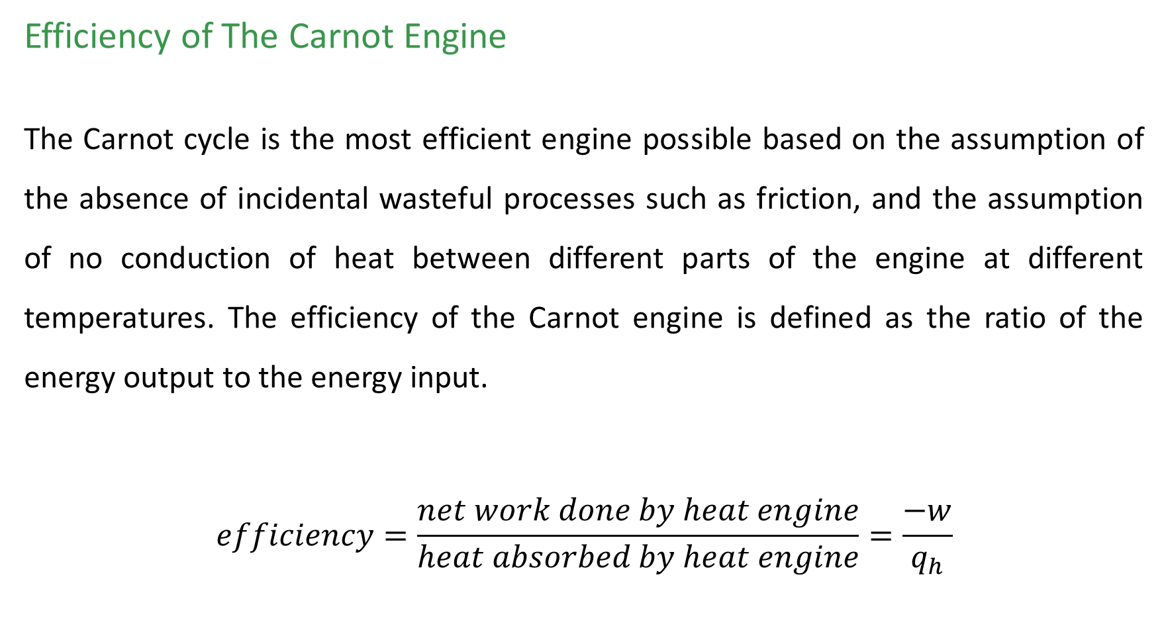
Efficiency of The Carnot Engine
The Carnot cycle is the most efficient engine possible based on the assumption of the absence of incidental wasteful processes such as friction, and the assumption of no conduction of heat between different parts of the engine at different temperatures. The efficiency of the Carnot engine is defined as the ratio of the energy output to the energy input.
$$efficiency=\frac{net work done by heat engine}{heat absorbed by heat engine}=\frac{−w}{q_{h}}$$

Slide 43

$$efficiency=\frac{−w}{q_{h}}=\frac{nRT_{h}\ln\left(\frac{V_{2}}{V_{1}}\right)+nRT_{c}\ln\left(\frac{V_{4}}{V_{3}}\right) }{nRT_{h}\ln\left(\frac{V_{2}}{V_{1}}\right) }$$
Since process II (2-3) and IV (4-1) are adiabatic
$${\left(\frac{T_{2}}{T_{3}}\right)}^{\frac{1}{γ−1}}=\frac{V_{3}}{V_{2}}$$
and
$${\left(\frac{T_{1}}{T_{4}}\right)}^{\frac{1}{γ−1}}=\frac{V_{4}}{V_{1}}$$
since T₁ = T₂ and T₃ = T₄

Slide 44

thus $\frac{V_{3}}{V_{2}}=\frac{V_{4}}{V_{1}}$
and $V_{3}V_{1}=V_{4}V_{2}$
then $\frac{V_{3}}{V_{4}}=\frac{V_{2}}{V_{1}}$
$efficiency=\frac{−w}{q_{h}}=\frac{nRT_{h}\ln\left(\frac{V_{2}}{V_{1}}\right)−nRT_{c}\ln\left(\frac{V_{2}}{V_{1}}\right) }{nRT_{h}\ln\left(\frac{V_{2}}{V_{1}}\right) }=\frac{T_{h}−T_{c}}{T_{h}}=1−\frac{T_{c}}{T_{h}}$
T_{c} and T_{h} must be in Kelvin

Slide 45

Also w_{sys} = q_{h} – q_{c}
$$efficiency=\frac{q_{h}−q_{c}}{q_{h}}=1−\frac{q_{c}}{q_{h}}$$
therefore
$$\frac{q_{h}−q_{c}}{q_{h}}=\frac{T_{h}−T_{c}}{T_{h}}$$
$$1−\frac{q_{c}}{q_{h}}=1−\frac{T_{c}}{T_{h}}$$
$$\frac{q_{c}}{q_{h}}=\frac{T_{c}}{T_{h}}$$

Slide 46
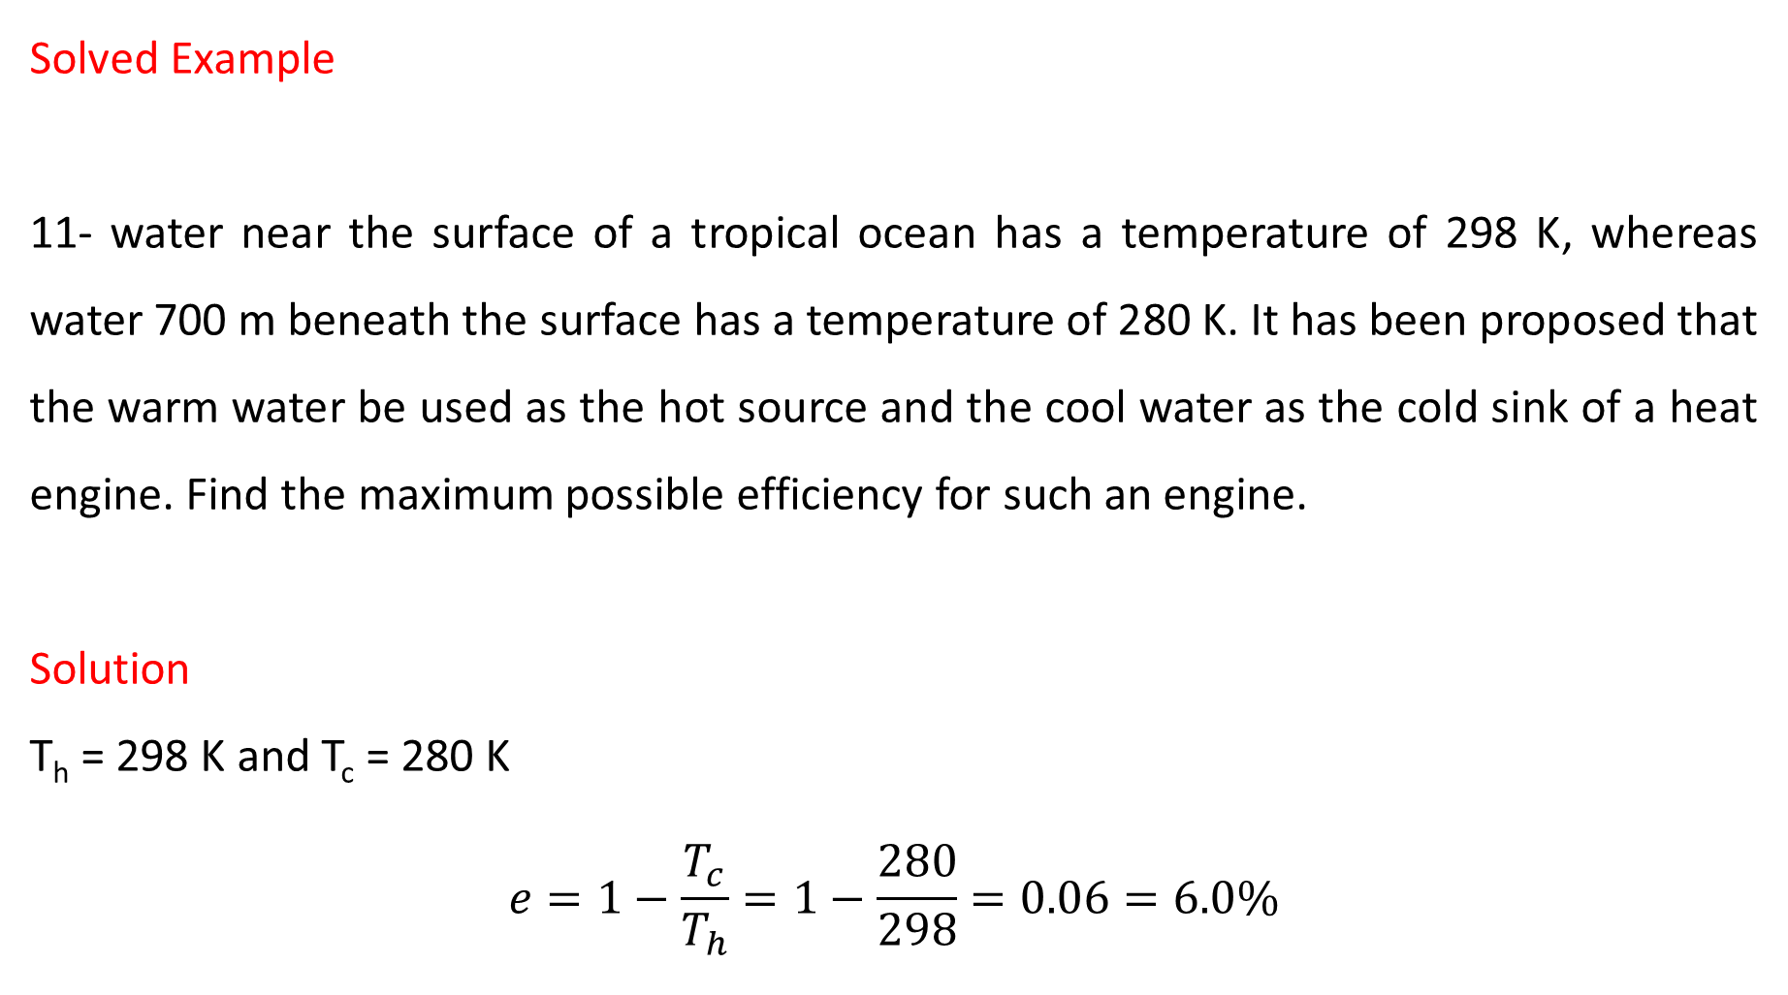
Solved Example
11- water near the surface of a tropical ocean has a temperature of 298 K, whereas water 700 m beneath the surface has a temperature of 280 K. It has been proposed that the warm water be used as the hot source and the cool water as the cold sink of a heat engine. Find the maximum possible efficiency for such an engine.
Solution
T_{h} = 298 K and T_{c} = 280 K
$$e=1−\frac{T_{c}}{T_{h}}=1−\frac{280}{298}=0.06=6.0\%$$

Slide 47
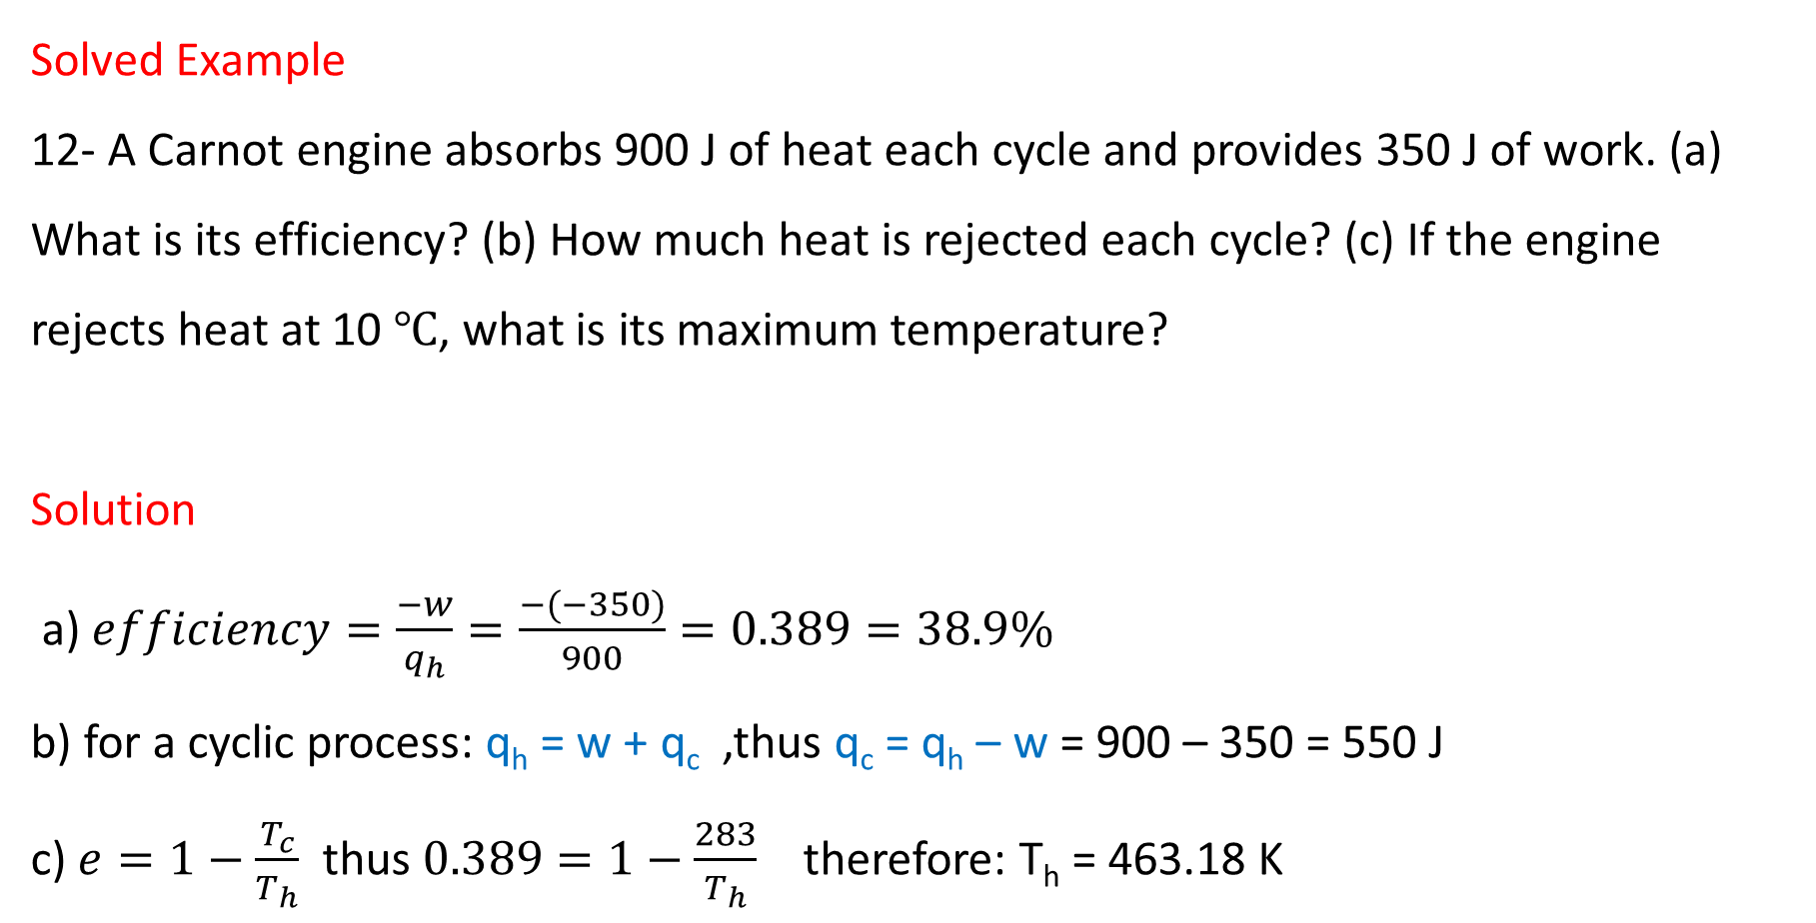
Solved Example
12- A Carnot engine absorbs 900 J of heat each cycle and provides 350 J of work. (a) What is its efficiency? (b) How much heat is rejected each cycle? (c) If the engine rejects heat at 10 ℃, what is its maximum temperature?
Solution
a) $efficiency=\frac{−w}{q_{h}}=\frac{−(−350)}{900}=0.389=38.9\%$
b) for a cyclic process: q_{h} = w + q_{c} ,thus q_{c} = q_{h} – w = 900 – 350 = 550 J
c) $e=1−\frac{T_{c}}{T_{h}}$ thus $0.389=1−\frac{283}{T_{h}}$ therefore: T_{h} = 463.18 K

Slide 48
4- Refrigerators and Air Conditioners
in the refrigeration process, work w is used to remove heat
q_{c} from the cold sink and deposit heat q_{h} into the hot resource
Where the interior of the unit is the cold sink, while the warmer exterior is the hot source.
The air conditioner also removes the heat from a room, which is the cold sink, and deposits heat outdoors, which is the hot source.
Hot source
T_{h}
Heat q_{h}
Engine
work
Heat q_{c}
Cold sink
T_{c}

Slide 49
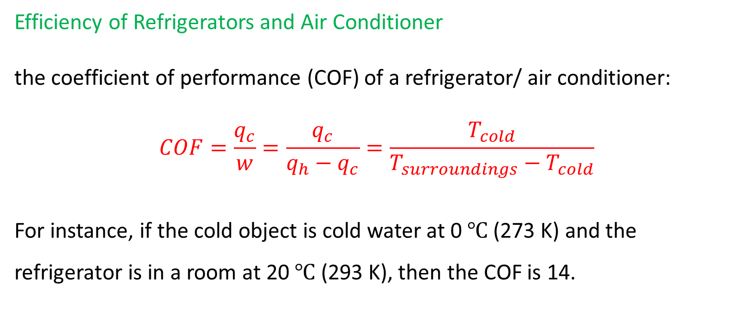
Efficiency of Refrigerators and Air Conditioner
the coefficient of performance (COF) of a refrigerator/ air conditioner:
$$COF=\frac{q_{c}}{w}=\frac{q_{c}}{q_{h}−q_{c}}=\frac{T_{cold}}{T_{surroundings}−T_{cold}}$$
For instance, if the cold object is cold water at 0 $℃$ (273 K) and the refrigerator is in a room at 20 $℃$ (293 K), then the COF is 14.

Slide 50
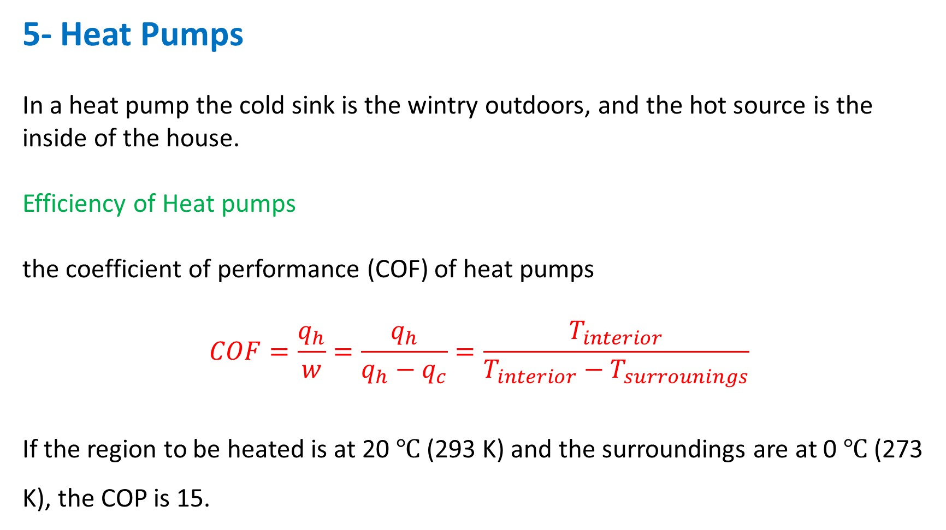
5- Heat Pumps
In a heat pump the cold sink is the wintry outdoors, and the hot source is the inside of the house.
Efficiency of Heat pumps
the coefficient of performance (COF) of heat pumps
$$COF=\frac{q_{h}}{w}=\frac{q_{h}}{q_{h}−q_{c}}=\frac{T_{interior}}{T_{interior}−T_{surrounings}}$$
If the region to be heated is at 20 $℃$ (293 K) and the surroundings are at 0 $℃$ (273 K), the COP is 15.

Slide 51
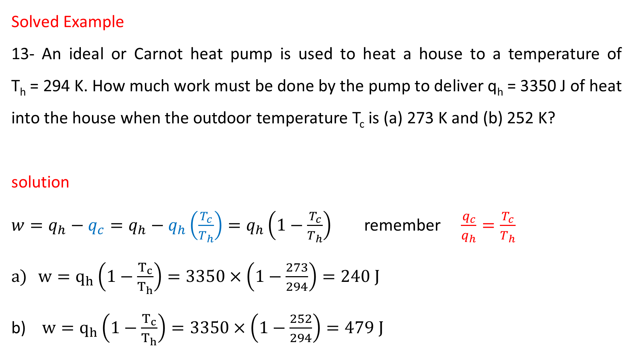
Solved Example
13- An ideal or Carnot heat pump is used to heat a house to a temperature of T_{h} = 294 K. How much work must be done by the pump to deliver q_{h} = 3350 J of heat into the house when the outdoor temperature T_{c} is (a) 273 K and (b) 252 K?
solution
$w=q_{h}−q_{c}=q_{h}−q_{h}\left(\frac{T_{c}}{T_{h}}\right)=q_{h}\left(1−\frac{T_{c}}{T_{h}}\right)$ remember $\frac{q_{c}}{q_{h}}=\frac{T_{c}}{T_{h}}$
$w=q_{h}\left(1−\frac{T_{c}}{T_{h}}\right)=3350×\left(1−\frac{273}{294}\right)=240 J$
$w=q_{h}\left(1−\frac{T_{c}}{T_{h}}\right)=3350×\left(1−\frac{252}{294}\right)=479 J$

Slide 52
Example
14- Each drawing represents a hypothetical heat engine or a hypothetical heat pump and shows the corresponding heats and work. Only one is allowed in nature. Which is it?

Slide 53
Solved Example
(The Entropy of the Universe Increases)
15- 1200 J of heat flow spontaneously through a copper rod from a hot reservoir at 650 K to a cold reservoir at 350 K. Determine the amount by which this irreversible process changes the entropy of the universe, assuming that no other changes occur.

Slide 54
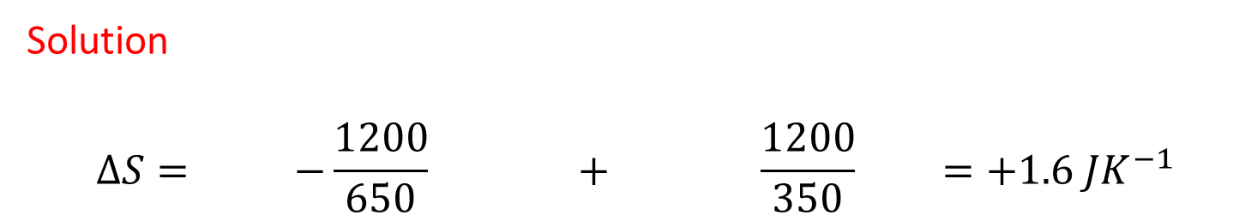
Solution
$$∆S= −\frac{1200}{650} + \frac{1200}{350} =+1.6 JK^{−1}$$
Entropy lost by hot source
Entropy gained by cold sink
Any irreversible process increases the entropy of the universe.

Slide 55
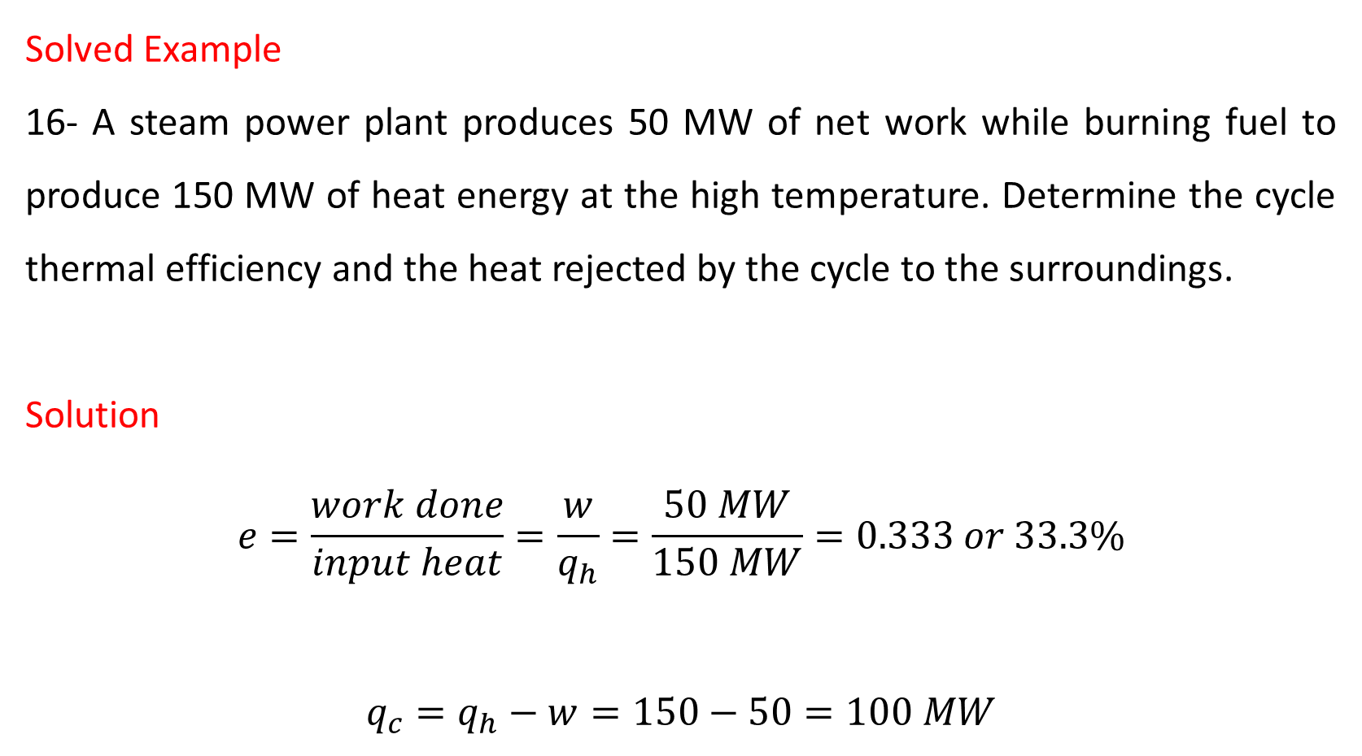
Solved Example
16- A steam power plant produces 50 MW of net work while burning fuel to produce 150 MW of heat energy at the high temperature. Determine the cycle thermal efficiency and the heat rejected by the cycle to the surroundings.
Solution
$$e=\frac{work done}{input heat}=\frac{w}{q_{h}}=\frac{50 MW}{150 MW}=0.333 or 33.3\%$$
$$q_{c}=q_{h}−w=150−50=100 MW$$

Slide 56
Solved Example
17- A Carnot heat engine receives 500 kJ of heat per cycle from a high-temperature hot source at 652 ℃ and rejects heat to a low-temperature cold sink at 30 ℃. Determine :
(a) The thermal efficiency of this Carnot engine.
(b) The amount of heat rejected to the low-temperature cold sink.
T_{h} = 652 ℃
Heat q_{h}
Engine
work
Heat q_{c}
T_{c} = 30 ℃

Slide 57

Solution
$e=1−\frac{T_{c}}{T_{h}}=1−\frac{\left(30+273\right)K}{\left(652+273\right)K}=0.672 or 67.2\%$
$\frac{q_{c}}{q_{h}}=\frac{T_{c}}{T_{h}}$
therefore $q_{c}=q_{h}\left(\frac{T_{c}}{T_{h}}\right)$
$$q_{c}=500×\left(\frac{30+273}{652+273}\right)=164 kJ$$

Slide 58
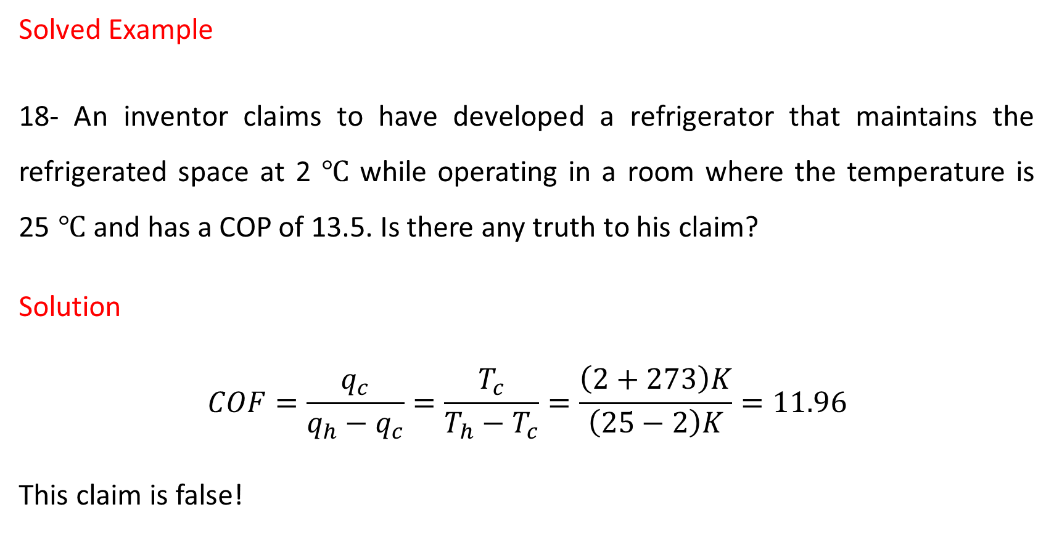
Solved Example
18- An inventor claims to have developed a refrigerator that maintains the refrigerated space at 2 ℃ while operating in a room where the temperature is 25 ℃ and has a COP of 13.5. Is there any truth to his claim?
Solution
$$COF=\frac{q_{c}}{q_{h}−q_{c}}=\frac{T_{c}}{T_{h}−T_{c}}=\frac{\left(2+273\right)K}{\left(25−2\right)K}=11.96$$
This claim is false!

Slide 59
Solved Example
19- In Figure (a) the heat is supplied by a hot reservoir (T = 650 K). In (b) the heat flows irreversibly through a copper rod into a second reservoir (T = 350 K) and then enters the engine. In either case, a 150-K reservoir is used as the cold reservoir. For each case, determine the maximum amount of work that can be obtained from the 1200 J of heat.

Slide 60
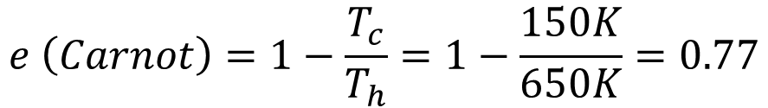
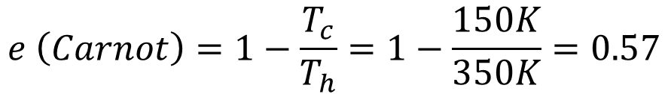
Solution
Before irreversible heat flow
$$e \left(Carnot\right)=1−\frac{T_{c}}{T_{h}}=1−\frac{150K}{650K}=0.77$$
$$w=e\left(Carnot\right)×q_{h}=0.77×1200=920 J$$
After irreversible heat flow
$$e \left(Carnot\right)=1−\frac{T_{c}}{T_{h}}=1−\frac{150K}{350K}=0.57$$
$$w=e\left(Carnot\right)×q_{h}=0.57×1200=680 J$$

Slide 61
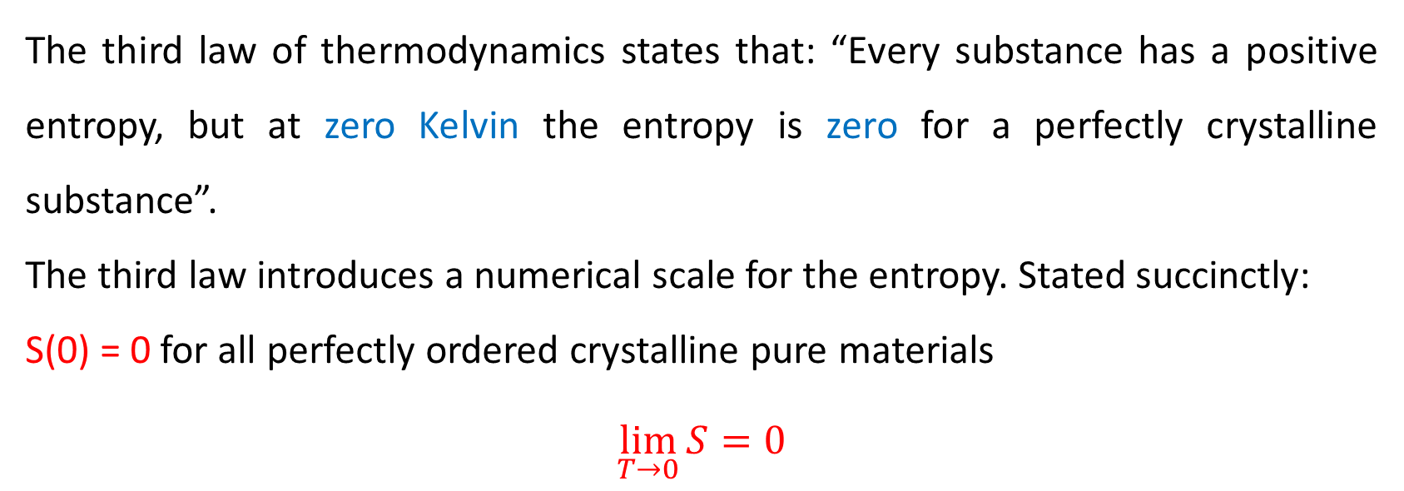
Third law of Thermodynamic
The third law of thermodynamics states that: “Every substance has a positive entropy, but at zero Kelvin the entropy is zero for a perfectly crystalline substance”.
The third law introduces a numerical scale for the entropy. Stated succinctly:
S(0) = 0 for all perfectly ordered crystalline pure materials
$$\lim_{T→0}{S}=0$$

Slide 64

The relationship between entropy and temperature
(7)
(6)
S
(5)
(4)
Gas
(3)
Liquid
(2)
(1)
Solid II
(0)
Solid I
0 – 15 K
0
T0
T1
T2
T3
T4
T

Slide 66
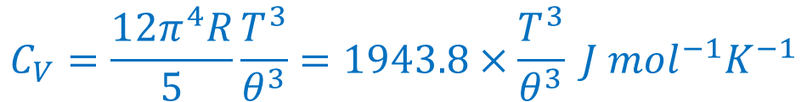
Note: The heat capacity from 0 K to 10-20 K can be estimate by Debye equation
$$C_{V}=\frac{12π^{4}R}{5}\frac{T^{3}}{θ^{3}}=1943.8×\frac{T^{3}}{θ^{3}} J {mol}^{−1}K^{−1}$$
The symbol θ is called the characteristic temperature and can be calculated from an experimental determination of the heat capacity at a low temperature. It is assumed that for a solid C_{V} = C_{P} at and near 0 K.

Slide 67

$$C_{P}=aT^{3}$$
This equation has been very useful in the extrapolation of measured heat capacities down to 0 K.
Solved Example
The molar constant pressure heat capacity of a certain solid at 10 K is 0.43 J K⁻¹ mol⁻¹. What is its molar entropy at this low temperature?

Slide 68

Solution
C_{P} (10) = 0.43 J K⁻¹ mol⁻¹
$${S\left(T\right)}_{total}=S\left(0\right)+S\left(T\right)$$
$$S\left(T\right)=\int_{0}^{T}{\frac{C_{P}}{T}}=\int_{0}^{T}{\frac{aT^{3}dT}{T}}=a\int_{0}^{T}{T^{2}dT}=\frac{1}{3}aT^{3}$$
$${S\left(T\right)}_{total}=S\left(0\right)+\frac{1}{3}C_{P}=S\left(0\right)+0.14 J K^{−1}{mol}^{−1}$$

Slide 69
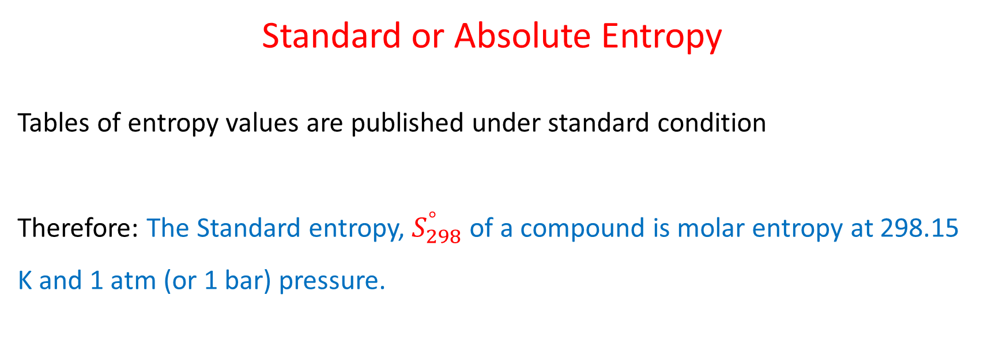
Standard or Absolute Entropy
Tables of entropy values are published under standard condition
Therefore: The Standard entropy, $S_{298}^{°}$ of a compound is molar entropy at 298.15 K and 1 atm (or 1 bar) pressure.

Slide 70
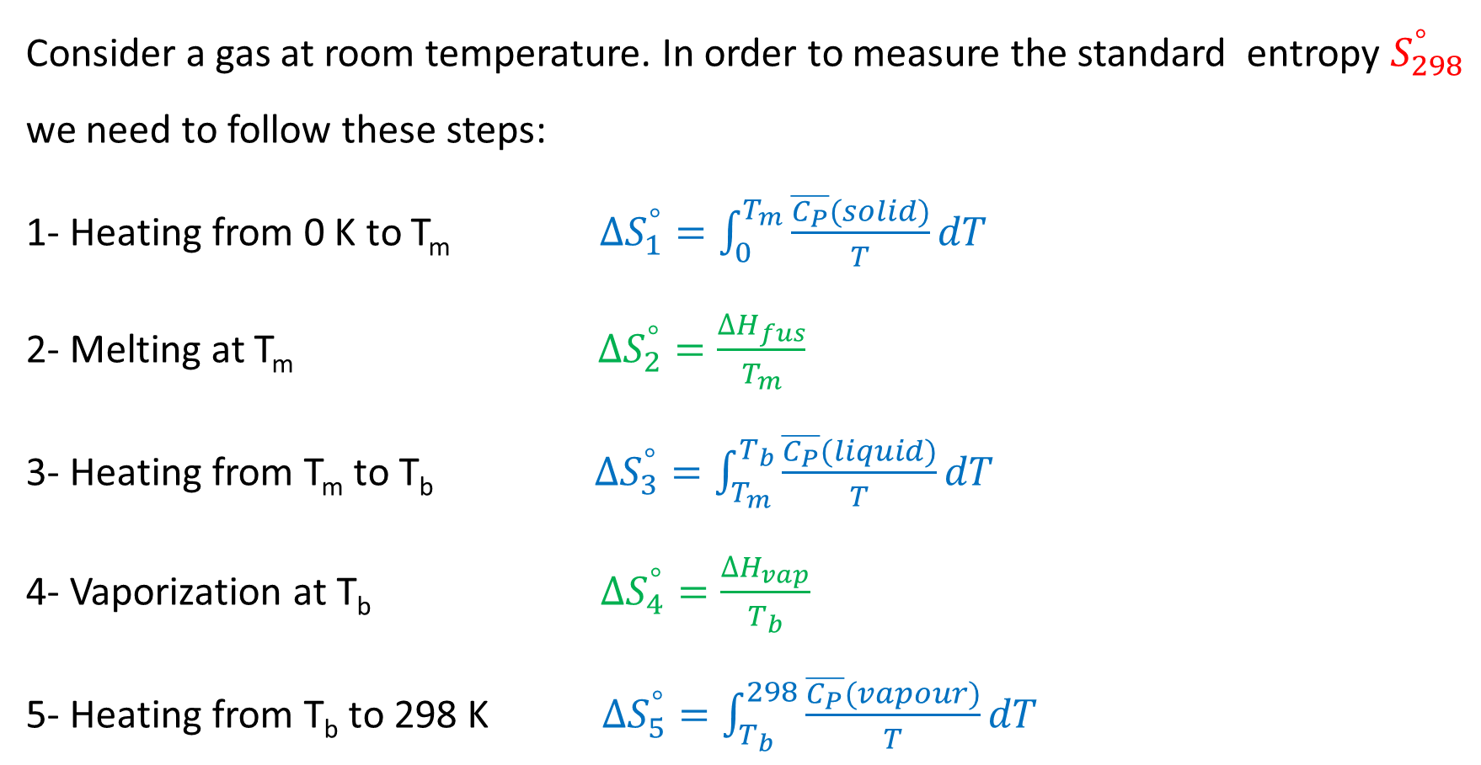
Consider a gas at room temperature. In order to measure the standard entropy $S_{298}^{°}$ we need to follow these steps:
1- Heating from 0 K to T_{m} $∆S_{1}^{°}=\int_{0}^{T_{m}}{\frac{\overline{C_{P}}(solid)}{T}dT}$
2- Melting at T_{m} $∆S_{2}^{°}=\frac{∆H_{fus}}{T_{m}}$
3- Heating from T_{m} to T_{b} $∆S_{3}^{°}=\int_{T_{m}}^{T_{b}}{\frac{\overline{C_{P}}(liquid)}{T}dT}$
4- Vaporization at T_{b} $∆S_{4}^{°}=\frac{∆H_{vap}}{T_{b}}$
5- Heating from T_{b} to 298 K $∆S_{5}^{°}=\int_{T_{b}}^{298}{\frac{\overline{C_{P}}(vapour)}{T}dT}$

Slide 71
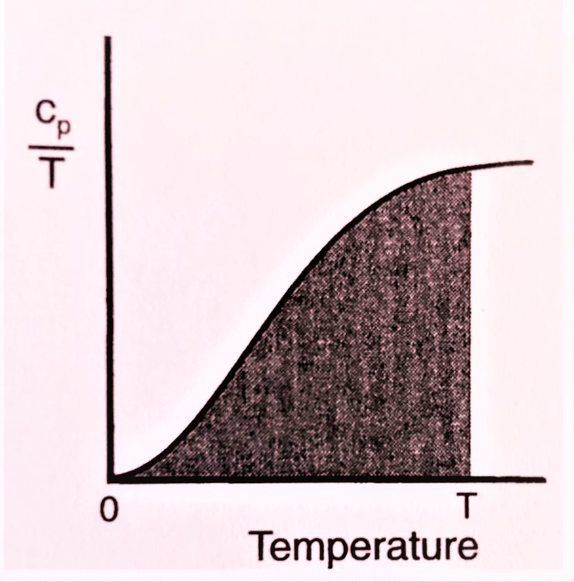
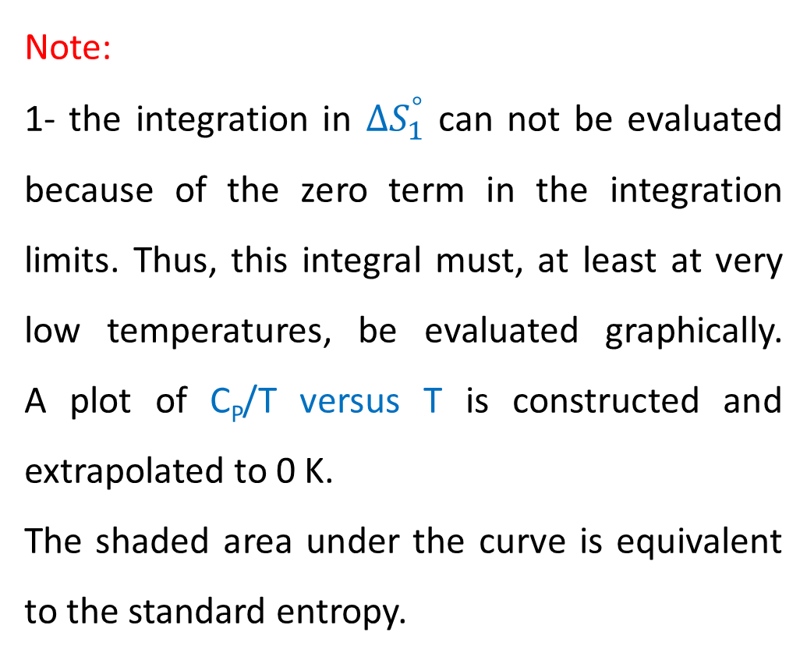

Then:
$$∆S_{298}^{°}=∆S_{1}^{°}+∆S_{2}^{°}+∆S_{3}^{°}+∆S_{4}^{°}+∆S_{5}^{°}$$
Note:
1- the integration in $∆S_{1}^{°}$ can not be evaluated because of the zero term in the integration limits. Thus, this integral must, at least at very low temperatures, be evaluated graphically. A plot of C_{P}/T versus T is constructed and extrapolated to 0 K.
The shaded area under the curve is equivalent to the standard entropy.

Slide 72
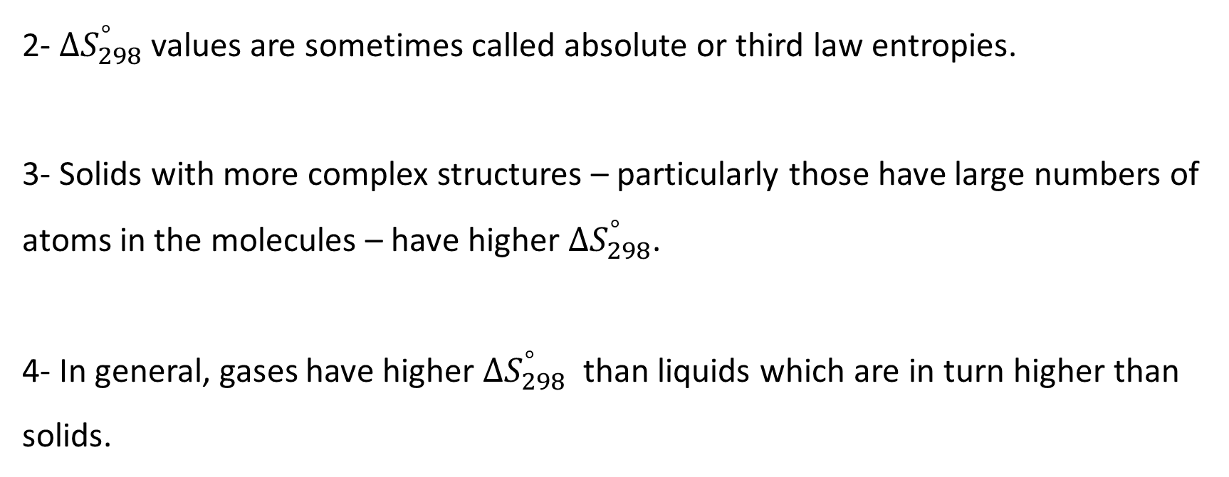
2- $∆S_{298}^{°}$ values are sometimes called absolute or third law entropies.
3- Solids with more complex structures – particularly those have large numbers of atoms in the molecules – have higher $∆S_{298}^{°}$.
4- In general, gases have higher $∆S_{298}^{°}$ than liquids which are in turn higher than solids.

Slide 73
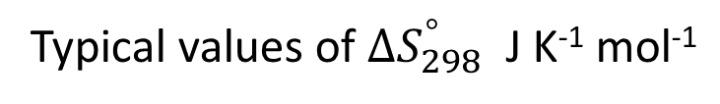
Typical values of $∆S_{298}^{°}$ J K⁻¹ mol⁻¹
197.3 | CO (g) | 5.7 | C (s) (graphite)
205.1 | O₂ (g) | 2.4 | C (s) (diamond)
213.6 | CO₂ (g) | 33.3 | Cu (s)
130.7 | H₂ (g) | 77.4 | Hg (l)
103.5 | Glycine, NH₂CH₂CO₂H (s) | 72.4 | NaCl (s)
45.0 | Ice, H₂O (s) | 212.0 | D- Glucose, C₆H₁₂O₆ (s)
69.9 | Water, H₂O (l) | 360.2 | Sucrose, C₁₂H₂₂O₁₁ (s)
188.8 | Water Vapour, H₂O (g) | 124.3 | Benzene, C₆H₆ (l)
160.7 | Ethanol, C₂H₅OH (l) | 269.2 | Benzene, C₆H₆ (g)

Slide 74
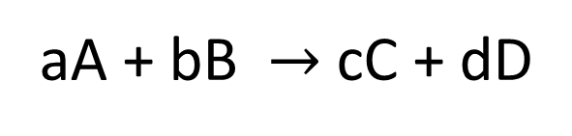
Entropy Changes in Chemical Reactions
In the same way as with enthalpy, we define the standard entropy of reaction as the difference in standard entropy of products from that of the reactants
$$∆S_{298}^{°}\left(reaction\right)=\sum{n ∆S_{298}^{°} \left(products\right)−\sum{m ∆S_{298}^{°} \left(reactants\right)}}$$
aA + bB $→$cC + dD
$$∆S_{298}^{°}\left(reaction\right)=\left[c ∆S_{298}^{°} \left(C\right)+d ∆S_{298}^{°} \left(D\right)\right]−[a ∆S_{298}^{°} \left(A\right)+b ∆S_{298}^{°} \left(B\right)]$$

Slide 75
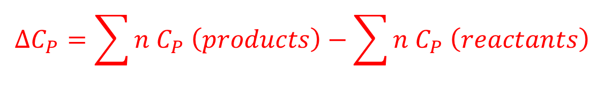

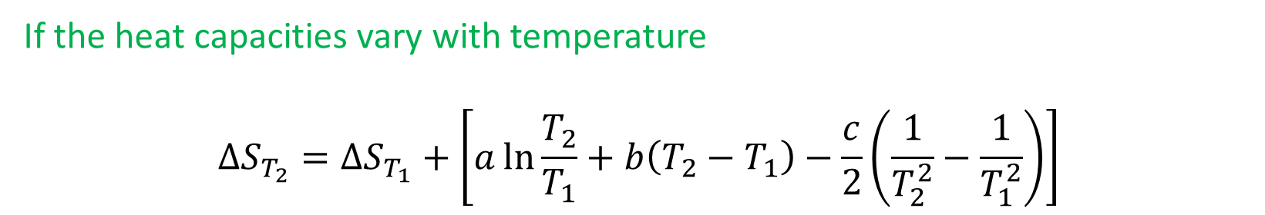
Effect of Temperature on Entropy (Kirchhoff’s Law)
In the same way as with enthalpy, the entropy changes when the temperature is changed
$$∆S_{T_{2}}=∆S_{T_{1}}+∆C_{P}\ln{\frac{T_{2}}{T_{1}}}$$
$$∆C_{P}=\sum{n C_{P} \left(products\right)−\sum{n C_{P} \left(reactants\right)}}$$
If the heat capacities vary with temperature
$$∆S_{T_{2}}=∆S_{T_{1}}+\left[a\ln{\frac{T_{2}}{T_{1}}}+b\left(T_{2}−T_{1}\right)−\frac{c}{2}\left(\frac{1}{T_{2}^{2}}−\frac{1}{T_{1}^{2}}\right)\right]$$

Slide 76
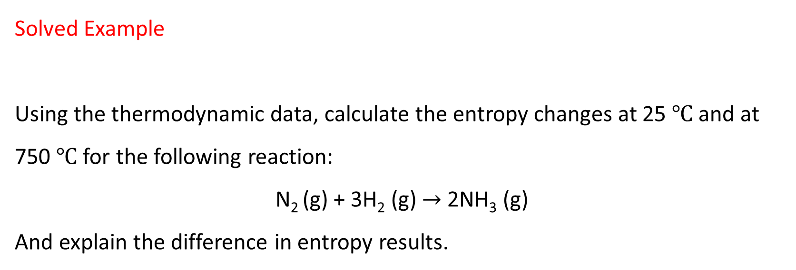
Solved Example
Using the thermodynamic data, calculate the entropy changes at 25 ℃ and at 750 ℃ for the following reaction:
N₂ (g) + 3H₂ (g) $→$ 2NH₃ (g)
And explain the difference in entropy results.

Slide 77
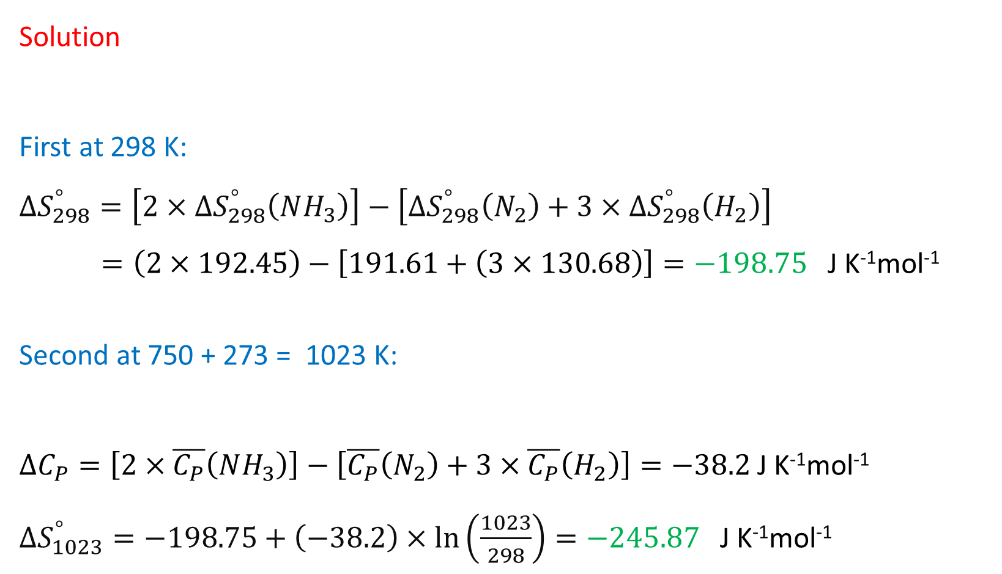
Solution
First at 298 K:
$$∆S_{298}^{°}=\left[2×∆S_{298}^{°}\left(NH_{3}\right)\right]−\left[∆S_{298}^{°}\left(N_{2}\right)+3×∆S_{298}^{°}\left(H_{2}\right)\right]$$
$=\left(2×192.45\right)−\left[191.61+\left(3×130.68\right)\right]=−198.75$ J K⁻¹mol⁻¹
Second at 750 + 273 = 1023 K:
$∆C_{P}=\left[2×\overline{C_{P}}\left(NH_{3}\right)\right]−\left[\overline{C_{P}}\left(N_{2}\right)+3×\overline{C_{P}}\left(H_{2}\right)\right]=−38.2$ J K⁻¹mol⁻¹
$∆S_{1023}^{°}=−198.75+\left(−38.2\right)×\ln\left(\frac{1023}{298}\right)=−245.87$ J K⁻¹mol⁻¹

Slide 78
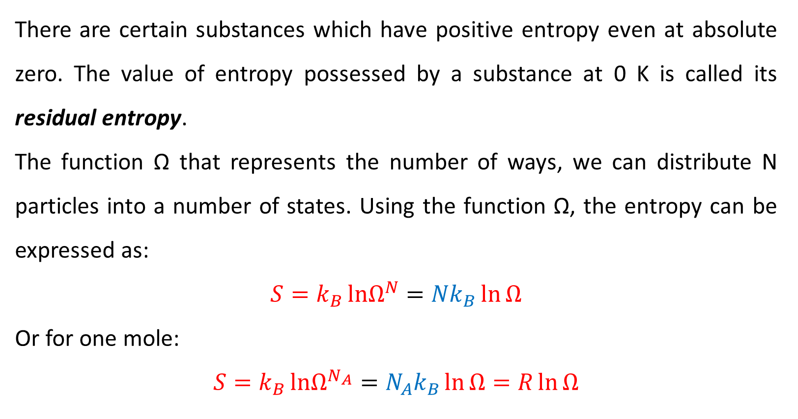
Concept of Residual Entropy
There are certain substances which have positive entropy even at absolute zero. The value of entropy possessed by a substance at 0 K is called its residual entropy.
The function Ω that represents the number of ways, we can distribute N particles into a number of states. Using the function Ω, the entropy can be expressed as:
$$S=k_{B}{lnΩ^{N}}={Nk}_{B}\ln{Ω}$$
Or for one mole:
$$S=k_{B}{lnΩ^{N_{A}}}={N_{A}k}_{B}\ln{Ω}=R\ln{Ω}$$

Slide 79

$$S=k_{B}{lnΩ^{N}}={Nk}_{B}\ln{Ω}$$
N is numbers of atoms or molecules, If N = N_{A} therefore N_{A}k_{B} = R.
k_{B} is Boltzmann's constant which is equal to 1.3807 × 10⁻²³ (J · K⁻¹),
N_{A} Avogadro number.
At zero Kelvin the system is in its lowest energy state. For a perfect crystal there is only one way to distribute the energy and Ω = 1, therefore S = 0. However, the entropy not equal to zero at T = 0 K if the substance is not a perfect crystal.

Slide 80
The residual entropy arises because the molecules can arrange themselves in more that one ways. For example, in case of carbon monoxide (CO), the molecule CO has a very small dipole moment and there is a finite chance that CO will crystallize following type of arrangements even at 0 K:
For each CO molecule, there are two possible orientations of the molecule, therefore there are two ways each CO can exist in the lattice. Thus Ω = 2 for each molecule.

Slide 81
Calculation of residual entropy:
In a system containing one Avogadro number of molecules (one mole), in the case of CO when Ω = 2 the entropy is given by:
S = N_{A} × k_{B} × ln Ω = R × ln Ω = 8.314 × ln 2 = 5.7 J K⁻¹ mol⁻¹
The entropy at zero Kelvin is known as residual entropy. There are number of substances that show similar statistical variations in orientation that lead to a residual entropy.

