Slide 1
Part 6
Free Energy and Chemical Equilibria

Slide 2
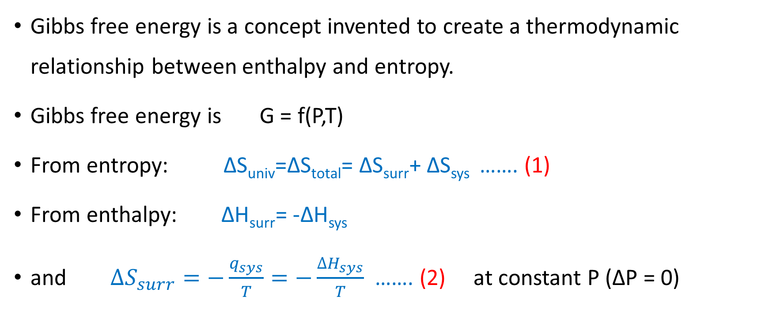
Gibbs Free Energy
Gibbs free energy is a concept invented to create a thermodynamic relationship between enthalpy and entropy.
Gibbs free energy is G = f(P,T)
From entropy: ∆S_{univ}=∆S_{total}= ∆S_{surr}+ ∆S_{sys} ……. (1)
From enthalpy: ∆H_{surr}= -∆H_{sys}
and $∆S_{surr}=−\frac{q_{sys}}{T}=−\frac{∆H_{sys}}{T}$ ……. (2) at constant P (∆P = 0)

Slide 3
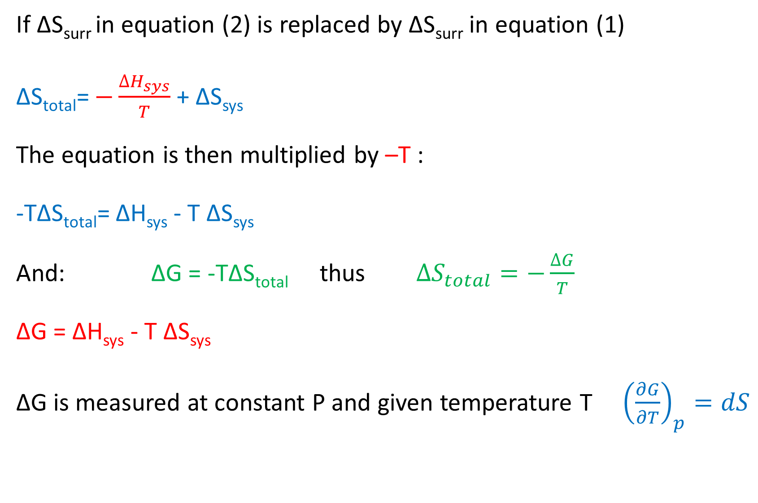
If ∆S_{surr} in equation (2) is replaced by ∆S_{surr} in equation (1)
∆S_{total}= $−\frac{∆H_{sys}}{T}$ + ∆S_{sys}
The equation is then multiplied by –T :
-T∆S_{total}= ∆H_{sys} - T ∆S_{sys}
And: ∆G = -T∆S_{total} thus $∆S_{total}=−\frac{∆G}{T}$
∆G = ∆H_{sys} - T ∆S_{sys}
∆G is measured at constant P and given temperature T ${\left(\frac{∂G}{∂T}\right)}_{p}=dS$

Slide 4
At standard condition (T = 25 ℃, P = 1 atm and 1 M aqueous solution):
∆Gº = ∆Hº - T ∆Sº
Gibbs free energy function gives very useful information about the state of thermodynamic process:
∆G = -ev for spontaneous process
∆G = +ev for non-spontaneous process
∆G = zero at equilibrium

Slide 5
The table below summarized the sign of ∆H, ∆S, ∆G and spontaneity
Case | ∆H | ∆S | ∆G | spontaneity
High Temperature | - | + | - | Spontaneous
Low Temperature | - | + | - | Spontaneous
High Temperature | - | - | + | Non Spontaneous
Low Temperature | - | - | - | Spontaneous
High Temperature | + | + | - | Spontaneous
Low Temperature | + | + | + | Non Spontaneous
High Temperature | + | - | + | Non Spontaneous
Low Temperature | + | - | + | Non Spontaneous

Slide 6
Standard State Free Energy of Formation ∆G_{f}º
The change in free energy that occurs when a compound is formed from its elements at standard state conditions.
The standard state free energy of the reaction can be calculated from the standard state free energies of the formation of their elements:
∆Gº_{reaction} = ∑ ∆Gº_{f (products)} - ∑ ∆Gº_{f (reactants)}
Like ∆H_{f}º , ∆G_{f}º = 0 for an element in its standard state:
Example : ∆G_{f}º (O₂(g)) = 0

Slide 7
1- Is the following reaction spontaneous under standard conditions?
4KClO₃ (s) → 3KClO₄ (s) + KCl (s)
 | ∆Hº_{f} (kJ / mol) | Sº (J / mol)
KClO₃ (s) | -397.7 | 143.1
KClO₄ (s) | -432.8 | 151.0
KCl (s) | -436.7 | 82.6

Slide 8
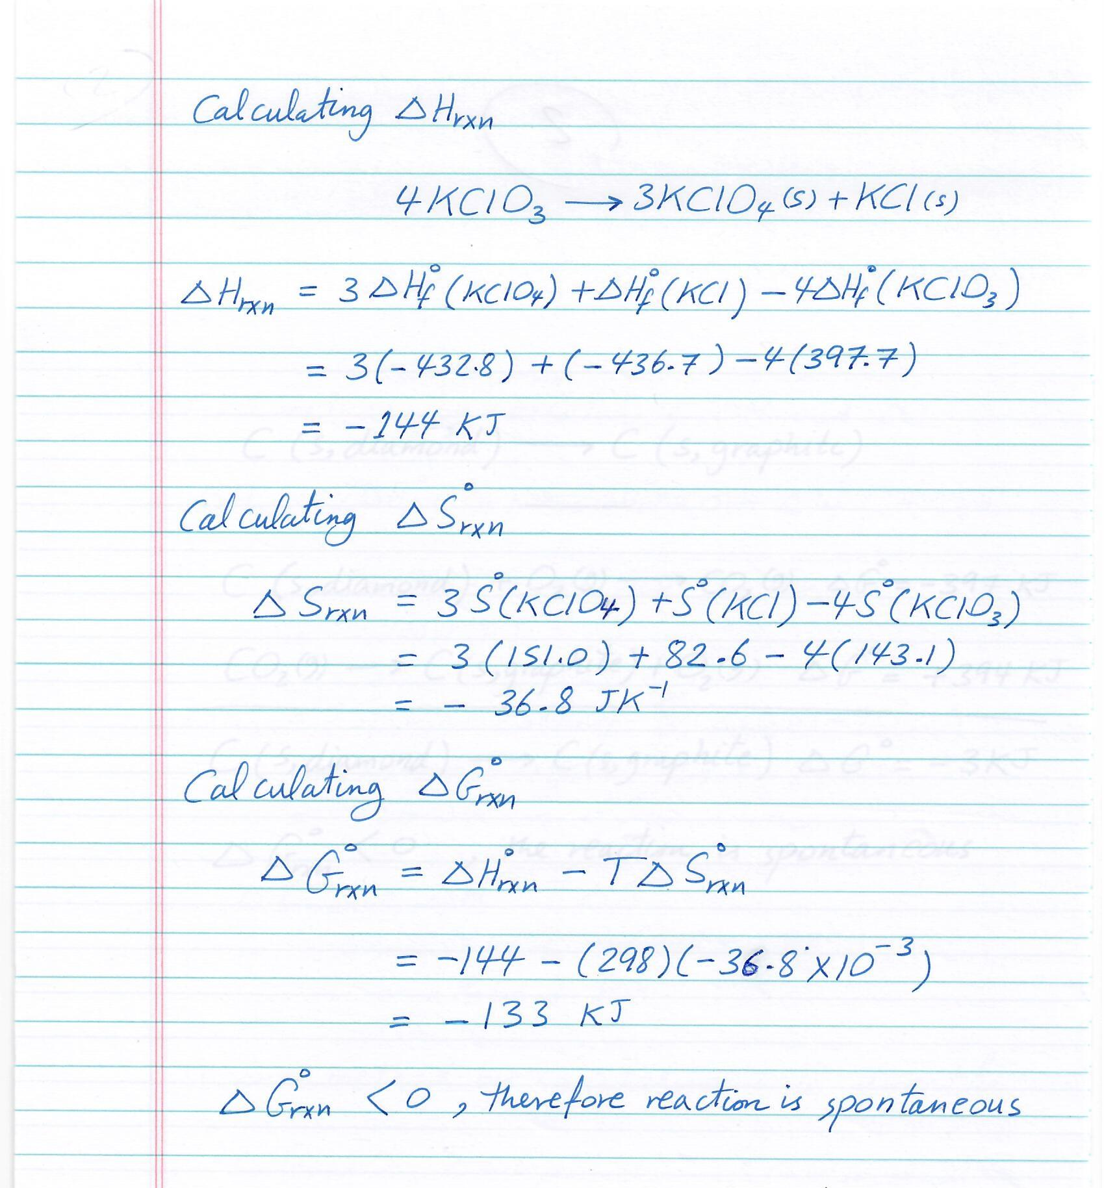

Slide 9
2- Is the following reaction spontaneous under standard conditions?
C (s, diamond) → C (s, graphite) ∆Gº = ?
If:
C (s, diamond) + O₂ (g) → CO₂ (g) ∆Gº = -397 kJ
C (s, graphite) + O₂ (g) → CO₂ (g) ∆Gº = -394 kJ

Slide 10
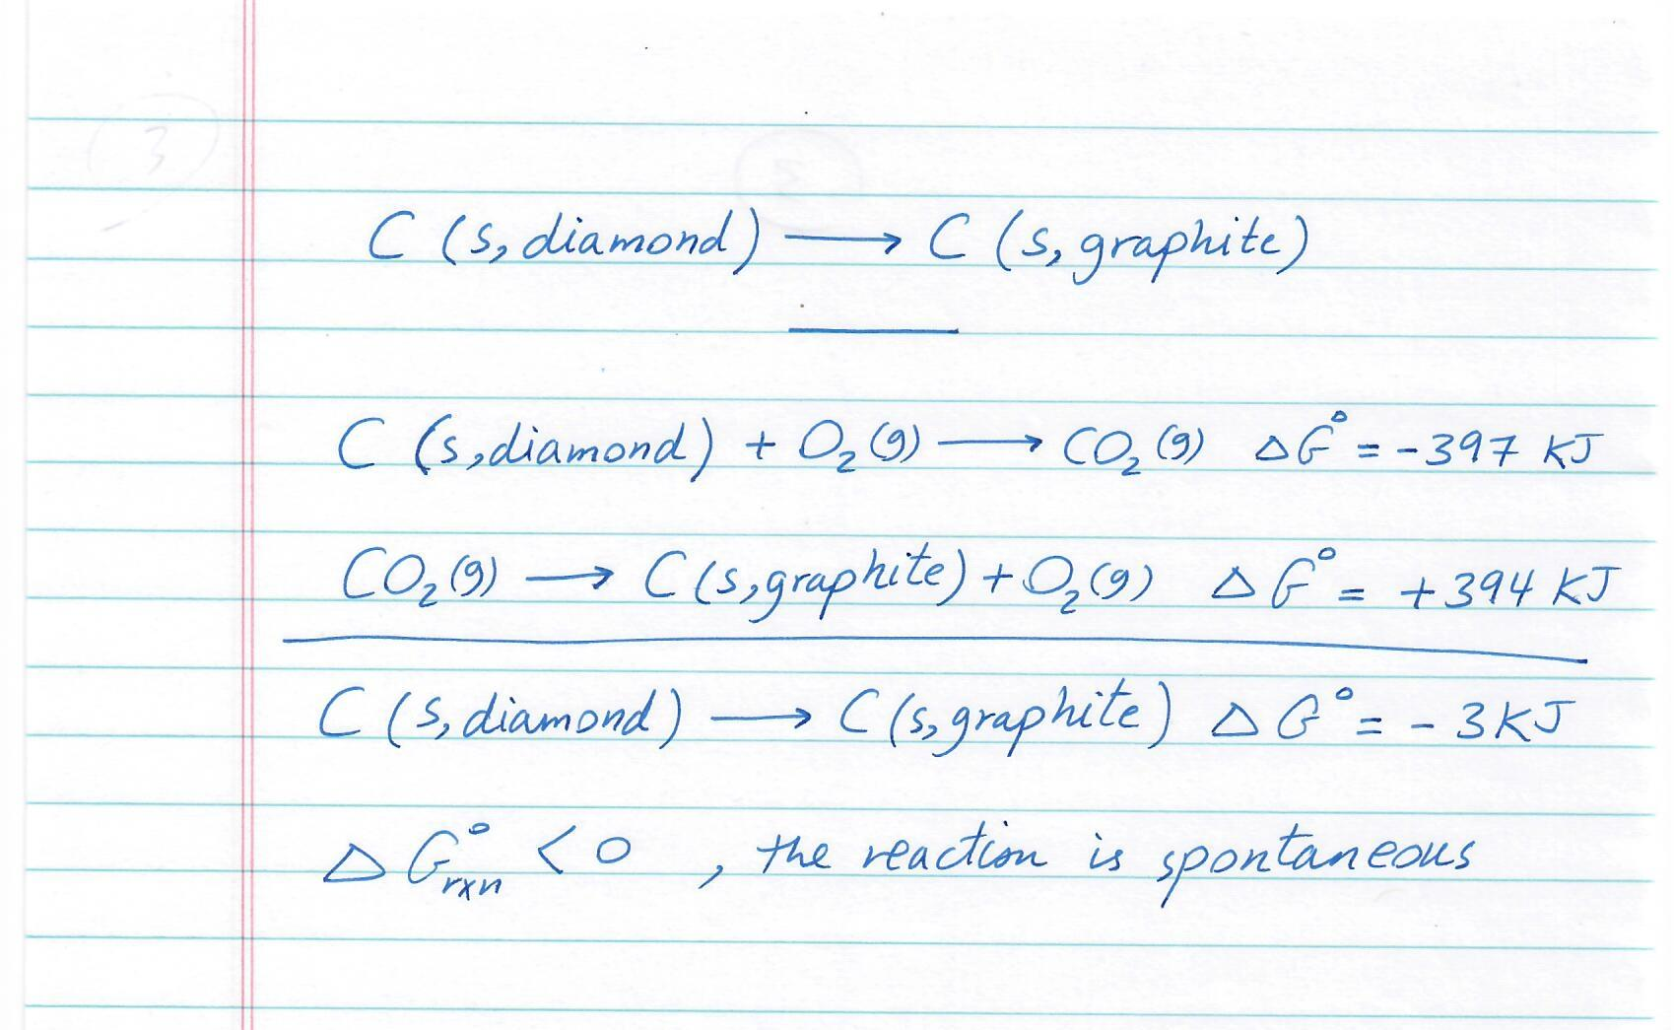

Slide 11
3- Calculate ∆G at 25 ℃ for the following reaction, via two methods
CH₃CO₂H (l) + 2O₂ (g) → 2CO₂ (g) + 2H₂O (g)
 | ∆Gº_{f} (kJ / mol) | ∆Hº_{f} (kJ / mol) | Sº (kJ / mol)
CH₃CO₂H (l) | -389.9 | -484.5 | 159.8
O₂ (g) | - | - | 205.1
CO₂ (g) | -394.4 | -393.5 | 213.7
H₂O (g) | -228.6 | -241.8 | 188.8

Slide 12
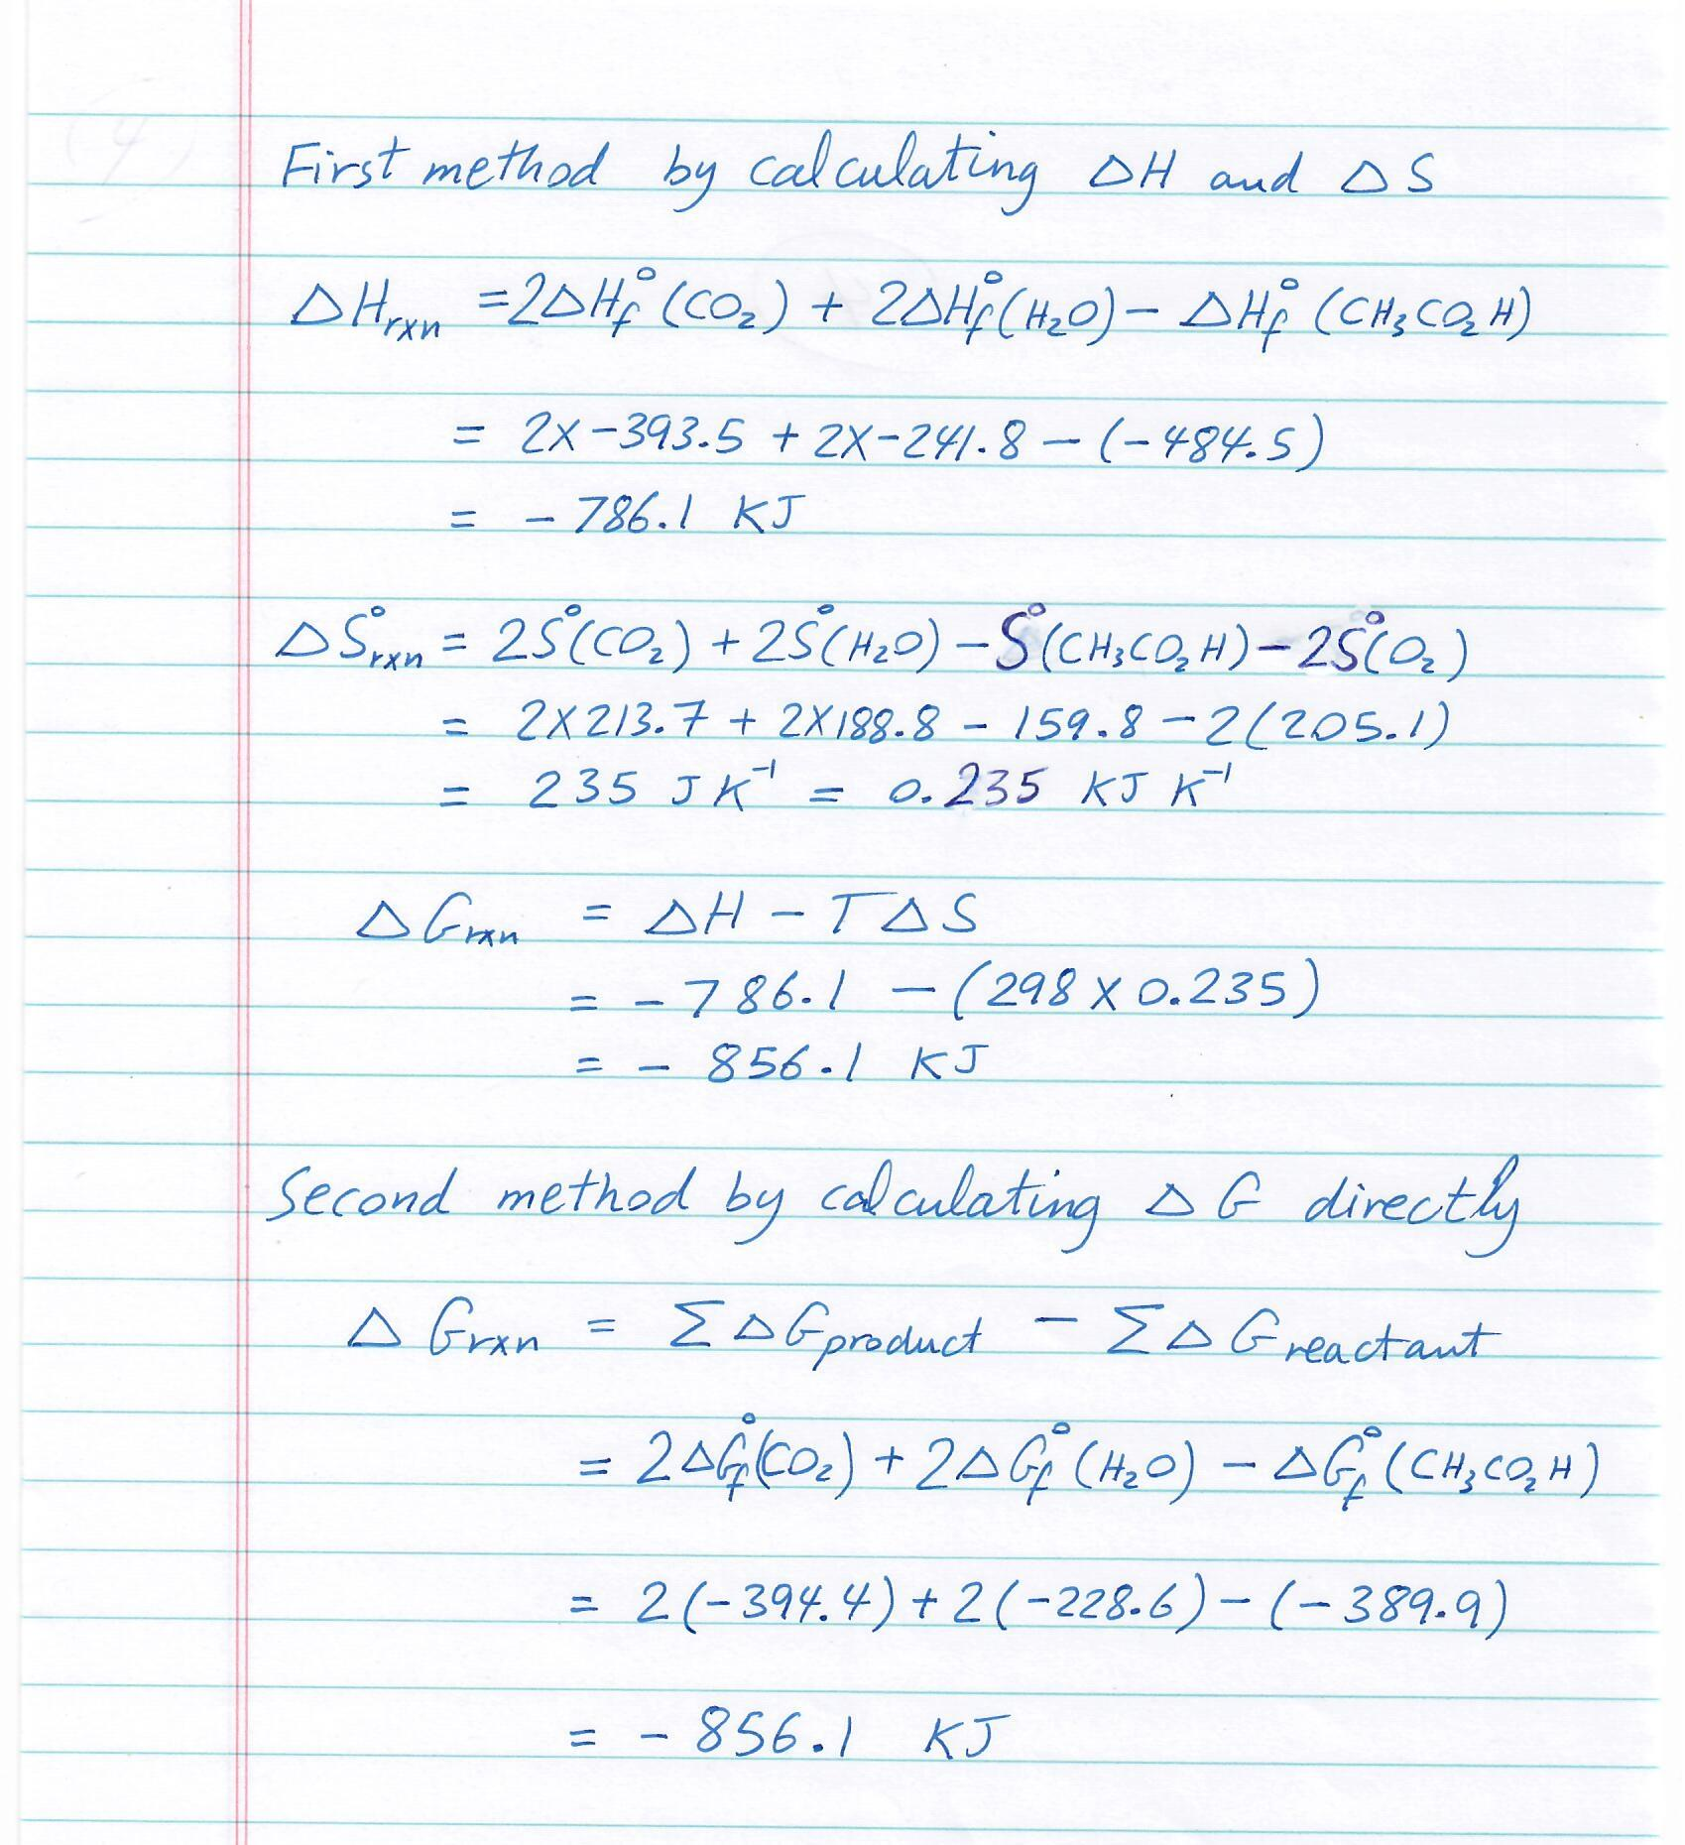

Slide 13
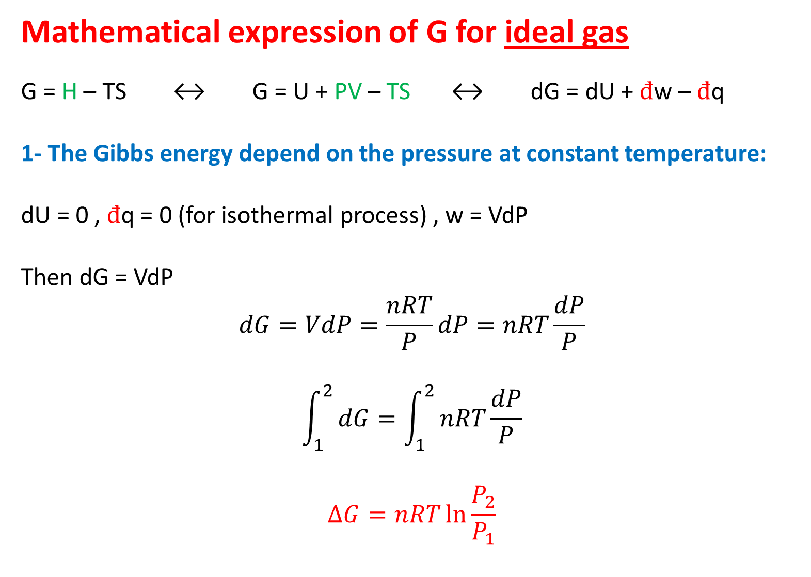
Mathematical expression of G for ideal gas
G = H – TS ↔ G = U + PV – TS ↔ dG = dU + $đ$w – $đ$q
1- The Gibbs energy depend on the pressure at constant temperature:
dU = 0 , $đ$q = 0 (for isothermal process) , w = VdP
Then dG = VdP
$$dG=VdP=\frac{nRT}{P}dP=nRT\frac{dP}{P}$$
$$\int_{1}^{2}{dG=\int_{1}^{2}{nRT\frac{dP}{P}}}$$
$$∆G=nRT\ln{\frac{P_{2}}{P_{1}}}$$

Slide 14
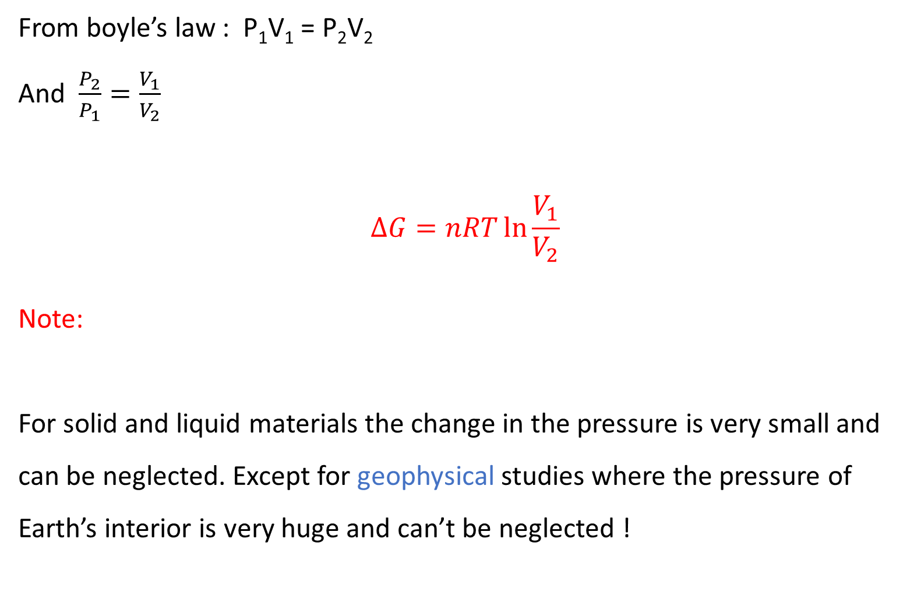
From boyle’s law : P₁V₁ = P₂V₂
And $\frac{P_{2}}{P_{1}}=\frac{V_{1}}{V_{2}}$
$$∆G=nRT\ln{\frac{V_{1}}{V_{2}}}$$
Note:
For solid and liquid materials the change in the pressure is very small and can be neglected. Except for geophysical studies where the pressure of Earth’s interior is very huge and can’t be neglected !

Slide 15
Examples
4- For the reaction at 298 K: 2A + B → C
∆H = 400 kJ mol⁻¹ and ∆S = 0.2 kJ K⁻¹ mol⁻¹
At what temperature will the reaction become spontaneous considering ∆H and ∆S to be constant over the temperature range? (note ∆G = 0 at equilibrium)

Slide 16
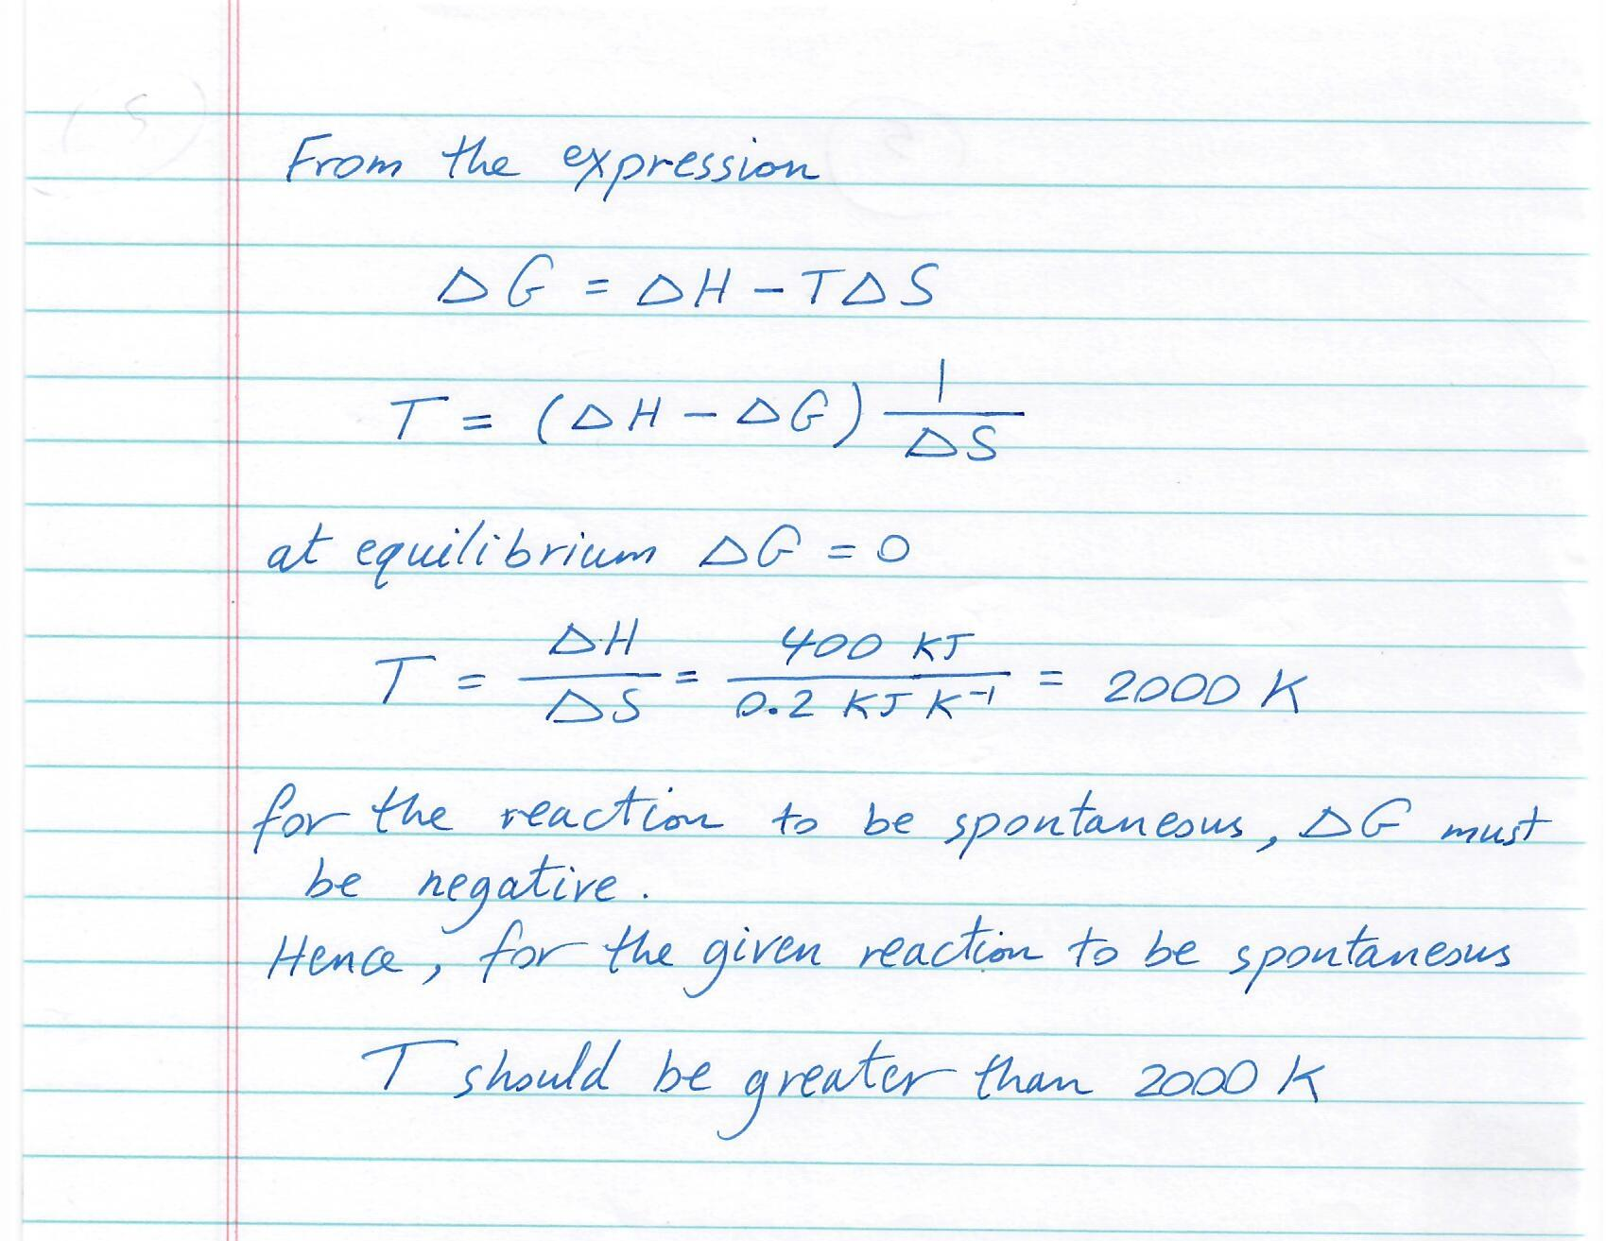

Slide 17
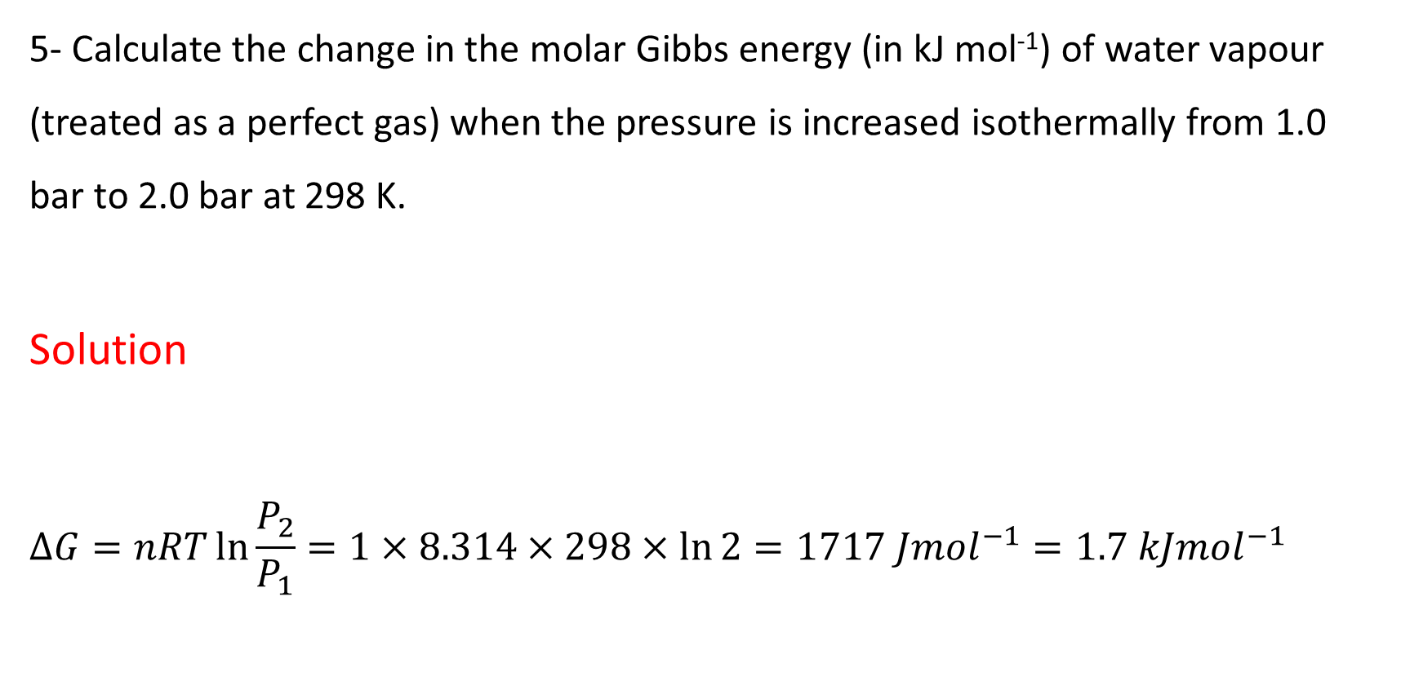
5- Calculate the change in the molar Gibbs energy (in kJ mol⁻¹) of water vapour (treated as a perfect gas) when the pressure is increased isothermally from 1.0 bar to 2.0 bar at 298 K.
Solution
$$∆G=nRT\ln{\frac{P_{2}}{P_{1}}}=1×8.314×298×\ln{2}=1717 J{mol}^{−1}=1.7 kJ{mol}^{−1}$$

Slide 18
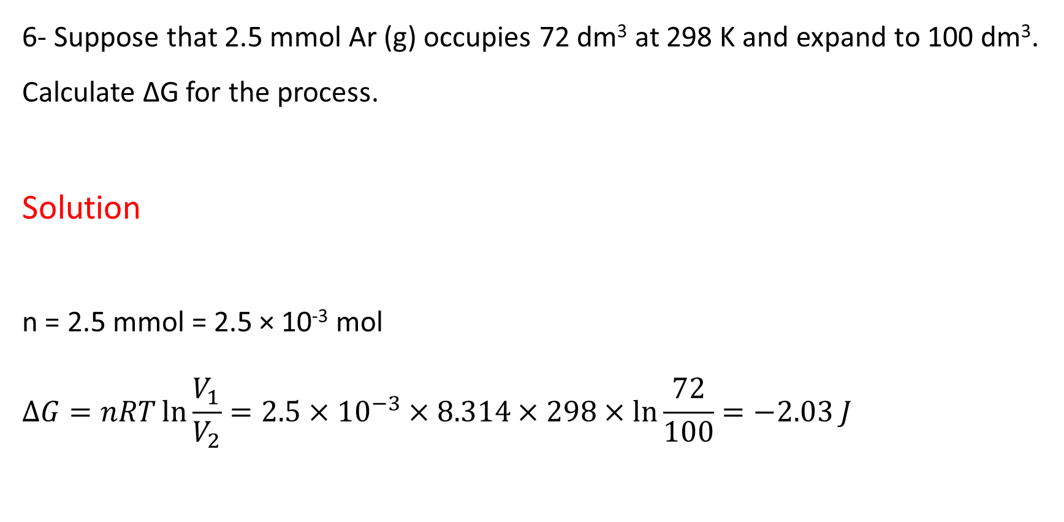
6- Suppose that 2.5 mmol Ar (g) occupies 72 dm³ at 298 K and expand to 100 dm³. Calculate ∆G for the process.
Solution
n = 2.5 mmol = 2.5 × 10⁻³ mol
$$∆G=nRT\ln{\frac{V_{1}}{V_{2}}}=2.5×{10}^{−3}×8.314×298×\ln{\frac{72}{100}}=−2.03 J$$

Slide 19
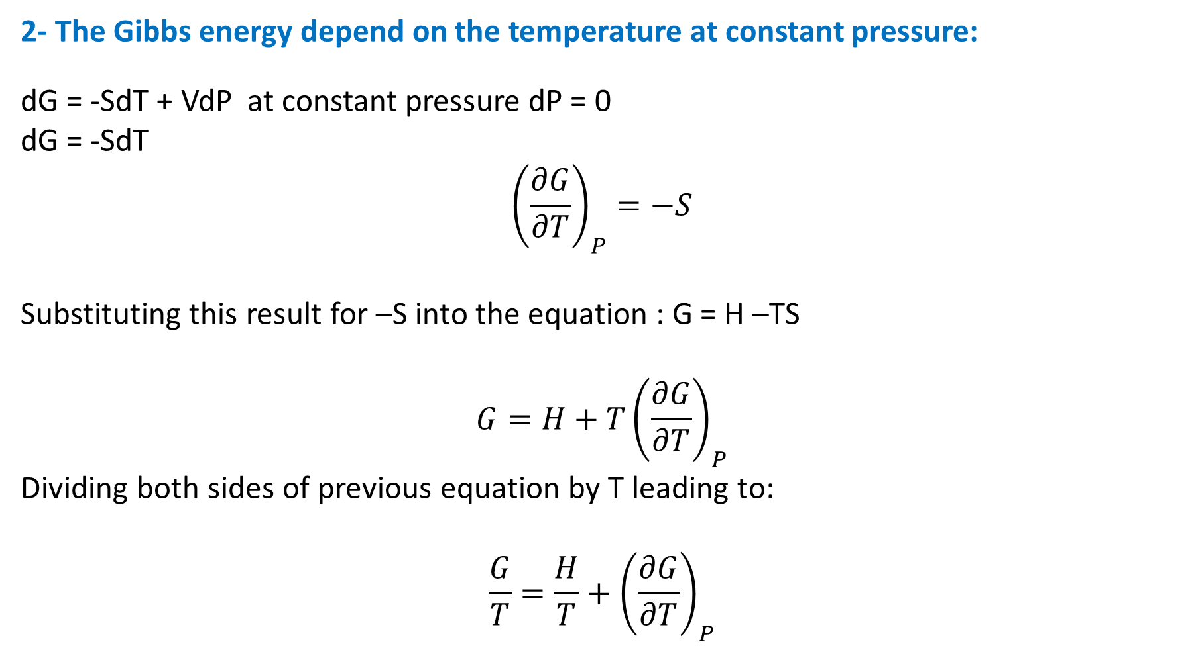
2- The Gibbs energy depend on the temperature at constant pressure:
dG = -SdT + VdP at constant pressure dP = 0
dG = -SdT
$${\left(\frac{∂G}{∂T}\right)}_{P}=−S$$
Substituting this result for –S into the equation : G = H –TS
$$G=H+T{\left(\frac{∂G}{∂T}\right)}_{P}$$
Dividing both sides of previous equation by T leading to:
$$\frac{G}{T}=\frac{H}{T}+{\left(\frac{∂G}{∂T}\right)}_{P}$$

Slide 20
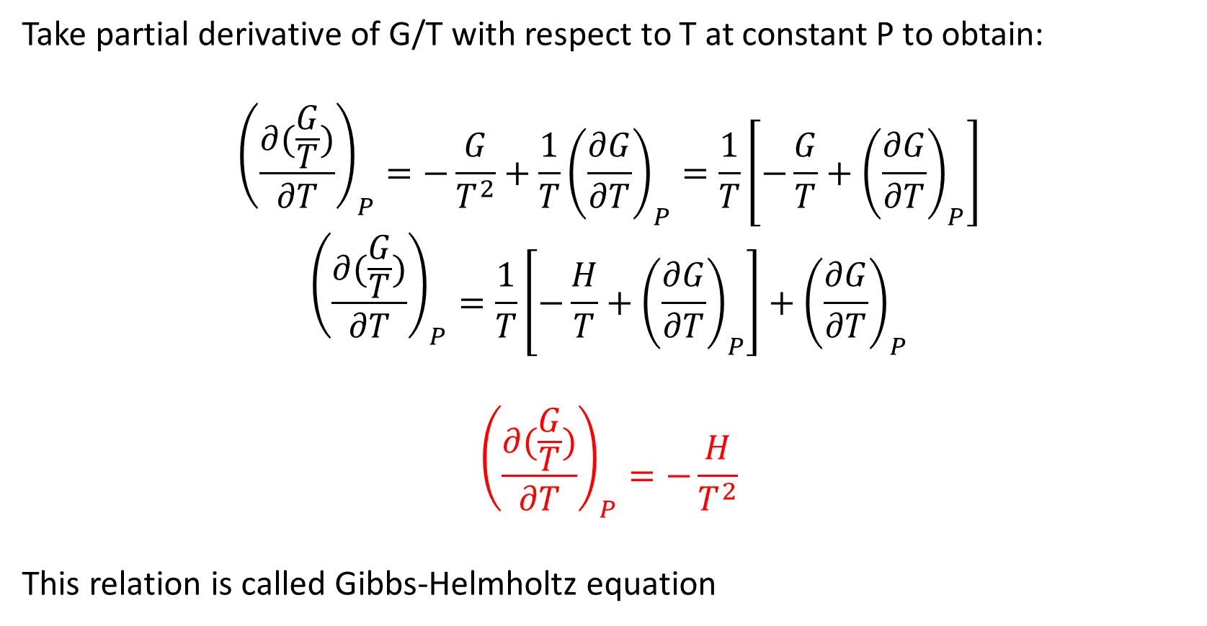
Take partial derivative of G/T with respect to T at constant P to obtain:
$${\left(\frac{∂(\frac{G}{T})}{∂T}\right)}_{P}=−\frac{G}{T^{2}}+\frac{1}{T}{\left(\frac{∂G}{∂T}\right)}_{P}=\frac{1}{T}\left[−\frac{G}{T}+{\left(\frac{∂G}{∂T}\right)}_{P}\right]$$
$${\left(\frac{∂(\frac{G}{T})}{∂T}\right)}_{P}=\frac{1}{T}\left[−\frac{H}{T}+{\left(\frac{∂G}{∂T}\right)}_{P}\right]+{\left(\frac{∂G}{∂T}\right)}_{P}$$
$${\left(\frac{∂(\frac{G}{T})}{∂T}\right)}_{P}=−\frac{H}{T^{2}}$$
This relation is called Gibbs-Helmholtz equation

Slide 21

Another useful form of the Gibbs-Helmholtz equation may be obtained by considering the derivative
$${\left(\frac{∂(\frac{G}{T})}{∂\left(\frac{1}{T}\right)}\right)}_{P}=−T^{2}{\left(\frac{∂(\frac{G}{T})}{∂T}\right)}_{P}$$
$${\left(\frac{∂(\frac{G}{T})}{∂\left(\frac{1}{T}\right)}\right)}_{P}=H$$
$${\left(\frac{∂(\frac{∆G}{T})}{∂\left(\frac{1}{T}\right)}\right)}_{P}=∆H$$

Slide 22
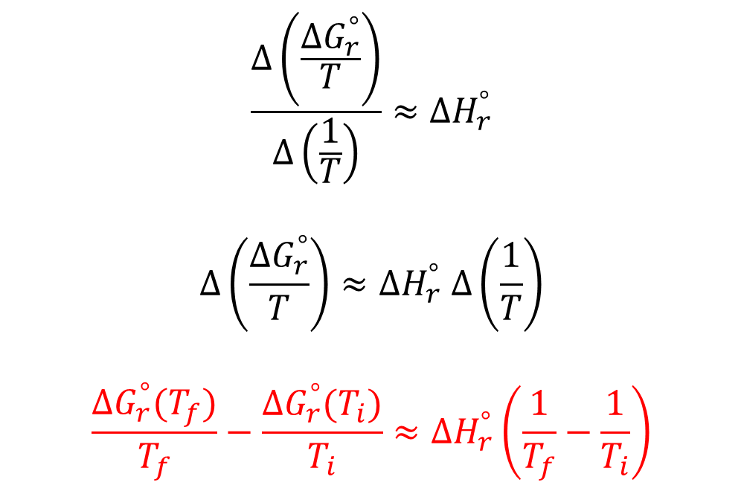
$$\frac{∆\left(\frac{∆G_{r}^{°}}{T}\right)}{∆\left(\frac{1}{T}\right)}≈{∆H}_{r}^{°}$$
$$∆\left(\frac{{∆G}_{r}^{°}}{T}\right)≈{∆H}_{r}^{°} ∆\left(\frac{1}{T}\right)$$
$$\frac{{∆G}_{r}^{°}(T_{f})}{T_{f}}−\frac{{∆G}_{r}^{°}(T_{i})}{T_{i}}≈{∆H}_{r}^{°}\left(\frac{1}{T_{f}}−\frac{1}{T_{i}}\right)$$

Slide 23
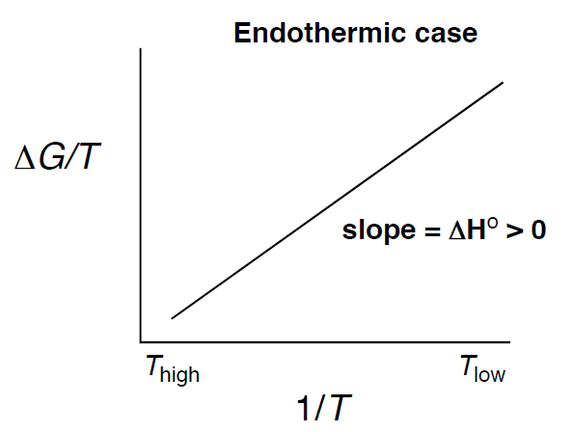
Exploring the Temperature Dependence of the Gibbs Free Energy Change
T_{final} > T_{initial}
∆G_{final} < ∆G_{initial}

Slide 24
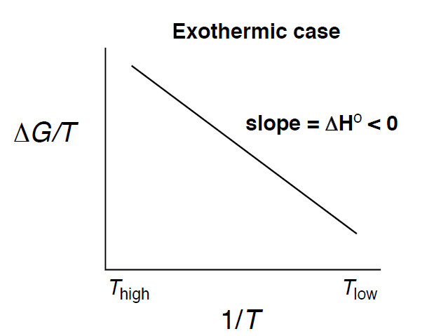
Exploring the Temperature Dependence of the Gibbs Free Energy Change
T_{final} > T_{initial}
∆G_{final} > ∆G_{initial}

Slide 25
Example
7- The standard enthalpy ∆Hº of the reaction:
N₂(g) + 3H₂ (g) 2NH₃ (g) is -92.2 kJ mol⁻¹ and the standard Gibbs function
∆Gº is -31.0 kJ mol⁻¹ both at 298 K.
Estimate the Gibbs function ∆Gº at (a) 500 K and (b) 1000 K.
Is the reaction spontaneous at room temperature ?
Is the formation of ammonia favoured or disfavoured by a rise in temperature?

Slide 26
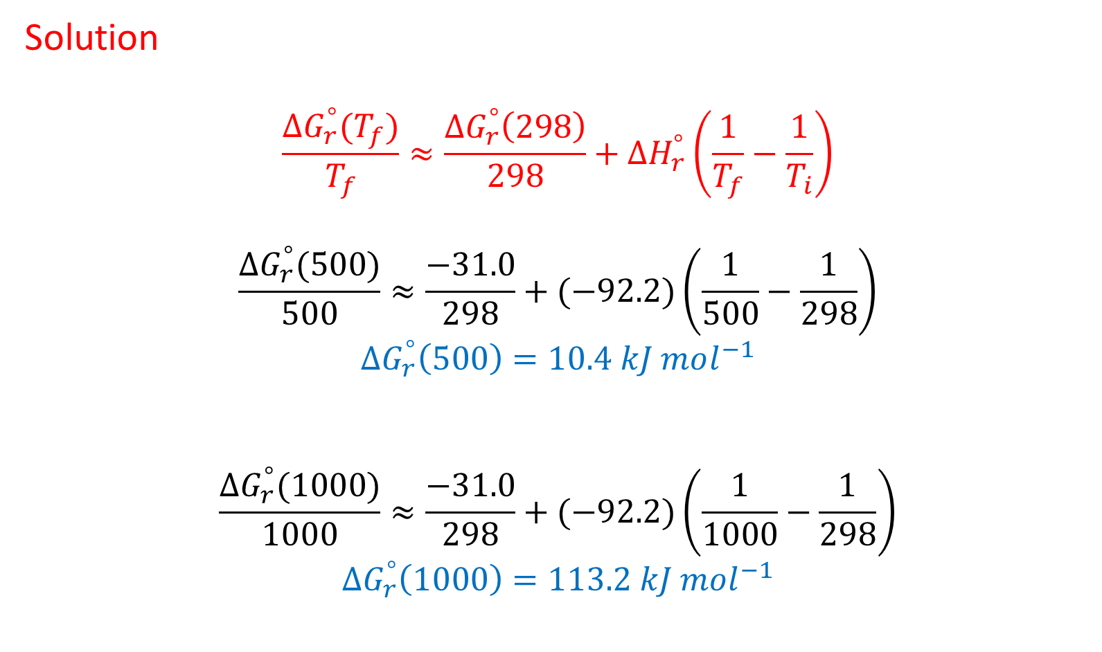
Solution
$$\frac{{∆G}_{r}^{°}(T_{f})}{T_{f}}≈\frac{{∆G}_{r}^{°}\left(298\right)}{298}+{∆H}_{r}^{°}\left(\frac{1}{T_{f}}−\frac{1}{T_{i}}\right)$$
$$\frac{{∆G}_{r}^{°}(500)}{500}≈\frac{−31.0}{298}+(−92.2)\left(\frac{1}{500}−\frac{1}{298}\right)$$
$${∆G}_{r}^{°}\left(500\right)=10.4 kJ mol^{−1}$$
$$\frac{{∆G}_{r}^{°}(1000)}{1000}≈\frac{−31.0}{298}+(−92.2)\left(\frac{1}{1000}−\frac{1}{298}\right)$$
$${∆G}_{r}^{°}\left(1000\right)=113.2 kJ mol^{−1}$$

Slide 27
With increasing temperature the free energy increases, indicating that the process is not favoured with increasing temperature.
And because the reaction is exothermic so the increasing temperature will shift the balance to forming reactants

Slide 28
Helmholtz Energy
Helmholtz energy function (A) was introduced by German Physicist Hermann von Helmholtz and is defined by
A = U – TS
Where U is internal energy, T is Kelvin temperature and S is entropy. The symbol A is the first letter of the German word Arbeit which means work.
Therefore, Helmholtz energy (A) is also called work function.

Slide 29
A = U – TS
∆A = ∆U – T∆S
dA < 0 for spontaneous change
At constant temperature and reversible process
∆A = w_{max}

Slide 30

From the first law: dU = đq + đw
At constant V : đw = -PdV = 0 therefore: dU = đq
From second law
$dS=\frac{\text{đ}q}{T}=\frac{dU}{T}$
Then: dU = TdS at constant volume (no work)
d(U – TS) = 0

Slide 31
Chemical Equilibrium

Slide 32
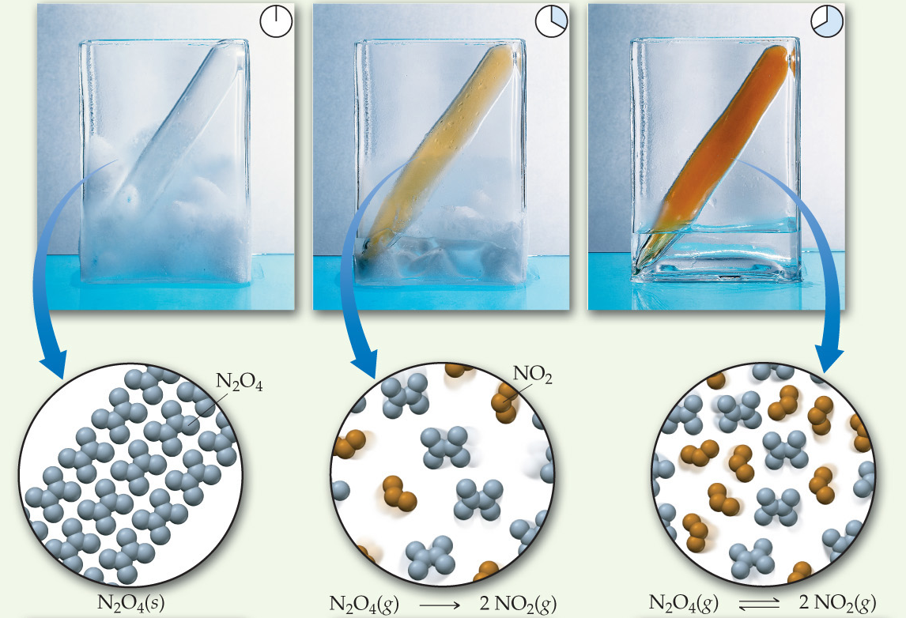
The Concept of Equilibrium
Chemical equilibrium occurs when a reaction and its reverse reaction proceed at the same rate.

Slide 33
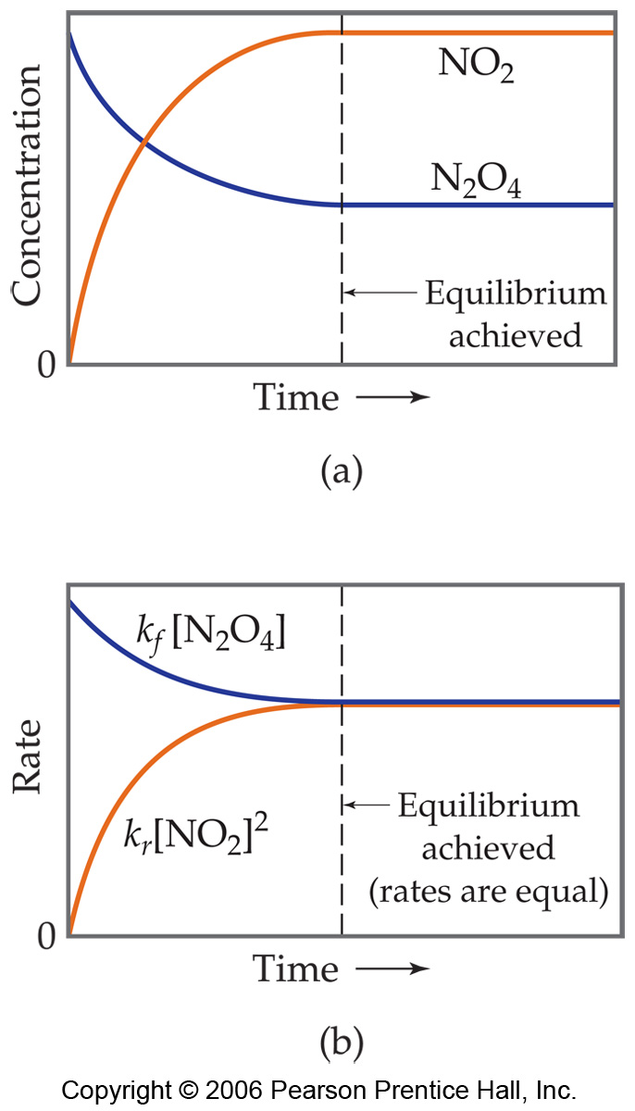
The Concept of Equilibrium
As a system approaches equilibrium, both the forward and reverse reactions are occurring.
At equilibrium, the forward and reverse reactions are proceeding at the same rate.

Slide 34
A System at Equilibrium
Once equilibrium is achieved, the amount of each reactant and product remains constant.

Slide 35
Depicting Equilibrium
Since, in a system at equilibrium, both the forward and reverse reactions are being carried out, we write its equation with a double arrow.
N₂O_{4 (g)}
2 NO_{2 (g)}
[NO₂]²
[N₂O₄]
K_{eq} =

Slide 36
The Equilibrium Constant
Consider the generalized reaction
aA + bB
cC + dD
The equilibrium expression for this reaction would be
[C]^{c}[D]^{d}
[A]ª[B]^{b}
K_{c} =

Slide 37
The Equilibrium Constant
Since pressure is proportional to concentration for gases in a closed system, the equilibrium expression can also be written
(P_{C}^{c}) (P_{D}^{d})
(P_{A}ª) (P_{B}^{b})
K_{p} =
Also equilibrium constant can be expressed by using the mole fraction as below:
(X_{C}^{c}) (X_{D}^{d})
(X_{A}ª) (X_{B}^{b})
K_{X} =

Slide 38


Write the equilibrium expression for K_{c} for the following reactions:

Slide 39
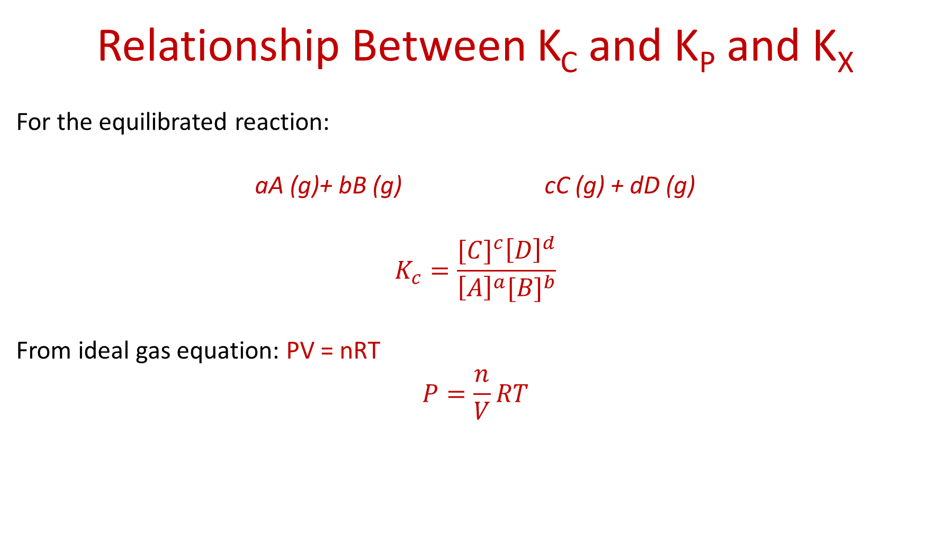
Relationship Between K_{C} and K_{P} and K_{X}
For the equilibrated reaction:
aA (g)+ bB (g) cC (g) + dD (g)
$$K_{c}=\frac{{[C]}^{c}{\left[D\right]}^{d}}{{\left[A\right]}^{a}{[B]}^{b}}$$
From ideal gas equation: PV = nRT
$$P=\frac{n}{V}RT$$

Slide 40
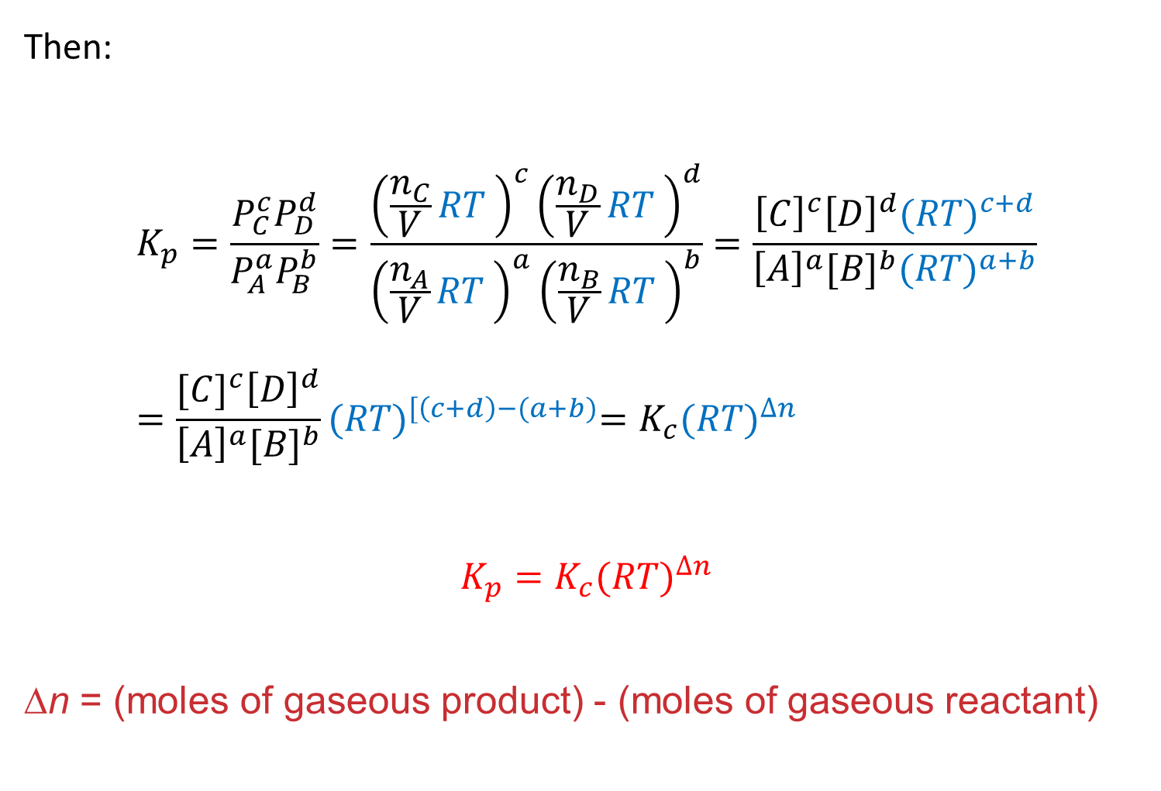
Then:
$$K_{p}=\frac{P_{C}^{c}P_{D}^{d}}{P_{A}^{a}P_{B}^{b}}=\frac{{\left(\frac{n_{C}}{V}RT \right)}^{c}{\left(\frac{n_{D}}{V}RT \right)}^{d}}{{\left(\frac{n_{A}}{V}RT \right)}^{a}{\left(\frac{n_{B}}{V}RT \right)}^{b}}=\frac{{\left[C\right]}^{c}{\left[D\right]}^{d}{(RT)}^{c+d}}{{\left[A\right]}^{a}{[B]}^{b}{(RT)}^{a+b}}=\frac{{[C]}^{c}{\left[D\right]}^{d}}{{\left[A\right]}^{a}{[B]}^{b}}{(RT)}^{[\left(c+d\right)−(a+b)}=K_{c}{(RT)}^{∆n}$$
$$K_{p}=K_{c}{(RT)}^{∆n}$$
Δn = (moles of gaseous product) - (moles of gaseous reactant)

Slide 41
K_{C} = K_{X} (n_{total} / V)^{∆n}
K_{P} = K_{X} (P_{total})^{∆n}

Slide 42

In the synthesis of ammonia from nitrogen and hydrogen,
K_{c} = 9.60 at 300 °C. Calculate K_{p} for this reaction at this temperature.

Slide 43
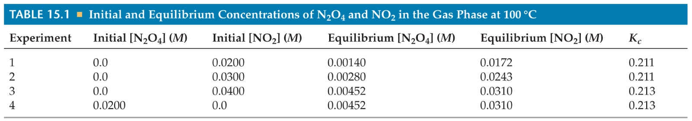
Equilibrium Can Be Reached from Either Direction
As you can see, the ratio of [NO₂]² to [N₂O₄] remains constant at this temperature no matter what the initial concentrations of NO₂ and N₂O₄ are.

Slide 44
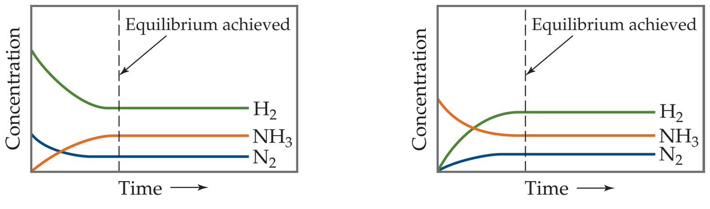
Equilibrium Can Be Reached from Either Direction
It doesn’t matter whether we start with N₂ and H₂ or whether we start with NH₃: we will have the same proportions of all three substances at equilibrium.

Slide 45
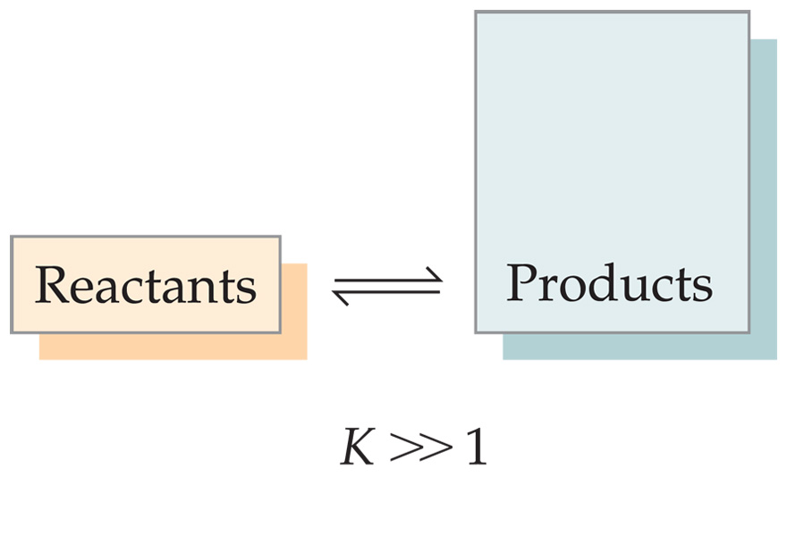
What Does the Value of K Mean?
If K>>1, the reaction is product-favored; product predominates at equilibrium.

Slide 46
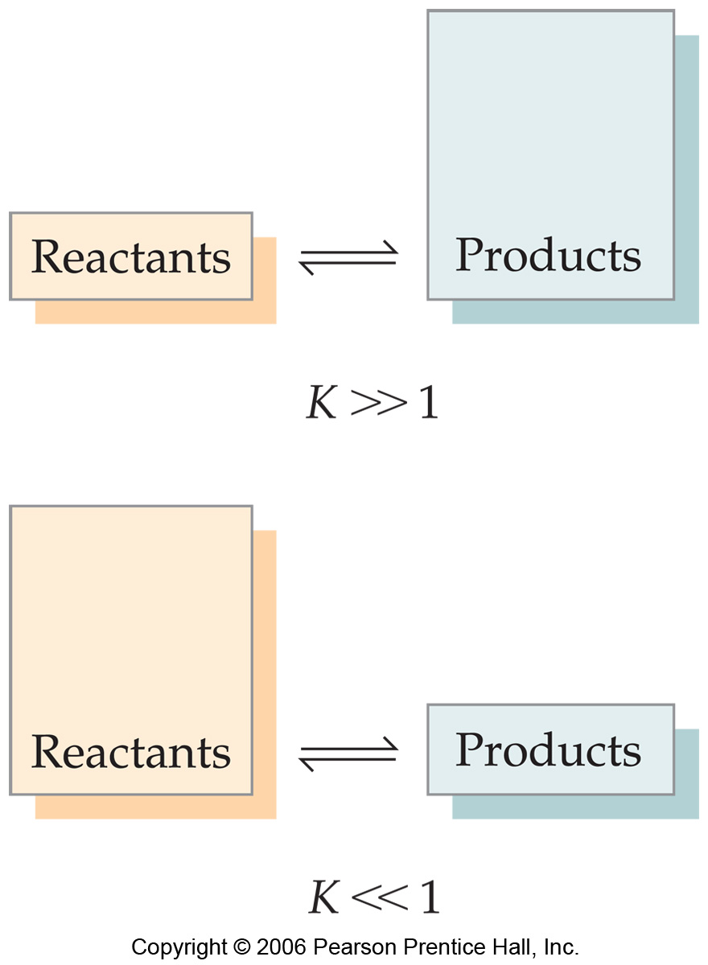
What Does the Value of K Mean?
If K>>1, the reaction is product-favored; product predominates at equilibrium.
If K<<1, the reaction is reactant-favored; reactant predominates at equilibrium.

Slide 47
Manipulating Equilibrium Constants
The equilibrium constant of a reaction in the reverse reaction is the reciprocal of the equilibrium constant of the forward reaction.
[NO₂]²
[N₂O₄]
N₂O₄ _{(g)}
2 NO₂ _{(g)}
K_{c} = = 0.212 at 100 °C
[N₂O₄]
[NO₂]²
2 NO₂ _{(g)}
N₂O₄ _{(g)}
K_{c} = = 4.72 at 100 °C

Slide 48
Manipulating Equilibrium Constants
The equilibrium constant of a reaction that has been multiplied by a number is the equilibrium constant raised to a power that is equal to that number.
[NO₂]²
[N₂O₄]
N₂O_{4(g)}
2 NO_{2(g)}
K_{c} = = 0.212 at 100 °C
[NO₂]⁴
[N₂O₄]²
2 N₂O_{4(g)}
4 NO_{2(g)}
K_{c} = = (0.212)² at 100 °C

Slide 49
Manipulating Equilibrium Constants
The equilibrium constant for a net reaction made up of two or more steps is the product of the equilibrium constants for the individual steps.
A B K = K₁
B C K = K₂
A C K = K₁ × K₂

Slide 50

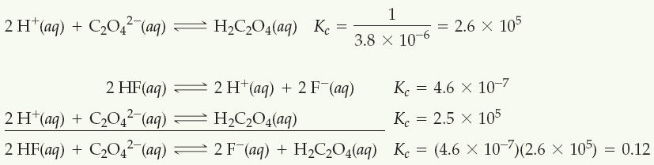
Given the following information,
determine the value of K_{c} for the reaction
Solution

Slide 51
Heterogeneous Equilibrium
The concentrations of solids and liquids do not appear in the equilibrium expression.
PbCl_{2 (s)}
Pb²⁺ _{(aq)} + 2 Cl⁻_{(aq)}
K_{c} = [Pb²⁺] [Cl⁻]²

Slide 52
Why “K” constant is dimensionless (no unit)?
The thermodynamic equilibrium constant is defined in terms of activities “a”.
In the solution that has concentration above 0.1 mol/L there are significant interaction between the solute molecules.
The activity is a measure of concentration but takes into account interactions between solution species.

Slide 53
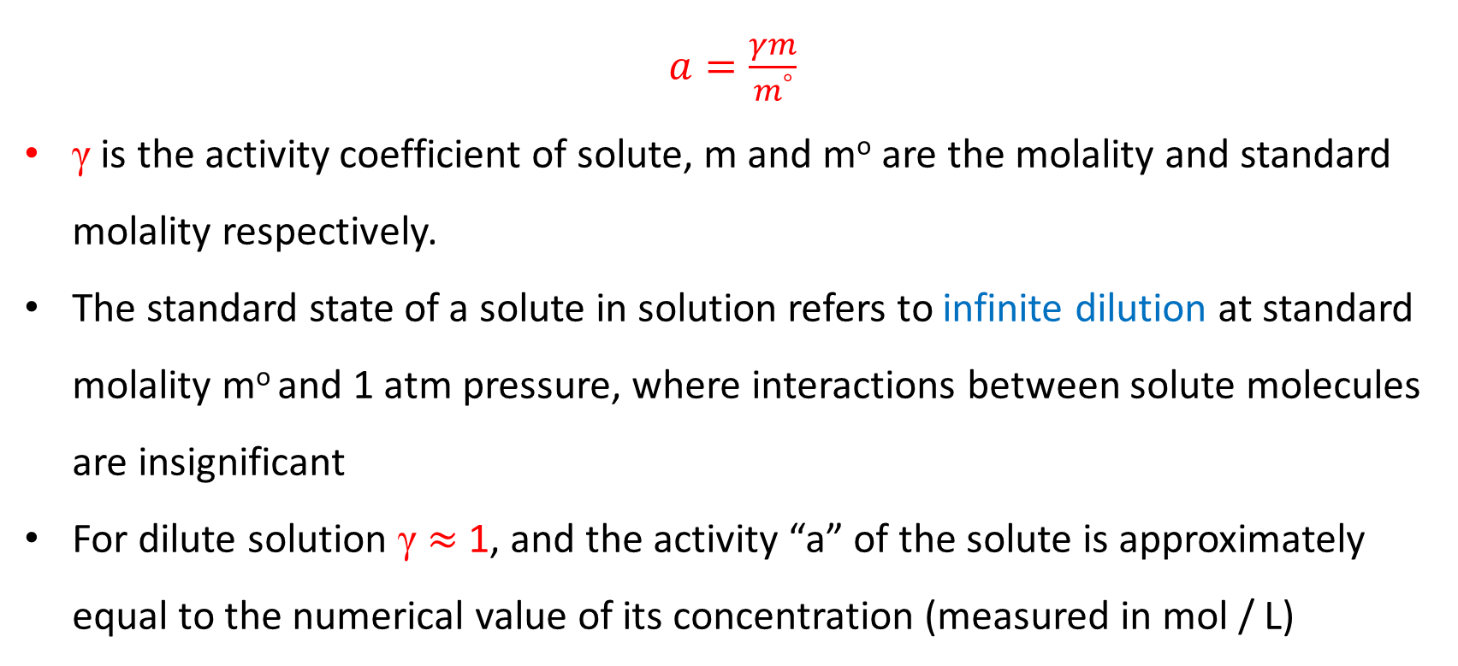
$a=\frac{γm}{m^{°}}$
γ is the activity coefficient of solute, m and mº are the molality and standard molality respectively.
The standard state of a solute in solution refers to infinite dilution at standard molality mº and 1 atm pressure, where interactions between solute molecules are insignificant
For dilute solution γ $≈$ 1, and the activity “a” of the solute is approximately equal to the numerical value of its concentration (measured in mol / L)

Slide 54
Equilibrium Calculations
8- A closed system initially containing 1.00 x 10⁻³ M H₂ and 2.00 x 10⁻³ M I₂ at 448 °C is allowed to reach equilibrium. Analysis of the equilibrium mixture shows that the concentration of HI is 1.87 x 10⁻³ M. Calculate K_{c} at 448 °C for the reaction taking place.
H₂ (g) + I₂ (g)
2 HI (g)

Slide 55
Solution
What Do We Know?
 | [H₂], M | [I₂], M | [HI], M
Initially | 1.00 x 10⁻³ | 2.00 x 10⁻³ | 0
Change
At equilibrium |  |  | 1.87 x 10⁻³

Slide 56
[HI] Increases by 1.87 x 10⁻³ M
 | [H₂], M | [I₂], M | [HI], M
Initially | 1.00 x 10⁻³ | 2.00 x 10⁻³ | 0
Change |  |  | +1.87 x 10⁻³
At equilibrium |  |  | 1.87 x 10⁻³

Slide 57
Stoichiometry tells us [H₂] and [I₂] decrease by half as much.
 | [H₂], M | [I₂], M | [HI], M
Initially | 1.00 x 10⁻³ | 2.00 x 10⁻³ | 0
Change | -9.35 x 10⁻⁴ | -9.35 x 10⁻⁴ | +1.87 x 10⁻³
At equilibrium |  |  | 1.87 x 10⁻³

Slide 58
We can now calculate the equilibrium concentrations of all three compounds…
 | [H₂], M | [I₂], M | [HI], M
Initially | 1.00 x 10⁻³ | 2.00 x 10⁻³ | 0
Change | -9.35 x 10⁻⁴ | -9.35 x 10⁻⁴ | +1.87 x 10⁻³
At equilibrium | 6.5 x 10⁻⁵ | 1.065 x 10⁻³ | 1.87 x 10⁻³

Slide 59
…and, therefore, the equilibrium constant.
[HI]²
[H₂] [I₂]
K_{c} =
(1.87 x 10⁻³)²
(6.5 x 10⁻⁵)(1.065 x 10⁻³)
=
= 51

Slide 60
Examples
9- At certain temperature a 1.00 L flask initially contained 0.298 mol of PCl₃ (g) and 8.70 × 10⁻³ mol of PCl₅ (g). After the system had reached equilibrium and 2.00 × 10⁻³ mol of Cl₂ (g) was found in the flask.
Calculate the equilibrium concentrations of all specious and the value of K_{c}
PCl₅ (g) PCl₃ (g) + Cl₂ (g)

Slide 61
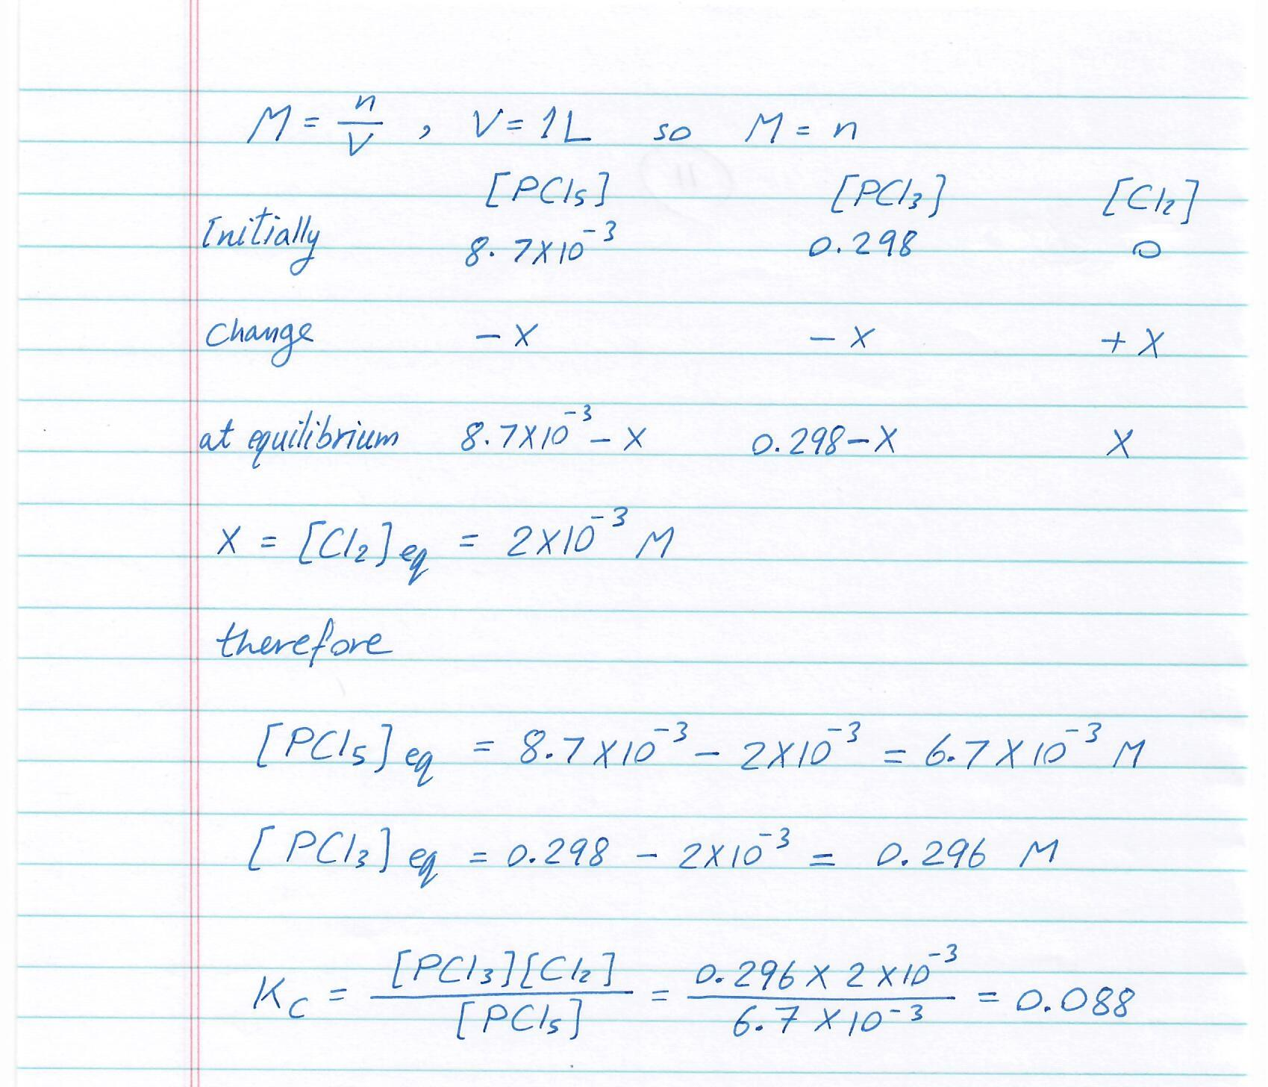

Slide 62
10- 2.5 moles of Fe₂O₃ (s) and 4.5 moles of H₂ (g) were placed in an 1.0 L reaction vessel at 420 °C. After the following reaction reached equilibrium, 1.5 moles of Fe₂O₃ (s) remained.
Fe₂O₃ (s) + 3H₂ (g) 2Fe (s) + 3H₂O (g)
Calculate the equilibrium constant K_{c} for this reaction at 420 °C.

Slide 63
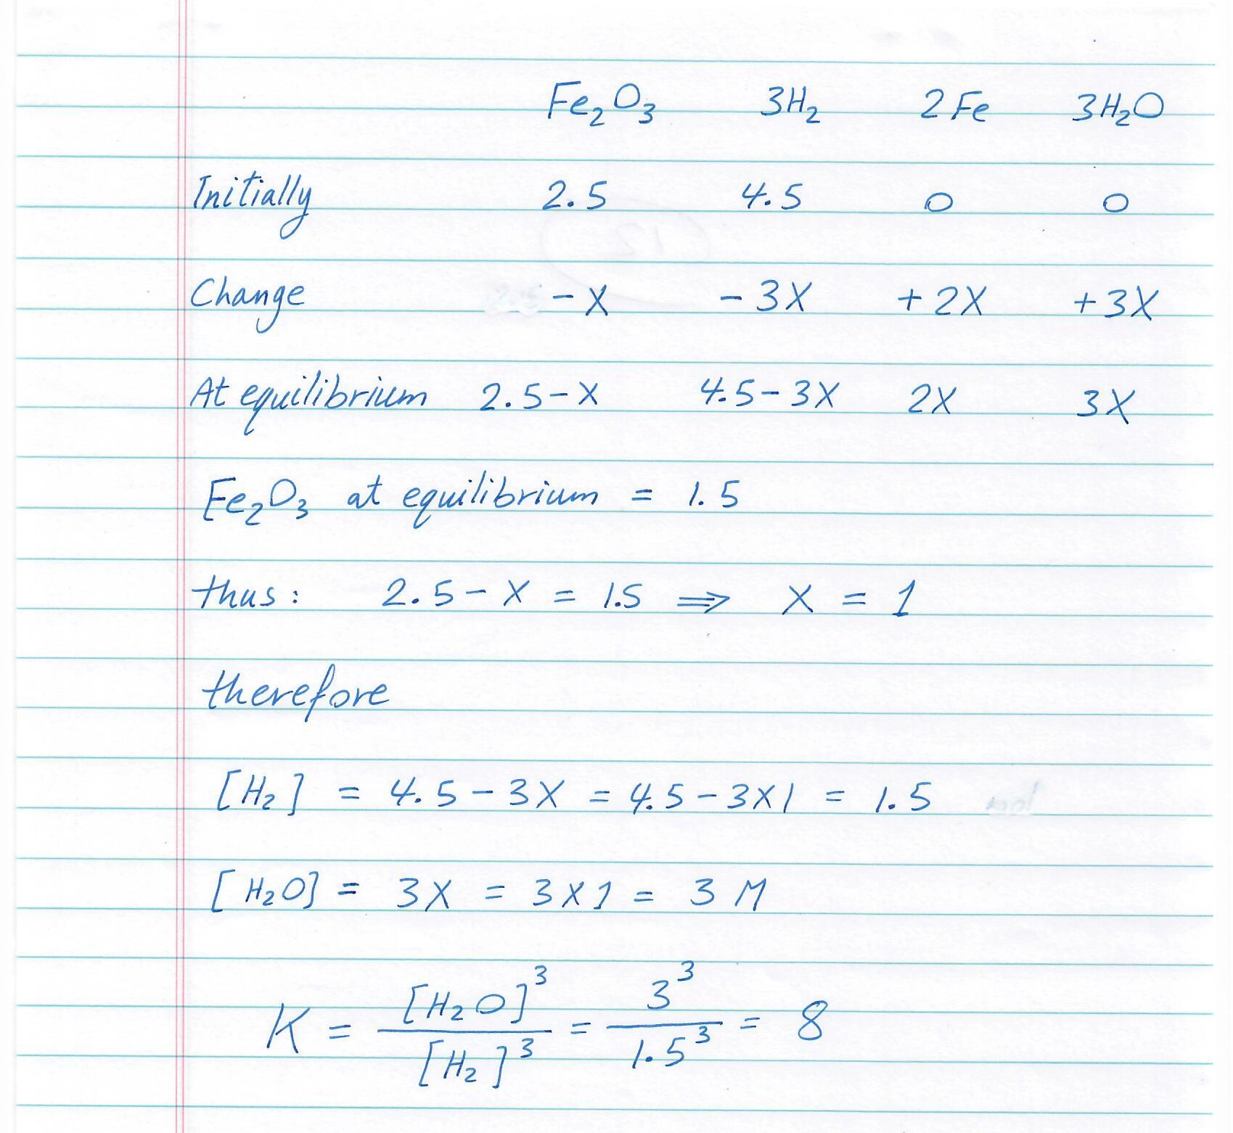

Slide 64
The Reaction Quotient (Q)
Q gives the same ratio the equilibrium expression gives, but for a system that is not at equilibrium.
To calculate Q, one substitutes the initial concentrations on reactants and products into the equilibrium expression.

Slide 65
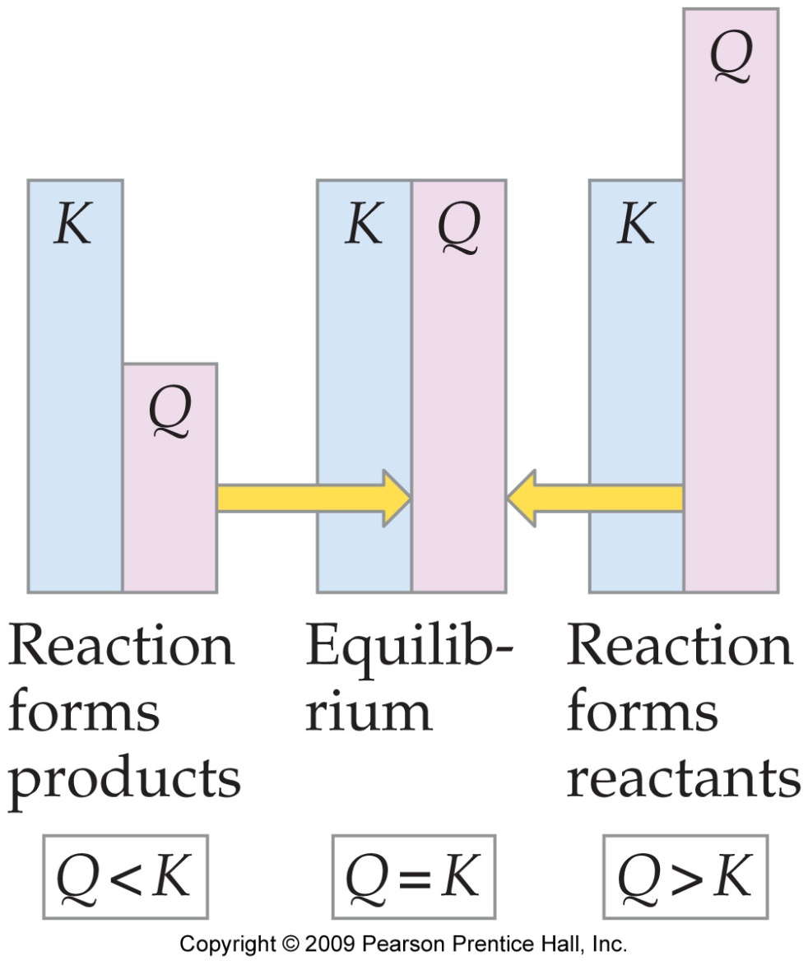
If Q = K,
the system is at equilibrium.

Slide 66
If Q > K,
there is too much product, and the equilibrium shifts to the left.

Slide 67
If Q < K,
there is too much reactant, and the equilibrium shifts to the right.

Slide 68
Le Châtelier’s Principle
“If a system at equilibrium is disturbed by a change in temperature, pressure, or the concentration of one of the components, the system will shift its equilibrium position so as to counteract the effect of the disturbance.”

Slide 69
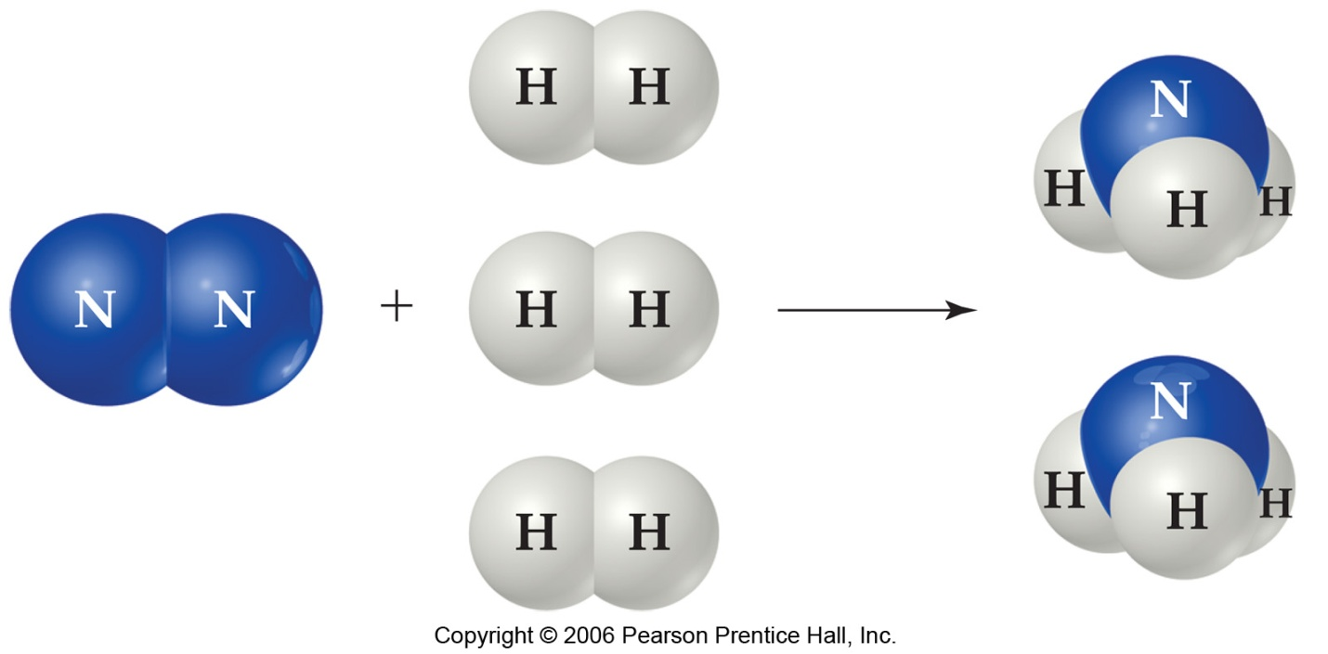
Factors that Affect Chemical Equilibrium
1- The effect of Concentration of reactants and products
The transformation of nitrogen and hydrogen into ammonia (NH₃) is of tremendous significance in agriculture, where ammonia-based fertilizers are of utmost importance.

Slide 70

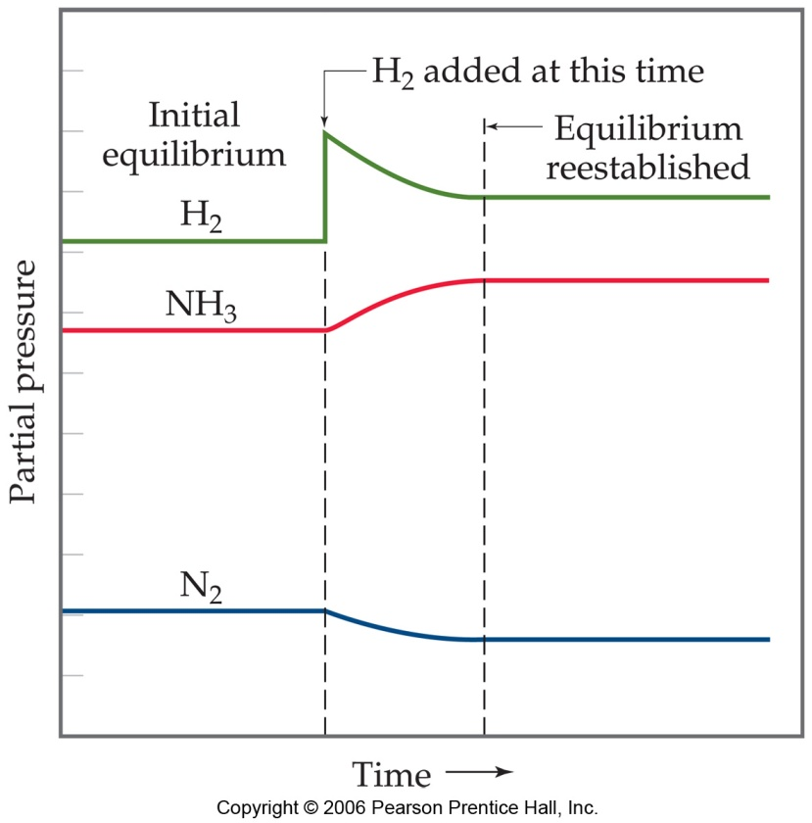
If H₂ is added to the system, N₂ will be consumed and the two reagents will form more NH₃.

Slide 71
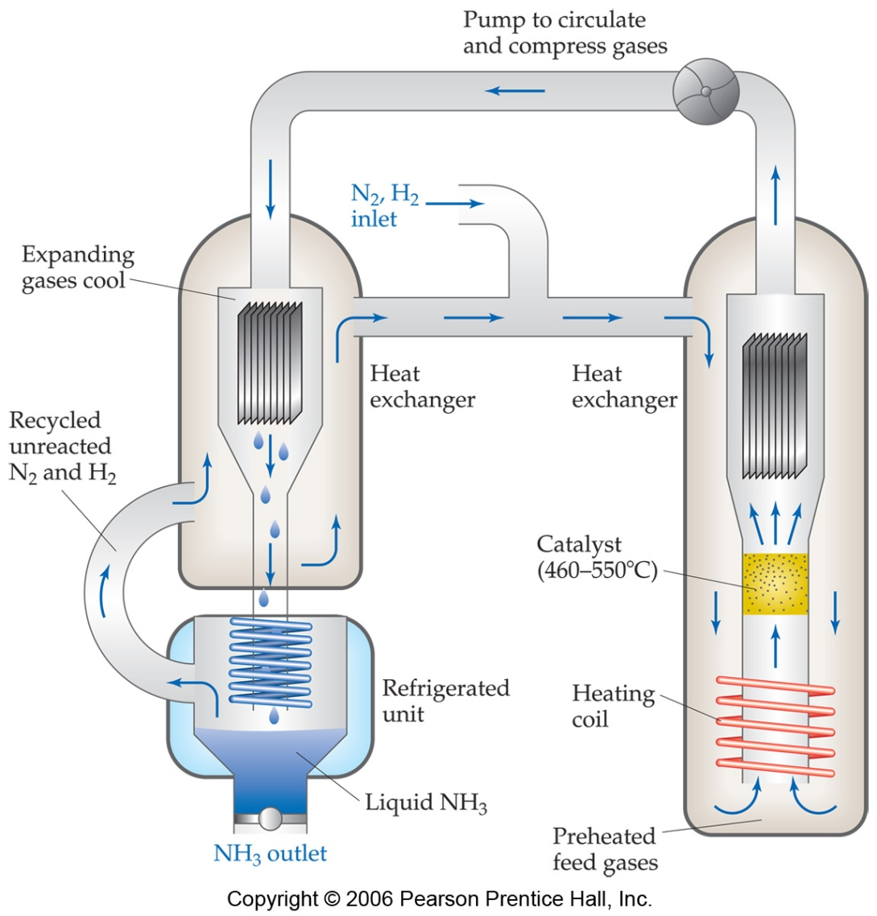
The Haber Process
This apparatus helps push the equilibrium to the right by removing the ammonia (NH₃) from the system as a liquid.

Slide 72
2- The Effect of Changes in Temperature
If the reaction endothermic: reactant + heat ⇌ product
∆H > 0, the increase of temperature will push the reaction towards the product, therefore increase of K
If the reaction exothermic: reactant ⇌ product + heat
∆H < 0, the increase of temperature will push the reaction towards the reactant, therefore decrease of K.

Slide 73
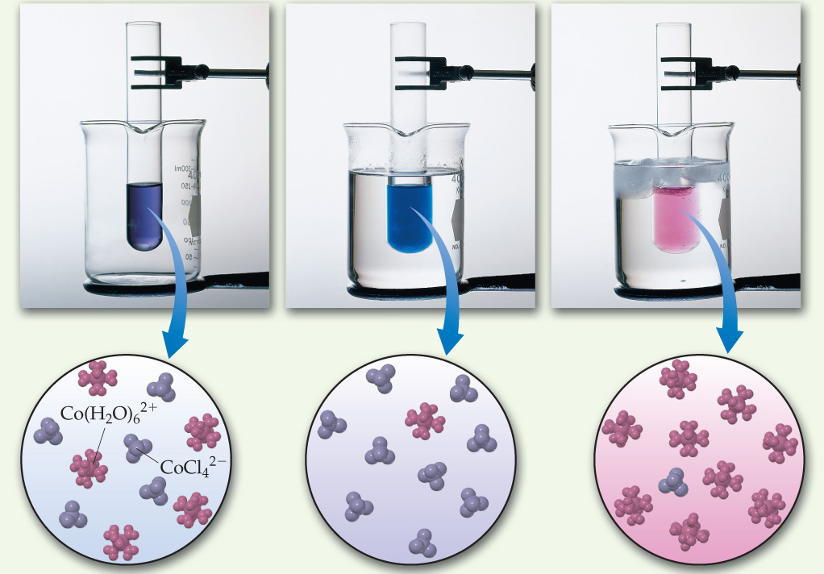
Co(H₂O)₆²⁺ (aq) + 4 Cl (aq)
CoCl₄⁻² (aq) + 6 H₂O (l)

Slide 74
3- The Effect of Pressure and Volume changes on Equilibrium
Increase the pressure of gas mixture in equilibrium, will shift the equilibrium towards forming the less gaseous moles.
A (g) + 2B (g) ⇌ C (g) + 3D (g)
Decrease the pressure of gas mixture in equilibrium, will shift the equilibrium towards forming the great gaseous moles.
P α 1/V

Slide 75
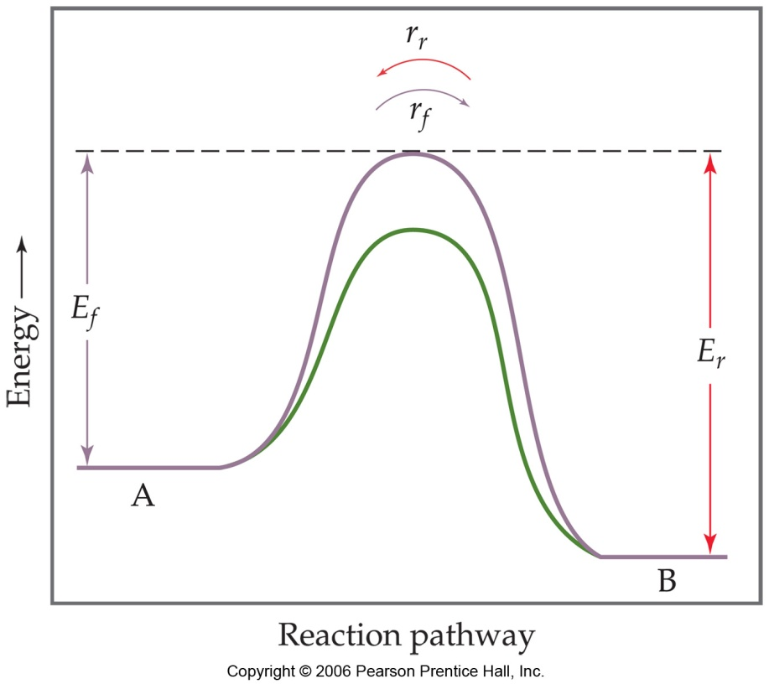
4- The Effect of Catalysts
Catalysts increase the rate of both the forward and reverse reactions.
When one uses a catalyst, equilibrium is achieved faster, but the equilibrium composition remains unaltered.

Slide 76
Beware!
Only a change in temperature changes the value of the equilibrium constant K.
The change in concentration, pressure and volume will alter the equilibrium concentration. But they can not change the equilibrium constant as long as the temperature does not change
The equilibrium not only for chemical change. Also physical change involve equilibrium such as fusion, vaporization, solubility, condensation …. Etc.

Slide 77
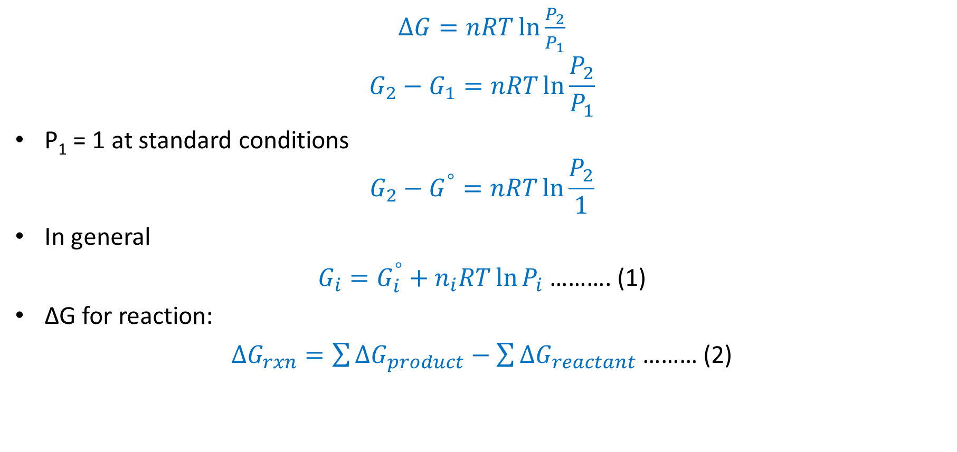
Relation between ∆G and K
$∆G=nRT\ln{\frac{P_{2}}{P_{1}}}$
$$G_{2}−G_{1}=nRT\ln{\frac{P_{2}}{P_{1}}}$$
P₁ = 1 at standard conditions
$$G_{2}−G^{°}=nRT\ln{\frac{P_{2}}{1}}$$
In general
$G_{i}=G_{i}^{°}+n_{i}RT\ln{P_{i}}$ ………. (1)
∆G for reaction:
$∆G_{rxn}=\sum{∆G_{product}−\sum{∆G_{reactant}}}$ ……… (2)

Slide 78
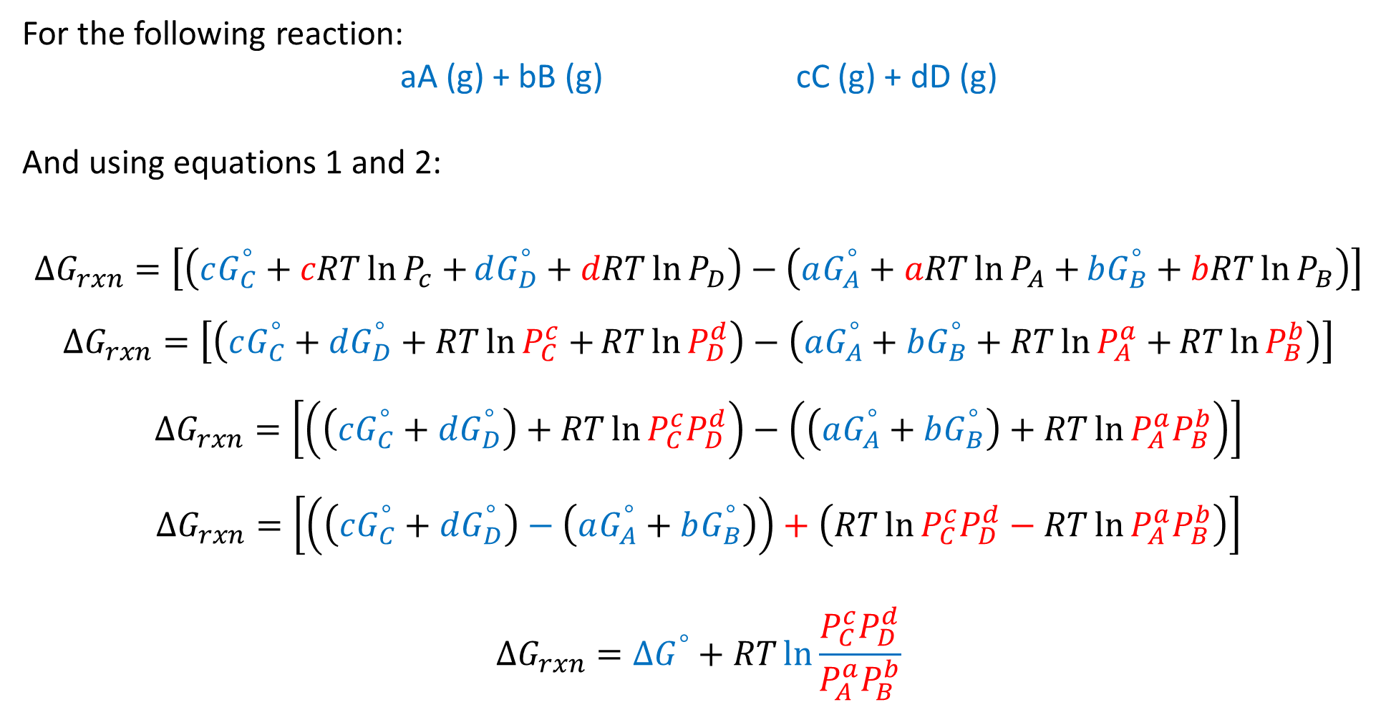
For the following reaction:
aA (g) + bB (g) cC (g) + dD (g)
And using equations 1 and 2:
$$∆G_{rxn}=\left[\left(cG_{C}^{°}+cRT\ln{P_{c}+}dG_{D}^{°}+dRT\ln{P_{D}}\right)−\left(aG_{A}^{°}+aRT\ln{P_{A}+}bG_{B}^{°}+bRT\ln{P_{B}}\right)\right]$$
$$∆G_{rxn}=\left[\left(cG_{C}^{°}+dG_{D}^{°}+RT\ln{P_{C}^{c}+}RT\ln{P_{D}^{d}}\right)−\left(aG_{A}^{°}+bG_{B}^{°}+RT\ln{P_{A}^{a}+}RT\ln{P_{B}^{b}}\right)\right]$$
$$∆G_{rxn}=\left[\left(\left(cG_{C}^{°}+dG_{D}^{°}\right)+RT\ln{P_{C}^{c}P_{D}^{d}}\right)−\left(\left(aG_{A}^{°}+bG_{B}^{°}\right)+RT\ln{P_{A}^{a}P_{B}^{b}}\right)\right]$$
$$∆G_{rxn}=\left[\left(\left(cG_{C}^{°}+dG_{D}^{°}\right)−\left(aG_{A}^{°}+bG_{B}^{°}\right)\right)+\left(RT\ln{P_{C}^{c}P_{D}^{d}}−RT\ln{P_{A}^{a}P_{B}^{b}}\right)\right]$$
$$∆G_{rxn}=∆G^{°}+RT\ln{\frac{P_{C}^{c}P_{D}^{d}}{P_{A}^{a}P_{B}^{b}}}$$

Slide 79

$$∆G_{rxn}=∆G^{°}+RT\ln{\frac{P_{C}^{c}P_{D}^{d}}{P_{A}^{a}P_{B}^{b}}}$$
The reaction Quotient:
$$Q_{P}=\frac{P_{C}^{c}P_{D}^{d}}{P_{A}^{a}P_{B}^{b}}$$
$$∆G_{rxn}=∆G^{°}+RT\ln{Q_{P}}$$
At equilibrium ∆G = 0 and Q_{P} = K_{P}
$$0=∆G^{°}+RT\ln{K_{P}}$$
$$∆G^{°}=−RT\ln{K_{P}}$$

Slide 80
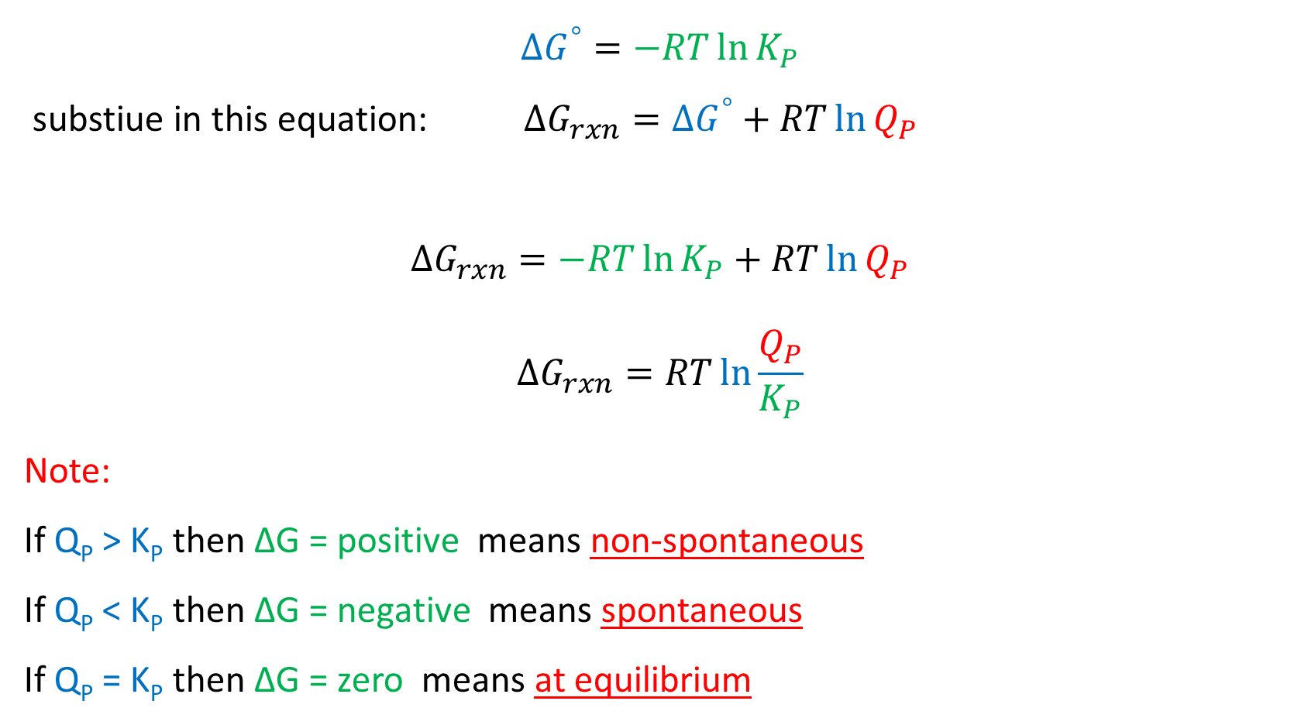
$$∆G^{°}=−RT\ln{K_{P}}$$
substiue in this equation: $∆G_{rxn}=∆G^{°}+RT\ln{Q_{P}}$
$$∆G_{rxn}=−RT\ln{K_{P}}+RT\ln{Q_{P}}$$
$$∆G_{rxn}=RT\ln{\frac{Q_{P}}{K_{P}}}$$
Note:
If Q_{P} > K_{P} then ∆G = positive means non-spontaneous
If Q_{P} < K_{P} then ∆G = negative means spontaneous
If Q_{P} = K_{P} then ∆G = zero means at equilibrium

Slide 81

Examples
11- Calculate the ∆Gº for an equilibrated reaction has K = 10 at 27 ℃.
Solution:
$$∆G^{°}=−RT\ln{K_{P}}$$
∆Gº = - (8.314 J K⁻¹ mol⁻¹) $×$ (300 K) ln 10 = -5744.14 J mol⁻¹ = -5.744 kJ mol⁻¹

Slide 82
12- Using standard thermodynamic data to calculate ∆G_{rxn} at 298 K for the reaction below, assuming that all gases have a pressure of 22.51 mmHg.
4HCl (g) + O₂ (g) 2H₂O (g) +2Cl₂ (g)

Slide 83
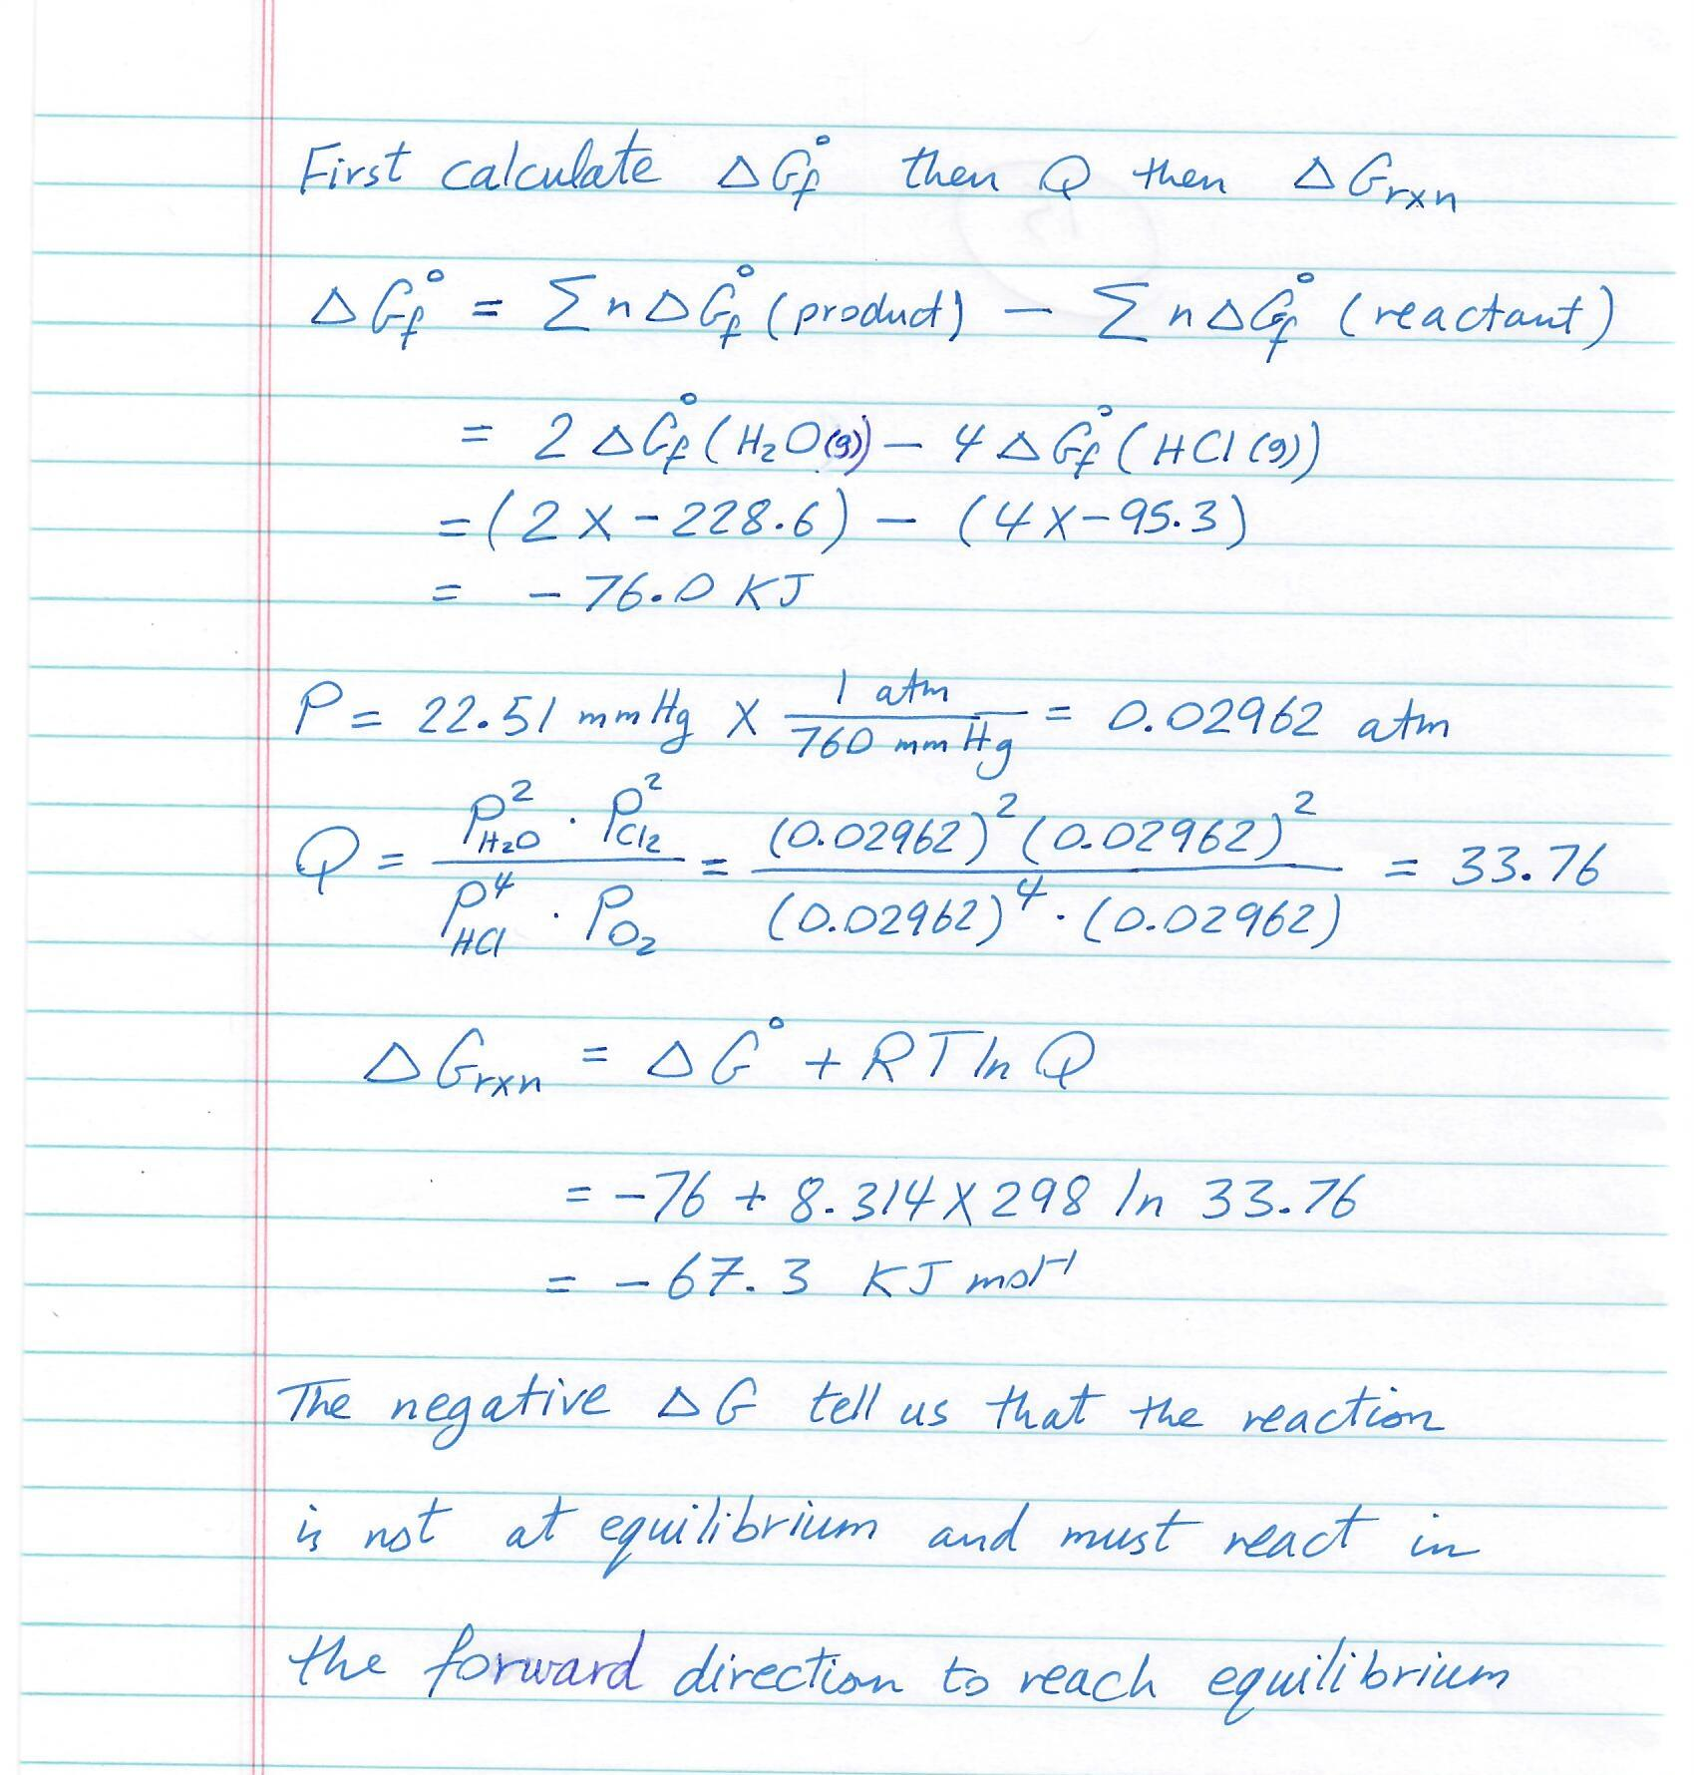

Slide 84
13- Using standard thermodynamic data, calculate the equilibrium constant “K” at 298 K for the reaction below:
Fe (s) + 2HCl (aq) FeCl₂ (s) + H₂ (g)

Slide 85
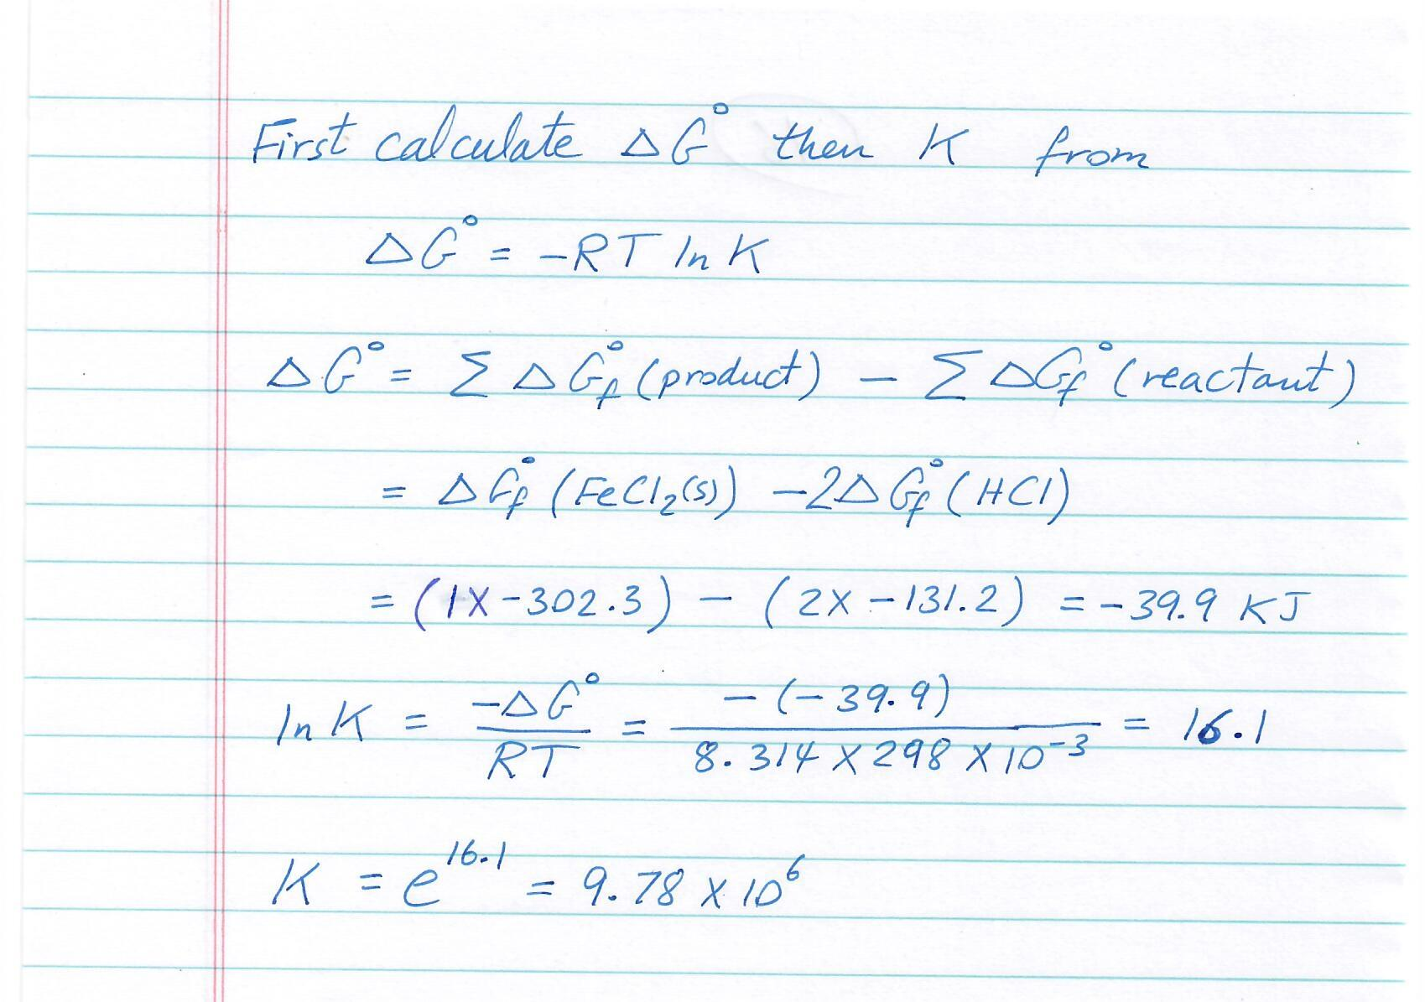

Slide 86
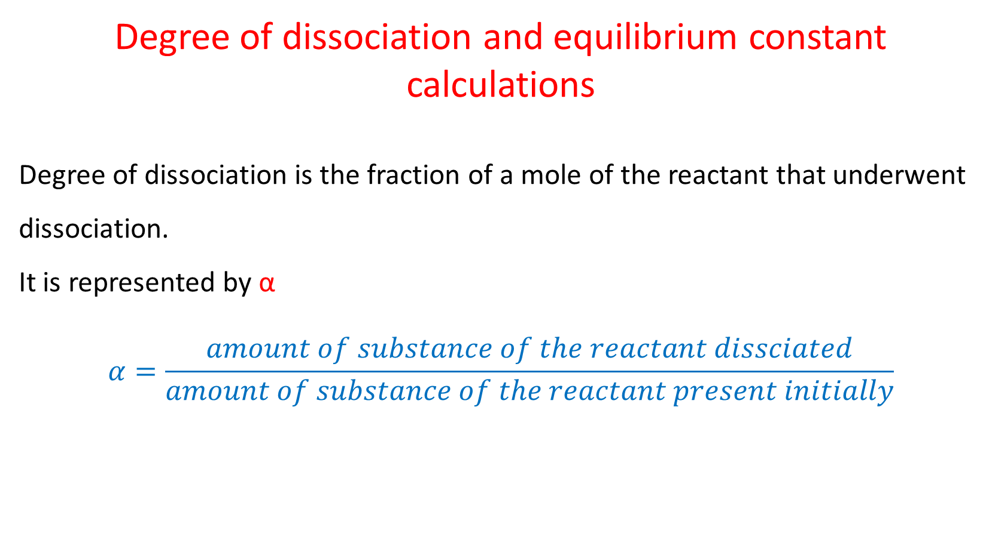
Degree of dissociation and equilibrium constant calculations
Degree of dissociation is the fraction of a mole of the reactant that underwent dissociation.
It is represented by α
$$α=\frac{amount of substance of the reactant dissciated}{amount of substance of the reactant present initially}$$

Slide 87
Example
14- If the following reaction: A (g) ⇌ 2B (g) started with n moles of A and α is the fraction of A molecules that dissociated. Define K_{X} and K_{P}.
Solution:
 | A | 2B
Initial | n | 0
Change | -αn | +2nα
At equilibrium | n(1-α) | 2nα

Slide 88
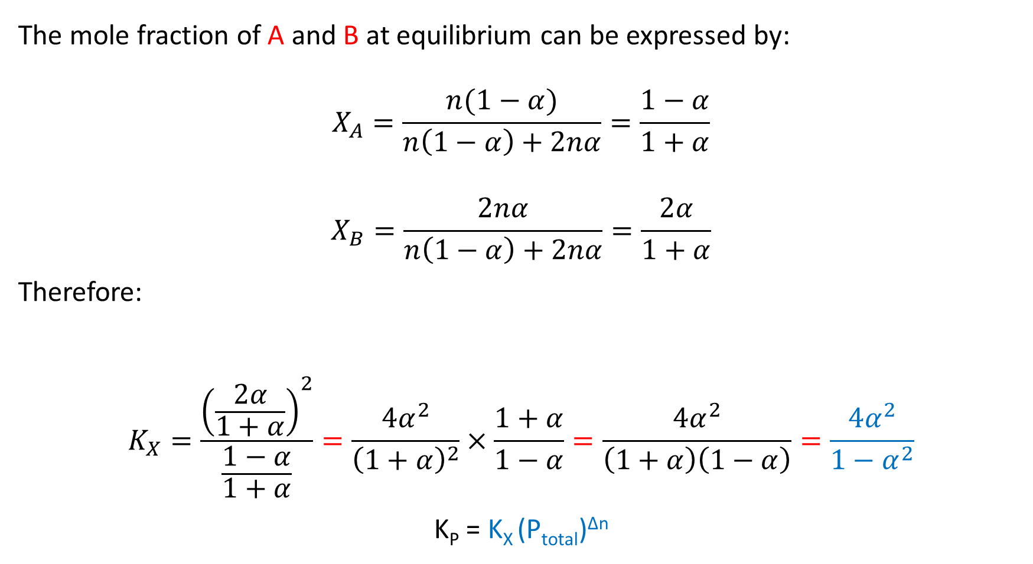
The mole fraction of A and B at equilibrium can be expressed by:
$$X_{A}=\frac{n(1−α)}{n\left(1−α\right)+2nα}=\frac{1−α}{1+α}$$
$$X_{B}=\frac{2nα}{n\left(1−α\right)+2nα}=\frac{2α}{1+α}$$
Therefore:
$$K_{X}=\frac{{\left(\frac{2α}{1+α}\right)}^{2}}{\frac{1−α}{1+α}}=\frac{4α^{2}}{{\left(1+α\right)}^{2}}×\frac{1+α}{1−α}=\frac{4α^{2}}{\left(1+α\right)\left(1−α\right)}=\frac{4α^{2}}{1−α^{2}}$$
K_{P} = K_{X} (P_{total})^{∆n}

Slide 89
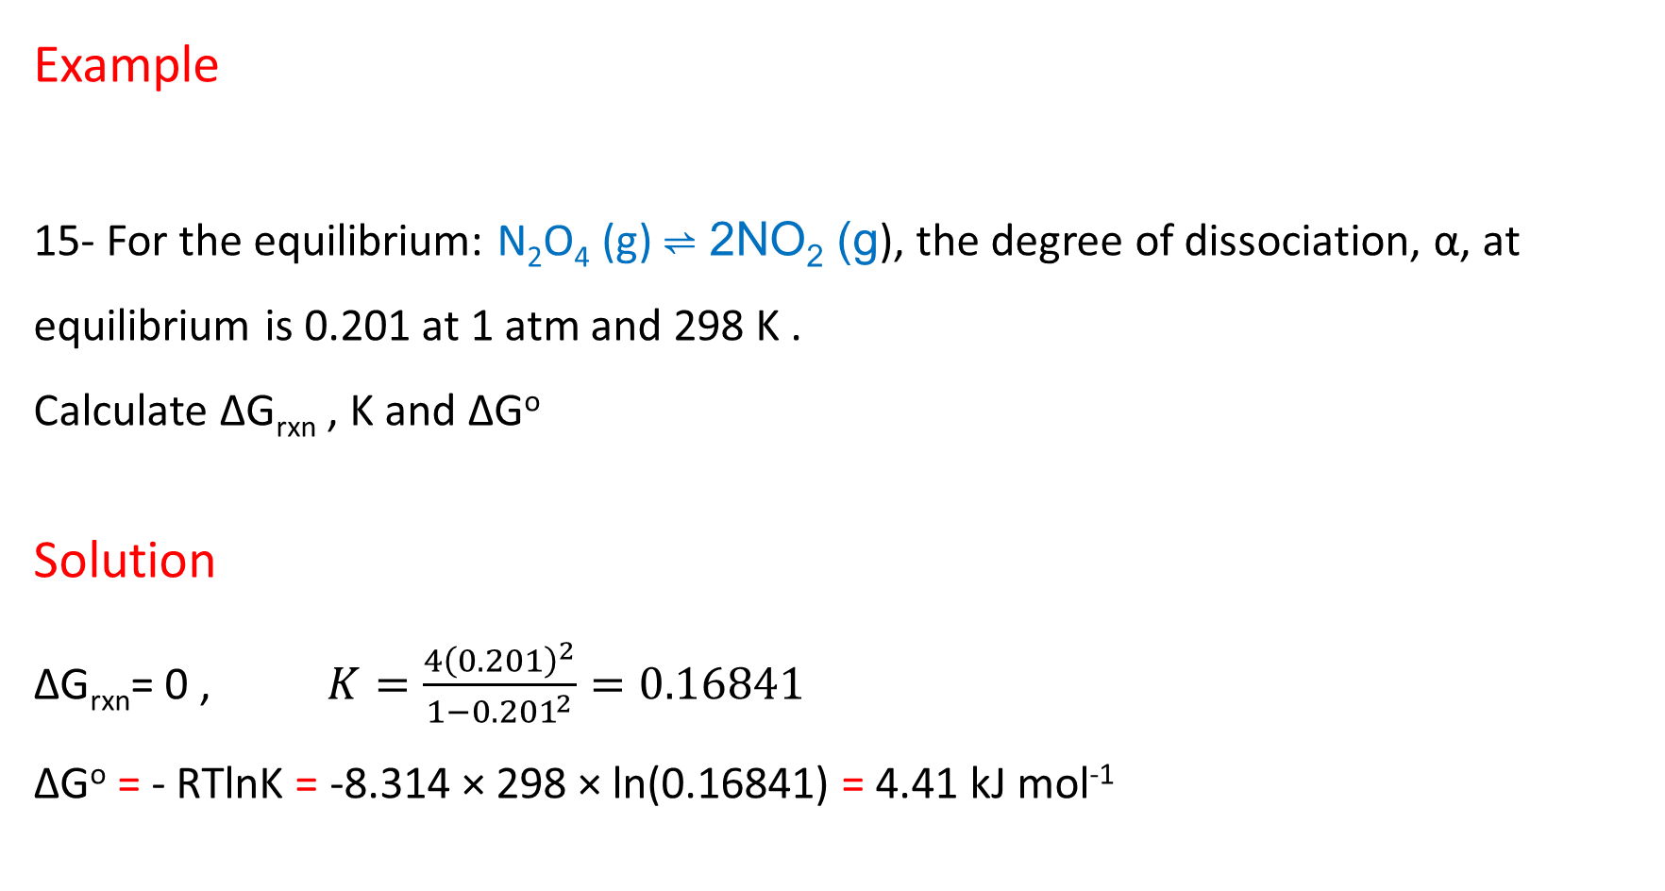
Example
15- For the equilibrium: N₂O₄ (g) ⇌ 2NO₂ (g), the degree of dissociation, α, at equilibrium is 0.201 at 1 atm and 298 K .
Calculate ∆G_{rxn} , K and ∆Gº
Solution
∆G_{rxn}= 0 , $K=\frac{4{\left(0.201\right)}^{2}}{1−{0.201}^{2}}=0.16841$
∆Gº = - RTlnK = -8.314 × 298 × ln(0.16841) = 4.41 kJ mol⁻¹

Slide 90
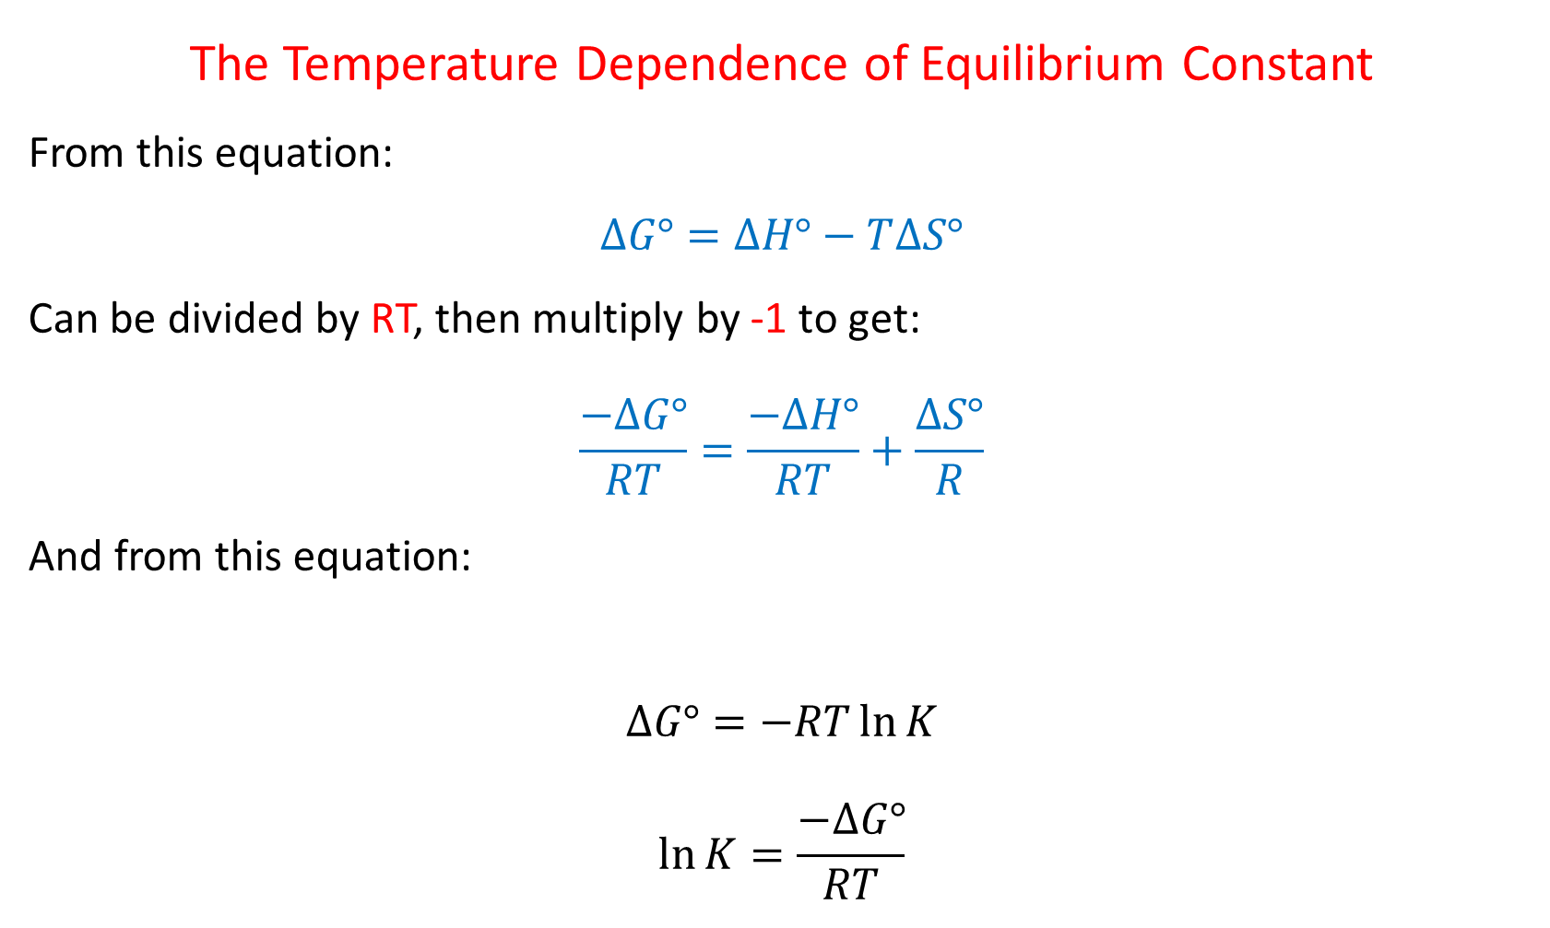
The Temperature Dependence of Equilibrium Constant
From this equation:
$$∆G°=∆H°−T∆S°$$
Can be divided by RT, then multiply by -1 to get:
$$\frac{−∆G°}{RT}=\frac{−∆H°}{RT}+\frac{∆S°}{R}$$
And from this equation:
$$∆G°=−RT\ln{K}$$
$$\ln{K=\frac{−∆G°}{RT}}$$

Slide 91
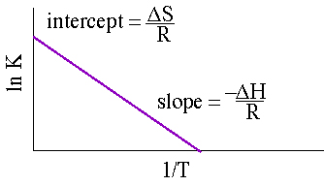

Therefore:
$$\ln{K=\frac{−∆G°}{RT}=\frac{−∆H}{RT}+\frac{∆S}{R}}$$
$$\ln{K=\frac{−∆H}{RT}+\frac{∆S}{R}}$$
This equation is straight line equation y = mx + b
Plotting ln K vs. 1/T we get:
$slope=\frac{−∆H}{R}$ and $intercept=\frac{∆S}{R}$

Slide 92
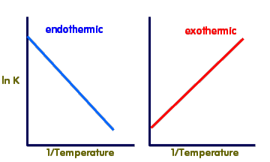
If the reaction endothermic: reactant + heat ⇌ product
∆H > 0, the increase of temperature will push the reaction towards the product, therefore increase of K.
If the reaction exothermic: reactant ⇌ product + heat
∆H < 0, the increase of temperature will push the reaction towards the reactant, therefore decrease of K.

Slide 93

∆H can be obtained by calculation by using van’t Hoff equation. We just need two different temperatures (T₁, T₂) and their corresponding equilibrium constants (K₁ , K₂)
i.e. K₁ , T₁ and K₂ , T₂
$\ln{\frac{K_{2}}{K_{1}}=\frac{−∆H}{R}}\left(\frac{1}{T_{2}}−\frac{1}{T_{1}}\right)$ or $\ln{\frac{K_{2}}{K_{1}}=\frac{∆H}{R}}\left(\frac{1}{T_{1}}−\frac{1}{T_{2}}\right)$
Note:
Assume that ∆H and ∆S are constant over the temperature range

Slide 94
Examples
16- The reaction:
2Al₃Cl₉ (g) 3Al₂Cl₆ (g)
Has an equilibrium constant of 8.8 × 10³ at 443 K and the enthalpy of reaction ∆H_{rxn} = 39.8 kJ mol⁻¹ at the same temperature.
Estimate the equilibrium constant at temperature of 600 K.

Slide 95


Slide 96
17- Molecular bromine is 24 percent dissociated at 1600 K and 1 atm in the equilibrium:
Br₂ (g) 2Br (g)
Calculate:
K at 25 ℃
∆Gº
K at 2000 ℃
Given that ∆Hº = 112 kJ mol⁻¹ over the temperature range

Slide 97


Slide 98

Clapeyron and Clausius-Clapeyron equations
Clapeyron equation
We will use this diagram in deriving the Claperyron and Clausius-Clapeyron equation.
This diagram represents a generalized phase diagram. The line acts as a phase line, or a coexistent curve, separating phases α and β.
As we know, this indicates that at all points on the line, phases α and β are in equilibrium.
P
α
β
T

Slide 99
P
α
β
T

Slide 100
P
α
β
T
This expression, the Clepeyron equation, is applied to and change in a one component system.

Slide 101
Clausius-Clapeyron equation
- In the case of vaporization or sublimation, we can assume that the volume of the gases formed, is so much greater than that of the solid or liquid.

Slide 102
Clausius-Clapeyron equation
Useful Information
The Clausius-Clapeyron models the change in vapor pressure as a function of time
The equation can be used to model any phase transition (liquid-gas, gas-solid, solid-liquid)
Another useful form of the Clausius-Clapeyron equation is:
We can see from this form that the Clausius-Clapeyron equation depicts a line
Can be written as:
which clearly resembles the model y=mx+b, with ln P representing y, C representing b, 1/T acting as x, and -∆H_{vap}/R serving as m. Therefore, the Clausius-Clapeyron models a linear equation when the natural log of the vapor pressure is plotted against 1/T, where -∆Hvap/R is the slope of the line and C is the y-intercept

Slide 103
Clausius-Clapeyron equation
Useful Information
We can easily manipulate this equation to arrive at the more familiar form of the equation. We write this equation for two different temperatures:
Subtracting these two equations, we find:

Slide 104
Common Applications
Calculate the vapor pressure of a liquid at any temperature (with known vapor pressure at a given temperature and known heat of vaporization)
Calculate the heat of a phase change
Calculate the boiling point of a liquid at a nonstandard pressure
Reconstruct a phase diagram
Determine if a phase change will occur under certain circumstances

Slide 105
Real World Applications
Chemical engineering
  Determining the vapor pressure of a substance
Meteorology
  Estimate the effect of temperature on vapor pressure
  Important because water vapor is a greenhouse gas
The Clausius-Clapeyron can only give estimations
  We assume changes in the heat of vaporization due to temperature are negligible and therefore treat the heat of vaporization as constant
  In reality, the heat of vaporization does indeed vary slightly with temperature

Slide 106

Example : Clapeyron

Slide 107

Example: Clausius-Clapeyron

Slide 108
Thermodynamics of Mixing Ideal Gases
A solution is created when two or more components mix homogeneously to form a single phase. Studying solutions is important because most chemical and biological life processes occur in systems with multiple components. Understanding the thermodynamic behavior of mixtures is integral to the study of any system involving either ideal or non-ideal solutions because it provides valuable information on the molecular properties of the system.
Most real gases behave like ideal gases at standard temperature and pressure. This allows us to combine our knowledge of ideal systems and solutions with standard state thermodynamics in order to derive a set of equations that quantitatively describe the effect that mixing has on a given gas-phase solution’s thermodynamic quantities.

Slide 109
Gibbs free energy of mixing ideal gases
Unlike the extensive properties of a one-component system, which rely only on the amount of the system present, the extensive properties of a solution depend on its temperature, pressure and composition. This means that a mixture must be described in terms of the partial molar quantities of its components. The total Gibbs free energy of a two-component solution is given by the expression
G = n₁G₁ + n₂G₂ (1)
Where G is the total Gibbs energy of the system, n_{i} is the number of moles of component i and G_{i} is the partial molar Gibbs energy of component i. The molar Gibbs energy of an ideal gas can be found using the equation
where G∘ is the standard molar Gibbs energy of the gas at 1 bar, and P is the pressure of the system.

Slide 110
In a mixture of ideal gases, the system’s partial molar Gibbs energy is equivalent to its chemical potential, or that
G_{i} = μ_{i} (3)
This means that for a solution of ideal gases, Eq. (2) can become
where µ_{i} is the chemical potential of the i component, µ_{i}° is the standard chemical potential of component i at 1 bar, and P_{i} is the partial pressure of component i.
Now pretend we have two gases at the same temperature and pressure, gas 1 and gas 2. The Gibbs energy of the system before the gases are mixed is given by Eq. (1), which can be combined with Eq. (4) to give the expression

Slide 111
If gas 1 and gas 2 are then mixed together, they will each exert a partial pressure on the total system, P₁ and P₂, so that P₁+ P₂= P. This means that the final Gibbs energy of the final solution can be found using the equation
The Gibbs energy of mixing, Δ_{mix}G, can then be found by subtracting G_{initial} from G_{final}.
ΔG_{mix} = G_{final} - G_{initial}
where P_{i} = X_{i}P and X_{i} is the mole fraction of gas i.

Slide 112
This equation can be simplified further by knowing that the mole fraction of a component is equal to the number of moles of that component over the total moles of the system, or X_{i} = n_{i}/n. Eq. (7) then becomes
ΔG_{mix} = nRT(X₁ ln X₁+ X₂ lnX₂) (8)
This expression gives us the effect that mixing has on the Gibbs free energy of a solution. Since x₁ and x₂ are mole fractions, and therefore less than 1, we can conclude that Δ_{mix}G will be a negative number. This is consistent with the idea that gases mix spontaneously at constant pressure and temperature

Slide 113

Entropy of mixing ideal gases

Slide 114
Thermodynamic studies of an ideal gas’s dependence of Gibbs free energy of temperature have shown that
(δG/δT)_{P} = −S (9)
This means that differentiating Eq. (8) at constant pressure with respect to temperature will give an expression for the effect that mixing has on the entropy of a solution. We see that
(δG_{mix}/δT)_{P} = nR(X₁lnX₁ + X₂ lnX₂)
= − ΔS_{mix}
ΔS_{mix} = − nR(X₁ lnX₁ + X₂ lnX₂) (10)
Since the mole fractions again lead to negative values for ln X₁ and ln X₂, the negative sign in front of the equation makes ΔS_{mix} positive, as expected. This agrees with the idea that mixing is a spontaneous process.

Slide 115
The Entropy of Mixed Ideal Gases
1

Slide 116
mole fraction is:
2
using equation 1 and 2

Slide 117


Slide 118
Enthalpy of mixing ideal gases
We know that in an ideal system ΔG=ΔH−TΔS, but this equation can also be applied to the thermodynamics of mixing and solved for the enthalpy of mixing so that it reads
ΔH_{mix} = ΔG_{mix} + TΔS_{mix} (11)
Plugging in our results for ΔG_{mix} and ΔS_{mix}, we get
ΔH_{mix}=nRT(X₁ lnX₁ + X₂ lnX₂) + T∗[-nR(X₁ lnX₁+ X₂ lnX₂)]
This result makes sense when considering the system. The molecules of ideal gas are spread out enough that they do not interact with one another when mixed, which implies that no heat is absorbed or produced and results in a ΔH_{mix} of zero.

