Slide 1
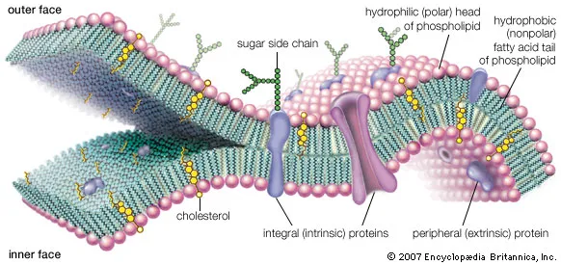
Biology of Cell Membrane ZOO 543

Slide 2
Activities | Grade
First midterm exam Week 8: 10/9/2023 | 15
Attendance and participation | 5
Activity/Homework | 10
Practical | 30
Final Examination | 40
Total | 100

Slide 3
Cell membrane
The cell membrane, cytoplasmic membrane or plasma membrane (a structural component of all living cells
Is a living, dynamic layer that surrounds and limits the cell.
It is too thin to be visible with a light microscope. A typical cell membrane is about 8nm thick,
The cell membrane forms a selectively and differentially permeable barrier, because it allows only certain types of substances to pass through (into or out of the cell)
Because it changes over time. It is alive and changing rather than static

Slide 4
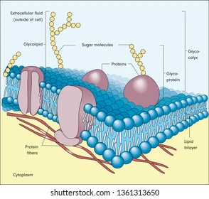
Structure of the plasma membrane
Typically composed of lipids and proteins in a near 50:50 ratio
The most commonly accepted model for the structure of the cell membrane (the Fluid Mosaic Model) was developed by Seymour J. Singer and Garth L. Nicholson in 1972 and shows
Proteins "floating like icebergs in a sea of lipid". Most membrane illustrations are based on this model and show lipids arranged in a bi-layer with proteins floating in and sometimes penetrating through this layer

Slide 5
Structure of the plasma membrane
The fundamental structure of the membrane is
1) The phospholipid bilayer which forms a stable barrier between two aqueous compartments.
2) Proteins embedded within the phospholipid bilayer carry out the specific functions of the plasma membrane, including selective transport of molecules and cell-cell recognition.

Slide 6
Structure of the phospholipid bilayer
Phospholipid consist of fatty acids and alcohol.
The phospholipids are arranged in two layers, called aphospholipid bilayer.
Each phospholipid molecule has a head and two tails.
The head “loves” water (hydrophilic) and the tails “hate” water (hydrophobic)
The water-hating tails are on the interior of the membrane, whereas the water-loving heads point outwards, toward either the cytoplasm or the fluid that surrounds the cell.

Slide 7
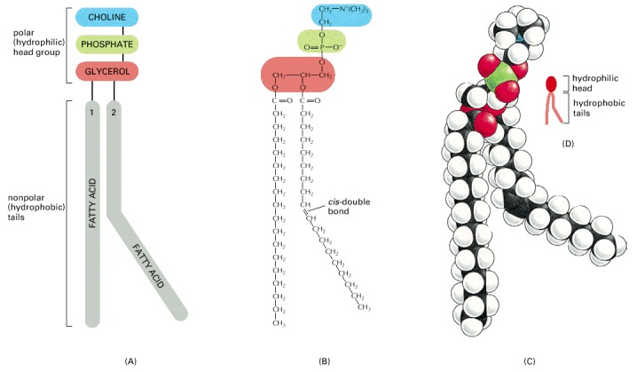
This example is phosphatidylcholine, represented (A) schematically, (B) by a formula, (C) as a space-filling model, and (D) as a symbol. The kink resulting from the cis-double bond is exaggerated for emphasis.

Slide 8
Structure of the phospholipid bilayer
Molecules that are hydrophobic can easily pass through the plasma membrane, if they are small enough, because they are water-hating like the interior of the membrane.
Molecules that are hydrophilic, cannot pass through the plasma membrane because they are water-loving like the exterior of the membrane, and are therefore excluded from the interior of the membrane.

Slide 9
Structure of the plasma membrane
Major Type of phospholipids
The plasma membranes of animal cells contain four major phospholipids (phosphatidylcholine, phosphatidylethanolamine, phosphatidylserine, and sphingomyelin), which together account for more than half of the lipid in most membranes.
These phospholipids are asymmetrically distributed between the two halves of the membrane bilayer
The outer consists mainly of phosphatidylcholine and sphingomyelin, whereas phosphatidylethanolamine and phosphatidylserine are the predominant phospholipids of the inner leaflet.

Slide 10
Structure of the plasma membrane
Major Type of phospholipids
A fifth phospholipid, phosphatidylinositol, is localized to the inner half of the plasma membrane.
Although phosphatidylinositol is a quantitatively minor membrane component, it plays an important role in cell signaling,
The head groups of both phosphatidylserine and phosphatidylinositol are negatively charged, so their predominance in the inner leaflet results in a left negative charge on the cytosolic face of the plasma membrane.

Slide 11
Structure of the plasma membrane
In addition to the phospholipids, the plasma membranes of animal cells contain glycolipids and cholesterol.
The glycolipids are found exclusively on the outer side of the plasma membrane, with their carbohydrate portions exposed on the cell surface. They are relatively minor membrane components, constituting only about 2% of the lipids of most plasma membranes.
Cholesterol, is a major membrane constituent of animal cells, being present in about the same molar amounts as the phospholipids.

Slide 12
The outer leaflet consists predominantly of phosphatidylcholine, sphingomyelin, and glycolipids, whereas the inner leaflet contains phosphatidylethanolamine, phosphatidylserine, and phosphatidylinositol
Cholesterol is distributed in both leaflets.
The negative charge of the head groups of phosphatidylserine and phosphatidylinositol is indicated.
The structures of phospholipids, glycolipids, and cholesterol

Slide 13
Two general features of phospholipid bilayers are critical to membrane function.
1. The structure of phospholipids is responsible for the basic function of membranes as barriers between two aqueous compartments.
Because the interior of the phospholipid bilayer is occupied by hydrophobic fatty acid chains, the membrane is impermeable to water-soluble molecules, including ions and most biological molecules.

Slide 14
Two general features of phospholipid bilayers are critical to membrane function
2. Bilayers of the naturally occurring phospholipids are sticky fluids, not solids.
The fatty acids of most natural phospholipids have one or more double bonds, which introduce kinks into the hydrocarbon chains and make them difficult to pack together
The long hydrocarbon chains of the fatty acids therefore move freely in the interior of the membrane, so the membrane itself is soft and flexible.
In addition, both phospholipids and proteins are free to diffuse laterally within the membrane a property that is critical for many membrane functions

Slide 15
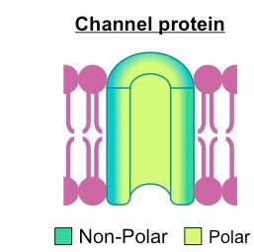
Membrane proteins
They extend through the lipid bilayer, with part of their mass on either side
The amino acids of a membrane protein are localised according to polarity:
Non-polar (hydrophobic) amino acids associate directly with the lipid bilayer
Polar (hydrophilic) amino acids are located internally and face aqueous solutions
Transmembrane proteins typically adopt one of two tertiary structures:
Single helices / helical bundles
Beta barrels (common in channel proteins)

Slide 16
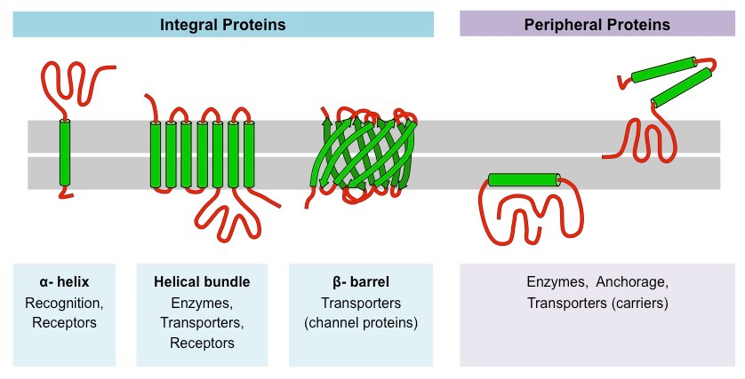

Slide 17
Functions of membrane proteins
Junctions – Serve to connect and join two cells together
Enzymes – Fixing to membranes localises metabolic pathways
Transport – Responsible for facilitated diffusion and active transport
Recognition – May function as markers for cellular identification
Anchorage – Attachment points for cytoskeleton and extracellular matrix
Transduction – Function as receptors for peptide hormones

Slide 18
Functions of membrane proteins examples
Receptors for hormones or neurotransmitters
Antibodies of the immune system that recognize foreign substances (antigens)
Cell-recognition molecules that bind cells together
Cell membrane structures that directly pass chemical information between cells
Anchoring cells to extracellular surfaces like connective tissue
Molecular transport (entry into or exit of substances from cells)
Enzymes that catalyze crucial reactions in cells.

Slide 19
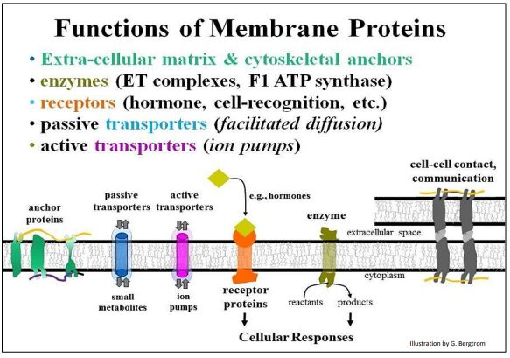
Functions of membrane proteins examples

Slide 20
Basic Function | Specific Actions | Examples
Facilitated Transport | Regulate diffusion of substances across membranes along a concentration gradient | Ca²⁺ & other ion channels, glucose transporters
Active Transport | Use energy to move ions from low to high concentrations across membranes | Mitochondrial protein pumps, the Na⁺/K⁺ ion pump in neurons
Signal Transduction | For e.g., hormones that can't enter cells, these convey information from molecular signals to cytoplasm, leading to a cellular response | Protein hormone and growth factor signaling, antibody/antigen interactions, cytokine mediation of inflammatory responses etc.
Cell-cell interactions | Cell-cell recognition and binding to form tissues | Formation of desmosomes gap junctions and tight junctions.
Anchors to cytoskeleton | Link membrane proteins to cytoskeleton | Give cells their shape, cell movement and response to molecular signals
Enzymatic | Usually multifunctional proteins with enzymatic activities | The F1 ATP synthase that uses proton gradient to make ATP; adenylyl cyclase that makes cAMP during signal transduction; note that some receptor proteins are linked to enzymatic domains in the cytoplasm

Slide 21
Membrane functions
Separating the cell from the environment surrounding it
Recall that the cell membrane contains and limits the cell.
2. Controlling what types of materials enter and exit the cell
Since the movements of materials into and out of cells are essential to cellular function, membrane transport mechanisms have been extensively studied. Some of the best-understood mechanisms are described below.

Slide 22
membrane transport mechanisms
Passive transport
Occurs when substances cross the plasma membrane without any input of energy from the cell.
No energy is needed because the substances are moving from an area where they have a higher concentration to an area where they have a lower concentration
Active transport
Some substances require energy to cross a plasma membrane because they are moving from an area of lower concentration to an area of higher concentration.
The energy comes from the energy-carrying molecule called ATP
Active transport may also require transport proteins, such as carrier proteins, which are embedded in the plasma membrane.

Slide 23
Membrane transport mechanisms
1.Diffusion is The movement of particles will always be down concentration gradient (chemical gradient) or an electrical gradient
A concentration gradient exists when there is a difference in the concentration of particles between one area and another.
The direction of movement will be from an area of high concentration to an area of lower concentration
Involve liquids, solids or gasses.
Since it is a passive transport process, i.e., does not require energy,

Slide 24
Membrane transport mechanisms
Diffusion can be categorized depending upon the types of particles moving, and how they pass through the membrane.
A. Simple diffusing molecules do not combine with the constituents of the membrane.
B. Facilitated requires a membrane because integral proteins are necessary to facilitate the transport process
Gasses such as oxygen and carbon dioxide are among those particles able to move into and out of cells via simple diffusion
Ions (charged particles) require facilitate the diffusion process to move

Slide 25
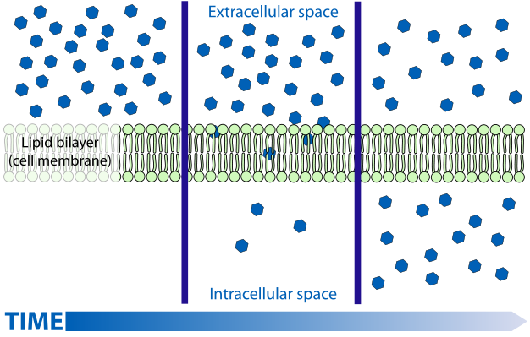

Slide 26
Membrane transport mechanisms
2. Osmosis It is the movement of solvent (most often water) from an area of low solute concentration (high water) to an area of higher solute concentration (low water) through a selectively permeable membrane (Cell Membranes)
Cell Membranes allow small molecules such as oxygen, water carbon dioxide, and oxygen to pass through but do not allow larger molecules like glucose Sucrose, proteins, and starch To enter the cell directly.

Slide 27
Membrane transport mechanisms
2. Osmosis
Type of solutions:
A) Hypertonic solution The concentration of solute in the solution can be greater than the concentration of solute in the cells. The water flowwill be out of the cell.
B) Isotonic solution The concentration of solute in the solution can be equal to the concentration of solute in cells. The amount of water entering the cell is the same as the amount leaving the cell.
C) hypotonic solution The concentration of solute in the solution can be less than the concentration of solute in the cells. The water flow will be into the cell.

Slide 28
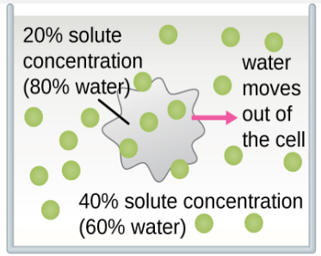
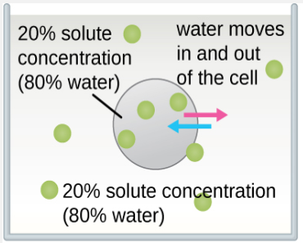
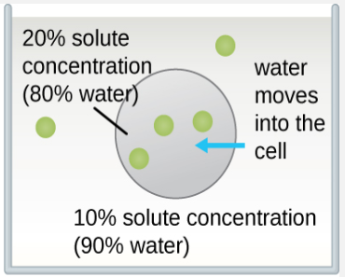
Hypertonic solution
A solution that has a higher solute concentration than another solution. Water particles will move out of the cell, causing crenation.
Isotonic solution
A solution that has the same solute concentration as another solution. There is no net movement of water particles, and the overall concentration on both sides of the cell membrane remains constant.
Hypotonic solution
A solution that has a lower solute concentration than another solution. Water particles will move into the cell, causing the cell to expand and eventually lyse.

Slide 29
Membrane transport mechanisms
3. Facilitated Diffusion
Water and many other substances cannot simply diffuse across a membrane.
Hydrophilic molecules, charged ions, and relatively large molecules such as glucose all need help with diffusion.
The help comes from special proteins in the membrane known as transport proteins.
Diffusion with the help of transport proteins is called facilitated diffusion. There are several types of transport proteins, including channel proteins and carrier proteins

Slide 30
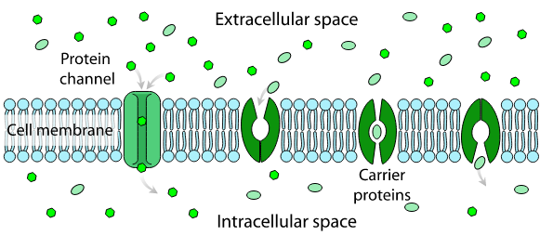
Facilitated diffusion
Facilitated Diffusion Across a Cell Membrane. Channel proteins and carrier proteins help substances diffuse across a cell membrane. In this diagram, the channel and carrier proteins are helping substances move into the cell (from the extracellular space to the intracellular space). The channel protein has an opening that allows the substances to cross. In a carrier protein, the substance binds to the protein, which then causes the protein to changes shape, thereby releasing the substance into the cell.

Slide 31
Membrane transport mechanisms
Active Transport
1) Pump
It includes two pump mechanisms (primary and secondary active transports) exist for the transport of small-molecular weight material and macromolecules.
a) The primary active transport moves ions across a membrane and creates a difference in charge across that membrane.
The primary active transport system uses ATP to move a substance, such as an ion, into the cell
The Sodium-Potassium Pump is an example for The primary active

Slide 32
Membrane transport mechanisms
Active Transport
Sodium-Potassium Pump
A mechanism of active transport that moves sodium ions out of the cell and potassium ions into the cells
Both ions are moved from areas of lower to higher concentration, so energy is needed for this "uphill" process.
The energy is provided by ATP.
Requires carrier proteins. Carrier proteins bind with specific ions or molecules, and they change shape. As carrier proteins change shape, they carry the ions or molecules across the membrane

Slide 33
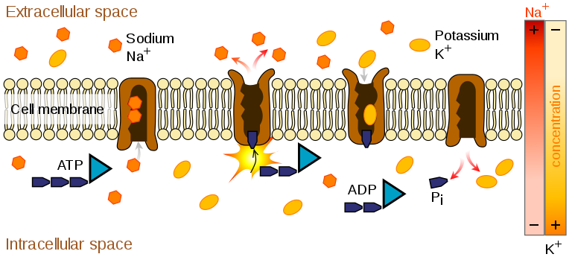
Membrane transport mechanisms
Sodium-Potassium Pump
The sodium-potassium pump moves sodium ions (Na + ) out of the cell and potassium ions (K + ) into the cell. First, three sodium ions bind with a carrier protein in the cell membrane. Then, the carrier protein receives a phosphate group from ATP. When ATP loses a phosphate group, energy is released. The carrier protein changes shape, and as it does, it pumps the three sodium ions out of the cell. At that point, two potassium ions bind to the carrier protein. The process is reversed, and the potassium ions are pumped into the cell.

Slide 34
Membrane transport mechanisms
b) Secondary active transport describes the movement of material using the energy of the electrochemical gradient established by the primary active transport.
Allowing substances such as amino acids and glucose move into the cell through membrane channels.
ATP itself is formed through secondary active transport using a hydrogen ion gradient in the mitochondrion.
It is critical for vital body functions, including the transmission of nerve impulses and the contraction of muscles.
It consumes a large percentage of the body's energy with the sodium-potassium pump.

Slide 35
Membrane transport mechanisms
Active Transport
2) Vesicle Transport
Some molecules, such as proteins, are too large to pass through the plasma membrane, regardless of their concentration inside and outside the cell.
Very large molecules cross the plasma membrane with vesicle transport. Vesicle transport requires energy, so it is also a form of active transport. There are two types of vesicle transport:
Endocytosis
Exocytosis

Slide 36
Membrane transport mechanisms
Endocytosis
a type of vesicle transport that moves a substance into the cell.
The plasma membrane completely engulfs the substance, a vesicle pinches off from the membrane, and the vesicle carries the substance into the cell.
It is used by all cells of the body because most substances important to them are polar and consist of big molecules, and thus cannot pass through the hydrophobic plasma membrane.

Slide 37
Membrane transport mechanisms
Type of Endocytosis
Phagocytosis phagocytes extend pseudopodia by membrane evagination. The pseudopodia of amoeba (and amoeboid cells generally) engulf particles of food that end up in digestive vesicles (phagosomes) inside the cytosol. Phagocytes are a class of white blood cells that are part of our immune system. They engulf foreign particles that must be eliminated from the body. A lysosome fuses with the phagosome, after which stored hydrolytic enzyme are activated. The result is the digestion of the engulfed particles. Phagocytosis begins upon contact between the outer cell surface and those particles. The main kinds of endocytosis are phagocytosis, pinocytosis and receptor-mediated endocytosis, shown below.2. Pinocytosis is a non-specific, more or less constant pinching off of small vesicles that engulf extracellular fluid containing solutes; they are too small to include significant particulates.

Slide 38
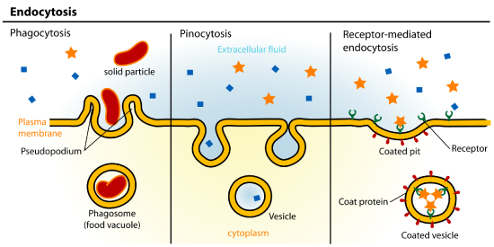
Membrane transport mechanisms
Type of Endocytosis
When an entire cell or other solid particle is engulfed, the process is called phagocytosis.
When fluid is engulfed, the process is called pinocytosis.
receptor-mediated endocytosis

Slide 39
Membrane transport mechanisms
Type of Endocytosis
3. Receptor-mediated endocytosis this kind of endocytosis relies on the affinity of receptors for specific extracellular substances. Upon binding their ligands, the receptors aggregate in differentiated regions of cell membranes called coated pits. The coated pits then invigilate, forming a coated vesicle, thereby bringing their extracellular contents into the cell. After the coated vesicles deliver their contents to their cellular destinations, the vesicle membranes are recycled into the plasma membrane
Clathrin-mediated endocytosis is he major endocytic route for internalization of many cargoes

Slide 40
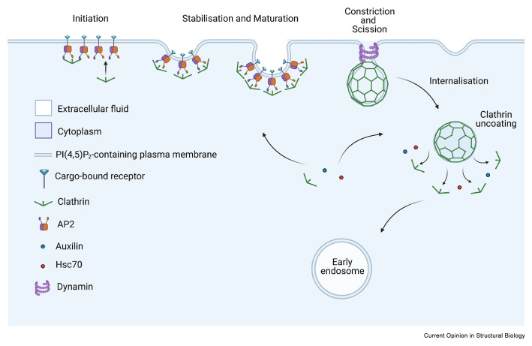
Stages of clathrin-mediated endocytosis. Schematic diagram illustrating the assembly and disassembly of a clathrin-coated pit. Briefly, AP2 (and other clathrin-associated sorting proteins) binds cargo and phosphoinositide moieties in the membrane, which triggers clathrin recruitment and subsequent lattice assembly. Other adaptor proteins are recruited to the invaginating membrane to ensure stable lattice growth and close of the clathrin-coated pit. Dynamin (along with other adaptor proteins) drives membrane scission resulting in the clathrin-coated vesicle being fully internalised into the cytoplasm. Auxilin and Hsc70 are key factors mediating clathrin uncoating. The vesicle is then free and primed to fuse with an early endosome

Slide 41
Membrane transport mechanisms
Some human diseases are caused by a failure of receptor-mediated endocytosis.
For example, the form of cholesterol termed low-density lipoprotein or LDL (also referred to as “bad” cholesterol) is removed from the blood by receptor-mediated endocytosis. In the human genetic disease familial hypercholesterolemia, the LDL receptors are defective or missing entirely. People with this condition have life-threatening levels of cholesterol in their blood because their cells cannot clear the chemical from their blood.

Slide 42
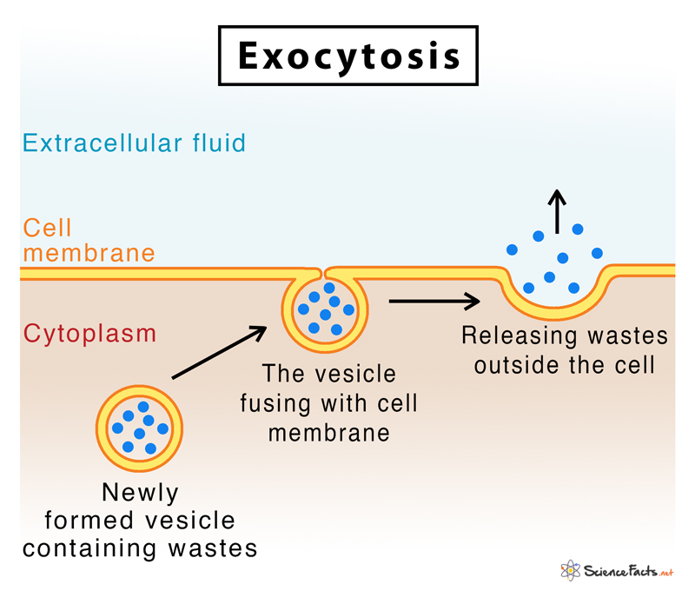
Membrane transport mechanisms
Exocytosis
is a type of vesicle transport that moves a substance out of the cell. A vesicle containing the substance moves through the cytoplasm to the cell membrane. Then, the vesicle membrane fuses with the cell membrane, and the substance is released outside the cell.
Allows cells to secrete waste substances and molecules, such as hormones and proteins.
Important for chemical signal messaging and cell to cell communication

Slide 43
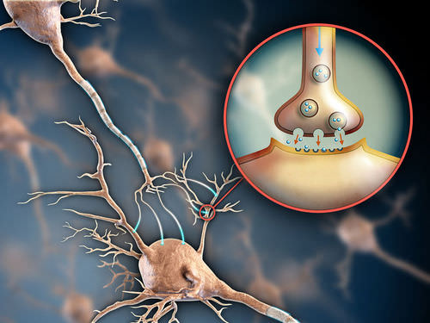
Membrane transport mechanisms
Exocytosis
is a type of vesicle transport that moves a substance out of the cell. A vesicle containing the substance moves through the cytoplasm to the cell membrane. Then, the vesicle membrane fuses with the cell membrane, and the substance is released outside the cell.
Allows cells to secrete waste substances and molecules, such as hormones and proteins.
Important for chemical signal messaging and cell to cell communication
an axon releasing dopamine by exocytosis.

Slide 44
Membrane transport mechanisms
Examples of exocytosis include:
Transportation of glucagon from the pancreas into the liver where it is further processed for easier absorption into the bloodstream
Transportation of protein-filled vesicles from T cells to virally infected cells
Elimination of carbon dioxide and water, which are waste products generated during aerobic respiration
Secretion of antibodies, enzymes and peptide hormones from different cells
Release of neurotransmitters from nerve cells
Recycling of receptors on the cell membrane that intercept signals
Release of digestive enzymes by the pancreas
an axon releasing dopamine by exocytosis.

