Slide 1
Chem. 108
Carboxylic Acids
And
Their Derivatives
Chapter 11

Slide 2
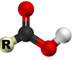
Carboxylic acids are strong organic acids which contain
the carboxyl group (-COOH, -CO₂H)
Carboxylic acids are classified as aliphatic or aromatic depending on whether R or an Ar is attached to the carboxylic group
R-COOH or Ar-COOH

Slide 3
Nomenclature
Formula IUPAC Common
alkan -oic acid prefix – ic acid
HCOOH methanoic acid formic acid
CH₃COOH ethanoic acid acetic acid
CH₃CH₂COOH propanoic acid propionic acid
CH₃CH₂CH₂COOH butanoic acid butyric acid

Slide 4
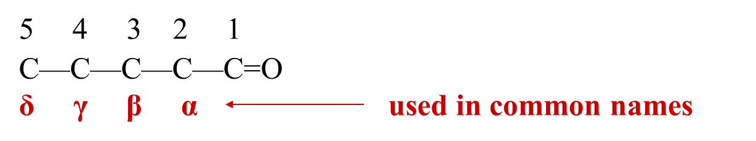
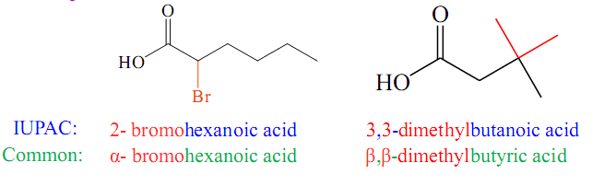
Naming Rules
Identify longest chain
(IUPAC) Number carboxyl carbon as 1
(Common) Assign α, β, γ, δ to carbon atoms adjacent to carboxyl carbon
Examples:

Slide 5
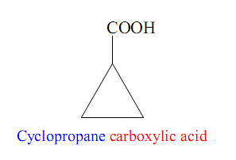
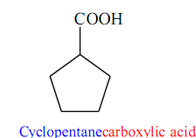
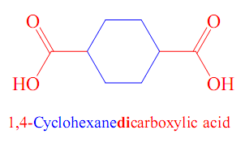
Naming Cyclic Carboxylic Acids
Cyclic compounds containing one or more COOH groups attached to the ring are named by identifying the name of the ring followed by the word carboxylic acid or dicarboxylic acids etc.

Slide 6
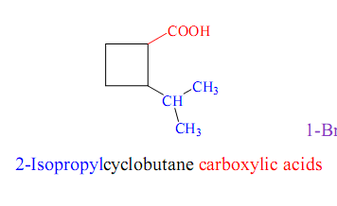
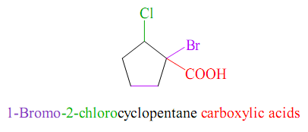
The carbon atom bearing the carboxylic group is numbered 1 and the substituents are numbered relative to it.

Slide 7
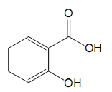
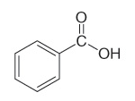
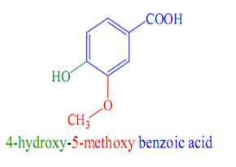
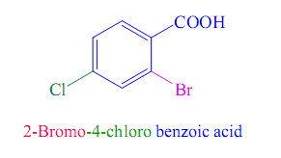
Naming Aromatic Carboxylic Acids
The simplest aromatic carboxylic acid is benzoic acid.
Substituted benzoic acids are named with benzoic acid as
the parent name.
Derivatives are named using numbers to show the location
of substituents relative to the carboxyl group.
The ring carbon attached to the carboxyl group is the #1 position.
Benzoic acid
Benzene carboxylic acid
Salicylic acid
2-Hydroxybenzoic acid
4-hydroxy-3-methoxybenzoic acid

Slide 8
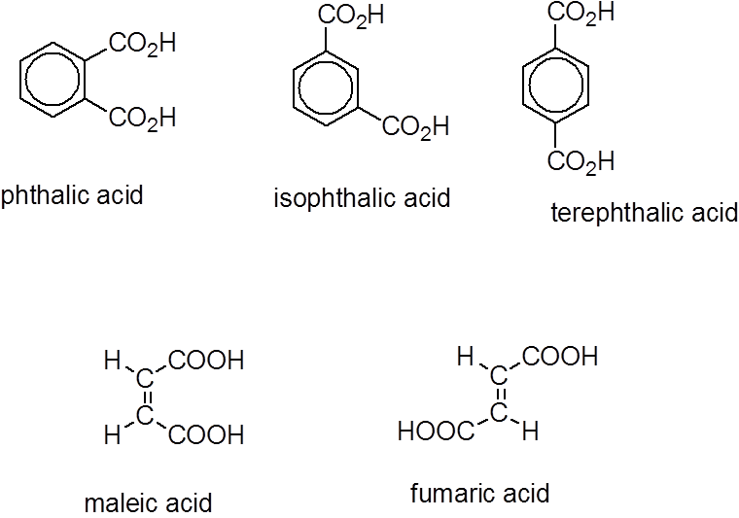
1,2-dicarboxylic acid
Phthalic acid
Benzene-1,2-dicarboxylic acid
isophthalic acid
Benzene-1,3-dicarboxylic acid
Terephthalic acid
Benzene-1,4-dicarboxylic acid

Slide 9
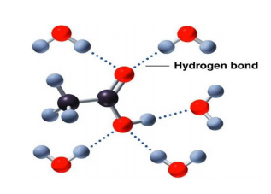
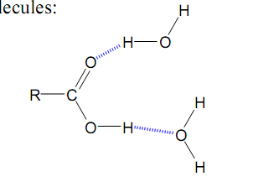
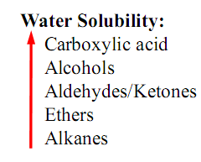
Physical Properties of Carboxylic Acids
1. Solubility
The carboxylic acid are highly polar organic compounds.
This polarity results from the presence of a strongly polarized carbonyl (C=O) group and hydroxyl (O-H) group.
As the number of carbons in a carboxylic acid series becomes greater, the solubility in water decreases.
Aromatic carboxylic acids are insoluble in water.

Slide 10
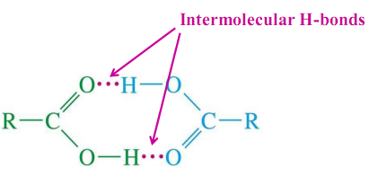
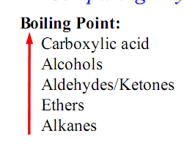
2. Boiling Point
Carboxylic acids are polar compounds and form very strong intermolecular hydrogen bonds to form a dimer.
As the number of carbons in a carboxylic acid series becomes greater, the boiling point increases.

Slide 11
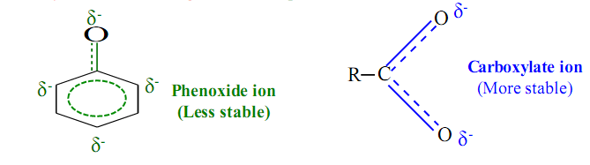
Acidity and Acid Strength
The most important chemical property of carboxylic acids chemistry is their acidic nature.
The mineral acids (HCl, HBr, HI, H₂SO₄, H₃PO₄ ) are defined as "strong acids" because they undergo complete dissociation.
Carboxylic acids are strong organic acids , they are much more acidic than alcohols.
Carboxylic acids are stronger acids than phenols.

Slide 12
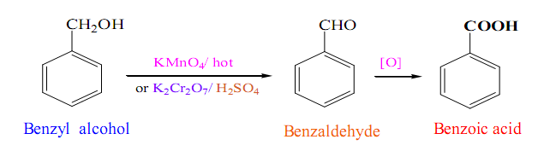
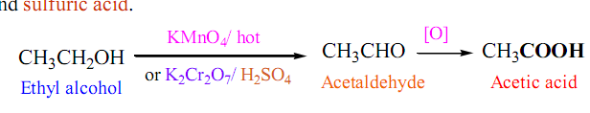
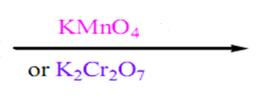
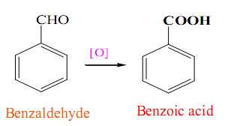

Preparation of Carboxylic acids
1. Oxidation:
A. Oxidation of primary alcohols and aldehydes
KMnO₄/ H⁺ / Δ
KMnO₄/ H⁺ / Δ
K₂Cr₂O₄ / H⁺
K₂Cr₂O₄ / H⁺

Slide 13
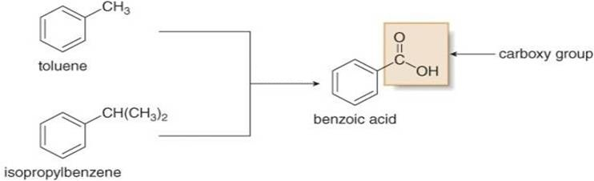
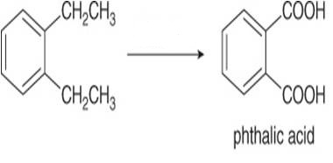
B. Oxidation of Alkylbenzene
KMnO₄ / OH⁻
Δ / H⁺
KMnO₄ / OH⁻
Δ / H⁺

Slide 14
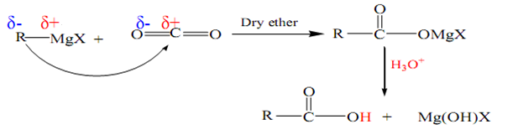

2. Carbonation of Grignard Reagents:
The addition of Grignard reagents to CO₂ in form of dry ice gives
an acid with one more carbon more than the original Grignard reagent.
δ-
Example:

Slide 15

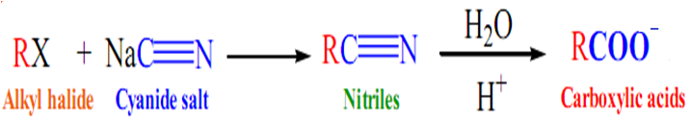
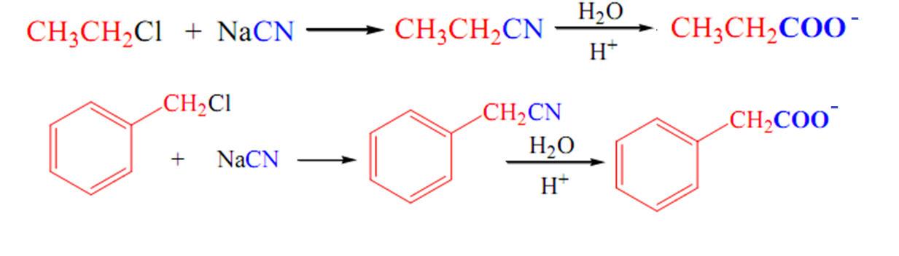
3. Hydrolysis of Nitriles:
Nitriles:
They are prepared by reacting a 1° or 2° alkyl halide with cyanide salt.
Acid hydrolysis of a nitriles yields a carboxylic acids.
+ NH₃
Examples:
+ NH₃
+ NH₃

Slide 16
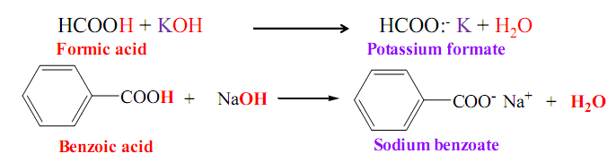
Reactions of Carboxylic acids
1. Reaction with Bases : Salt formation
The carboxyl hydrogen is replaced by metal ion, M⁺
A) With strong base:
⁺

Slide 17

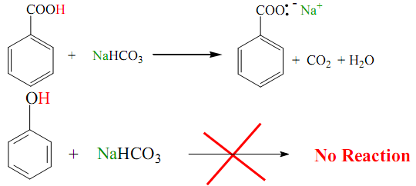
B) With weak base
Weaker acids like phenols react only with strong bases like
(NaOH or KOH) and will not react with NaHCO₃

Slide 18
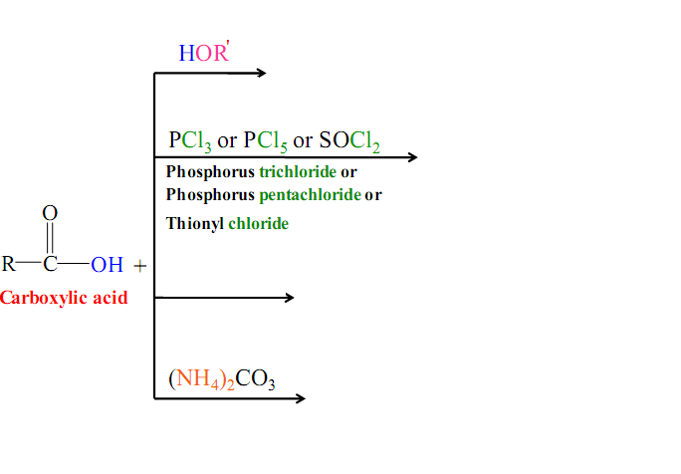
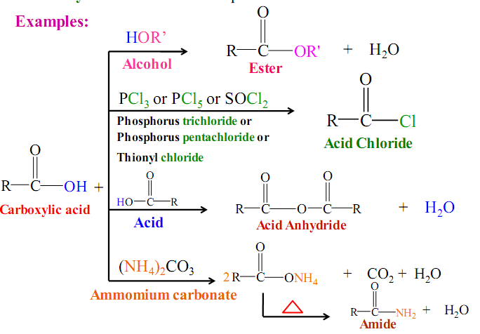

2. Reaction with Nucleophiles to form acid derivatives:
When the OH of a carboxylic acid is replaced by a nucleophile, :Nu , a carboxylic acid derivative is produced.

Slide 19
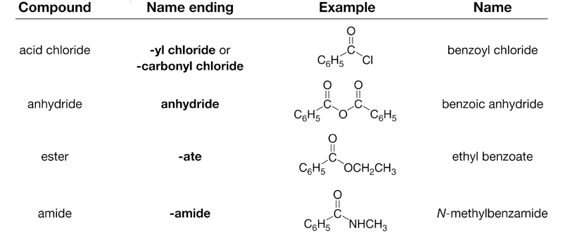
Derivatives of Carboxylic acids

Slide 20
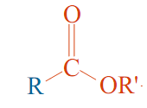
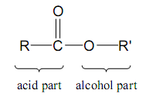
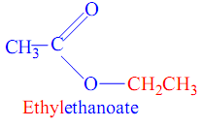
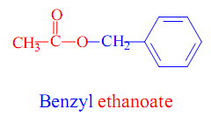
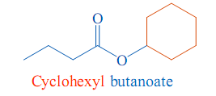
Nomenclature
Nomenclature: the functional derivatives’ names are derived from the common or IUPAC names of the corresponding carboxylic acids.
1. Esters:
alkyl alkanoate
Change –ic acid to –ate preceded by the alkyl is derived from the alcohol, R'OH.
Examples:

Slide 21
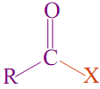
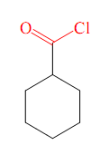
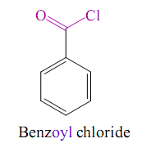
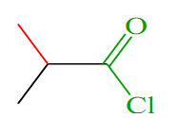

2. Acid Chlorides:
Change –ic acid to –yl chloride
Alkanoyl chloride
Examples:

Slide 22
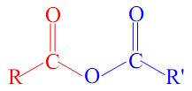
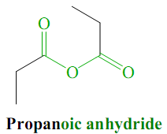
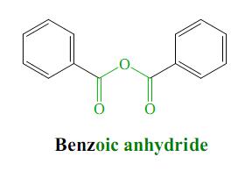
3. Acid Anhydride:
Change acid to anhydride
alkanoic anhydrides
Examples:

Slide 23

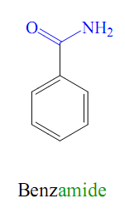
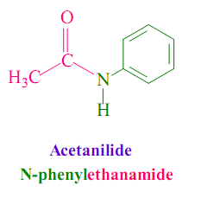
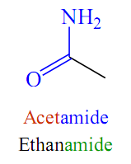
4. Amides:
Change -oic acid to –amide
alkanamide
Examples:

Slide 24
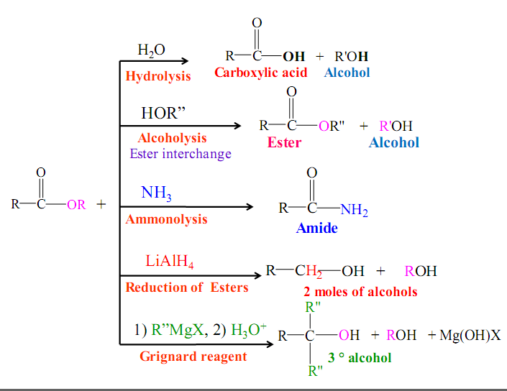
Esters Reactions:

Slide 25
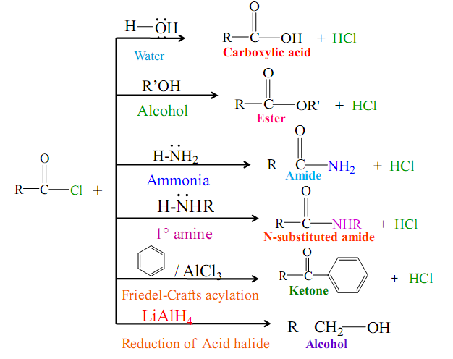
Acid Chlorides Reactions:

Slide 26

Acid Anhydride Reactions:

Slide 27








Amides Reactions:
/
4- Reaction of amides with alkaline hypohalite solution:
Reduced to amines containing one less carbon atom

