Slide 1
Chem. 108
Organic Halogen
Compounds
Chapter 6

Slide 2
Organic Halogen Compounds
An organic compound containing at least one
carbon-halogen bond (C-X)
  X (F, Cl, Br, I) replaces H
Can contain many C-X bonds
Classes and Names of Halogen Compounds
1- Alkyl halides, R-X
A compound containing a halogen covalently bonded to an sp³ hybridized carbon.
Alkyl halides are subdivided into primary (1°), secondary (2°), or tertiary (3°), depending on the type of carbon to which the halogen is attached.

Slide 3
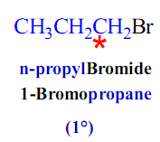


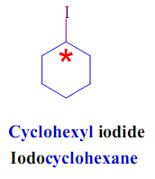
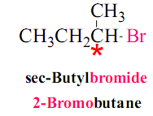

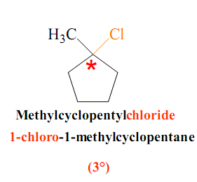
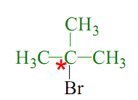
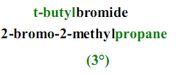
Examples:

Slide 4
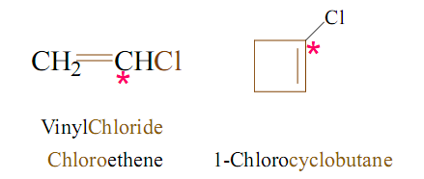
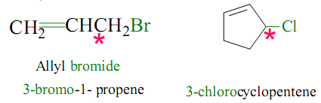
2- Vinylic halides, C=C-X
A compound containing a halogen bonded to an sp² hybridized carbon.
1-Chlorocyclobutene
3- Allylic halides, C=C-C-X
A compound containing a halogen bonded to an sp³ hybridized carbon next to doubly bonded carbon C=C .

Slide 5
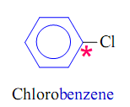
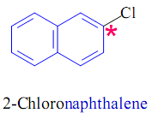
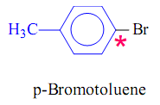
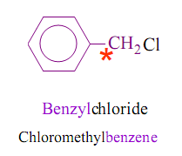
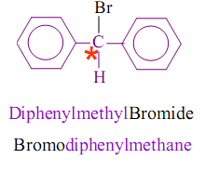
4- Aryl halides, Ar-X
A compound containing a halogen bonded to an aromatic ring.
5- Benzylic halides, Ar-C-X
A compound containing a halogen bonded to an sp³ hybridized carbon next to an aromatic ring.

Slide 6
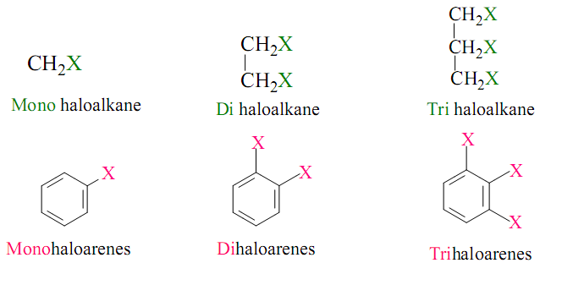
6- Polyhalogens
Haloalkane and Haloarene can be classified on the basis of number
of Halogen atoms.
They maybe classified as mono, di-, tri-, tetra-,…etc atoms
in their structure.

Slide 7
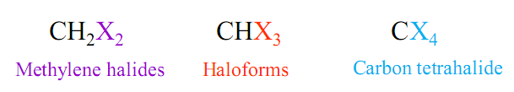
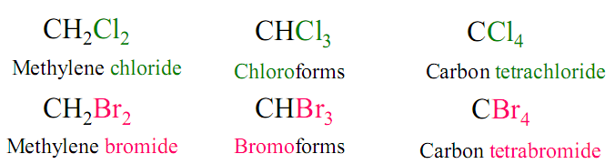
Common names of alkyl halides are used only.
Examples:

Slide 8
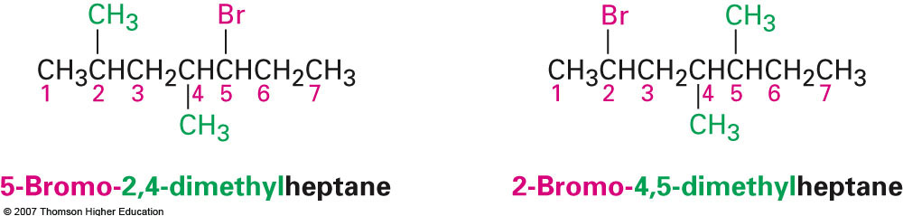
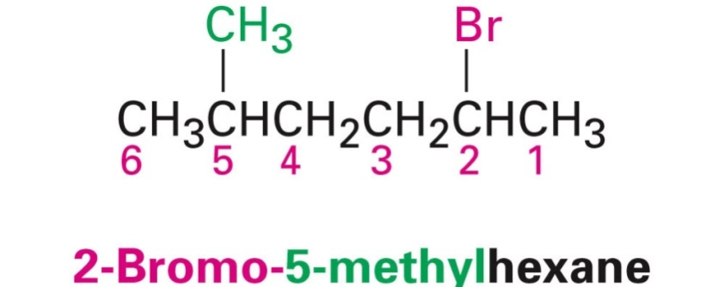
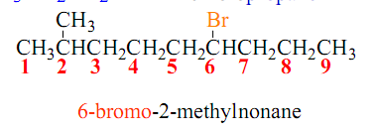
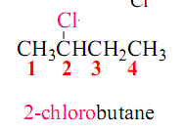
Nomenclature of Halogen Compounds

Slide 9
Physical Properties of Halogen Compounds
1- Solubility
All organic halides are soluble in the nonpolar solvents such as carbon tetrachloride (CCl₄) and benzene (C₆H₆), but they are insoluble in polar solvents such as water.

Slide 10
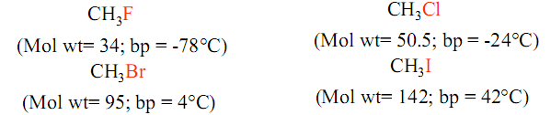
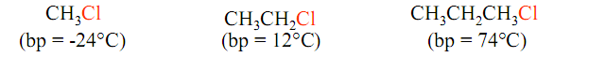
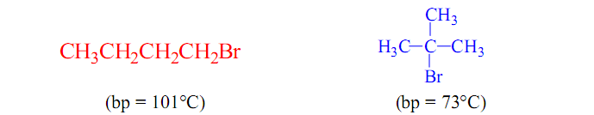
2- The boiling point
The boiling point of the organic halides increase, as the size of the halogen increase.
The boiling point also increase regularly with molecular weight.
As expected, within a series of isomers, the straight-chain compounds
has the highest boiling points, and the most branched isomer the lowest boiling point.

Slide 11
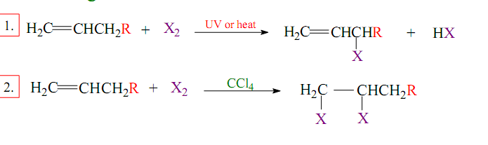
Preparation of Halogen Compounds
A Chloro, Bromo, and Iodo Compounds
1. Direct Halogenation of Hydrocarbons
(a) Halogenation of alkanes: alkyl halides
(b) Halogenation of alkenes

Slide 12
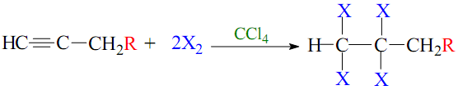
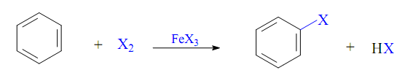
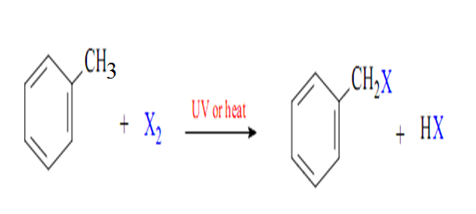
(c) Halogenation of alkynes
(d) Halogenation of aromatic ring and alkyl benzenes

Slide 13


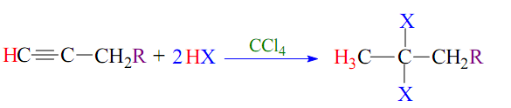
2. Addition of HX to Unsaturated Hydrocarbons
(a) Addition of HX to alkenes:
(b) Addition of HX to alkynes:

Slide 14
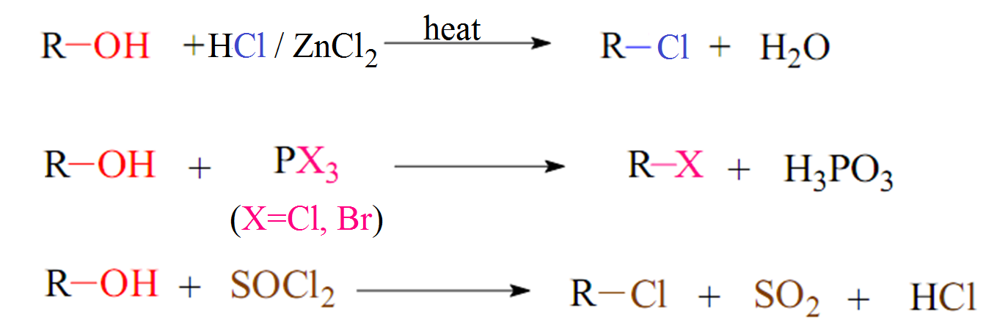
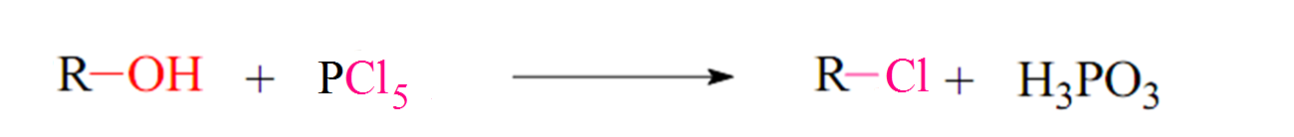
3. Conversion of Alcohols:
The hydroxyl group of an alcohol is replaced by halogen on reaction
with concentrated halogen acid (HX), phosphorus halides (PX₃ or PX₅),
and thionylchlorid (SOCl₂).

Slide 15
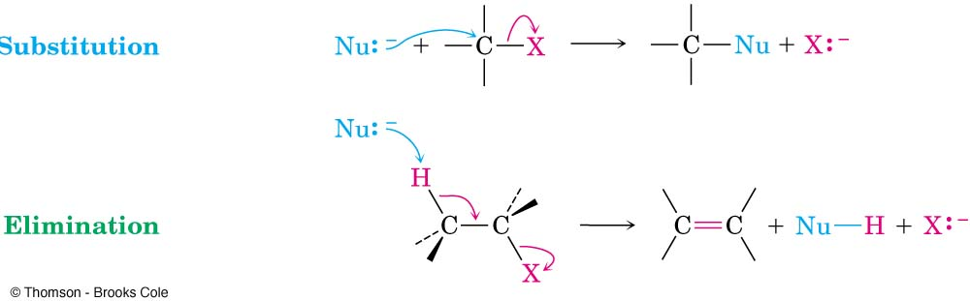
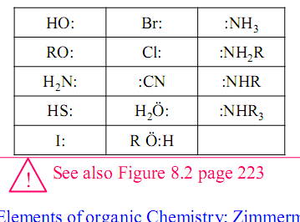
Reactions of Halogen Compounds
Nucleophilic substitution reactions (S_{N} )
Elimination reactions ( E )
Reaction with certain metals to form Organometallic compounds
1- Nucleophilic substitution reactions ( S_{N} )
Examples of Common Nucleophiles:

Slide 17
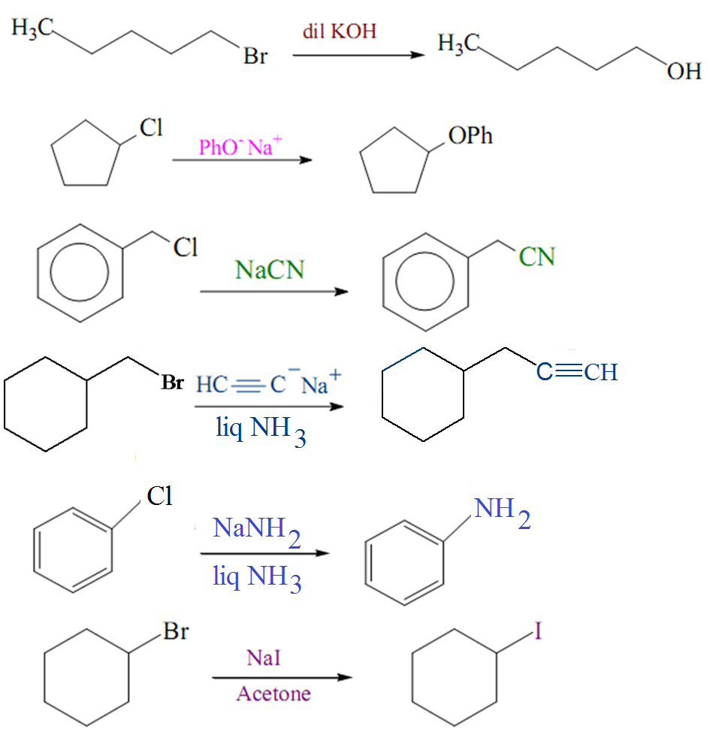
Examples:

Slide 18
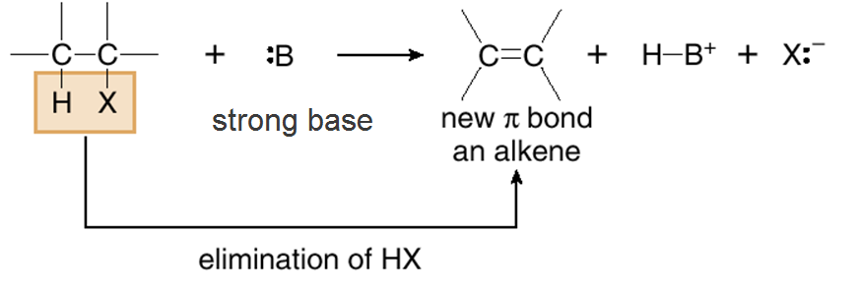
2- Elimination reactions ( E )

Slide 19
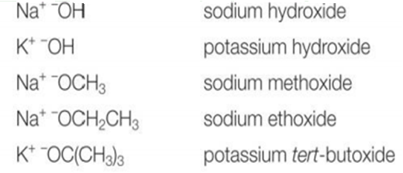
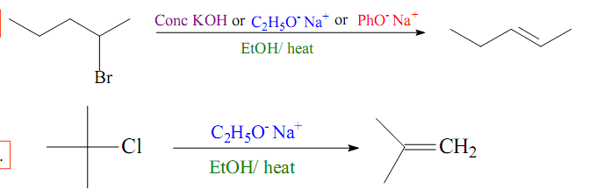
Common basis used in dehydrohalogenation
Examples:
+
90 %
10 %
+
90 %
10 %

Slide 20
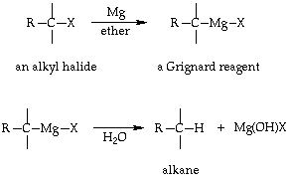
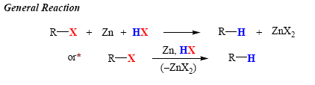
3- Reaction with certain metals to form Organometallic compounds
A- Reduction with Mg and Zn
Grignard Reaction

Slide 21

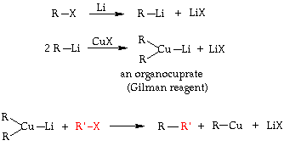
B- Reduction with alkali metals ( Li, Na, or K)
Wurtz Reaction
Corey-House (Gilman reagent)

Slide 22
Homework
1- Write the structure and name the following compounds according
to the IUPAC system.
Bromoform
Vinyl bromide
t.Butyl iodide
Allyl chloride
2- Complete the following reactions.

