Slide 1
Chapter 13
Concrete Form Design

Slide 2
Concrete Form Design
SLAB FORM DESIGN Method
WALL AND COLUMN FORM DESIGN
DESIGN OF LATERAL BRACING

Slide 3
EXAMPLE 13-1
Design the formwork (Figure 13-2) for an elevated concrete floor slab 6 in. (152 mm) thick.
Sheathing will be nominal I-in. (25-mm) lumber while 2 x 8 in. (50 x 200 mm) lumber will be used for joists.
Stringers will be 4 x 8 in. (100 x 200 mm) lumber.
Assume that all members are continuous over three or more spans.
Commercial 4000-lb (17.8-kN) shores will be used.
It is estimated that the weight of the formwork will be 5 lb/sq ft
(0.24 kPa).
The adjusted allowable stresses for the lumber being used are as follows:

Slide 4
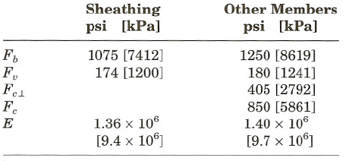
EXAMPLE 13-1
Maximum deflection of form members will be limited to 11360.
Use the minimum value of live load permitted by ACI.
Determine joist spacing, stringer spacing, and shore spacing.

Slide 5
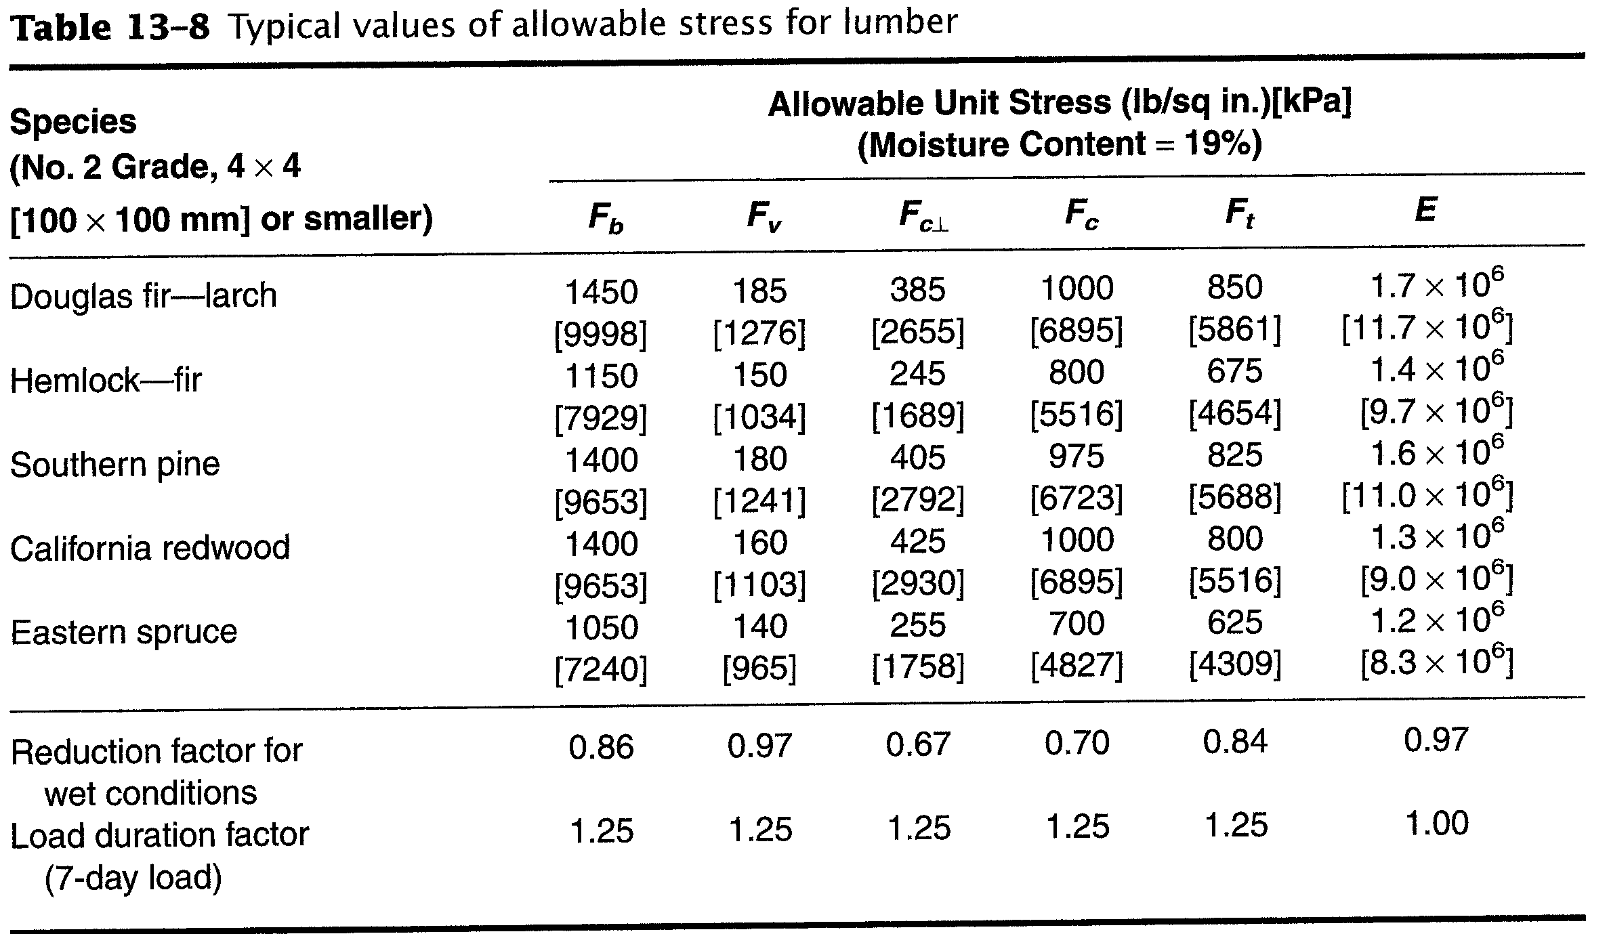

Slide 6
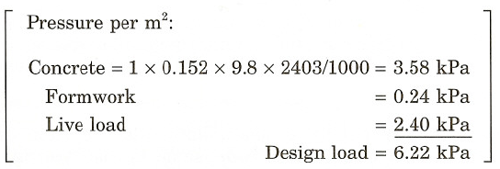
Solution

Slide 7
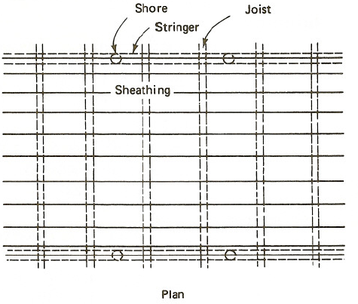
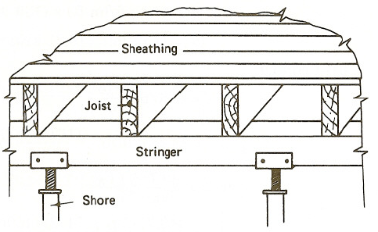
Figure 13-2 Slab form

Slide 8
Deck Design
Consider a uniformly loaded strip of decking (sheathing) 12 in.
(or 1 m) wide placed perpendicular to the joists (Figure 13-1a) and analyze it as a beam.
Assume that the strip is continuous over three or more spans and use the appropriate equations of Table 13-5 and 13-5A.
w =(1 sq ft/lin ft) x (130 lb/sq ft) = 130 lb/ft
[w =(1 m2/m) x (6.21 kN/m2) =6.21 kN/m]

Slide 9
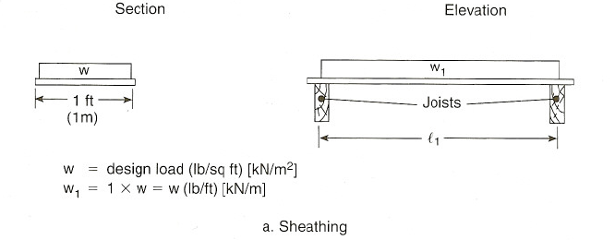
Figure 13-1 Design Analysis for form member

Slide 10
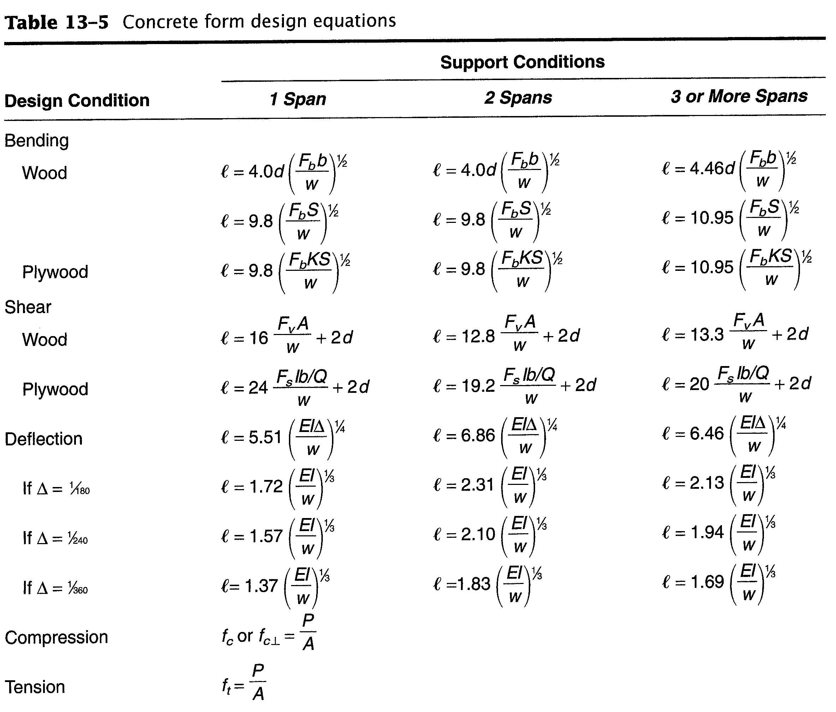

Slide 11
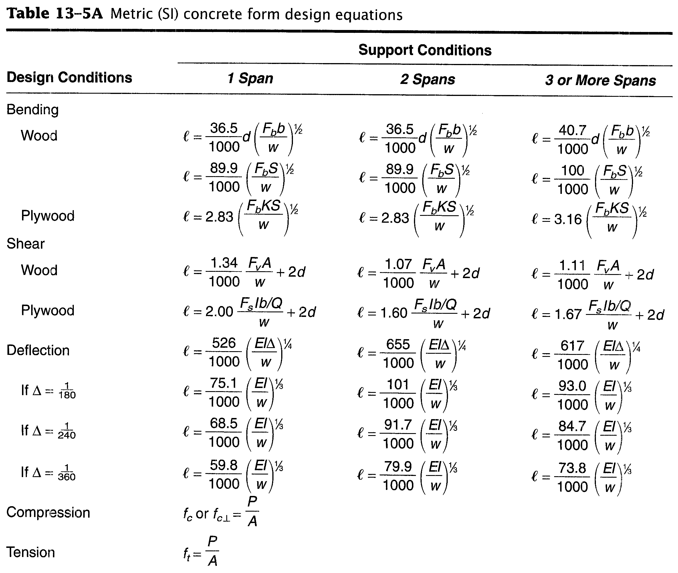

Slide 12
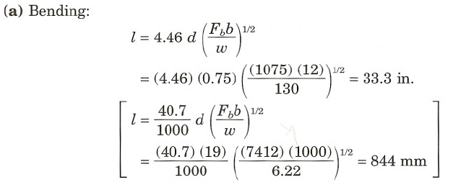
Deck Design

Slide 13
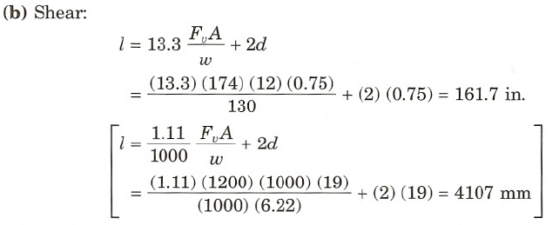
Deck Design

Slide 14
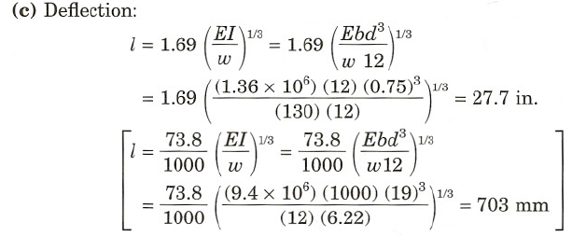
Deck Design

Slide 15
Deflection governs in this case and the maximum allowable span is 27.7 in. (703 mm).
We will select a 24-in. (610-mm) joist spacing as a modular value for the design.

Slide 16
Joist design
Consider the joist as a uniformly loaded beam supporting a strip of design load 24 in. (610 mm) wide (same as joist spacing; see Figure 13-1b).
Joists are 2 x 8 in. (50 x 200 mm) lumber.
Assume that the joists are continuous over three spans.
w =(2 ft) x (1) x (130 lb/sq ft) =260 lb/ft
[ w =(0.610 m) x (1) x (6.22 kPa) = 3.79 kN/m]

Slide 17
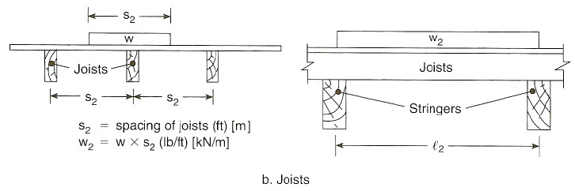
Figure 13-1 Design Analysis for form member

Slide 18
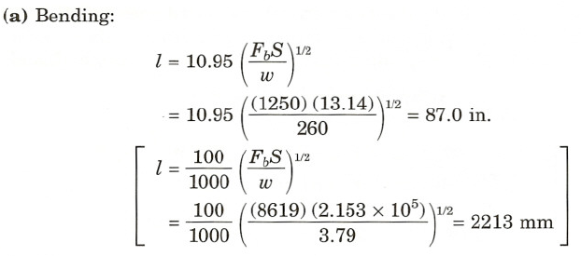
Joist design

Slide 19
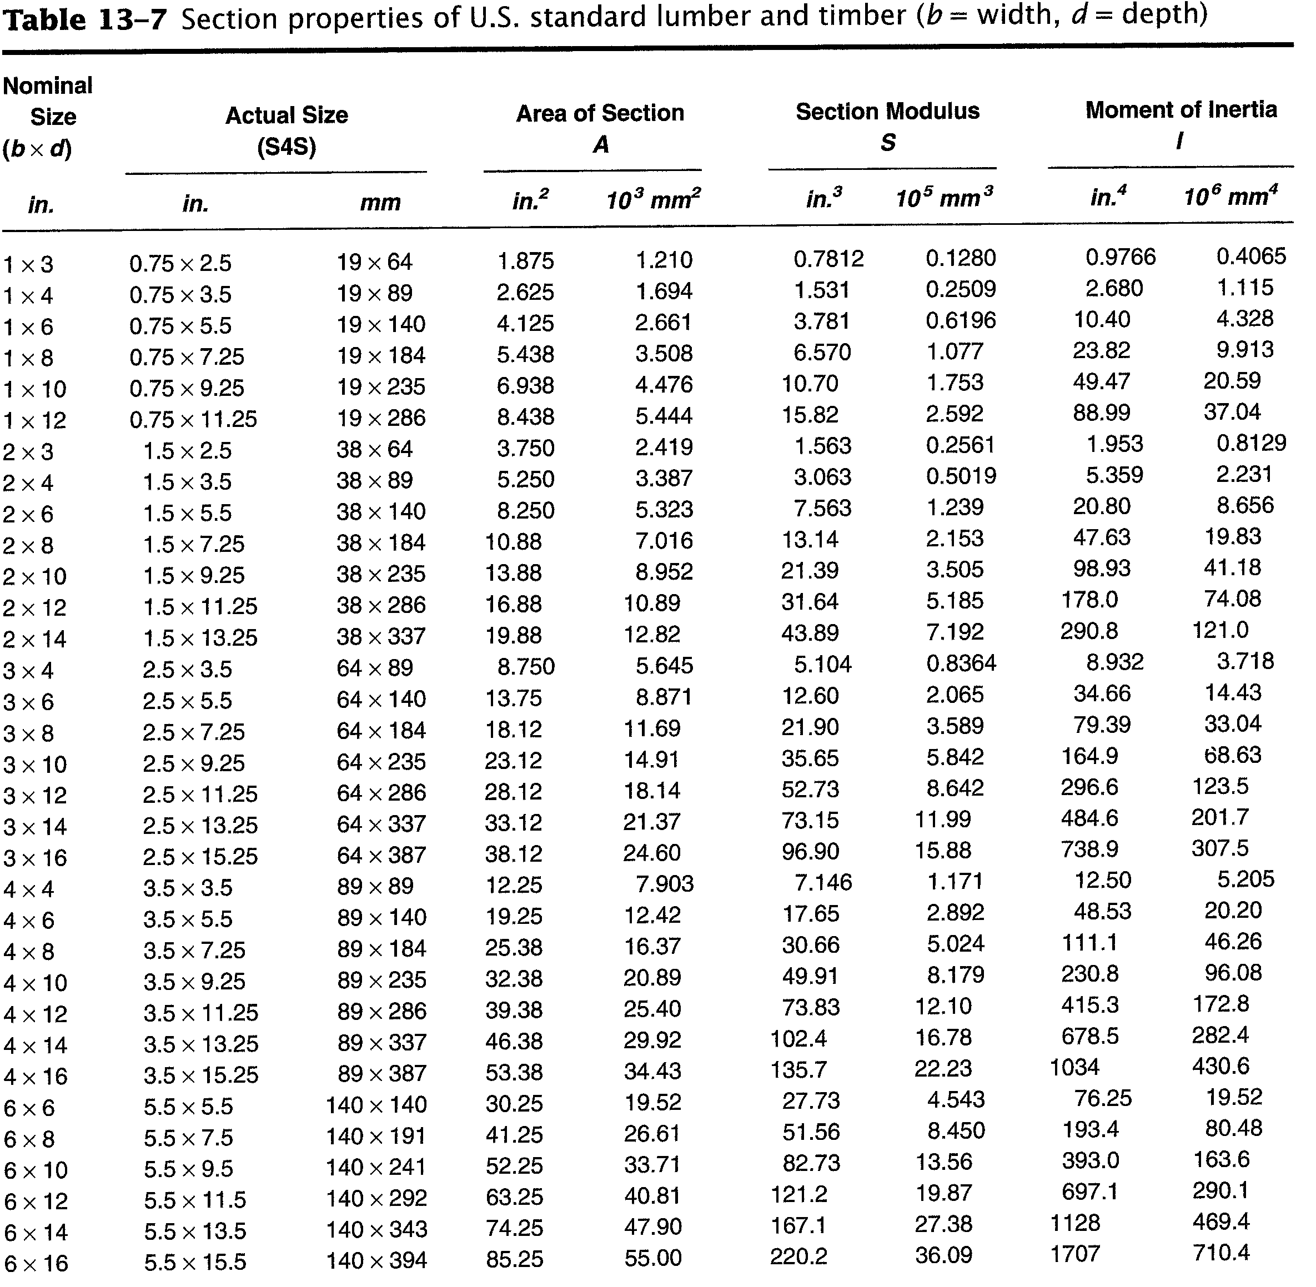

Slide 20
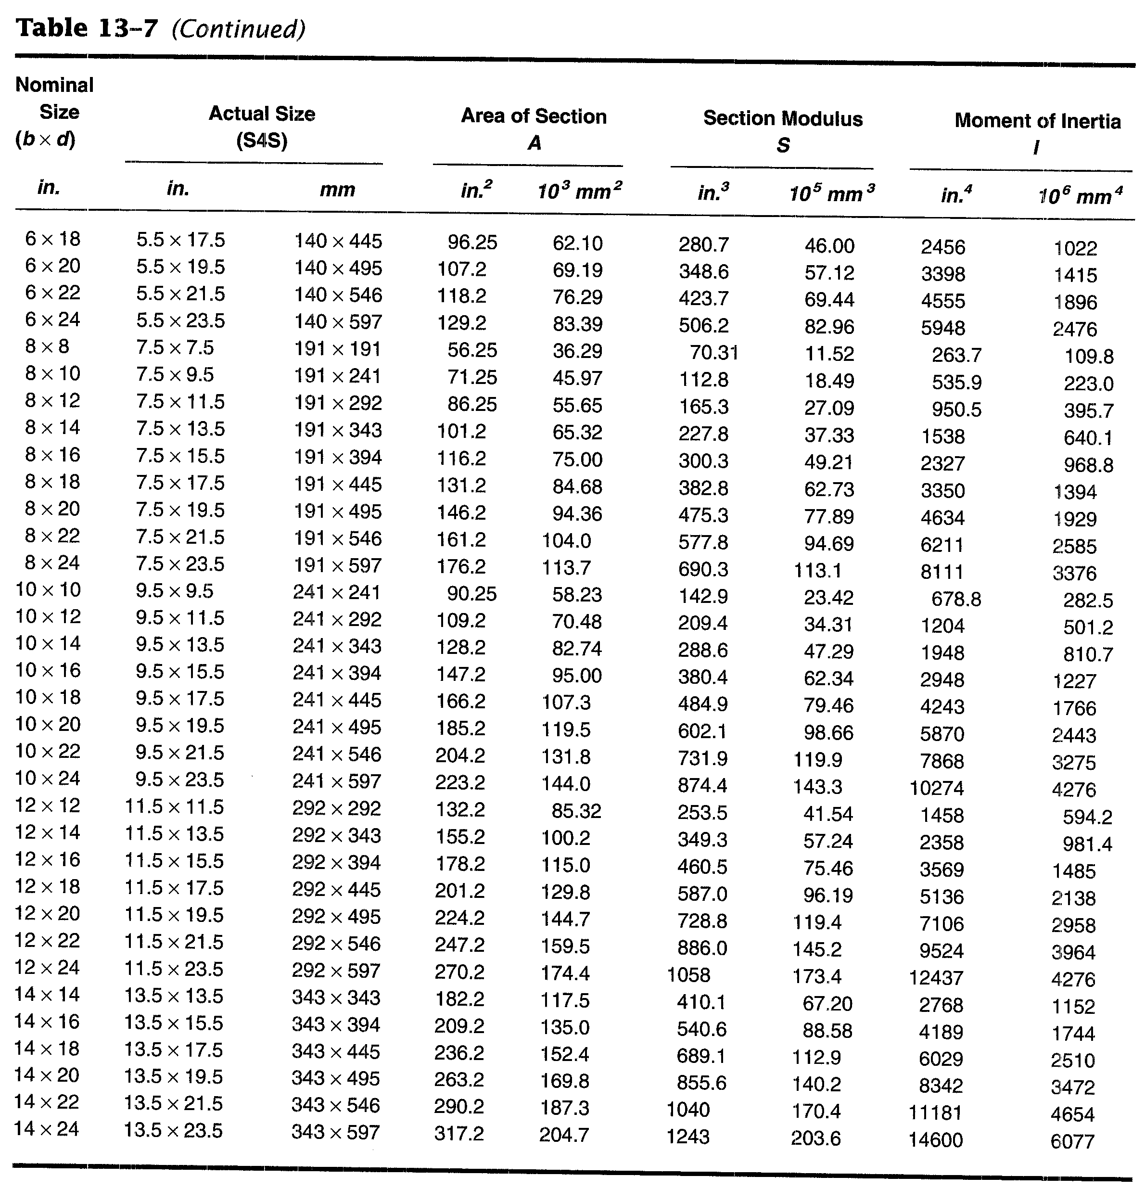

Slide 21
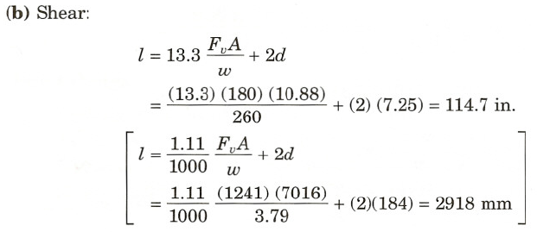
Joist design

Slide 22
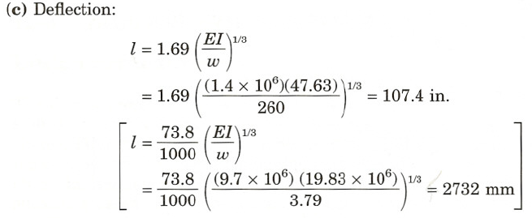
Joist design

Slide 23
Joist design
Thus bending governs and the maximum joist span is 87 in. (2213 mm).
We will select a stringer spacing (joist span) of 84 in. (2134 mm).

Slide 24
Stringer Design
To analyze stringer design, consider a strip of design load 7 ft (2.13 m) wide (equal to stringer spacing) as resting directly on the stringer (Figure 13-1c).
Assume the stringer to be continuous over three spans.
Stringers are 4 x 8 (100 x 200 mm) lumber.
Now analyze the stringer as a beam and determine the maximum allowable span.
w =(7) (130) =910 lb/ft
[w =(2.13) (1) (6.22) = 13.25 kN/m]

Slide 25
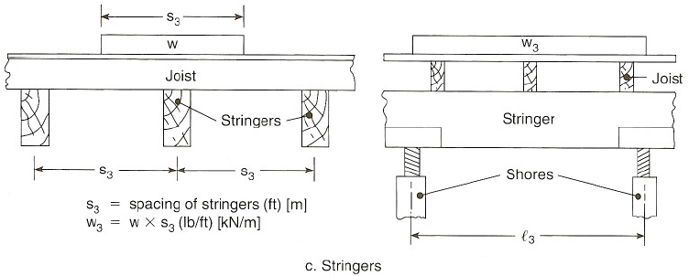
Figure 13-1 Design Analysis for form member

Slide 26
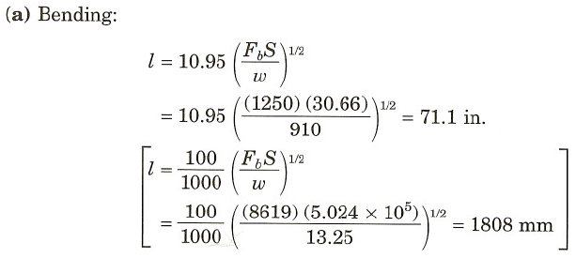
Stringer Design

Slide 27
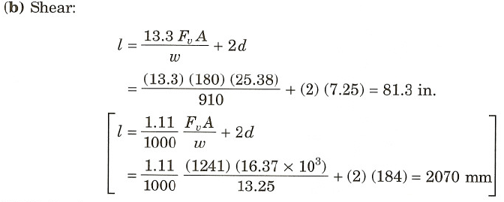
Stringer Design

Slide 28
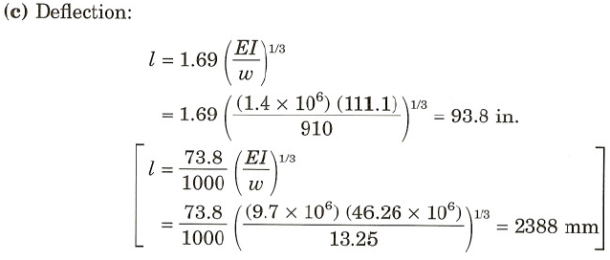
Stringer Design
Bending governs and the maximum span is 71.1 in. (1808 mm).

Slide 29
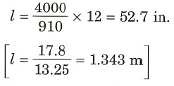
Check Shore Strength
Now we must check shore strength before selecting the stringer span (shore spacing).
The maximum stringer span based on shore strength is equal to the shore strength divided by the load per unit length of stringer.
Thus the maximum stringer span is limited by shore strength to 52.7 in. (1.343 m).
We select a shore spacing of 4 ft (1.22 m) as a modular value.

Slide 30
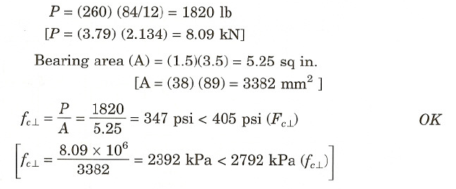
Check for Crushing
Before completing our design, we should check for crushing at the point where each joist rests on a stringer.
The load at this point is the load per unit length of joist multiplied by the joist span.

Slide 31
Final Design
Decking: nominal1-in. (25-mm) lumber
Joists: 2 x 8's (50 x 200-mm) at 24-in. (610-mm) spacing
Stringers: 4 x 8's (100 x 200-mm) at 84-in. (2.13-m) spacing
Shore: 4000-lb (17.8-kN) commercial shores at 48-in. (1.22-m) intervals

