Slide 1
Zoo 424 Experimental embryology Lecture 2

Slide 2
Principle of Experimental Embryology
ZOO 424
Lecture 2 and 3
Cellular and Embryonic Determination, Induction and
Differentiation
التحديد والحث الجنيني
والتمايز الخلوي
Zoo 424 Experimental embryology Lecture 2

Slide 3
الحث الجنيني والتحديد الخوي ثم التمايز الخلوي
Cellular and Embryonic Induction,
Determination and Differentiation
Living organism arise from embryos, which consists of a fertilized ova, which is considered the first cell of the organism. This cell is divided into several mitotic divisions to produce the Blastula then form gastrula, which begins with the cellular differentiation and given the three embryonic layers (Ectoderm, mesoderm, endoderm). How these cells that they emergence from a single cell that are different from each other even though they contain the same chromosomes and genes?
The answer is that this difference occurs through the process of induction and determination then cellular differentiation during embryonic development process.

Slide 4
What is meaning of the process of embryonic development?
Embryonic stage consists of two main phases, namely:
1- Growthالنمو
2- Cellular Differentiationالتمايز الخلوي
1- Growth
Is the increase in the number and size of cells and body weight of the embryo, this occurs by cell proliferation through cellular divisions or increase of the cell size by increase of the cytoplasm of cells (as ovum and nerve cells), or what is known as interstitial growth (increase of the material between cells as in connective tissue.

Slide 5
التكوين
Development
Cell Differentiationالتمايز الخلوي
Growthالنمو
النمو بالمضاعفة الخلوية
خلايا متجددة
خلايا الدم خلايا الجلد
خلايا مستمرة التكوين
--------------------------
ا ا ا
خلايا الكبد خلايا الغدد خلايا العضلات
خلايا مستقرة التكوين
الخلايا العصبية
نمو الخلايا المفردة
البويضات
النمو الخلالي
الزيادة في المادة بين خلوية
الأنسجة الضامه كالغضاريف)

Slide 6
2- Cellular Differentiation التمايز الخلوي
-Cellular differentiation occurs by the embryonic determination التحديدand inductionالتحفيز . Differentiation is the process of asymmetric embryonic cell transformation in early of growth so that these embryonic cells different from each other in terms of form and function, these cells become differentiated with a particular specific form and function.
The ability of cells to differentiate at the beginning of early embryonic development is equal, where this cells can be differentiate into any type and then lose their ability in the progress of embryo age.

Slide 7
2- cont. Cellular Differentiation تكملة تعريف التمايز الخلوي
If cells differentiated they lose their ability to differentiate again, that is, they are not able to give any type of cells or tissues else type that differentiated to and can not be changed.
If the amount of certain cells that differentiate into neurons cells, for example, they keeps as nervous cells and can not be turned into other cells.

Slide 8
Cellular Determination التحديد الخلوي
It is an internal process precedes the process of cellular differentiation or change in morphology, through it determined the characteristics and features internally before they appear on the differentiated cells (change, transformation and activation of specific genes in these cells which will differentiate in order to pave about change apparent shape later to give specific tissue or system).
So if you determine the fate of specific cells to differentiate into specific tissue it can not be changed, such as eggs which boiled by water can not be back to its original state.

Slide 9
Cellular Determination Experiments تجارب التحديد الخوي
When make exchange for transfer and culture of the neural tube area place with the skin area and vice versaوبالعكس between two different embryos and that by transfer some parts from outer ectoderm area or layer ( neural tube area in the future) to early gastrula frog pigmented (Dark) embryo, and cultured on other not stained embryo of the same age, but place the skin area and taking the skin area and culture it on the same first embryo place the neural tube area.

Slide 10
Schematic drawing illustrates the process of cellular determination process of embryos
نسيج متوقع للأدمة
نسيج متوقع للأنبوبة العصبية
جنين النيوت فى مرحلة المبطنة المبكرة
أ) نقل الأنسجة وزراعة قبل حدوث عملية التحديد :
عند نقل أجزاء من نسيج منطقة الأنبوبة العصبية فى مرحلة المبطنة أو الجاسترولا المبكرة لجنين النيوت داكن اللون وزراعتها على جنين آخر فاتح اللون مكان نسيج منطقة الأدمة فإن نسيج الأنبوبة العصبية نما كجزء من منطقة الجلد (الداكن) ولم يكون نسيج عصبي.

Slide 11
cont. Cellular Determination experiment تكملة تجارب التحديد الخلوي
Each part moved grew as the place which transfer to and did not grow according to what is destined to, that is, the tissue destined that is neural tube grew as part from skin area and the skin grew as part of the neural tube in the embryo who was transferred to it (Figure 4).
But, when transfer these parts between tow late gastrula, each part grew as it is estimated, that is, neural tube tissue give neural tube on the embryo which transferred to and the skin give skin on the embryo transferred to.

Slide 12
cont. Cellular Determination تكملة التحديد الخلوي
This indicates that, determination process of the transferred tissue before transfer did not occur in the early gastrula and thus grew as according to the region which transferred to.
But when it transfer from late gastrula stage, the tissue cells transferred have been determine its fate ,and thus grew according to what is destined to not according to the place which transferred to.

Slide 13
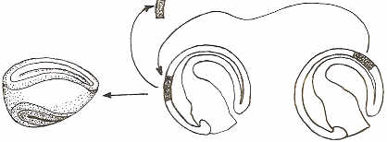
جنين فى طور الأنبوبة العصبية
الصفيحة العصبية الثانوية
جنين النيوت فى مرحلة المبطنة المتأخرة
ب) نقل الأنسجة وزراعتها بعد حدوث عملية التحديد:
عند نقل نسيج الأنبوبة العصبية من جنين النيوت (الداكن) فى مرحلة المبطنة او الجاسترولا المتأخرة (وبعد حدوث عملية التحديد) وزراعتها فإن النسيج المنقول نما وأعطى أنبوبة عصبية ثانوية أخرى على الجنين المنقول إليه وذلك لأنه عند نقله كان النسيج قد تحدد مصيره على المستوى الجزيئى.
والسؤال الذي يطرح نفسه الأن من المسئول عن عملية التحديد؟

Slide 14
Embryonic Inductionالتحفيز الجنيني
Cellular or embryonic induction is determines the fate of cells to give a differentiated tissue or organ. Cellular or embryonic induction: is the ability of certain cells in the embryo to identify and convert other cells. If the process of cellular differentiation required the determination process, the determination is doing through the induction of embryo cells.
Embryo induction is that determines the fate of the cells to differentiate and give us the tissues and organs and different organs. Then, If the inducing tissue issued a catalyst message leading to cellular differentiation at the molecular level in the responding tissue which leads to cellular or embryonic differentiation on the latter.

Slide 15
As it is known, the chromosomes and genes that carry in all the cells of the embryo are the same that came from a fertilized egg, but the stimulation of fetal works to activate the genes for the formation of muscle cells in form and function, for example, while the remaining genes which not related to muscle tissue as genes of hearing or eyes remain inactive, and vice versa.وبالعكس
The question that comes to mind now is how is the process of induction of the cell or embryonic cells?
But to understand it has to be knowledge and clarify the role of some cellular components and factors that control the process of cellular differentiation.

Slide 16
Factors control the process of cellular or embryonic differentiation
1- The role of the nucleus in the cellular differentiation process
2- The role of the cytoplasm in the cellular differentiation process
3- The role of the hormones in the cellular differentiation process
4- The role of the environment in the cellular differentiation process
4-1- Internal Environment
4-2- External Environment

Slide 17
1- The role of the nucleus in the cellular differentiation process
* As it is well known that the nucleus is the control center in the cell and that the experiments proceeded to remove the nuclei from embryonic cells, or even delay the arrival of the nucleus to the cytoplasm lead to not differentiation properly.
* Where work has been held by a thread on the fertilized egg so that one part contains the nucleus and other part contains the cytoplasm only and leave to period for developing, the part that contains the nucleus grows, while the other part not grows and if node opened to allow with transfer some of the nuclei to the other part (without nucleus) so it is grow .

Slide 18
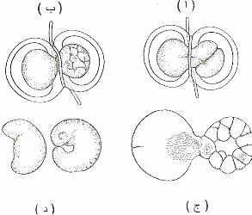
رسم توضيحى يوضح دور النواة فى عملية التمايز الخلوى للأجنة
1- The role of the nucleus in the cellular differentiation process
1- A thread on the fertilized ova, so that one part contains the nucleus and other part contains the cytoplasm only and leave to period for developing, the part that contains the nucleus grows, while the other part not grows
and if node opened to allow with transfer some of the nuclei to the other part (without nucleus) so it is grow.

Slide 19
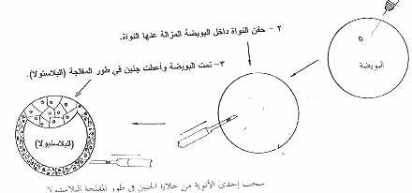
2-The removal or destructing the nucleus of a fertilized ova (by ultraviolet light or needle acupuncture) leads to the un-differentiation and when transferring the nucleus from embryo cells in the blastocyst stage, they give the entire embryo .
رسم توضيحى يوضح دور النواة فى عملية التمايز الخلوى للأجنة
2- تتجربة نقل النواة من إحدى الفلجات لجنين الضفدعة وحقنها داخل بويضة غير مخصبة بعد إزالة نواتها تكون جنبن
1- The role of the nucleus in the cellular differentiation process

Slide 20
Explanation
All nuclei of organism cells contain the same number of chromosomes, both in the embryonic stage or adult, and that these chromosomes are carry the genes, as these genes can be Coding, this mean that, produce genetic code through the formation of nucleic acids (mRNA), these nucleic acids in cellular differentiation stage are carry genetic code for specific differentiation or DNA with a special type for tissue that will be differentiated.

Slide 21
That this gene in these cells is will be activated, while other genes are not activated. For example, muscle cells encode for a protein myosin (a protein muscle contraction), while the nerve cells carrying this gene, but not be an active gene, so these genes are specific with active tissue specific differentiation genes.
Also found that during the process of cellular differentiation, there is a differentiation of nucleic acids. These difference of messages of ribonucleotides nucleic acids (mRNA) of the tissue to other tissue is a pointer to the role of the genetic material (DNA) and is the role played by the nucleus in the process of cellular and embryonic differentiation.

Slide 22
2- The role of the cytoplasm in the cellular differentiation
It is known that the ova be of large size in terms of the amount of cytoplasm and that are stored materials and components within the cytoplasm are necessary to the process of cellular differentiation and gene later. If that is the nucleus produce the orders and control in cell activities, the cell cytoplasm is the one who the implementation of instructions produced from the nucleus.

Slide 23
Cont. 2- The role of the cytoplasm in the cellular differentiation
That the tests conducted to demonstrate the role of cytoplasm in the process of cellular differentiation or early embryogenesis of many, including: -
1 - When exposing fertilized ova, or even before fertilization, to the centrifuge process, these ova do not grow properly due to the change of the components of the cytoplasm and destroide the internal structure (Fig. 7).

Slide 24
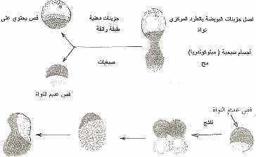

Slide 25
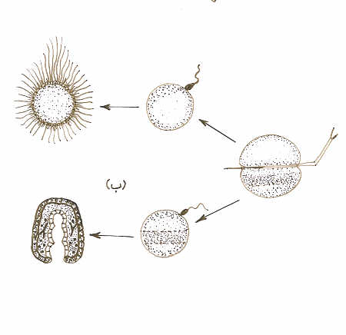
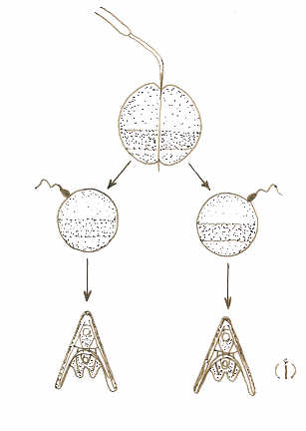
2 - When the sea urchin egg split and separate the animal pole part away from the vegetative pole, each part is not growing properly (Fig. 7).
عندما قسمت بويضة قنفذ البحر إلى نصفين من القطب الحيواني إلى القطب الخضري وإخصاب كل جزء على حده فإن كل جزء ينمو ويكون جنيناً كاملاً.
ب- لكن عندما تكون القسمة بين القطب الحيواني والقطب الخضري فإن كل جزء عند إخصابه لا ينمو بشكل سليم.
رسم توضيحى يوضح دور السيتوبلازم فى عملية التمايز الخلوى لبويضات قنفد البحر
من الواضح انه يوجد بعض المكونات الجزيئية فى سيتوبلازم القطب الخضرى ضرورية لنمو القطب الحيوانى

Slide 26
2- The role of the cytoplasm in the cellular differentiation
Also, when culture of each of the three parts of blastocyst sea urchin (animal pole / vegetative pole / and small cells bottom vegetative pole), each part separate does not give the proper growth of embryos and the culture of animal pole with small vegetative cells gives a healthy embryo, while the culture of vegetative pole cells with small vegetative cells does not give the proper growth (Fig. 8).

Slide 27
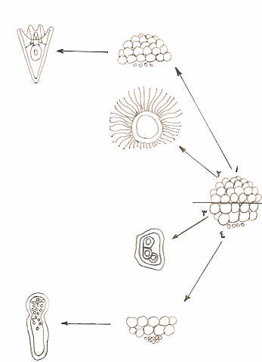
رسم تخطيطى يوضح دور السيتوبلازم فى عملية التمايز الخلوى للأجنة
1- تنمية فلجات منطقة القطب الحيوانى مع الفلجات الصغيرة لمنطقة القطب الخضرى تعطى طوراً يرقياً سليماً.
2- تنمية فلجات منطقة القطب الحيوانى لوحدها تعطى طور يرقة مهدبة فقط (نمو غير مكتمل)
3- تنمية فلجات منطقة القطب الخضرى لوحدها تعطى طور يرقة غير سليمة النمو
4- تنمية فلجات القطب الخضرى الصغيرة والكبيرة معا فقط تعطى يرقة غير سليمة النمو

Slide 28
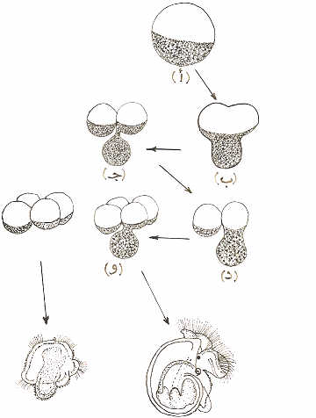
The removal of vegetative lobe of the four-cell stage of Asidia larva the remaining part is given abnormal larva
Also the same experiment has been conducted on the frog embryo, the culture of every part of the blastocyst embryo frog stage (animal pole / center area / vegetative pole) any part did not grow properly, while the development of animal pole with vegetative pole gives proper growth.
نمو يرقة غير سليمة عند ازالة الفص الخضرى
يرقة سليمة

Slide 29
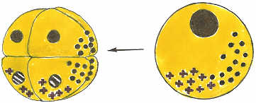
To know the importance of the vegetation pole in differentiation, the animal pole cells has been cultured with the dorsal or the ventral of the vegetation pole, the first has been developed properly while the other which contain the ventral vegetation pole has not been developed properly to the larval stage proper embryo frog (Fig. 10).
This indicates that certain parts has been stored in the cytoplasm of oocytes and then
distributed unequally during
cleavage between cells and are
necessary for the process of early embryonic differentiation (Fig. 11).

Slide 30
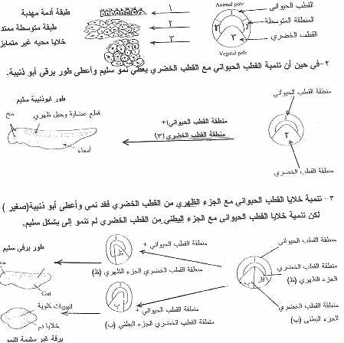

Slide 31
* إذاً فإذا كان للنواة دور في التحكم وإرسال الشفرة الوراثية فإن السيتوبلازم هو الذي يقوم بالتنفيذ وترجمة هذه الشفرة لكي تتم عملية التغير والتمايز الخلوي؛ فإن لم يكن الستوبلازم مهيأ فإن الشفرة الوراثية لا يمكن ترجمتها بواسطة الستوبلازم وبالتالي عدم التمايز بشكل سليم .
* أيضاً العلاقة بين النواة والسيتوبلازم متلازمة لعملية التمايز الخلوي والجنيني.

Slide 32
3- The role of the hormones
in the cellular differentiation process.
If the nucleus controls in all activities of the cell and that the cytoplasm is the loophole medium for these instructions or orders, the hormones affect the physiological performance of these organs formed. If the required hormone not secretion for organ differentiation in its specific time of differentiation, it occurs defect in the formation of this organ.
The study of the role of hormones in the process of cellular differentiation and embryonic came from the following observations:

Slide 33
1- Some of embryos that were born and some defects in the minors dwarf bones as a result of the lack of growth hormone or not responding to it during bone formation and therefore become short, and the increase of growth hormone it is leads to gigantism.
2- As in the case of twins of different sex in the cows or known as conflict of sex (Freemartin) where the material moves from the male twins to its twin female, these materials are working to defect in the growth of reproductive organs of female twins (undeveloped uterus and oviduct).

Slide 34
Fig the role of cytoplasm in differentiation
Dwarf bones as a result of the lack of growth hormone or not responding
The increase of growth hormone GH it is leads to gigantism.
Freemartin
In cow
When the hormone moves from the male twins to its twin female
Cuse the loss of the uterus and oviduct.

Slide 35
3- Experiments conducted on embryos as removing the pituitary gland or thyroid or exposing embryos during early stages of their development to steroid hormones as female estrogen or male testosterone.
When removal of the thyroid gland or injection of anti-hormone for thyroxin in tadpoles larvae, the parties do not grow and caudal fine do not disappear, and still swim and do not turns into amphibious stage. When thyroxine hormone injected in the early stage of larval, it's speed of the larva transformation process (metamorphosis)

Slide 36
4- As well as the removal of the pituitary gland from the early embryonic stages of chicken embryos leads to dwarf of embryos and growth abnormalities.
5- When eradication of the testis from the male chicken embryo, lead to the absence of the customariness, and injecting with testosterone lead to grow again.
6- The addition of testosterone in ponds breeding tilapia larvae turning it into a male.

Slide 37
4- The role of the environment in the cellular differentiation process
Environment plays an important role in the process of cellular and embryonic differentiation. They represent the medium in which the fetus is supplied by food and protection from environmental factors, internal or external. Environmental factors are divided into: -
1- Internal environmental factors
The internal environmental factors in the following: -
1- Environment of embryo itself as genetic, genes and the imbalance that occurs as a result of mutation

Slide 38
2- Mother environment and transmitted factors by mother are stored inside the egg
3- Pregnancy environment and food and protection provided by the mother for embryo.
2- External environmental factors
Such as heat, humidity, light, air and change the pH , radiation and pollutants of various kinds of chemical, medical, viruses and diseases and lack of or an increase of the important elements in the fetal environment; all these factors affect the growth and cellular differentiation of embryos.

Slide 39
1- Effect of temperature
The effect of temperature on growth and cellular differentiation in the following examples: -
a) When the development of embryo frog in two different grenades degrees by placing cotton on the part of the fetus during the phase of cleavage and to provide heat or cold, drip by a solution of the environment temperature is different from the other half to increase or decrease 5 ° C, this leads to abnormal growth of tube nerve, as in (Fig. 13).

Slide 40
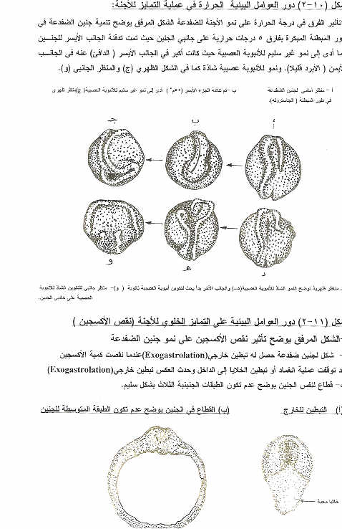

Slide 41
b) When incubated chicken eggs at a temperature of less than 35 or more than 40 ^{O}C, the growth of embryos is stops or may be long for eggs to hatch at a lower temperature or shorter at the high rate if they are within the appropriate temperature for the growth of embryos inside the eggs.
c) In a study conducted by researcher Ferguson and Joanen in 1982 on the eggs of crocodiles (from the Almicspe river) found that the eggs are incubated at a temperature of 32 ° C (both in the natural environment or in the lab), the most of it give females (87%) in the while that is being incubated at a temperature of 34 ° C most gives male.

Slide 42
d) Also found that the butterflies of European-type (Anaschnia levana), which consists of larvae grown in the spring, the color dark while the same type of these butterflies, which grows during the summer, the color will be light and that the effect of temperature on the larvae during early development.
2- Effect of oxygen (air)
The impact of oxygen on growth and cellular differentiation is appear from the following experiment: -
Decrease or increase in oxygen during the gastrula stage of frog embryo leads to outside lining formation process and not formation of the three embryonic layers properly (Fig. 14).

Slide 43
3- Effect of adding vitamins to the environment of agriculture
The effect of adding vitamins on the growth and cellular differentiation is clear from the following experiment: -
When vitamin A is add to the environment of cultivation of epithelial cells, leads to differentiation of cilia formation and the absence leads to the loss of these cilia.

Slide 44
الحث الجنيني والمنظمات الجنينية
Embryonic Induction and Organizers
What is the embryonic induction?
1- Oppenheimer in 1984 known the embryonic induction that is the interaction between the so-called inducing tissue and other called responding tissue
2- Walbot and Holder in 1987 known the Embryonic induction that is an overlap between two or more groups of embryonic cells, which change or determine the fate of the growth of at least one of the cells, cells that change of shape is called responding cells or tissue.

Slide 45
Then, the embryonic induction is the primary mechanism for the succession of cellular differentiation to form organs in the embryo; it is responsible for cell determination process during early embryonic development.
For example, Optic vesicle urges the ectoderm cells opposite it would become or form a lens of the eye, so lens of the eye do not be formed before the formation of optic vesicle, as well as if there was objection or the absence of the gene responsible for formation lens of the eye in this time period of embryo life, the lens of the eye does not consist and continued growth of the embryo but without the eye lens and can not be stimulated later.

Slide 46
فالحث الجنيني يحدث أثناء مرحلة زمنية معينة وحساسة من مراحل النمو والنسيج المتأثر بهذا الحث يجب أن يكون مؤهل للإستجابة لهذا الحث في تلك الفترة الزمنية حتى يتم التأثر بهذا الحث. لكن كيف يحدث هذا الحث الجنيني؟ انه يحدث من خلال المنظمات الجنينية. Embryonic organizer

Slide 47
What is the Embryonic Organizer?
Embryonic organizer is the ability of a specific tissue or stimulate the transfer of tissue or other tissues in order to differentiate and give the organs during the early stages of embryonic development.
Embryonic organizer In amphibian:
found that the dorsal lip of the Blatstula pore. In birds and mammals found that the Hensen node. are the embryonic organizers in these embryos as it works to stimulate the neural tube formation differentiation, through the experiments of transport and cultivation of parts of the embryos to other embryos.

Slide 48
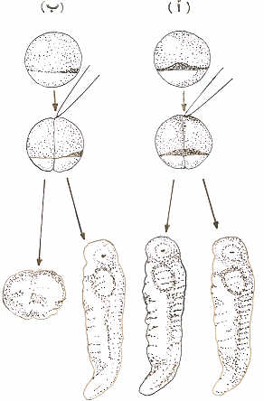
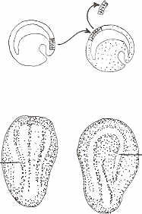
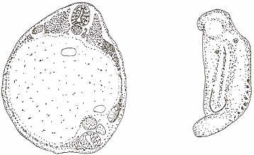
Embryonic Organizers in amphibian embryos
Through experiments conducted by Hans Spemann on the early embryos amphibians and during separation of a fertilized egg to two parts; one part contains the area of ​​ gray crescent and the other does not contain it, therefore the first grow and form a full embryo configuration, while the other does not grow (Fig. 15) . Also, the transport and cultivation of parts of the gray crescent of the frog embryo to another embryo lead to stimulation of neural tube formation on the recipient embryo.

Slide 49
لقد سمى سبيمان الشفة الظهرية لمبطنة جنين النيوت والضفدعة والسهيم بالمنظم الجنيني (Embryonic Organizer) فعرفت الشفة الظهرية بالمنظم الإبتدائي (Primary Organizer) الذي يعمل على تكوين الأنبوبة العصبية حيث تعتبر هي التحفيز الجنيني الإبتدائي (Primary Embryonic Induction)
فالمنظم الجنيني هنا وهو الشفة الظهرية لم يعمل على تحفيز وتكوين الأنبوبة العصبية فقط بل حتى عملية التوجه لمحور الجنين الأمامي الخلفي أي أن يكون المخ الأمامي في المقدمة ثم المخ المتوسط ثم المخ الخلفي ثم الحبل الشوكي في الخلف.

Slide 50
Stage dependence of induction : To know the competence of embryonic organizer depending on the chronological age or by stages of embryo development and its ability or the so-called property phase induction (Stage dependence of induction) on the induction and formation of different organs, Holtfreter (1936) put the dorsal lip to early gastrula under (undifferentiated) outer layer (ectoderm), it has worked to stimulate the composition of the front part of the head and when change the location of dorsal lip to late gastrula has worked to stimulate the composition of the back part of the neural tube (Fig. 17).

Slide 51
To find out the so-called property of regional induction (Regional specificity of induction) when transplants the front part only of a spinal cord cells in stage of neural tube and transfer to the embryo in the stage of early gastrula, they lead to form of the head as secondary embryo on the recipient embryo, while the transfer and cultivation of cells of the back part (spinal cord tissue) to the embryo in the early lining and under the outer layer of gastrula, it will form the tail or the back of the trunk and caudal fin as secondary embryo on the recipient embryo (Fig. 18).

Slide 52
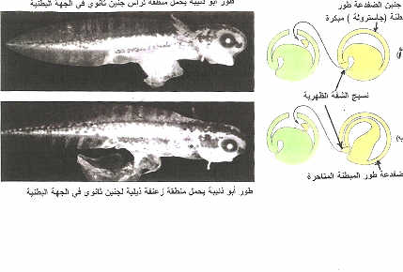
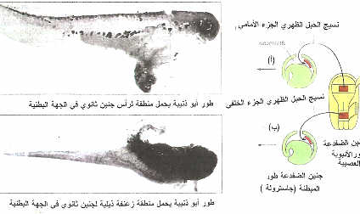
يوضح الخاصية المرحلية( Stage dependence) في عملية التحفيز الجنيني
الخاصية المكانية للتحفيز((Regional specificity of induction

Slide 53
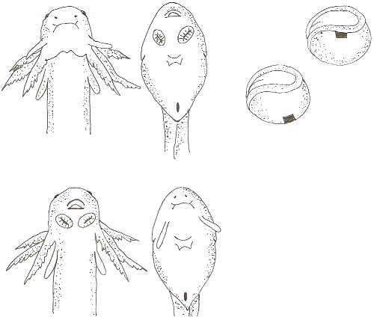
شكل يوضح بأن عملية التحفيز غير مرتبطة بالجنس: Intnra species induction
تجربة أجرها العالم سبيمان ومساعدة أوسكار حيث قاما بنقل وزراعة أجزاء من النسيج الميزنشيمي(والذي سوف يحفز لتكوين الممص الفمي ) لمنطقة الطبقة المتوسطة أو الميزوديرم من طور المبطنة الجاسترولة لجنين الضفدعة وزراعتها مكان منطقة الزوائد الفميه لمبطنة أو جاسترولة العلجوم (لنيوتNewt ) والعكس نقل أجزاء من النسيج الميزنشمي (والذي سوف يحفز لتكوين الزوائد الفمية ) لمنطقة القطعة المتوسطة أو الميزوديرم لمبطنة أو الجاسترولة العلجوم وزراعتها على مبطنة أو جاسترولة الضفدعة ، فالنتيجة كان أن تكون ممص فمي(من النسيج الطلائي ) للعلجوم أو النيوت وزائد فمية للنيوت على جنين الضفدعة .
من هذا يتضح أن النسيج الطلائي للنيوت استجاب للمحفز الصادر من النسيج المزنشيمي لجنين الضفدعة فتحول إلى ممص فمي والعكس تم تحفيز تكوين الزائد الفمية على جنين الضفدعة بواسطة النسيج الميزنشيمي المحفز للنيوت.
يرقة التيوت
يرقة الضقدعة

Slide 54
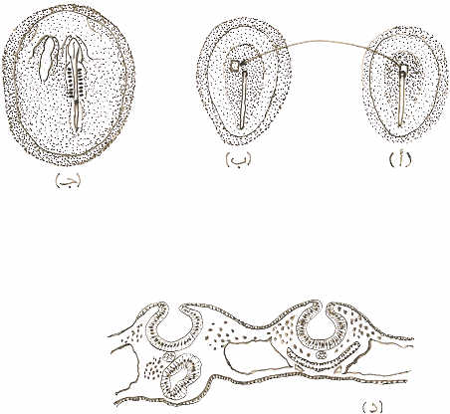
Embryonic organizers in the avian embryos
Waddington (1933) discovered embryonic organizers in birds embryos, namely Hensen node, it is working on the composition another embryo (neural tube and embryo trunk) when the transfer of Hensen node of chicken embryo in the lining stage or early gastrula and cultivated on the embryonic disk of embryo duck in the same age, these lead to formation of secondary embryo on the recipient embryo (Fig. 21).

Slide 55
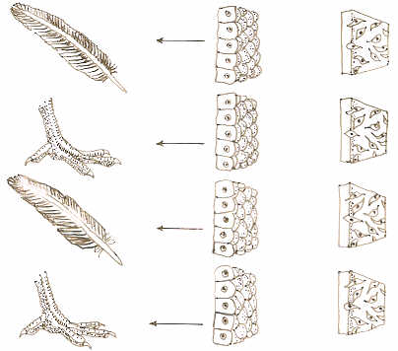
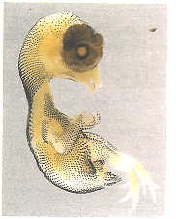
In an experiment conducted on the transfer and cultivation of parts of birds embryos (chicken) to study the relationship between inducing tissue and responding tissue.
Mesoderm of wing has been transferred and cultivated instead of Mesoderm of leg and under the outer layer (ectoderm) in the early chicken embryo and vice verse. The result that is leg formed instead of wing and wing formed instead of leg. (Fig. 22).

Slide 56
ومن هذه التجربة نستنتج انه على الرغم من أن الطبقة المتوسطة وهي في المرحلة الجنينية المبكرة تكاد تكون واحدة إلا أنها أعطت تحفيز مختلف فالأمامية تعطي ريش وجناح والخلفية تعطي حراشف و أرجل.أو بما يعرف الخاصية المكانية أو الموقعية للمحفز Regional Specificity of Induction)).

Slide 57
Embryonic organizers in mammals
Due to the nature of the growth of the mammalian embryo experiments conducted mostly on the stage of cleavage or in the form of cell transplantation tissue. When the destruction of one cell of an embryo mouse, in tow cell stage, the other cell grow and give the full embryo, as well as when the separation tow cell phase or four cells of an embryo sheep and their development to the blastula stage then transferred to the recipient mother physiological ready to receive the embryos, all each cell give full embryo (Fig. 23).

Slide 58
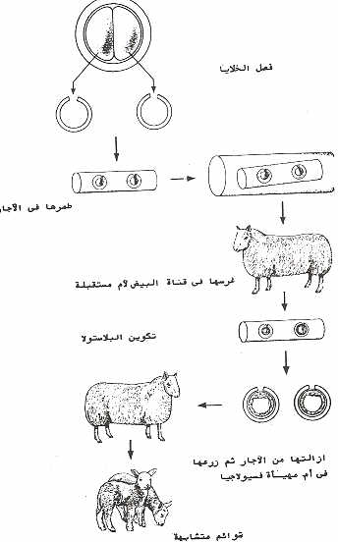
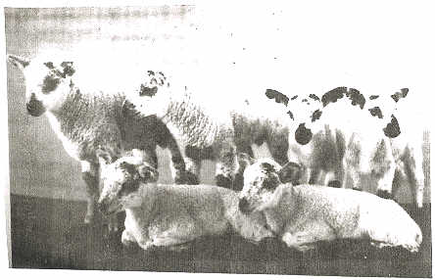

Slide 59
Interpretation of the organizers work and embryonic induction
تفسير عمل المنظمات الجنينية أولا : الاتصال الخلوي Cellular Contact
Several experiments have been carried out to see how the effect process occurs between the inducing tissue and responding tissue? and the first experiments were that explain did the direct cell contact between the inducing and responding tissue is important for the process of embryonic induction and then happened cellular differentiation of responding tissue?.
* As well as the presence of cells of the dorsal cord under the outer layer cells or ectroderm is necessary to form the neural tube.

Slide 60
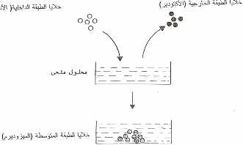
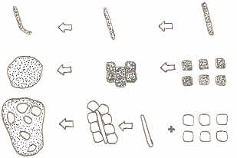

Slide 61
* As is well known that the existence of the relationship and the closeness between animal pole cells (the outer layer or ectoderm) and the vegetative pole cells (the inner layer or endoderm) is needed to form cells of the middle layer (Mezoderm)
* As is indicated by culture experiments of cells and tissues that the cultivation of the dorsal cord cells or cells of the somites, each alone, this does not lead to the formation of cartilage tissue, but when cultivated with some, this leads to the formation of cartilage tissue (Fig. 24).

Slide 62
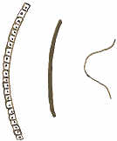
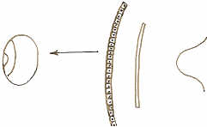
To find out whether cellular connectivity directly between the inducing and responding tissue is necessary for the process of differentiation, impermeable thin membrane made ​​of cellophane has been put between the optic cup (inducing tissue) and the outer layer (Ectoderm) opposite to it (responding tissue) to know did the optic cup induction the formation lens of the eye from the outer layer (or ectoderm)? It is found that the lens of the eye is not made up (Fig. 25).
Ectoderm
Impermeabl
layere
permeable
lens
optic cup
optic cup

Slide 63
* In another experiment, use permeable membrane which is a segment of the agar as it allows the passage of molecules and it put between the cup visual and the outer layer opposite to it ​​(Ectoderm), the result was that formed the eye lens (Fig. 25).
* In another experiment, put impermeable membrane between the dorsal lip and the outer layer (Ectoderm), the nervous tissue is not composed from the outer layer and in the case of using permeable membrane between them, the nervous tissue was formed (Fig. 26).

Slide 64
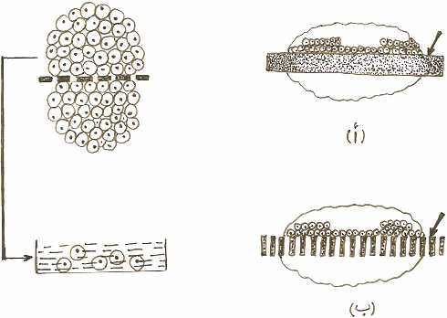
إداً إن تجارب الغشاء غير المنفذ تفيد بأن الاتصال الخلوي بين النسيج الحاث والنسيج المستجيب ضروري لحدوث عملية التحفيز. كذلك في تجارب الغشاء المنفذ وعند فحص الأغشية المنفذة بالمجهر الإلكتروني وجد أن هذه الأغشية بها خملات دقيقة (Microvillies) مما أدى إلى أن العلماء مبدئيا او خطأ استنتجوا أن الاتصال الخلوي المباشر بين النسيج الحاث والنسيج المستجيب ضروري لحدوث عملية التحفيز الجنيني
.لكن .........

Slide 65
لكن أظهرت تجارب التأثير الكيميائى التالية أن الإتصال المباشر بين النسيج الحاث والنسيج المستجيب غير ضرورى لحدوث عملية التحفيز
ثانيا :التأثير الكيميائي Chemical Actions
The recent experiments indicate that direct cell contact between the inducing and responding tissue is not necessary for the process of embryonic induction, but induction process depends on the movement of molecules from the inducing tissue to responding tissue through the following experiments: -

Slide 66
1- The same previous experiments for cellular connect were done again but used membranes with fine holes not allow the composition of microvilli through it self and placed between the inducing and responding tissue, then took the responding tissue (tissue outer layer ectoderm) and implant alone in a development medium, it is changed into nerve tissue which took place the process of differentiation; also the membrane was examined by electron microscope, did not note the presence of microvilli in the holes.

Slide 67
2- When the vegetative pole cells or the inner layer (Endoderm) were cultivated in the development medium and then lifted up and put the animal pole cells or the outer layer (Ectoderm) in the same medium they turn into the cells of the middle layer (mesoderm) (Fig. 27).
3- The previous same idea of experiment was returned but the dorsal lip was growing in medium and then removed from medium and place the outer layer tissue (ectoderm) in the same medium, it turned into nervous tissue.

Slide 68
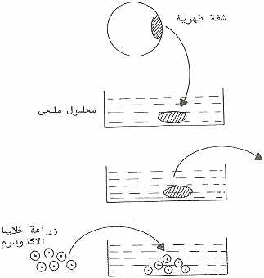
ولتفسير ذلك من التجارب السابقة أتضح أن البيئة قد إحتوت على مواد أو جزيئات أفرزت من النسيج الحاث (الشفة الظهرية) وعند تنمية النسيج المستجيب في نفس البيئة وبعد إزالة النسيج الحاث عملت هذه المواد أو الجزيئات على تحفيز النسيج المستجيب (الطبقة الخارجية أو الأكتوديرم) وتحويله إلى نسيج عصبي، وعند زراعة أي نسيج آخر غير الشفة الظهرية في البيئة فإنه لا يعمل على تحول خلايا الطبقة الخارجية (الأكتوديرم) إلى نسيج عصبي؛ مما يدل أيضا على أن نسيج الشفة الظهرية هو الذى يمتلك المواد الخاصة والتي تعمل على الحث العصبي.

Slide 69
Third: The nature of the chemicalطبيعة المادة الكميائية المحفيزة
To find out the nature of the chemical produced from inducing tissue to responding tissue, the scientists have been conducted the following experiment: -
After lifting up of the inducing tissue (dorsal lip) from the medium trypsin enzyme was added (which works in the digestion of protein material) to the medium in which the inducing tissue has been developed, then put the responding tissue (ectoderm), we found that the ectoderm was not changed into nervous tissue (Fig. 28)

Slide 70
ومن ذلك إستنتج الباحثون أن طبيعة المادة المفرزة هي عبارة عن بروتين يفرز من النسيج الحاث (الشفة الظهرية) إلى النسيج المستجيب (الأكتوديرم).

Slide 71
Fourth: How the organizer affects?
1- التأثير أو العامل الموضعي Paracrine Factor
When studying how the organizer materials transfer from inducing tissue to responding tissue. In the study conducted by Grobestein (1956) and others on the differentiation of tubules of kidney and teeth, they found that the differentiation process has been done even in the case of presence of barriers with gaps or no gaps and placed between the inducing and responding tissue. There are some organizers need to be gaps and other organizers need to contact with the responding tissue until the process of influencing was done.

Slide 72
When the material organizer was secreted as protein for example from inducing tissue and transmitted over a short distance (across the space between the cell that separates between inducing and responding tissue) to the responding tissue and occurs changes or effects this effect is called site effect or local organizer (Paracrine Factors Or Growth and Differentiation Factors (GDFs)).
But when the material organizer move from inducing tissue to responding tissue through the blood stream as induction of the formation of kidney tubules and teeth, as effect of action hormones, this is called hormonal effect or influence (Endocrine factor)

Slide 73
2- الخاصية الجزيئية لعملية التحفيز Molecular Specificity of Induction
Inducing tissue Secrete the organizer material (for example, protein) and move to the responding tissue, then attached with the receptor on the cell membrane and this link lead to activation of certain factors within the cytoplasm of responding cells and carrying signal into the nucleus of responding cells, these signals linked with genetic material, which activates the gene or group of specific genes in responding cells, these activated genes determined the fate of cells.

Slide 74
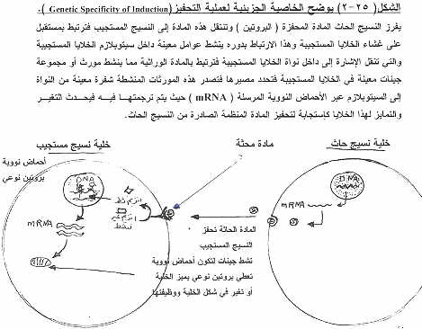
Also, these activated genes issued certain genetic code from the nucleus to the cytoplasm via sending nucleic acids (mRNA) which are translated to the cytoplasm which leads to change and differentiation of these cells as response to material organizer of inducing tissue (Fig. 29).

Slide 75
شكراً لحسن إستماعكم

