Slide 2
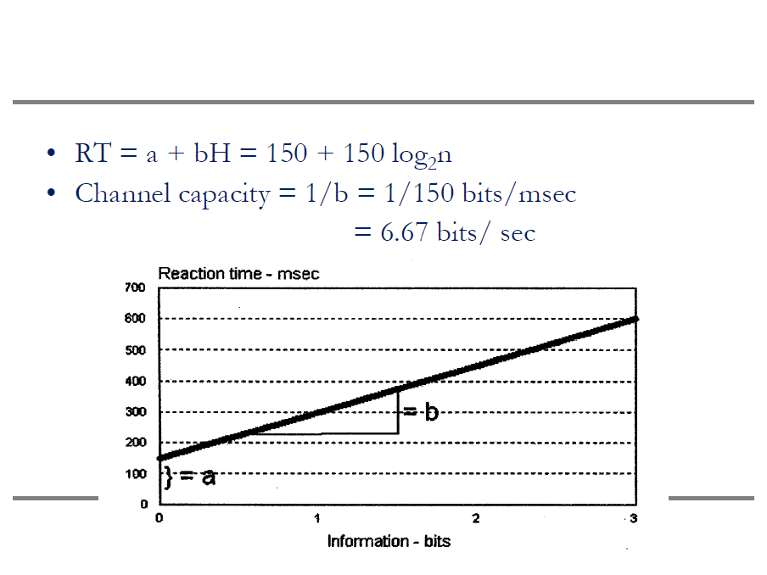

Slide 3
Solved Problems

Slide 4
1. The Hick-Hyman law provides one measure of information processing ability. Assume that an air traffic controller has a channel capacity bandwidth limit of 2.8 bits/second in decision making. a. Assuming equally-likely alternatives, how many choices can this person make per second? b. As the controller gains expertise he/she develops expectations of which routes different planes will fly. Explain how this will increase the controller's channel capacity on this task. c. Describe at least three different general methods for improving the controller's information processing in this task. (Use methods we have studied in this course--don't just say "automate")

Slide 5
1. a. H = 2.8/sec = log₂(N); 10^{.84}=N; N=6.92, or about 7. 1. b. Actually makes more knowledge, or less uncertainty. So, less potential knowledge gain. We can process less info. faster and more accurately than more info. 1. c. A few ideas: · Allow more time and look-ahead in system · Earlier training on various target probabilities · Less targets per controller · Allow errors; may be redundance in system · Multiple channels or modalities in presentation · Better compatibility in the system.

Slide 6
2. After watching a dice-rolling game, you notice that a one side of a die appears twice as often as it should. All other sides of the die appear with equal probability. a. Compute the information that is present in the unfair die. b. Determine the redundancy present in the unfair die. c. In your own words, concisely state the meaning of the term "redundancy" in (b) above.

Slide 7
2. a. A die has 6 sides; since one side is twice as likely as any other, we have: (2x) + 5x =1; So, x=1/7 [note: 2/6 vs. 5/6 does not add to one!] Hav = 5/7log₂(1/1/7) + 2/7log₂(1/2/7) = 2.01+.518 = 2.53 bits 2. b. Hmax = log₂(6) = 2.59 bits %redundancy = (1 - (2.53/2.59))*100% = 2.3% 2. c. Reduction in uncertainty due to unequally likely events.

Slide 8
3. How much Information (H) is contained in a fair roll of a 6-sided die? If an individual realizes that the die is unfair, with 20% chance of each of 4 sides appearing, and 10% on each of the other two, how does H change? What does this mean?

Slide 9
3. A 6-sided die should land on any of its sides with equal probability. Thus, information (H) is log₂6 = log₁₀6 /.301 = 2.58 bits of information. If the die is unfair (and the gambler realizes it), these should be less potential information gain; or less information in the die. In other words, the gambler already has some pre-existing knowledge so his/her potential information gain from the die will be less. If a rapid decision were required based on the outcome of the die, it should be faster due to this preexisting bias. To quantify, H_{ave} = [(4).2log₂(1/.2) + (2).1log₂(1/.1)] = [4(.46) + 2(.33)] = 1.86 + .66 = 2.52 bits of information. This is, in fact, lower than the maximum information case above. This result means that the gambler already has the equivalent of .06 bit of pre-existing information. The computation of Redundancy is a well-accepted measure of this pre-existing information. Here, %Redundancy = [1-2.52/2.58]*100% = 2.3%.

Slide 10
4. A display can show one numerical digit (0-9) per second, with equally-likely digits, in a choice reaction time task. If an observer accurately processes the information from the display, what is the observer's channel capacity, in bits/second?

Slide 11
4. The observer must decide from among 10 choices/second. This is log2(10) = 3.32 bits/sec. This is known as the bandwidth, or channel capacity for rate of processing.

Slide 12
5.What would your answer to Question 4 be if equally-likely double digits (0, 1, 2, ..., 99) could be presented? Why or why not does this make sense to you?

Slide 13
5. This is now log2(100) = 6.62 bits/sec. This makes sense if you consider that twice as many binary decisions were required--the first splits the numbers into groups of 50 and 50, the second splits one of these into two 25 groups, etc. Note that decision making ability is not linearly related to task complexity.

Slide 14
6. Consider Question 4 again, with unequally-likely digits. The probabilities of the digits appearing are shown below. Determine both the channel capacity and the redundancy.
Digit | 0 | 1 | 2 | 3 | 4 | 5 | 6 | 7 | 8 | 9
Prob | 0 | .08 | .25 | .12 | .10 | .08 | .05 | .10 | .22 | 0

Slide 15
6. Hmax = log2(10)/sec = 3.32 bits/sec Hav = [2(.08log2(1/.08) + .25 log2(1/.25) + .12 log2(1/.12) + ... + .22 log2(1/.22)] = 2.81 bits/sec = new channel capacity So, Redundancy = [1-(2.81/3.32)] *100% = 15.1%

Slide 16
7. Based upon his company experience, Ali knows that 50% of the chips are routed to Line 1, 30% to Line 2, and 20% to Line 3. Given a choice RT intercept of 250 msec, and a processing bandwidth of 7.5 bits/second, how much time does Ali require to make each routing decision? How much faster or slower is this, compared to the condition when all three routes are equally-likely?

Slide 17
7. The information (Hav) associated with each routing decision is: Hav = .5 log₂ (1/.5) + .3 log₂ (1/.3) + .2 log₂ (1/.2) = 3.32 {.5 log₁₀ (2) + .3 log₁₀(3.33) + .2 log₁₀ (5) } = 3.32(.15 + .157 + .14) = 1.48 bits A bandwidth of 7.5 bits/second equates to: 1000 ms/sec * 1/ 7.5 sec/bit = 133.3 msec/bit The expected choice RT is then: 250 + 133.3 (Hav) = 250 + 133.3 (1.48) = 447 msec If all equally-likely, H=log₂(3) = 1.59 bits RT = 250 + 133.3 (1.59) = 462 msec So, if Ali understands the stated probabilities, his expected decisions will be (462-447) = 15 msec faster than if all are equally-likely.

