Slide 1

ALGAE

Slide 2
According to five king dome classifiction system whish was suggested by Ropert wittaker in 1969. the 5 kingdoms were ( monera , protista , plants ,animals ,fungi) . So algae included in kingdome monera wich contains cyanophyta or blue green algae and kingdom protista which contains all other groups of algae.
Position of algae:

Slide 3
Classification of algal division based on:
1-Biochemical criteria:
A-pigments.
B-storage products.
C- cell wall composition.
2-Morphological criteria.
3-genetic differences.
4-many can survive desiccation for several years

Slide 4
Kingdome
Monera
(cyanobacteria) Cyanophyta.
Protista
A. Euglenophyta
B. Chlorophyta
( green algae)
C. Chrysophyta (yellow -green)
D. Bacillariophyta (diatoms)
E. Phaeophyta (brown algae)
F. Rhodophyta
(red algae)
Division

Slide 5
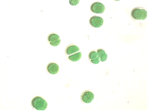
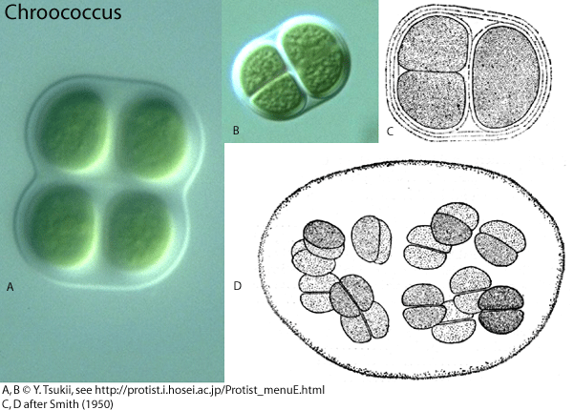
K: Monera
D: Cyanophyta
Cl: Cyanophyceae
Or:Chroococcales
F:Chroococcaceae
Ex: Chroococcus sp.
Singel Cell
Cell division stage

Slide 6
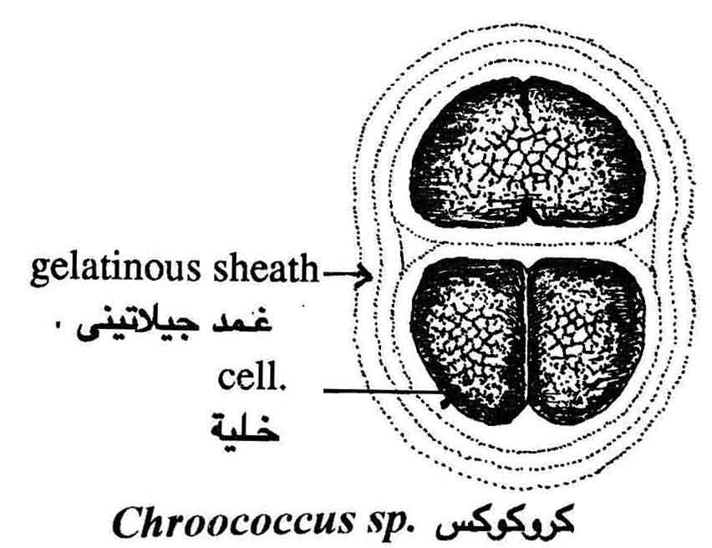
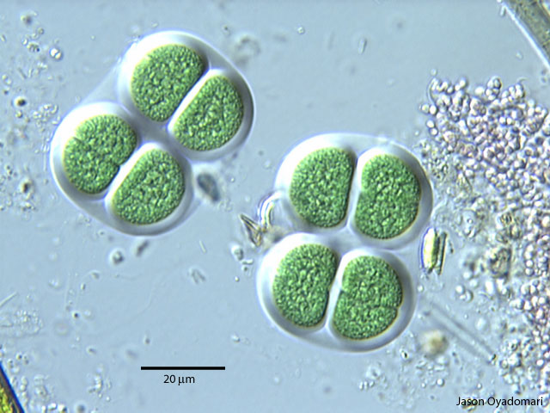

Slide 7
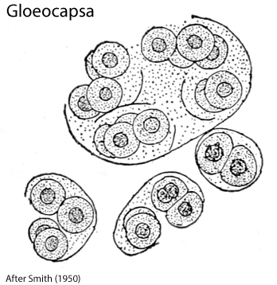
K: Monera
D: Cyanophyta
Cl: Cyanophyceae
Or:Chroococcales
F:Chroococcaceae
Ex: Gloeocasa sp.

Slide 8
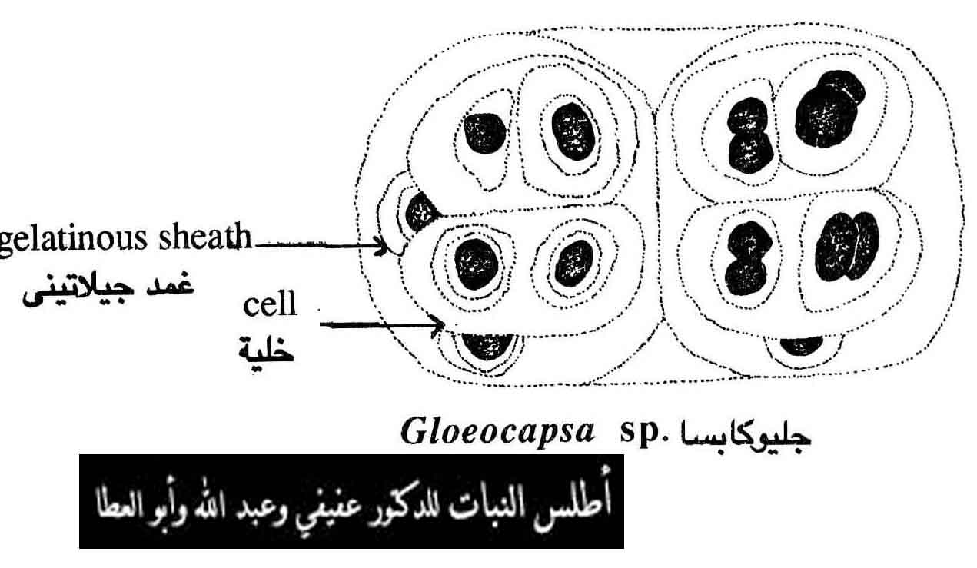
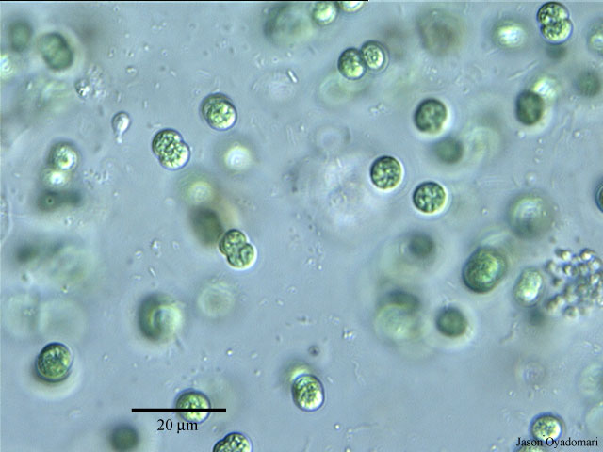

Slide 9
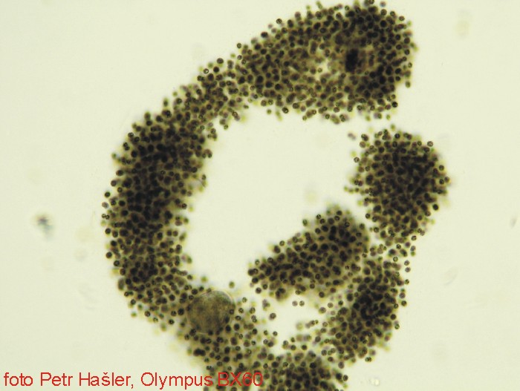
K: Monera
D: Cyanophyta
Cl: Cyanophyceae
Or:Chroococcales
F:Chroococcaceae
Ex: Microcystis sp.
Spherical Cell
Gelatinous sheath

Slide 10
