Slide 1
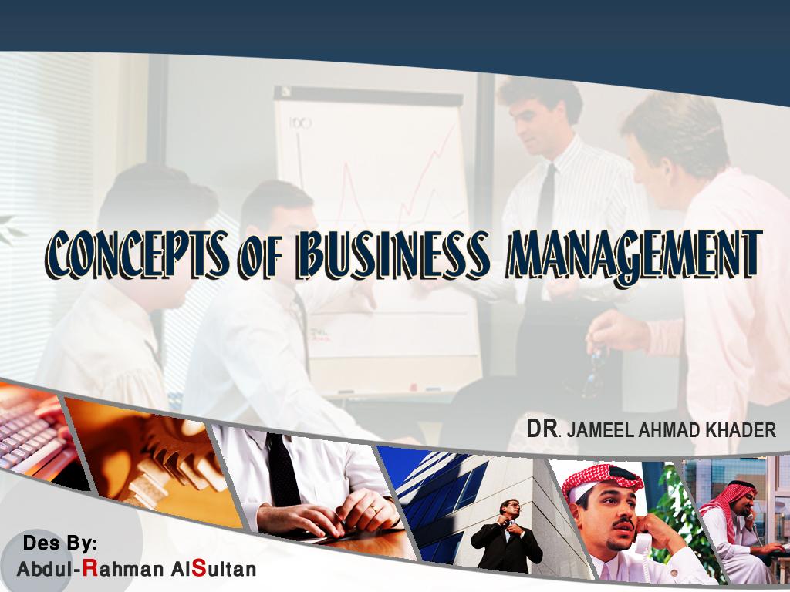

Slide 2


Slide 3
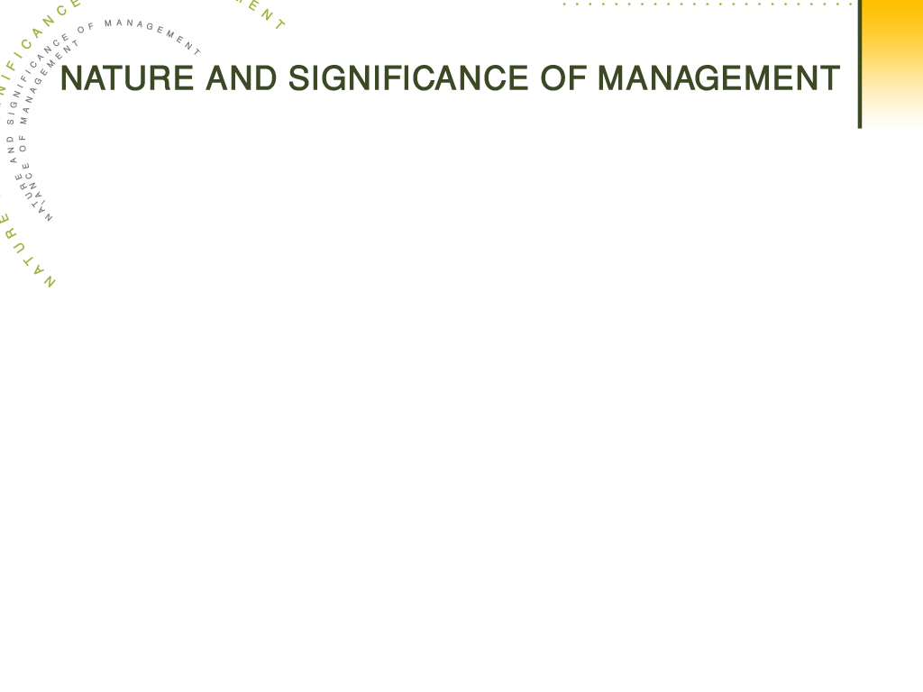
'' Management is the art and science of preparing, organizing and directing human efforts to control the forces and utilize the material of nature for the benefit of men''.
American Society of Mechanical Engineers
CHAPTER OUTLINE
Introduction
FAYOL’S PRINCIPLES OF MANAGEMENT
Definition of Management
Nature of Management
Objectives of Management

Slide 4
DEFINITION OF MANAGEMENT
A few definitions by some of the prominent writers on the subject are given below:
(1) “Management is the art of knowing what you want to do and then seeing that it is done in the best and cheapest way”.
F.W. Taylor
(2) “To manage is to forecast and to plan, to organize, to command, to coordinate and to control”.
Henry Fayol
(3) “Management is the coordination of all resources through the process of planning, organizing, directing and controlling in order to attain stated objectives”.
Sisk

Slide 5
NATURE OF MANAGEMENT
The following are the characteristics of management :
1. Management is Universal
The principles and techniques of management have universal application. They can be applied to all types of organizations business, social, educational and religious.
2. Management is Social Process
Management is basically a social activity because management is mainly related with the human activities of an enterprise.
3. Management is Goal-Oriented
The purpose of management is to achieve certain goals. The main objective of management is to maximize efficiency and economy of human efforts.

Slide 6
4. Management is Activity-Based
Management refers to a distinct class of activities which could be learnt and put into practice.
5. Management is Integrative Process
The essence of management is integration of human and other resources in a manner that it leads to effective performance.
6. Management is a Group Activity
It is concerned with group efforts because it creates effective cooperation among persons working together in a group.
Nature and Significance of Management
7. Management is Intangible
The management is not a tangible activity of business enterprise. It is the direction and control of the business activity which can be feeled but can not be seen or touched.

Slide 7
8. Management is Dynamic
Management involves creating an internal environment or conditions, whereby people are able to perform their tasks efficiently. Management is a continuously growing process.
9. Management is a Multi-Disciplinary Subject
Management contains principles drawn from many social sciences like sociology, economics etc.
10. Management Accomplishes Results Through Others
The essence of management is integration of human and other resources in such a way that it leads to effective performance.
11. Management is Both a Science and an Art
The management, as a science provides general principles, which can guide the managers in their professional activities. The management, as an art, provides the best possible solutions of the problems and the best possible exploitation of available resources.

Slide 8
OBJECTIVES OF MANAGEMENT
In brief the objectives of management are as follows:
1. Higher Efficiency
Management seeks to obtain maximum output with minimum resources and efforts.
2. Satisfaction of Customers
Management attempts to produce products required by the customers.
3. Adequate Return on Capital
Management must achieve a reasonable rate of return for the owners of the business.
4. Satisfied Workforce
Management attempts to build a team of good workers who are happy and satisfied with the organization.

Slide 9
5. Better Working Conditions
Management seeks to achieve a system to ensure fair wages for the work, security of employment and better working conditions for the work force.
6. Relations with Suppliers
Management seeks to achieve good relations with the suppliers of raw materials and capital so as to continue in production.
7. Contribution to Nationals Goals
The management must contribute to the national goals. It should use the judicious use of scarce resources of the country.

Slide 10

FAYOL’S PRINCIPLES OF MANAGEMENT
Henry Fayol, the French industrialist is regarded as the real father of modern management science. A brief description of Fayol’s fourteen principles of management which he described in his book ‘General and Industrial Management’ is given below:
Division of Work
This principle implies that every employee should be assigned only one type of work. It aims at the maximum production with least efforts. It also helps in securing the maximum efficiency.
Authority and Responsibility
Authority is the right to give orders to the subordinates. Responsibility means the duty which the subordinates is expected to perform. Sufficient authority should be delegated to a subordinate to enable him to discharge his duties.

Slide 11
Discipline
Discipline means getting obedience to rules and regulations
of an organization. In the absence of discipline the organization cannot succeed. Discipline depends upon effective leadership.
Unity of Command
A subordinate should receive orders from one supervisor only. If he gets orders from two or more officers at the same time, he gets confused. He cannot discharge his duties properly. Unity of command is related to functioning of personnel.
Unity of Direction
Unity of direction means that each group of persons having same objects must have one head and one plan. It will help in establishing the coordination and uniformity in the activities. It is related to the functioning business as a whole.

Slide 12
Subordination of Individual Interests to General Interest
The interests of the organization must prevail upon the
personal interests of individuals. General interest must be given more attention in comparison to the personal interests.
Remuneration of Personnel
The remuneration of personnel must be fair and satisfactory. The wage system must motivate the employees, to do better and more and may ensure safety and security of the employees. The wage system must be satisfactory to both the employees and employer.

Slide 13
Centralization
It means concentration of authority at one place or at one
level in the organization. On the other hand, decentralization means dispersal of authority to the lower levels in the organization. A proper balance between centralization and decentralization must be maintained. Small firms have absolute centralization but in large concerns, there is less degree of centralization.
Scalar Chain
This principle is related to the arrangement of things and the placement of people. This principle emphasizes that there must be a clear line of authority right from the top management to the bottom. Orders of management and feeling of subordinates must pass through the proper channels of authority. Such types of channels must be short cut only when it is essential to do so.

Slide 14
Order
Order means everything should be in a proper arrangement. There should be a place of everything and everything should be in its place. Similarly, there should be right man in the right place.
Equity
Personnel must be treated with kindness and equity if loyalty is expected of them. This principle does not mean that all the employees of the organization are equal and must be treated and paid equal.

Slide 15
Stability of Tenure
This principle requires that there must be stability in the service of the employees. The employees should not be transfer from one place to another very quickly in business activities because it lower the progress of activates. Management should remove the feelings of insecurity of job from the minds of personnel. If the job of a person is not secure, he will be on lookout for the job else where and his work will not be satisfactory.
Incentives
The subordinates should be given an opportunity to take some initiatives in making and executing the plans. The employees should be provided proper incentives in planning an activities schedule for the enterprise.

Slide 16
Esprit de Corps
This principle means the harmony and understanding among the personnel. The management and workers must work together as a team for the accomplishment of the targets of the enterprise. This principle is based upon two theories – “union is strength” and “unity of the staff is the foundation of success in any organization”.

