Slide 1
Manufacturing Processes 1
Course Data Catalogue

Slide 2
Manufacturing Processes 1
Course Data Catalogue

Slide 3
Manufacturing Processes 1
Course Data Catalogue
Class Work
Experimental Work

Slide 4
Manufacturing Processes 1
Course Data Catalogue
Course outcomes

Slide 5
Manufacturing Processes 1
Course Data Catalogue
Course instructor

Slide 6
Manufacturing Processes 1- Reference
Course Data Catalogue
Updated Aug, 2014

Slide 7
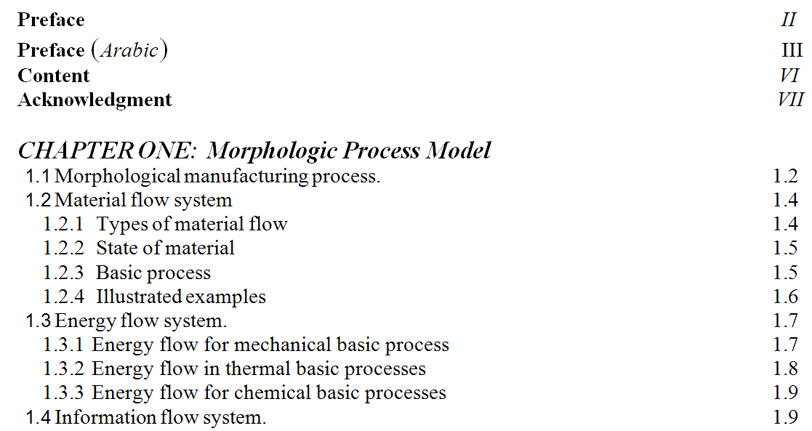
Content

Slide 8
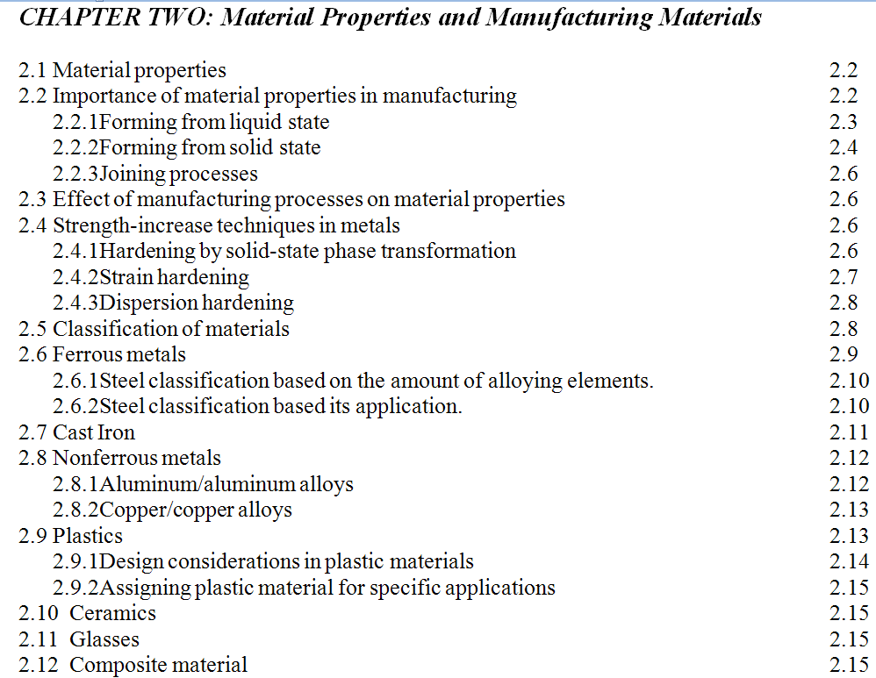
Content
Only covered

Slide 9
Content

Slide 10
Content

Slide 11
Content

Slide 12
Content

Slide 13
Content

Slide 14
Content

Slide 15
Content

Slide 16
Content

Slide 17
End of Content

