Slide 1
INPUT & OUTPUT
scanf & printf

Slide 2
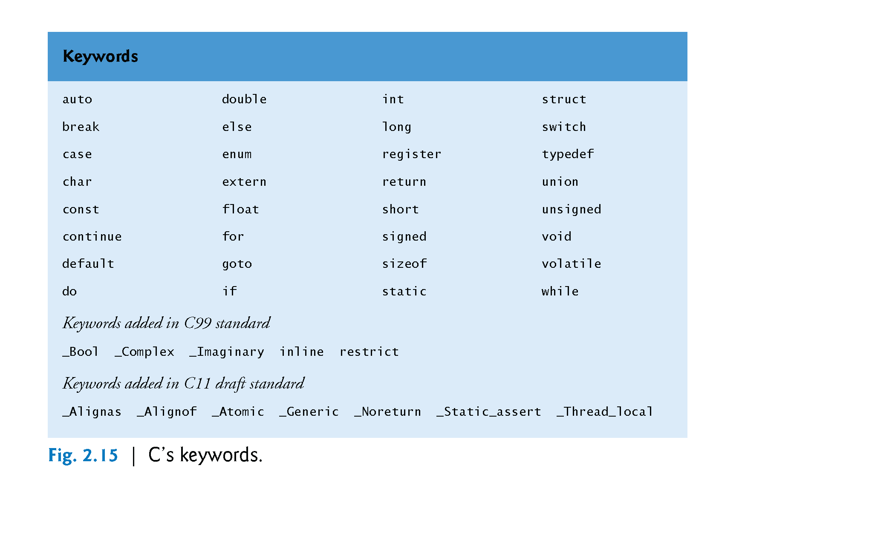
1. C KEYWORDS
Dr. Soha S. Zaghloul 2 Copyright © Pearson, Inc. 2013. All Rights Reserved.

Slide 3
2. Another Simple C Program: Adding Two Integers
Our next program uses the Standard Library function scanf to obtain two integers typed by a user at the keyboard, computes the sum of these values and prints the result using printf.
Dr. Soha S. Zaghloul 3 Copyright © Pearson, Inc. 2013. All Rights Reserved.

Slide 4
2. Another Simple C Program: Adding Two Integers (Cont’d)
Dr. Soha S. Zaghloul 4 Copyright © Pearson, Inc. 2013. All Rights Reserved.

Slide 5
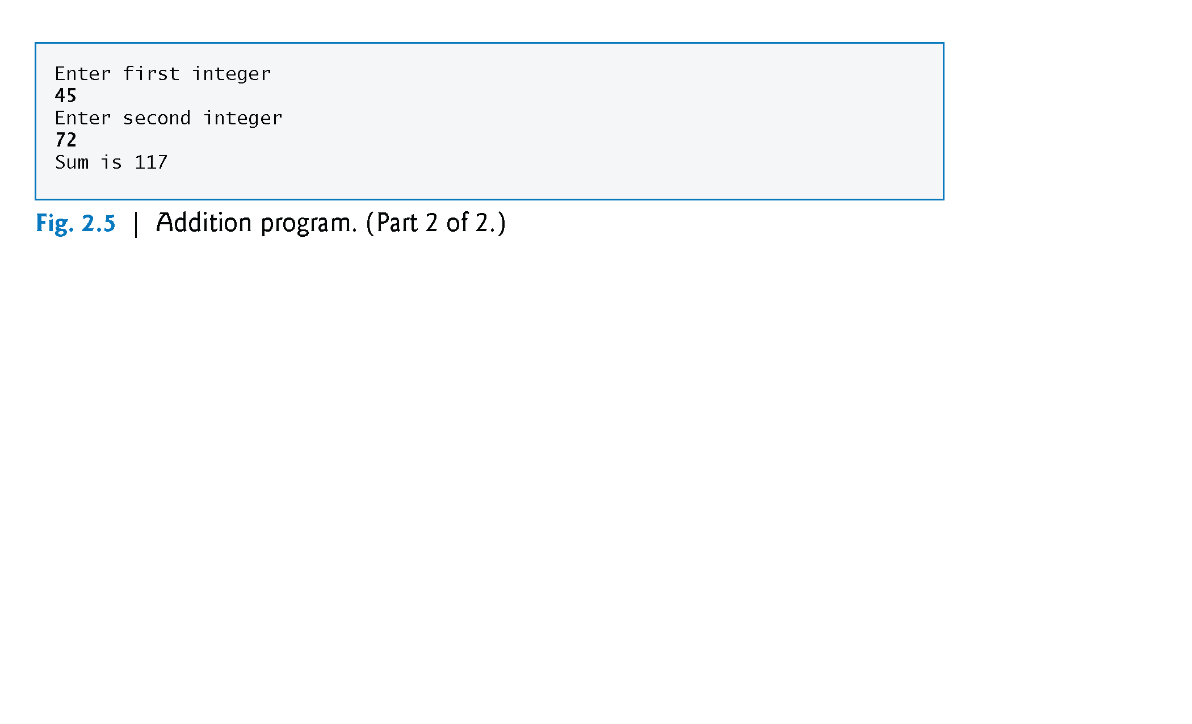
2.1 Another Simple C Program: Adding Two Integers – PROGRAM OUTPUT
The numbers emphasized in bold are entered by the user
Dr. Soha S. Zaghloul 5 Copyright © Pearson, Inc. 2013. All Rights Reserved.

Slide 6
2.2 VARIABLES
Variables and Variable Definitions
Lines 8–10
int integer1; /* first number to be input by user */ int integer2; /* second number to be input by user */ int sum; /* variable in which sum will be stored */
are definitions.
The names integer1, integer2 and sum are the names of variables—locations in memory where values can be stored for use by a program.
These definitions specify that the variables integer1, integer2 and sum are of type int, which means that they’ll hold integer values, i.e., whole numbers such as 7, –11, 0, 31914 and the like.
Dr. Soha S. Zaghloul 6 Copyright © Pearson, Inc. 2013. All Rights Reserved.

Slide 7
2.2 VARIABLES (cont’d)
All variables must be defined with a name and a data type before they can be used in a program.
The preceding definitions could have been combined into a single definition statement as follows:
int integer1, integer2, sum;
but that would have made it difficult to describe the variables with corresponding comments as we did in lines 8–10.
Dr. Soha S. Zaghloul 7 Copyright © Pearson, Inc. 2013. All Rights Reserved.

Slide 8
2.2.1 VARIABLES - Identifiers
Identifiers and Case Sensitivity
A variable name in C is any valid identifier.
Rules for specifying an identifier are:
1) Consist of only letters (A-Z and a-z), digits (0 – 9) and underscore (_)
2) Should start with a letter
3) Should not be a reserved word
C is case sensitive—uppercase and lowercase letters are different in C, so a1 and A1 are different identifiers.
Dr. Soha S. Zaghloul 8 Copyright © Pearson, Inc. 2013. All Rights Reserved.

Slide 9
2.2.1 variables – Identifiers (cont’d)
Dr. Soha S. Zaghloul 9 Copyright © Pearson, Inc. 2013. All Rights Reserved.

Slide 10
2.2.1 variables – Identifiers (cont’d)
Examples of valid identifiers:
letter_1, CENT_PER_INCH, Hello, variable
Examples of invalid identifiers:
Invalid Identifier | Reason Invalid
1Letter | Starts with a digit
double | Reserved word
int | Reserved word
TWO*FOUR | Character * not allowed
joe’s | Character ‘ not allowed

Slide 11
2.2.2 variables – Standard Data Types
Data Type | Represents | Operations | Examples
int | Integer values in the range -32,767 through 32767 | Add, Subtract, Multiply, Divide and Compare | -10500 435 +15 -25 32767
double | Real numbers that include a decimal point or an exponent (scientific notation) | Add, Subtract, Multiply, Divide and Compare | 3.14159 0.005 123.0 15.0e-4 2.245e2 1.15e-3 12e+5
char | An individual character value. These are enclosed in single quotes inside the code. Do not enclose them when entering them as data while run-time. | Compare | ‘A’ ‘z’ ‘2’ ‘9’ ‘*’ ‘:’ ‘”’ ‘ ‘

Slide 12
2.2.2 variables – Standard Data Types
Data Type | Invalid Example | Reason
int | 15.0 -32,768 +30,000 | Contains a decimal point Out of range Comma is not allowed
double | 150 0.1234e 15e-0.3 34,500.99 | No decimal point Missing exponent Non-integer exponent Comma is not allowed
char | ’20’ D | Not a single character Not enclosed between single quotes. However, it is valid as data input while execution.

Slide 13
2.3 pROMPT MESSAGES
Prompting Messages
Line 12
printf( "Enter first integer\n" ); /* prompt */
displays the literal “Enter first integer” and positions the cursor to the beginning of the next line.
This message is called a prompt because it tells the user to take a specific action.
Dr. Soha S. Zaghloul 13 Copyright © Pearson, Inc. 2013. All Rights Reserved.

Slide 14
2.4 the scanf FUNCTION
The scanf Function and Formatted Inputs
The next statement
scanf( "%d", &integer1 ); /* read an integer */
uses scanf to obtain a value from the user.
The scanf function reads from the standard input, which is usually the keyboard.
Dr. Soha S. Zaghloul 14 Copyright © Pearson, Inc. 2013. All Rights Reserved.

Slide 15
2.4 the scanf FUNCTION (cont’d)
This scanf has two arguments, "%d" and &integer1.
The first, the format control string, indicates the type of data that should be input by the user.
The %d conversion specifier indicates that the data should be an integer (the letter d stands for “decimal integer”).
The % in this context is treated by scanf (and printf as we’ll see) as a special character that begins a conversion specifier.
The second argument of scanf begins with an ampersand (&)—called the address operator in C—followed by the variable name.
Dr. Soha S. Zaghloul 15 Copyright © Pearson, Inc. 2013. All Rights Reserved.

Slide 16
2.4 the scanf FUNCTION (cont’d)
The &, when combined with the variable name, tells scanf the location (or address) in memory at which the variable integer1 is stored.
The computer then stores the value that the user enters for integer1 at that location.
Therefore, remember to precede each variable in every call to scanf with an ampersand.
Dr. Soha S. Zaghloul 16 Copyright © Pearson, Inc. 2013. All Rights Reserved.

Slide 17
2.4 the scanf FUNCTION (cont’d)
When the computer executes the preceding scanf, it waits for the user to enter a value for variable integer1.
The user responds by typing an integer, then pressing the Enter key to send the number to the computer.
The computer then assigns this number, or value, to the variable integer1.
Any subsequent references to integer1 in this program will use this same value.
Functions printf and scanf facilitate interaction between the user and the computer.
Because this interaction resembles a dialogue, it’s often called interactive computing.
Dr. Soha S. Zaghloul 17 Copyright © Pearson, Inc. 2013. All Rights Reserved.

Slide 18
2.4 the scanf FUNCTION (cont’d)
Dr. Soha S. Zaghloul 18 Copyright © Pearson, Inc. 2013. All Rights Reserved.

Slide 19
2.5 Another prompt and scanf
Line 15
printf( "Enter second integer\n" ); /* prompt */
displays the message Enter second integer on the screen, then positions the cursor to the beginning of the next line.
This printf also prompts the user to take action.
Line 16
scanf( "%d", &integer2 ); /* read an integer */
obtains a value for variable integer2 from the user.
Dr. Soha S. Zaghloul 19 Copyright © Pearson, Inc. 2013. All Rights Reserved.

Slide 20
2.6 the assignment statement
Assignment Statement
The assignment statement in line 18
sum = integer1 + integer2; /* assign total to sum */
calculates the total of variables integer1 and integer2 and assigns the result to variable sum using the assignment operator =.
The statement is read as, “sum gets the value of integer1 + integer2.” Most calculations are performed in assignments.
The = operator and the + operator are called binary operators because each has two operands.
The + operator’s two operands are integer1 and integer2.
The = operator’s two operands are sum and the value of the expression integer1 + integer2.
Dr. Soha S. Zaghloul 20 Copyright © Pearson, Inc. 2013. All Rights Reserved.

Slide 21
2.6 the assignment statement
Integer1 + integer2 = sum
Dr. Soha S. Zaghloul 21 Copyright © Pearson, Inc. 2013. All Rights Reserved.

Slide 22
2.7 The printf STATEMENT
Printing with a Format Control String
Line 20
printf( "Sum is %d\n", sum ); /* print sum */
calls function printf to print the literal Sum is followed by the numerical value of variable sum on the screen.
This printf has two arguments, "Sum is %d\n" and sum.
The first argument is the format control string.
It contains some literal characters to be displayed, and it contains the conversion specifier %d indicating that an integer will be printed.
The second argument specifies the value to be printed.
Notice that the conversion specifier for an integer is the same in both printf and scanf.
Dr. Soha S. Zaghloul 22 Copyright © Pearson, Inc. 2013. All Rights Reserved.

Slide 23
2.7 The printf STATEMENT (cont’d)
Calculations in printf Statements
We could have combined the previous two statements into the statement
printf( "Sum is %d\n", integer1 + integer2 );
The right brace, }, at line 21 indicates that the end of function main has been reached.
Dr. Soha S. Zaghloul 23 Copyright © Pearson, Inc. 2013. All Rights Reserved.

Slide 24
2.7 The printf STATEMENT (cont’d)
Formatting int in Program Output
The field width is the number of columns to use for the display of the value.
Add a number between % and d in the printf format string to specify the field width.
A minus sign before the field width justifies the output to the left.
Example:
printf(“Results: %3d meters = %4d ft. %2d in. \n”, meters, feet, inches);
Outputs:
Results:~~21~meters~=~~~68~ft.~11~in.
~ denotes a space. The spaces specified by the field width are in red (~). Blue spaces are caused by the format string of printf.
For negative numbers, the minus sign is included in the count of the digits displayed.
Dr. Soha S. Zaghloul 24 Copyright © Pearson, Inc. 2013. All Rights Reserved.

Slide 25
2.7 The printf STATEMENT (cont’d)
Formatting int in Program Output
The following table displays numbers with different placeholders:
Value | Format | Output
234 | %4d | ~234
-234 | %4d | -234
234 | %5d | ~~234
-234 | %5d | ~-234
234 | %1d | 234
-234 | %1d | -234
234 | %-5d | 234~~
-234 | %-5d | -234~
Dr. Soha S. Zaghloul 25 Copyright © Pearson, Inc. 2013. All Rights Reserved.

Slide 26
2.7 The printf STATEMENT (cont’d)
Formatting double in Program Output
For double numbers, we need to specify the field width and the number of decimal places desired.
The field width should be large enough to accommodate all digits before and after the decimal point.
So, the form of the format placeholder is %n.mf where n is a number representing the total field width, and m is the desired number of decimal places.
For example, if x is a variable of type double, whose value is between -99.99 and 999.99; then, we could use the placeholder %6.2f to display an accuracy of x of two decimal places.
Dr. Soha S. Zaghloul 26 Copyright © Pearson, Inc. 2013. All Rights Reserved.

Slide 27
2.7 The printf STATEMENT (cont’d)
Formatting double in Program Output
The following table displays x using format string placeholder %6.2f for different values of x:
Value of X | Displayed Output
-99.42 | -99.42
.123 | ~~0.12
-9.536 | ~-9.54
-25.554 | -25.55
99.999 | 100.00
999.4 | 999.40
Dr. Soha S. Zaghloul 27 Copyright © Pearson, Inc. 2013. All Rights Reserved.

Slide 28
2.8 Memory Concepts
Variable names such as integer1, integer2 and sum actually correspond to locations in the computer’s memory.
Every variable has a name, a type and a value.
In the addition program of Fig. 2.5, when the statement (line 13)
scanf( "%d", &integer1 ); /* read an integer */
is executed, the value entered by the user is placed into a memory location to which the name integer1 has been assigned.
Suppose the user enters the number 45 as the value for integer1.
The computer will place 45 into location integer1 as shown in Fig. 2.6.
Dr. Soha S. Zaghloul 28 Copyright © Pearson, Inc. 2013. All Rights Reserved.

Slide 29
Dr. Soha S. Zaghloul 29 Copyright © Pearson, Inc. 2013. All Rights Reserved.

Slide 30
2.8 Memory Concepts (Cont.)
Whenever a value is placed in a memory location, the value replaces the previous value in that location; thus, this process is said to be destructive.
Returning to our addition program again, when the statement (line 16)
scanf( "%d", &integer2 ); /* read an integer */
executes, suppose the user enters the value 72.
This value is placed into location integer2, and memory appears as in Fig. 2.7.
These locations are not necessarily adjacent in memory.
Dr. Soha S. Zaghloul 30 Copyright © Pearson, Inc. 2013. All Rights Reserved.

Slide 31
2.8 Memory Concepts (Cont.)
Once the program has obtained values for integer1 and integer2, it adds these values and places the total into variable sum.
The statement (line 18)
sum = integer1 + integer2; /* assign total to sum */
that performs the addition also replaces whatever value was stored in sum.
Dr. Soha S. Zaghloul 31 Copyright © Pearson, Inc. 2013. All Rights Reserved.

Slide 32
2.8 Memory Concepts (Cont.)
This occurs when the calculated total of integer1 and integer2 is placed into location sum (destroying the value already in sum).
After sum is calculated, memory appears as in Fig. 2.8.
The values of integer1 and integer2 appear exactly as they did before they were used in the calculation.
Dr. Soha S. Zaghloul 32 Copyright © Pearson, Inc. 2013. All Rights Reserved.

Slide 33
Dr. Soha S. Zaghloul 33 Copyright © Pearson, Inc. 2013. All Rights Reserved.

Slide 34
Dr. Soha S. Zaghloul 34 Copyright © Pearson, Inc. 2013. All Rights Reserved.

Slide 35
2.8 Memory Concepts (Cont.)
They were used, but not destroyed, as the computer performed the calculation.
Thus, when a value is read from a memory location, the process is said to be nondestructive.
Dr. Soha S. Zaghloul 35 Copyright © Pearson, Inc. 2013. All Rights Reserved.

