Slide 1
2.2 Set Operations

Slide 2
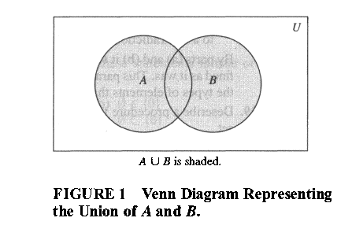
The Union
DEFINITION 1
Let A and B be sets. The union of the sets A and B , denoted by AUB , is the set that contains those elements that are either in A or in B , or in both.
This tells us that
A U B = {x | x ϵ A V x ϵ B } .

Slide 3
EXAMPLE 1
Find The union of the sets {1,3,5} and {1,2,3}.

Slide 4
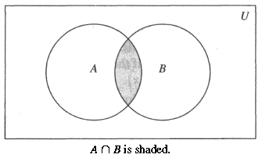
The Intersection
DEFINITION 2
Let A and B be sets. The intersection of the sets A and B , denoted by A ∩ B , is the set containing those elements in both A and B .
This tells us that
A ∩ B = {x | x ϵ A Λ x ϵ B } .

Slide 5
EXAMPLE 3
Find The intersection of the sets {1,3,5} and {1,2,3}.

Slide 6
Disjoint Sets
DEFINITION 3
Two sets are called disjoint if their intersection is the empty set.
EXAMPLE 5
Let A = {1,3,5,7,9} and B = {2, 4, 6, 8 , 10} is disjoint or not.

Slide 7
The Difference Of Two Sets
DEFINITION 4
Let A and B be sets. The difference of A and B , denoted by A - B , is the set containing those elements that are in A but not in B .
An element x belongs to the difference of A and B if and only if x ϵ A and x ɇ B . This tells us that
A - B = {x | x ϵ A Λ x ɇ B } .

Slide 8
EXAMPLE 6
Find The difference of {1,3,5} and {1,2,3}

Slide 9
The Complement Of a Set
DEFINITION 5
Let U be the universal set. The complement of the set A , denoted by Ā , is the complement of A.
In other words Ā=U-A.
An element belongs to Ā if and only i f x ɇ A . This tells u s that
Ā = {x | x ɇ A } .

Slide 10
Homeworks
Page 130
3 (a,b,c,d)
14
19
25 (a,c)
59

