Slide 1
Chapter 20
IMPROVING PRODUCTIVITY AND PERFORMANCE

Slide 2
State of the Industry
The serious decline in U.S. construction industry productivity during the 1960s and 1970s led the Business Roundtable to conduct its Construction Industry Cost Effectiveness (CICE) study.
This study, completed in 1982, was probably the most comprehensive study ever made of the U.S. construction industry.

Slide 3
State of the Industry
Although the study found that the U.S. construction industry faced a number of problems in remaining competitive in the international construction market, it concluded that the majority of problems could be overcome by improved management of the construction effort.

Slide 4
At the project management level, the study discovered inadequate management performance in a number of areas which include:
construction safety,
control of the use of overtime,
training and education,
worker motivation and
failure to adopt modern management systems.

Slide 5
What is Productivity?
"Productivity" means the output of construction goods and services per unit of labor input.

Slide 6
Tools for Better Management
A number of studies, including the CICE study, have shown that most on-site delays and inefficiencies lie within the control of management.
Management is responsible for planning, organizing, and controlling the work.
If these management responsibilities were properly carried out, there would be few cases of workers standing idle waiting for job assignment, tools, or instructions.
One of the major tools for improving construction productivity is work improvement; that is, the scientific study and optimization of work methods.

Slide 7
Workers' physical capacity, site working conditions, morale, and motivation are important elements in determining the most effective work methods and the resulting productivity for a particular task.
Other techniques available to assist the construction manager in improving construction productivity and cost-effectiveness include:
network planning methods,
economic analyses,
safety programs,
quantitative management methods (linear programming),
simulation, and the use of computers.

Slide 8
WORK IMPROVEMENT
An important component of work improvement is preplanning, that is, detailed planning of work equipment and procedures prior to the start of work.
Physical models and traditional work improvement techniques may be used in the preplanning process.
Traditional work improvement techniques include:
1. Time studies,
2. Flow process charts,
3. Layout diagrams,
4. Flow diagrams, and
5. Crew balance charts

Slide 9
Physical models
Models are often used for large and complex projects such as power plants, dams, and petrochemical process plants to check physical dimensions, clearance between components, and general layout.
Computer graphics and computer-aided design (CAD) can perform similar functions faster and at lower cost than can physical models or other manual techniques.

Slide 10
1. Time Studies
Time studies are used to collect time data relating to a construction activity for the purpose of either statistical analysis or of determining the level of work activity.
It is important that the data collected be statistically valid.
Work sampling is the name for a time study conducted for the purpose of determining the level of activity of an operation.
A study of a construction equipment operation, for example, may classify work activity into a number of categories, each designated as either active or nonworking.

Slide 11
1. Time Studies
Sampling for labor effectiveness may also divide observations into categories such as effective work, essential contributory work, ineffective work, and nonworking.
Analysis of work by category will again assist management in determining how labor time is being utilized and provide clues to increasing labor effectiveness.
Although time studies are traditionally made using stopwatches and data sheets, there is growing use of time-lapse equipment for conducting work improvement studies on construction projects provides several advantages over stopwatch studies.
Modified super-8mm cameras and projectors provide a relatively inexpensive method of recording and analyzing time-lapse film.

Slide 12
2. A flow process chart
A flow process chart for a construction operation serves the same purpose as does a flowchart for a computer program.
That is, it traces the flow of material or work through a series of processing steps (classified as operations, transportation, inspections, delays, or storage).
Depending on the level of detail, it usually indicates the distance and time required for each transportation and the time required for each operation, inspection, or delay.
From the chart the manager should be able to
visualize the entire process and
to tabulate the number of operations, transportation, inspections, delays, and storage involved, and
the time required for each category.

Slide 13
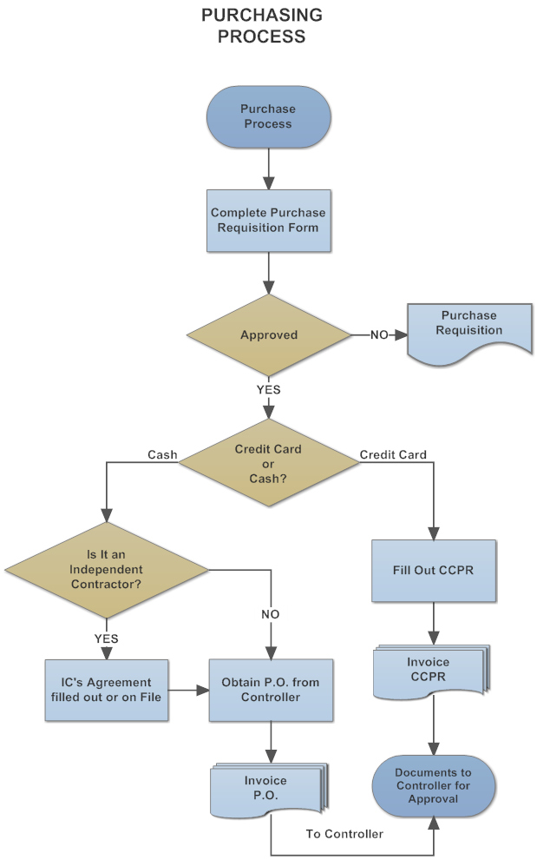
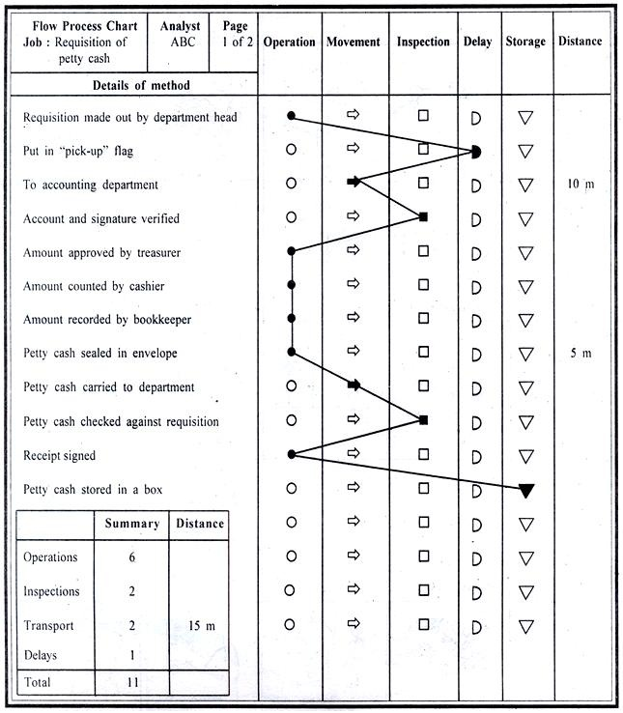

Slide 14
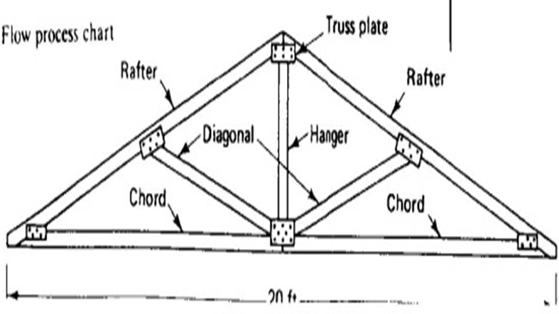

Slide 15
3. Layout Diagrams
-A layout diagram is a scaled diagram that shows the location of all physical facilities, machines, and material involved in a process.
Since the objective of a work improvement study is to minimize processing time and effort, use a layout diagram to assist in reducing the number of material movements and the distance between operations.

Slide 16
Layout Diagrams

Slide 17
4. A flow diagram
A flow diagram is similar to a layout diagram but also shows the path followed by the worker or material being recorded on a flows process chart.
The flow diagram should indicate the direction of movement and the locations where delays occur.
Step numbers on a flow diagram should corresponded to the sequence number used on the corresponding flow process chart.

Slide 18
flow process charts, flow diagrams, and layout diagrams must be studied together for maximum benefit and must be consistent with each other.
-Since layout diagrams and flow diagrams help us to visualize the operation described by a flow process chart, these diagrams should suggest
jobs that might be combined,
storage that might be eliminated, or
transportation that might be shortened.

Slide 19
5. Crew Balance Charts
A crew balance chart uses a graphical format to document the activities of each member of a group of workers during one complete cycle of an operation.
A vertical bar is drawn to represent the time of each crew member during the cycle.
The bar is then divided into time blocks showing the time spent by that crew member on each activity which occurs during the cycle.
The crew balance chart enables us easily to compare the level of activity of each worker during an operation cycle.

Slide 21
Human Factors
Workers who are fatigued, bored, or hostile will never perform at an optimum level of effectiveness.
Some major human factors to be considered include environmental conditions, safety conditions, physical effort requirements, work hours, and worker morale and motivation.
Attempts at sustained higher levels of effort will only result in physical fatigue and lower performance.
Physical work requirements should be adjusted to match worker capability.

Slide 22
Studies have shown that worker productivity is seriously reduced by sustained periods of overtime work.
When the premium cost of overtime is considered, it is apparent that the labor cost per unit of production will always be higher for overtime work than for normal work.
Worker morale and motivation have also been found to be important factors in construction worker productivity.
Factors inhibiting craft productivity , nonavailability of material was the most Significant, followed by nonavailability of tools, and the need to redo work.

Slide 23
Some of the worker demotivators identified by the study.
• Disrespectful treatment of workers.
• Lack of sense of accomplishment.
• Nonavailability of materials and tools.
• Necessity to redo work.
• Discontinuity in crew makeup.
• Confusion on the project.
• Lack of recognition for accomplishments.
• Failure to utilize worker skills.
• Incompetent personnel.
• Lack of cooperation between crafts.
• Overcrowded work areas.
• Poor inspection programs.
• Inadequate communication between project elements.
• Unsafe working conditions.
• Workers not involved in decision making.

Slide 24
Some of the worker motivators identified in the study
• Good relations between crafts.
• Good worker orientation programs.
• Good safety programs.
• Enjoyable work.
• Good pay.
• Recognition for accomplishments.
• Well-defined goals.
• Well-planned projects.

