Slide 1
King Saud University College of Engineering IE – 341: “Human Factors Engineering” Fall – 2017 (1st Sem. 1438-9H)
Chapters 3. Information Input and Processing
Part – 2: Fitts’s Law (Chapter 9)
Prepared by: Ahmed M. El-Sherbeeny, PhD

Slide 2
Fitts’s Law
Fitts’s Law is used to reach a relation between
size of, as well as distance to target
and speed (or response time, RT) to reach target
Fitts and Peterson* found that:
the longer the distance (D)
and/or the smaller the target (W)
⇒ the longer the movement will take
Target can be button on screen or break pedal, etc.
This has many (increasing) applications in HCI (human-computer interaction)
The most important finding: edges of a screen are easiest (i.e. shortest time) to reach: can you show how?
Notes:
* Based on multiple studies in 1954-1964

Slide 3
Fitts’s Law
Watch the following video on Fitts' (or Fitts's) Law: https://youtu.be/E3gS9tjACwU
Notes:
* Based on multiple studies in 1954 and 1964

Slide 4
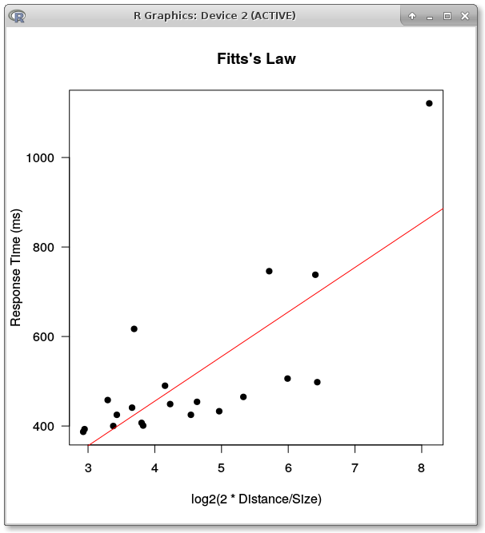
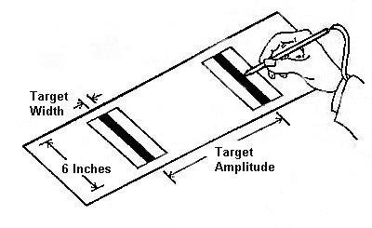
Fitts’s Law
Q: where does the red line cross the y-axis? What do you think this means?*
Notes:
* This is the constant a in the Fitts’ Law equation (see next slide), which is the minimum RT (independent of any experimental conditions) required by a certain person to respond/move; this is about 200-300 ms.

Slide 5
Fitts’s Law
Fitts’s Law:
$$T=a+b\log_{2}\left(\frac{2D}{W}+1\right)$$
$T$: movement time (aka MT)
D: distance to target (aka amplitude)
W: width of target (i.e. target size, e.g. button)
a, b: empirically derived constants (depend on the type of movement)
Note, there are different versions of Fitts’s Law (e.g. D/W instead of 2D/W)*
Q: what happens if $D≈0$? or if $W→∞$? What does that mean (i.e. any useful implications?)
Notes:
* Note, the distance-width ratio is multiplied by 2 simply to avoid negative logarithms when the target width is greater than the distance to the center of the target.
* Log to the base 2 is used; movement time is related to the information (in bits) contained in the movement (i.e. as in Hick-Hyman law)

Slide 6
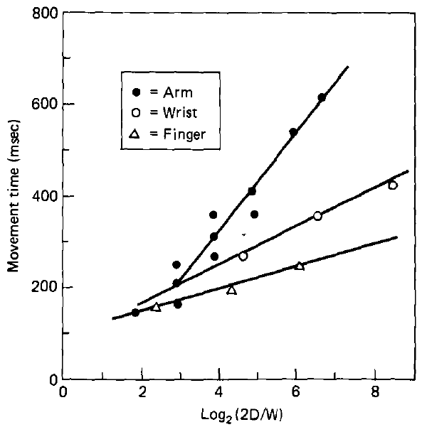
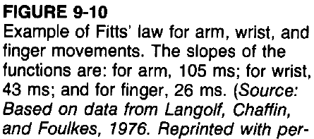
Fitts’s Law
To show effect of constants a, b:
Figure 9-10: data from movements of the
arm
wrist (hand), and
finger (Q: why?)
slope of line decreases from arm to finger*
as slope ↓ ⇒ effect of (D/W) ratio ↓
Note, Fitts' law also applies:&
movements of the head
movements of the feet
movements made underwater
remotely manipulated movements
Notes:
* Q: why is the log expression for (D/W) is usually referred to as the index of difficulty (ID)? A: as can be seen from figure above, slope (i.e. log expression of D/W) ↓ as control becomes easier (i.e. finger)
& - All of these are based on different studies made in the 1970’s, 1980’s, and 1990’s. There are, of course, studies still made today on this.

Slide 7
Fitts’s Law
Interactive Exercise on Fitts’s Law http://fww.few.vu.nl/hci/interactive/fitts/
Another interactive exercise and further explanation: http://www.psytoolkit.org/lessons/fitts.html
Another interactive exercise: http://simonwallner.at/ext/fitts/

Slide 8
References
Human Factors in Engineering and Design. Mark S. Sanders, Ernest J. McCormick. 7th Ed. McGraw: New York, 1993. ISBN: 0-07-112826-3.
Movement time prediction in human-computer interfaces. MacKenzie, I. S. (1995). In R. M. Baecker, W. A. S. Buxton, J. Grudin, & S. Greenberg (Eds.), Readings in human-computer interaction (2nd ed.) (pp. 483-493). Los Altos, CA: Kaufmann. [reprint of MacKenzie, 1992]

