Slide 1
King Saud University College of Engineering IE – 341: “Human Factors” Spring – 2016 (2nd Sem. 1436-7H)
Chapter 3. Information Input and Processing
Part – 1*
Prepared by: Ahmed M. El-Sherbeeny, PhD

Slide 2
DISPLAYING INFORMATION
Human information input and processing depends on the sensory reception of relevant external stimuli which contain the information
The original source of information (the distal stimulus) is some object, event, or environmental condition.
Information from the distal stimulus may come to us:
directly (e.g. direct observation of plane), or
indirectly (e.g. radar or telescope).

Slide 3
Cont. DISPLAYING INFORMATION
In the case of indirect sensing, the new distal stimuli may be
coded stimuli (e.g. visual or auditory displays), or:
reproduced stimuli (e.g. TV, radio, hearing aids)
In both cases the coded or reproduced stimuli become the actual distal stimuli to the human sensory receptors.
Human factors are required when indirect sensing applies.
Display is a term that applies to any indirect method of presenting information (e.g. highway traffic sign, radio).

Slide 4
INFORMATION PRESENTED BY DISPLAYS (General)
Information presented by displays can be dynamic or static.
Dynamic information: changes continuously or is subject to change through time. Examples are: traffic lights, radar displays, temperature gauges.
Static information: remains fixed over time. e.g: alphanumeric data, traffic signs, charts, graphs, labels. Note that static information presented through VDT’s (video display terminals) is considered static information.

Slide 5
INFORMATION PRESENTED BY DISPLAYS (Detailed)
Quantitative: such as temperature or speed.
Qualitative: represents approximate value, trend or rate of change.
Status: reflects the condition of a system (such as on or off, and traffic lights).
Warning and signal: indicating danger or emergency.

Slide 6
INFORMATION PRESENTED BY DISPLAYS (Detailed)
Representational: pictorial or graphical representation of objects, areas, or other configurations, e.g. photographs, maps, heartbeat oscilloscope.
Identification: used to identify a condition, situation or object, e.g. traffic lanes, colored pipes.
Alphanumeric and symbolic: e.g. signs, labels, printed material, computer printouts.
Time-phased: display of pulsed or time-phased signals. The duration and inter-signal intervals are controlled.

Slide 7
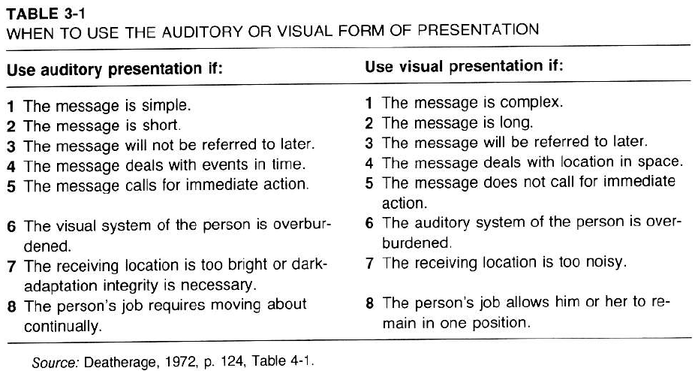
SELECTION OF DISPLAY MODALITY
Visual or auditory displays? Tactual sense? The selection of the sensory modality depends on a number of considerations.
Table 3.1 helps in making a decision regarding visual or auditory presentation of information.

Slide 8
CODING OF INFORMATION
Coding takes place when the original stimulus information is converted to a new form and displayed symbolically.
Examples are:
radar screens where the aircrafts are converted and presented as dots on the screen
maps displaying populations of different cities with different symbols.

Slide 9
CODING OF INFORMATION (Cont.)
Information is coded along various dimensions.
Examples:
Varying the size, brightness, color and shape of targets on a computer screen.
Varying the frequency, intensity, or on-off pattern of an audio warning signal.
Each of the above variations constitutes a dimension of the displayed stimulus, or a stimulus dimension.

Slide 10
CODING OF INFORMATION (Cont.)
The usefulness of any stimulus dimension in conveying information depends on the ability of people to:
Identify a stimulus based on its position along the stimulus dimension (such as identifying a target as bright or dim, large or small)
This is an example of absolute judgment.
Distinguish between two or more stimuli which differ along the stimulus dimension (such as indicating which of the two stimuli is brighter or larger)
This is an example of relative judgment.

Slide 11
CHARACTERISTICS OF A GOOD CODING SYSTEM
Detectability of codes:
stimulus must be detectable by human sensory mechanisms under expected environmental conditions
e.g. is worker able to see the control knob in mine?
Discriminability of codes:
every code symbol must be discriminable (differentiable) from other symbols
the number of coding levels is important
Meaningfulness of codes:
coding system should use codes meaningful to user
Meaning could be
inherent in the code (e.g. bent arrow on traffic sign)
or learned (e.g. red color for danger)
Meaningfulness: related to conceptual compatibility

Slide 12
CHARACTERISTICS OF A GOOD CODING SYSTEM (cont.)
Standardisation of codes:
when a coding system is to be used by different people in different situations, it is important that the codes be standardised, and kept the same for different situations
e.g. meaning of the red color in different parts of a factory
Use of multidimensional codes:
this can increase the number and discriminability of coding stimuli used.

Slide 13
COMPATIBILITY
It is the relationship between the stimuli and the responses to human expectations.
A major goal in any design is to make it compatible with human expectations.
It is related to the process of information transformation
the greater the degree of compatibility, the less recording must be done to process information
This leads to faster learning and response time, less errors, and reduced mental workload.
People like things that work as they expect them to work.

Slide 14
COMPATIBILITY (Cont.)
Four types of compatibility:
Conceptual
Movement
Spatial
Modality
1. Conceptual compatibility:
related to degree that codes, symbols correspond to conceptual associations people have.
It relates to how meaningful codes and symbols are to people who use them.
e.g.: airplane symbol to denote an airport on a map means much more than a square or circle
e.g.: creating meaningful abbreviations and names for computer applications

Slide 15
COMPATIBILITY (Cont.)
2. Movement compatibility:
relates to the relationship between the movement of the displays and controls and the response of the system being displayed or controlled.
e.g.: to increase the volume on the radio, we expect to turn the knob clockwise.
e.g.: upward movement of a pointer is expected to correspond to an increase in a parameter
3. Spatial Compatibility
Refers to the physical arrangement in space of controls and their associated displays
e.g. how displays are lined-up with respect to corresponding control knobs

Slide 16
COMPATIBILITY (Cont.)
4. Modality compatibility:
refers to the fact that certain stimuli-response modality combinations are more compatible with some tasks than with others.
e.g.: responding to a verbal command that needs verbal action is faster than responding to a written or displayed command requiring the same verbal action.

