Slide 1
King Saud University College of Engineering IE – 341: “Human Factors” Spring – 2016 (2nd Sem. 1436-7H)
Chapter 3. Information Input and Processing
Part – 4: Signal Detection Theory
Prepared by: Ahmed M. El-Sherbeeny, PhD

Slide 2
Contents
A Model of Information Processing
Perception
Signal Detection Theory

Slide 3
A Model of Information Processing

Slide 4
A Model of Information Processing
What are models? What are they used for?
Models are “abstract representations of a system or process”
Best way to evaluate models is to see what they are used for
“Good” model = one that can represent behavior of actual system well
Types of models:
Mathematical, physical, structural, verbal
Information theory: mathematical model of info. transfer in communication systems
Signal Detection Theory: also mathematical model
Stages of Human Information Processing:
Model of human information processing (next slide) shows
Major stages of human info. Processing
Relationships between them
Notes:
Source: Sander and McCormick (Ch. 3), 1993
Abstract: i.e. theoretical

Slide 5
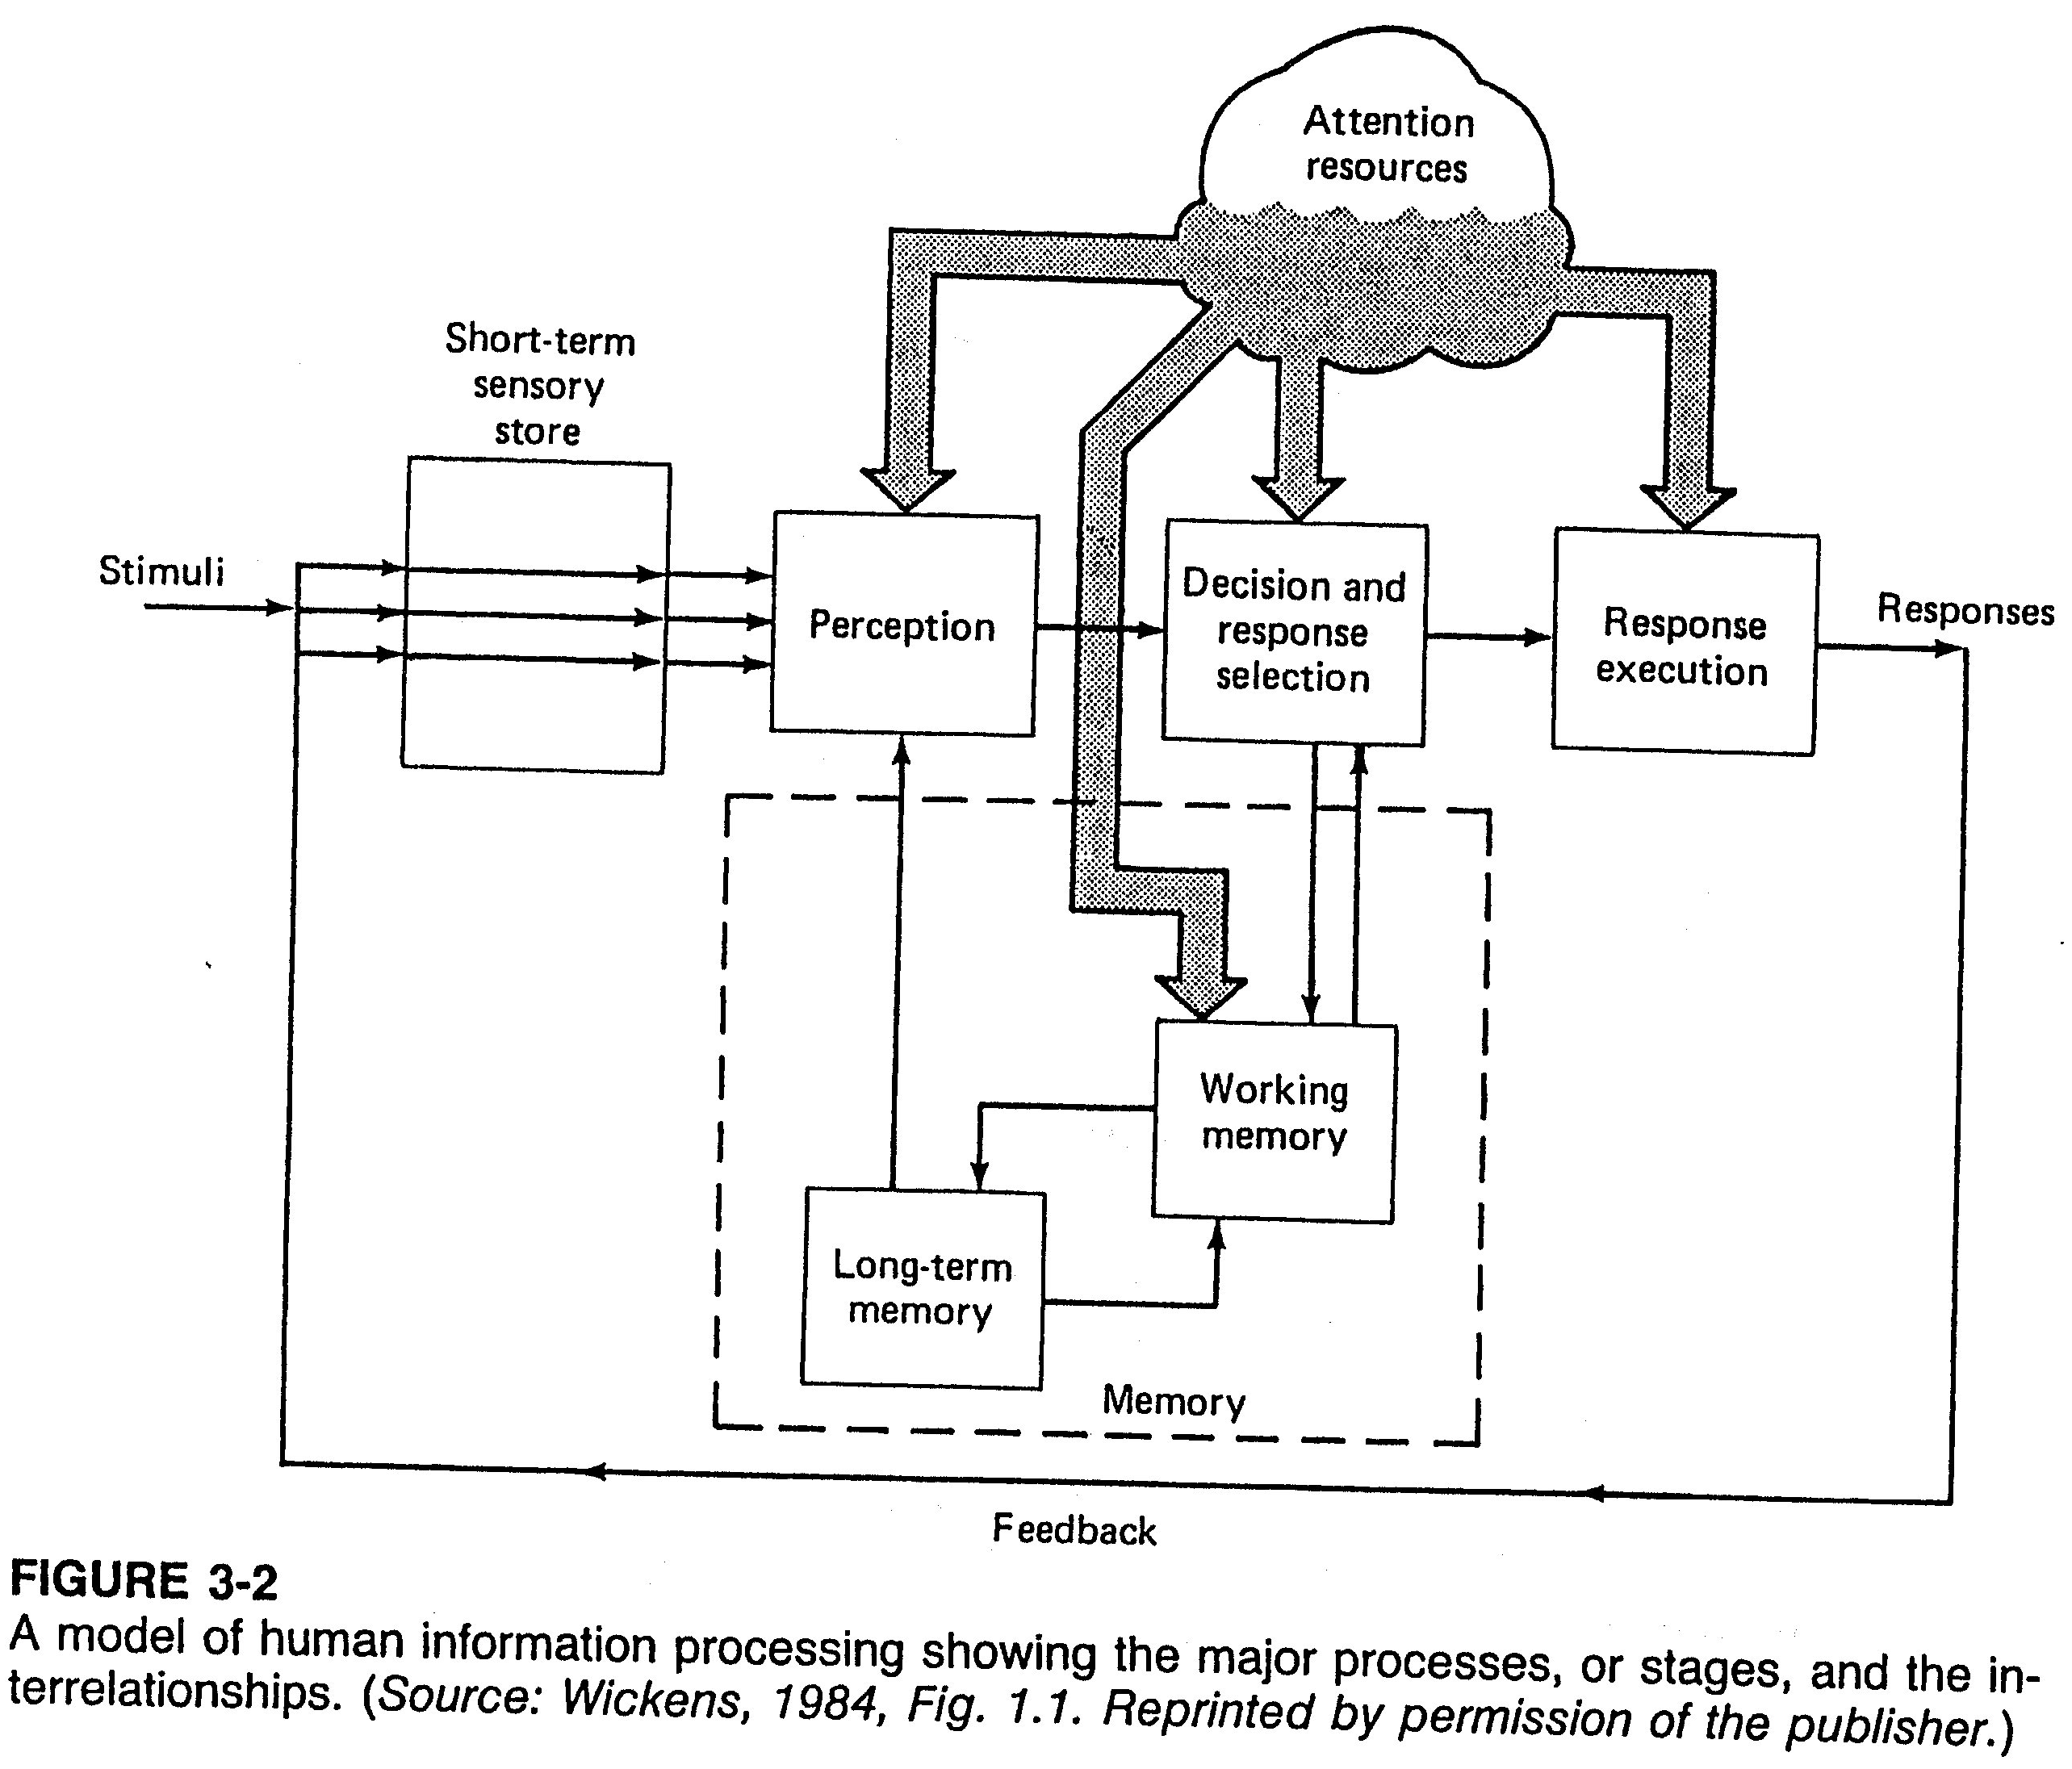
Cont. A Model of Information Processing
Notes:
Source: Sander and McCormick (Ch. 3), 1993
Note how model is like a black box receiving stimuli, and producing stimuli, which in turn provide feedback, which starts the cycle again
Use example: when some warning light (e.g. “change oil” comes on while driving on the highway)

Slide 6
Perception

Slide 7
Perception
Levels of Perception
Level of perception depends on: stimulus & task that person faces
Forms of perception:
Detection (most basic form): determine if signal is present/not
Identification/Recognition: indicating in which class target belongs
Multilevel classification: making abs. judgment along stimulus dimension
Activities Involved with Perception:
Perception involves our prior
Experiences
Learned associations (line connecting long-term memory – perception)
Simple detection involves complex
Information processing
Decision making
This is included within signal detection theory
Notes:
Source: Sander and McCormick (Ch. 3), 1993

Slide 8
Signal Detection Theory

Slide 9
Signal Detection Theory
Overview of Signal Detection Theory (SDT)
Involves situations where
Two discrete situations exist: signal / no signal
Situations cannot be easily discriminated
Examples:
Detecting cavity on tooth x-ray
Detecting defective component in a factory
Detecting rain in weather forecast
Concepts Associated with SDT
Concept of noise
Possible outcomes
Concept of response criterion
Influencing the response criterion
Concept of sensitivity
Applications of SDT
Notes:
Source: Sander and McCormick (Ch. 3), 1993

Slide 10
Cont. Signal Detection Theory
Concept of Noise
Nature of Noise:
Involved with any situation
Interferes with detection of signal
Noise is generated:
Externally (e.g. false radar return on radar screen)
Internally: within person (e.g. miscellaneous neural activity)
Noise value:
Intensity varies from low to high with time
Forms normal (bell-shaped) distribution
When “signal” occurs:
Intensity is added to background noise
Person must decide if input (what s/he senses) consists of:
Only noise, or
Noise + signal
Notes:
Source: Sander and McCormick (Ch. 3), 1993

Slide 11
Cont. Signal Detection Theory
Possible Outcomes
First note the following:
Person must decide: signal occurred / did not occur (2 possibilities)
There are two realities: signal did occur / did not occur
Thus, there are four possible outcomes:
Hit: saying “signal” where there is signal
False Alarm (FA): saying “signal”/there’s no signal
Miss: saying “no signal” / there is signal
Correct Rejection (CR): saying “no signal” / there’s no signal
Response | Signal
 | Yes | No
Yes | s / y | s / n
No | ns / y | ns / n
⇒
Response | Signal
 | Yes | No
Yes | HIT | FA
No | MISS | CR
Notes:
Source: Sander and McCormick (Ch. 3), 1993

Slide 12
Cont. Signal Detection Theory
Concept of Response Criterion
SDT helps with understanding how detection process works
Basis of SDT:
People set criterion along “hypothetical continuum of sensory activity”*
People then use this as a basis for making their decisions
We then find out position of criterion along continuum
This determines probability of four outcomes (last slide)
This process is illustrated in next slide (Figure 3-3)
Notes regarding Figure 3-3:
Figure shows hypothetical distributions of sensory activity in cases:
Only noise is present
Signal is added to noise
The two distributions (noise and signal + noise overlap)
⇒ noise level alone may be > signal + noise (in which case?)
Notes:
Source: Sander and McCormick (Ch. 3), 1993
* i.e. people (depending on their judgment/personality/data/experience, etc) decide where signal occurs along all available sensory possibilities

Slide 13
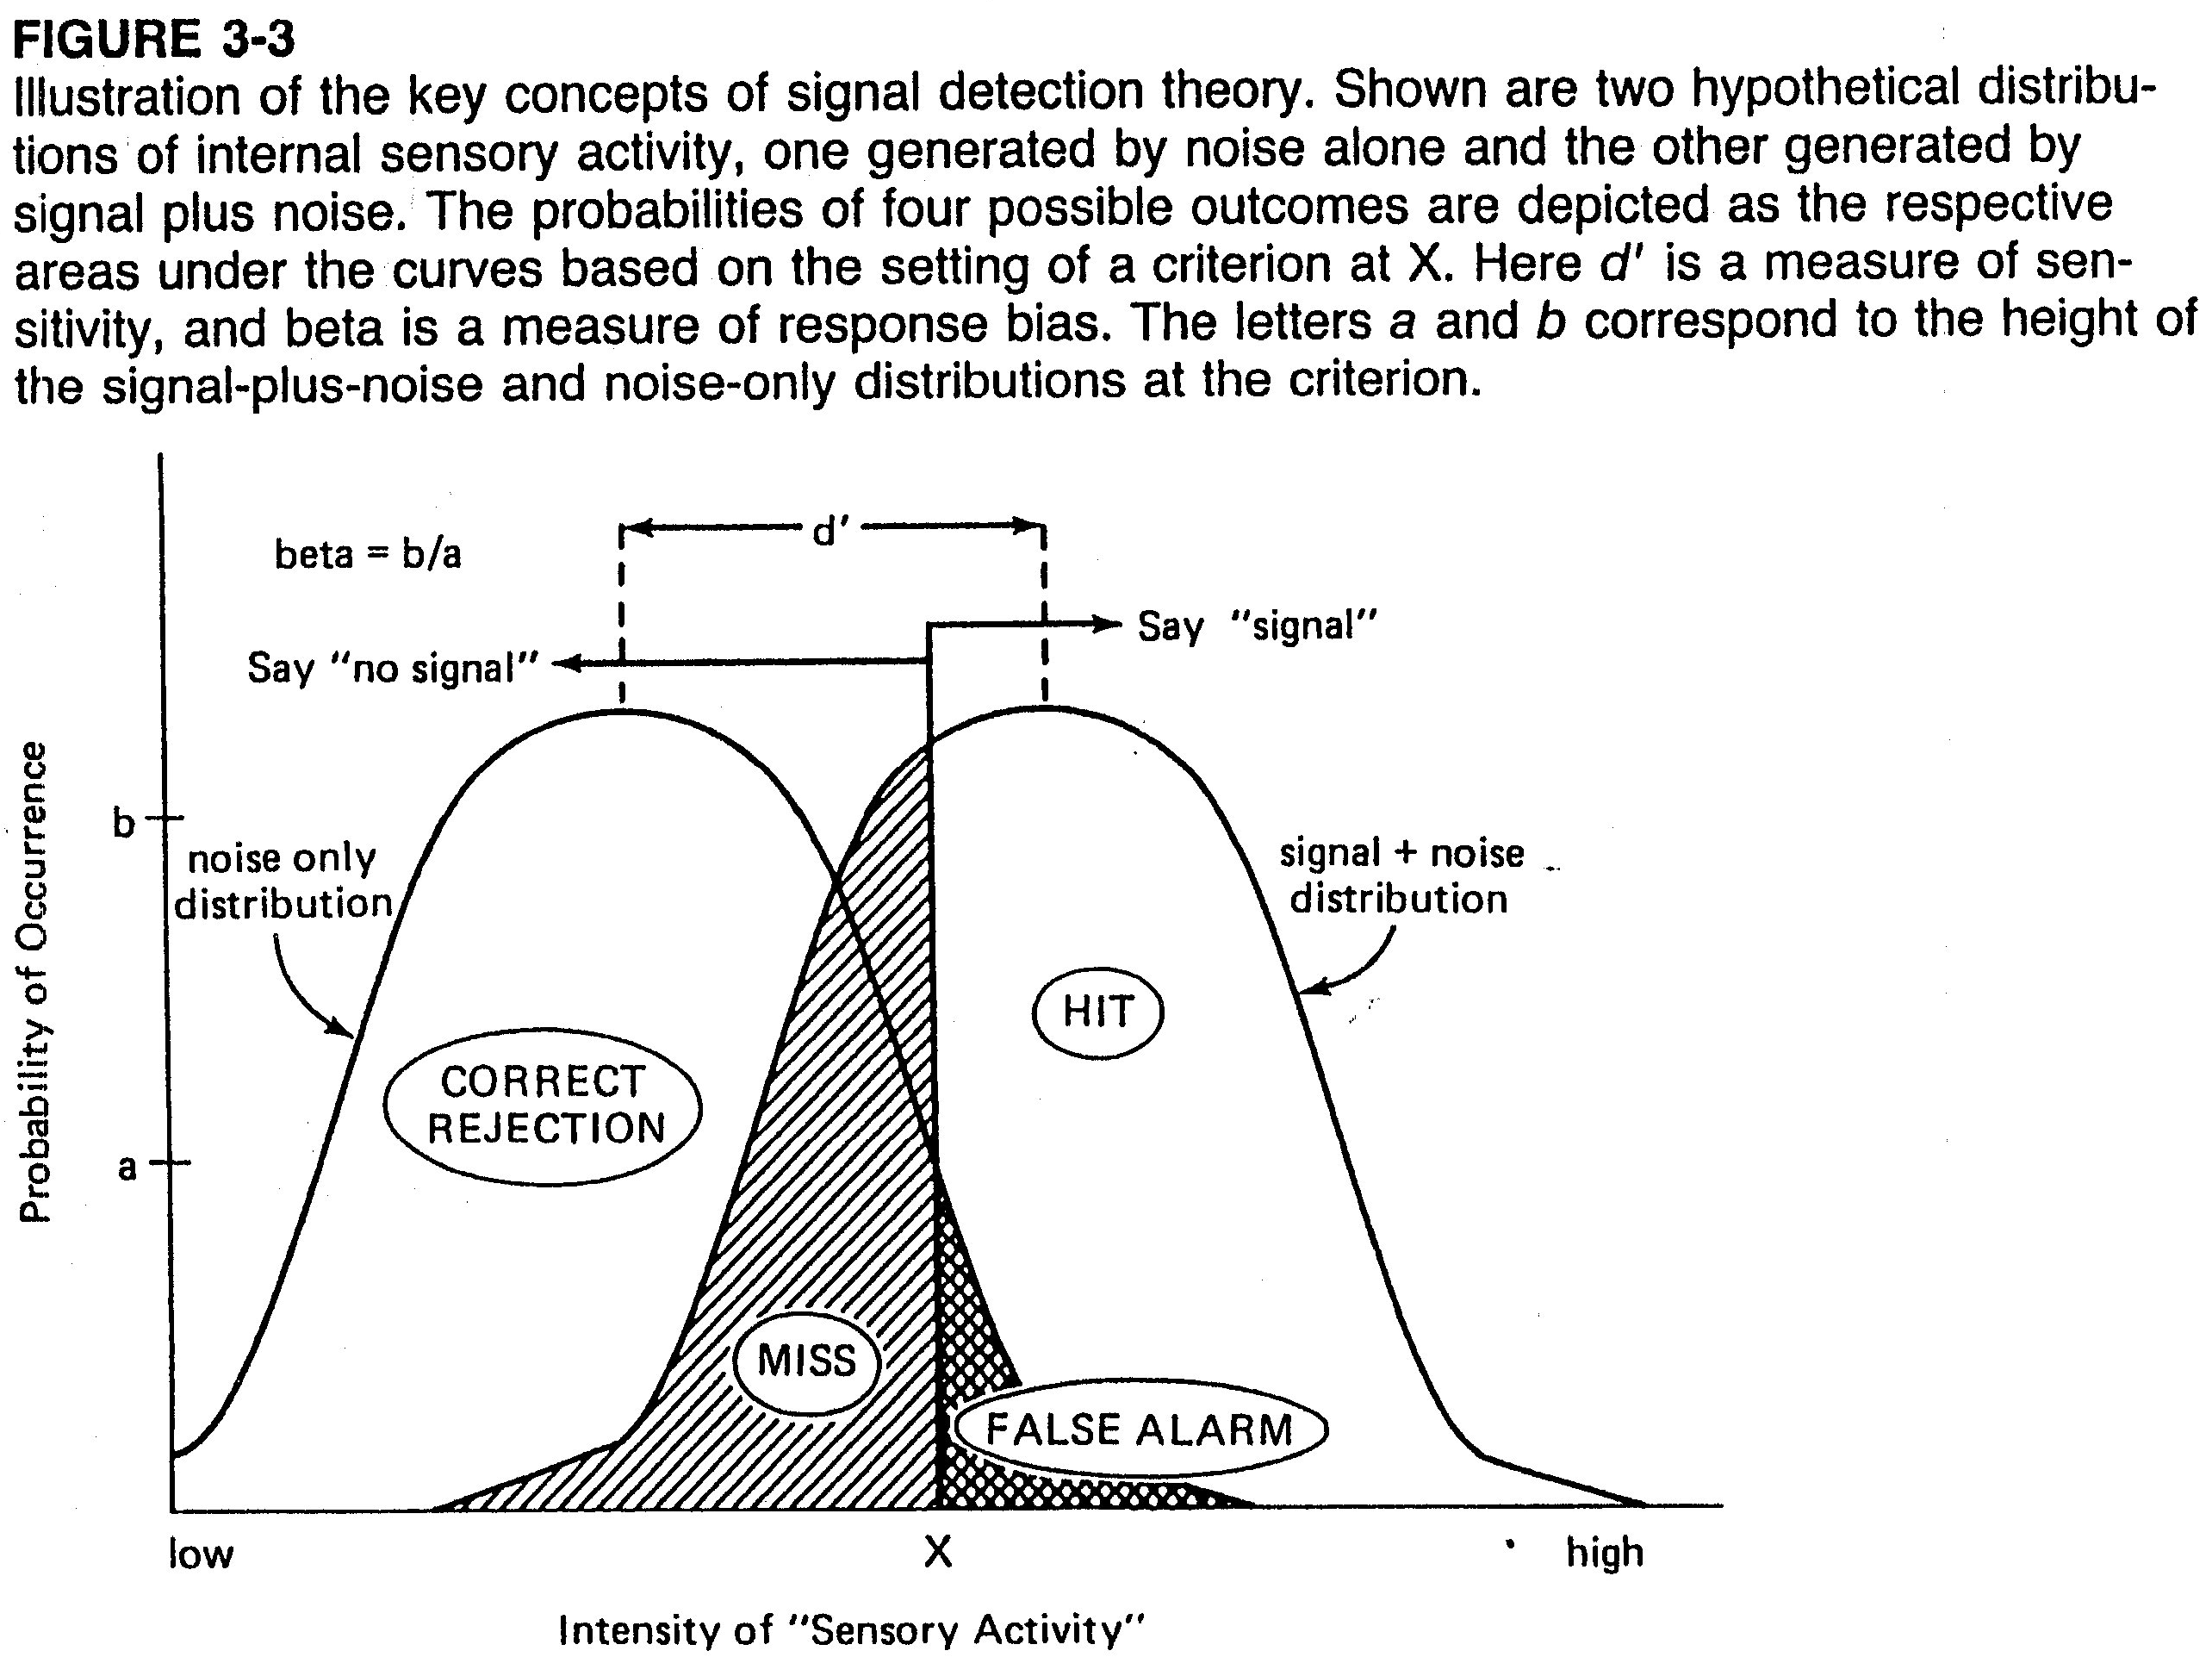
Cont. Signal Detection Theory
Notes:
Source: Sander and McCormick (Ch. 3), 1993

Slide 14
Cont. Signal Detection Theory
Cont. Concept of Response Criterion (RC)
SDT assumes person sets criterion, such that when:
Level of sensory activity > set criterion ⇒ person says: “signal present”
Level of sensory activity < set criterion ⇒ person says: “no signal”
Probabilities of four outcomes determined based on criterion (Figure)
Quantity “beta” (aka response criterion / response bias)
Based on position of criterion
$beta = b / a$
i.e. beta is ratio of signal : noise, or ratio of height of 2 curves @ criterion
Values of beta (see next slide)
Beta = 1, when two distributions intersect (can you show this?)
When criterion is shifted to right ⇒
Beta increases (i.e. $>1.0$)
Person says “signal” less ⇒ hits ↓, but also FA ↓
Person is considered: “conservative”
When criterion is shifted to left ⇒
Beta decreases (i.e. $<1.0$)
Person says “signal” more ⇒ hits ↑, but also FA ↑
Person is considered: “risky” (aka “liberal”)*
Notes:
Source: Sander and McCormick (Ch. 3), 1993
* Q: based on the criterion shown in the figure in the last slide, is the person here considered conservative or liberal?

Slide 15
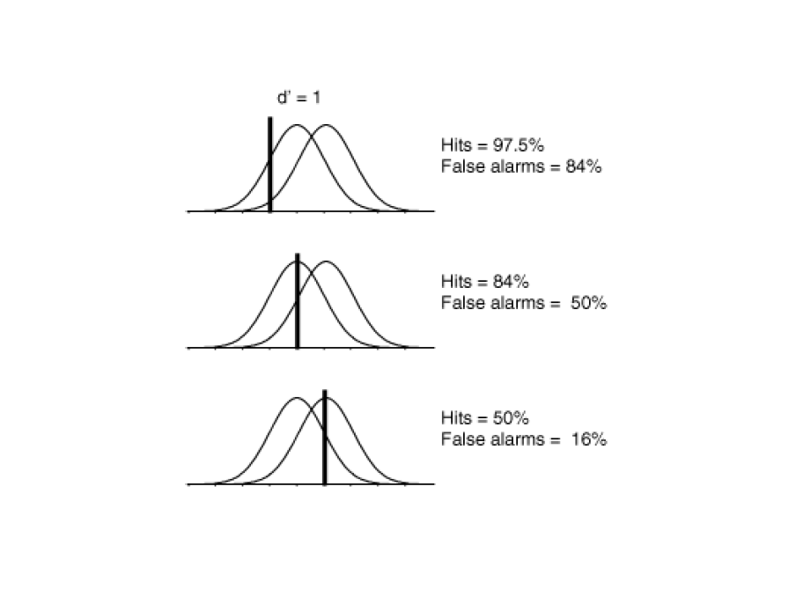
Cont. Signal Detection Theory
Effect of changing $beta$ / criterion (constant $d’$)
Notes:
Source: Sander and McCormick (Ch. 3), 1993
What is beta in each case above? Which cases are conservative, which cases are risky (liberal)? What is optimum case? Why?

Slide 16
Cont. Signal Detection Theory
Influencing the Response Criterion
Two variables affect setting the criterion
Probability of detecting a signal
Costs and benefits associated with 4 possible outcomes
Probability of detecting a signal:
e.g. If you told dentist tooth was hurting you ⇒
Probability that you have cavity ↑
⇒ after seeing suspicious spot on x-ray ⇒ dentist will likely say: “cavity”
⇒ criterion ↓ (i.e. beta ↓) ⇒ i.e. dentist can make “risky” assessment
Costs and benefits associated with 4 possible outcomes
What is cost of false alarm (saying “cavity”, when there’s no cavity)?
⇒ tooth gets drilled without need
What is cost of miss (saying “no cavity”, when there is cavity)?
⇒ cavity worsens ⇒ may lose tooth
So, what should dentist do? (i.e. after weighing costs?)
Most likely: set low criterion ⇒ call suspicious spot: “cavity”
But what if you go regularly? ⇒ he will be more conservative (why?)* ⇒ will set a high criterion, and will not call it “cavity”
Notes:
Source: Sander and McCormick (Ch. 3), 1993
* He will be more conservative, since he knows that even if he missed it this time, it will show up more in next visit, so he will be reluctant (i.e. more conservative) this time to drill in the fear he might drill needlessly (thus, he will balance the issue from the two sides)

Slide 17
Cont. Signal Detection Theory
Concept of Sensitivity
What is sensitivity? It is keenness / resolution of sensory system
RC vs. sensitivity in SDT: they are both independent of each other
How to measure sensitivity (aka: $d’$)
Sensitivity: $d’$ = separation between 2 distributions (see Figure 3-3)
Measured in units of standard deviation: (aka Z-score)
SD’s of 2 distributions are assumed equal
As separation ↑ ⇒ sensitivity ↑ ⇒ $d’$ ↑ (note, best to have high $d’$ *)
Most applications: $d^{′}=\left[0.5−2\right]$ (see next slide)
Factors affecting $d^{′}$
Some signal systems have more noise than others, thus:
As noise ↑ ⇒ $d^{′}$ ↓
Also note, as signal ↓ ⇒ $d^{′}$ (can you show this on Figure 3-3?)
Ability of people to memorize physical characteristics of signal
Memory aids ⇒ $d^{′}$ ↑ (see Figure 3-2)
e.g. for dentist: $d^{′}$ ↑ by:
Using better x-ray equipment
Comparing x-ray of patient with previous x-rays of cavities
Notes:
Source: Sander and McCormick (Ch. 3), 1993
* note, increasing $d’$ (i.e. less noise in general) will make it less likely to make less false alarms, less misses, more hits, more correct rejections

Slide 18
Cont. Signal Detection Theory
Effect of changing $d’$
Notes:
Source: Sander and McCormick (Ch. 3), 1993

Slide 19
Cont. Signal Detection Theory
Applications of SDT
Many practical applications (from various studies):
Sonar target applications
Industrial inspection tasks
Medical Diagnosis
Forensic science
Eye witness testimony
Air traffic control
Weather forecasting
Reservations
SDT should not be accepted without criticism (use with “grain of salt”)
Using in some situations may ⇒ invalid results
Reasons:
Theory developed in lab (controlled conditions/experiments)
Subjects given many, many trials
Controlled signals and background noise levels
Some applications don’t match these conditions
Notes:
Source: Sander and McCormick (Ch. 3), 1993

Slide 20
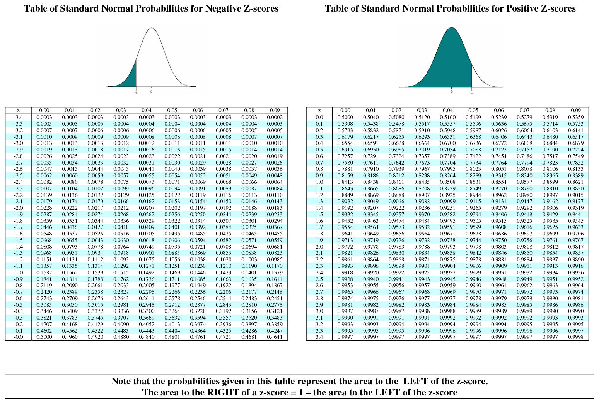
Cont. Signal Detection Theory
Notes:
Source: Sander and McCormick (Ch. 3), 1993

