Slide 1
CHAPTER ONE : Fits and Tolerances
1
CHAPTER ONE – Part 2
Geometrical Tolerances
Main references:
http://www.gdandtbasics.com/gdt-symbols/
http://www.engineeringessentials.com/gdt/
CONTENTS

Slide 2
Dimension
A dimension is "a numerical value expressed in appropriate units of measure and indicated on a drawing and in other documents along with lines, symbols, and notes to define the size or geometric characteristic, or both, of a part or part feature"
Dimensions on part drawings represent nominal or basic sizes of the part and its features.
The dimension indicates the part size desired by the designer, if the part could be made with no errors or variations in the manufacturing process

Slide 3
Tolerances
A tolerance is "the total amount by which a specific dimension is permitted to vary. The tolerance is the difference between the maximum and minimum limits"
Variations occur in any manufacturing process, which are manifested as variations in part size
Tolerances are used to define the limits of the allowed variation
Notes:
https://www.google.com/url?sa=t&rct=j&q=&esrc=s&source=web&cd=1&cad=rja&uact=8&ved=0ahUKEwisto-g--LKAhWhg3IKHUKtCNoQFggcMAA&url=http%3A%2F%2Fwww.endustri.anadolu.edu.tr%2Fmumtaze%2FENM208%2Ficerik%2FLecture-3_Tolerances_and_Surfaces.ppt&usg=AFQjCNFR_ATYTlWDdlFETfrnMt3fxHvRcw&sig2=mEVXyZRTxT0HEWU0WiupUA&bvm=bv.113370389,d.bGQ

Slide 4
Types of Tolerances
A Dimensional tolerance is the total amount a specific dimension is permitted to vary, which is the difference between maximum and minimum permitted limits of size.
A Geometric tolerance is the maximum or minimum variation from true geometric form or position that may be permitted in manufacture.
Geometric tolerance should be employed only for those requirements of a part critical to its functioning or interchangeability. These are much more difficult to measure/verify as compared to dimensional tolerances.

Slide 5
Overview of Geometric Tolerances
Geometric tolerances define the shape of a feature as opposed to its size.
We will focus on three basic types of geometric tolerances:
Form tolerances: straightness, circularity, flatness, cylindricity;
Orientation tolerances; perpendicularity, parallelism, angularity;
Location tolerances: position, symmetry, concentricity.

Slide 6
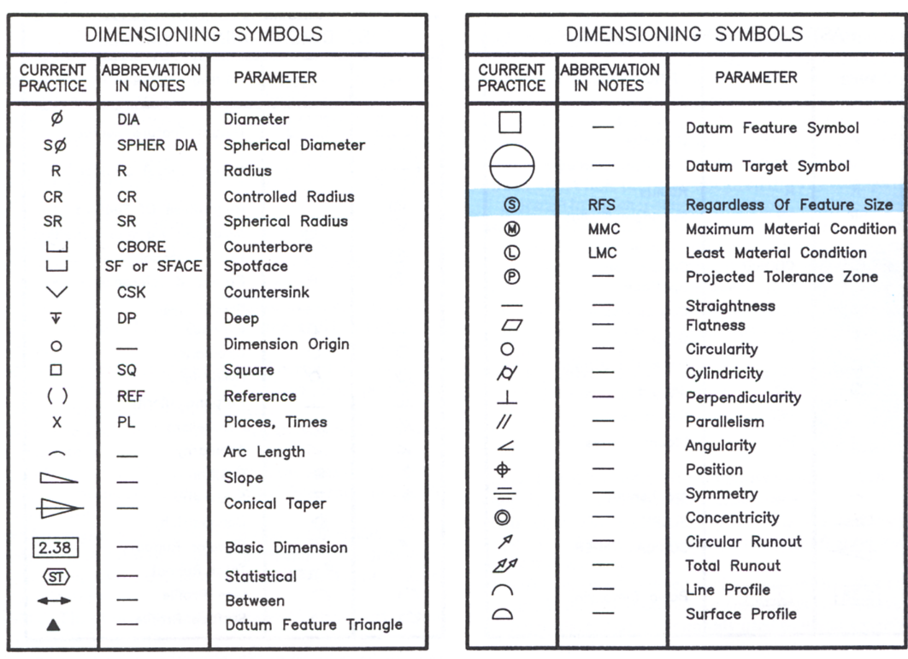
Symbols for Geometric Tolerances
Form
Orientation
Location

Slide 7
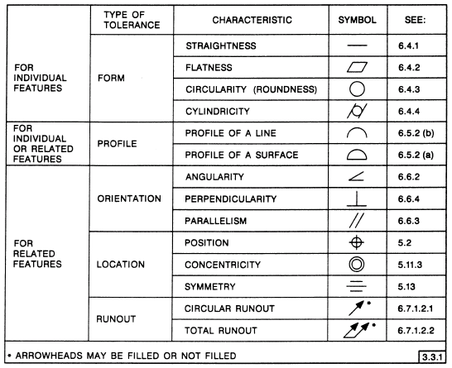
Most Common Symbols

Slide 8
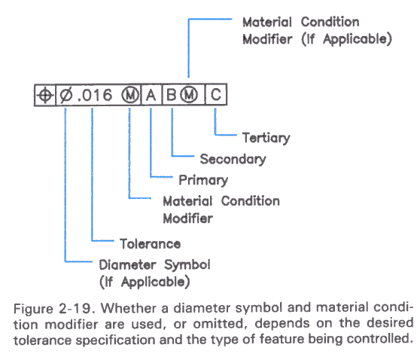
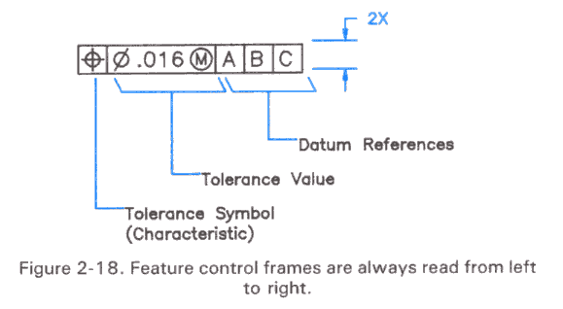
Feature Control Frame
A geometric tolerance is prescribed using a feature control frame.
It has three components:
1. the tolerance symbol,
2. the tolerance value,
3. the datum labels for the reference frame.

Slide 9
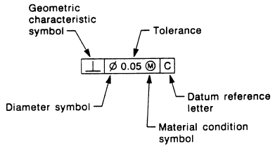
Feature Control Frame
How do you read this feature control frame?
“The specified feature must lie perpendicular within a tolerance zone of 0.05 diameter at the maximum material condition, with respect to datum axis C.”
In other words, this places a limit on the amount of variation in perpendicularity between the feature axis and the datum axis. In a drawing, this feature control frame would accompany dimensional tolerances that control the feature size and position.

Slide 10
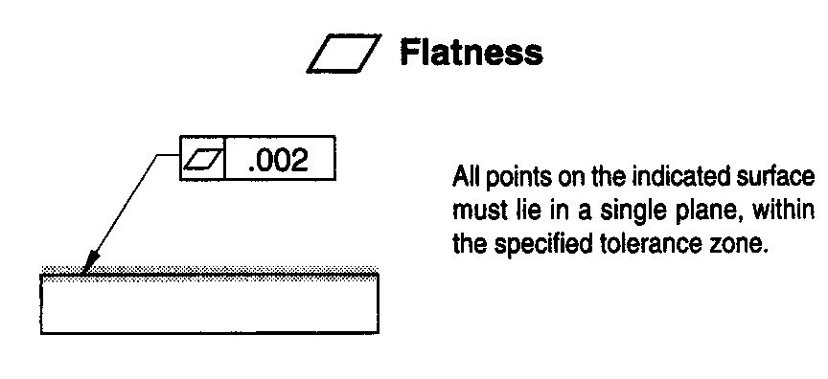
Geometrical Tolerances (Form)
The flatness tolerance defines a distance between parallel planes that must contain the highest and lowest points on a face.

Slide 11
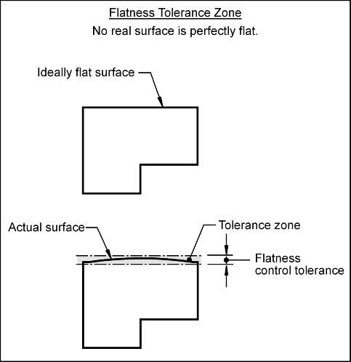
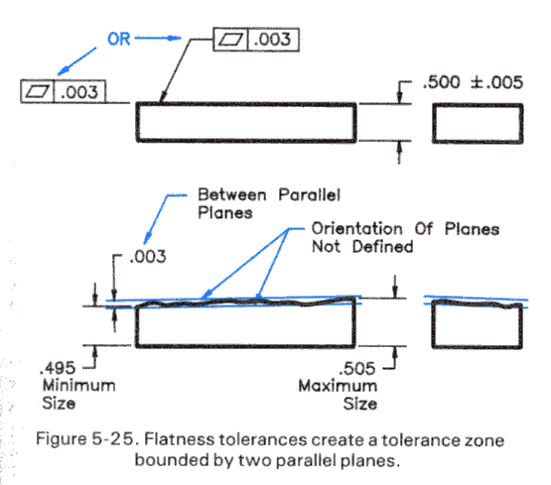
Flatness
Flatness tolerance is typically used for sliding surfaces, sealing surfaces, and appearance, etc.
Notes:
http://www.engineeringessentials.com/gdt/

Slide 12
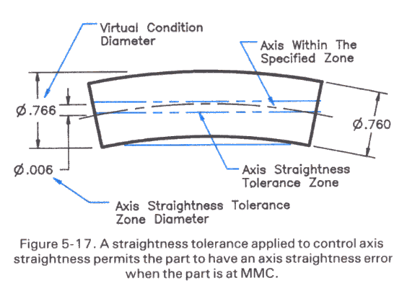
Geometrical Tolerances (Form)
Straightness tolerancing is typically applied to a cylindrical features (pins, shafts, bars,etc.) to control bowing and other distortions.

Slide 13
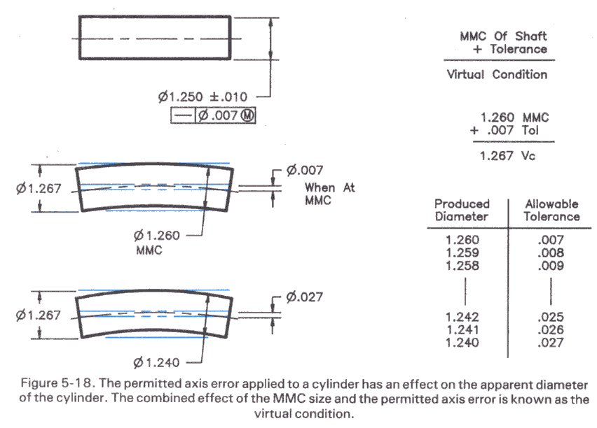
Geometrical Tolerances (Form)
Add the straightness tolerance to the maximum shaft size (MMC) to obtain a “virtual condition” Vc, or virtual hole, that the shaft must fit to be acceptable.
Notes:
http://www.practicalmachinist.com/vb/general-archive/flatness-vs-straightness-74599/
look under geometric dimensioning and tolerancing. a.k.a. gd&t. a flatness tolerance specifies how much a part surface is allowed to vary from the perfect plane implied by the print. a flatness tolerance zone is the distance between two parallel planes; the part surface must lie between them. flatness tolerancing is typically used for sliding surfaces, sealing surfaces, and appearance, etc. a straightness tolerance is used to control the straightness of a surface or an axis. it specifies how much the surface or axis is allowed to vary from the perfect straight line implied by the print. straightness tolerancing is typically applied to a cylindrical features (pins,shafts,bars,etc.) to control bowing and other distortions it may also be applied to flat surfaces. this is straight out of my gd&t book, i hope it helps straightness tolerance of a flat surface means that each longitudinal element of the surface must lie within the tolerance zone specified on the print in the direction indicated.

Slide 14
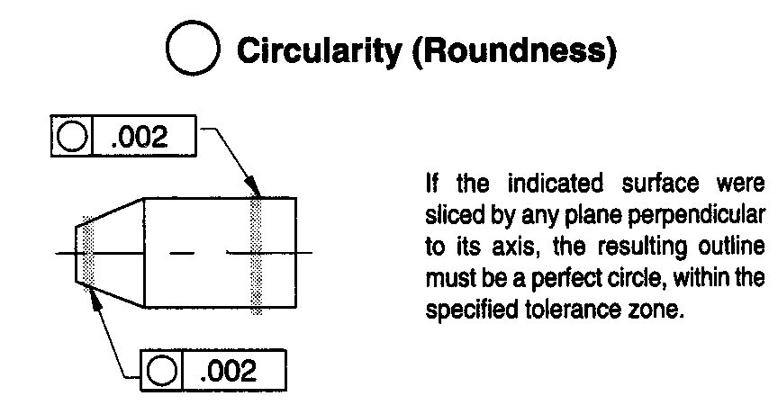
Geometrical Tolerances (Form)
The circularity control defines how much each circular cross-sections of a cylinder, sphere or cone may deviate from its perfect circular form.

Slide 15
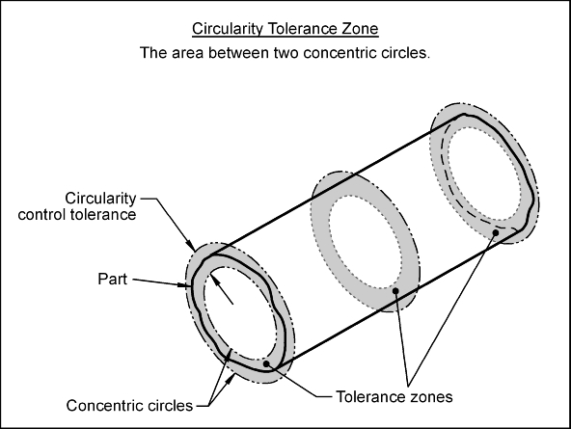
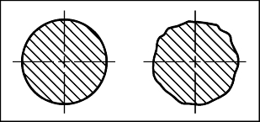
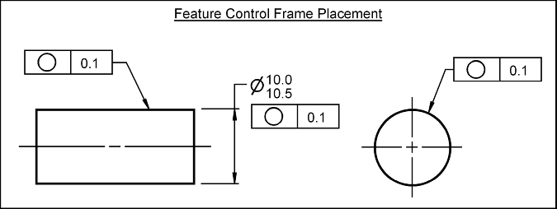
Circularity
Notes:
http://www.engineeringessentials.com/gdt/
https://www.pmpa.org/docs/technical-conference/gaining-confidence-with-gd-t---part-1.pdf?sfvrsn=0 (HOW TO MEASURE GEO TOLERANCES)

Slide 16
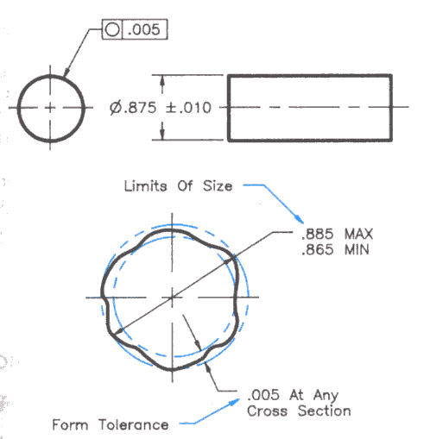
Circularity
Notes:
https://www.pmpa.org/docs/technical-conference/gaining-confidence-with-gd-t---part-1.pdf?sfvrsn=0 (HOW TO MEASURE GEO TOLERANCES)

Slide 17
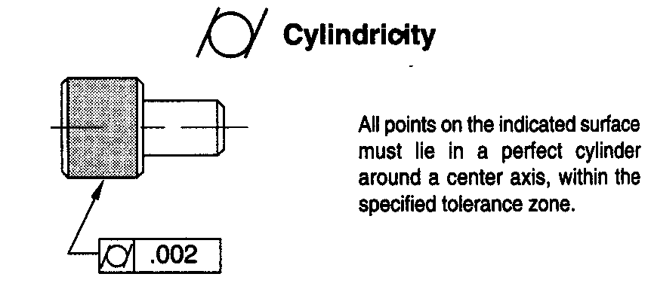
Geometrical Tolerances (Form)
The cylindricity control defines how much a cylindrical surface on a real part may vary from an ideal cylinder that is perfectly round, perfectly straight and has no taper.

Slide 18
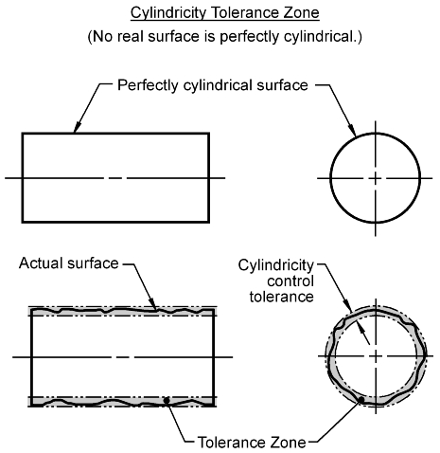
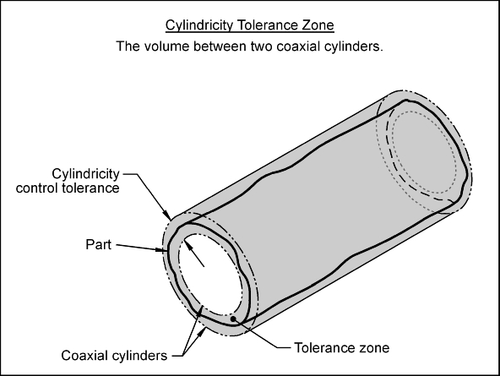
Cylindricity
Notes:
http://www.engineeringessentials.com/gdt/cylindricity/cylindricity.htm

Slide 19
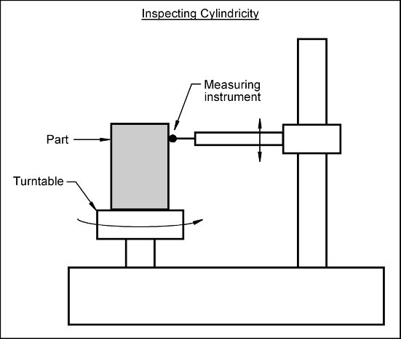
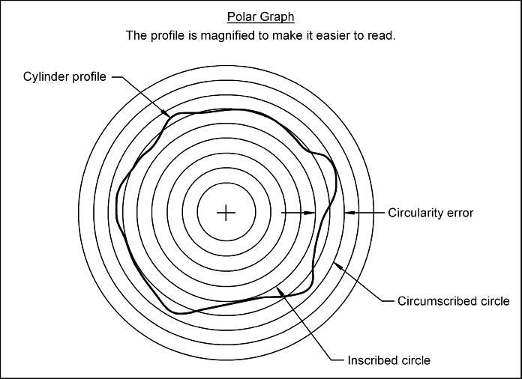
Cylindricity
CMM Video: https://www.youtube.com/watch?v=m5be1CWYRc0
Notes:
http://www.engineeringessentials.com/gdt/cylindricity/cylindricity.htm

Slide 20
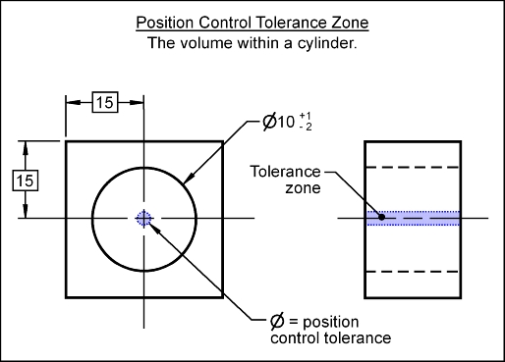
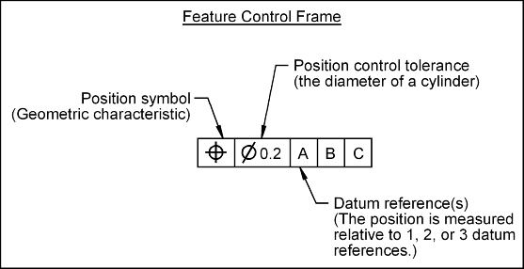
Position
Geometrical Tolerances (Location)
The position tolerance can control a center point, axis, or center plane. The position tolerance defines how much the location of a feature may deviate from its true position.
The position tolerance zone for a controlled axis is the volume defined by a cylinder. The diameter of the cylinder is the stated value of the position control tolerance. The axis being controlled must lie with in the volume defined by the tolerance zone.

Slide 21
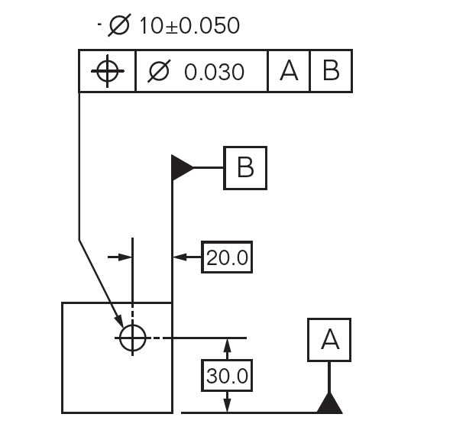
Position
Geometrical Tolerances (Location)

Slide 22
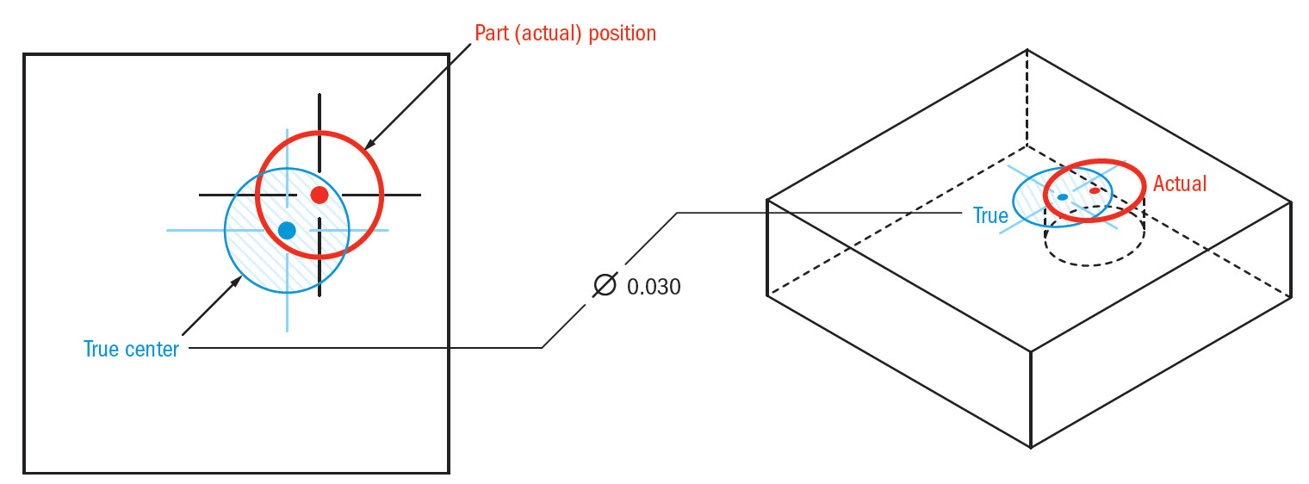
Position
Geometrical Tolerances (Location)
Notes:
http://www.gdandtbasics.com/true-position/

Slide 23
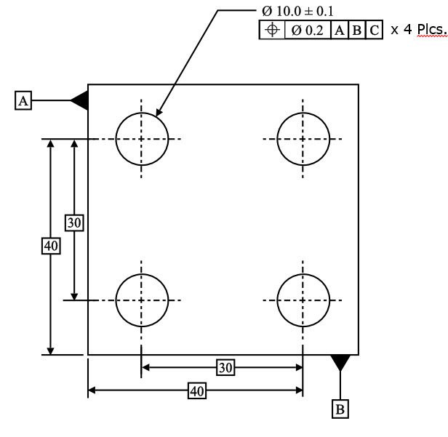
Position
Geometrical Tolerances (Location)

Slide 24
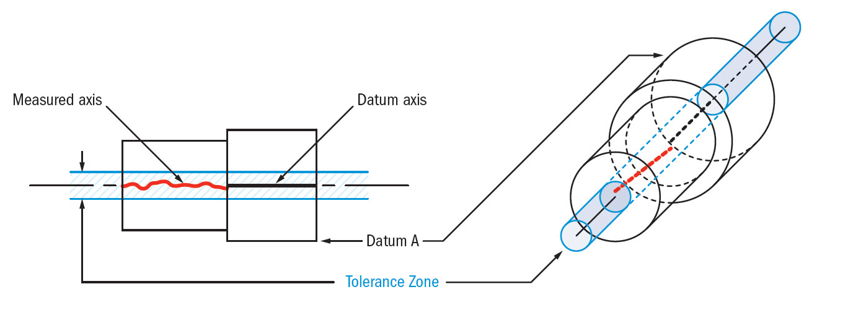
Concentricity
Geometrical Tolerances (Location)
Concentricity, sometimes called coaxially, is a tolerance that controls the central axis of the referenced feature, to a datum axis.
Notes:
http://www.gdandtbasics.com/concentricity/

Slide 25
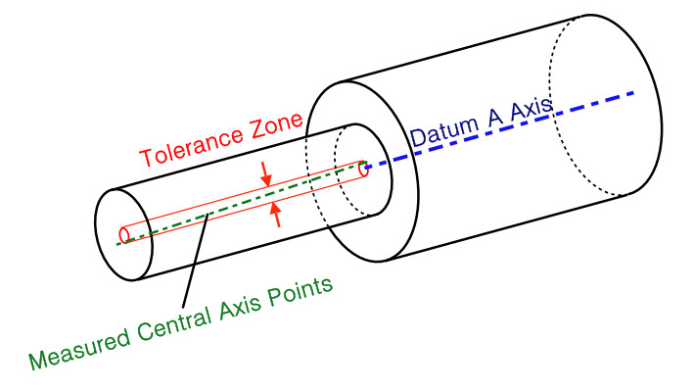
Concentricity
Geometrical Tolerances (Location)
A concentricity tolerance specifies a cylindrical tolerance zone whose axis coincides with a datum axis and within which all cross-sectional axes of the feature being controlled must lie.
Notes:
http://www.gdandtbasics.com/concentricity/
http://www.etinews.com/blog/wp-content/gallery/effective-training/blog-question-april2010a.jpg

Slide 26
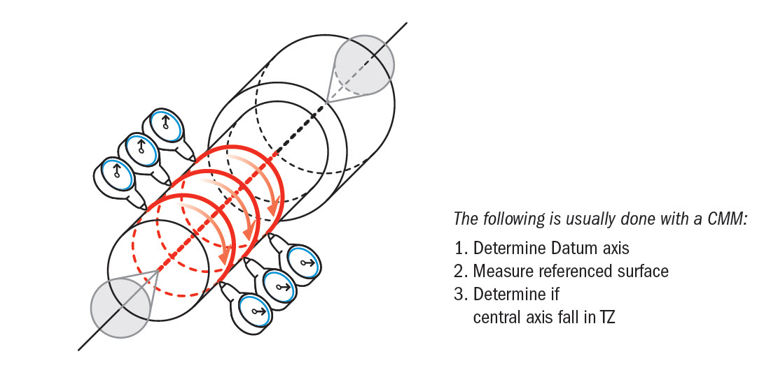
Concentricity
Geometrical Tolerances (Location)
A concentricity tolerance specifies a cylindrical tolerance zone whose axis coincides with a datum axis and within which all cross-sectional axes of the feature being controlled must lie.
Notes:
http://www.gdandtbasics.com/concentricity/

Slide 27
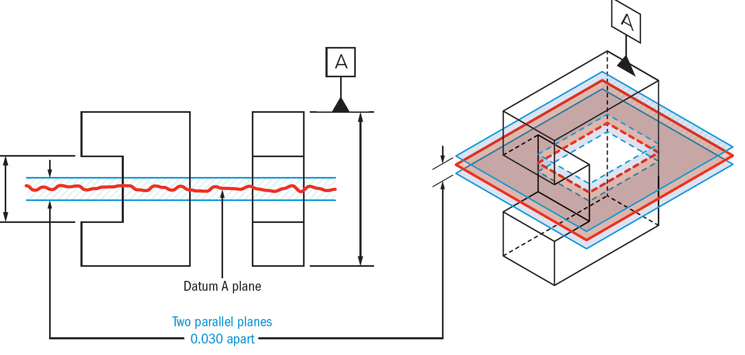
Symmetry
Geometrical Tolerances (Location)
Symmetry is a 3-Dimensional tolerance that is used to ensure that two features on a part are uniform across a datum plane.
Symmetry is very difficult to measure. Due its tolerance zone being constrained to a virtual plane
Notes:
http://www.gdandtbasics.com/profile-of-a-line/

Slide 28
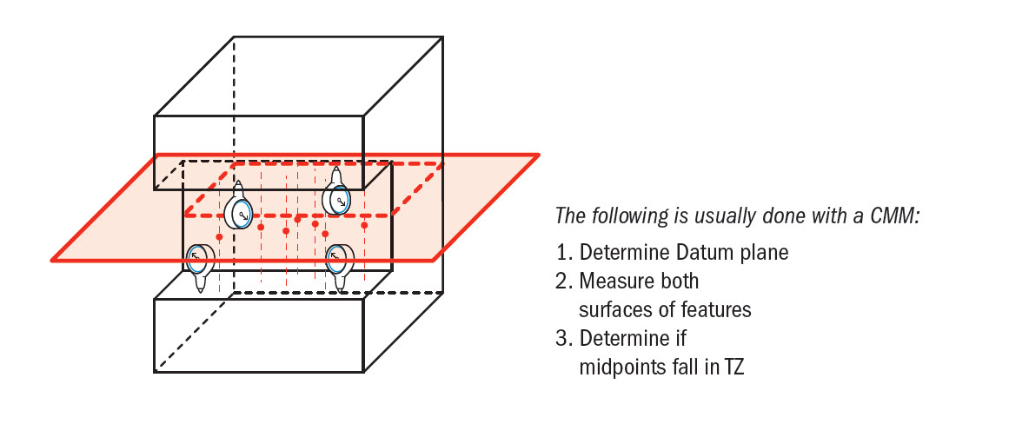
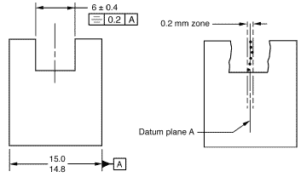
Symmetry
Symmetry is very difficult to measure. Due its tolerance zone being constrained to a virtual plane
Notes:
http://www.gdandtbasics.com/profile-of-a-line/

Slide 29
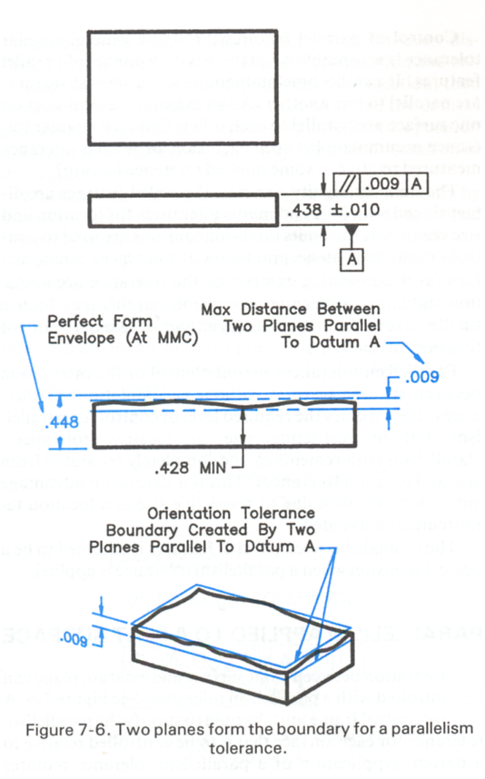
Parallelism Tolerance
Geometrical Tolerances (orientation)
A parallelism tolerance is measured relative to a datum specified in the control frame.
If there is no material condition (i.e.. regardless of feature size), then the tolerance defines parallel planes that must contain the maximum and minimum points on the face.
It relates the orientation of one surface plane parallel to another datum plane in a 3-Dimensional tolerance zone. The tolerance indirectly controls the 0° angle between the parts by controlling where the surface can lie based on the datum.

Slide 30
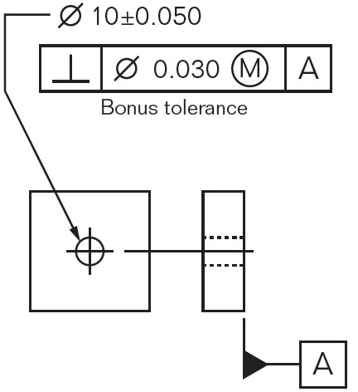
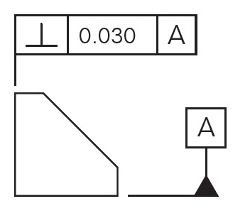
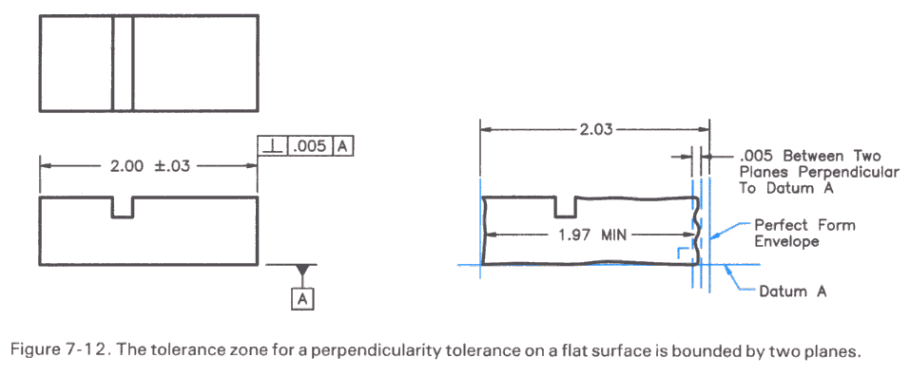
Perpendicularity
It describes the orientation of one surface plane perpendicular to another datum plane. The tolerance of the perpendicularity indirectly controls the 90° angle between the parts by controlling the location where the surfaces have to lie.

Slide 31
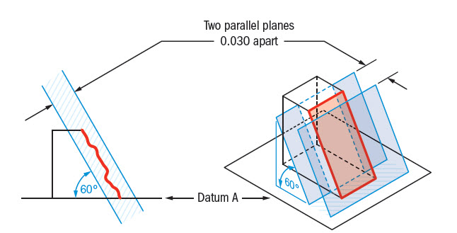
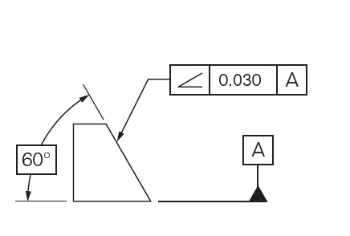
Angularity
Angularity is the symbol that describes the specific orientation of one feature to another at a referenced angle
Angularity does not directly control the angle of the referenced surface; it controls the envelope (like flatness) that the entire surface can lie.

Slide 32
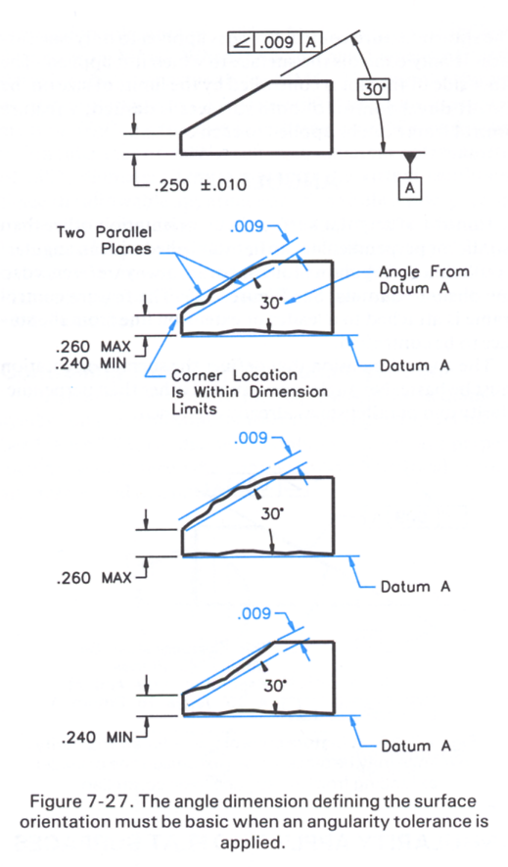
Angularity
Angularity does not directly control the angle of the referenced surface; it controls the envelope (like flatness) that the entire surface can lie.

Slide 33
Runout
Runout is how much one given reference feature or features vary in its form and orientation with respect to another datum when the part is rotated 360° around the datum axis. It is essentially a control of a circular feature, and how much variation it has with the rotational axis.
Tolerance zone is defined by a datum axis where all points on the called surface must fall into. The zone is a direct reference to the datum feature. Runout is the total variation that the reference surface can have, when the part is rotated around the datum’s true axis.
Notes:
http://www.gdandtbasics.com/runout/

Slide 34
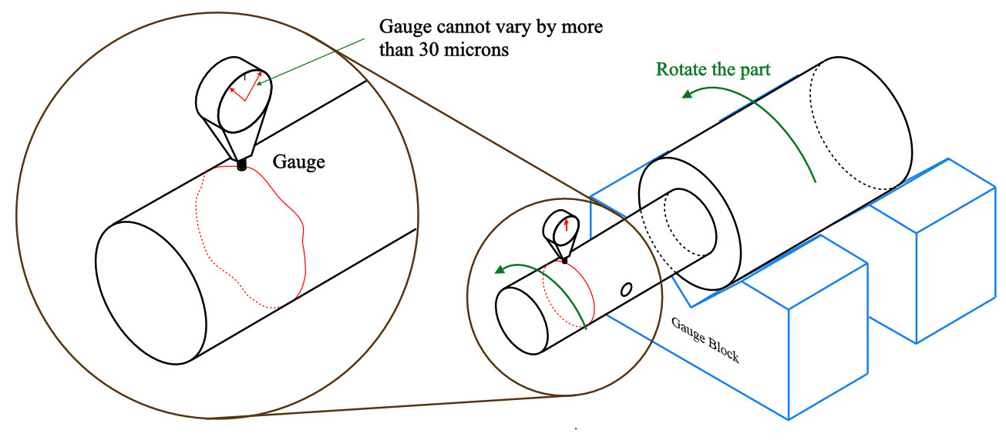
Runout
Tolerance zone is defined by a datum axis where all points on the called surface must fall into. The zone is a direct reference to the datum feature. Runout is the total variation that the reference surface can have, when the part is rotated around the datum’s true axis.
0.03
Notes:
http://www.gdandtbasics.com/runout/

Slide 35
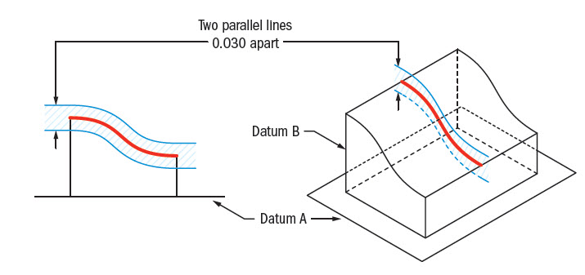
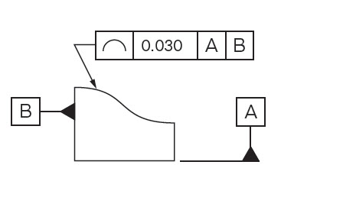
Profile of a Line
Profile of a line describes a tolerance zone around any line in any feature, usually of a curved shape.
Tolerance zone is defined by two parallel curves that follow the contour of the true surface profile.
Notes:
http://www.gdandtbasics.com/profile-of-a-line/

Slide 36
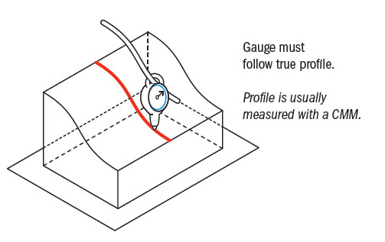
Profile of a Line
Profile of a line is measured using a gauge that is referenced to the true profile at the given specific cross section.
Notes:
http://www.gdandtbasics.com/profile-of-a-line/

