Slide 1
The human population and its impact
Department of Civil Engineering
College of Engineering
King Saud University
GE 302 – Industry and the Environment
Topic 3

Slide 2
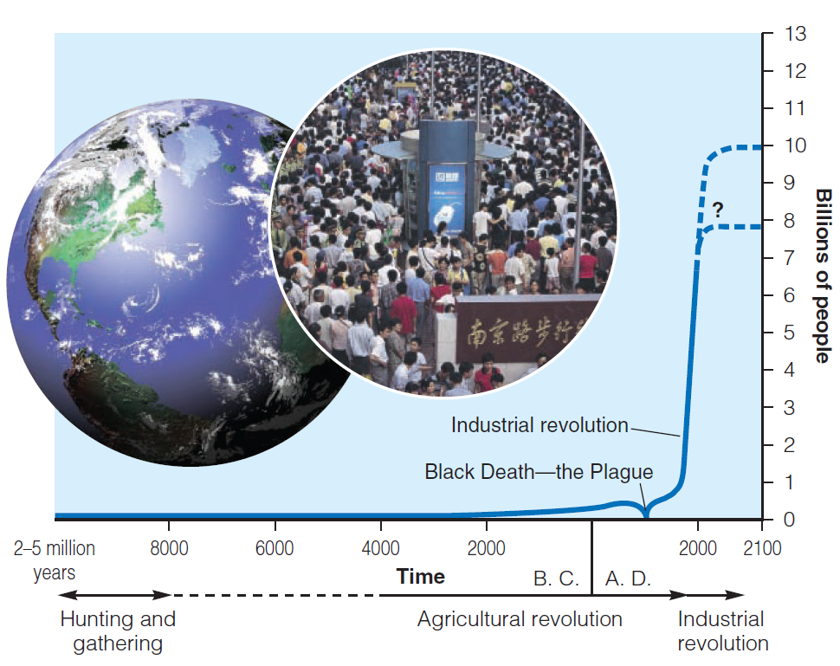
For most of history, the human population grew slowly. But for the past 200 years, the human population has grown rapidly, resulting in the characteristic J-curve of exponential growth

Slide 3
Three major factors account for population increase in the past 200 years:
Modern agriculture technique allow to grow more food.
Death rates drop because of improved sanitation and health care and development of antibiotics and vaccines to help control infectious diseases.
Humans adaptability to live in any climate zones and habitats.
Most of the increase in the world’s population during the last 100 years took place because of a sharp drop in death rates – not a sharp rise in birth rates.

Slide 4
Recently, The rate of population growth has slowed, but the world’s population is still growing exponentially at a rate of about 1.21% a year.
This growth is unevenly distributed, according to the data in 2010 for newborn:
About 1% of the newborn were added to the world’s more-developed countries, which are growing at 0.17% a year.
The other 99% were added to the world’s middle- and low-income, less developed countries, which are growing 9 times faster at 1.4% a year, on average

Slide 5
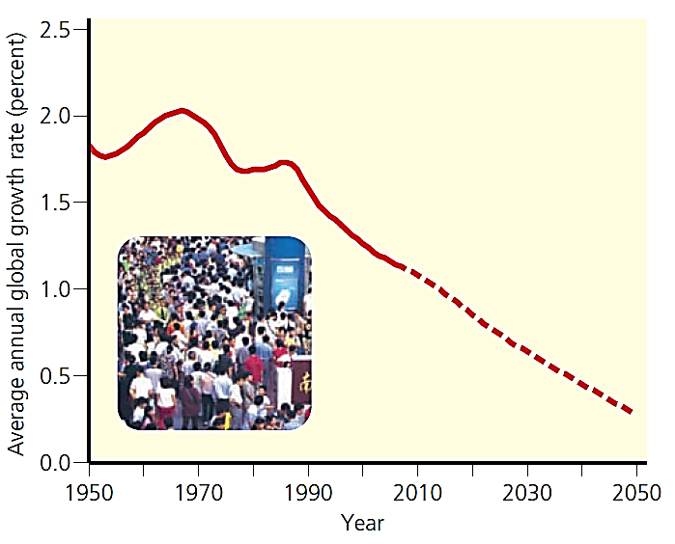
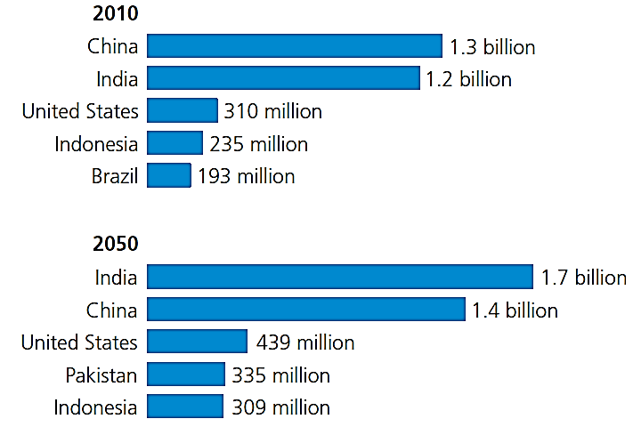
Annual growth rate of world population, 1950–2010, with projections to 2050.
Populations of the world’s five most populous countries in 2010 and 2050 (projected).
(Data from United Nations Population Division and U.S. Census Bureau)

Slide 6
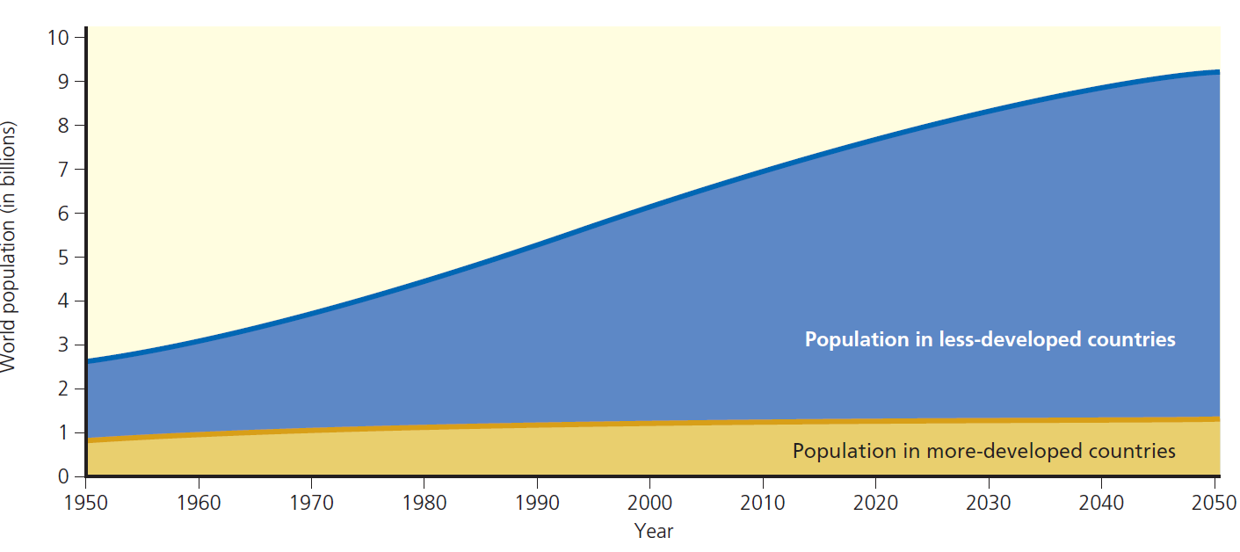
Most of the world’s population growth between 1950 and 2010 took place in the world’s less-developed countries. This gap is projected to increase between 2010 and 2050. (Data from United Nations Population Division,

Slide 7
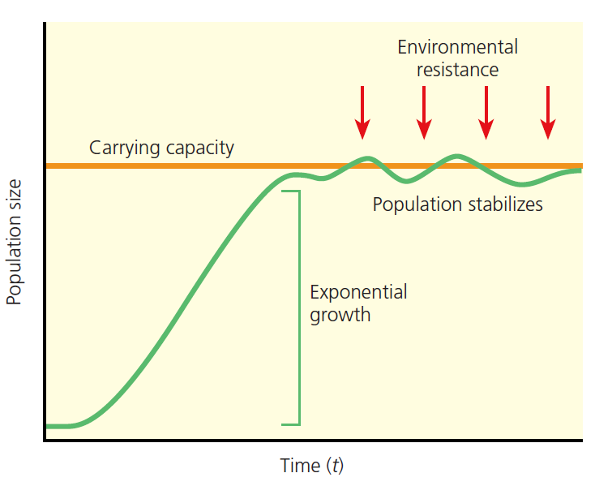
Carring capacity Maximum population of a particular species that a given habitat can support over a given period
Environmental resistance that case the caring capacity is:
shrinkage in resources such as food, water, and space
No population can continue to increase in size indefinitely. Exponential growth occurs when a population has essentially unlimited resources to support its growth.
Such exponential growth is eventually converted to logistic growth, in which the growth rate decreases as the population becomes larger and faces environmental resistance (right half of the curve).
Over time, the population size stabilizes at or near the carrying capacity of its environment, which results in a sigmoid (S-shaped) population growth curve.
Notes:
Depending on resource availability, the size of a population often fluctuates around its carrying capacity. However, a population may temporarily exceed its carrying capacity and then suffer a sharp decline or crash in its numbers

Slide 8
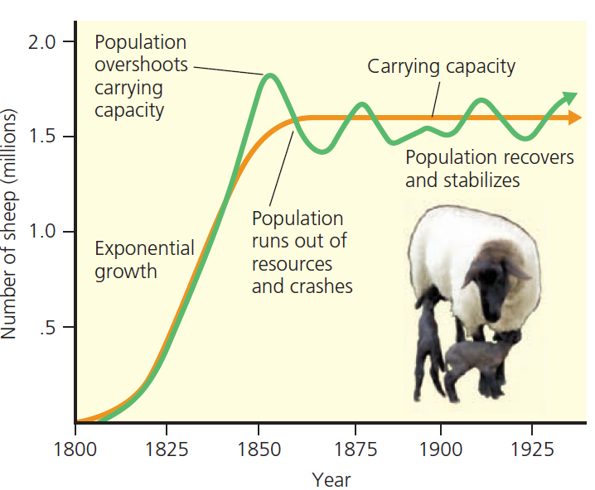
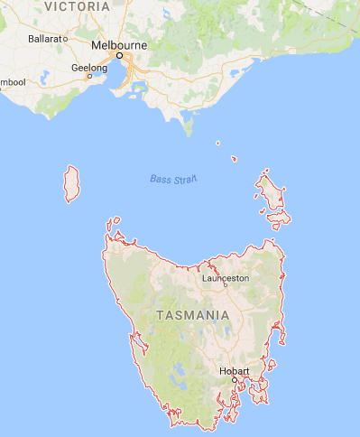
This graph tracks the logistic growth of a sheep population on the island of Tasmania between 1800 and 1925.
After sheep were introduced in 1800, their population grew exponentially. By 1855, they had overshot the land’s carrying capacity. Their numbers then stabilized and fluctuated around a carrying capacity of about 1.6 million sheep.
Notes:
Question: What is an example of environmental resistance that humans have not been able to overcome?

Slide 9
The eight major ways in which we humans have altered natural systems to meet our growing population’s resource needs (causes of natural capital degradation):
Reducing biodiversity.
Increasing use of net primary productivity.
Increasing genetic resistance in pest species and disease-causing bacteria.
Eliminating many natural predators.
Introducing harmful species into natural communities.
Using some renewable resources faster than they can be replenished.
Disrupting natural chemical cycling and energy flow.
Relying mostly on polluting and climate-changing fossil fuels.

Slide 10
What Factors Influence the Size of the Human Population?
The average number of children born to women in a population (total fertility rate) is the key factor that determines population size.
Population size increases through births (fertility) and immigration, and decreases through deaths (mortality) and emigration.
Population change =
(Births + Immigration) – (Deaths + Emigration)
Birth rate, or crude birth rate is the number of live births per 1,000 people in a population in a given year.
Death rate, or crude death rate is the number of deaths per 1,000 people in a population in a given year.

Slide 11
Fertility rate: the number of children born to a woman during her lifetime.
Two types of fertility rates affect a country’s population size and growth rate:
Replacement-level fertility rate
is the average number of children that couples in a population must bear to replace themselves.
It is slightly higher than two children per couple: 2.1 in more-developed countries and as high as 2.5 in some less-developed countries.
Total fertility rate (TFR)
is the average number of children born to women in a population during their reproductive years.
This factor plays a key role in determining population size

Slide 12
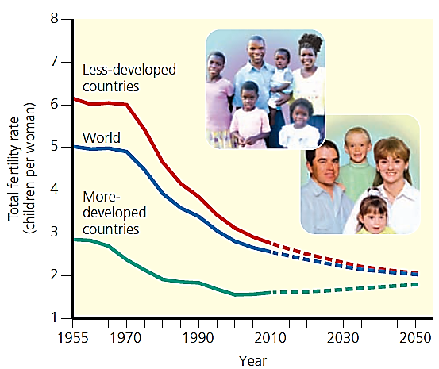
This graph tracks the total fertility rate for both the more-developed and less-developed regions of the world, 1955 – 2010, with projections to 2050
Between 1955 and 2010, the average TFR dropped from 2.8 to 1.7 children per woman in more-developed countries and from 6.2 to 2.7 in less-developed countries.

Slide 13
Several Factors Affect Birth Rates and Fertility Rates:
Importance of children as a part of the labor force.
Cost of raising and educating children.
In the United States, for example, it costs more than $220,000 to raise a middle-class child from birth to age 18.
The availability of, or lack of, private and public pension systems.
Urbanization.
Educational and employment opportunities available for women.
Average age at marriage.
The availability of legal abortions.
The availability of reliable birth control methods.
Religious beliefs, traditions, and cultural norms.

Slide 14
Two useful indicators of the overall health of people in a country or region are:
Life expectancy (the average number of years an individual can be expected to live)
In 2010, Japan had the world’s longest life expectancy of 83 years.
In the world’s poorest countries, life expectancy is 57 years or less.
Infant mortality rate (the number of babies out of every 1,000 born who die before their first birthday).
Infant mortality is viewed as one of the best measures of a society’s quality of life because it reflects a country’s general level of nutrition and health care.
Several Factors Affect Death Rates:
Increased food supplies and distribution, better nutrition.
Medical advances such as immunizations and antibiotics.
improved sanitation, and safer water supplies.

Slide 15
How Does a Population’s Age Structure Affect Its Growth or Decline?
Age structure is the numbers or percentages of males and females in young, middle, and older age groups in that population.
Population experts construct a population age structure diagram by plotting a given population’s percentages of males and females in each of three age categories:
Pre-reproductive (ages 0–14), consisting of individuals normally too young to have children
Reproductive (ages 15–44), consisting of those normally able to have children
Post-reproductive (ages 45 and older), with individuals normally too old to have children.

Slide 16
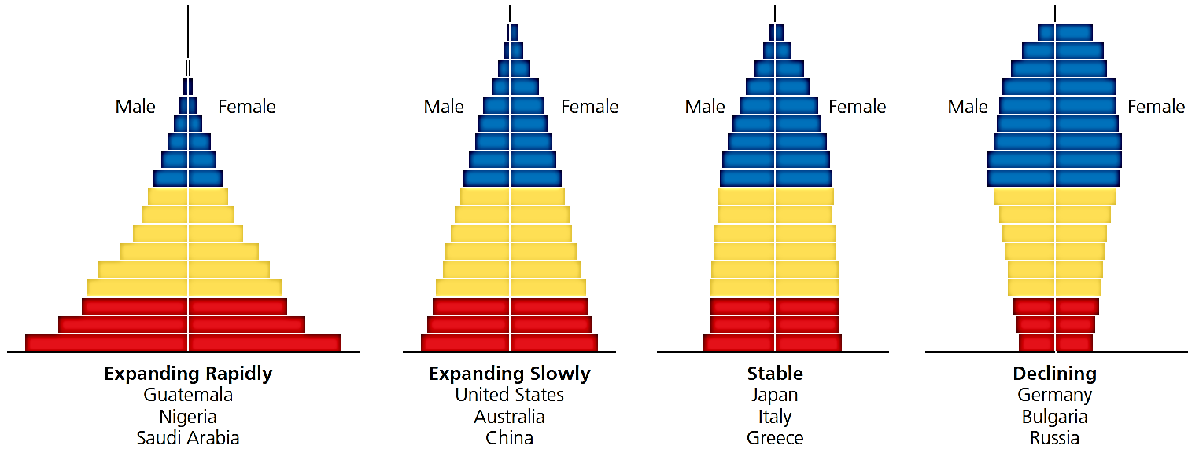
This chart represents the generalized population age-structure diagrams for countries with rapid (1.5–3%), slow (0.3–1.4%), zero (0–0.2%), and negative (declining) population growth rates.

Slide 17
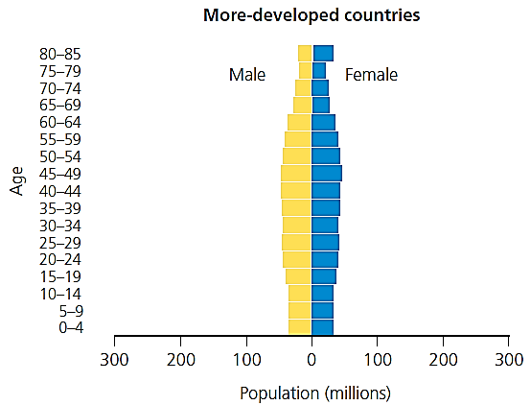
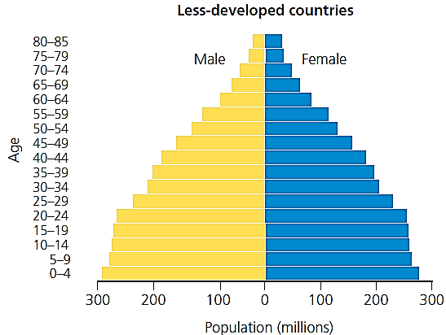
Global outlook: These charts illustrate population structure by age and sex in less-developed countries and more-developed countries for 2010
Even if the global replacement level fertility rate of 2.1 children per woman were magically achieved tomorrow, the world’s population would keep growing for at least another 50 years. This continued growth results from a population’s age structure.
Notes:
Question: If all girls under 15 were to have only one child during their lifetimes, how do you think these structures would change over time?

Slide 18
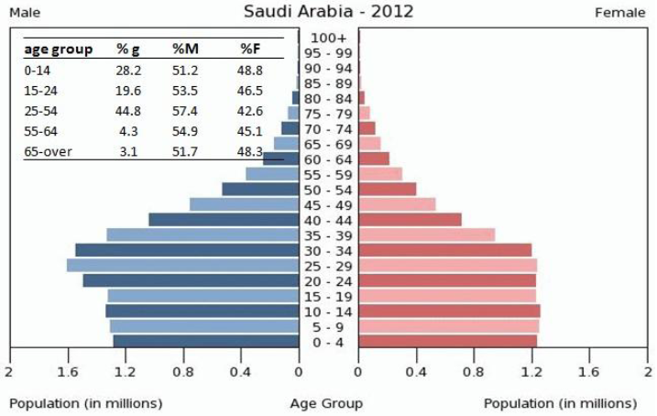
Population Pyramid of Saudi Arabia

Slide 19
Problems with Rapid Population Decline:
Can threaten economic growth.
Labor shortages.
Less government revenues with fewer workers.
Less entrepreneurship and new business formation.
Less likelihood for new technology development.
Increasing public deficits to fund higher pension and health-care costs
Pensions may be cut and retirement age increased.

Slide 20
How Can We Slow Human Population Growth?
We can slow human population growth by:
Reducing poverty, through economic development and education.
Empowering Women, by elevating the status of women.
Promote Family Planning

Slide 21
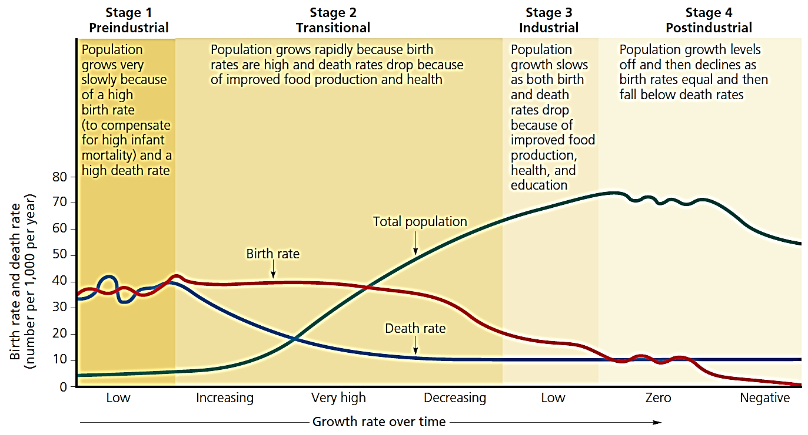
The demographic transition, which a country can experience as it becomes industrialized and more economically developed, can take place in four stages.

Slide 22
Some analysts believe that most of the world’s less developed countries will make a demographic transition over the next few decades.
But other analysts fear that rapid population growth, extreme poverty, and increasing environmental degradation in some low-income, less-developed countries could leave these countries stuck in stage 2 of the demographic transition. Many of such countries are classified as failing states.
Failing states caused by:
Population growth rate.
Internal conflict.
Corrupt governments.
Poor economic management.

Slide 23
Three big ideas learned from this topic:
The human population is increasing rapidly and may soon bump up against environmental limits.
Even if population growth were not a serious problem, the increasing use of resources per person is expanding the overall human ecological footprint and putting a strain on the earth’s resources.
We can slow human population growth by reducing poverty through economic development, elevating the status of women, and encouraging family planning.

Slide 24
Calculating average annual population growth/decline rate %, arithmetic growth
$$Growth or Decline rate=\frac{P_{present}−P_{past}}{P_{past}}×100\%$$
Where: P_{present} = population at present
P_{past} = population at past
Example_1:
In 2010, the population in Riyadh was 4,700,000. This grew to 5,280,000 in 2015. What is the annual percentage population growth rate for Riyadh?
$$5 years growth rate=\frac{5,280,000−4,700,000}{4,700,000}×100=12.3\%$$
Annual growth rate = 12.3/5 = 2.5%

Slide 25
Calculating the expected population if growth rate is given, arithmetic growth
$$P_{future}=P_{presen }×(1+i×n)$$
Where: i = growth or decline rate
n = number of years
Example_2:
The current population in Jeddah is 3,500,000, if the population growth rate is expected to be 2.3%, what will be the population after 3 years from now?
$$P_{future}=3,500,000×(1+0.023×3)$$
Expected population after 3 years = 4,741,500 capita

Slide 26
Calculating the expected population if crude birth and death rates and migration is given
Population change =
(Births + Immigration) – (Deaths + Emigration)
Example_3:
In 2006, 5.3 billion people lived in less developed countries of the world, where the average crude birth and death rates were 23 and 8, respectively. What is total population in 2007?
Total births = Population X crude birth rate
= 5.3 billion X 23 deaths/1000 people = 121.9 million
Total death = 5.3 billion X 8/1000 = 42.4 million
Total population = current pop. + pop. Change
= 5300 mil. + 121.9 mil. – 42.4 mil. = 5,379.5 million

Slide 27
Ecological Footprint Analysis
Example_4:
Please return to chapter 6 in textbook page 145

