Slide 1
Time Response, Stability, and
Steady State Error

Slide 2
1 Time Response
The mathematical representation of a system (Transfer function or State space) is used to analyze its transient and steady-state responses to see if these characteristics yield the desired behavior.
Performance of controlled systems can be tested and compared by their responses to certain test signals (Step functions, impulse functions, ramp functions, sinusoidal functions, etc.).
A response of a dynamic system can be analyzed in two parts:
Steady-state response: The behavior of the output as $t→∞$
Transient response: The behavior of the output as it goes from an initial state to a final state.
This chapter is devoted to the analysis of system transient response.

Slide 3
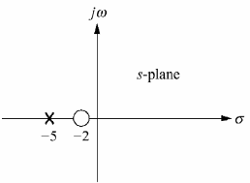
Time Response
Poles, Zeros, and System Response
The output response of a system is the sum of two responses:
1. the forced response (steady-state response or particular solution),
2. the natural response (the homogeneous solution).
Output response = forced response (e.g. constant) + natural response (e.g. exponential)
Poles of a Transfer Function (TF): The values of s that cause $TF→∞$
roots of the denominator (characteristic polynomial) of the transfer function
Zeros of a TF: the values of s that cause TF = 0.
roots of the numerator of the transfer function
Example: Poles and Zeros of a First-Order System
System Output (unit step response)
where
and
System showing input and output
Inverse Laplace transform:
System Output in time domain (time response)
pole-zero plot of the system

Slide 4
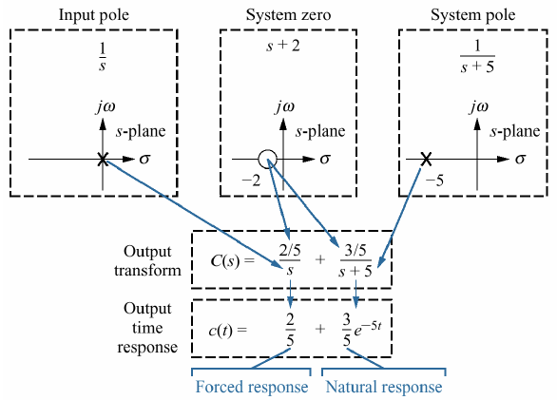
Example: Poles and Zeros of First Order System
Input function
Input poles
generates
Forced response
( pole at the origin generated a step function at the output)
generates
System poles
Natural response
Transfer function
(A pole $α$ on the real axis generates an exponential response of the form $e^{−αt}$ that will decay to zero).
System poles
And zeros
generates
Amplitudes for both the forced and natural responses
Evolution of a system response.

Slide 5
Evaluating Response using Poles
Problem:
Given the following system, write the output, c(t), in general terms. Specify the forced and natural parts of the solution.
Solution:
Forced
response
Natural
response
Taking inverse Laplace transform,
Each system pole generates an exponential as part of the natural response.
The input's pole generates the forced response.
Poles of the system produce the
Natural response that Will decay to zero

Slide 6
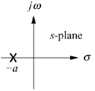
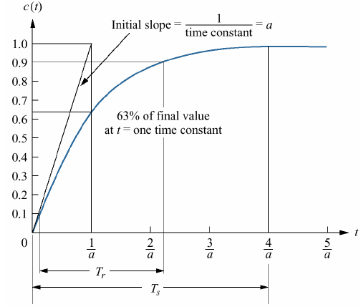
First-Order System: Time Constant
A first-order system without zero:
If the input is a unit step: $R\left(s\right)=\frac{1}{s}$ then the Laplace
transform of the step response is :
the input pole at the origin generated the forced response
Taking the inverse transform
The system pole at –a generated the natural response
Significance of parameter a (system pole) (only parameter needed to describe the transient response),
When
Hence,

Slide 7
Some Terminology
(three transient response performance specifications).
1. Time constant $T_{c}$: Time it takes for the step response to rise to 63% of its final value.
$$T_{c}=\frac{1}{a}$$
we can call the parameter $a$ (system pole) the exponential frequency (The reciprocal of the time constant)
$T_{c}$is related to the speed at which the system responds to a step input.
2. Rise Time $T_{r}$: Rise time is defined as the time for the response to go from 0.1 to 0.9 of its final value.
found by solving for the difference in time at c($t_{2}$) = 0.9 and c($t_{1}$) = 0.1
$$time for C(t)=0.1$$
$$t_{2}=−\frac{\ln\left(0.1\right)}{a}=\frac{2.31}{a}$$
$$C\left(t_{2}\right)=0.9=1−e^{−at_{2}}$$
$$T_{r}=t_{2}−t_{1}=\frac{2.13}{a}−\frac{0.11}{a}=\frac{2.2}{a}$$
$$T_{r}=\frac{2.2}{a}$$
Rise time:
$$C\left(t_{1}\right)=0.1=1−e^{−at_{1}}$$
$$t_{1}=−\frac{\ln{(0.9)}}{a}=\frac{0.11}{a}$$
$$time for C(t)=0.9$$
3. Settling time $T_{s}$: The time for the response to reach, and stay within, 2% of its final value.
Letting$C\left(T_{s}\right)=0.98$and solving $C\left(t\right)$ for time, ${t=T}_{s}$, we find the settling time to be
$$T_{s}=−\frac{\ln\left(0.98\right)}{a}=\frac{4}{a}$$
$$T_{s}=\frac{4}{a}$$
$$C\left(T_{s}\right)=0.98=1−e^{−aT_{s}}$$

Slide 8
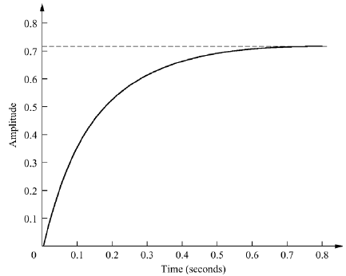
First-Order Transfer Function via Testing
With a step input, we can measure the time constant and the steady-state value, from which the transfer function can be calculated.
A simple first order system has :
$$final value about 0.72$$
and step response is:
In the time domain (ILT):
$$c\left(t\right)= \frac{K}{a}−\frac{K}{a}e^{−at} (eq.1)$$
$$63\% of 0.72=0.45$$
From the response, we identify K and a to obtain the transfer function.
To find a:
$$63\%$$
$$final value about 0.72$$
$$Time constant=Time(0.63×0.72)$$
$$from the graph$$
$$=Time\left(0.45\right)=0.13 second$$
$$time \left(amplitude =0.45\right)=0.13 s$$
$$a=1/{0.13}=7.7$$
To find K: From $(eq.1)$, the forced response reaches a steady-state value of $K/a=0.72$ $K=5.54$
$$K=5.54$$
$$G\left(s\right)=\frac{K}{s+a}$$
Transfer function,
and
$$a=7.7$$

Slide 9
Second-Order System₁
Parameters of First-order system determine the speed of the system.
Parameters of Second-order system determine the form (shape) of the system.
Consider the general system,
System poles
$$s_{1,2}=−\frac{a}{2}∓\frac{\sqrt{a^{2}−4b}}{2}$$
General case of second order system
For un-damped(without damping) system, $a=0$, and the poles are on $jω−axis$ at $∓j\sqrt{b}$,
Natural Frequency
Hence $b= {ω_{n}}^{2}$
un-damped system
For an under-damped system, poles have real part $σ=−a/2$ (exponential decay ),
Exponential decay frequency
D$amping Ratio$
$$\left( ξ=\frac{\text{exponential} \text{decay}}{natural frequency}\right)$$
Natural frequency
$ω_{n}$ : (Natural Frequency ) the frequency of oscillation of the system without damping.
$ξ :$ (D$amping Ratio$) dimensionless measure describing how oscillations in a system decay.
$σ :$ $(Attenuation)$ exponential decay , real part of the pole
Poles
$$b= {ω_{n}}^{2}$$
$$a={2 ξ ω}_{n}$$
Canonical form
(two finite poles and no zeros)

Slide 10
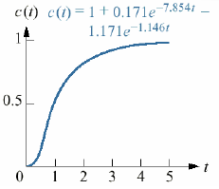
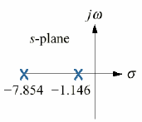
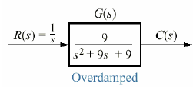
Second-Order System₂
The sign of the discriminant of the denominator polynomial depends on the damping ratio $ξ$, three cases.
$$s_{1,2}=−\frac{a}{2}∓\frac{\sqrt{a^{2}−4b}}{2}$$
$$a={2 ξ ω}_{n}$$
System poles
$$b= {ω_{n}}^{2}$$
Case1: Overdamped system: ($ξ>1$) Two real poles
$$a=9 and b=9$$
the general case
(two finite poles and no zeros)
$$C\left(s\right)=\frac{1}{s}+\frac{0.171}{s+7.854}−\frac{1.171}{s+1.146}$$
$$c\left(t\right)=1+0.171e^{−7.854t}−01.171e^{−1.146t}$$
Overdamped system
$$Two real poles$$

Slide 11
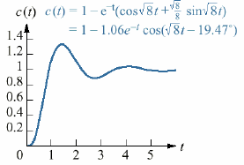
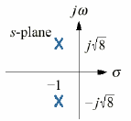
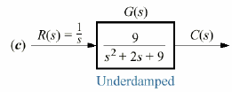
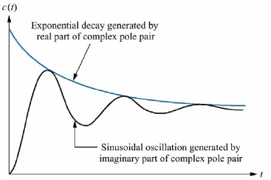
Second-Order System
Case 2: Under-damped Response ($0<ξ<1$) : (Two complex poles that come from the system).
Poles from the system:
exponential decay
frequency of the
sinusoidal oscillation.
$$a=2 and b=9$$
$$Two complex poles$$
From,
$${ K}_{4}\cos\left(α+β\right)=K_{4}cosα cosβ−K_{4}sinα sinβ$$
$$=K_{2}\cos\left(\sqrt{8}t\right)+K_{3}\operatorname{sis}\left(\sqrt{8}t\right)$$
Second-order
step response
components
generated by
complex poles
Where,

Slide 12
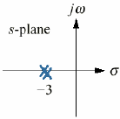
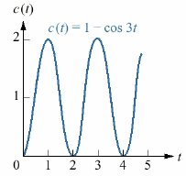
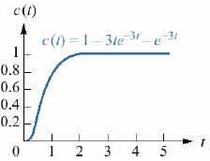
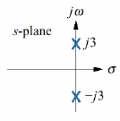
Second-Order System
Case 3: Un-damped Response ($ξ=0)$: pole at the origin that comes from the input and two imaginary poles that come from the system.
Case 4: Critically Damped Response ($ξ=1)$ : pole at the origin that comes from the input and two multiple real poles that come from the system.
$\text{two} \text{poles}\text{ (}\text{double}\text{) }\text{on} \text{the} \text{real} \text{axis} \text{at}\text{ —}$3
$$a=6 and b=9$$
$$a=0 and b=9$$
$$\text{two} \text{system} \text{poles} \text{on} \text{the} \text{imaginary} \text{axis}$$
$$input pole$$
$$system poles$$
There is no exponential term, so no decay.
There is no sinusoidal term, so no oscillation.

Slide 13
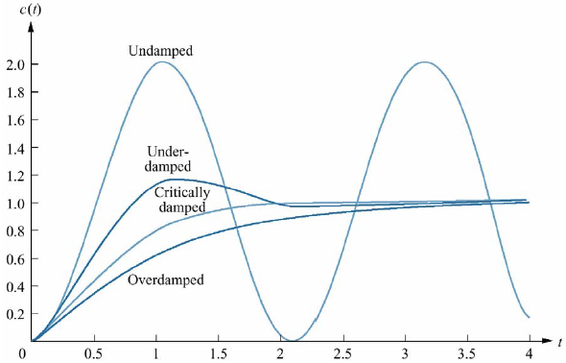
Second-Order System
Over-damped responses
Two
Two real poles at $−σ_{1},−σ_{2}$
All Together
$$ξ>1$$
Two
Under-damped responses
Two complex poles at $−σ_{d}∓jw_{d}$
$$0<ξ<1$$
Un-damped responses
Two
Two imaginary poles at $∓jw_{1}$
$$ξ=0$$
Critically damped responses
Two
$$ξ=1$$
Two real poles at $−σ_{1}$
Step responses for second-order system damping cases

Slide 14
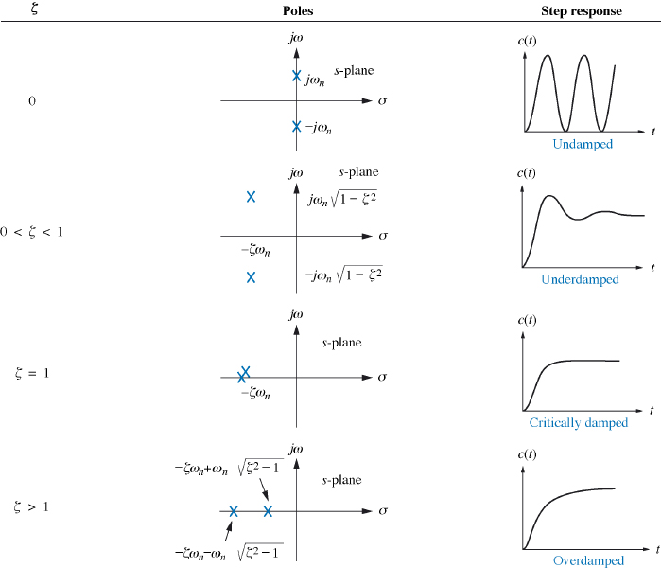
Second-Order System As a Function of Damping Ratio
Relationship between the quantities $ω_{n} and ξ$ and the pole location.
Solving for the poles of the transfer function
Example
For the system find the value of $ξ$ and report the kind of response expected.
$$G\left(s\right)=\frac{ω_{n}^{2}}{s^{2}+2ξω_{n}s+ω_{n}^{2}}= \frac{12}{s^{2}+8s+12}$$
We have
$$ω_{n}^{2}=12$$
$$ω_{n}=\sqrt{12}$$
and
$$2ξω_{n}=8$$
$$ξ=\frac{8}{2\sqrt{12}}=\frac{2}{\sqrt{3}}>1$$
System is over-damped.
Second-order response as a function of damping ratio

Slide 15
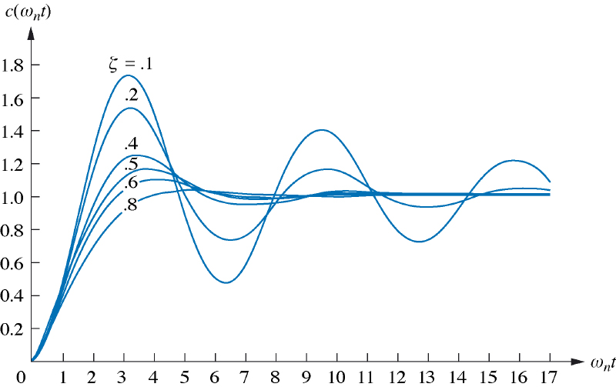
Underdamped Second-Order Systems
The nature of the response obtained is related to the value of the damping ratio $ξ$ (over-damped, critically damped, underdamped, and un-damped responses.).
Step response for the general second-order system,
$$C\left(s\right)= R\left(s\right)G\left(s\right)=\frac{1}{s}\frac{ω_{n}^{2}}{ s^{2}+2ξω_{n}s+ω_{n}^{2}}$$
Expanding by partial fractions, ($ξ$< 1 the underdamped case )
The lower the value of ζ, the more oscillatory the response is.
inverse Laplace transform
Where,
Second-order underdamped responses for damping ratio values

Slide 16
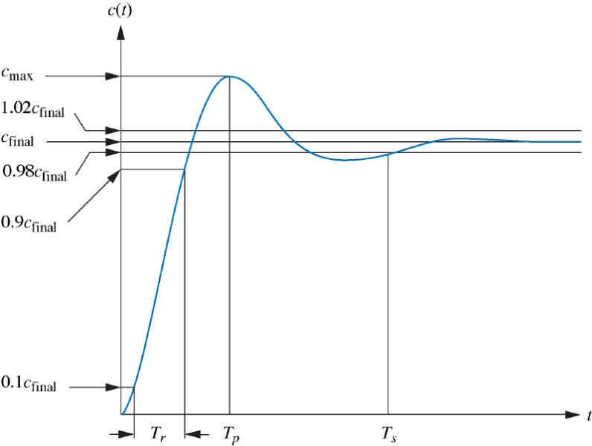
Underdamped Second-Order Systems
Specifications
Other parameters associated with the underdamped response are rise time, peak time, percent overshoot, and settling time.
Rise time
The time required for the waveform to go from 0.1 of the final value to 0.9 of the final value.
$$T_{r}$$
Second-order underdamped response specifications
The time required to reach the first, or maximum, peak.
Peak time
$$T_{p}$$
The amount that the waveform overshoots the steady-state, or final, value at the peak time, expressed as a percentage of the steady-state value.
percent
overshoot
$$\%OS$$
and
$$\%OS=e^{−\left({ξπ}/{\sqrt{1−ξ^{2}}}\right)}×100$$
The time required for the transient's damped oscillations to reach and stay within ±2% of the steady-state value.
settling time
$$T_{s}$$
Derivation: self study.

Slide 17
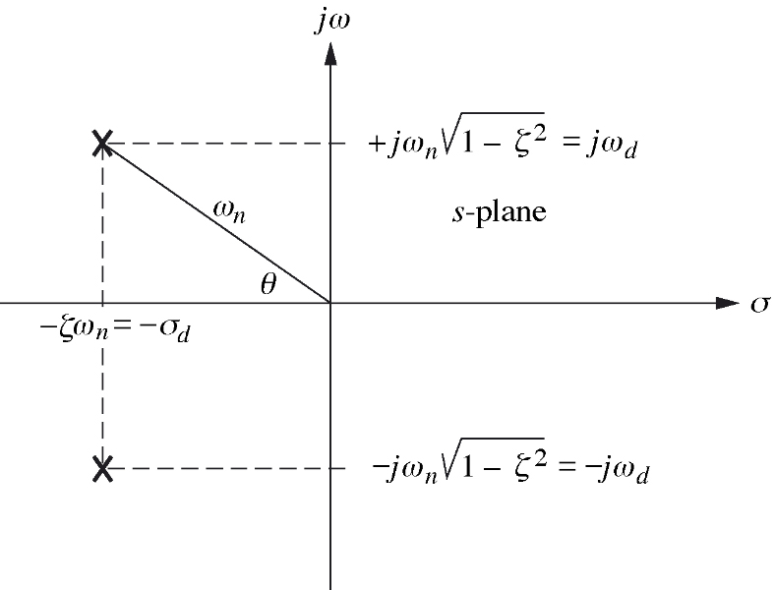
Under-damped Second-Order Systems
Specifications (continued)
from the Pythagorean theorem
Damped frequency of oscillation
$$ω_{d}^{2}+σ_{d}^{2}=ω_{n}^{2}$$
$$ω_{d}=\sqrt{ω_{n}^{2}−σ_{d}^{2}}=\sqrt{ω_{n}^{2}−{ξ }^{2}ω_{n}^{2}} → ω_{d}=ω_{n}\sqrt{1−{ξ }^{2}}$$
$$σ_{d}={ξω}_{n}$$
Damping Ratio
$$\cos\left(θ\right)=\frac{σ_{d}}{ω_{n}}=\frac{{ξω}_{n}}{ω_{n}}=ξ$$
damped frequency of oscillation,
Natural frequency
inversely proportional to the imaginary part of the pole.
inversely proportional to the real part of the pole.
exponential damping frequency.

Slide 18
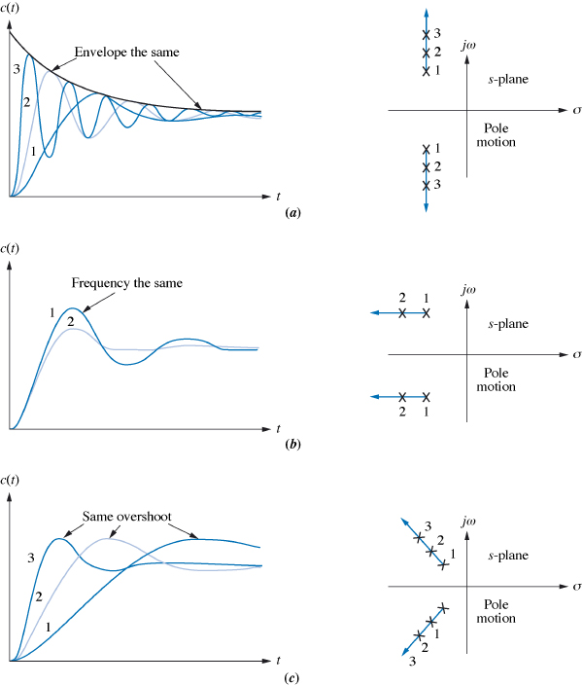
Under-damped Second-Order Systems
Step Response as Pole moves
poles move in a vertical direction
(with constant real part )
frequency increases
envelope remains the same (constant real part )
settling time is virtually the same
overshoot increases, the rise time decreases
poles move in a horizontal direction
(with constant imaginary part )
As the poles move to the left, response damps out more rapidly.
peak time is the same for all waveforms (constant imaginary part )
poles move in along a constant radial line direction
The percent overshoot remains the same.
The farther the poles are from the origin, the more rapid the response.

Slide 19
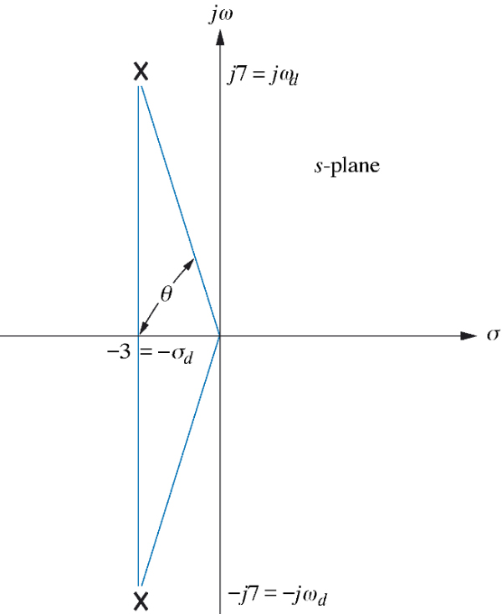
Finding TP, %OS, and TS From Pole Location
Problem:
Given the pole plot find $ξ$, $ω_{n}$, $T_{p}$, %OS, and $T_{s}$.
Solution:
Damping ration,
$$ω_{n}^{2}=ω_{d}^{2}+σ_{d}^{2}$$
$$ω_{n}=\sqrt{ω_{d}^{2}+σ_{d}^{2}}=\sqrt{7^{2}+{3 }^{2}}=7.616$$
Natural frequency,
Peak time,
$$\%OS=e^{−\left({ξπ}/{\sqrt{1−ξ^{2}}}\right)}×100=26\%$$
Percent overshoot,
The approximate settling time,

Slide 20
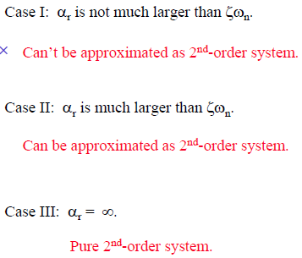
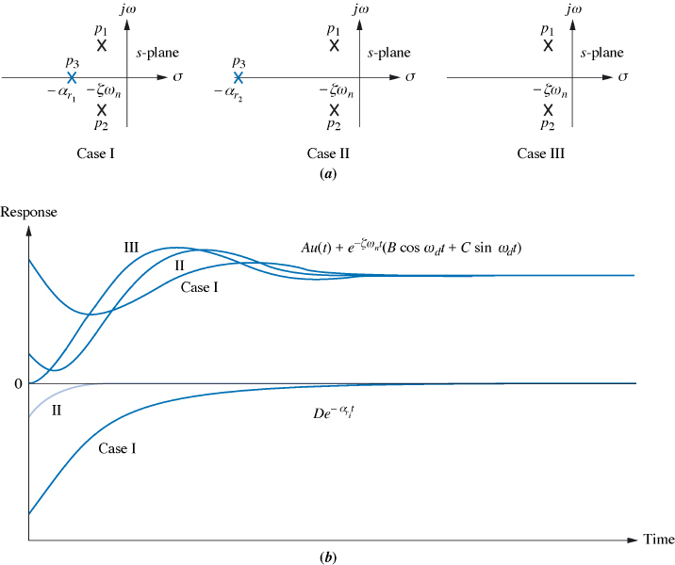
System Response with Additional Poles
If a system has more than two poles or has zeros, we cannot use the formulas to calculate the performance specifications that we derived.
We need to approximate that system to a second-order system that has just two dominant complex poles.
Assuming two complex poles at
And the real pole at
Time domain step response,

Slide 21
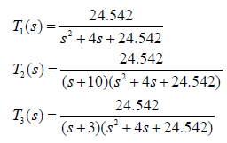
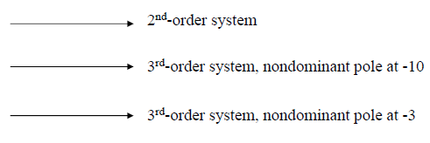
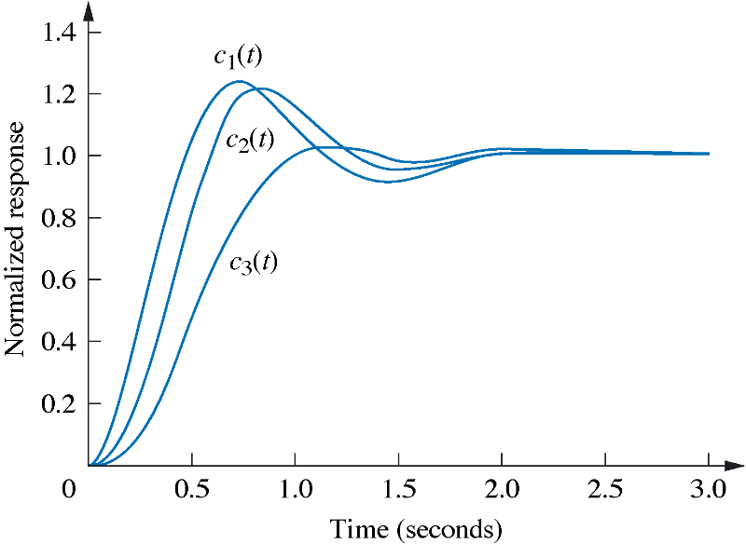
Comparing Responses of Three-Pole Systems
if the real pole is five times farther to the left than the dominant poles
system is represented by its dominant second-order pair of poles.

Slide 22
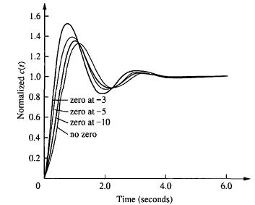
Evaluating Pole-Zero Cancellation
Effect of a zero on the system: A system with a zero consists of the derivative of the original response and the scaled version of the original response. If the zero is very large, the Laplace transform of the response is approximately the scaled version of the original response. As the zero becomes smaller, the derivative term contributes more to the response and has a greater effect.
$$\left(s+a\right)C\left(s\right)=sC\left(s\right)+aC(s)$$
pole-zero cancellation
derivative response
scaled response
Problem: For any function for which pole-zero cancellation is valid, find the approximate response.
Effect of adding a zero to a two-pole system
Solution:
The partial-fraction expansion of $C_{1}\left(t\right)$ is
That residue (1) is not negligible. So a 2nd-order step response approximation cannot be made for $C_{1}\left(t\right)$.
The partial-fraction expansion of $C_{2}\left(t\right)$ is
That residue (0.033) is negligible, so cancel zero and that pole.
Hence, the approximate response,

Slide 23
2. Stability
Stability is the most important system specification.
the total response of a system
Stable system: If natural response approaches zero as time approaches infinity (LTI System).
Marginally stable system: If natural response neither decays nor grows but remains constant or oscillates as time approaches infinity.
BIBO (Bounded Input, Bounded Output) yields stable system.
Stable systems have closed-loop transfer functions with poles only in the left-half plane.

Slide 24
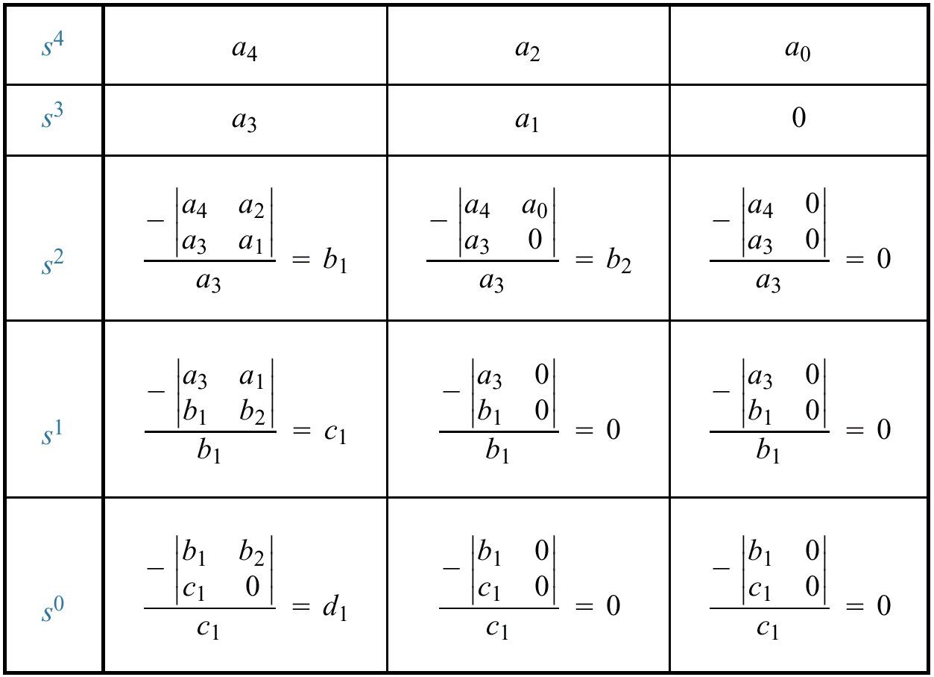
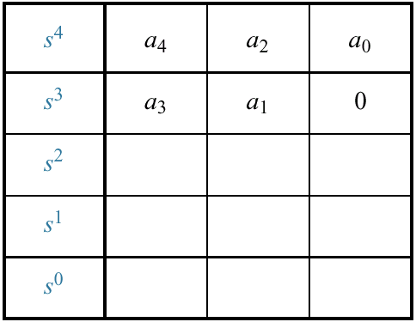
Routh-Hurwitz Criterion
This method Provides stability information with solving for system poles.
How many poles are in left / right plane or in jw axis, not where
Routh Table Generation:
Completed Routh table
Denominator:

Slide 25
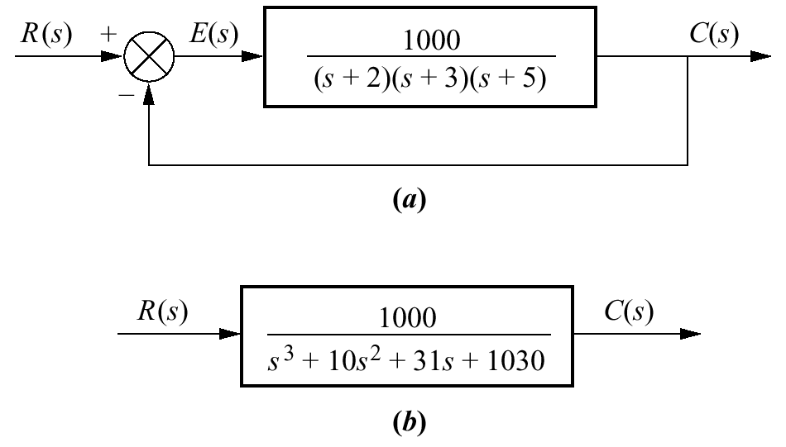
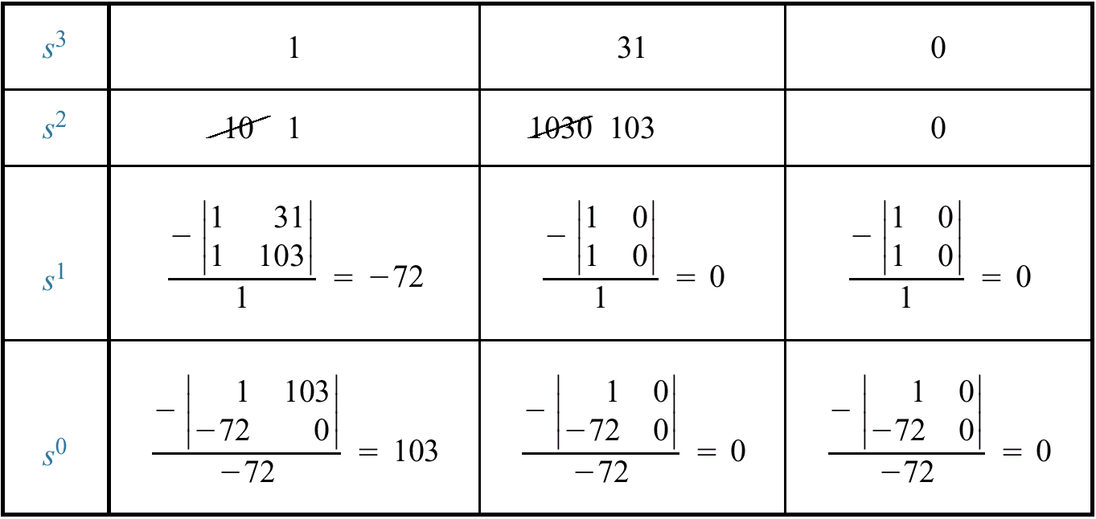
Routh-Hurwitz Criterion: Example
PROBLEM:
Make the Routh table for the system shown in Figure
SOLUTION:
The first step is to find the equivalent closed-loop system
Interpreting the Basic Routh Table
How many sign changes in the first column → the number of poles in the right-half plane
Two such poles : unstable system.
Any row can be multiplied by a positive number. the row was multiplied by 1/10
the number of roots of the polynomial that are in the right half-plane is equal to the number of sign changes in the first column.
the first column

Slide 26
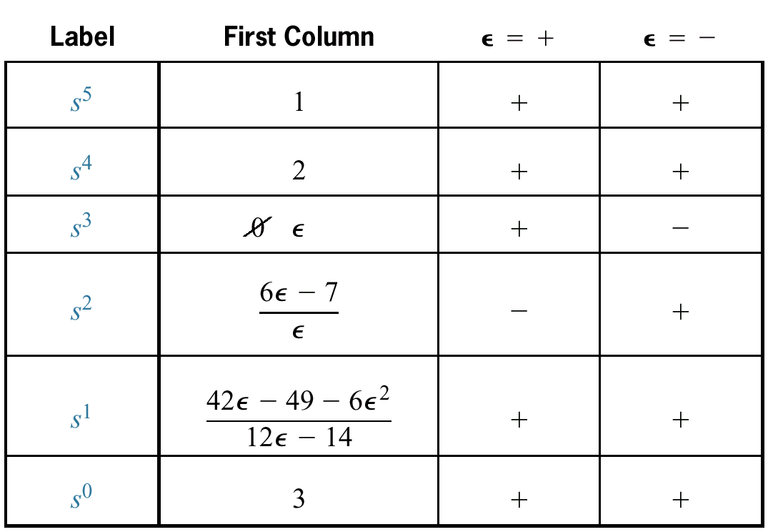
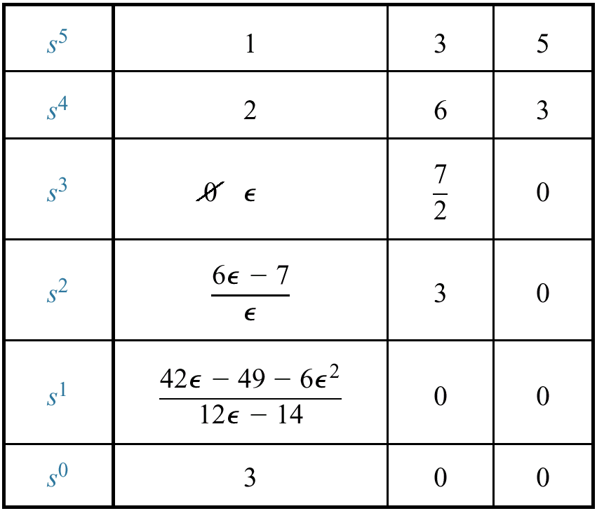
Routh-Hurwitz Criterion: Special Cases
1. Zero Only in the First Column
If the first element of a row is zero, division by zero in the next row
Example:

Slide 27
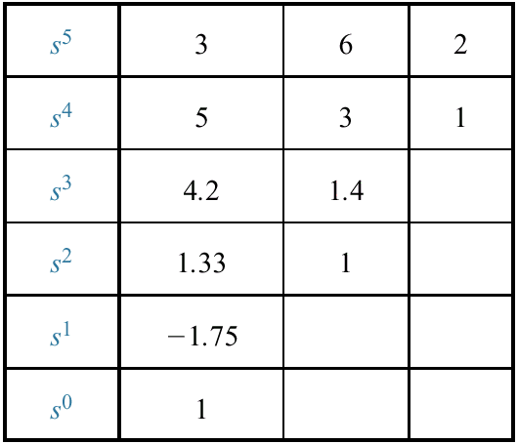
Routh-Hurwitz Criterion: Special Cases
Zero Only in the First Column: reverse coefficients
The polynomial that has the reciprocal roots of the original, is another method that can be used when a zero appears only in the first column of a row.
reciprocal roots
(s is replaced by l/d),
Since there are two sign changes, the system is unstable and has two right-half-plane poles
Example:
Reverse coefficients:

Slide 28
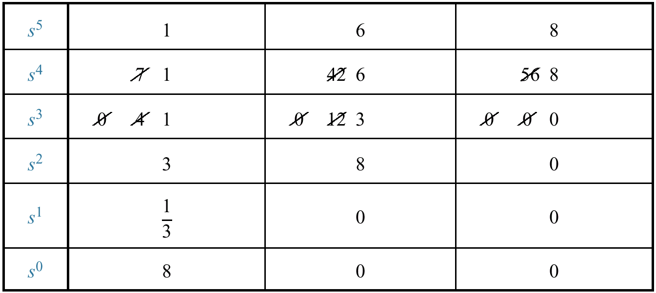
Routh-Hurwitz Criterion: Special Cases
2. Entire Row is Zero
An entire row consists of zeros because there is an even polynomial that is a factor of the original polynomial (only even powers of s and have roots that are symmetrical about the origin.)
Example:
Derivative of the polynomial of the row above the zeros row
the row was multiplied by 1/7
entire row consists of zeros
Stable system.

Slide 29
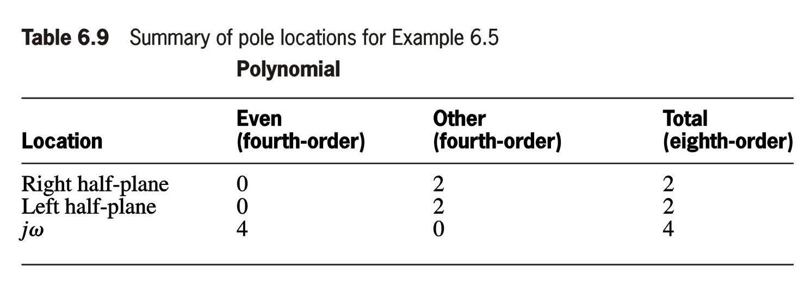
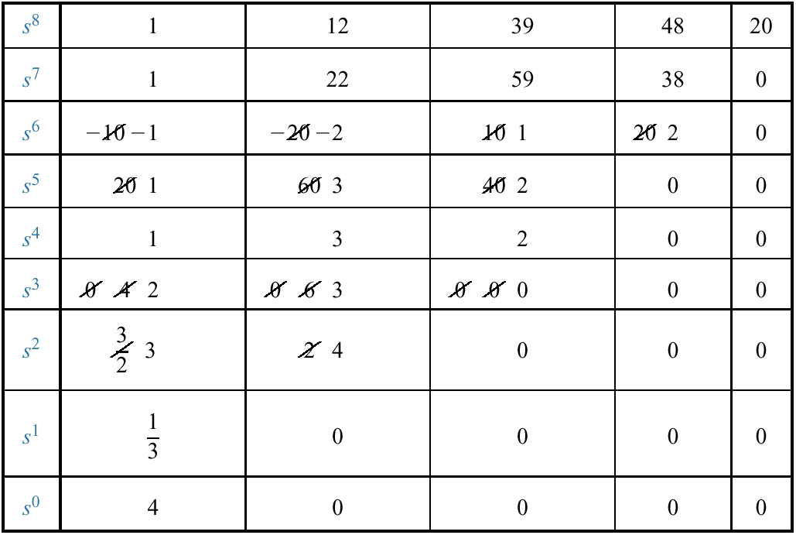
Pole Distribution via Routh Table with Row of Zeros
PROBLEM:
Tell how many poles are in the right half-plane, in the left half-plane, and on the jw-axis.
:Even polynomial
Taking the derivative
the row was multiplied by 1/10
Two sign changes
the row was multiplied by 1/20
entire row consists of zeros
the row was multiplied by 1/2
interpretation
No sign change

Slide 30
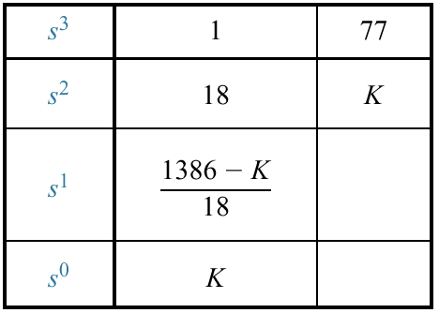
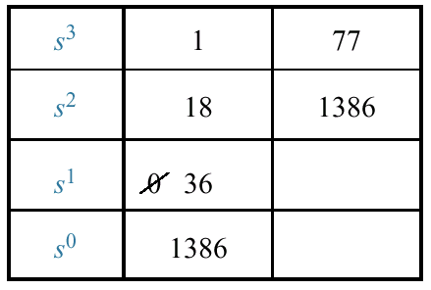
Stability Design via Routh-Hurwitz
Changes in the gain K of a feedback control system change the closed-loop pole locations (can move poles from region to another region on the S-plane).
PROBLEM:
Find the range of gain, K, for the system that will cause the system to be stable, unstable, and marginally stable. Assume K > 0.
Variable gain K
1. If K < 1386, then stable system.
2. If K > 1386, then two sign changes; two right-half plane poles and one left-half plane pole. Unstable system.
3. If K = 1386, an entire row of zeros → jω poles.
replacing K=1386
can be positive, zero, or negative
No sign change
Row of zeros
2 poles in j ω axis and one left-half plane pole
no sign changes above the even polynomial
the system is marginally stable

Slide 31
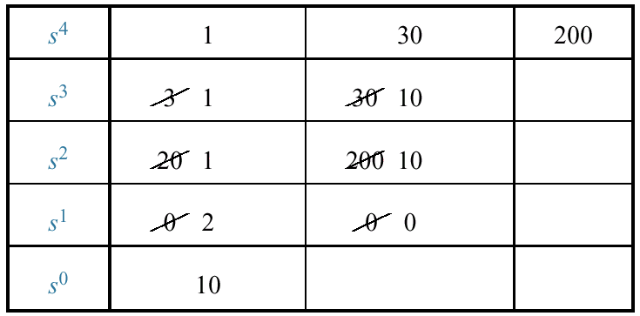
Factoring via Routh-Hurwitz
The Routh-Hurwitz criterion is often used in limited applications to factor polynomials containing even factors.
PROBLEM:
Factor the polynomial
(1)
(2)
Dividing polynomial (1) by (2) yields:

Slide 32
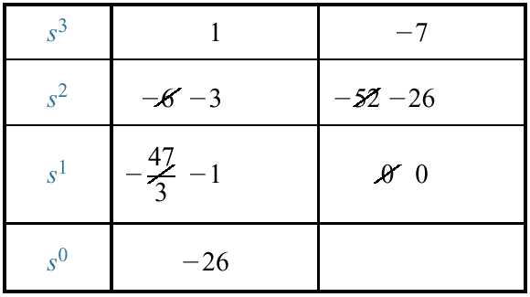
Stability in State Space
The values of the system's poles are equal to the eigenvalues of the system matrix, A.
PROBLEM: find out how many poles are in the left half-plane, in the right half-plane, and on the jw-axis.
SOLUTION:
Using this polynomial, form the Routh table
one sign change: One right-half-plane pole and two left-half-plane poles.
Unstable system.

Slide 33
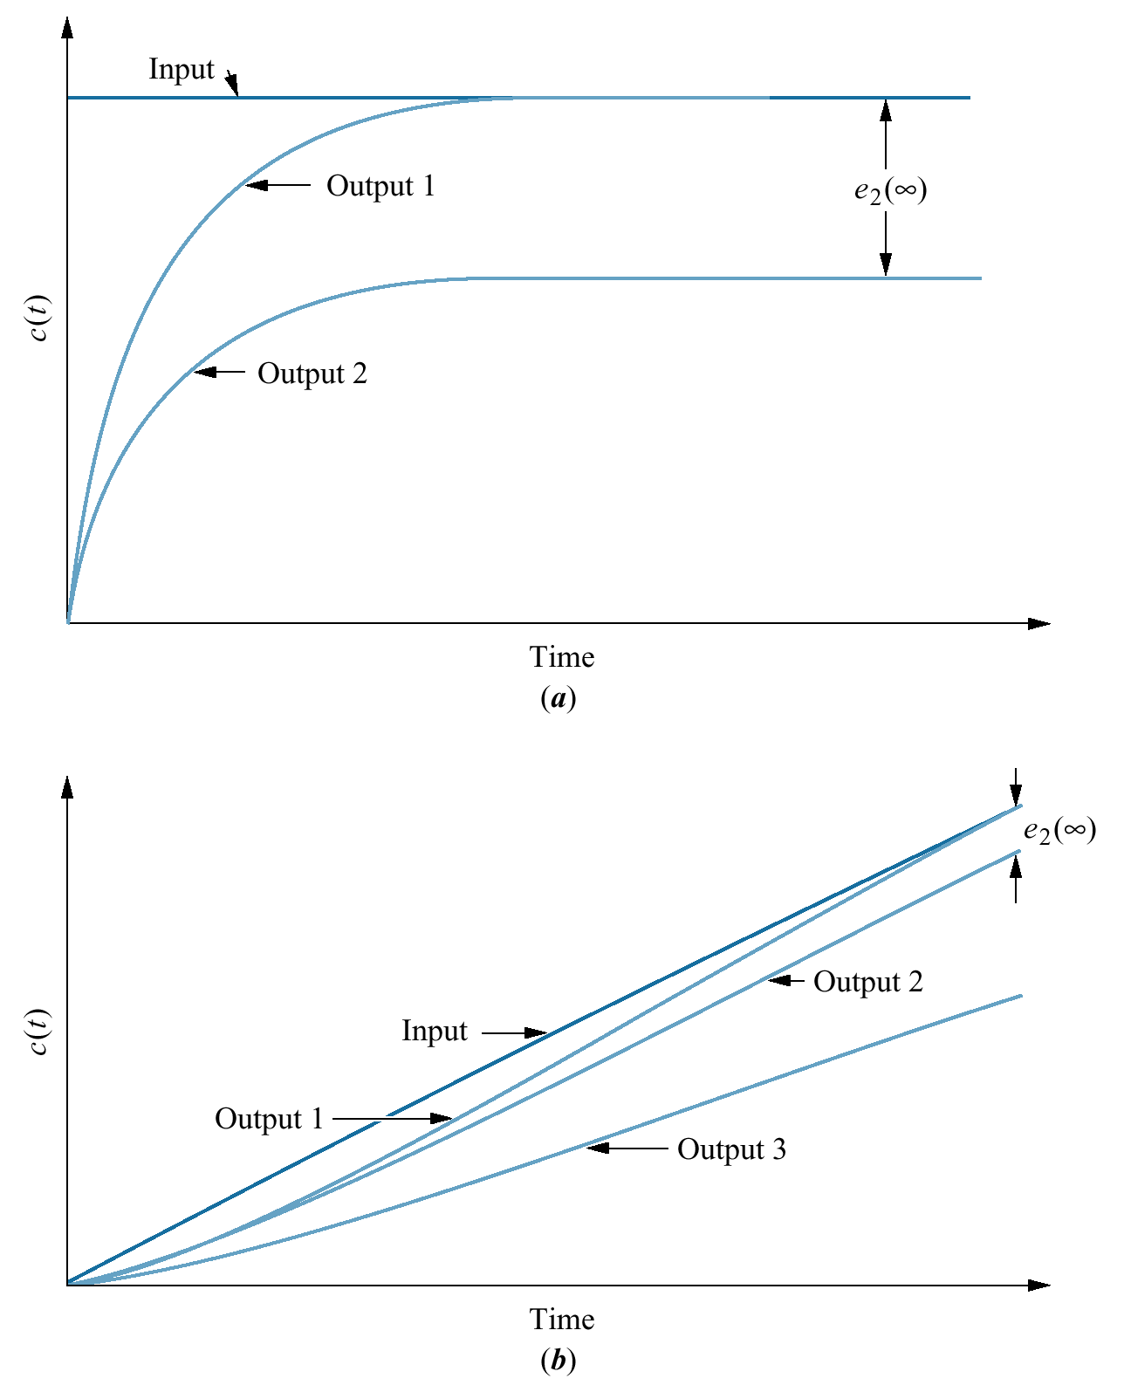
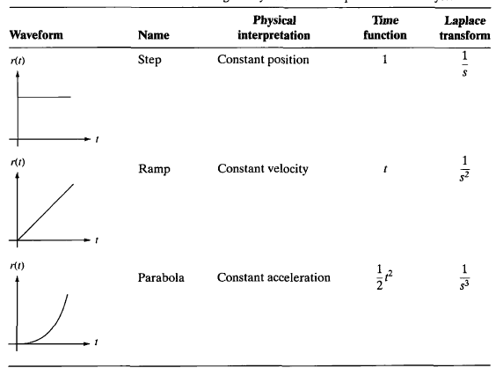
3. Steady-State Errors
Steady-State Error: The difference between the input and the output for a prescribed test input (step / ramp / parabola) as t →∞
Test waveforms for evaluating steady-state errors of position control systems
step input
ramp input
Steady-state error

Slide 34
Evaluating Steady-State Errors₁
Problem: Find the steady-state error for the following system with
input
output
Error
Closed-loop control system error
and input is step response.
Solution:
Step input
We have the error
Applying final value theorem
T(s) is stable, hence E(s) is stable.
Applying final value theorem,

Slide 35
Evaluating Steady-State Errors₂
Ramp input: tu(t)
For zero steady-state error,
[Final-value theorem]
Parabolic input: (1/2)t²u(t)
Step input: u(t)
For zero steady-state error,
For zero steady-state error,

Slide 36
Evaluating Steady-State Errors example1
u(t): unity step
Problem:
Find steady-state errors for inputs 5u(t), 5tu(t), and 5t²u(t) to the above system.
Solution:
Let, the system is stable.

Slide 37
Evaluating Steady-State Errors-example2
One integration, s¹
No integration will make it constant,
one integration makes it zero.
No integration will make it infinity.
one integration makes it constant.
Two integrations will make it constant and 3 or more will make it zero.

Slide 38
Static Error Constants
The steady-state error performance specifications are called static error constants.
steady-state error.
PROBLEM:
evaluate the static error constants and find the expected error for the standard step, ramp, and parabolic inputs.
step input, u(t)
ramp input, t u(t)
Position constant, K_{p}:
Velocity constant, K_{v}:
Acceleration constant, K_{a}:

Slide 39
System Type
Type 0: if n = 0; (no integration)
Type 1: if n = 1; (one integration)
Type 2: if n = 2; (two integrations)
Problem:
Find the value of K so that there is 10% error in the steady state.
Solution:
Type 1.
Input should be ramp, because only ramp yields a finite error in Type 1 system.

Slide 40
System Type
Relationships between input, system type, static error constants, and steady-state errors

Slide 41
Steady-State Error for Disturbances
Feedback control systems are used to compensate for disturbances or unwanted inputs that enter a system.
disturbance
Problem:
Find the steady-state error component due to a step disturbance
Solution:
steady-state error due to R(s),
steady-state error due to disturbance D(s),
steady-state error due to step disturbance D(s)=1/s,

Slide 42
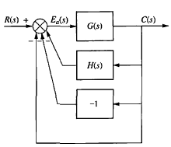
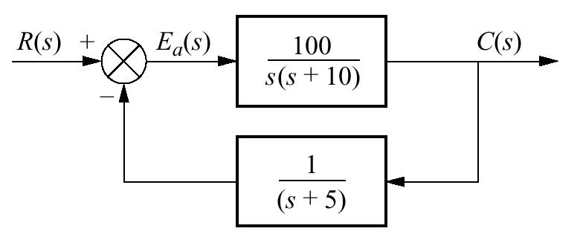
Steady-State Error for Nonunity Feedback System
Form a unity feedback system by adding and subtracting unity feedback paths (input and output units must be same.).
PROBLEM:
Find the system type, error constant, and the steady-state error for a unit step input.
Type 0 (as no integration).
For step input, static error constant is K_{p}.
Negative value means the output step is larger than the input step.

