Slide 1
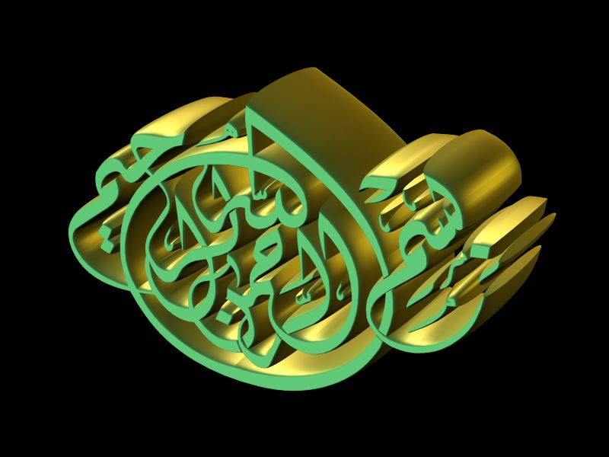
Experimental Embryology
الخلايا الجنينية والسرطانية
Embryonic and Cancer Cells

Slide 2
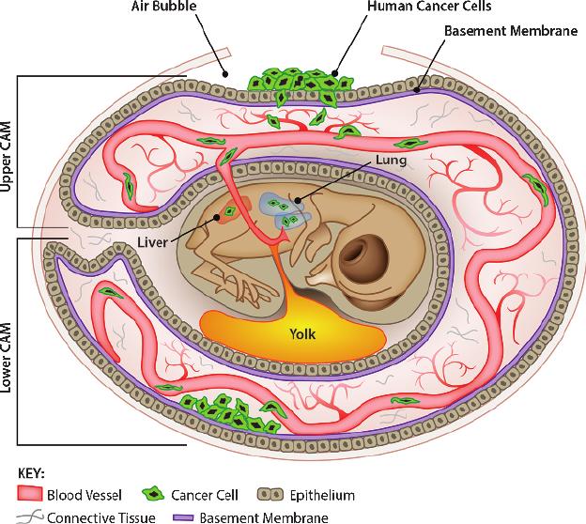
Principals of Experimental Embryology
المحاضرة (4)
الخلايا الجنينية والسرطانية
Lect.(4)
Embryonic and Cancer Cells

Slide 3
المحاضرة (4) الخلايا الجنينية والسرطانية
Lect.(4) Embryonic and Cancer Cells
1- Introduction and Definition
2- Type of Cancer cells
3- Type of Cancer cell
4- Cancer Reasons
5- Cancer Theories
6- Similarities and differences between embryonic and cancer cells

Slide 4
المحاضرة (4) الخلايا الجنينية والسرطانية
Lect.(4) Embryonic and Cancer Cells
1- Introduction and Definition
At the beginning perhaps comes to mind a question: Why does this subject here in the experimental embryology ! It is known that cancer is the abnormal growth of cells in the tissues and organs of the body. The cancer cells did not come from abroad, but it is originally from the body and as a result of influences what (whether internal or external) has turned this healthy cells into cancer cells in the body; means that the cancer cells, originally cells were differentiated and then lost this differentiation, and also lost the control in the divisions properly.

Slide 5
As well as, embryonic stem cells are undifferentiated cells at the beginning and then differentiate and division properly. As we known from regeneration subject, the developing cells lose their differentiation and then return to the differentiation or trans differentiation for the amputee part.
إذن التمايز وإزالة التمايز الخلوي هو الذي يربط موضوع الأجنة بالخلايا السرطانية. فهناك بعض التشابه والاختلاف بين الخلايا الجنينية والسرطانية،

Slide 6
2- أنواع الخلايا السرطانية2-Type of Cancer cells
There are two types of cancer cells:1-normal tumors الاورام الحميدية and2 Malignant tumors or cancer الاورام الخبيثة .
1- Normal tumors are not proper growth of the cells, but does not affect the place where it grows, also does not spread and its not difficult to control, for examples of the moles in the body. الثالول او الشامات
While 2- malignant tumor cells are not proper growth of cells, its affects different organs or tissue in the body and spread ,also difficult to control, such brain cancer, Lung and colon cancer……

Slide 7
3- Cancer Cells namesمسميات السرطان
Depends on the layer cells that are derived from cancer cells
1-الساركوما Sarcoma :: خلايا مستمده من الطبقة الوسطى الميزوديرم (الأنسجة الضامة)From mesoderm cells or connective tissues
2- الكارسينوما Carcinoma: خلايا مستمده من الطبقة الطلائية (الأكتوديرم والأندوديرم).From the ectoderm cells (Epithelial cells)
3-الميلانوما :Melanoma الخلايا الصبغية للجلد From the melanocytes .
4-اللوكيميا Leukemia: سرطان الدم من خلايا نخاع العظام From the bone marrow
5-التيراتوما Teratoma: سرطان الخلايا الجرثومية أو الخلايا المنبتة مثل الخلايا التناسلية الأولية (From Primordial Germ-Cells-PGCs).

Slide 8
4- Causes of cancer
There are many things believed to cause cancer, but can be summarized in three things as main reasons of the cancer, namely:
1-chemicals, 2- radiation, and 3-viruses.
All these causes are involved in the way of their effect on the cells, these substances affect the chromosomes in the cells and affecting therefore the genes responsible for the control of cell division, then division uncontrolled and turn into cancer cells.

Slide 9
1- Chemicals
* The chemicals that lead to cancer called Carcinogen, mean has carcinogenic effect
* Chemicals reach to the body either through touch or during breathing or by mouth with food.
* Chemicals listed in the following table, not for inventory but are examples and you can refer to the references and all bulletins from the Food organization, Cancer Society, fighting against smoking, Academy of Science in the New York and others.

Slide 10
جدول يوضح بعض المواد الكيميائية التي تؤدي إلى الإصابة بالسرطان
المادة الكيميائية * | أجهزة الجسم المتوقع إصابتها بالسرطان | طريقة وصول المادة للجسم
قطران السجائرٍ Smoking أزبستوس) أموزايت، كرزولايت | الحنجرة الرئتين تجويف الرئة والصدر المعدة والأمعاء | الاستنشاق الفم الاستنشاق الفم
البنزينFuel gas | نخاع العظام | الاستنشاق/ الجلد
الكلوروفورم Chloroform | الرئتين | الاستنشاق
النفثايل أمينNaphthalin | سرطان المثانة البولية | الاستنشاق/ الفم
كبريتاتالكادميومCadmium | سرطان البروستاتا | الاستنشاق /الفم
النيكل (تكرير النيكل)Nikel | سرطان تجاويف الفم و الرئة | الاستنشاق
كلوريد الفينيلFinial chlorid | سرطان الكبد، المخ ،الرئة | الاستنشاق /الجلد
كلورو ميثايل او إيثرEther | الرئة | الاستنشاق

Slide 11
2- Radiation types and sources
X-rays (X) for medical diagnosis, gamma rays, which were sometimes issued from some of the devices and radioactive chemicals, and ultraviolet radiation UV from the sun and some lighting sources, radiation from nuclear reactors and nuclear bombs. As was the case when the United States dropped the atomic bomb on Japan and the resulting damaging environmental effects on Japan and deformities of the embryos for several generations, as well as the leakage of radiation from Chernobyl in Russia, and his effects successor on human life and birth in the region that has spread there.
When exposing the cells to sufficient doses of radiation, they turn to cancer cells. UV rays cause skin cancer and the atomic bombs caused blood cancer or leukemia.

Slide 12
3- Viruses
Rous in (1911) discovered that the viruses caused the cancer, when isolated the virous and the carcenogenic virus was injected in the chickens which free from cancer, it is causes cancer for injected chickens.
* The virus inject the genetic material (DNA, RNA) into the cell and it is linked with the genetic material of the injected cell.
and may change the behavior and function of the cell and thereby creating a disable or change of certain properties within the cell and causes cell to become a cancer cell.

Slide 13
5- نظريات السرطان 5- Cancer Theories
There are three theories explain the cancer as follows: -
1- نظرية السرطان التهيجي 1- Irritation Cancer Theory
Chemicals and radiation causes irritation of cells , they lose the ability to control the normal cell proliferation, then they becomes cancer cells and divide in uncontrolled manners.
2- نظرية السرطان الجنيني 2- Embryonic Tumor Theory
This theory states that there are cells in the body since the embryonic stage continue without differentiation, and then turn to cancer cells later, this theory is based on the similarities between stem cells and cancer cells.

Slide 14
3- نظرية الجين الورمي 3-Oncogene Theory
A - This theory is closest to the acceptance, where assume that there are already tumor genes in cells, and these genes can be activated by carcinogens. Evidenced the validity of this theory when injected tumor genes isolated from cancer cells in healthy cells, they turned into cancer cells.
B- Proto-Oncogene-Activation تنشيط طلائع الجينات الورمية
It is the normal genes are present in the cells, but in latent inactive images, and any alteration or change it stimulated genes, and turning it into a tumor genes, there are 40 proto oncogenes isolated as tumor genes that are found on chromosome No. 11,18. It can activate these genes, in experimental animals by any one of the following ways: -

Slide 15
Proto-Oncogene-Activation في الكرموسومات منشطات طلائع الجينات الورمية
1- Viruses الفيروسات
Protooncogenes of tumor genes on chromosomes can be activated by some viruses. When tumor virus were injected inside the normal cells, it turning these cells into cancer cells.
2- Mutation الطفرة
Mutation can made by by chemical or carcinogen or radiation witch can led to activate the protooncogene
3- Amplification التفخيم
Repeated copies of the tumor genes makes normal cell turn into a cancer cell (See to next Fig..)

Slide 16
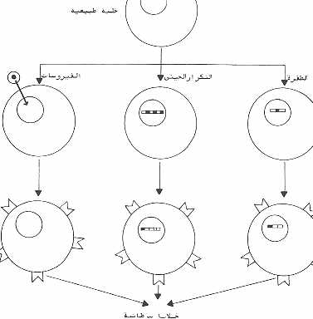
رسم تخطيطي يوضح كيف يتم تنشيط طلائع الجينات الورمية في الخلايا السليمة بوساطة بعض العوامل مثل الطفرة، التكرار الجيني أو الفيروسات كلها تحول الخلايا السليمة إلى خلايا سرطانية.

Slide 17
* The reasons for the spread of cancer cells:أسباب انتشار الخلايا السرطانية
1- Increase the rate of division of cancer cells, which helps to disintegrationالزيادة في معدل انقسام الخلايا السرطانية يساعد في الإنتشار
2- Changes in the surface of cancer cells, helping to circumvention of the immune system. التغير في سطح الخلية
3- Rupture of the tissues and separation of cells from each other as a result of enzymatic secretions produced by cancer cells. تمزق الانسجة وانفصال الخلايا عن بعضها
4- loss of Contact Inhibition property فقدان خاصية التثبيط التلامسي
5- Cell proliferation may be due to activate genes specific to that.تنشيط جينات خاصة بالإنقسام الورمي

Slide 18
6- Similarities and differences between embryonic cells and cancer cellsالتشابه والأختلاف بين الخلايا السرطانية والجنينية
1- original cellsأصل الخلايا
The origin of all embryonic cells and cancer cells is one the fertilized egg. But embryonic cells appear in the beginning and while cancer cells appear later.
2 - Reproduction and growthالتكاثر والنمو
Embryonic cells continue in reproduction and growth and then differentiate, as well as cancer cells continue in reproduction and grow but without discipline, and even in cell cultures when the normal cells are crowded, they are stop, while cancer cells are continue.

Slide 19
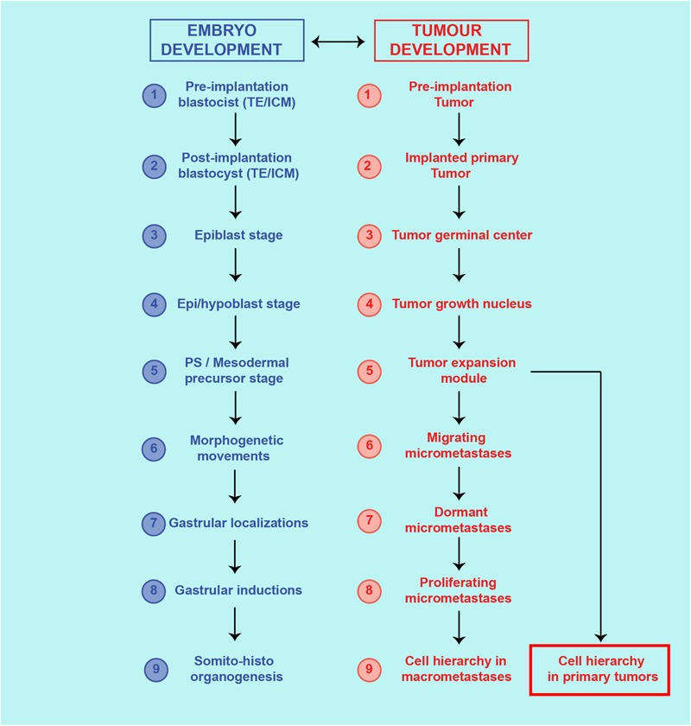
Theoretical similarities between cancer process and ontogenetic development. Correspondence of steps and structures between the cancer process and embryo development.

Slide 20
* AutoWarburg suggested that the increase in growth and reproduction due to the increase in the absorption of food and insertion of the food into the cells and all of this is due to the change in the permeability of the cell membrane.
3 - Cell migration and transferالهجرة والإنتقال
Malignant cancer cells move from the place and spread in other tissues of the body such as cancer of skin cells (melanoma), cells migrate and settle in the lungs (Fig. 50). Also, some embryonic cells move from the place of composition and settle in other tissues such as the primary germ cells and neural crest cells.

Slide 21
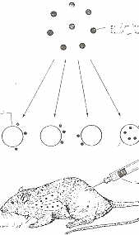
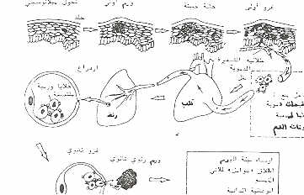
عند حقن خلايا سرطان الجلد (الميلانوسيت) في الفأر فإنها تهاجر وتستقر في الرئتين.
بعض الخلايا الورمية من الجلد تهاجر عبر الأنسجة وتيار الدم.

Slide 22
* خاصية التعرف أو الالتصاق للخلايا الجذعية، والتصاقها في أنسجة خاصة مثل خلايا نخاع العظام عند حقنها تتجه إلى موقعها بالجسم والخلايا التناسلية تتجه إلى المنسل غير المتمايز في الجنين، بينما الخلايا السرطانية الصبغية أو الميلانوما تلتصق بالرئة.
4 - Cell surface and respirationخاصية سطح الخلية والتنفس الخلوي
* Cellular respiration process and glucose consume were increased in cancer and embryonic cells, where increase of the sugar analysis process (Glycolysis).

Slide 23
5- Differentiation التمايز
Cellular differentiation is advantage to embryonic cells, and the removal of differentiation (dedifferentiation) occurs in some regeneration and cancer cells, and trans-differentiation as in iris and retinal cells transformation into the lens cells. Cancer cells can lose differentiation and trans-differentiation property.
Culture of the cancer cell nucleus and place of oocyte nucleus, they are growing properly in the frog. When trnasfer the teratoma cells under the skin of mouse, they form tumors.
But the transfer of cancer cells themselves in the Blastula stage, they grow properly and form embryos free from tumor and normal mice (look to next Fig.).

Slide 24
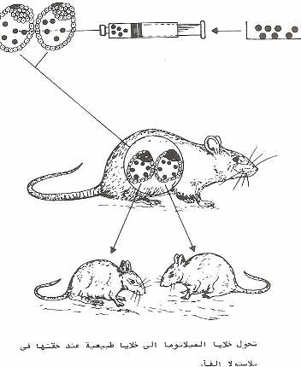
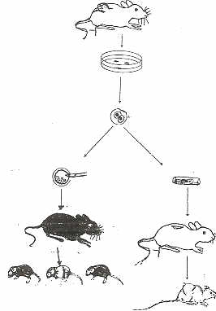
Fig.: When transfer the teratoma cells under the skin of mouse, they form tumors.
But the transfer or injecting of cancer cells insid the Blastula stage, they grow properly and form embryos free from tumor and developed to normal mice.

Slide 25
شكراً لحسن إستماعكم

