Slide 1
Medical Genetics 453 CLS
May Alrashed, PhD

Slide 2
History Of Genetics

Slide 3
Charles Darwin (1809-1882)
Established that all species of life have descended over time from common ancestry
Proposed the scientific theory that this branching pattern of evolution resulted from a process that he called natural selection.
He published his theory with compelling evidence for evolution in his 1859 book ”On the Origin of Species”, overcoming scientific rejection of earlier concepts of transmutation of species.

Slide 4
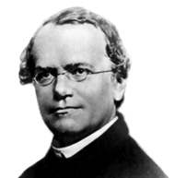
Gregor Johann Mendel (1822-1884)
Scientist and Augustinian friar who gained posthumous fame as the founder of the new science of genetics.
Mendel demonstrated that the inheritance of certain traits in pea plants follows particular patterns, now referred to as the laws of Mendelian inheritance.
Gregor Mendel, who is known as the "father of modern genetics."

Slide 5
Used Pisum Sativum (Graden Pea) in his study.
There are 7 characteristics of pea in his study
Published the results of his investigations of the inheritance of "factors" in pea plants.
Mendelian laws of Inheritance
1. Law of Segregation
2. Law of Independent Assortment

Slide 6
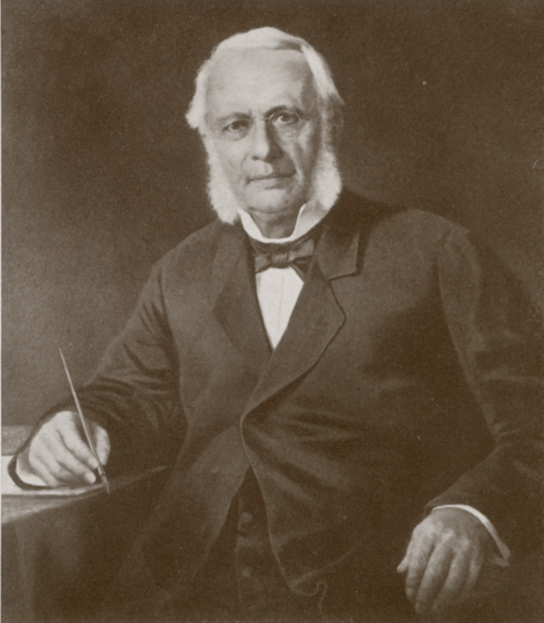
Friedrich Miescher (1844-1895)
He was the first researcher to isolate and identify nucleic acid.
Discovered a new type of weak acid, abundant in the nuclei of the white blood cell; Miescher's weak acid turned out to be the chemical substance we now call deoxyribonucleic acid or DNA.

Slide 7
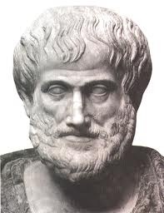
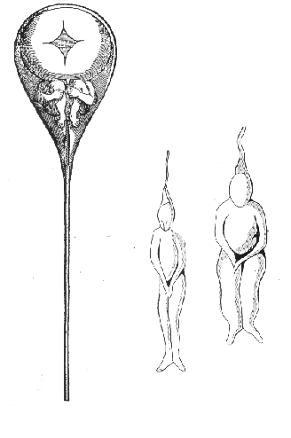
Aristotle
The ancient Greek philosopher Aristotle contributed in tow theories:
Pangenesis theory (according to which tiny particles are formed in different parts of the body. These particles migrate to the gametes and from there to the offspring where they guide the formation of the respective parts)
Preformatonism – there is a preformed bodies (Homunculus) that organisms develop from miniature versions of themselves
A tiny person inside a sperm, as drawn by Nicolaas Hartsoeker in 1695

Slide 8
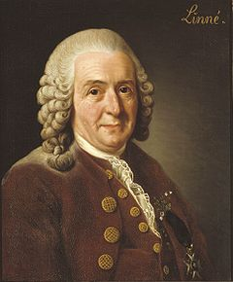
Carl Linnaeus (1707 –1778)
Father of modern taxonomy.
Laid the foundations for the modern scheme of binomial nomenclature.

Slide 9
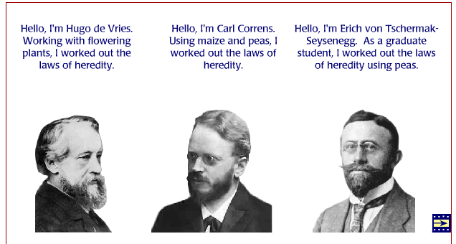
Three scientists who rediscovered Mendel's laws in 1900. They were all working independently on different plant hybrids, and came to the same conclusions about inheritance as Mendel.

Slide 10
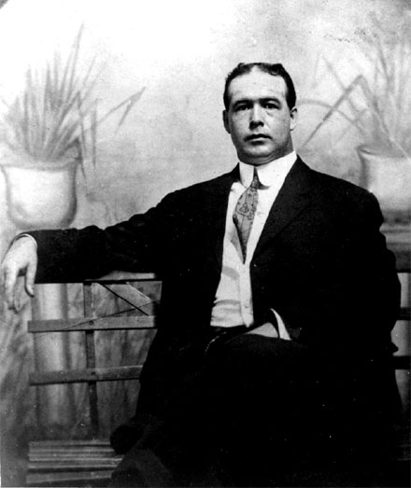
Walter Sutton (1835-1913)
Pointed out the interrelationships between cytology and Mendelism, closing the gap between cell morphology and heredity.
Fertilization.
Affiliated the behavior of chromosomes to the genes.

Slide 11
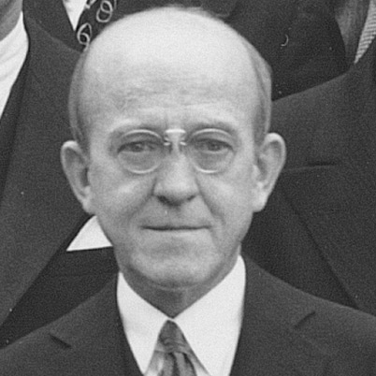
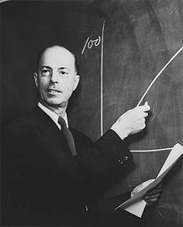
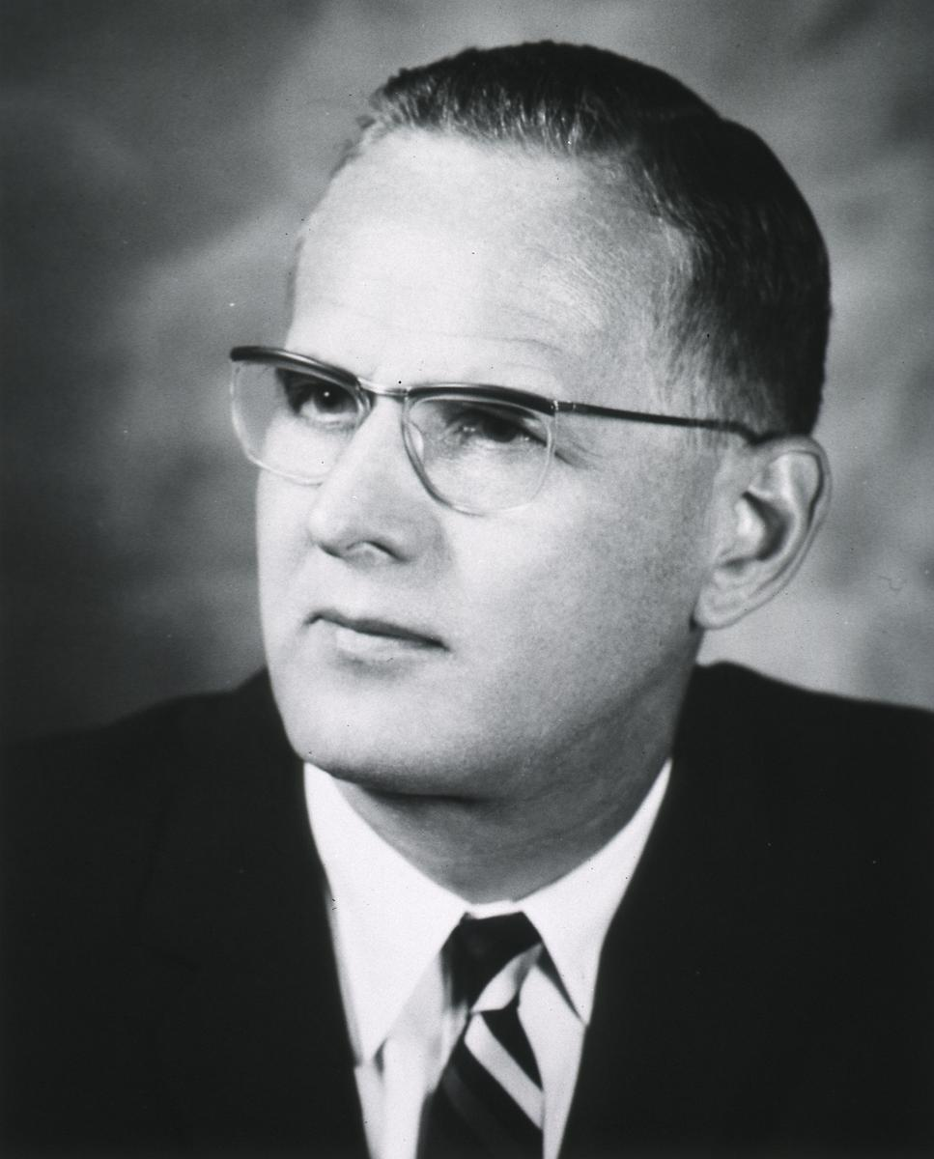
Avery, MacLeod, McCarty
Reported that they had purified the transforming principle in Griffith's experiment and that it was DNA.
DNA- genetic material

Slide 12
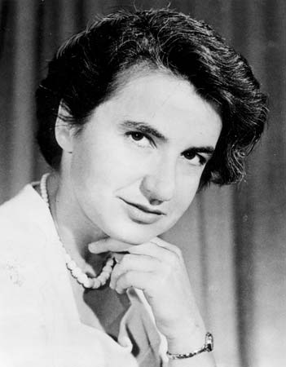
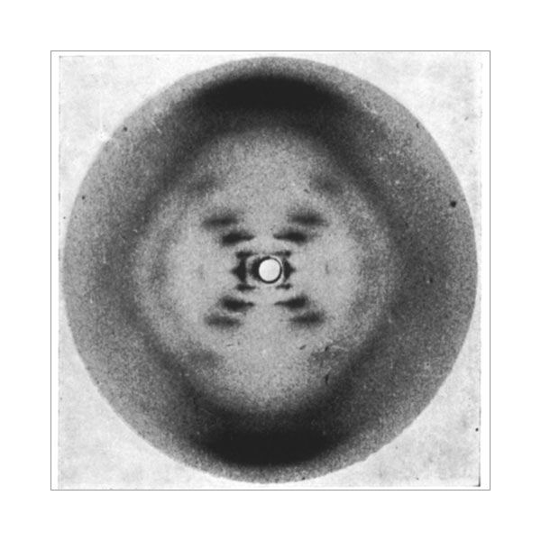
Rosalind Franklin (1920–1958)
an English chemist and X-ray crystallographer who made contributions to the understanding of the fine molecular structures of DNA
Obtained sharp X-ray diffraction photographs of DNA.

Slide 13
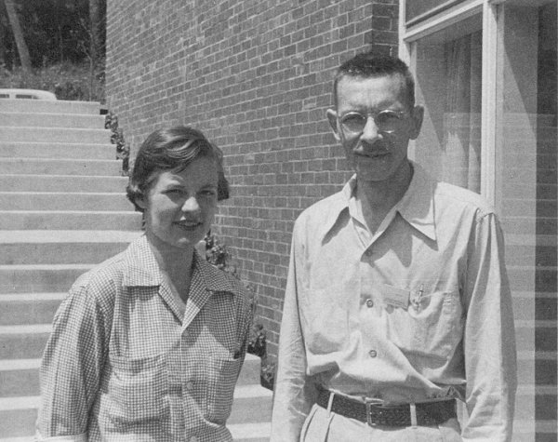
Martha Chase Alfred Hershey
Used phages in which the protein was labeled with 35S and the DNA with 32P for the final proof that DNA is the molecule of heredity.
Hershey shared the 1969 Nobel Prize in Physiology or Medicine with Max Delbrück and Salvador Luria for their “discoveries concerning the genetic structure of viruses

Slide 14
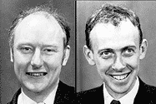
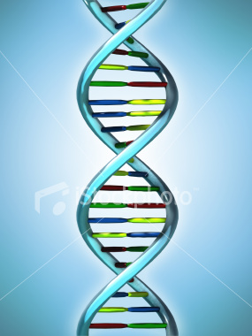
Francis Crick, James Watson
Solved the three-dimensional structure of the DNA molecule in 1953.
DNA is double stranded.

Slide 15
Summary

Slide 18
SCOPE AND BRANCHES
Behavioral Genetics- examines the role of genetics in animal (including human) behavior.
Classical Genetics- consists of the technique and methodologies of genetics that predate the advent of molecular biology.
Conservation Genetics- interdisciplinary science that aims to apply genetic methods to the conservation and restoration of biodiversity.
Ecological Genetics- study of genetics in natural populations.
Genomics- discipline in genetics concerning the study of the genomes of organisms.

Slide 19
SCOPE AND BRANCHES
CYTOGENETICS
Science that deals with the physical basic of heredity (cell)
MOLECULAR GENETICS
Chemical basis of heredity
Newest and most advanced field of Genetics
Genomic (Study of genes of an organism)
Proteomics (study of proteins coming from DNA replication.)

Slide 20
CLASSICAL GENETICS
Study of analysis of offspring to mating (parents to offspring)
POPULATION GENETICS
Deals with the transmission of trait with a large group of individual through a passage of time.
BEHAVIORAL GENETICS
Study of behavior of an organism.

