Slide 1
Motion Study and Work Design
Sections:
Basic Motion Elements and Work Analysis – part 1
Micromotion Analysis – part 1
Principles of Motion Economy and Work Design – part 2

Slide 2
Definitions
Motion study - analysis of the basic hand, arm, and body movements of workers as they perform work
Work design - design of the methods and motions used to perform a task
Includes:
Workplace layout and environment
Tooling and equipment used in the task

Slide 3
Motion Study and Work Design
Principles of Motion Economy and Work Design

Slide 4
Principles of Motion Economy
Developed over many years of practical experience in work design
Guidelines to help determine
Work method
Workplace layout
Tools, and equipment
Objectives:
maximize efficiency and
minimize worker fatigue
Notes:
i.e. these are methods used to maximize/optimize the use of therbligs

Slide 5
Three Categories of Principles
Principles that apply to the use of the human body
Principles that apply to the workplace arrangement
Principles that apply to the design of tooling and equipment

Slide 6
1. Use of Human Body
Design work to fully utilize both hands
Natural tendency of most people: use their preferred hand* to accomplish most of work
Other hand: minor role, e.g. holding object, while preferred hand works on it
first principle: both hands should be used as equally as possible
The two hands should begin and end their motions at the same time
follows from 1
Sometimes must design method so work is evenly divided between right-hand & left-hand side of workplace
In this case, division of work should be organized according to following principle (3)
Notes:
* i.e. right hand for right-handed people and left hand for left-handed people

Slide 7
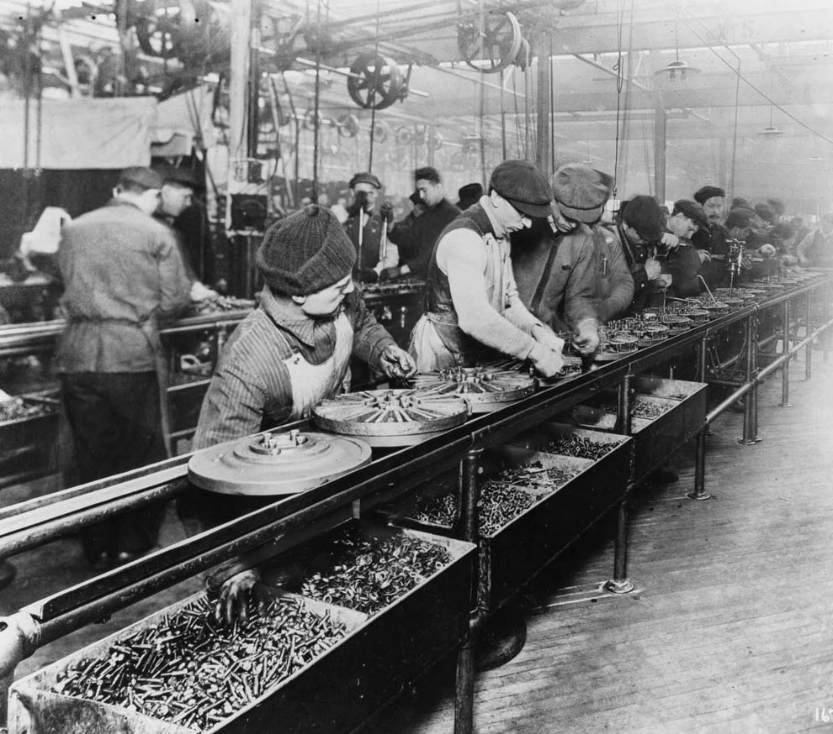
1. Use of Human Body
Hand and arm motions should be symmetrical and simultaneous
i.e. minimize amount of hand-eye coordination required by worker
since both hands: doing same movements at same time ⇒ less concentration required than if 2 hands had to perform different & independent motions
Design work to favor preferred hand
Preferred hand: faster, stronger, more practical
If the work to be done cannot be divided evenly between 2 hands ⇒ take advantage of worker’s best hand
e.g. work units should:
enter workplace on side of worker’s preferred hand
& exit workplace on the opposite side**
Notes:
* i.e. right hand for right-handed people and left hand for left-handed people
* e.g. of hand-eye coordination: playing tennis
* Note that 4 is a consequence of 3
** why? The reason is that greater hand-eye coordination is required to initially acquire the work unit, so the worker should use the preferred hand for this element. Releasing the work unit at the end of the cycle requires less coordination.

Slide 8
1. Use of Human Body
Worker’s two hands should not be idle at the same time
Avoid periods when neither hand is working
It may not be possible to completely balance workload between the right & left hands
but it should be possible to avoid having both hands idle at the same time
The exception to this principle: during rest breaks
Work cycle of worker-machine system also exception
if worker is responsible for monitoring machine during its automatic cycle,
and monitoring involves using worker’s cognitive senses rather than hands*
Notes:
* If machine monitoring: not required, ⇒ internal work elements should be assigned to worker during the automatic cycle

Slide 9
1. Use of Human Body
Next 5 principles of motion economy attempt to utilize laws of physics to assist use of hands and arms while working
Method should consist of:
smooth continuous curved motions
rather than straight motions with abrupt changes in direction*
Reason behind this principle:
straight-line path sequence includes start and stop actions (accelerations, decelerations) ⇒ consume worker’s time & energy
Motions consisting of smooth continuous curves: minimize lost time in starts & stops
Notes:
* note, it takes less time to move through a sequence of smooth continuous curved paths than through a sequence of straight paths that are opposite in direction, even though the actual total distance of the curved paths may be longer (since the shortest distance between two points is a straight line)

Slide 10
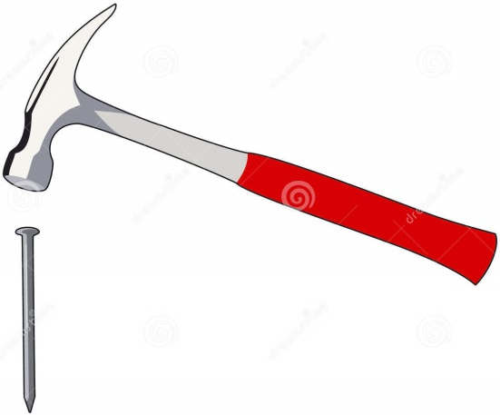
1. Use of Human Body
Use momentum to facilitate task
When carpenters strike nail with hammer ⇒ they’re using momentum ($mass ∗ velocity$)
Imagine applying static force to do this!
When work situations provide opportunity to use momentum (like above): use it
Previous principle (smooth continuous curved motions) shows beneficial use of momentum to make a task easier
Take advantage of gravity – Don’t oppose it
Less time & energy required to move heavy object from higher to lower elevation than to move object upward
Principle usually implemented by proper layout and arrangement of the workplace
Notes:
* Principle 7: often associated with workplace arrangement principles of motion economy (category 3)

Slide 11
1. Use of Human Body
Method should achieve a natural rhythm of the motions involved
Rhythm: motions that have regular recurrence and flow from one to the next
Basically, the worker learns rhythm & performs motions without thinking
Like natural & instinctive motion pattern in walking

Slide 12
1. Use of Human Body
Use lowest classification of hand and arm motion (five classifications)
Finger only
Finger and wrist
Finger, wrist, and forearm
Finger, wrist, forearm, and upper arm
Finger, wrist, forearm, upper arm, and shoulder
For lower classification, worker perform hand and arm motion: more quickly & with less effort
⇒ work method: should be composed of motions at lowest classification level possible
Accomplished by: locating parts & tools as close together as possible in workplace

Slide 13
1. Use of Human Body
Two remaining human body principles of motion economy (11 and 12): recommendations for using body members other than hands and arms

Slide 14
1. Use of Human Body
Minimize eye focus and travel
Eye focus occurs when eye must adjust to change in viewing distance
e.g. from 25 in. to 10 in., with little or no change in line of sight
Eye travel occurs when eye must adjust to a line-of-sight change
e.g. from one location in the workplace to another, but the distances from eyes are same
Since eye focus and eye travel each take time,
⇒ desirable to minimize need for worker to make these adjustments as much as possible
Accomplished by minimizing distances between objects (e.g. parts and tools) used in workplace

Slide 15
1. Use of Human Body
Design method to utilize feet and legs where appropriate
Legs: stronger than arms, although feet are not as practical as hands
Work method can sometimes be designed to take advantage of greater strength of legs
e.g.: in lifting tasks

Slide 16
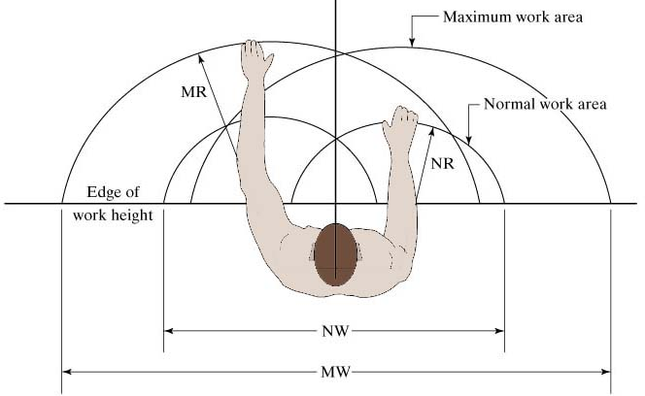
2. Workplace Arrangement
Normal and maximum working areas in the workplace
Notes:
Note how all female working dimensions are about 10% less than those of male working dimensions
Also note, this principle is studied extensively in anthropometry (Barnes, Farley, Ayoub, etc.)

Slide 17
2. Workplace Arrangement
First 3 principles:
Deal with immediate work area
Lead to natural rhythm in workplace
Remaining principles (4 – 7):
Deal with use of gravity, and
General conditions of the workplace

Slide 18
2. Workplace Arrangement
Locate tools and materials in fixed positions within the work area
“a place for everything & everything in its place”
Worker eventually learns fixed locations,
⇒ allowing him to reach for object,
without wasting time looking & searching

Slide 19
2. Workplace Arrangement
Locate tools and materials close to where they are used
Helps minimize distances worker must move (TE and TL) in workplace
Any equipment controls should also be located in close proximity:
Refers to normal & maximum working area (Fig. 10.2)
Desirable to keep parts & tools used in within normal working area (for each hand & both hands working together
If method requires worker to move beyond maximum working area:
⇒ worker must move > than just arms & hands
⇒ more energy, more time, more worker fatigue
Notes:
* remember, TE: travel empty, TL: travel loaded (i.e. move item)

Slide 20
2. Workplace Arrangement
Locate tools and materials to be consistent with sequence of work elements
Items should be arranged in logical pattern that matches sequence of work elements
Those items that are used first in cycle should be on 1 side of work area
Items used next should be next to first, and so on
Alternative: locate items randomly in the work area
⇒ increases amount of searching required
& detracts from rhythm of work cycle
Fig. 10.3: shows top view of workplace layout that illustrates 1st 3 principles
Note, layout in (b)
locates bins in more accessible pattern
consistent with sequence of work elements

Slide 21
Illustration of First Three Principles
Figure 10.3: Two workplace layouts.
(a) Poor arrangement of parts and tools in workplace
Notes:
Q: can you identify how this arrangement defies the first 3 workplace arrangement principles?

Slide 22
Illustration of First Three Principles
(b) Good arrangement of parts and tools in workplace
Notes:
Note, numbers here indicate sequence of work elements in relation to locations of hand tools and parts bins

Slide 23
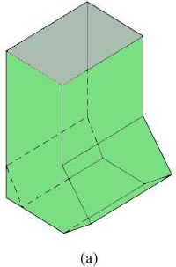
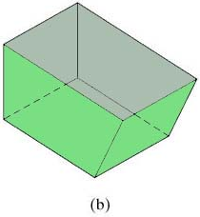
2. Workplace Arrangement
Use gravity feed bins to deliver small parts and fasteners
Two types of bins used for small parts and fasteners in the workplace:
gravity feed bin
This’s a container that uses gravity to move items in it to a convenient access point for the worker
conventional rectangular bin
slower acquisition of items than gravity feed bin

Slide 24
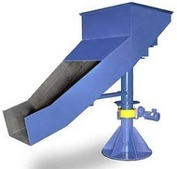
2. Workplace Arrangement
Use gravity drop chutes for completed work units where appropriate
Drop chutes should lead to container adjacent to worktable
Entrance to gravity chute should be located near normal work area
⇒ allows worker to dispose finished work unit quickly & conveniently
Most appropriate for lightweight work units that are not fragile

Slide 25
2. Workplace Arrangement
Provide adequate illumination
Issue of illumination is normally associated with ergonomics
Also long known to be important factor in work design
Illumination: especially important in visual inspection tasks

Slide 26
2. Workplace Arrangement
A proper chair should be provided for the worker:
Adjustable to the size of the worker
Seat height and back adjustments
Padded seat and back
Means of increasing & decreasing amount of back support
Chair height should be in proper relationship with work height
Adjustable chair for workplace: next slide

Slide 27
Adjustable Chair for Workplace
Notes:
Q: can you identify all the adjustability aspects of the chair mentioned in the last slide?

Slide 28
3. Design of Tooling and Equipment
Workholding devices should be designed for the task
Mechanical workholder with fast-acting clamp
permits work unit to be loaded quickly, and
frees both hands to work on the task productively
Typical workholder: must be custom-designed for work part processed in task

Slide 29
3. Design of Tooling and Equipment
Hands should be relieved of work elements that can be performed by the feet using foot pedals
Foot pedal controls instead of hand controls
to operate certain types of equipment
e.g. Sewing machines, foot pedals used as integral components in operation of equipment
Training: often required for operator to become proficient in use of foot pedals

Slide 30
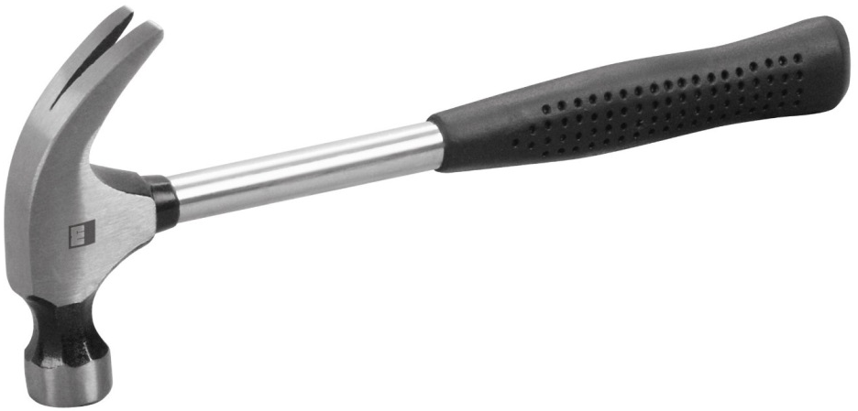
3. Design of Tooling and Equipment
Combine multiple functions into one tool where possible
Many common hand tools implement this principle
e.g. claw hammer: designed for both striking and pulling nails
e.g. nearly all pencils are designed for both writing and erasing*
Less time usually required to reposition such a double-function tool than to put one tool down and pick another one up
Notes:
* Remember the bonus exercise from part 1 of this chapter?

Slide 31
3. Design of Tooling and Equipment
Perform multiple operations simultaneously rather than sequentially
Work cycle: usu. conceptualized as sequence of work elements or steps
Steps are performed one after the other by worker and machine
In some cases: work method can be designed so steps are accomplished at same time rather than sequentially*
Special tooling and processes can often be designed to simultaneously accomplish multiple operations
Notes:
* See: Principles that apply to the use of the human body

Slide 32
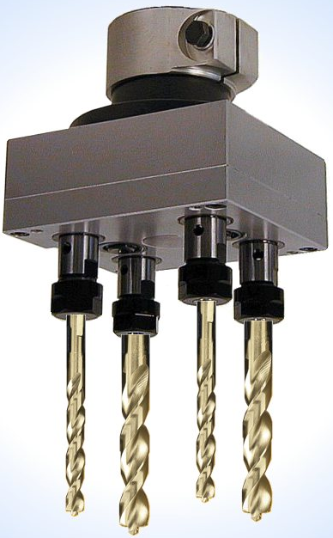
3. Design of Tooling and Equipment
Where feasible, perform operation on multiple parts simultaneously
Usu. applies to cases involving use of powered/ machine tool, e.g.:
drilling of holes in a printed circuit board (PCB)
PCBs are stacked 3 or 4 thick
NC drill press drills each hole through entire stack in one feed motion

Slide 33
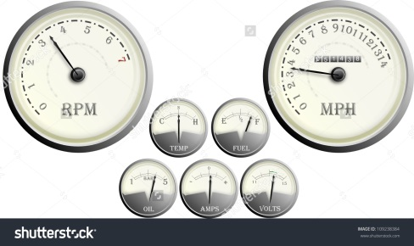
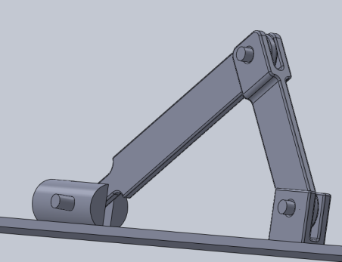
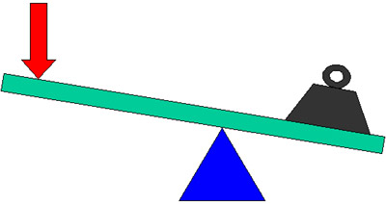
3. Design of Tooling and Equipment
Design equipment controls for operator convenience and error avoidance
Equipment controls include devices that regulate operation of the equipment
Dials
Cranks
Levers
Switches
Push buttons, etc.
All controls needed by operator should be located within easy reach
⇒ minimize body motions required to access & activate them

Slide 34
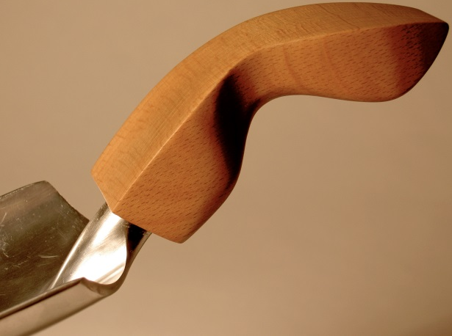
3. Design of Tooling and Equipment
Hand tools and portable power tools should be designed for operator comfort and convenience
e.g. tools should have handles/grips: slightly compressible
⇒ can be held & used comfortably for duration of shift
Location of handle/grip relative to working end of tool:
should be designed for max. operator safety, convenience, and effectiveness of tool
If possible, tool should accommodate both right-handed & left handed workers

Slide 35
3. Design of Tooling and Equipment
Mechanize or automate manual operations if economically and technically feasible
⇒ this will almost always outperform worker in terms of speed, repeatability, and accuracy
⇒ results in higher production rates & better quality products
Economic feasibility depends on quantities produced:
Higher quantities: likely to justify investment in mechanization & automation

