Slide 1
Domain of Nursing
The specific domain of nursing is
People’s unique responses to and experience of health, illness, frailty, disability and health-related life events in whatever environment or circumstances they find themselves.
People’s responses may be physiological, psychological, social, cultural or spiritual, and are often a combination of all of these.
The term “people” includes individuals of all ages, families and communities, throughout the entire life span.

Slide 2
Scope of Nursing
The focus of nursing
Is the whole person and the human response rather than a particular aspect of the person or a particular pathological condition.
Scope of Nursing
Nurses provide care for three types of clients:
Individuals
Families
Communities.
Nursing practice involves four areas:
Promoting health and wellness
Preventing illness
Restoring health
Care of the dying.

Slide 3
Regulation of Nursing
Legal regulation
Laws
Civil Law: Private parties sue one another
Criminal Law: The government files a lawsuit against a person
Administrative Law: Institutional rules, polices, procedures, Or Organizational policies
Professional Regulation
Nurse's practice act

Slide 4
Ethical regulation
Value Base:
Ethical values which respect the dignity, autonomy and uniqueness of human beings, acceptance of personal accountability for decisions and actions.
Codes of ethics..

Slide 5
Partners of Nurses
Nurses work with
Patients
Relatives (families)
Other members of a health team.
Where appropriate nurses will
Lead the team
Coordinate care
Delegate responsibilities
Supervise the work of others
At other times they will participate under the leadership of others.

Slide 6
Roles of Professional Nurse
Caregiver
Providing direct care to the ill person, such as administering medications, baths, and specific procedures and treatments.
Clinical Decision Maker
Performing diagnostic and assessment procedures, such as measuring blood pressure and examining feces for occult blood in order to plan care accordingly

Slide 7
Teacher
Teaching clients about recovery activities, such as exercises that will accelerate recovery after a stroke.
Consultant
Consulting with other health care professionals about client problems.

Slide 8
Roles of Professional Nurse(Cont.)
Patient Advocate
Educating clients about their rights, and how to attain them.
Case Manager
Providing ongoing support and expertise through comprehensive assessment, planning, implementation and overall evaluation of individual patient needs

Slide 9
Rehabilitator
Rehabilitating clients to their optimal functional level following physical or mental illness, injury, or chemical addiction.
Comforter
Involves comforting and caring for people of all ages on health-disease continuum. it includes helping clients live as comfortably as possible until death

Slide 10
Settings for Nursing
In the past, the acute care hospital was the main practice setting open to most nurses.
Today many nurses work in hospitals, but increasingly they work in clients homes, community agencies, ambulatory clinics, long-term care, health maintenance organization (HMOs), and nursing practice centers.

Slide 12
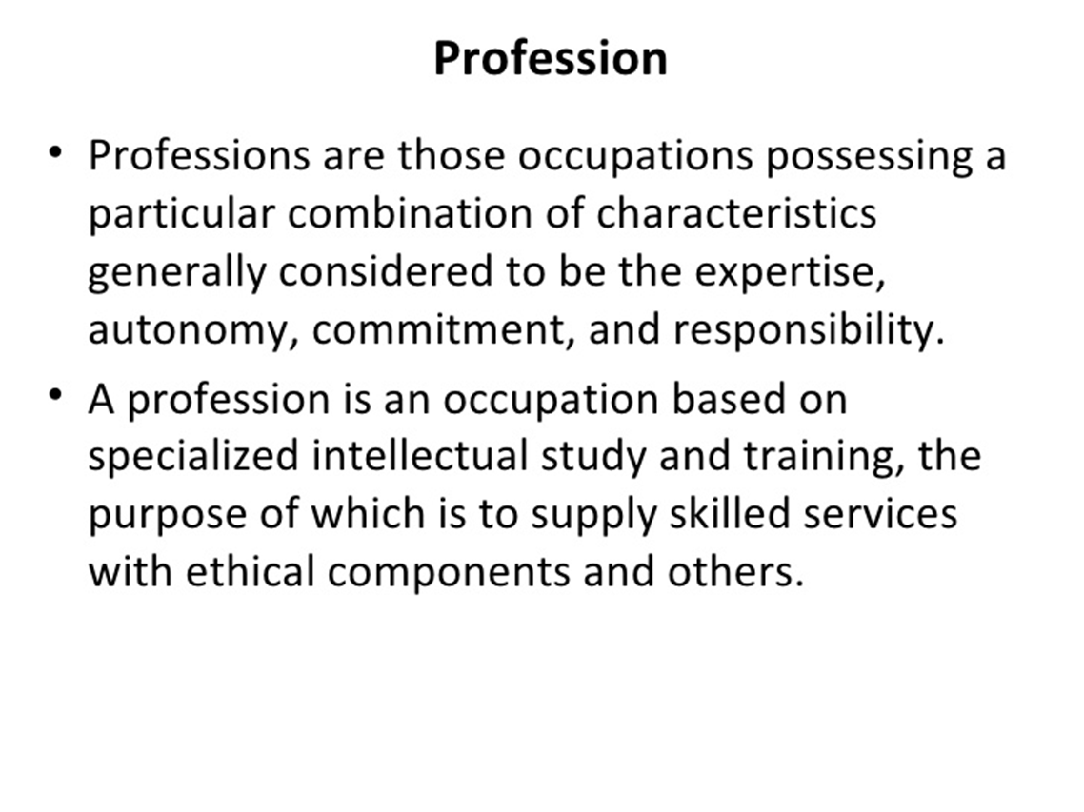

Slide 17
Nursing as a Practice Profession
Is nursing a profession?
What is a profession?

Slide 18
Characteristics of a Profession
In general, a profession—whether nursing or another profession, such as medicine, teaching, or law—has certain characteristics
A systematic body of knowledge that provides the framework for the profession’s practice
Standardized, formal higher education
Commitment to providing a service that benefits individuals and the community

Slide 19
4. Maintenance of a unique role that recognizes autonomy, responsibility, and accountability
5. Control of practice responsibility of the profession through standards and a code of ethics
6. Commitment to members of the profession through professional organizations and activities

Slide 20
Evolution of a Profession Professionalization
Practitioners perform full-time work in the discipline
Determine work standards, identify a body of knowledge and establish educational programs
Promote organization into effective occupational associations (licensure/certification)
Establish codes of ethics

Slide 21
Barriers to Professionalism
Variability in educational preparation
Gender issues
Historical influences
External conflicts
Internal conflicts

Slide 22
What about Nursing???
Is nursing
A profession?
or
An occupation?

Slide 23
Nursing knowledge
Specialized knowledge
Expands knowledge by scientific method
Institutions of higher education
Services vital to human and social welfare
Autonomously forms professional policy
Intellectual and personal qualities
Compensation = freedom, professional growth and economic security

Slide 24
Nursing Service
Service is vital to humanity and society
Knowledge continually enlarged through research
Individual accountability
Educated in institutions of higher education

Slide 25
Autonomy
Motivated by altruism
Code of ethics
Association = high standards of practice

Slide 26
Commitment
Nurses Social Policy Statement – 2003
Code of Ethics for Nurses – American Nurses Association - 2001

Slide 27
Autonomy
The quality or state of being self-governing; especially: the right of self-government
Self-directing freedom and especially moral independence
Guided by a code of ethics that regulates relationships between professional and client

Slide 28
Common culture, norms and values between members
Clear standard of educational preparation for entry into practice
Members value service above personal gain
Compensation for member

Slide 29
Thank you

