Slide 1
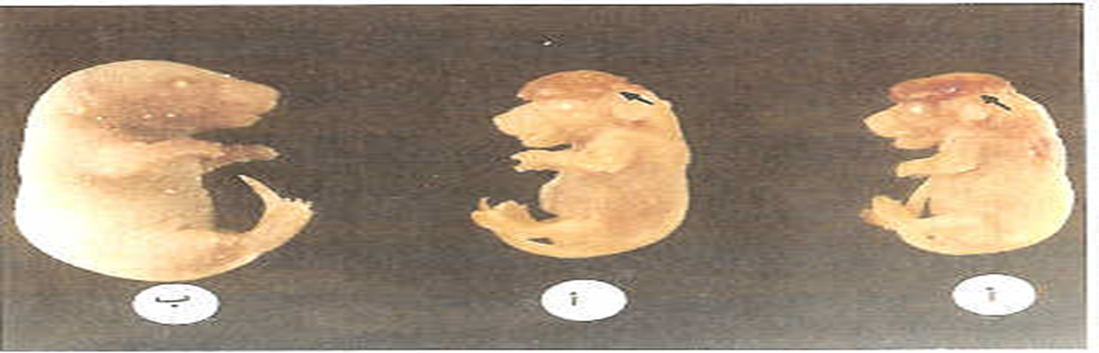

بسم الله الرحمن الرحيم
التشوهات الخلقية
Teratology
or Congenital Malformation

Slide 2
التشوهات الخلقية: عناصر المحاضرة lecture contents
Teratology or Congenital Malformation
I- Introduction , Definition and history view
II- Critical period during embryonic development:
1-Period before cellular differentiation
2- Period during cellular differentiation
3-The Growth phase and organs formation
III- Factors that cause birth defects
3-1- Internal factors and genetic background
3-2- External factors

Slide 3
I- Introduction, Definition and history view
علم التشوهات الخلقية A- Teratology or Congenital malformations
It is a science that examines the changes and effects that occur at different structural and formal organization of living organisms in the embryonic stage; as a result of exposure to internal or external factors during the developmental embryonic stages.
If this anomaly in growth is away from the shape of organism differed greatly from the natural form this status is called Monster. المسخ

Slide 4
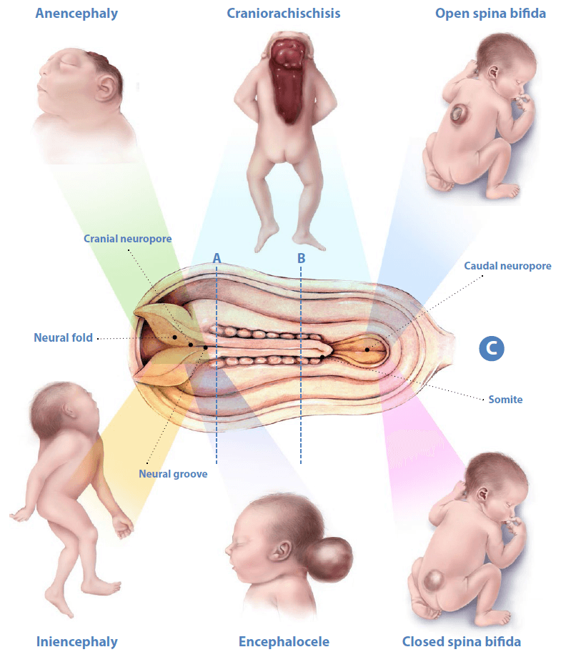
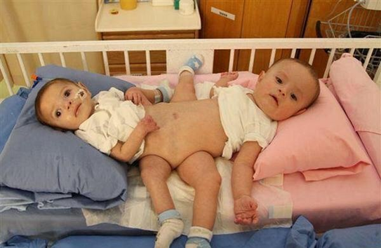
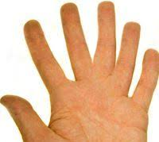
Some Neural tube defects
A two-headed twins or
congegated twins

Slide 5
B- The history of teratology
B-The history of teratology back to the sculpture and drawings that illustrate some kinds of distortions that existed at a certain stage.
1-For example, they found in southern Turkey at 1962 on the masterpiece carved from marble: a two-headed twins dating back to 6500 BC.
2- Until recently, some people believe that the need of a pregnant woman to certain things during pregnancy (the so-called cravingالتوحم ) or even to look at some of the things or animals may lead to the appear on the embryo..

Slide 6
3-A courts was held in 1641, when a pig was born with one socket eye (Cyclopic eyeعين ذات محجر واحد ) in a farm, the neighbor of the farm,(George Spencer in New Haven city at Kentecket) unfortunately he had one eye and the other is abnormal, they thought that he intercourse with the pig, so adjudged on him and the pig with death in April 1642.
4- As well as in Copenhagen in 1683 executed death adjudge on a woman because she was born a child with small head (Microcephaly) like a cat head. They thought that she may intercourse with the cat.

Slide 7
5- The researcher Etienne Geoffrey de Saint Hilaire 1772-1844 made several experiments on embryos of chicken eggs,
He aspires to return them to their ancestors in the evolutionary tree, so that the chicken eggs will hatch and gives reptiles embryos, by exposing chick embryos to several environmental factors such as breathing, temperature, and change in membrane embryonic.
-He did not succeed in reaching what he thought, but open the door to experiments to create embryonic malformations later.

Slide 8
6- Dareste in 1891 think that there are several environmental factors can lead to deformity itself; because they stop or interfere during a certain stage of embryonic development which lead to deformity, he was tested magnetic, electric and heat field and some chemicals on the eggs, causing some distortions, but no one pay attention to his experiments.
7- In 1931, Stockared completed experiments of Dareste and tested on a number of different embryos types (from the reptile, bird, fish and amphibians), and showed that fetal exposure to any distorted factor during a certain stage of embryonic growth, deformity was happens.However, he was still believed that human embryo is not affected by these factors; because it is surrounded by uterus, embryonic membranes and placenta which are protect embryos from external factors distorted.

Slide 9
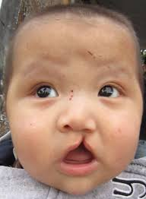
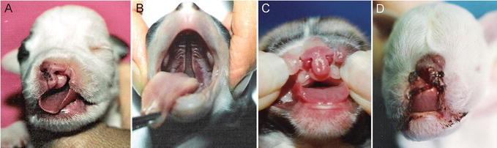
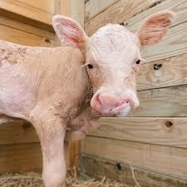
Lost of some vitamins and minerals: نقص بعض العناصر الغذائية
8-Also in 1935 , Hale published report, indicates that a lack of vitamin A in the diet of pregnant pigs leads to the birth of embryos with the moth roof defect Cleft palate (انشقاق سقف الحلق ).
9-Also Warkany in 1940 noted that the lack of mineral elements in nutrition or exposure to chemicals lead to the birth of rat embryos with malformations.
Cleft palate (انشقاق سقف الحلق ).

Slide 10
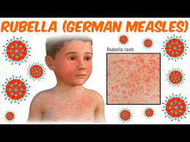
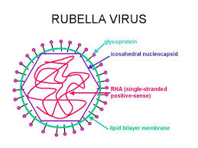
11- In 1941 Gregg discovered Rubella virus that causes German measlesالحصبة الألمانية , embryos which were exposed to rubella virus in Austria, has malformed in the eyes, ears, delayed speech and failed the intelligence test.
12-In 1961, Linz revealed the role of drugs in causing malformations in human embryos.

Slide 11
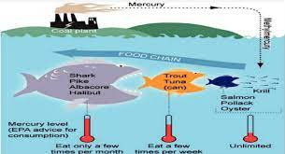
13- There was an accident pollution in the Minamata city in Japan 1953, were a large number of embryos after pregnant mothers eating meals of fish contaminated with the mercury compound as a result of the bowled of plastics factory residue containing mercury compound in the Minamata Bay, mercury moved from water to fish to turn into a highly toxic material is named methyl mercury, a substance that can pass easily from the mother's blood to the embryo through the placenta, and poisoning of pregnant women with this material resulted in birth of deformed children and the mentally retarded.ادى الى مواليد مشوهة او متخلفة عقليا

Slide 12
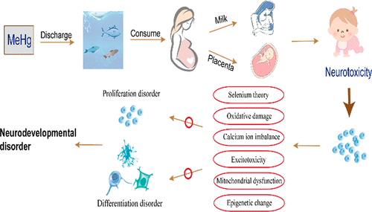
The effect of Methyl mercury MeHg

Slide 13
14-Also, there is an same accident pollution with mercury compounds in Iraq between 1971-1972 due to the arrival of a shipment of wheat contaminated with a fungicide material containing methyl mercury.
Wheat flour was used in making bread and desserts, which ate by a large number of pregnant women and led to death a large number of women, embryos and children after this accident incident.

Slide 14
II- Critical period during embryonic development
A- Period before cellular differentiation:
This phase is extends from fertilization to the beginning of the early gastrula, during the formation of the three embryonic layers,(the formation of ectoderm, endoderm and mesoderm) .
-The human embryo reach to this phase in the third to fourth week, while the mouse embryo reach to early gastrula stage in the fifth to sixth day, and in the frog embryo after one day. while chick embryo finish the cleavage stage before hen laying the egg.
The cleavage period is characterized by non occurrence of any cellular differentiation affects the fate of the cells of the embryos, if any fetal exposure to distorted effects during this period, the cells either to die or embryos to be completed and compensate the damage of cells without occurrence distortions like the experiment of Willium Roux when he destroyed one of the blastomear of the 2 cell stage embryo

Slide 15
B- The determination and cellular differentiation Phase
Is the stage of establishment early organs in the embryos and it is sensitive period that most of the congenital malformations occurs during it. If the fetal exposure to any stimuli distorted during this period, the organ which is formed ​​up it will have some deformation takes place according to the degree of stimuli impact.
فعلى سبيل المثال إذا كان هناك مؤثر مشوه أثناء فترة تكوين الكأس البصرية للعين فإن تكوين العيون يتأثر، لكن إذا كان التعرض للمؤثر بعد تكون العين، فإنها لا تتأثر، ولكن يتأثر العضو الذي يتكون أثناء فترة التعرض وهكذا...

Slide 16
cont. 2- The period of Cellular differentiation Phase
This phase extends from the late gastrula formation or to the formation of the early organs.
The period of this stage vary depending on the embryo type, where as an example: In the human embryo it start after the attachment of the embryo with uterus, from 1st month to fifth month of pregnancy, while in mice from seventh day to the fourteenth day.

Slide 17
C- The Growth phase or organs growth phase:
-This period extend after the initial formation of the embryo organs to the end of pregnancy in mammals or hatching for birds, reptiles and fish.
-In the human embryo: this stage extend from sixth month of pregnancy to the ninth month, even after birth
-In Mice :from fourteenth day to nineteenth day
In chicken embryo, from day14 and it might extend to after hatched stage.
At this stage some of the distortions occurs that affect the physiological performance of organs, such as the fusion of the fingers or of deformation of teeth or feathers, or the lack of certain enzymes types in the intestine, or no secretion of some hormones from glands like growth hormone.
After birth also some malformations are occur such as affect of fragility in the bones, or in kidney malformation causes high blood pressure, or the deficit in glands secretion as the absence of insulin secretion, causing diabetes and its complications.

Slide 18
III- Factors that cause birth defects
3-1- Internal factors and genetic
Most of the mutations that cause congenital malformations either
1- على مستوى جين واحد مثل At the level of a single gene, such as مرض تليف العضلات a-Dutcheny dystrophy of the muscle disease
There is a certain gene responsible of this disease on sex chromosome X - where the muscle contraction protein is not formed in the muscle cells - and the muscle fibers turn into to fatty tissue – and then disability and male death before the puberty age of males..

Slide 19
ب) مرض تاي ساك (Tay Sach disease) b-
Is a deficit in the formation of digestive enzymes (Hexosaminidase) within the (Lysosomes) in the nerve cells - which leads to the accumulation of waste materials (sphingolipids) and turn into materials semi-greasy, especially in nerve cells - which leads to blindness and semi-paralysis and then death after a few years of birth.
ج) طفرة الذيل المعقد c- T - Complex
The gene responsible of this defect has several alleles - where the cause fusion of vertebrae backbone - affects the different stages of embryonic development.

Slide 20
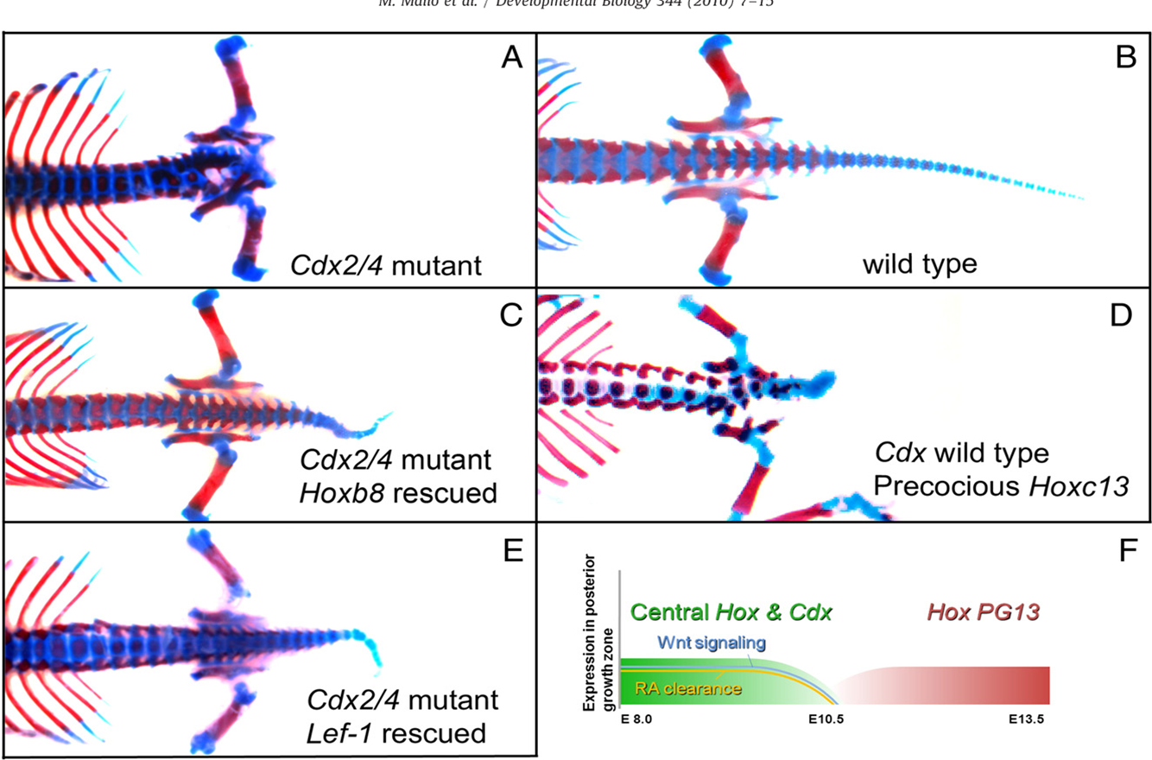
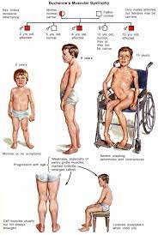
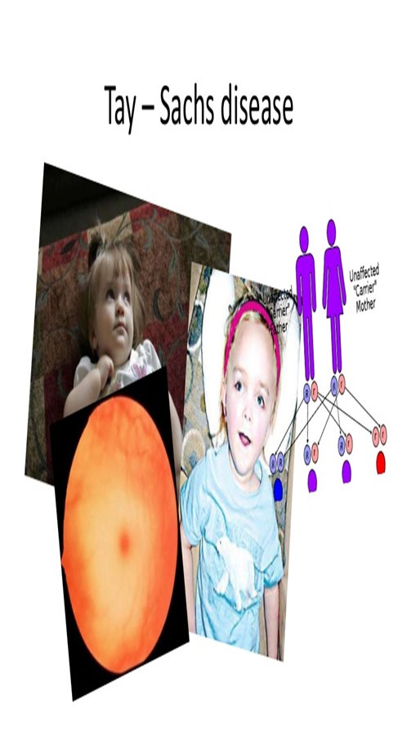
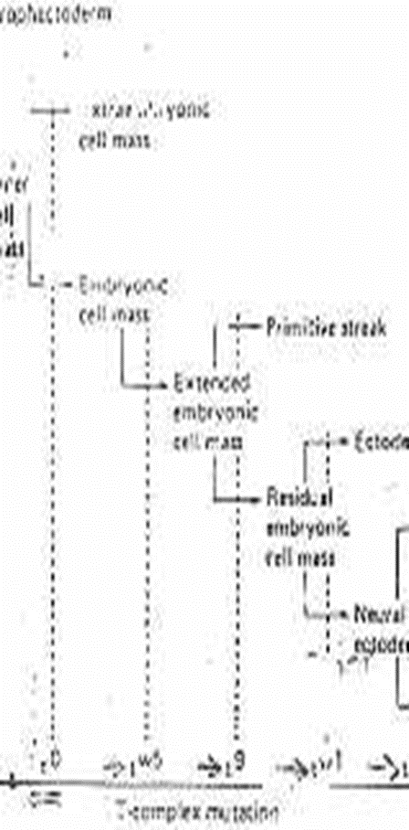
c- T - Complex
a-Dutcheny dystrophy of the muscle disease

Slide 21
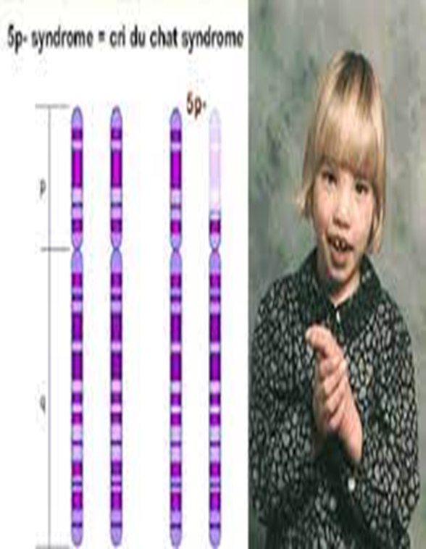
ب- على المستوى الكروموسومي B-At the chromosome level
This lack of part of chromosome or entire chromosome or increase in the whole chromosome, such as the following syndromes: -
أ) مرض أو متلازمة بكاء يشبه مواء القط 1- Cri-du chat Syndrome 1-
Due to lack of part (short arm) of the chromosome No. 5 - which causes the small size of the skull or brain (Microcephaly) and severe mental retardation.

Slide 22
ب) متلازمة داون (Trisomy 21) 2-Down syndrome
Is the increase in chromosome number 21, this chromosome is the smallest chromosome in the cells - where the individual is physically retarded somewhat - individual short fathom and parties - the individual susceptible to leukemia and a defect in the heart sometimes – often the individual patient are die at the age of 30-35 years.
صوره توضح التشوهات الخلقية وتأثير العامل الوراثي (متلازمة دوان) على مراحل التكوين

Slide 23
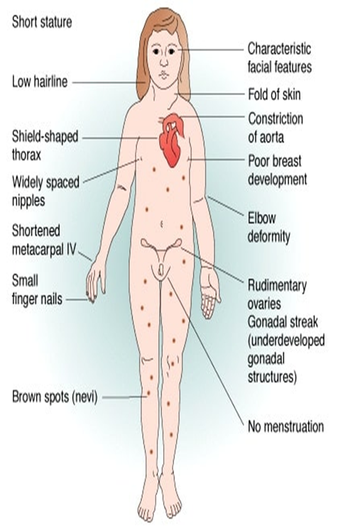
3- Turner Syndrome (XO): متلازمة تيرنر
A condition that affects only females, results when one of the X chromosomes (XO) (sex chromosomes). Turner syndrome symptoms include short stature and lack of breast development and periods. Treatment for Turner syndrome may include hormone therapy.
2- Turner Syndrome (XO):

Slide 24
3-2- العوامل الخارجية 3-2External factors
The percentage of malformation state caused by some external factors is about (10%).
Include various environmental pollutants as radiations, viruses, chemicals, medicines and drugs.
1-Radiation
Radiation cause malformation for embryos; through their impact on the genetic material of cells (DNA) - and the impact of changes by the decrease or damage of chromosomes and genes, which could lead to the death of some cells or deviation from the its normal track - especially during the stage of differentiation of embryonic cells which lead to distortions (malformations).

Slide 25
Cont. about the 1-Radiation (external environment teratology
-A good example of the effect of radiation is produced during the Second World War after the United States dropped the atomic bomb on the Hiroshima and Nkazaki cities in Japan. This has led to encompass destruction of two cities, so that the embryos that were in the wombs of mothers who lived in that period had not been delivered from the distortions occurred during her pregnancy, but beyond that to the eggs in the ovaries, leading to the continued appearance of malformations of babies born in subsequent generations. It has been shown that the rate of 25% of births were suffering from congenital abnormalities in the nervous system.

Slide 26
Cont. about the 1-Radiation (external environment teratology)
Experimentally, when the pregnant female rats exposure to 200 ringtone dose through the fourteenth day of pregnancy, this leads to the occurrence of congenital malformations in the brain, foot and reduction in the fingers.
Exposing the birds embryos in the seventh or ninth day of incubation the eggs to X-ray, this leads to stunting or reduction and malformations of the beak and limbs.

Slide 27
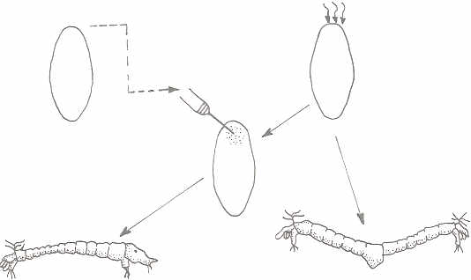
As well as when exposing one mollusc front invertebrates egg (Chironomus Samoensis) to the rays, they grow improperly to give the two bodies without head.
When injection parts from the front of the normal egg cytoplasm that contains nucleic acid (Poly A mRNA) in these egg exposed to radiation, this restores normal differentiation.

Slide 28
2- الفيروسات Viruses
* Some viruses that infect the mother during pregnancy causes abnormalities. For example,
Infected with Rubella virus (Rubella) causes the German measles leads to malformations in the sense organs specially of the eye.
Infection with fever inflated cells virus (Cytomegalo virus) causes the magnitude of the liver and spleen, reduction head size and mental retardation.

Slide 29
3- الأدوية Medicines
أ) عقار الثاليدوميد a- Thalidomide
Used in 1941 for the treatment of German measles and when taken led to the birth of children without limbs, atrophy of the body, and appearance of incision in the skull, and lack in the formation of backbone, and some malformations in the ear, heart, and eyelids.
( عقار الأمينوبترين b- Aminopterin
Used as a treatment for abortion and lead to birth defects in the nervous system and structural and split in the roof of the mouth.

Slide 30
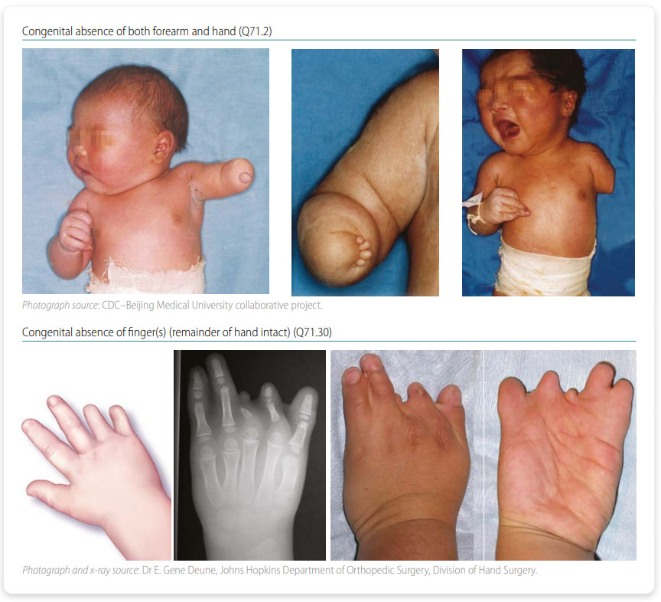
Deformation of the arms or legs

Slide 31
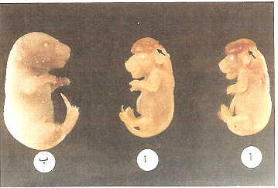
ج) عقار الميتوميسن س (Mitomycen –c)c-
Use this medication for the treatment of cancer. When tested on pregnant female mice led to the deformation and the emergence of the brain to the outside (Anencephaly) in fetuses and small size
د) أدوية الثايرويد (الغدة الدرقية) d-Thyroid drugs
Cause disturbances in bone growth and structural system through the metabolism of cells and tissues

Slide 32
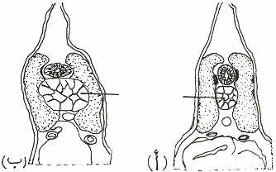
4) المواد الكيميائية Chemicals
1- Lead Chloride : works on the nervous system malformation
2- Thyosinat Material: affect the formation of the dorsal cord in embryos
الجنين السليم الجنين المعرض لمادة الثيوسينيت
وقد تضخمت فيه منطقة الحبل الظهري
3- Thallium salts: Thallium acetate, thallium sulfate and thallium nitrate lead to the palace of the jaw and the delay in the embryo growth and abnormalities of the limbs and palace or absence of the beak in birds.

Slide 33
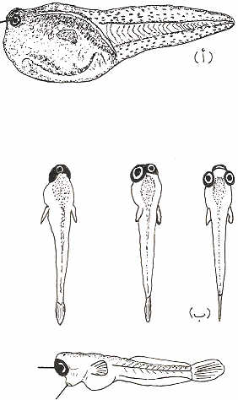
4- Chlorides Salts, such as lithium chloride, causes lead to lining out in sea urchin embryos - Non-differentiation and transformation dorsal cord cells and remain as cells from the middle layer (Mesoderm) - as well as cause in the formation of the eye with one hole when exposure the embryos frog in the lining process or gastrula stage. Magnesium chloride salts cause the proportion of twins in birds or eye with one hole in fish and frog larva Cycolopia. (العين ذات المحجر الواحد
العين ذات المحجر الواحد Cycolopia)
فتحة الفم

Slide 34
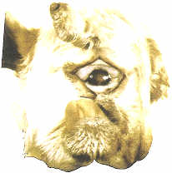
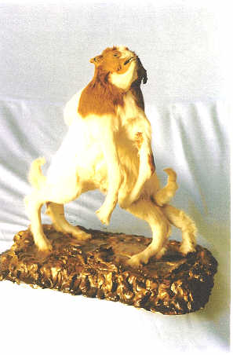
5- Methyl mercury: which is eaten with contaminated food may lead to the formation of deformed embryos with Cycolopia
صورة توضح أمثلة لتأثير االطعام الملوث بكلوريد الزئبق على إحداث التشوهات الخلقية في الأجنة: العين ذات المحجر الواحد Cycolopia في الأغنام نتيجة أكل الأم علف ملوث أثناء الحمل المبكر
صورة لجنين ماعز توأم سيامي قد يكون تعرض لبعض المواد الكيميائية التي تضاف للأعلاف أثناء حفظها وقد تناولتها الأم أثناء الحمل او نتيجة لعامل وراثي.

Slide 35
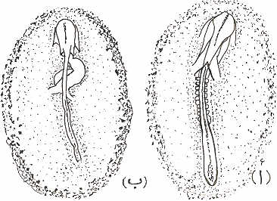
5- المضادات الحيوية Antibiotics
التتراسيكلينTetracycline :
Lead to a split in the palate and atrophy of the jaw and the union of the fingers.
ب- الأكتينوميوسين د D-Actinomycin:
Leads to atrophy of neural tube as well as of muscle somite.
ج- البيروميوسين:Puromycin
When dealing with bird embryos at the stage of the primitive streak cause of the heart tube defect and heart differentiation.
ج- البيروميوسين
:Puromycin
الأنبوبة القلبية
القطع العضلية
ب- الأكتينوميوسين د
D-Actinomycin

Slide 36
6-الهرموناتHormones
Progesterone: female converts organically to the male.
Testosterone: turns female frogs to males of the genus Rana Rana)) lead to delayed sexual differentiation of the genus buffo (Bufo)
3-Female twins to the fetus converts to Freemartin in (cow ) as a result of leaking testosterone from twin to female cross the placenta.
and total or partial transformation of ripe gonad in birds.
7- الأمراضDiseases
A-Syphilis: الزهري Syphilis leads to deafness and mental retardation and cirrhosis of the liver. يؤدي إلى الصمم والتخلف العقلي وتليف الكبد.
B- Herpes: الهيربز the small eyes, and mental retardation. يؤدى إلى صغر العينين والتخلف العقلي.

Slide 37
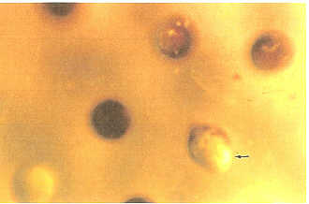
8- الحرارة
زيادة درجة الحرارة لأجنة قنفذ البحر 30 - 35 مْ يمنع تكون الجاسترولة
منع الهواء (الأوكسجين) يؤدي إلى الإنغماد للخارجExogastrolation في أجنة الضفادع Increase the temperature of the Sea Urchin embryos 30-35c prevents formation gastrula.
B. Prevention of air (oxygen) leads to o Exogastrolation in frog embryos.
يشير السهم إلى صور جنين ضفدعة، حصل له تبطين للخارج (Exogastrolation) وخروج خلايا القطب الخضري (المحية) للخارج نتيجة لنقص الأكسجين في البيئة التي تم تنميتها فيها.

Slide 38
شكراً لحسن إستماعكم

